Slide 1
Riverlink
Review of operations, finances and customer service
January 2026

Slide 2
Quarterhill Introduction
Overview: Quarterhill has over four decades of experience in the Tolling and Enforcement industries.
Catering to the foremost toll authorities in the
United States, Quarterhill handles over 2 billion toll transactions each year.
Quarterhill builds smarter transportation tech for a more modern industry—on a global scale that includes presence in North America and Europe, as well as other parts of the world. QH proudly provides solutions for government agencies, toll operators, and private sectors.

Slide 3


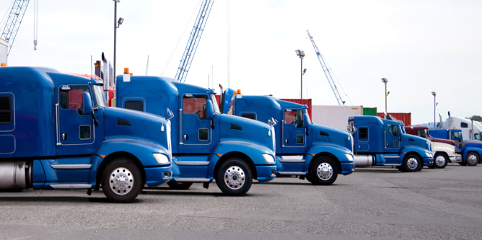
Who We Are
Tolling
Roadside Technologies
Commerce and Mobility Platforms
Audit and Enforcement
Tolling Services
Enforcement
Commercial Vehicles
Automated Enforcement
Freight Mobility
Smart Transportation
Data Solutions
Logistics
Freight Mobility Data, Analysis and Planning
Identification and Characterization
Safety and Asset Management
Notes:
Our roots go back to IRD, the pioneers of weigh-in-motion (WIM) technology. Over decades, we’ve advanced from static scales to WIM-based enforcement and now cloud-based VWS systems. Today, as Quarterhill, we combine roadside sensors, advanced screening algorithms, and AI-enabled enforcement tools to help agencies protect infrastructure and improve roadway safety worldwide.

Slide 4
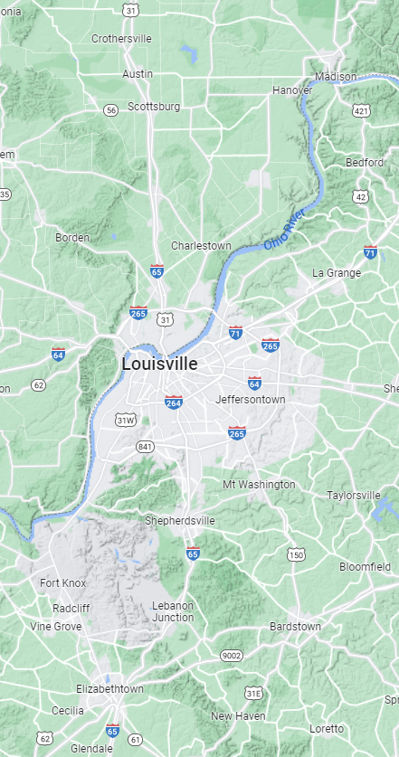



Project Highlights
1 July 2021: Contract signed + effective
5 September 2023: “Go Live” of QH system
Quarterhill provides a Back Office System and operational support for Riverlink customers in Indiana and Kentucky. The service spans over the Lincoln Bridge, Kennedy Bridge, and Lewis and Clark Bridge. Quarterhill is the second provider for this contract; the Riverlink project started with provider Kapsch TrafficCom in 2016.
Before “Go Live,” the system brought in ~$745M in revenue over 6.75 years, averaging $110M in revenue per year.
Since “Go Live,” the system has brought in ~$323M in revenue, an average of $144M per year, representing 30% more annual revenue than the initial tolling provider Kapsch.
Currently, 98% of calls are answered within 60 seconds; 84% of chats were answered within 60 seconds, on average.
© 2025 Quarterhill – Confidential and Proprietary

Slide 5
1. Revenue Collected
A full accounting and review of all toll revenue collected since the system’s inception.

Slide 6
Revenue Collected
Since the contract was priced in January 2021:
Riverlink has received $21.97M in CPI related revenue increases to date, an annual average of 4.10% and totaling 16.7% To date, QH has received $0M in CPI related revenue increases.
Since “Go Live” in September 2023:
Before “Go Live,” the system brought in ~$745M in revenue. Over the 6.75 years since the project started, Before “QH Go Live,” the States averaged $110M in revenue per year. After “Go Live,” the system has brought in ~$323M in revenue. Over the 2.25 years since “QH Go Live,” the States have averaged $144M per year, representing 30% more annual revenue than the initial tolling provider.

Slide 7
2. Operating Costs
A detailed evaluation of the company’s operating and administrative costs.

Slide 8
Operating Costs
Note:
Above results include September 2023 forward (from “Go Live”)
Note:
December 2025 monthly results estimated based on historical averages
Excerpt of Contract 12.5.2. TSP2 Requests to for Adjustments to Operations and Maintenance Price.
Beginning with the third (3rd) anniversary of the Effective Date of this Contract and every two (2) year interval thereafter, TSP2 may, no later than sixty (60) days prior to such anniversary date, submit a written request to the Joint Board for an increase in the Operations and Maintenance Price. Such request shall be made upon demonstrable and unforeseen cost increases of at least ten (10%) to TSP2 in connection with the Work applicable to the Operations and Maintenance Price, as specified in Form G. Requests made upon incorrect assumptions made by TSP2 in its Proposal as it relates to the Operations and Maintenance Price will not be considered by the Joint Board.

Slide 9
3. Customer Service
An analysis of the customer service provided to the public, including resolution rates for billing disputes and general responsiveness.

Slide 10
Customer Service Analysis:
Calls + Chats

Slide 11
Customer Service Analysis:
Average Response Time

