Slide 1

SERVS Project Updates Kentucky State Police February 2026 Legislative Oversight & Investigations Committee

Slide 2

Phase I – West & User Equipment Funded and 100% Completed 2 Cores Completed 70 Console Positions Completed 14 Existing Tower Sites - Radio Installs Completed 4 New Tower Sites – Towers Constructed & Radio Installs Completed Subscriber Equipment Completed
Notes:
Post 1, 2

Slide 3
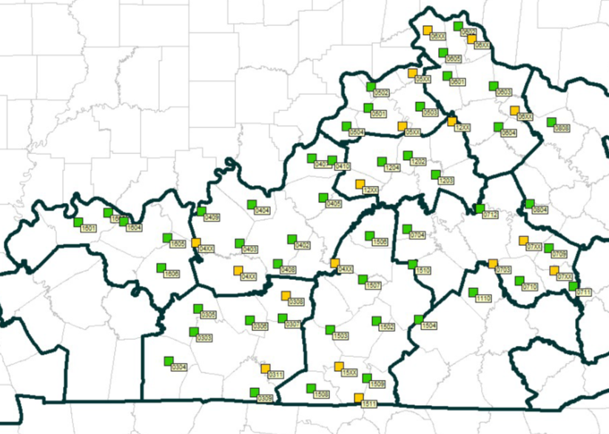
Phase II – Central Funded and 77% Completed 48 Existing Tower Sites - Radio Installs Completed 13 New Tower Sites – Pending Acquisition 3 New Tower Sites – Construction Completed 2 New Tower Sites- Under Construction
Notes:
Post 3, 4, 5, 6, 7, 12, 15, 16

Slide 4
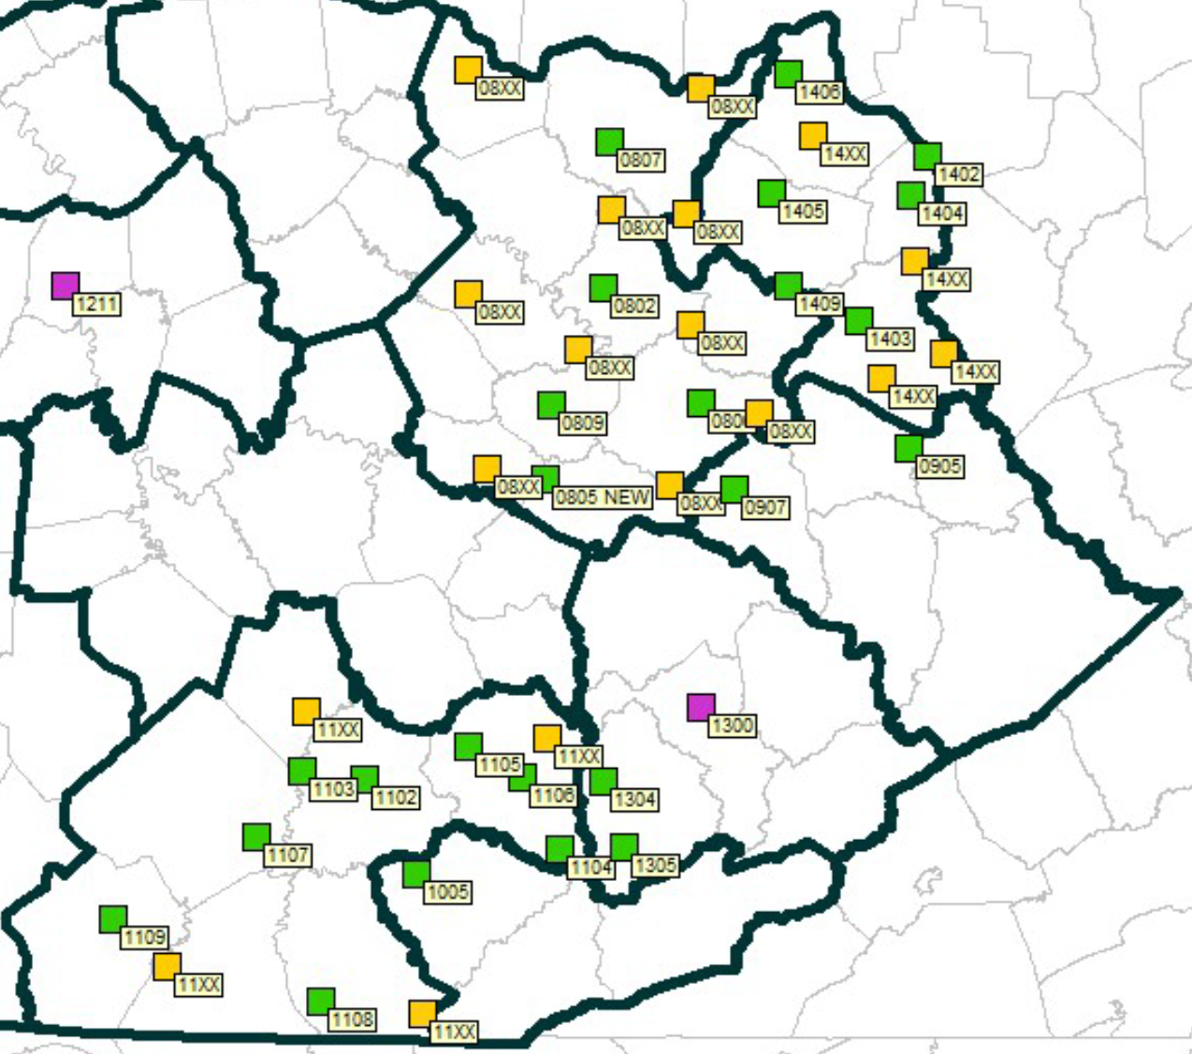
Phase IIIA - East Funded and 0% Completed (estimated to be at least 60% completed this biennium) 2 Cores – In Progress 24 Existing Sites – Radio Installation In Progress 18 New Sites Pending
Notes:
Post 8, 11, 14

Slide 5
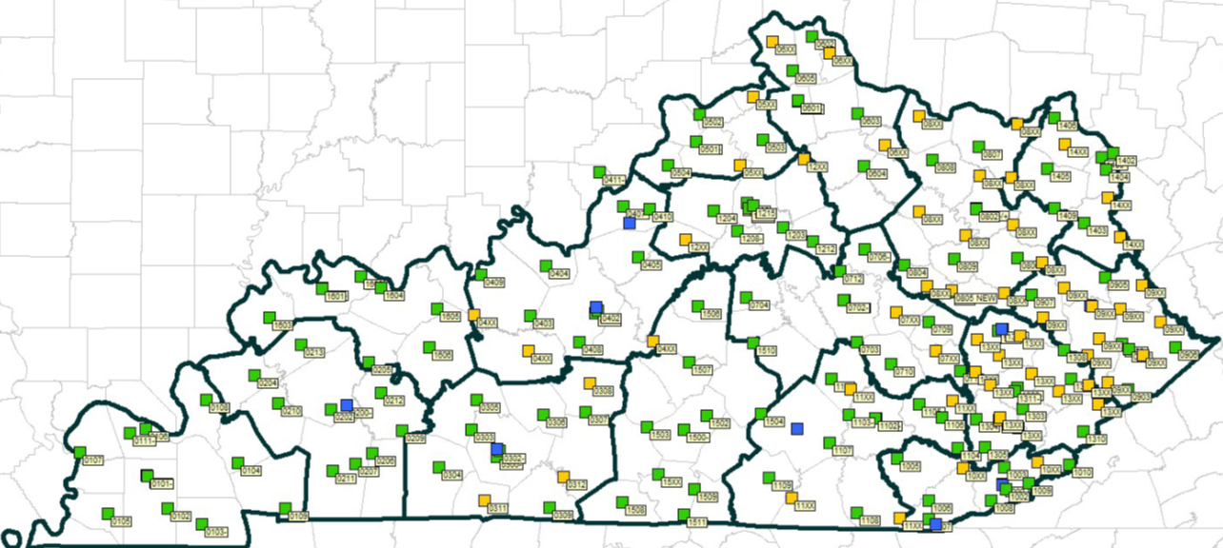
Phase III - Statewide Funded and 69% Completed (Router Upgrade Portion) 129 Existing Sites Replaced 58 New Sites Pending 4 New Sites Completed 3 New Sites to be Completed 30 Days
Notes:
Statewide

Slide 6
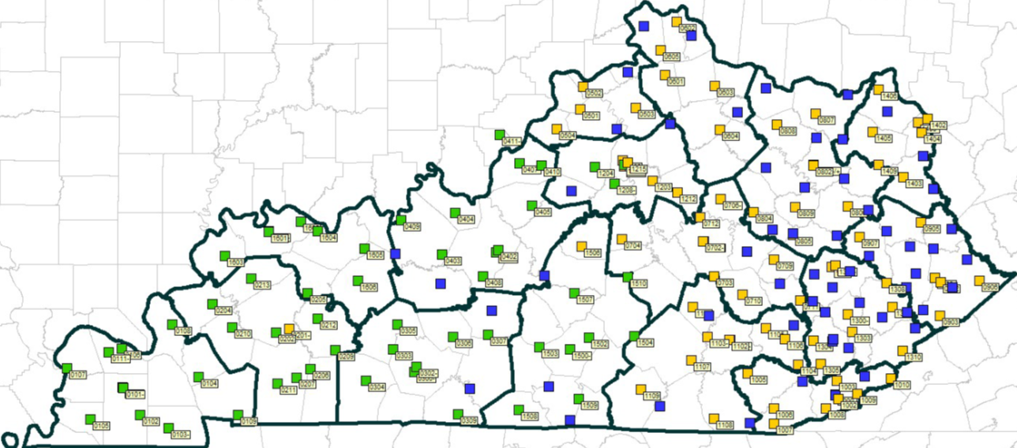
Phase III - Statewide Funded and 68% Completed (Microwave Upgrade Portion) 129 Existing Sites Replaced 1 Existing Site to be Completed 30 days 4 New Sites Completed 58 New Sites Pending 3 New Sites to be Completed 30 Days
Notes:
Statewide

Slide 7
Closeout Phase - East Funding Requested 16 Existing Sites – Radio Installations to be completed by the end of 2027 25 New Sites – Pending Site Acquisition
Notes:
Post 9, 10, 13

Slide 8
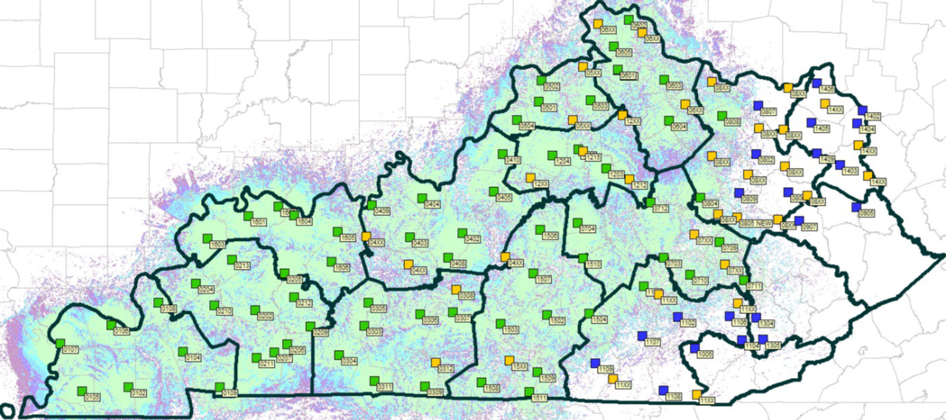
Post 1 / 2 / 16 Fully operational Post 3 Equipment installs completed on existing sites New constructed site completed Jan 2026. Equipment installs begin Feb 2026 Scheduled to be fully operational Spring 2026
Current Coverage
& Post Status
Post 16
Post 2
Post 1
Post 3

Slide 9
Approved Status
SERVS User Agency Status Update
State Police Post 1 and 2 Fully operational
State Police Post 16 Fully operational
Graves County Sheriff’s Office Fully operational
• Mayfield Police Department Fully operational
• Mayfield Fire/EMS Department Fully operational
Currently in Process
Simpson County
• Concord Fire (McCracken Co)
• Calloway County Fire
Hart County
Elizabethtown PD
• Carroll County
• Grant County
• Floyd County – Prestonsburg
State Police Post 3
• Fleming County – Flemingsburg
• Pendleton County
• Rockcastle County
• Lincoln County
• Morgan County
Boyd County Sheriff
KY Department of Corrections
• KY Fish and Wildlife

Slide 10
Combined SERVS Project Status as of 21 January 2026

Slide 11
SERVS Budget Status as of 15 January 2026

Slide 12
SERVS Site Acquisition as of 21 January 2026

Slide 13
SERVS Site Acquisition as of 21 January 2026
Site Status - Typical Progression of Steps
Collect site information, provide site options
Review site options and information
Title Work and Appraisal
Legal Review
Contract / Survey and Environmental
Closing/Recording
Construction

Slide 14
SERVS Site Acquisition as of 21 January 2026
Site Status - Typical Progression of Steps
Collect site information, provide site options
Review site options and information
Title Work and Appraisal
Legal Review
Contract / Survey and Environmental
Closing/Recording
Construction

Slide 15
SERVS Site Acquisition as of 21 January 2026
Site Status - Typical Progression of Steps
Collect site information, provide site options
Review site options and information
Title Work and Appraisal
Legal Review
Contract / Survey and Environmental
Closing/Recording
Construction

