Slide 1

SERVS Program Update
Kentucky State Police
Communications Branch
July 2026
Legislative Oversight &
Investigations Committee

Slide 2
Executive Summary
Statewide Modernization & Upgrade Effort: Progressing across all phases
Phase I: Completed 2024
Phase II: 77% Completed - Estimated Completion 2028
Phase III: 70% Completed - All Existing Sites Completed 2024
New Site Completion Aligns with Phase II (2028) and Phase IIIA (2029)
Will Remain Incomplete Until Closeout Phase Towers Funded/Constructed
Phase IIIA: 52% Completed– Estimated Completion 2029
Closeout Phase: Not Funded
Overall Program Completion: Contingent Upon Funding for Closeout Phase

Slide 3
Phase I Western Ky
KSP Posts 1 & 2
(2019-2023)
Status: Funded and 100% Complete ($35,100,000)
Total Sites: 18
Existing Sites (14 Total)
  Shelter Upgrades: 14 Completed
  Radio Installation: 14 Completed
  Generator Installs: 14 Completed
  AC Plant Upgrades: 14 Completed
  DC Plant Upgrades: 14 Completed
New Sites (4 Total)
  Land Acquisition: 4 acquired
  Construction: 4 Sites completed

Slide 4
Phase II Western and Central Ky
KSP Posts 3, 4, 5, 6, 7, 12, 15, & 16
(2020-2028)
Status: Funded and 77% Complete ($52,450,000)
Total Sites: 65
Existing Sites (48 Total)
  Shelter Upgrades: 45 Completed (3 under contract; scheduled completion Dec 2026)
  Radio Installation: 48 Completed
  Generator Installs: 47 Completed (1 under contract; scheduled completion Dec 2026)
  AC Plant Upgrades: 48 Completed
  DC Plant Upgrades: In progress (scheduled completion Dec 2026)
New Sites (17 Total)
  Land Acquisition:
  9 acquired
  3 in contract phase
  5 in negotiations/review
  Construction:
  2 completed
  7 in process
Schedule: New site construction scheduled through 2028

Slide 5
Phase III – Statewide Microwave & Network Buildout (2022– Unknown)
Status: Funded and 70% Complete ($80,909,000)
Total Sites: 195
Existing Sites (130 Total) Completed
  Microwave Upgrades: 130 completed
  Router Upgrades: 130 completed
New Sites (65 Total)
  Microwave:
    7 completed
    32 occur during Phase II and IIIA construction
    (26 more will remain incomplete until Closeout Phase funded)
  Router:
    7 completed
    32 occur during Phase II and IIIA construction
    (26 more will remain incomplete until Closeout Phase funded)
Schedule: Completion aligned with final site construction for Phase II & IIIA (2028 and 2029)
26 new sites will remain incomplete until Closeout Phase towers are funded and constructed

Slide 6
Phase IIIA – Eastern Kentucky Initial Segment
KSP Posts 8, 11, & 14
(2024–2029)
Status: Funded and 52% Complete ($47,900,000)
Total Sites: 42
Existing Sites (24 Total)
  Shelter Upgrades: 21 completed (3 under contract; completion Dec 2026)
  Radio Installation: completed June 2026
  Generator Installs: 21 completed (3 under contract; completion Dec 2026)
  AC Plant Upgrades: 22 completed (2 under contract; completion Dec 2026)
  DC Plant Upgrades: In progress (completion Dec 2026)
New Sites (18 Total)
  Land Acquisition:
    1 acquired
    2 in contract phase
    16 in review
  Construction:
    1 completed
Schedule: New site construction through 2029

Slide 7
Closeout – Eastern Kentucky Remaining Segment
KSP Post 9, 10, & 13
Status: Not Funded (Estimated cost of $107,427,000 as of April 2026)
Total Sites 42
Existing Sites (16 Total)
  Radio Installation: 16 sites – not funded
  DC Plant Upgrades: 16 sites – not funded
  Shelter, Generator, and AC upgrades funded in Phase III to be completed in December 2026
New Sites (26 Total)
  Land Acquisition:
    0 acquired
    2 in contract phase
    24 in review
  Construction:
    0 completed – not funded
Schedule: Unknown – contingent upon funding

Slide 8
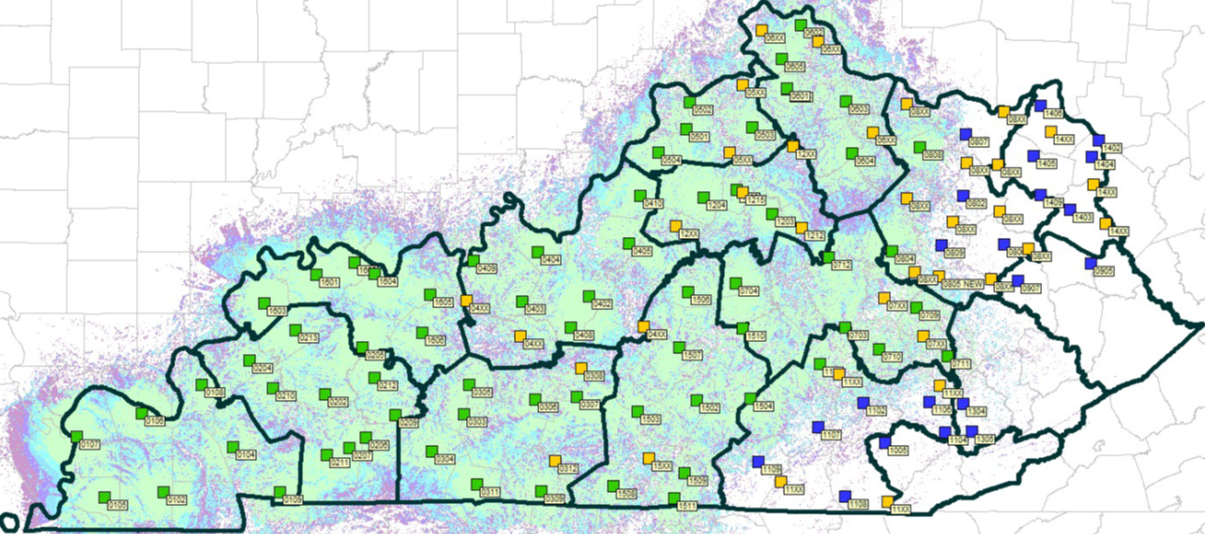

Post 1 / 2 / 16 / 3
Fully operational
Post 15
Next Post to come online in 2027
Current Coverage
& Post Status
Post 5
Post 6
Post 8
Post 14
Radio Installs In progress
New Sites Pending
Exiting Sites Completed
Post 12
Post 4
Post 7
Post 16
Post 9
Post 13
Post 2
Post 15
Post 1
Post 3
Post 11
Post 10

Slide 9
SERVS User Agencies - Fully Operational
State Police Post 1 and 2
State Police Post 16
State Police Post 3
Graves County Sheriff’s Office
• Mayfield Police Department
• Mayfield Fire/EMS Department
• Simpson County PD
Franklin Simpson County Ambulance Service
Franklin Simpson Fire Rescue
Simpson County Office of Emergency Management
Simpson County Sheriff’s Office
South Central Kentucky Drug Task Force
Alcohol, Tobacco, and Firearms (ATF)

Slide 10
SERVS User Agencies - Currently in Process
• Concord Fire (McCracken Co) Pendleton County
Ledbetter Fire Protection District Rockcastle County
Lyon County Sheriff Morgan County
Barren County Emergency Management Boyd County Sheriff
Hart County Sheriff KY Department of Corrections
Warren County Emergency Management KY Fish and Wildlife
Paintsville Fire Department Homeland Security Investigations
US Forestry Service United States Marshall’s Service
Calloway County Fire United States Postal Inspectors
Elizabethtown Fire Jefferson County Search Dogs Association
• Carroll County US Army Corps of Engineers
• Grant County Kentucky Transportation Cabinet
• Floyd County – Prestonsburg Kentucky Emergency Management
• Fleming County – Flemingsburg
Henderson County Sheriff
Jessamine County
Lincoln County
Livingston County Sheriff

