Slide 1
Legislative Committee Update
Legislative Oversight & Investigations Committee
July 6, 2026

Slide 2
How College Athletics Landscape has Evolved
July 1, 2025
2024
New Era of College Athletics
2023
Transfer Portal Ruling
2021
The House Settlement
Approval of the House v NCAA settlement
Universities will have to adapt to new economic and operational realities to maintain competitive excellence
2019
Name, Image, and Likeness
    NCAA changed their transfer policy again
    Now allows for immediate eligibility for all NCAA Division I transfer student-athletes who are academically eligible, essentially a free agency model
2018
Alston Payments
2023 NCAA House settlement proposes billions in damages for past athletes and revenue sharing for current/future athletes
2015
Launch of Transfer Portal
Student-athletes can receive compensation for their name, image and likeness (NIL)
Cost of Attendance
    Addressed in NCAA v. Alston
    Ruled NCAA could not limit education-related benefits that schools could provide to student-athletes (ex: computers, instruments, and other education expenses, totaling about $6k)
2014
Simplified and standardized the student-athlete transfer process
2008
Full Scholarships
Meals
    Covered in O’Bannon v. NCAA
Allowed schools to offer “full cost-of attendance” benefits to include cost of- living expenses, totaling about
$7,500
    Allowed DI schools to provide unlimited meals and snacks to student- athletes
Addressed concerns about their nutritional needs
Transfer Portal Eligibility
    Covered in White v. NCAA
    Allowed schools to provide athletes with health insurance and education- related funds to cover the full cost of attendance
The NCAA changed their transfer portal policy
Athletes can transfer once without having to sit out a year
Collectives created alongside many institutions

Slide 3

Terms of the House Settlement
The House settlement fundamentally transforms college athletics by introducing direct student-athlete compensation, escalating financial pressures, and prompting schools to reevaluate their competitive strategies, divisional alignment, and compliance practices—ushering in a new era where institutional decisions will be driven as much by legal and financial realities as by athletic ambition.
Back-Pay
Revenue Sharing
Roster Limits
Monitoring of
NIL Deals
Division I student-athletes from 2016–2024 who didn’t receive NIL pay are eligible for retroactive payments over the next ten years.
Starting in 2025–26, schools that are party to the settlement (P5, Notre Dame) and those that have opted in, can pay student-athletes directly, up to ~$20.5M per school. The ‘cap’ will increase 4% each year and then will be re-evaluated every three years for the duration of the 10-year settlement.
No more scholarship limits per team, but new sport-specific roster limits will apply. All scholarships have now become equivalency scholarships, eliminated “head count” scholarships.
As of a recent update, NIL deals worth between $600-$15,000 must be reported to NIL GO ONLY IF the student-athlete has earned $50,000+ in the current year. The College Sports Commission will review for valid business purpose and range of compensation.

Slide 4
House Settlement | Categories of Revenue
Payments to student-athletes can only be drawn from eight (8) specific categories of revenue brought in by the institution.
What types of revenue can be shared with student-athletes?
Ticket Sales | Revenue received for sales of admissions to athletic events, including public and faculty sales, student sales, shipping & handling fees, and registration fees. This may NOT include sales to non-athletics events (e.g., concerts in athletics facilities), and it may NOT include philanthropic gifts connected to ticket sales, such as those attached to premium seating.
Guarantees | Revenue received from participation in away games, including payments received due to game cancellations.
Media Rights | Revenue received for radio, television, internet, digital, and e-commerce rights, including the portion of conference distributions related to media rights, if applicable.
NCAA Distributions | Revenues received from the NCAA which could include revenue distributions, grants, NCAA championships travel reimbursements and payments received from the NCAA for hosting a championship. Some NCAA distributions may be paid through the conference office.
Conference Distributions (Non-Media and Non-Football Bowl) | Revenues received by conference distribution, excluding portions of distributions relating to media rights (covered above) or NCAA distributions (covered above). Note: Distributions for reimbursement of post-season bowl expenses may NOT be included.
Conference Distributions of Football Bowl-Generated Revenue | Conference distributions of revenue generated by a post-season football bowl to conference members. Note: Distributions for reimbursement of post-season bowl expenses may NOT be included.
Royalties, Licensing, Advertisement and Sponsorships | Revenues from sponsorships, licensing agreements, advertisement, royalties, in-kind products and services as part of a sponsorship agreement.
Athletics Restricted Endowment and Investments Income | Restricted investment and endowment income used for the operations of intercollegiate athletics. Note: Institutional allocations of income from unrestricted endowments qualify as “Direct Institutional Support” and may NOT be included.

Slide 5
College Sports Commission
The College Sports Commission helps oversee the evolving college athletics landscape by providing a centralized mechanism for monitoring rules, reviewing athlete compensation arrangements, and supporting NIL and compliance oversight.
College Sports Commission Oversight
Each year, schools can distribute up to 22% of the average revenue among schools in the ACC, Big Ten, Big 12, Pac-12 and SEC from media rights, ticket sales and sponsorships – known as the revenue sharing cap.
REVENUE SHARING
NCAA scholarship limits have been removed, and roster limits have been established for each sport. Schools have the option to offer partial or full scholarships to every student-athlete on a team’s roster, as long as the total number of student-athletes stays within the sport’s specific roster limit.
ROSTER LIMITS
All NCAA Division I student-athletes are required to report any Name-Image-Likeness (NIL) deals with total value between $600-$15,000 if the student-athlete has earned $50,000+ in NIL that year. All deals exceeding $50,000 must be reported. Deals must be cleared to confirm compliance with the rules and protect the student-athlete’s eligibility.
STUDENT ATHLETE NIL DEALS

Slide 6
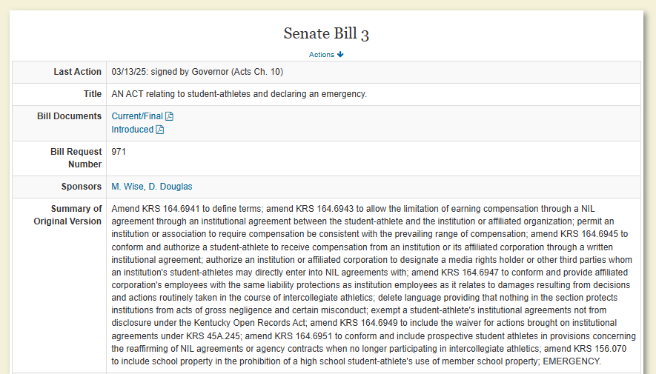
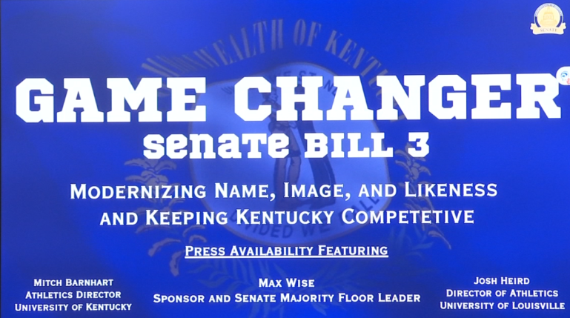
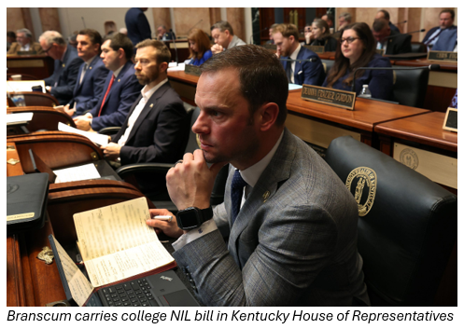
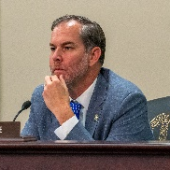
Kentucky Senate Bill 3 Summary and Insights
Modernizing Name, Image, and Likeness and Keeping Kentucky Competitive
Key Insights
Student Athlete Compensation
Universities can provide direct compensation to student-athletes via revenue sharing agreements
Sublicensing Opportunities
Universities can sublicense NIL rights to third parties thus expanding potential earning avenues for athletes
Fair Market Standards
Bill mandates that NIL compensation align with market rates to ensure fairness across institutions
Legal Protections
Provides liability protections for universities involved in NIL agreements and exempts contracts from disclosures
“It equips our universities with the tools to adapt to the shifting NIL landscape while protecting student-athletes and expanding their opportunities”
- Sponsoring Senator, Leader Max Wise
Immediate Implementation
Bill includes emergency clause to allow universities to take immediate effect upon passage
Source: Kentucky Senate Bill 3. Note: Information is to be used only for informational purposes.

Slide 7
Proposed Federal Legislation
SCORE Act vs Protect College Sports Act
SCORE Act (House, H.R. 4312)
Protecting College Sports Act / PCSA (Senate, S. 4668)
Student Compensation and Opportunity through Rights and Endorsements Act
Protect College Sports Act
Chamber & Sponsors
Chamber & Sponsors
House of Representatives; bipartisan — House Energy and Commerce Subcommittee on Commerce, Manufacturing & Trade Chair Gus Bilirakis (R-FL-12) and Rep. Janelle Bynum (D-OR-5)
Senate; bipartisan — Senate Commerce Committee Chair Ted Cruz (R-TX) and Ranking Member Maria Cantwell (D-WA)
Approach
Approach
Replaces patchwork of state NIL laws with a national standard; explicitly classifies student-athletes as non-employees
Narrower preemption provisions of state NIL laws, conference realignment, media rights pooling, transfer rules, agent regulation, recruitment and tampering rules
NIL Framework
NIL Framework
Uniform federal NIL standard replacing state-law patchwork; codifies House settlement revenue-sharing framework
National NIL framework for state laws that both conflict with and prevent compliance with federal law
Media Rights
Media Rights
Preserves existing conference and school media rights contracts; no government role in broadcast negotiations
Broadcasting framework with provisions governing media rights negotiation; "voluntary pooling of media rights"
Student-Athlete Benefits
Student-Athlete Benefits
Scholarship protections, degree completion, mental health, post-participation healthcare; agent fee cap of 5%
Medical trust fund; Mandated preservation of women's and Olympic sports scholarships and roster spots
Sport Sponsorship
Anti-Super League
Codifies minimum of 16 varsity sports for FBS institutions to protect non-revenue and Olympic sports
Anti-super league provision applies to all Power Four conferences; prevents further conference mergers
Status
Status
Reported out of House Energy & Commerce Committee, 30-23 — July 23, 2025
Reported from Senate Commerce Committee, 19-9 — June 18, 2026

