Slide 1
Legislative Oversight and Investigations Committee
September 10, 2026
Cash Management System
& Project Lettings

Slide 2
Cash Management Budget Bill Language
Road Fund Cash Management: …Notwithstanding KRS Chapter 45, specifically including KRS 45.242 and 45.244, the Secretary may concurrently advance projects in the Biennial Highway Construction Plan by employing management techniques that maximize the Cabinet's ability to contract for and effectively administer the project work. Under the approved Cash Management Plan, the Secretary shall continuously ensure that the unspent project and Road Fund balances available to the Transportation Cabinet are sufficient to meet expenditures consistent with appropriations provided.

Slide 3
CASH MANAGEMENT SYSTEM
Established for 2000-02, modified in 2002-04 to specify minimum Road Fund balance of $100 million, included in subsequent budget bills
Permits KYTC to initiate work on highway projects by employing a cash flow financing program, which allows projects and payments to extend beyond the biennium with future funds

Slide 4
CASH MANAGEMENT SYSTEM
As presented in the State Highway Plan:
  Decisions about when to obligate state project dollars and how much state project work can be afforded at any point will be made by the Secretary of Transportation and based on monthly cash management evaluations received from KYTC’s Authorization Review Team (ART).
  The ART consists of the Cabinet’s:
  Secretary
  Deputy Secretaries
  State Highway Engineer
  Deputy State Highway Engineers
  KYTC Budget Director
                ART Team gauges system capacity

Slide 5
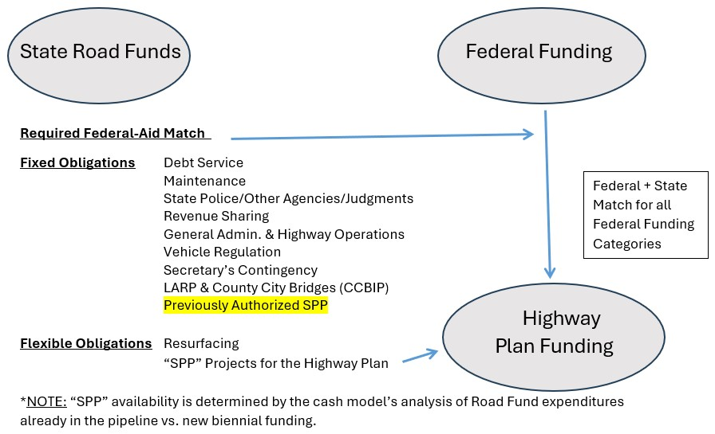
Highway Plan Funding

Slide 6
Road Fund Revenue
In millions
$1,875
$1,822

Slide 7
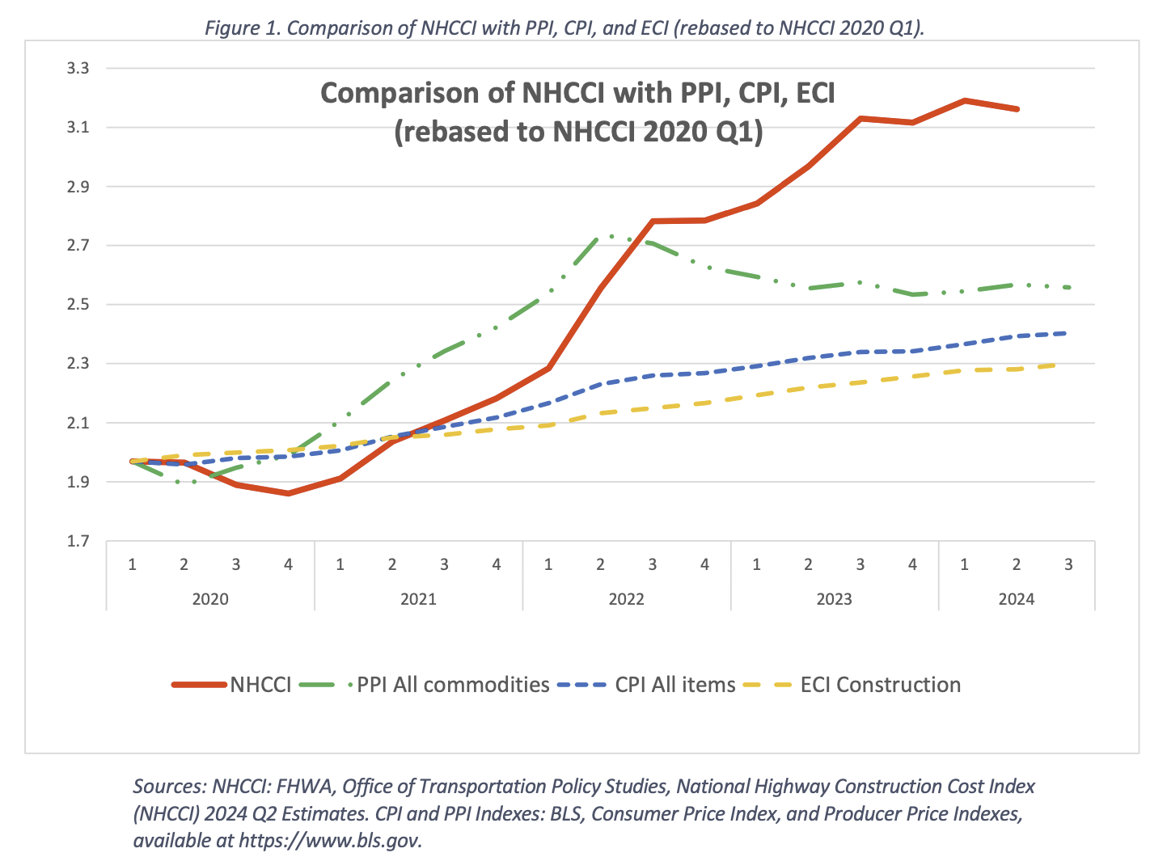
National Highway Construction Cost Index

Slide 8
Road Fund Match for Federal Construction

Slide 9
The Project Expenditure Pipeline

Slide 10
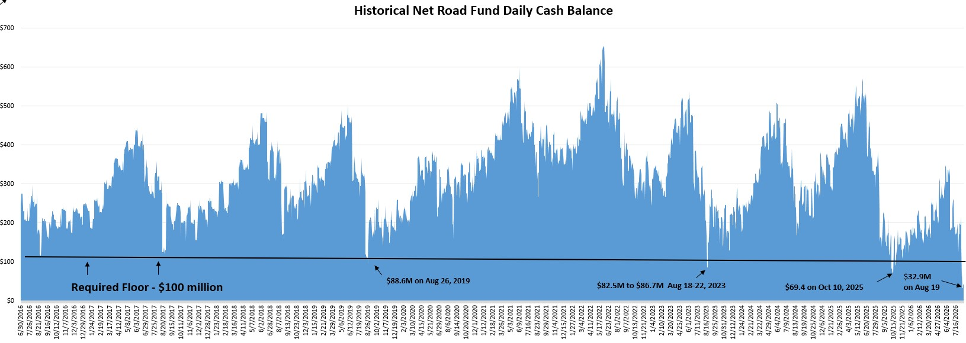
CASH MANAGEMENT SYSTEM
Daily Monitoring
$654
$572
$541
$348

Slide 11
Maintenance Components
Pavement Repair
Shoulder Repair
Mowing and Litter Pick-Up
Bridge Inspection and Repair
Guardrail Repair and Replacement
Traffic Signals and Lighting
Rest Area Staffing and Upkeep
Tree Cutting and Trimming
Maintaining Drainage
Emergency Response
Snow and Ice Response (SNIC)

Slide 12
Maintenance Costs
NHCCI trends caused tighter budget
Material and Contract Cost Increases
NHCCI increased 75%
Maintenance budget increased 30%
Back to Back Significant winters (SNIC)
  2024 – $47M
  2025 – $85M
  2026 – $95M

Slide 13
Year to Date Lettings (Jan – Aug)
Calendar Year | Total Awards | Traditional Awards | Alt Delivery Awards | Contracts Awarded
2023 | $713,275,361 | $712,851,819 | $423,542 | 442
2024 | $674,883,695 | $638,598,987 | $36,284,708 | 299
2025 | $1,107,830,420 | $839,846,127 | $267,984,293 | 397
2026 | $1,190,059,299 | $621,508,700 | $568,550,599 | 230

Slide 14
Pavement Management and Rural Secondary
Year to Date Lettings (Jan – Aug)
Calendar Year | Traditional Awards | Contracts Awarded
2023 | $152,625,250 | 261
2024 | $125,218,104 | 174
2025 | $200,395,196 | 257
2026 | $69,736,828 | 112
Excludes Local Assistance Road Program (LARP) Funding
Authorized by KYTC, but Contracted by Local Agencies

Slide 15
Fast Spending Projects
  Pavement Treatments
  Local Assistance Road Program (LARP)
    $40M Total in 2024-2026
    $90M Total in 2026-2028
  Traditional Project
    Spends Out over 3-5 Years
    Small percentage 5+ Years
  Fast Spending Projects
    Spend out over 12-18 months

Slide 16
Increased Fuel Costs
August 2025
  $3.800
March 2026
  $3.897
August 2026
  $5.348
Source: United States Energy Information Administration

Slide 17
2027 Letting Forecast
Primarily Federal and General Fund
Pavement Management Estimate
  $125M Dept of Highways
    State Maintenance Priority Routes
  $60M Rural Secondary
    State Rural Secondary Routes

