Slide 1
Update on Closing Kentucky’s Opportunity Gaps
President Aaron Thompson
Kentucky Council on Postsecondary Education
Aug. 18, 2021

Slide 2
Kentucky’s Educational Attainment Goal
2019 Educational Attainment
2030 Educational Attainment

Slide 3
Kentucky continues to surpass growth rate needed to reach the state 60x30 goal
Increases in the Number of Undergraduate Degree and Credential Holders in Kentucky
Required Growth Rate
Actual Growth Rate

Slide 4
CPE’s Guiding Framework to Meet the Goal
Kentucky’s Performance Funding Model
Kentucky’s Strategic Agenda for Postsecondary Education
CPE Policy for Diversity, Equity and Inclusion
CONTINUOUS ACCOUNTABILITY AND PROGRESS

Slide 5
How Our Framework Works
Strategic agenda: Sets goals and metrics aligned to the overall state goal (60x30) for all public campuses.
Diversity policy: Helps campuses set and meet goals specifically targeted to increase the success of underserved and underrepresented populations.
Kentucky is the first state in the nation to tie academic program approval to meeting diversity metrics.
Performance funding model: Rewards campuses for their progress in moving Kentucky toward goal completion.

Slide 6
How Performance Funding Incentivizes Student Success
The formula focuses campuses on
Retention and timely completion.
Undergraduate degrees and credentials.
Degree and credential attainment by minority, low income and underprepared students.
More degrees and credentials in fields that garner higher wages upon completion (STEM+H, high-demand, and targeted industries).

Slide 7
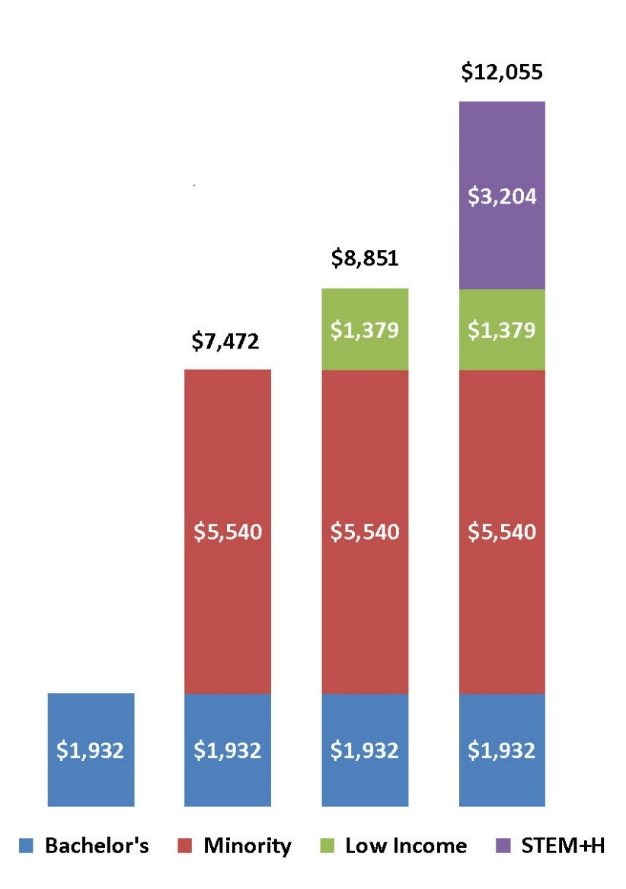
Example of How the Incentives Work
Premiums are cumulative

Slide 8
URM Progress at Our Public Institutions

Slide 9
Overview of Enrollment
While overall enrollment at public institutions has declined, URM enrollment has increased
All Students
-15.9%
URM Students
6.4%
Starting point of CPE’s, strategic agenda and diversity policy

Slide 10
Greatest need: Increase low-income URM enrollment
Public Universities Undergraduates
 | Fall 2012 | Fall 2019 | Change
All Students | 101,697 | 98,185 | -3%
All URM Students | 13,020 | 15,998 | 23%
URM Not Low-Income Students | 5,415 | 8,214 | 52%
URM Low-Income Students | 7,605 | 7,784 | 2%
KCTCS
 | Fall 2012 | Fall 2019 | Change
All Students | 108,302 | 78,484 | -28%
All URM Students | 14,358 | 13,126 | -9%
URM Not Low-Income Students | 5,402 | 6,773 | 25%
URM Low-Income Students | 8,956 | 6,353 | -29%
All Low-Income Students | 48,325 | 29,700 | -38.5%

Slide 11
Overall progress with retention rates, across populations
Public Universities
 | Fall 2011 – Fall 2012 | Fall 2019 – Fall 2020 | Change
All Students | 72.6% | 80.6% | +8pp
All URM Students | 64.8% | 78% | +13.2pp
URM Not Low-Income Students | 70.4% | 80% | +9.6pp
URM Low-Income Students | 66.5% | 75.2% | +8.7pp
KCTCS
 | Fall 2011 – Fall 2012 | Fall 2019 – Fall 2020 | Change
All Students | 50.9% | 57.1% | +6.2pp
All URM Students | 40% | 50.9% | +10.9pp
URM Not Low-Income Students* | 36.8% | 48% | +11.2pp
URM Low-Income Students | 52.4% | 52.2% | -0.2pp
*Data missing for Fall 2011 – Fall 2012; Number used is for Fall 2012 – Fall 2013.
Notes:
With the exception of KCTCS URM low-income students, which remained flat, progress was seen for both sectors and for all categories of students.

Slide 12
Another need: Increasing low-income URM graduation rates at both the universities and KCTCS
Public Universities (Six-Year Rates)
 | AY 2012 | AY 2019 | Change
All Students | 47.6% | 56.4% | +8.8pp
All URM Students | 33.6% | 44% | +10.4pp
URM Not Low-Income Students | 70.4% | 74.6% | +4.2pp
URM Low-Income Students | 66.5% | 69.2% | +2.7pp
KCTCS (Three-Year Rates)
 | AY 2012 | AY 2019 | Change
All Students | 24.9% | 36.3% | +11.4pp
All URM Students | 13.3% | 24.3% | +11pp
URM Not Low-Income Students | 36.8% | 42.4% | +5.6pp
URM Low-Income Students | 52.4% | 48.1% | -4.3pp
Notes:
With the exception of KCTCS URM low-income students, progress was seen for both sectors and for all categories of students.

Slide 13
Overview of Degree and Credential Attainment
URM undergraduate degree and credential progress is double that of all students
30.6%
All Students
URM Students
60.1%
Starting point of CPE’s, strategic agenda and diversity policy

Slide 14
Bachelor’s Degrees Awarded by Public Universities
Overall
 | AY 2012 | AY 2019 | Change
All Students | 16,244 | 19,147 | 18%
All URM Students | 1,548 | 2,707 | 75%
URM Not Low-Income Students | 524 | 1,082 | 106%
URM Low-Income Students | 1,024 | 1,625 | 59%
STEM+H
 | AY 2012 | AY 2019 | Change
All Students | 4,500 | 6,643 | 48%
All URM Students | 285 | 706 | 148%
URM Not Low-Income Students | 128 | 349 | 173%
URM Low-Income Students | 157 | 357 | 127%

Slide 15
Credentials Awarded by KCTCS (Includes certificates, diplomas and associate degrees)
Overall
 | AY 2012 | AY 2019 | Change
All Students | 28,545 | 29,291 | 3%
All URM Students | 3,085 | 4,679 | 52%
URM Not Low-Income Students | 637 | 1,484 | 133%
URM Low-Income Students | 2,448 | 3,195 | 31%
STEM+H
 | AY 2012 | AY 2019 | Change
All Students | 10,271 | 13,787 | 34%
All URM Students | 957 | 1,782 | 86%
URM Not Low-Income Students | 222 | 603 | 172%
URM Low-Income Students | 735 | 1,179 | 60%

Slide 16
How Campuses Are Facilitating Change and Progress
Redefining the way they look at student success, taking a more holistic, institution-wide look at student success through inter-departmental teams and strategic focus on data and predictive analytics.
Targeted recruiting practices, focusing more on URM and low-income students.
Increasing outreach via organizations and activities focused on these demographic groups.
Shifting institutional financial aid from merit to need-based and focusing on unmet need.
Implementing high impact practices, such as learning communities.
Focusing on the transition to postsecondary through academic readiness, bridge programming and early intervention strategies (such as early warning systems).
Increased focus on advising.
Training faculty and staff in cultural competency.
Notes:
UK LEADS project, which uses predictive analytics and ties institutional aid funds to required financial counseling that builds and encourages the financial literacy of UK’s students.
Henderson Community College and Madisonville Community College have created mentoring programs to support the academic success of African-American males while in college.
Jefferson Community and Technical College “Rise Together” initiative, which focuses on African-American students from low-income neighborhoods in Louisville.
NKU micro grants and micro scholarships; these offset the tuition and fees of students who cannot pay the remaining balance on their student account.
WKU’s Intercultural Student Engagement Center Academy, which uses a living-learning community model that supports the students socially as well as academically.
KSU has a “Pre-College Academy” geared toward low-income, first-generation, URM students with workshops on effective study habits, an opportunity to earn up to nine credit hours, and advising and mentoring.
Owensboro Community and Technical College AA/AS Success Coach, who is dedicated to assisting students in arts and science programs.
CPE is heading up a cultural competency certification initiative that will be piloted on several campuses this fall.

Slide 17
Questions?

