Slide 1
Diversity, Equity & Inclusion with the Alzheimer’s Association Edie Yau, Director of Diversity, Equity & Inclusion Engagement

Slide 2
OUR TIME TODAY
Level Set on Alzheimer’s
and other Dementia
Alzheimer’s and Dementia
Diversity and Disparities
Opportunities to
Enhance Inclusion
Moving Forward in Pursuit of
Health Equity

Slide 3
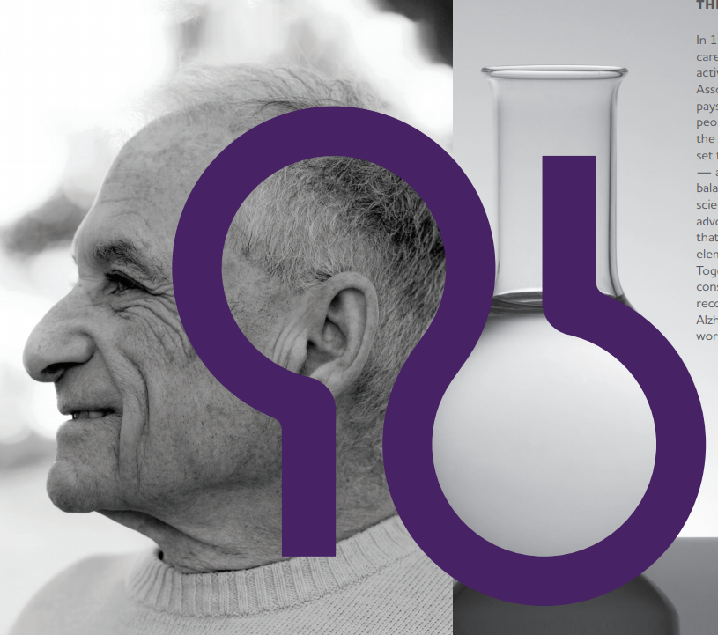
OUR WORK | COMMUNITY AND SCIENCE
The Alzheimer’s Association is a global organization working to advance care, support and research across the world
In 1980, our founders united caregivers, researchers and activists to create the Alzheimer’s Association.
Our mission symbol pays tribute to their ability to bring people and science together – for the benefit of all.

Slide 4
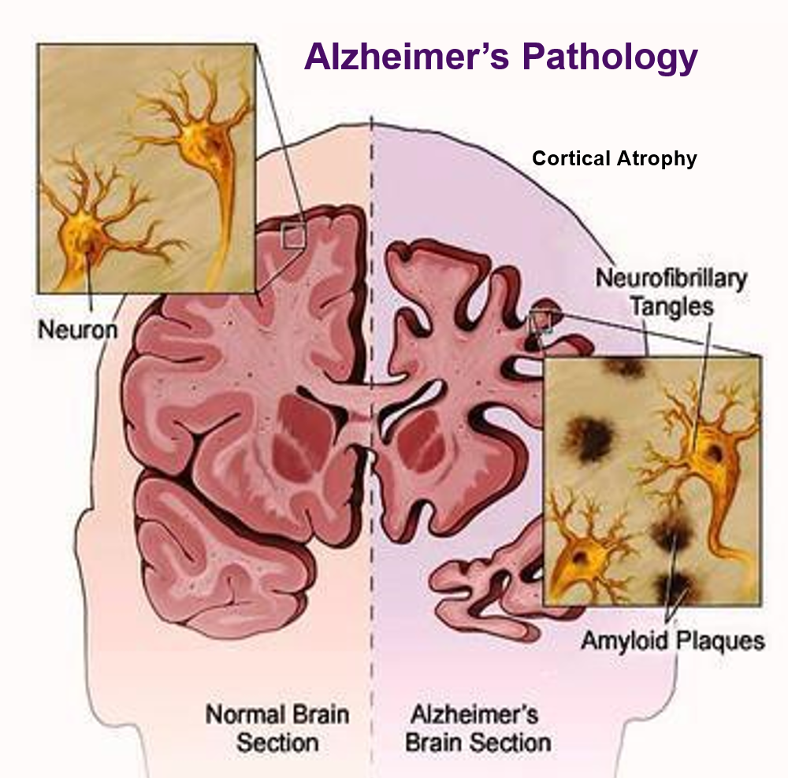
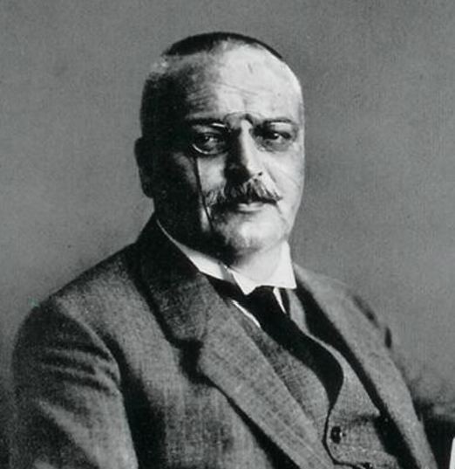
HALLMARKS OF ALZHEIMER’S DISEASE
Notes:
Alois Alzheimer – credited for discovering the disease in 1906 linking symptoms to microscopic brain changes in patient Auguste D
Dr. Solomon Carter Fuller – first African American psychiatrist and a trailblazer in dementia research alongside Alois Alzheimer.

Slide 5
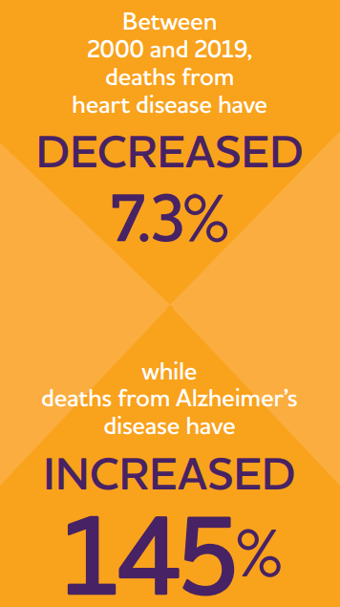
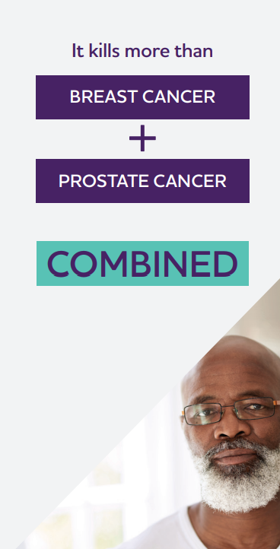
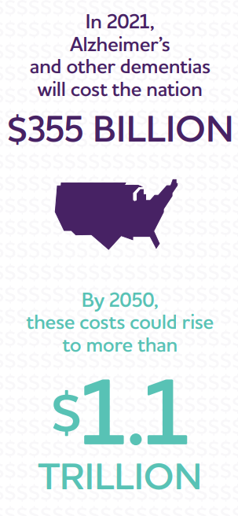
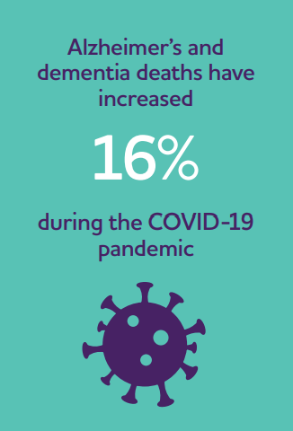
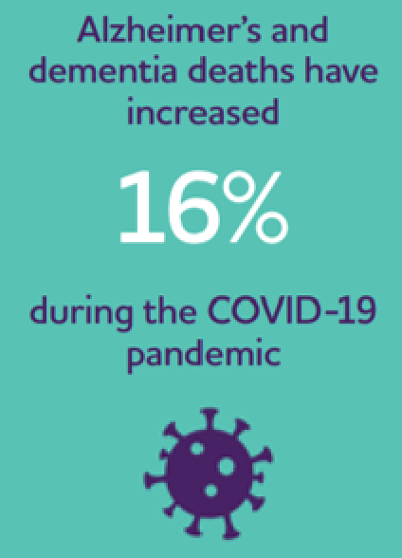
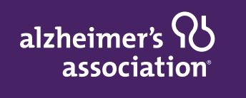
MORE
THAN
6
MILLION
Americans
are living with Alzheimer’s
Notes:
There are currently MORE THAN 6 MILLION Americans aged 65+ living with Alzheimer’s —– a number expected to more than double by 2050.
COVID-19 hitting people with Alzheimer’s hard —– 42,000 more deaths in 2020 than expected —– 16% increase.
Disease-related costs continue to rise: In 2021: $355B up
$50B from 2020.

Slide 6
ALZHEIMER'S FACTS AND FIGURES KENTUCKY
75,000
Individuals living with Alzheimer's in Kentucky
This number is projected to increase 14.7% between 2020 and 2025
Alzheimer's is the 6th leading cause of death
2,895
# of people in hospice with a primary diagnosis of dementia
1,735
# of emergency department visits per 1,000 people with dementia

Slide 7
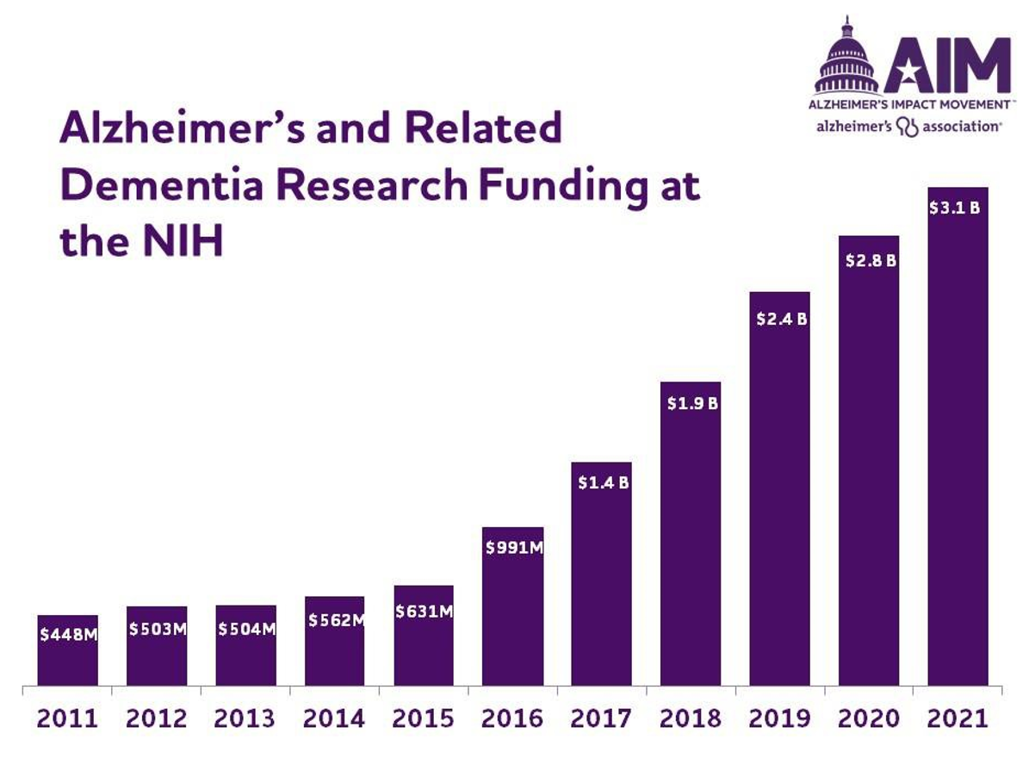
WE ADVOCATE
Notes:
Alzheimer's research funding at the NIH has increased six-fold since the passage of NAPA

Slide 8
INCREASED FEDERAL FUNDING EXPANDS ADRC NETWORK
Exploratory ADRCs: designed to expand and diversify research and education opportunities to new areas of the country, new populations, and new approaches to research
Notes:
Sanders Brown Center on Aging & Alzheimer's Disease Research Center at the University of Kentucky
In 1985, Sanders-Brown was among the first 10 ADRCs funded by the NIH and has been continuously funded since the designation was launched.

Slide 9
ANNOUNCEMENT SURPRISES THE FIELD
Trials halted due to futility analysis conducted on partial data set
MARCH ‘19
OCT ‘19
Announcement expanded data set shows promise
DEC ‘19
Results reported at CTAD
Launch of re-dosing studies to provide drug access to trial participants
MARCH ‘20
MID 2020
Submitted to FDA for regulatory review
FDA reviewed aducanumab, an anti-amyloid antibody for treatment of dementia and mild cognitive impairment (MCI) due to Alzheimer’s disease. This begins
the FDA’s review process under priority review.
AUG
‘20
FDA provides conditional approval for aducanumab, which will be known as aduhelm
JUNE ‘21

Slide 10
2021 Special Report Race, Ethnicity and Alzheimer’s in America
To learn more visit alz.org/facts

Slide 11
Gender, Racial and Ethnic Disparities in Alzheimer’s Prevalence
Almost two-thirds of Americans with Alzheimer’s are Women.
Older Black and Hispanic Americans are more likely than older Whites to have Alzheimer’s or other dementias.
Constellation: Fundamental and Unique
1
2
3

Slide 12
Gender, Racial and Ethnic Disparities in Alzheimer’s Prevalence

Slide 13
Gender, Racial and Ethnic Disparities in Alzheimer’s Prevalence
LGBT adults living with dementia face unique challenges
in accessing support

Slide 14
Gender, Racial and Ethnic Disparities in Alzheimer’s Prevalence
Diagnosis, disease progression and access/response to treatment may each be affected by:
Age,
Socioeconomic Position (education, income, occupation)
Gender Identity
Stress
Race/Ethnicity
Disability Status and
Geography (National Institute on Aging, 2020)
Investigation of differences in population-level outcomes that are associated with a broad, complex, and interrelated array of environmental, sociocultural, behavioral, biological factors (*Anderson, 1998).

Slide 15
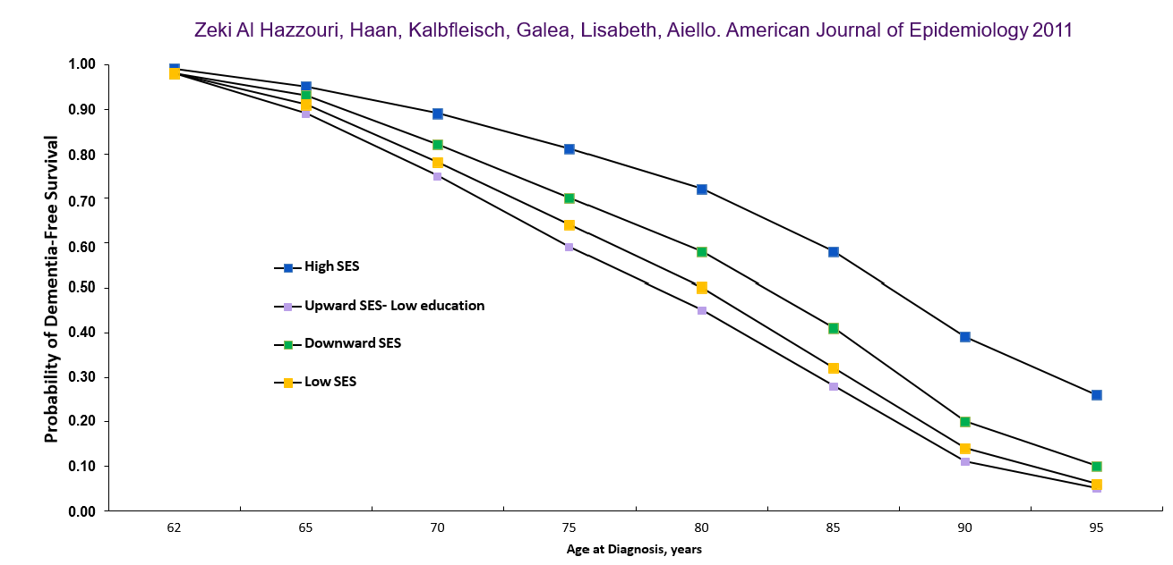
SOCIAL CLASS AND DEMENTIA
Gender, Racial and Ethnic Disparities in Alzheimer’s Prevalence
Zeki Al Hazzouri, Haan, Kalbfleisch, Galea, Lisabeth, Aiello. American Journal of Epidemiology 2011

Slide 16
FOCUS ON RISK REDUCTION
Gender, Racial and Ethnic Disparities in Alzheimer’s Prevalence
The Lancet Commission presents a new life-course model showing potentially modifiable, and non-modifiable, risk factors for dementia.
*Air Pollution, Traumatic Brain Injury, Excessive Alcohol Use
Notes:
2017 Lancet Commission identified 9 potentially modifiable risk factors: less education, hypertension, hearing impairment, smoking, obesity, depression, physical inactivity, diabetes, and low social contact
2020 added 3 more with more: excessive alcohol consumption, traumatic brain injury, and air pollution
Together the 12 modifiable risk factors account for around 40% of worldwide dementias, which consequently could theoretically be prevented or delayed.

Slide 17
More than one-third of Black Americans, and nearly one-fifth of Hispanic and Asian Americans believe discrimination would be a barrier to receiving Alzheimer’s care
DISCRIMINATION A PERCEIVED BARRIER
TO CARE
Gender, Racial and Ethnic Disparities in Alzheimer’s Prevalence

Slide 18
DISCRIMINATION WHEN SEEKING CARE
Gender, Racial and Ethnic Disparities in Alzheimer’s Prevalence
HALF of Black Americans and at least ONE-THIRD of Native, Asian and Hispanic Americans report experiencing health care discrimination

Slide 19
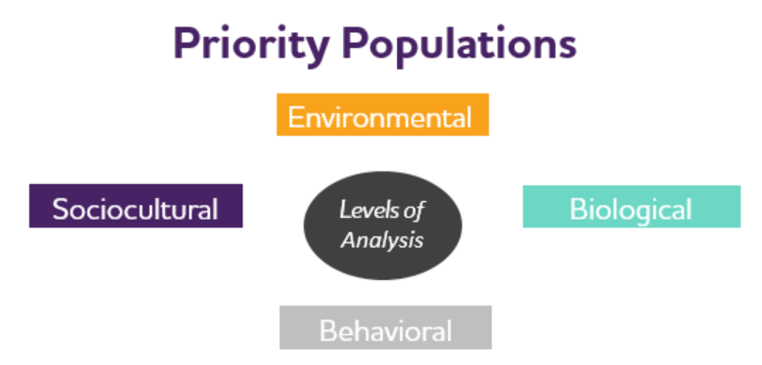
DIVERSE PERSPECTIVES AND DEMENTIA RISK
Gender, Racial and Ethnic Disparities in Alzheimer’s Prevalence
Are there unique pathways to dementia risk for at-risk communities?
Source: Hill CV, Perez-Stable EJ, Anderson NA & Bernard MA, Ethnicity & Disease, 25 (3), 2015

Slide 20
INCLUSION IN
DEMENTIA RESEARCH
Gender, Racial and Ethnic Disparities in Alzheimer’s Prevalence
FACT: LESS THAN 5% of trial participants are
Black/African American
Latino/Hispanic
Asian American/Pacific Islander
American Indian/Alaskan Native
UNDERSTANDING THE WHY
Less likely to be recruited for clinical trials
Higher drop-out rates in AD trials
Awareness/Education/Bioethics

Slide 21
CHANGING
THE COURSE
PURSUING EQUITY
IN ALZHEIMER’S &
ALL OTHER DEMENTIA
Conduct, Promote and Support Multi-Level Health Disparities Research
Increase Diversity in Health Systems and Health-Related Institutions
Enhancing Cultural Competence in Dementia Research and Care
Compliance/Accountabilities
Participatory Engagement to Build Trust and Agency
1
2
3
4
5

Slide 22
PURSUING EQUITY
Equity in Neuroscience and Alzheimer’s Clinical Trials (ENACT) Act
ENACT ACT OVERVIEW
Expand access & increase outreach to
underrepresented
populations
ENACT Act authorizes
$60 MILLION per year for FIVE YEARS
Increase diversity among
clinical trial staff
Reduce the
participation burden

Slide 23
PURSUING EQUITY
NEW Imaging Dementia—Evidence for Amyloid Scanning (IDEAS) Study
NEW IDEAS STUDY OVERVIEW
NEW GOAL, NEW STUDY
Assess if brain positron emission tomography (PET) scan results help guide doctors in diagnosing and treating memory conditions in participants of diverse racial and ethnic backgrounds.

Slide 24
PURSUING EQUITY
NEW Imaging Dementia—Evidence for Amyloid Scanning (IDEAS) Study
NEW IDEAS STUDY
PARTICIPANTS
Of the 7,000 participants:
HOW WILL THIS GOAL BE MET?
We will seek participants with:
diverse dementia presentation OR
diverse racial and ethnic backgrounds
2,000
Black / African American
2,000 Hispanic / Latino

Slide 25
PURSUING EQUITY
THROUGH NATIONAL PARTNERSHIPS
LOCAL ACTIVATION
NATIONAL SCOPE
PARTNERS ENGAGE THEIR MEMBERS AND COMMUNITIES THROUGH:
2,000
Black / African American
2,000 Hispanic / Latino

Slide 26
DEVELOPING OUR UNDERSTANDING
DEFINING
DIVERSITY, INCLUSION & EQUITY
DIVERSITY
INCLUSION
EQUITY
Numerical representation of differences
Different perspectives, characteristics & beliefs
Achieving an authentic & empowered participation and true sense of belonging
The action or state of including, or bring included within a group
Everyone gets what they need to survive, access to opportunity, resources and support
Different from “equality”, where everyone has the same access to & amount of resources
Stanford Social Innovation Review. (2016, September 15). What the Heck Does ‘Equity’ Mean? https://ssir.org/articles/entry/what_the_heck_does_equity_mean

Slide 27
DEVELOPING OUR UNDERSTANDING
A CLOSER LOOK
HEALTH EQUITY
HEALTH INEQUITY
Health equity is achieved when every person has the opportunity to attain their full health potential and no one is disadvantaged from achieving this potential because of social position or other socially determined circumstances.
Health inequities are reflected in differences in length of life; quality of life; rates of disease, disability, and death; severity of disease; and access to treatment (CDC, 2020).

Slide 28
What are the implications?
If we do nothing:
An increase of cases of AD
Burden is higher among Blacks and Hispanics
Experience barriers when accessing care
Diagnosed later, more cognitively and physically impaired - therefore in need of more medical care

Slide 29
