Slide 1
COMMISSION ON RACE AND ACCESS TO OPPORTUNITY Enabling an Intended Future for KSU
Ronald A. Johnson, PhD
Interim President
Kentucky State University
August 23rd, 2022

Slide 2
“As for the future, your task is not to foresee it, but to enable it”
Antoine de Saint Exupéry

Slide 3
Today’s Remarks
Restoring KSU’s Purpose and Financial Viability
KSU’s Transformation
Enabling an Intended Future for KSU
The Road Ahead…

Slide 4
Restoring KSU’s Purpose and Financial Viability
HB 250: Section 7.
KSU’s Mission Statement
KSU’s Purpose
KSU’s Impact and Financial Viability

Slide 5
“The Journey Is the Reward”
Steve Jobs

Slide 6
HB 250: Section 7.
… the financial health and success of Kentucky State University, a comprehensive, historically Black land-grant university, is vital to the well-being of Kentucky's postsecondary education system and the students it serves, an emergency is declared to exist, and this Act takes effect upon its passage and approval by the Governor or upon its otherwise becoming a law.
https://legiscan.com/KY/text/HB250/2022

Slide 7
KSU’s Mission Statement
Committed to – advancing the Commonwealth of Kentucky, enhancing society and impacting individuals
By providing – quality teaching with a foundation in liberal studies, scholarly research, and public service
To enable – productive lives within the diverse global economy
KSU – Public, comprehensive, historically black land-grant university
A History of Service…
Dedicated to Empowerment…

Slide 8
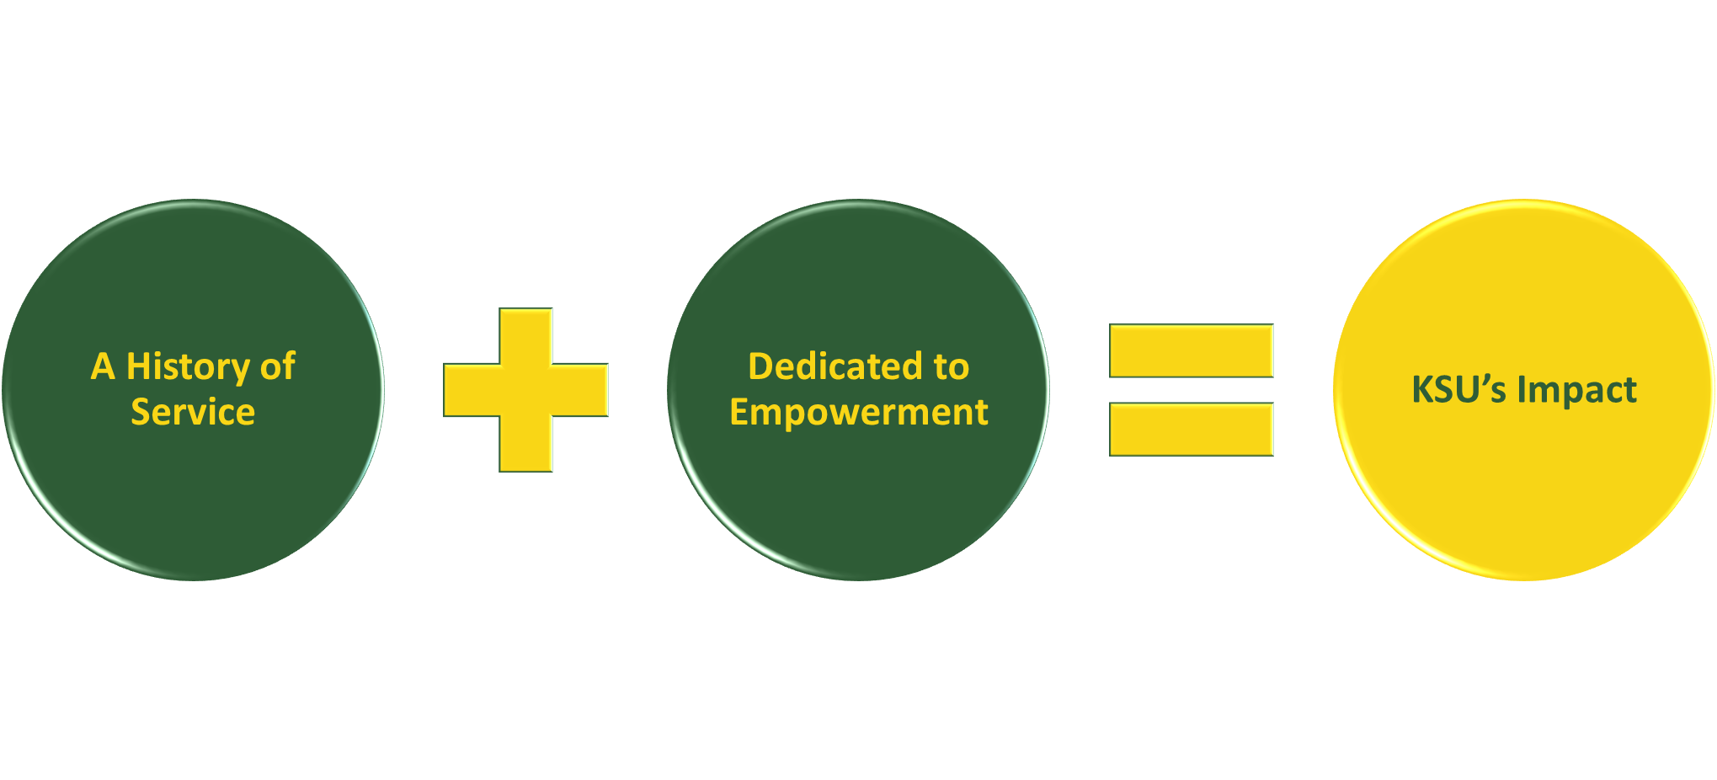
KSU’s Purpose

Slide 9
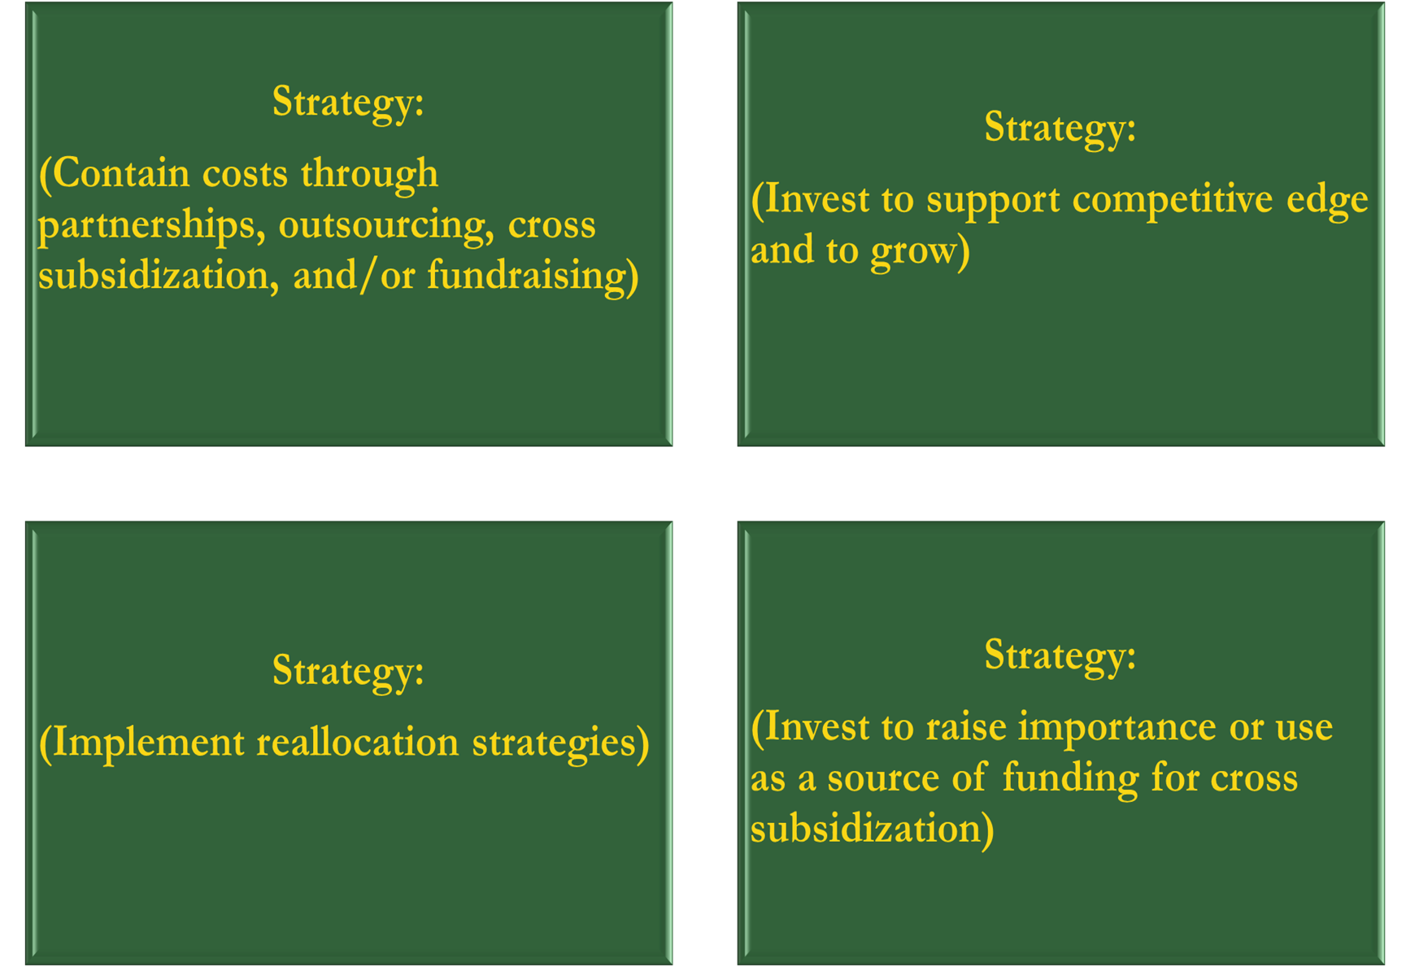
High
KSU’s Impact and Financial Viability
KSU’s Impact
Low
Low
High
Financial Viability

Slide 10
KSU’s Transformation
HB 250: Section 1. (1)
Leadership Transformation
Organizational Transformation

Slide 11
“If you want truly to understand something, try to change it”
Kurt Lewin

Slide 12
HB 250: Section 1. (1)
Section 1. (1) The General Assembly hereby finds a significant lack of efficiency and effectiveness in the instructional and operational performance of Kentucky State University and determines that immediate appropriate corrective action is warranted…
*https://legiscan.com/KY/text/HB250/2022

Slide 13
Leadership Transformation
“Leaders need many qualities but underlying them all is good judgment.
…ambition but no judgment run out of money.
…charisma but no judgment lead their followers in the wrong direction.
…passion but no judgment hurl themselves down the wrong paths.
…drive but no judgment get up very early to do the wrong things.
Sheer luck and factors beyond your control may determine your eventual success, but good judgment will stack the cards in your favor.”
https://hbr.org/2020/01/the-elements-of-good-judgment

Slide 14
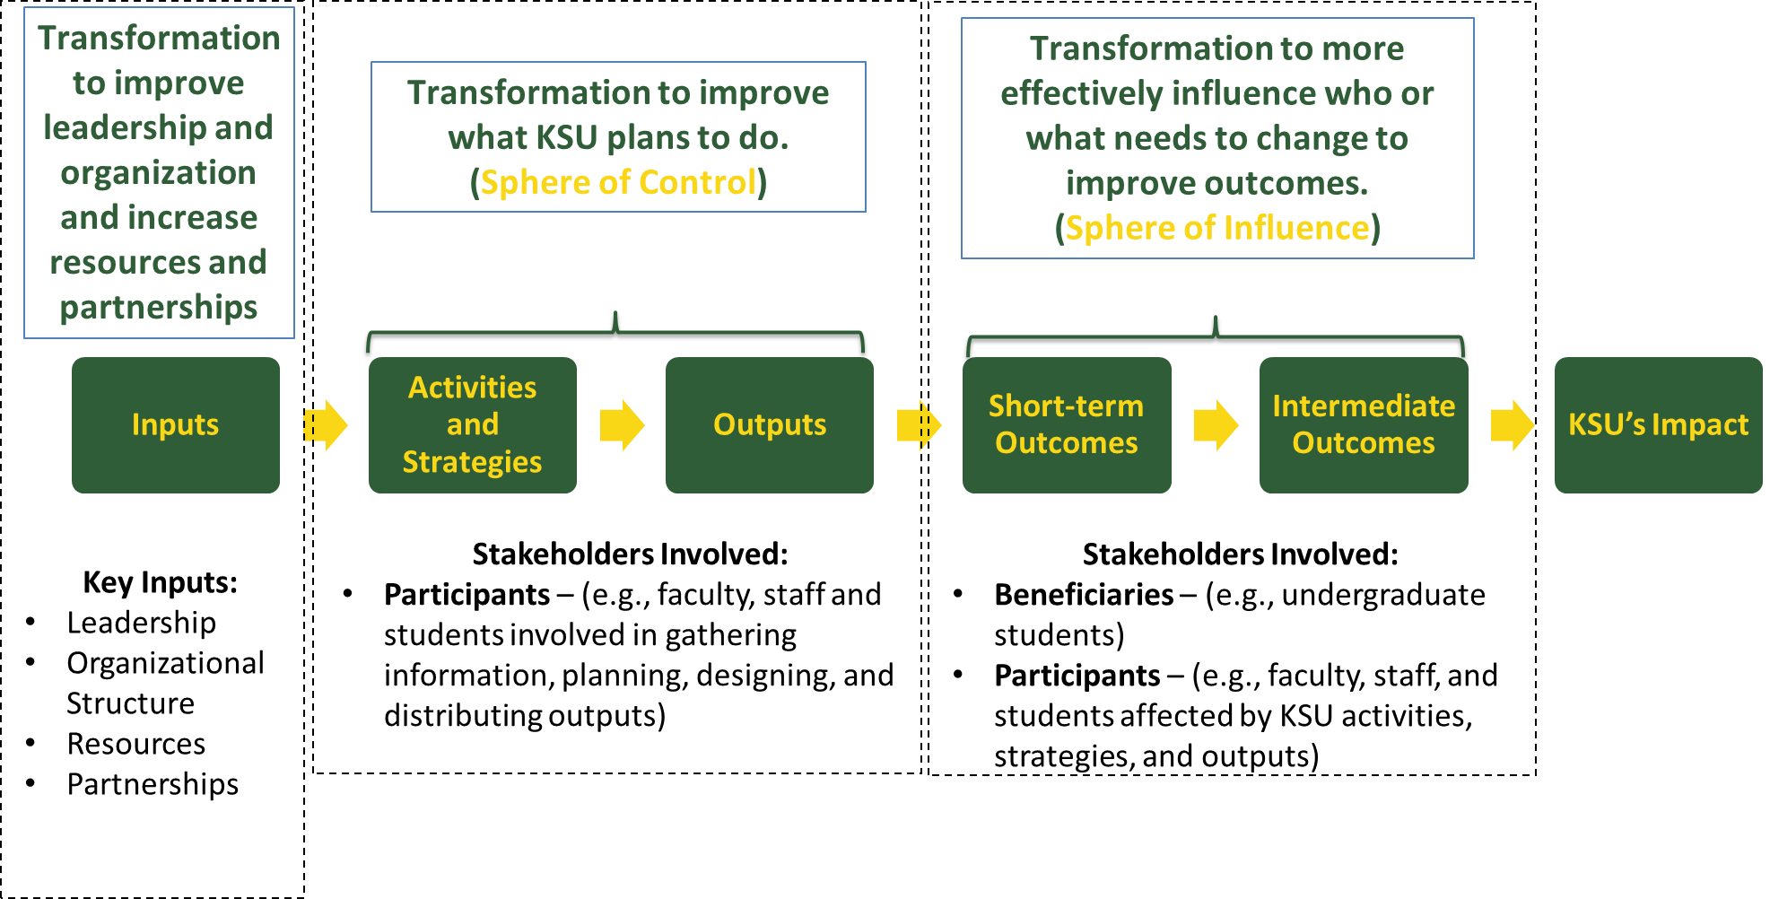
Organizational Transformation

Slide 15
Enabling an Intended Future for KSU

Slide 16
“Perfection of means and confusion of ends seems to characterize our age”
Albert Einstein

Slide 17
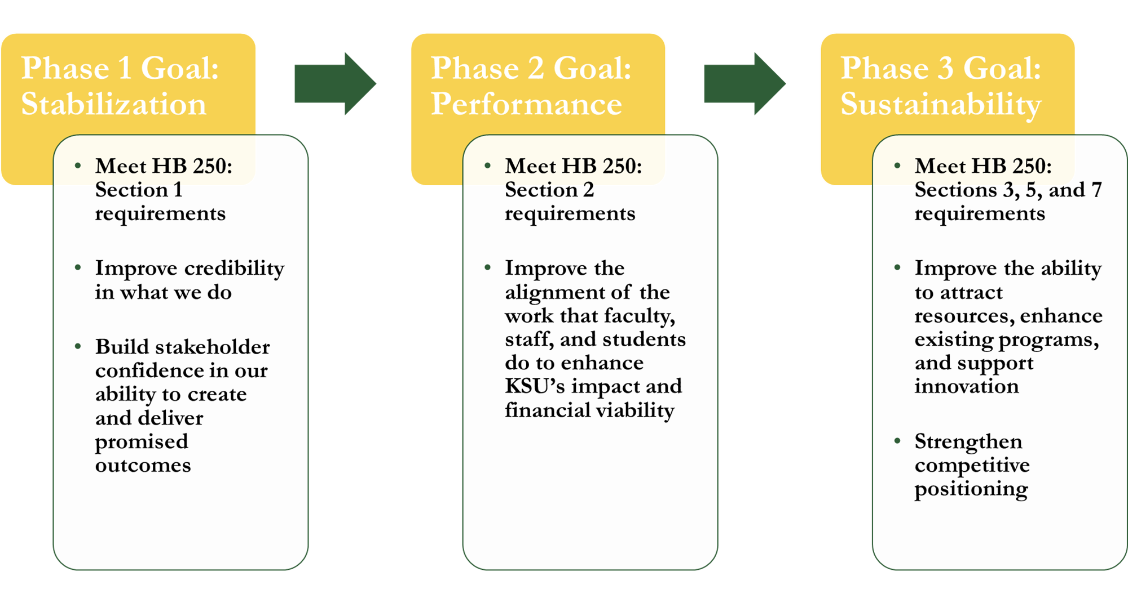
Our Three Phase Plan

Slide 18
The Road Ahead…

Slide 19
“We are committed to being “Good Shepherds” of KSU. It is a “Noble Institution” that matters even more today. Some hard decisions will need to be made but together we can enable an intended KSU future.”
Ronald A. Johnson, PhD

