Slide 2
“…..[it’s argued] the Negro is a criminal; you see he has the highest crime rate in any city." So the arguments go on ad infinitum. Those who use these arguments never say that if there are lagging standards in the Negro community—and there certainly are—they lag because of segregation and discrimination. They never go on to say that criminal responses are environmental, and not racial. Poverty, ignorance, economic deprivation, social isolation breed crime in any racial group. It is a tortuous logic to use the tragic results of segregation as an argument for the continuation of it. It is necessary to go to the causal root to deal with the problem.
Source: Delivered by Dr. Martin Luther King. Jr. at the Unitarian Universalist Association General Assembly Hollywood, Florida May 18, 1966

Slide 3
……zoning reforms that will begin to dismantle unfair policies and help create more equitable, affordable city.
On a recent life expectancy map of Louisville, the worst outcomes tend to align with neighborhoods “redlined” in a 1930s real estate map, illustrating the lasting effects of land use decisions.
Source: Louisville Metro

Slide 4
Pioneered by Baltimore in 1910, racial zoning emerged as an effective way to subjugate and segregate black folks. Baltimore's then-mayor did not mince words when discussing the motivation for such an ordinance: "Blacks should be quarantined in isolated slums in order to reduce the incidence of civil disturbance, to prevent the spread of communicable disease into nearby white neighborhoods, and to protect property values among the white majority.” Soon, similar policies spread to other cities including Atlanta, Birmingham, Dade County(Miami), Charleston, Dallas, Louisville, New Orleans, Oklahoma City, Richmond, St. Louis, and others.
Source: The Stanford Review, Baltimore’s Legacy of Racial Discrimination, May 20, 2015

Slide 6
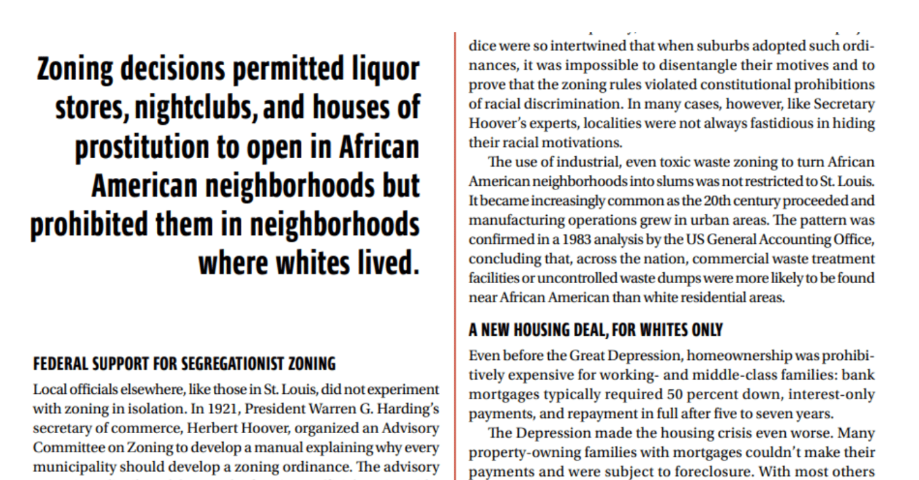
Source: Michael H. Wilson, Racial Zoning - The Color of Law: A Forgotten History of How, May 21, 2019

Slide 7
Planning Activities Conducted

Slide 8
Source: Harland Bartholomew: Destroyer of the Urban Fabric of St. Louis by Nathan Jackson, April 10, 2021

Slide 9
Sister Cities of Louisville
Source: David Rumsey Map Collection, The City of Louisville Kentucky. (with) The City of New Orleans Louisiana. Colton, G.W. 1856

Slide 11
Source: How the GI Bill’s Promise was denied to a million black WWII, Erin Blakemore, June 21, 2019

Slide 13
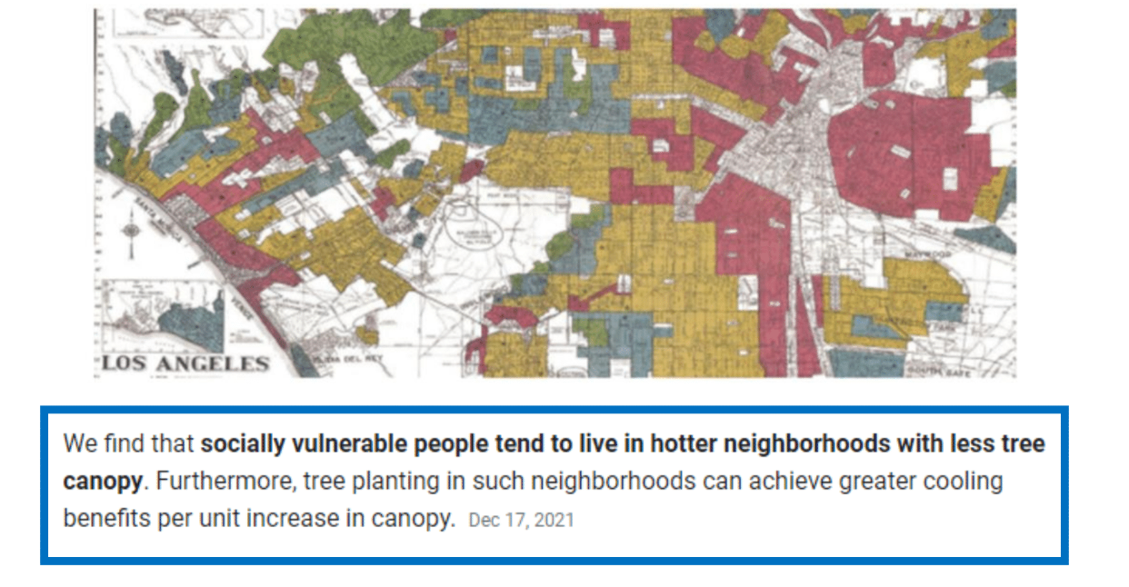
Urban Tree Canopy, Redlining, and Neighborhood Impacts

Slide 14
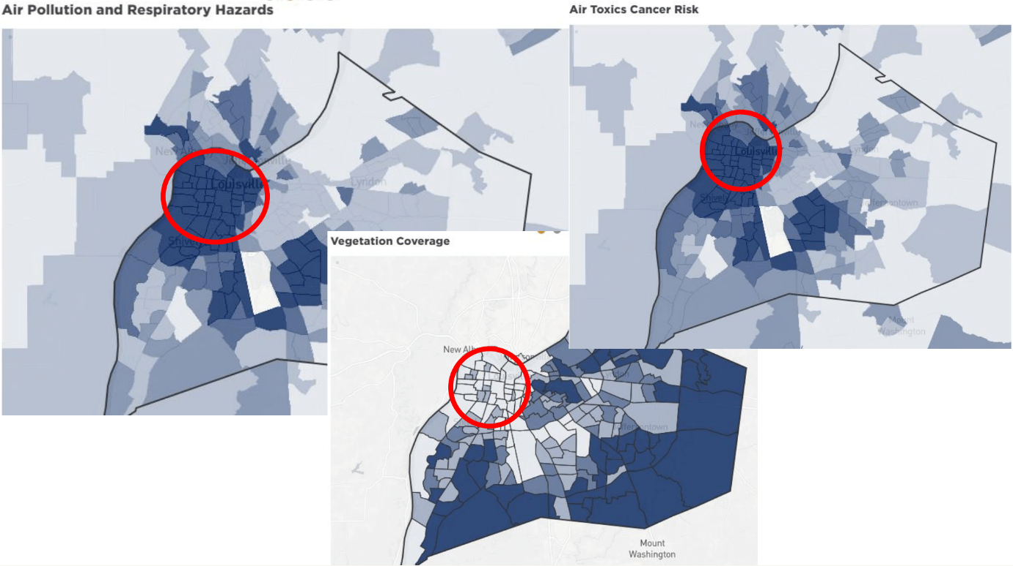
Source: Louisville Metro

Slide 15
“Environmental racism.” Communities of color aren't suffering by chance, they say.
Green Space 1%
Commercial & Industry 50%
Green Space 19%
Commercial & Industry 7%

Slide 16
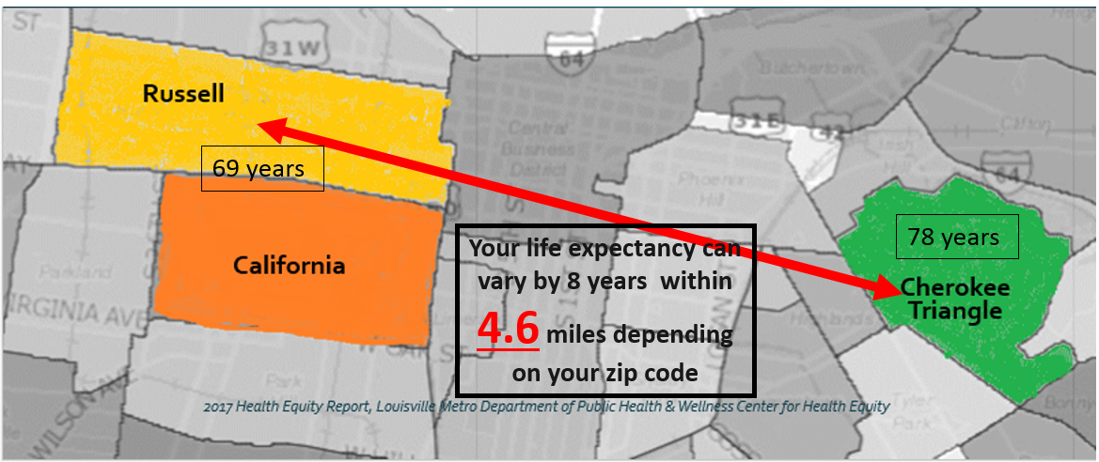
Where You Live Affects Your Health A Tale of Two Cites

Slide 17
What we know……..
70% Renters
60% Female Head of household
Median Income $22,000
1 banker for every 1200 people
2 Grocery stores in 3 mile radius
Utility disconnection rate >40%
87% AA population

Slide 18
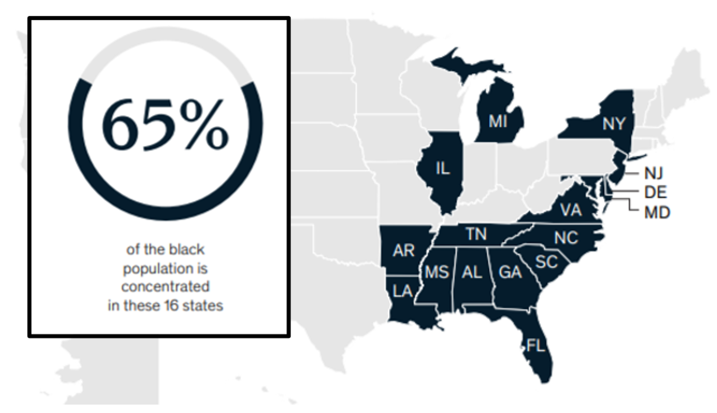

Slide 19
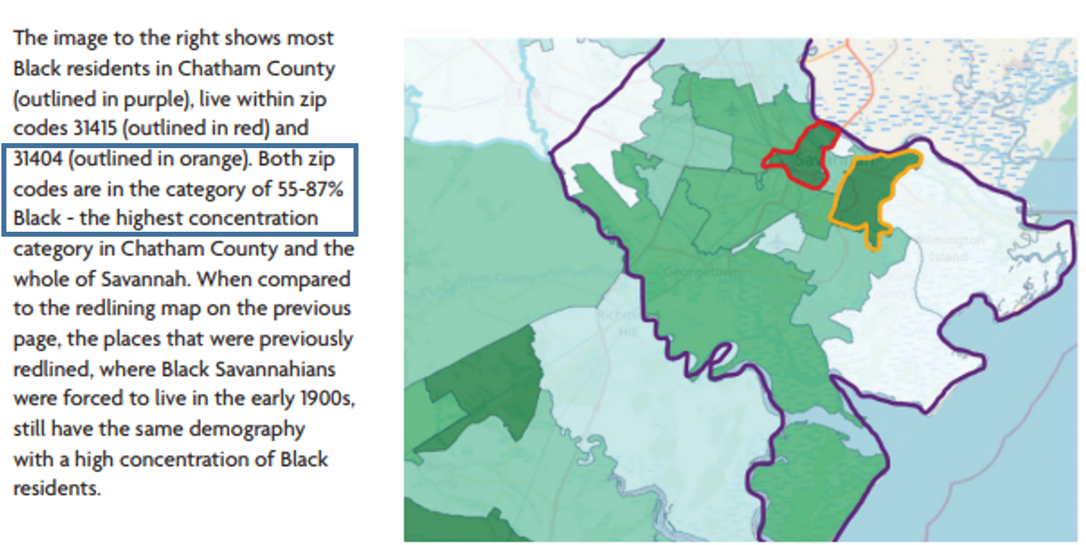
Source: percentage of population that is Black image taken from: Coastal Georgia Indicators

Slide 20
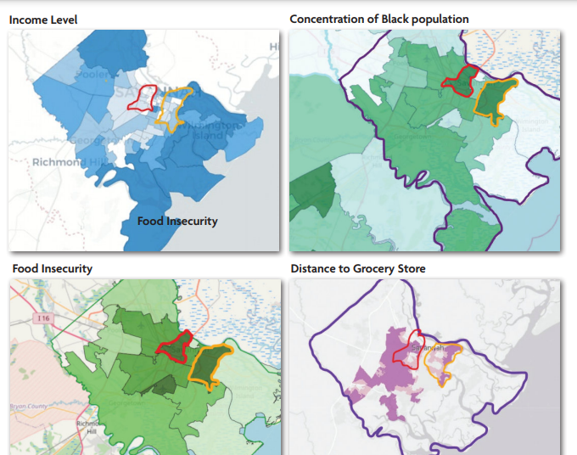
Source: percentage of population that is Black image taken from: Coastal Georgia Indicators

Slide 21
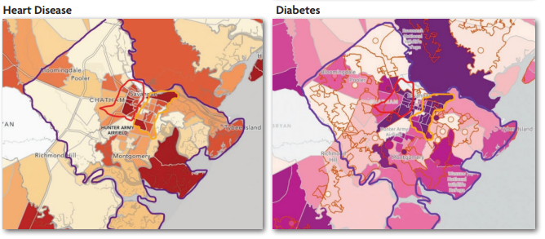
Source: percentage of population that is Black image taken from: Coastal Georgia Indicators

Slide 22
Age adjusted Hospitalization Rate due to Hypertension (2019)
Life Expectancy in Years of Age for Chatham County by Race (2021)
Source: Georgia County Health Rankings

Slide 23
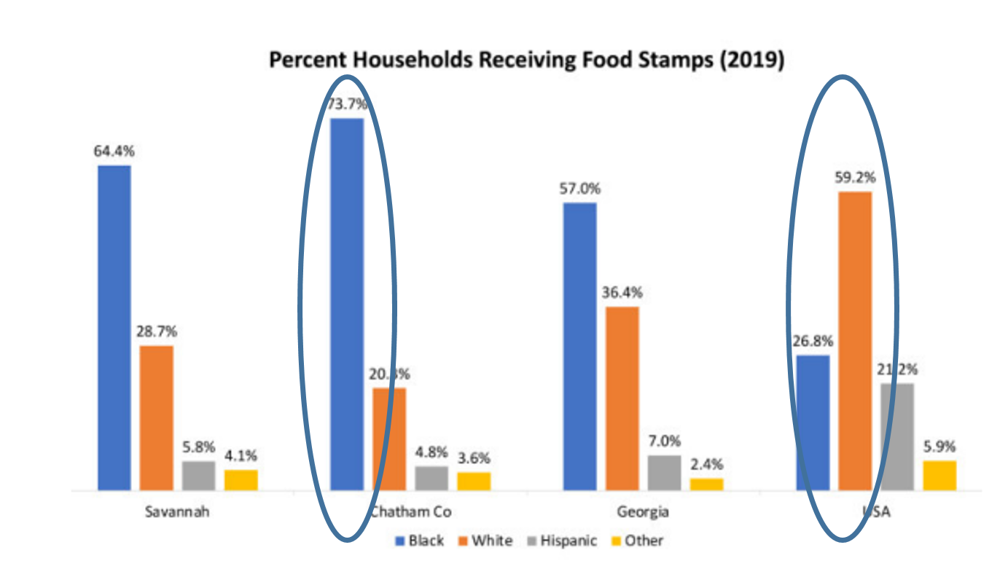
Source: Georgia County Health Rankings

Slide 24
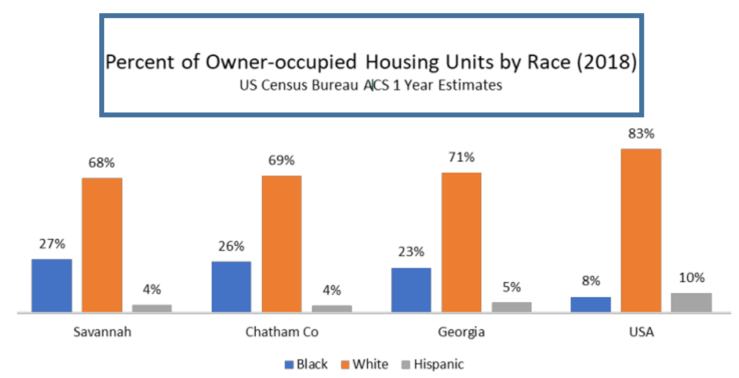
Source: Georgia County Health Rankings

Slide 25
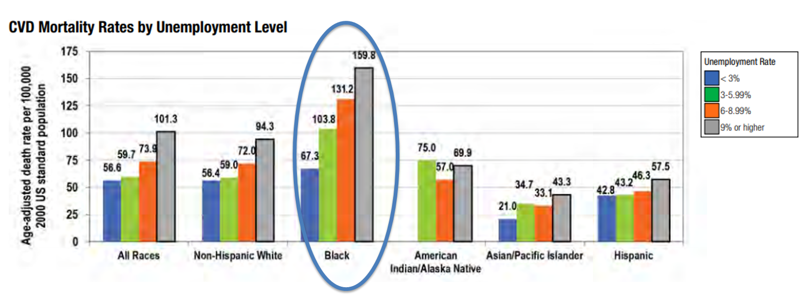
CVD and Workforce
Age-Adjusted Cardiovascular Disease (CVD), Liver Cirrhosis, and Homicide Mortality Rates by Unemployment Level, U.S, Population Aged 25-64 Years, 2012-2016
Source: Georgia County Health Rankings

Slide 26
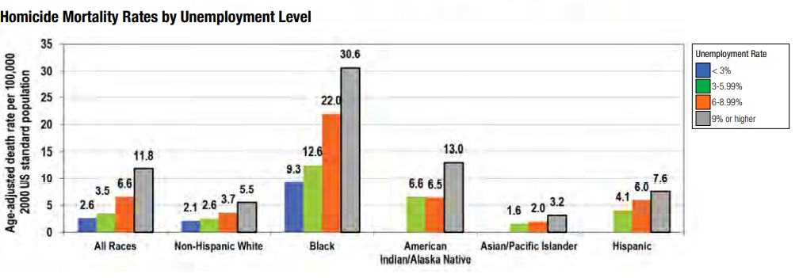
Homicide and Workforce
Age-Adjusted Cardiovascular Disease (CVD), Liver Cirrhosis, and Homicide Mortality Rates by Unemployment Level, U.S, Population Aged 25-64 Years, 2012-2016
Source: Georgia County Health Rankings

Slide 27
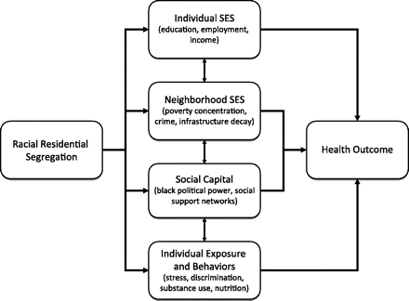
Social capital has been defined as the degree of social trust, extent of social networks, and willingness to provide mutual aid and reciprocity between individuals in a area .
Notes:
Figure 2. Possible pathways between segregation and health. SES, socioeconomic status.
Unless provided in the caption above, the following copyright applies to the content of this slide: Epidemiologic Reviews © The Author 2009. Published by the Johns Hopkins Bloomberg School of Public Health. All rights reserved. For permissions, please e-mail: journals.permissions@oxfordjournals.org.Epidemiologic Reviews © The Author 2009. Published by the Johns Hopkins Bloomberg School of Public Health. All rights reserved. For permissions, please e-mail: journals.permissions@oxfordjournals.org.

Slide 28
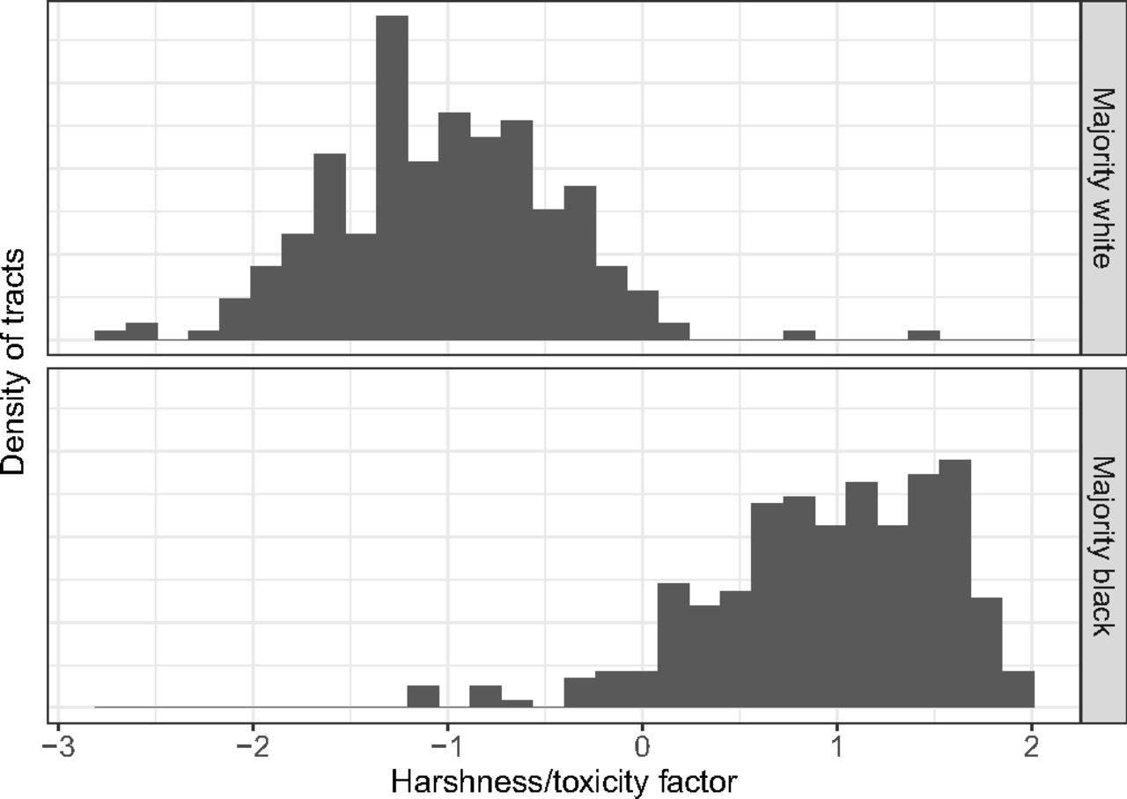
Punishing and toxic neighborhood environments independently predict the intergenerational social mobility of black and white children
Robert Manduca and Robert J. Sampson rsampson@wjh.harvard.eduAuthors Info & Affiliations
Contributed by Robert J. Sampson, February 25, 2019 (sent for review December 4, 2018; reviewed by John M. MacDonald and Bruce Western)
April 1, 2019116 (16) 7772-7777
https://doi.org/10.1073/pnas.1820464116

Slide 29
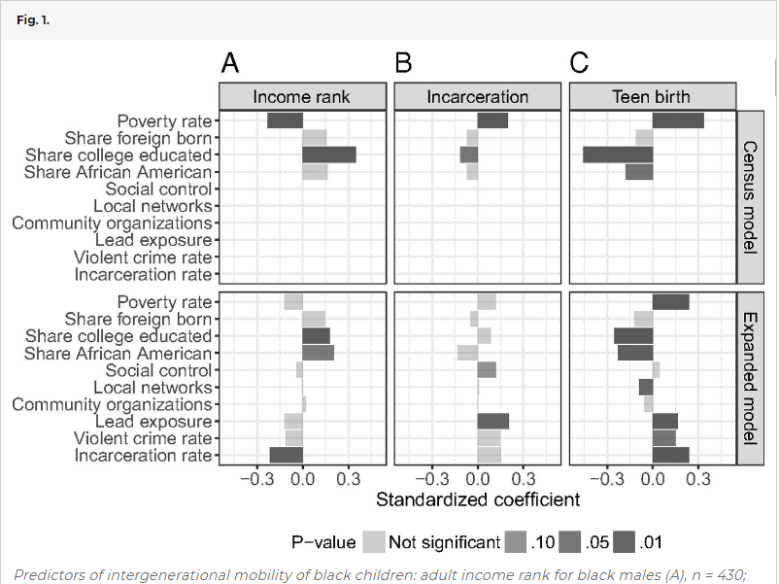

Slide 30
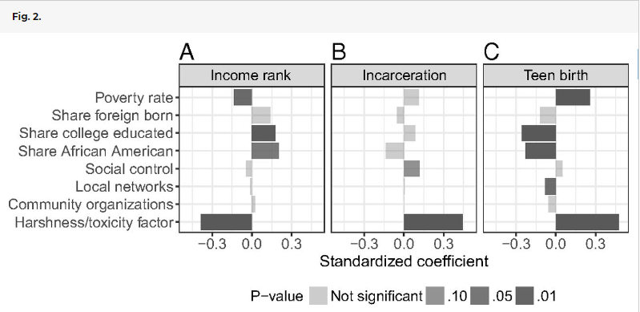

Slide 31
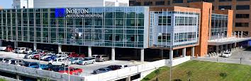
Health care systems are uniquely positioned as leading employers and Economic engines in their communities.
Provide quality healthcare – but leverage institutional resources to help address the economic, racial and environmental resource disparities that impact community health outcomes.

Slide 32
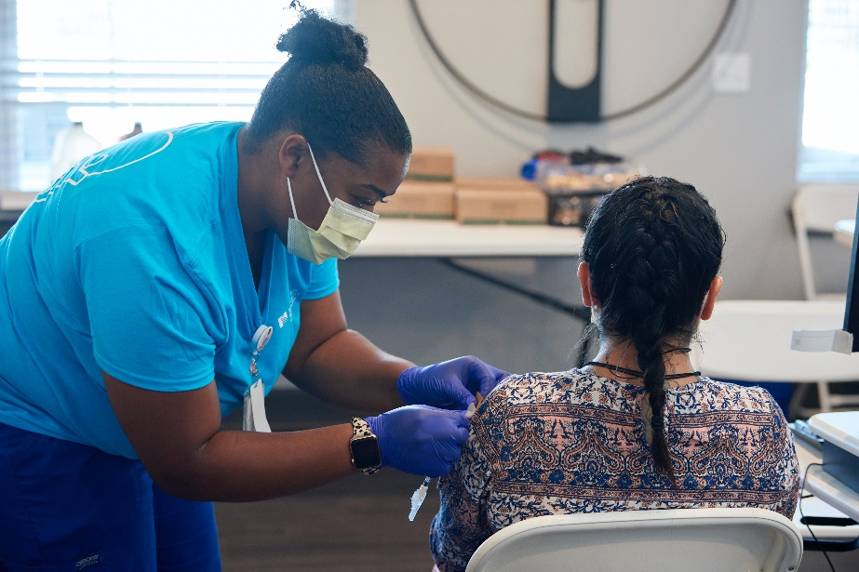
Health needs in West Louisville
Identified by community members
Access to care
Access to primary care
Transportation assistance
Lack of specialty providers
Source: Norton Healthcare Community Health Needs Assessment Survey

Slide 33
Pressing Problems and Barriers
Socio-Demographic
Health Literacy Trust
- Healthy lifestyle - Newly identified as a barrier to care
- How to access healthcare - Lack of trust in health systems

Slide 34
Health outcomes in West Louisville
Compared with the rest of Jefferson County
West Louisville has some of the highest death rates connected to:
Cancer
Heart disease
Stroke
Eastern Jefferson County has some of the lowest rates of death connected to these same health conditions.
Source: Louisville Metro Health Equity Report 2017

Slide 35
Access to Care
Unmet healthcare needs
Access options in the west and south sectors of Jefferson County
Need to be aware of digital access limitations
Specialty Care Access
Mental Health
Substance Use
Medically assisted treatment options for addiction
Pain management
Pediatric specialties
Impoverished / Poor
Mental Health / Substance Use
Minorities
Elderly

Slide 36
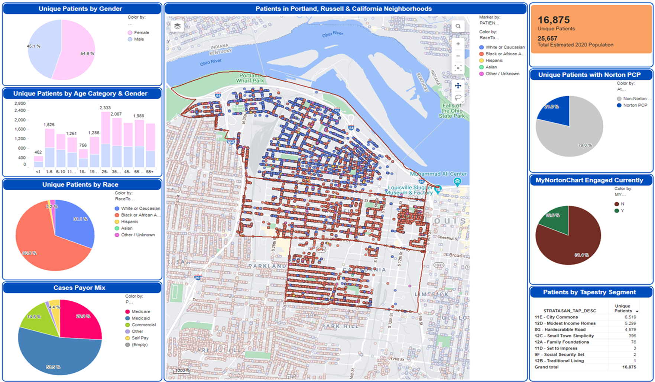
Patient Profile – West Louisville
Source: Norton Healthcare Enterprise Analytics dashboards

Slide 37
The time for change is now

Slide 38
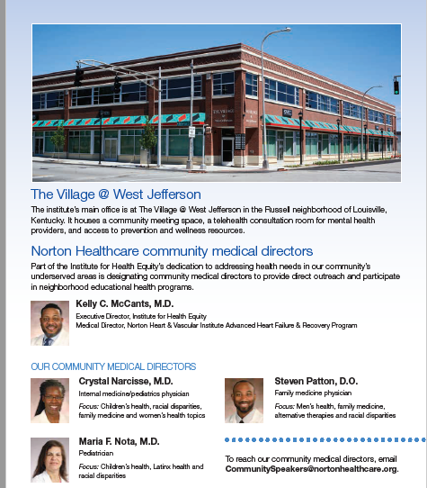

Slide 39
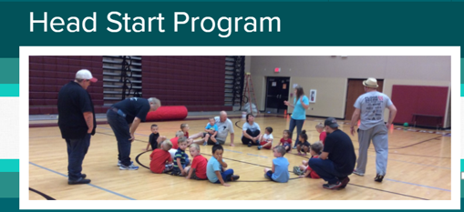
MOLO Village Community Development Corporation is a nonprofit organization founded in 2011 to engage residents of West Louisville’s historic Russell neighborhood in holistic approaches to community development. MOLO focuses its work on individuals and families impacted by the high rate of poverty, incarceration, and recidivism by helping them transform themselves into positive citizens that benefit the entire community. “MOLO” means "welcome” in Xhousa (a South African dialect) Plans to offer expanded youth programming and re-entry services. Prior to the pandemic, the organization served 800 - 1,000 residents per month. Currently the organization has pivoted by hosting a Jefferson County Public School education hub to support area children during non-traditional instruction. And, community outreach continues in partnership with St. Peters' United Church of Christ. Most notably is the operation of a Dare To Care Food Bank that serves hundreds through a weekly distribution event.

Slide 40
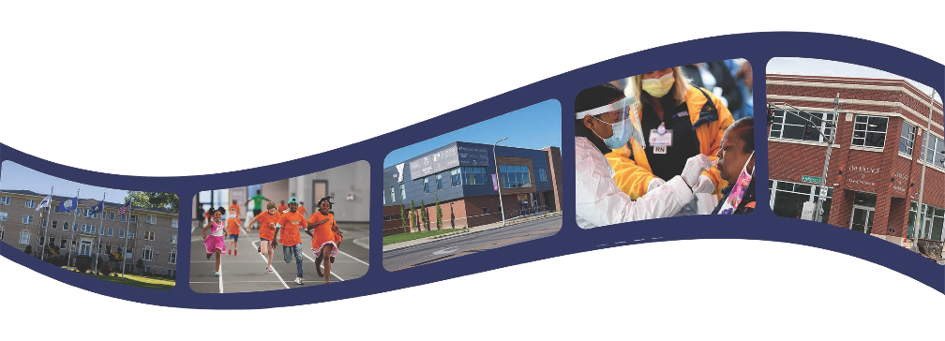
Norton Healthcare’s investment in West Louisville includes a primary care office at 18th Street and Broadway inside the Republic Bank Foundation YMCA.
The Norton Healthcare Sports & Learning Center is now attracting world-class athletes who are participating in indoor track races.
We developed partnerships with Louisville Urban League, St. Stephen Church and approximately 20 other churches in West Louisville for COVID-19 testing and vaccinations.
Norton Healthcare continues to support Simmons College of Kentucky.
Norton Healthcare also established a partnership with Bates Community Development Corp.
In November 2021, the Institute for Health Equity opened in The Village @ West Jefferson. This location is a part of MOLO Village.
Through community relationships, Norton Healthcare is connecting more people to care.

Slide 41
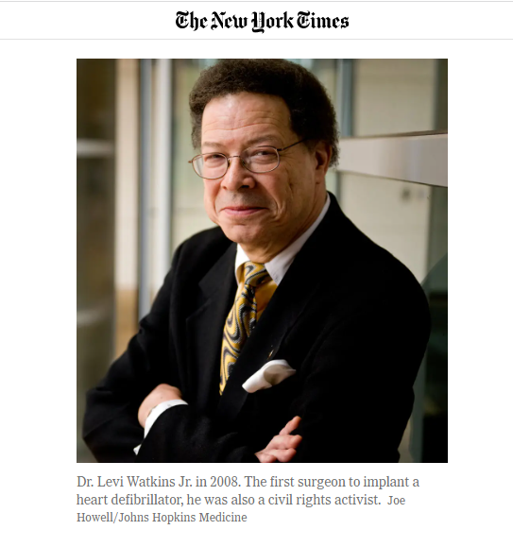
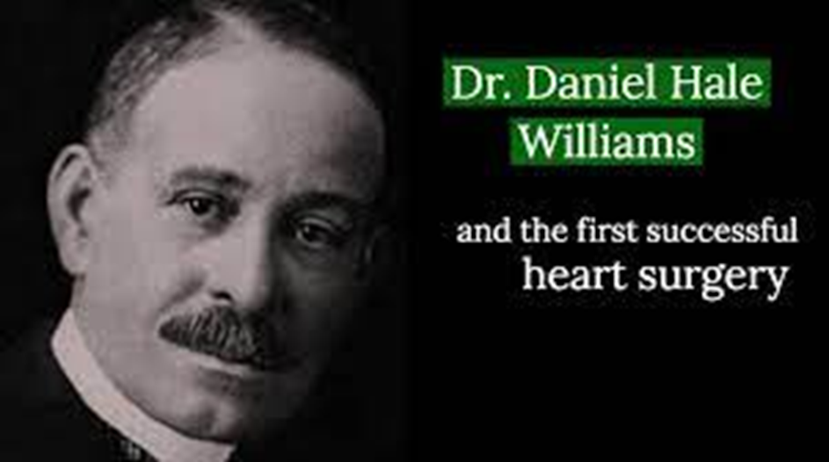
“Health Equity is not about treating all patients the same. It’s about identifying and overcoming the differences that may prevent us from achieving the same
desired outcome”

Slide 42
EIB & IHE
Equity, Inclusion and Belonging
Institute for Health Equity
Internal focus on employees
Social determinants of health from an employment lens
Minority recruiting
Ally education
Pipeline creation
External focus on community
Social determinants of health from a social services lens
Minority business and university partnerships
Patient education and advocacy
Access expansion
Our community’s experience will never exceed that our of employee’s experience.
Must be aligned an in-sync.
Works from a joint strategic plan that combines the community and employee initiatives.

Slide 43
Norton Healthcare West Louisville Hospital
Increasing Access, Removing Barriers

Slide 44
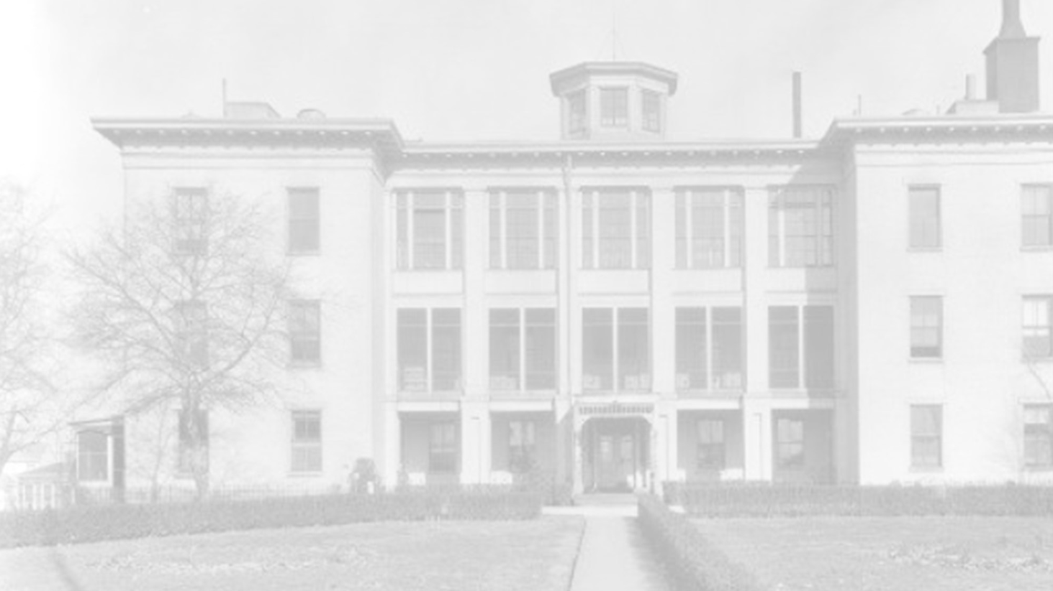
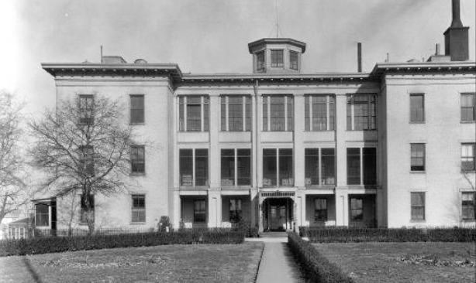
Hospital history
The last hospital built in West Louisville was in 1845.
The United States Marine Hospital opened in 1852 in the Portland neighborhood.
That hospital closed in 1933.
This will be the first hospital to be built in West Louisville in more than 150 years.

Slide 45
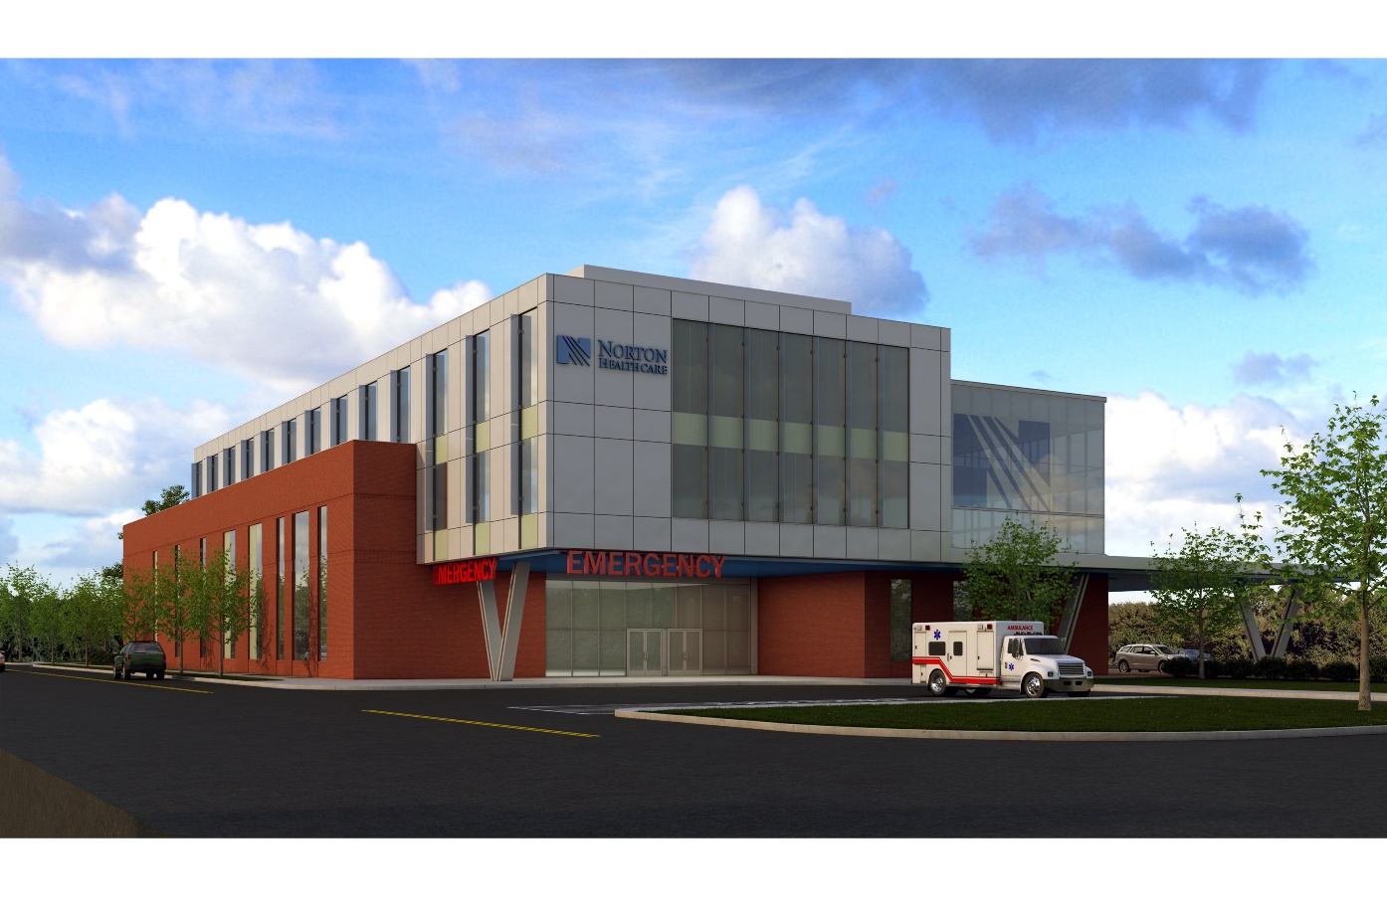
In partnership with Goodwill Industries of Kentucky, Norton Healthcare is building a $70 million hospital at 28th Street and Broadway on the new “Opportunity Campus.”
20 inpatient beds
Emergency department
Adult and pediatric primary care
Outpatient procedures
Imaging (X-rays, CT scans)
Women’s health
Cardiology
Neurology
Endocrinology

Slide 46
