Slide 1
The State of Maternal Health in Kentucky
Edward Miller MD
Division Director Maternal Fetal Medicine
Chief Diversity Officer UofL Health

Slide 2
Health Outcomes are Multifactorial

Slide 5
Medical Conditions Shorten Black Lives
Medical prevention and treatment would help
86% of the difference
in life expectancy
Years of Adult Black Lives Lost as Compared to Whites
Ratios from MMWR May 2, 2017
Years assume a 3.5-year total difference for adults
Note: “Other” includes conditions (e.g., diabetes) for which Black death rates are higher and some (e.g., COPD, cirrhosis) for which Black death rates are lower.

Slide 6
Key Terms
Pregnancy-associated death: Death while pregnant or within one year of the end of the pregnancy, irrespective of cause.
Pregnancy-related death: Death during pregnancy or within one year of the end of pregnancy from a pregnancy complication, a chain of events initiated by pregnancy, or the aggravation of an unrelated condition by the physiologic effects of pregnancy.
Maternal mortality: Death while pregnant or within 42 days of the end of pregnancy, irrespective of the duration and site of the pregnancy, from any cause related to or aggravated by the pregnancy or its management, but not from accidental or incidental causes.
Notes:
There are three commonly used measures of maternal deaths in the United States. While they all capture some aspect of maternal deaths, they are not equivalent.

Slide 7
Maternal Mortality Rates in the United States

Slide 8
How are we doing in Kentucky?
Notes:
America’s Health Rankings® is built upon the World Health Organization's definition of health: “Health is a state of complete physical, mental, and social well-being and not merely the absence of disease or infirmity.”
The America’s Health Rankings model, shown below, includes four drivers, or determinants of health: social and economic factors, physical environment, clinical care and behaviors all of which influence the fifth model category, health outcomes.

Slide 9
Social and Economic Status Among Women in Kentucky

Slide 10
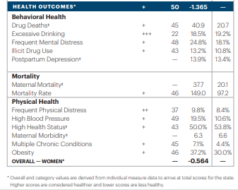
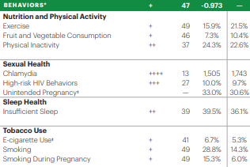

Slide 11
Causes of Maternal Death in Kentucky
Notes:
The MMRC uses death certificate data to categorize cause of maternal death as natural, accidental, homicide, or suicide. A significant contributor to maternal deaths in Kentucky is substance use, which is categorized as “accidental.” Substance use was the cause of 54.5% and 51.6% of accidental maternal mortalities in 2017 and 2018, respectively.
4 In 2017, the Kentucky MMRC found that mental health conditions, including depression, were a contributing factor in 39% of maternal deaths and a probable contributor in 15% of deaths

Slide 12
Drugs are a leading cause of “accidental” death in Kentucky
Notes:
The MMRC reviewed the cases of maternal death and in 2018 it was found that drug use contributed to more than half of cases of accidental death.
It is beneficial to learn if early identification and treatment for substance use have been undertaken for mothers throughout Kentucky. If depression screening was completed, it is necessary to understand if women were subsequently referred to community services that could help prevent accidental death. Psychosocial and environmental risk factors associated with maternal health conditions such as social inequality, lack of access, homelessness, chronic disease management, substance use, and food insecurity are pertinent to address

Slide 13
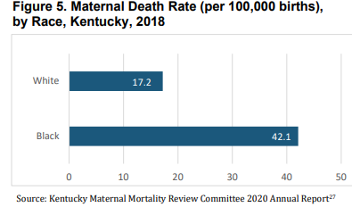
Black women are twice as likely to experience maternal death than white women in Kentucky
Notes:
There is evidence of significant racial disparities in maternal mortality in Kentucky, reflecting national trends. While Black individuals comprise only 8% of the total population of the state, they are disproportionally impacted by maternal mortality with a rate more than double that of White Kentuckians.
78% of maternal deaths were identified as preventable in Kentucky compared to 60% at the national level.

Slide 14
Rural women are disproportionately impacted
Notes:
National data points to stark racial disparities in rural communities, a particular concern in Kentucky given the geographic context. One national study found that Black women in rural areas experienced a rate of maternal mortality of 59.3 deaths per 100,000 live births, compared with 19.7 deaths per 100,000 live births among non-Hispanic white women. Additionally, between 2011-2016, pregnancy-related mortality was 14.6 deaths per 100,000 live births in large metropolitan areas, compared to 23.8 deaths per 100,000 live births in rural counties.28

Slide 15
COVID-19 Exacerbated these Disparities
Notes:
The US Government accountability office just a few weeks ago released their analysis of the CDC’s maternal mortality data. They found that maternal deaths increased during the COVID-19 pandemic. Further data showed that COVID-19 was a contributing factor in 25% of all maternal deaths in 2020 and 2021 combined. Note from this graph however that the number of maternal deaths not due to COVID 19 were still increased in comparison to the prior year.

Slide 16
Outcomes Worsened and Disparities Persisted During the Pandemic
The maternal death rate for Black or African-American (not Hispanic or Latina) women was 44.0 per 100,000 live births in 2019, then increased to 55.3 in 2020, and 68.9 in 2021. In contrast, White (not Hispanic or Latina) women had death rates of 17.9, 19.1, and 26.1, respectively.
Notes:
Disparities in other adverse outcomes, such as preterm and low birthweight births, persisted for Black or African-American (not Hispanic or Latina) women, according to GAO analysis of CDC data.

Slide 17
Preterm Birth Rates in Kentucky
Notes:
Preterm and low birthweight births. According to our analysis of CDC data, the rates of preterm and low birthweight births for all women remained substantially unchanged from 2016 through 2020, and then increased from 2020 to 2021. Existing disparities in rates of preterm and low birthweight births for Black women, which were higher compared with other races and ethnicities and the national average, also continued into 2020 and 2021. (See figs. 4 and 5
In addition to these increased rates of preterm birth, other disparities were highlighted during COVID. The rates of low birth and very low birthweight infants rose among black women, the rates of NICU admission also rose among black women,

Slide 18
Not Making the Grade

Slide 19
Black women are less likely to enter prenatal care in the first trimester
They are less likely to receive adequate care
Minority patients generally receive lower quality care even with equal access to care and insurance coverage
Alexander et. al. Racial differences in prenatal care use in the U.S.
IOM Unequal Treatment: Confronting Racial and Ethnic Disparities in Healthcare

Slide 20
Black - White Maternal Mortality disparity is the largest among all conventional perinatal health disparities
Black women consistently experience 4X greater risk of pregnancy related death than white women
This is independent of age, parity or education
Black women are more likely to die from complications of hemorrhage, hypertensive disorders and cardiomyopathy
National data set revealed Black women did not have statistically significant greater prevalence of pre-eclampsia, eclampsia, placental abruption or previa than white women but were 2-3X more likely to die from these conditions

Slide 21
“Of all the forms of inequality, injustice in health care is the most shocking and inhumane.”
Dr. Martin Luther King Jr

