Slide 3
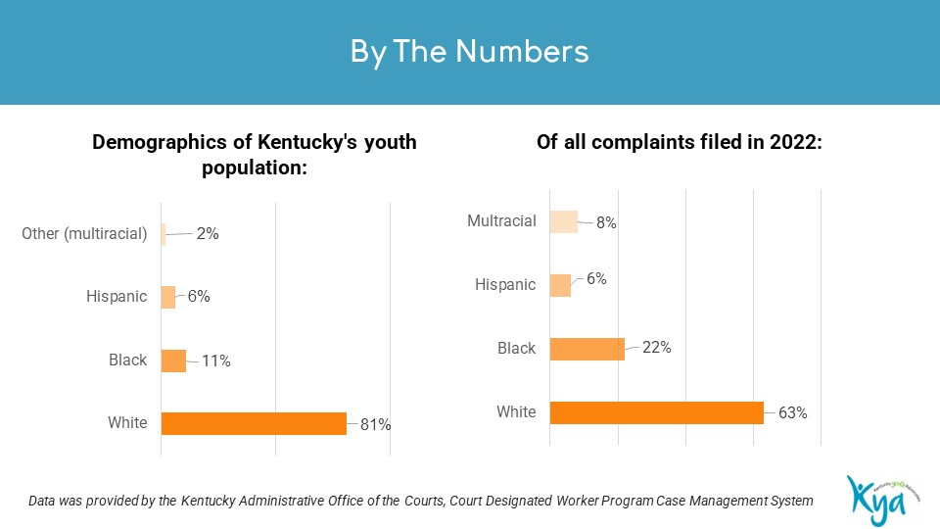

Slide 4
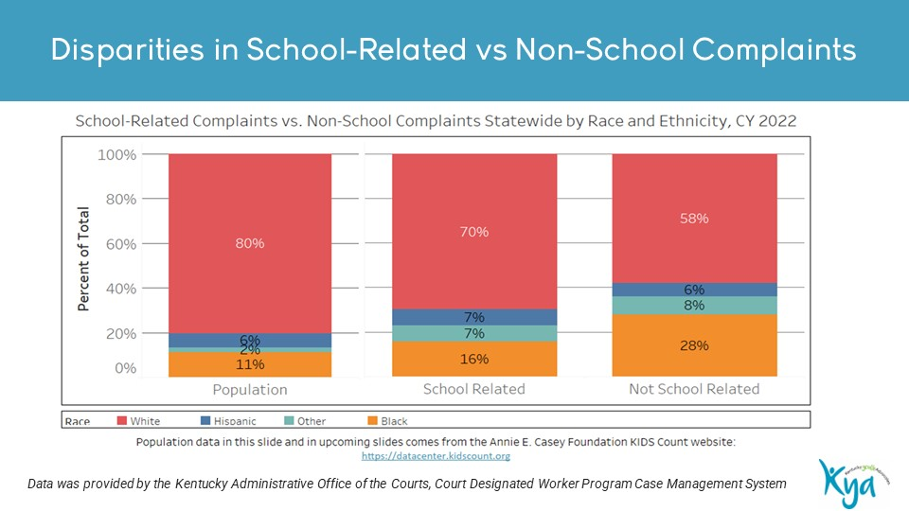

Slide 5
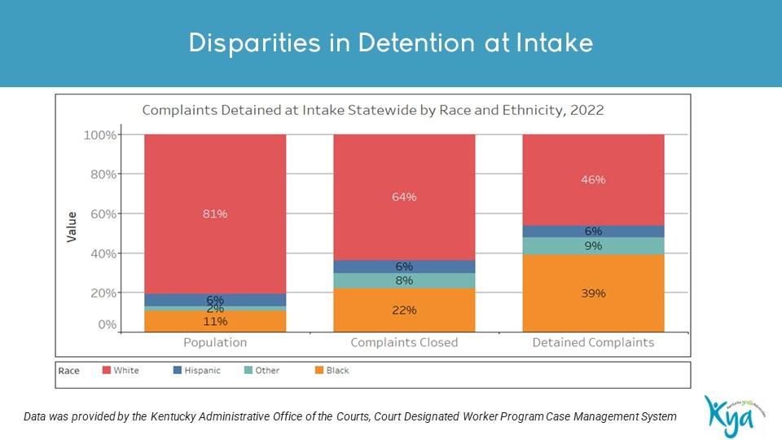

Slide 12
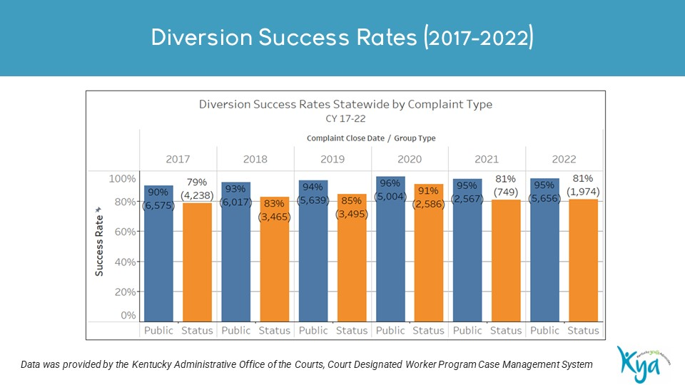

Slide 14
Cortney Downs, MSSW, CSW, Kentucky Youth Advocates
Shannon Moody, PhD, MSSW, CSW, Kentucky Youth Advocates

