Slide 1
Kentucky Center for Statistics
Uniting our data
Informing our Commonwealth
Commission on Race and Access to Opportunity
July 24, 2023

Slide 3
2023-25 Research Agenda Themes

Slide 4
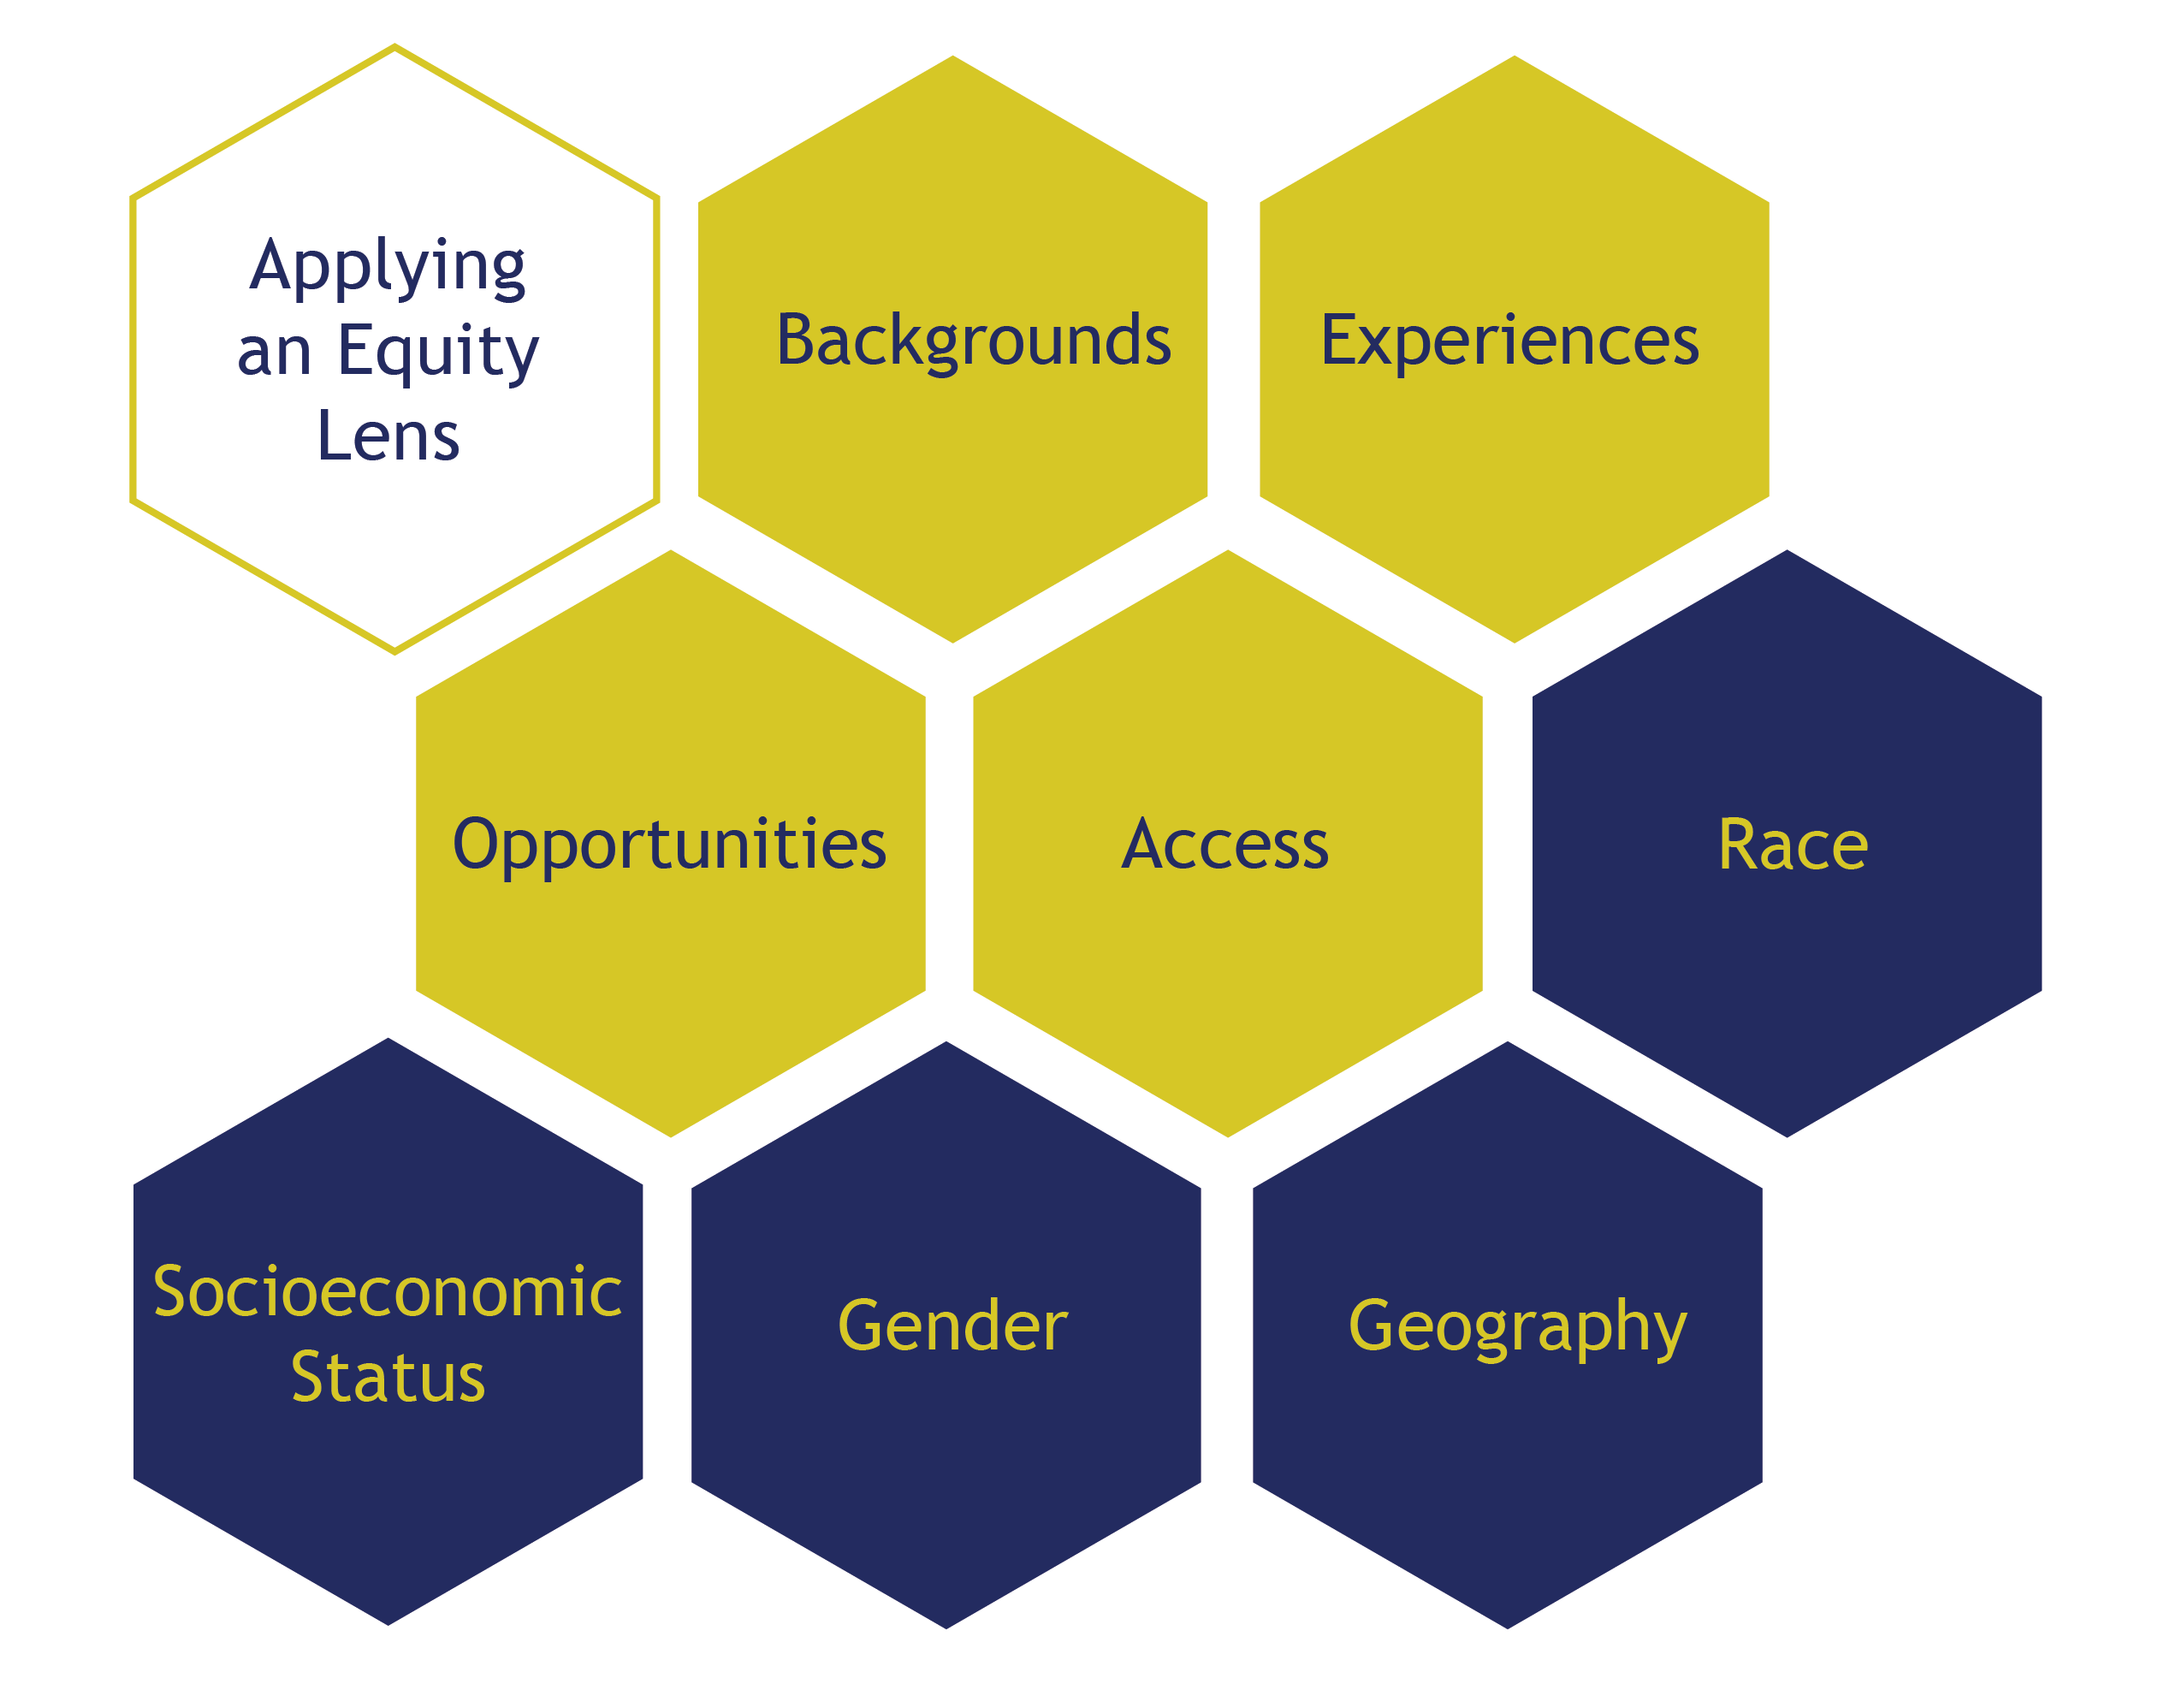
Birth
Education
Workforce

Slide 5
Presentation Outline
Population Overview
Kentucky Population by Race 2010 vs. 2020
Youth Population by Race 2010 vs. 2020
Poverty Rates by Race 2012 vs. 2021
Inmate Population by Race 2012 vs 2022
Education Overview
K-12 Enrollment by Race 2012 vs. 2021
K-12 Discipline by Race 2013
K-12 Discipline by Race 2022
High School Graduation Rate by Race 2013 vs. 2022
KEES Awards by Race 2012 vs. 2021
Dual Credit Scholarship Awards by Race 2019 vs. 2021
Work Ready Scholarship Awards by Race 2018 vs. 2021
Postsecondary Enrollment by Race 2014 vs. 2023
Postsecondary Completion by Race 2013 vs. 2022
Adult Education Participation Rate by Race 2012 vs. 2021
Workforce Overview
Median Income by Race 2012 vs. 2021
Labor Force Participation Rate by Race 2012 vs. 2021
Unemployment Rate by Race 2012 vs. 2021

Slide 6
Population Trends

Slide 7
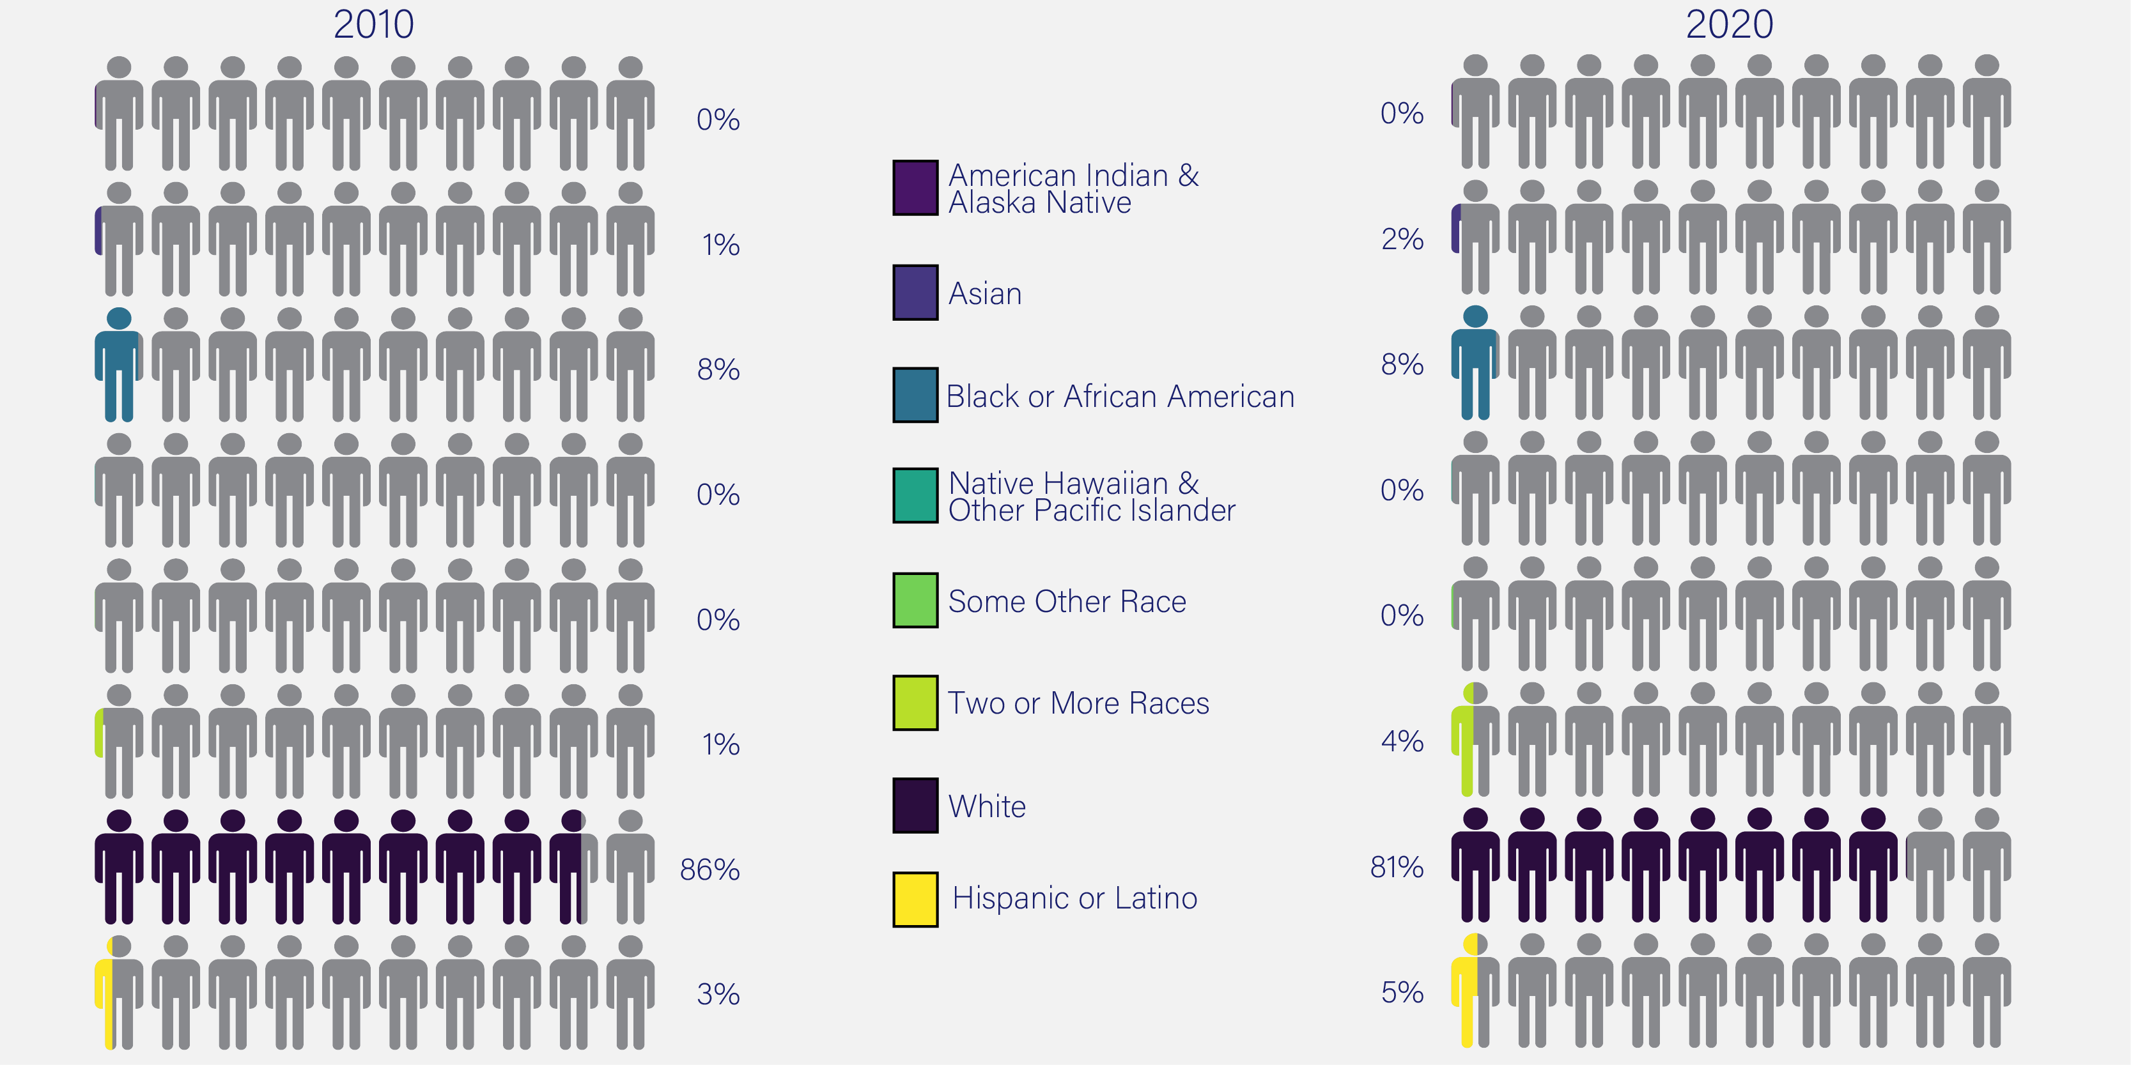
Kentucky Populations
4,339,367
Total
Population
4,505,836
Total
Population
Source: US Census Bureau, Decennial Census, DEC Redistricting Data

Slide 8
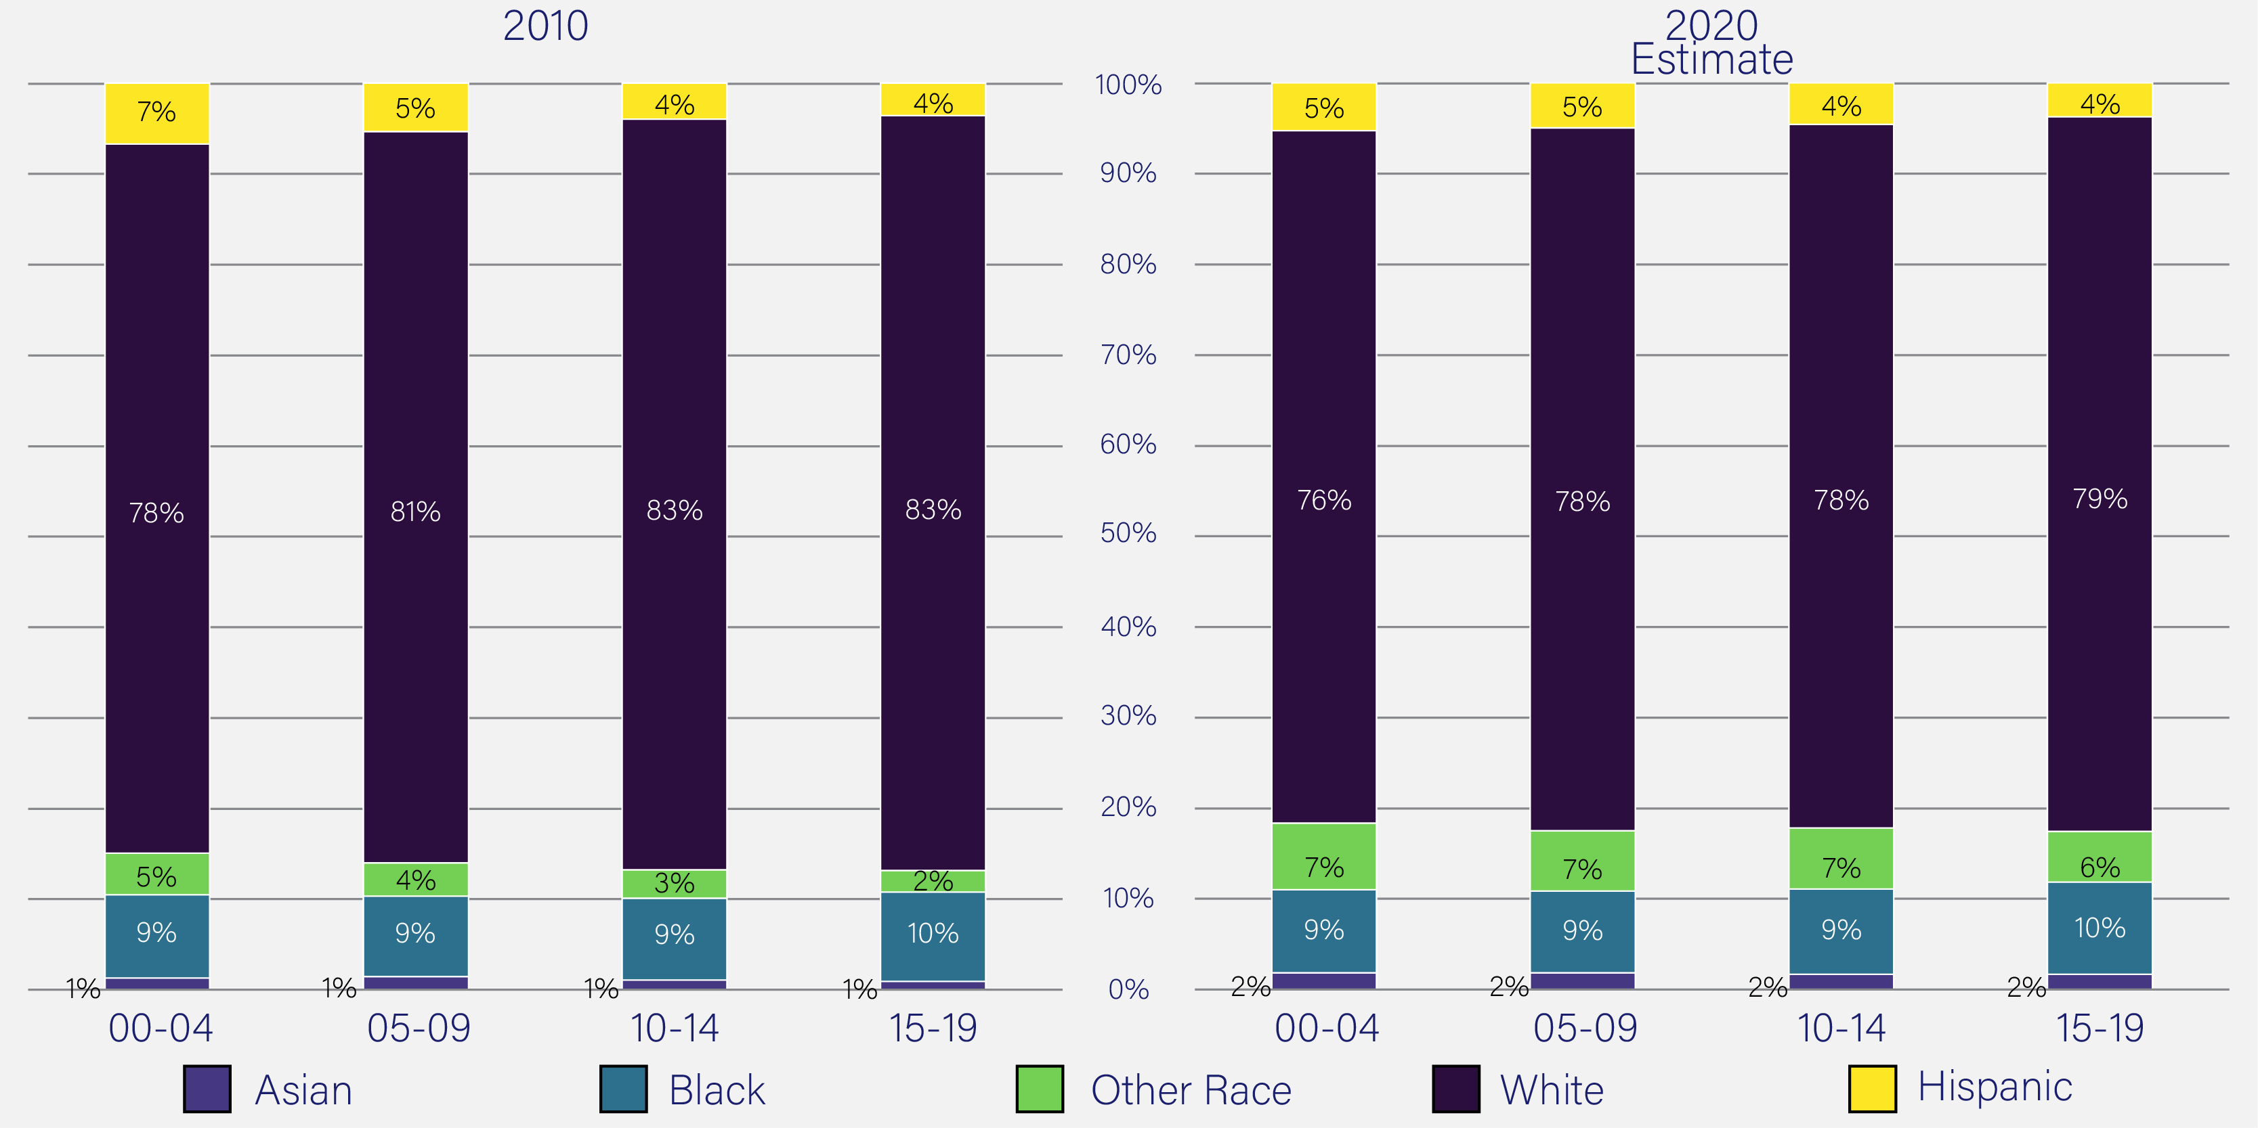
Kentucky’s Youth Population
1,146,204
Total Youth Population
1,139,177
Total Youth Population
Source: US Census Bureau, Decennial Census

Slide 9
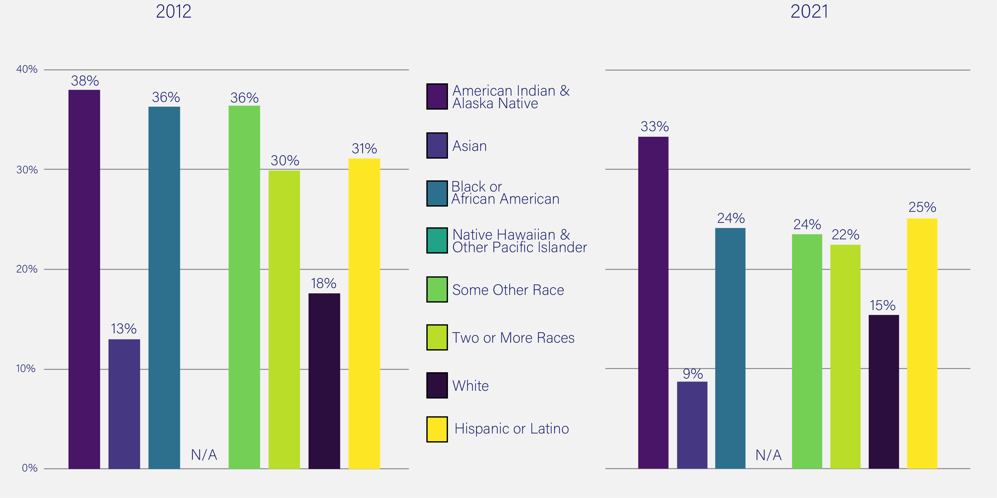
Poverty Rate
19.4%
KY Poverty Rate
16.5%
KY Poverty Rate
Poverty Status in the Past 12 Months – 2012 & 2021
Source: US Census Bureau, American Community Survey

Slide 10
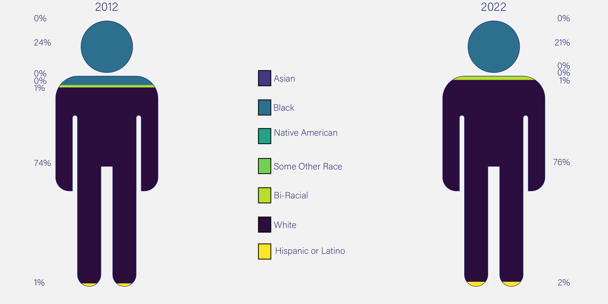
Kentucky Inmate Populations
21,857
Total Inmate Population
19,712
Total Inmate Population
Kentucky Inmate Profiles - September 2012 & 2022
Source: Kentucky Department of Corrections, Monthly Reports, Inmate Profile September 2022 and September 2012
Source: Kentucky Department of Corrections, Monthly Reports, Inmate Profile September 2022 and September 2012

Slide 11
Population Trends
Between 2010 and 2020 non-white racial groups, except American Indian/Alaskan Native, increased.
Between 2010 and 2020, the youth population (ages 0 to 19) has decreased.
Between 2012 and 2021, the poverty rate decreased for all races.
The Kentucky inmate population decreased between 2012 and 2022. The percentage of white inmates increased, and the percentage of black inmates decreased.

Slide 12
Education Trends

Slide 13
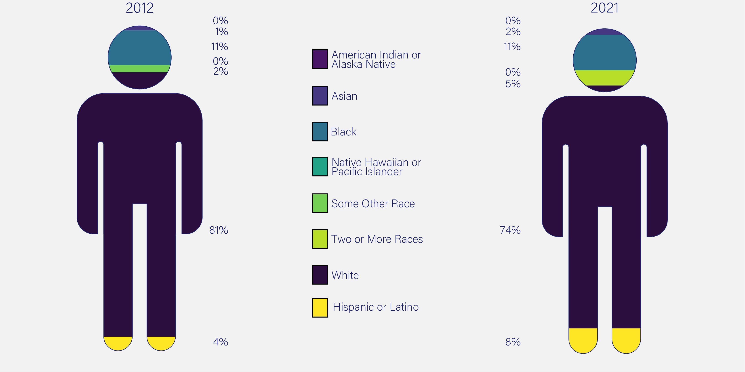
K-12 Public School Enrollment
649,688
Total
Enrollment
638,236
Total
Enrollment
Kentucky Public K-12 Student Membership, AY 2011-12 & AY 2020-21
Source: Kentucky Department of Education, School Report Card, Student Membership

Slide 14
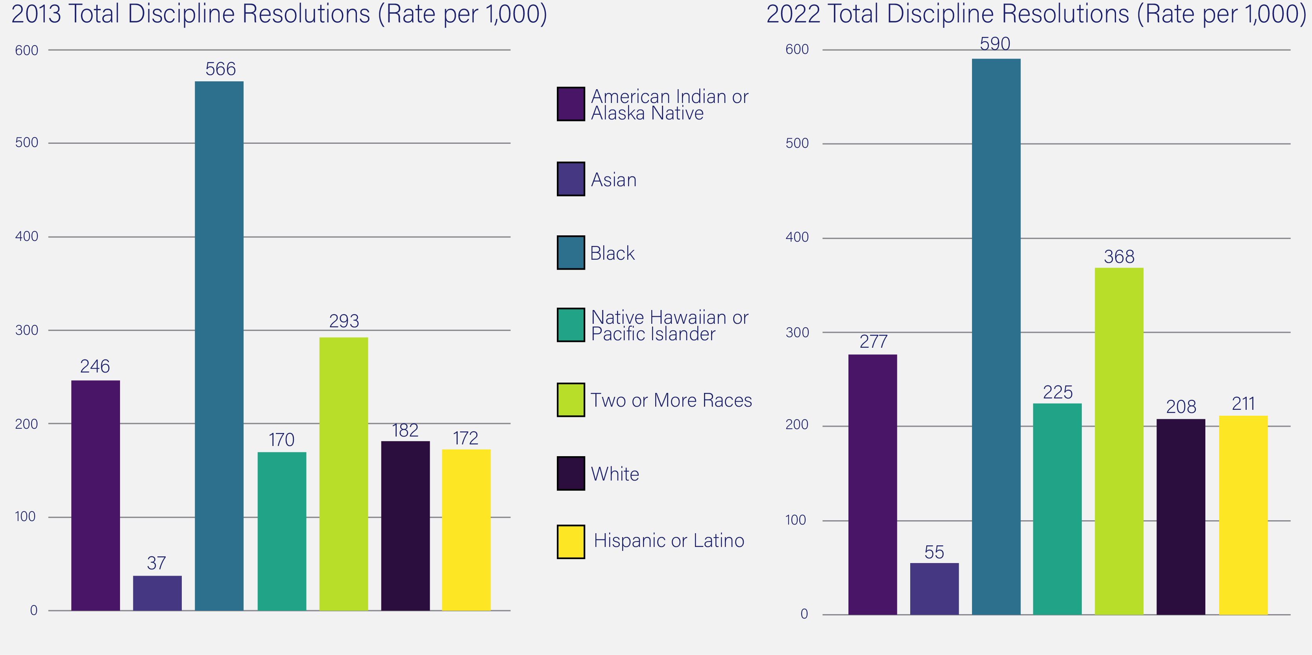
K-12 Discipline Rates By Race
All Students: 70,140
All Students: 78,997
Safe Schools Discipline - AY 2012-13 & 2021-22
Source: Kentucky Department of Education, School Report Card

Slide 15
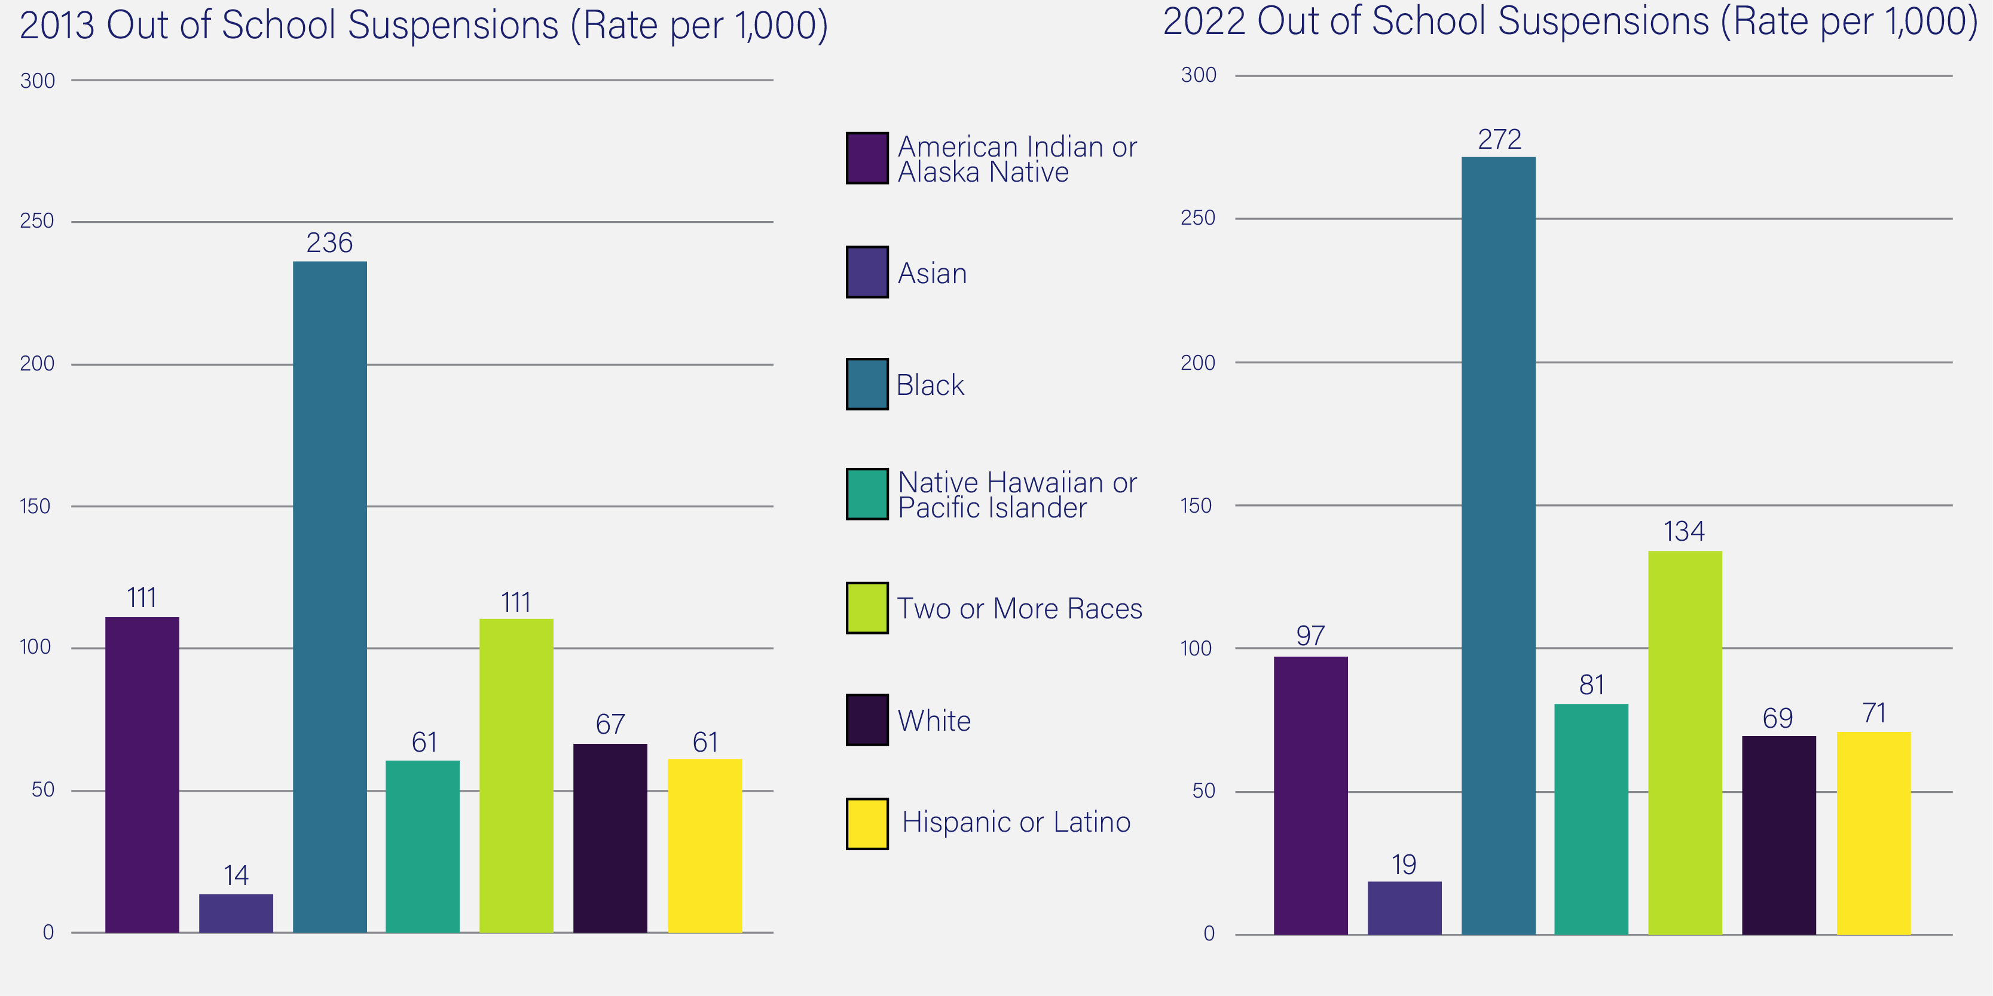
K-12 Discipline Rates By Race
All Students: 32,628
All Students: 34,951
Safe Schools Discipline – AY 2012-13 & 2021-22
Source: Kentucky Department of Education, School Report Card

Slide 16
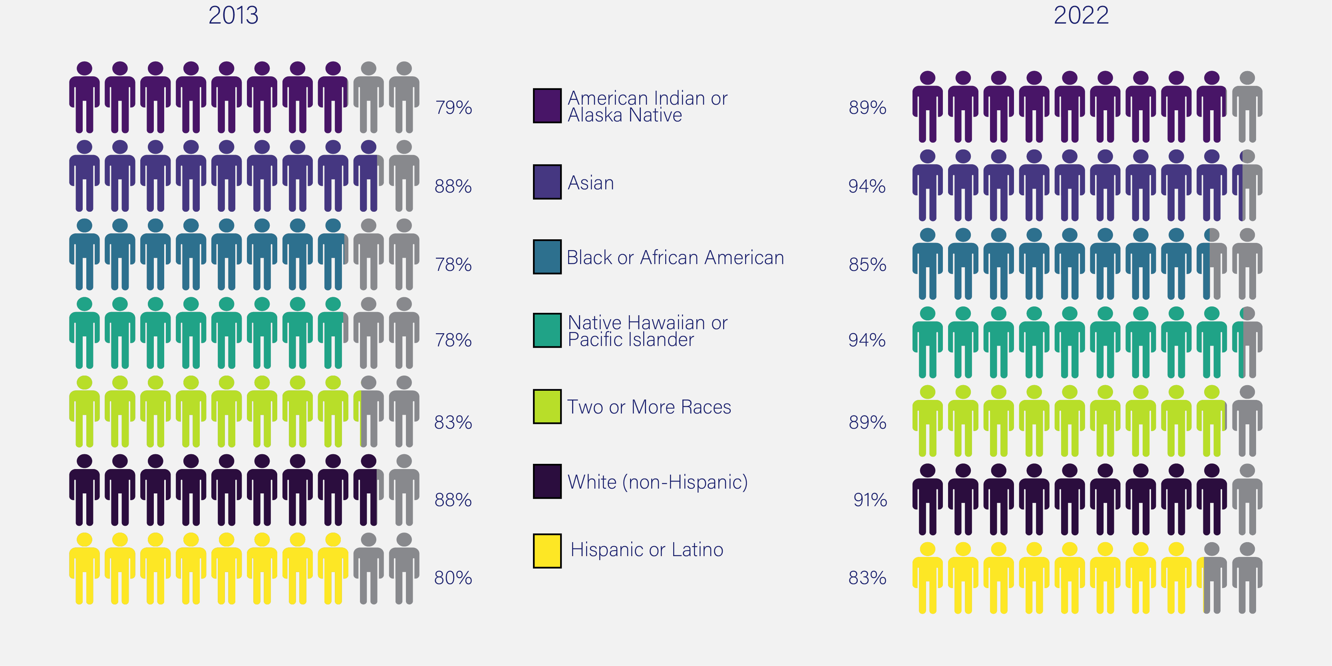
High School Grad Rate
86.1%
KY 4-Year
Graduation Rate
89.9%
KY 4-Year
Graduation Rate
2012-13 & 2021-22 Cohort Graduation Rates
Source: Kentucky Department of Education, School Report Card, School Accountability, Graduation Rate

Slide 17
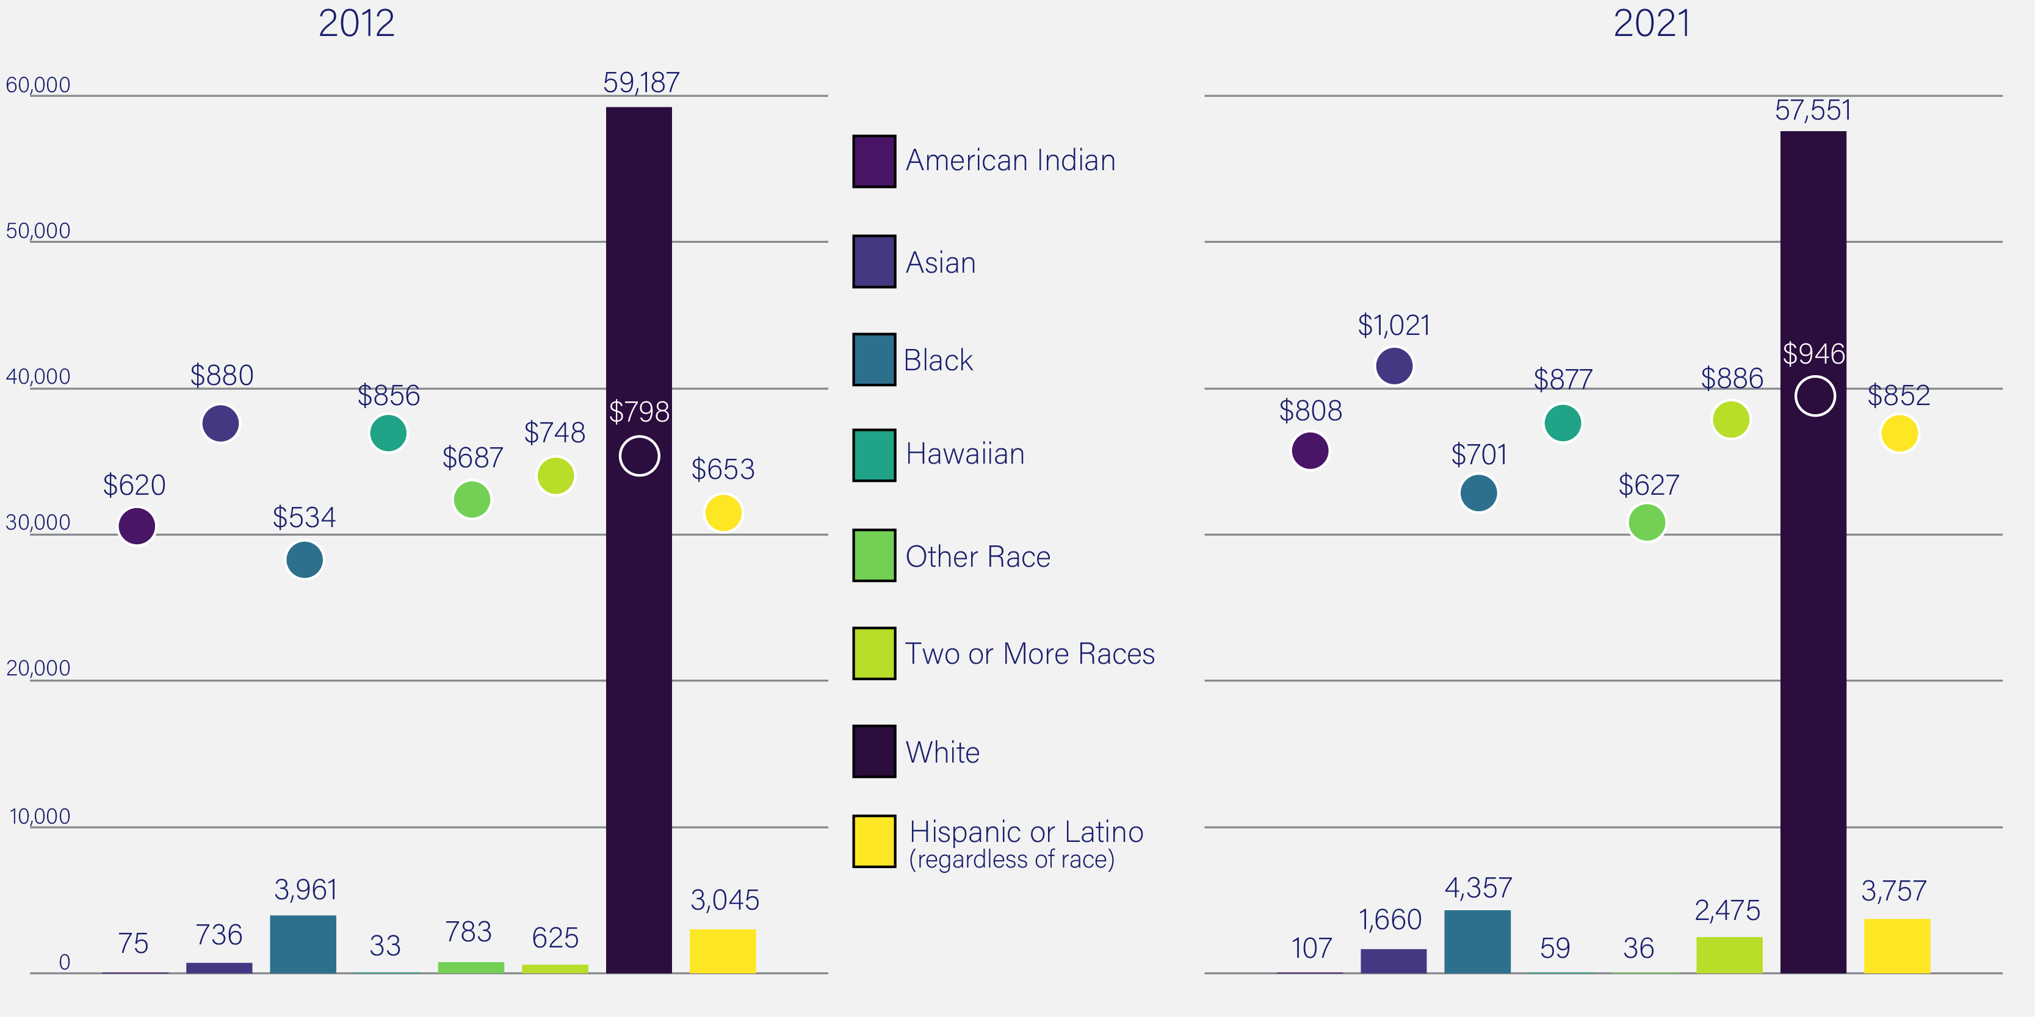
KEES Award Disbursements
KEES Disbursements - AY 2011-12 & AY 2020-21
Source: KLDS

Slide 18
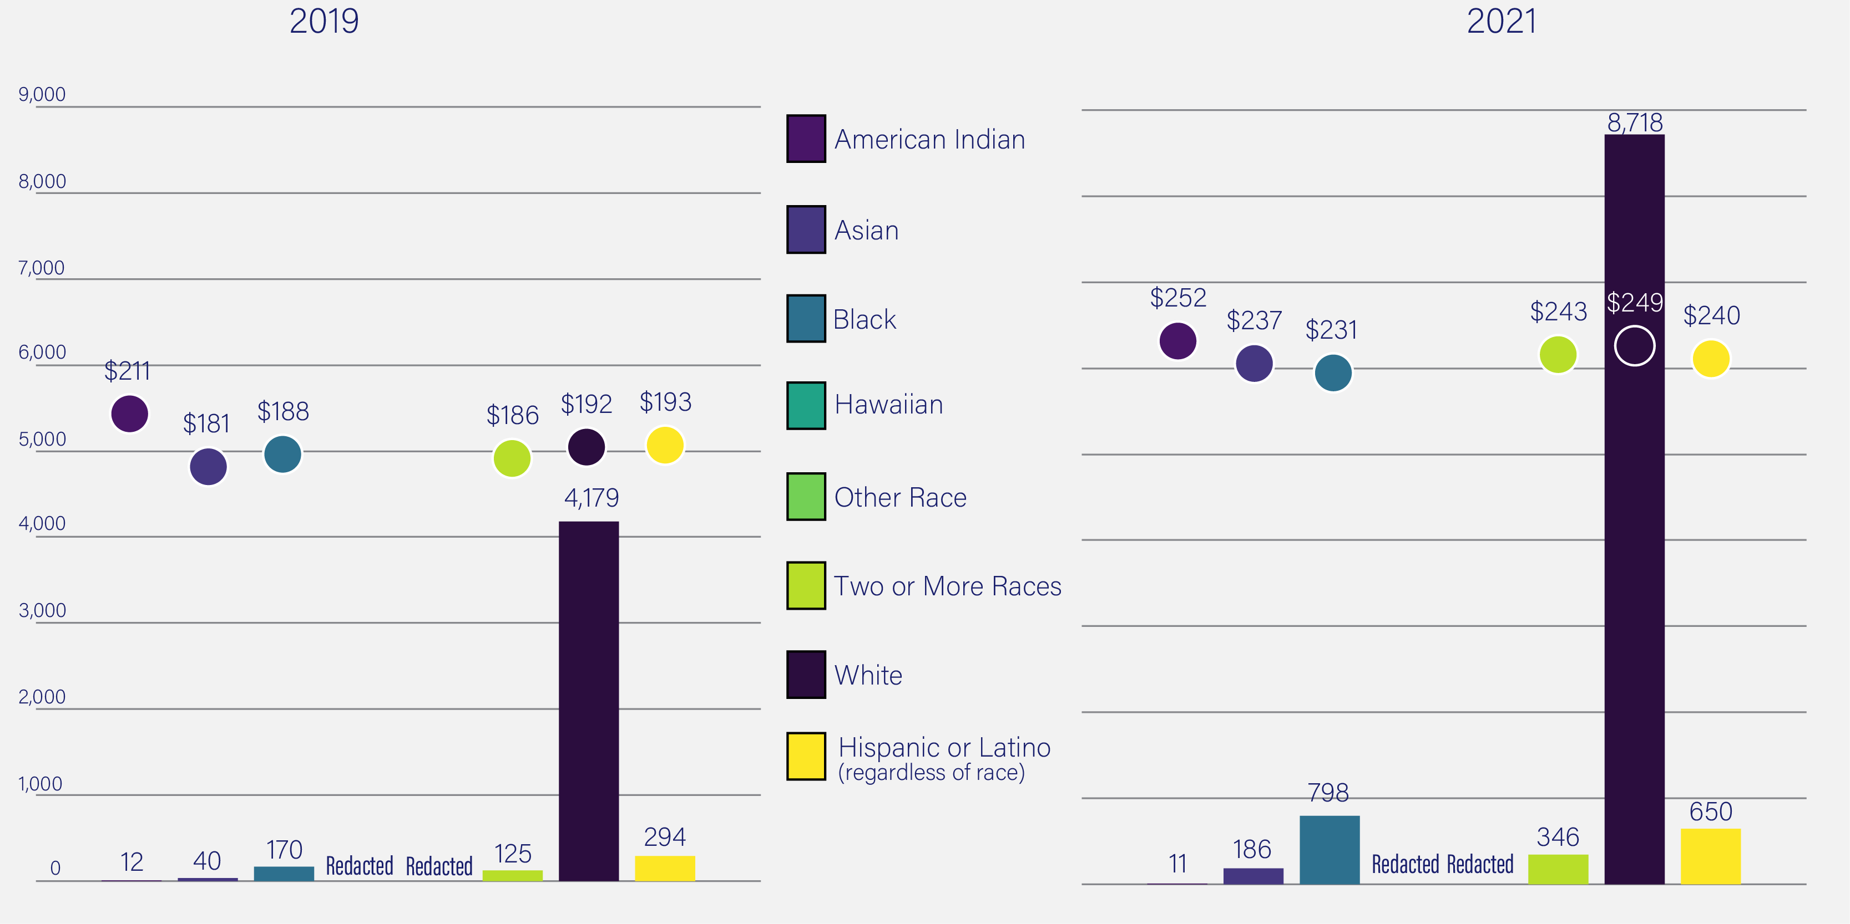
Dual Credit Scholarship Awards
Dual Credit Scholarship Disbursements - AY 2018-19 & AY 2020-21
Source: KLDS

Slide 19
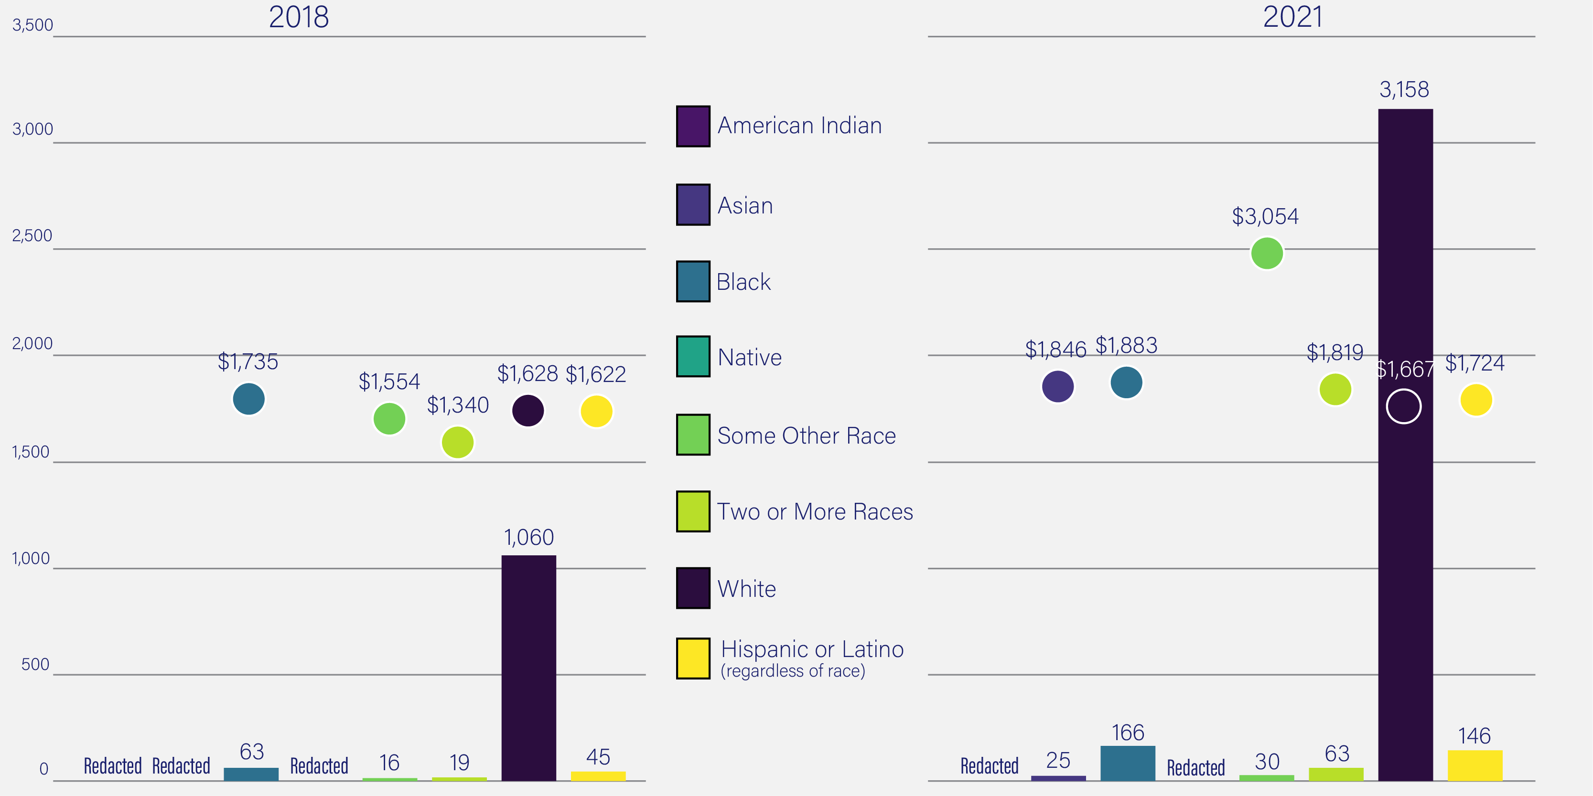
Work Ready Scholarship Awards
Work Ready Scholarship Disbursements - AY 2017-18 & AY 2020-21
Source: KLDS

Slide 20
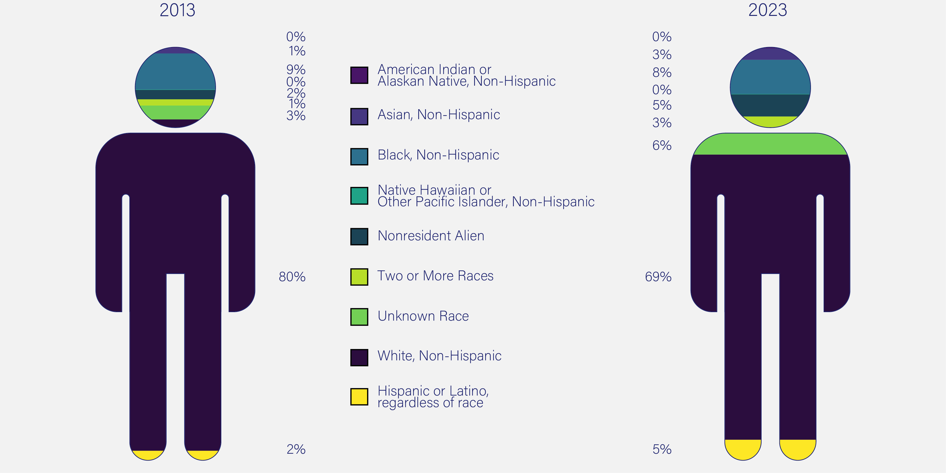
Kentucky’s Postsecondary Enrollment
261,613
Total
Postsecondary Enrolled
250,828
Total
Postsecondary Enrolled
Postsecondary Student Enrollment, AY 2012-13 to AY 2022-23*
* Counts are for the fall semester and include all postsecondary enrollment levels.
Source: Kentucky Council on Postsecondary Education's Data and Advanced Analytics Team. http://cpe.ky.gov/data/

Slide 21
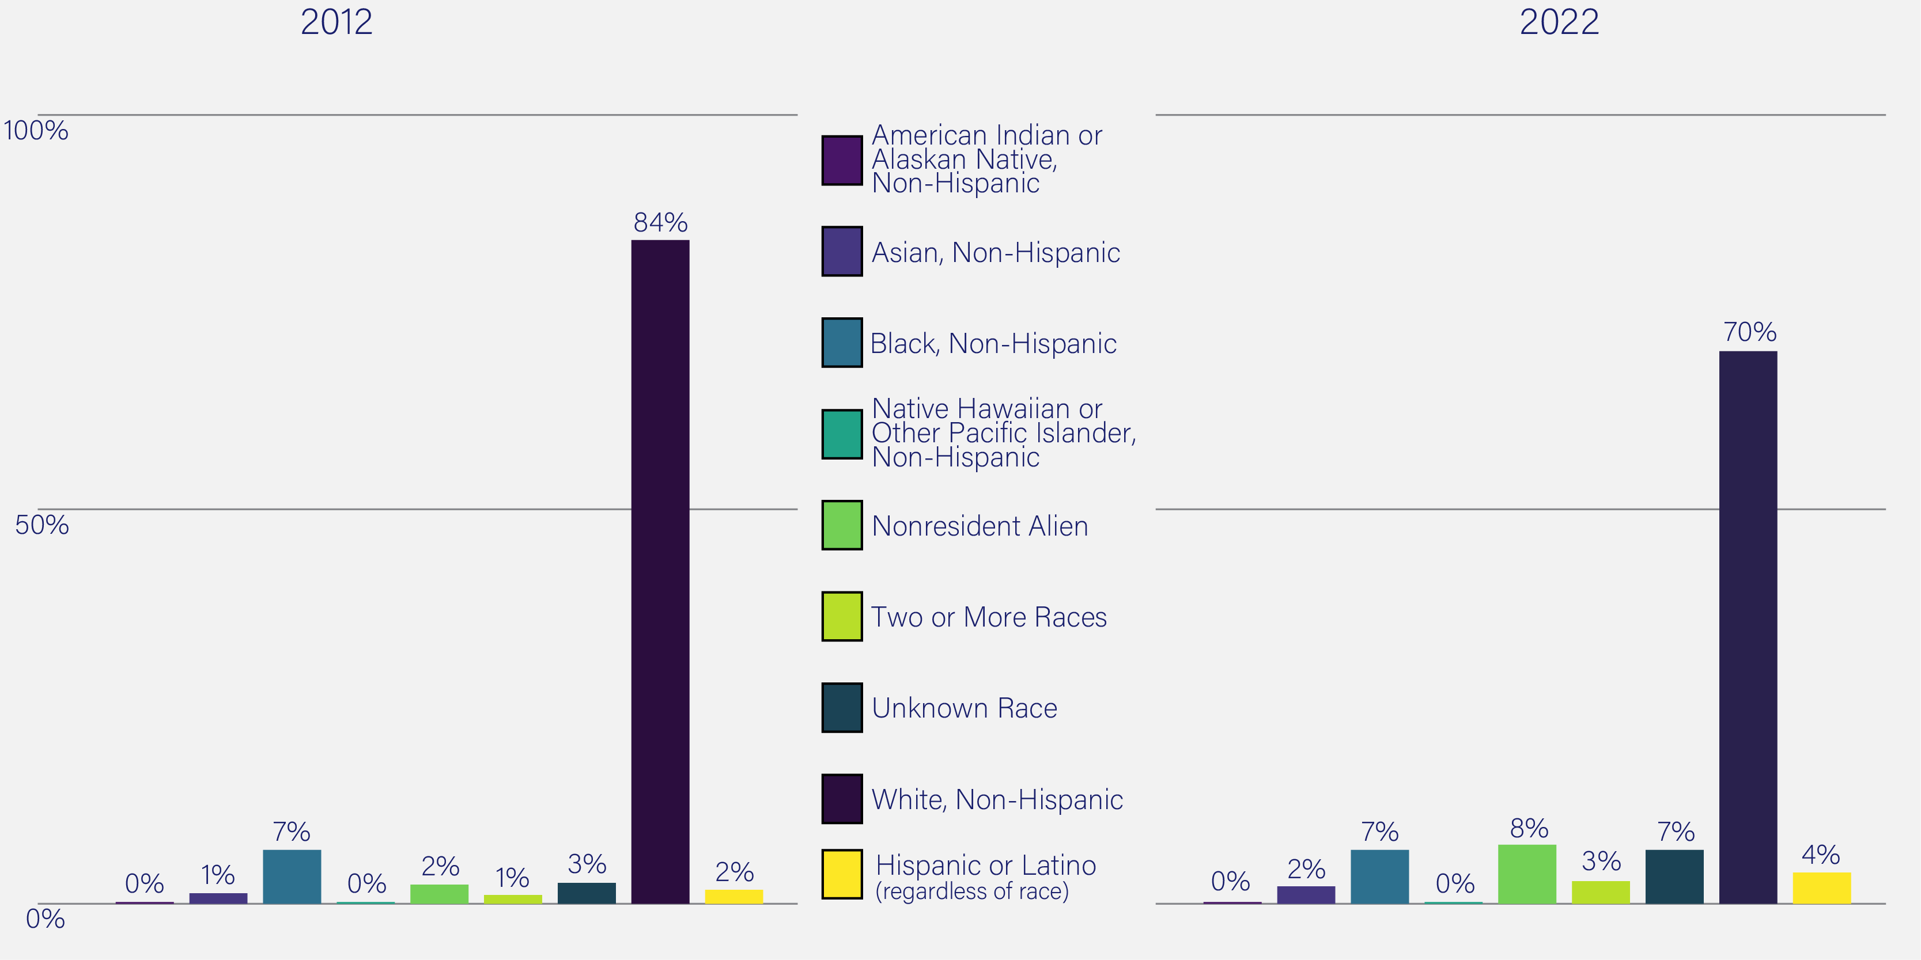
Kentucky’s Postsecondary Completers
47,049
Total
Postsecondary Completers
60,946
Total
Postsecondary Completers
Postsecondary Degree Completers, AY 2011-12 to AY 2021-22*
* Counts are for the fall semester and include all postsecondary enrollment levels.
Source: Kentucky Council on Postsecondary Education's Data and Advanced Analytics Team. http://cpe.ky.gov/data/

Slide 22
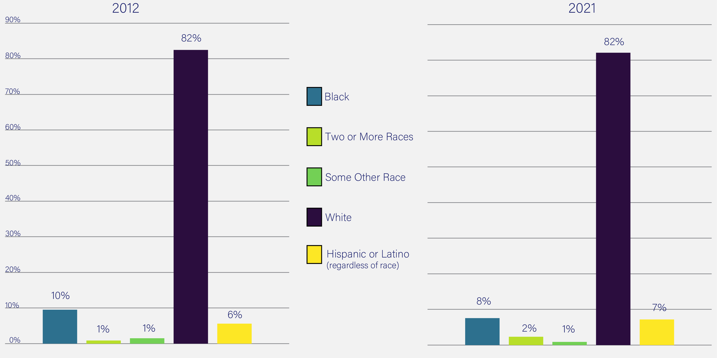
Adult Education Participation Rate
Adult Ed GEDs by Race - FY 2011-12 & FY 2020-21
Source: KLDS

Slide 23
Education Trends
K-12 enrollment for the non-white student group has increased, while enrollment for the white student group has decreased.
Between 2013 and 2022, the percentage of discipline resolutions in public K-12 schools dropped for white and black students and increased for other races.
Between 2013 and 2022, high school graduation rates for all races increased.
Between 2012 and 2021, the Average KEES disbursed increased for all groups except for other races. KEES award disbursements increased for all except white students and for other races.

Slide 24
Education Trends
Dual Credit Scholarship disbursements increased for all observable racial groups.
Work Ready Scholarship Awards and disbursements increased among all observable racial groups from 2018 to 2021.
Between 2013 and 2023, postsecondary enrollment increased for Hispanic, Asian, Two or more races, Nonresidential Alien, and Unknown races. American Indian, native Hawaiian, white, and black races all decreased.
Between 2012 and 2022, postsecondary degree completions increased for all observable groups except American Indian/Alaskan Native.
Between 2012 and 2021, Adult Education Participation Rates increased for individuals of two or more races and Hispanic/Latino students and decreased amongst the other racial demographics.

Slide 25
Workforce Trends

Slide 26
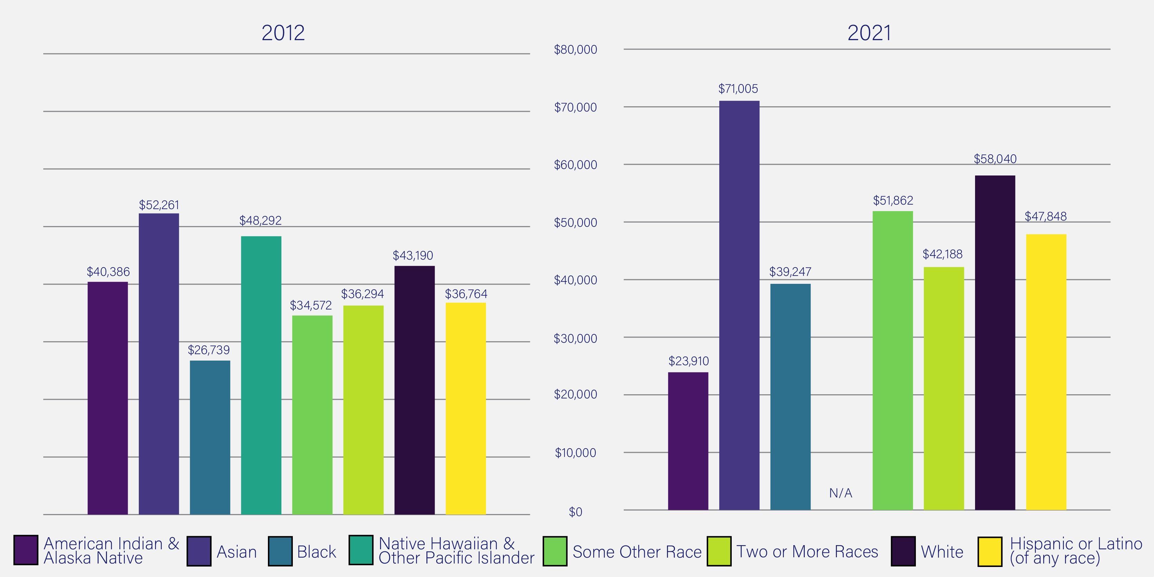
Kentucky’s Median Income
$41,724
Median Income
$55,573
Median Income
Median Income in the Past 12 Months
Source: US Census Bureau, American Community Survey

Slide 27
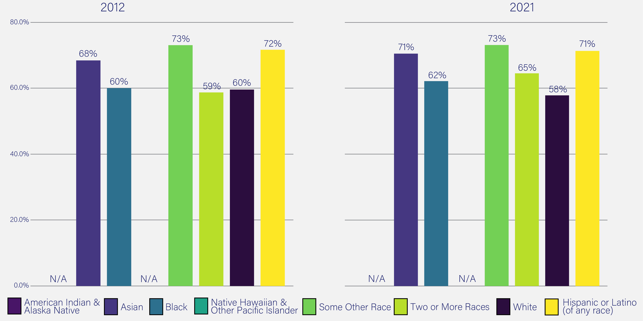
Kentucky’s Labor Force
59.8%
KY LFPR
(16 and older population)
58.8%
KY LFPR
(16 and older population)
Included are all persons in the civilian noninstitutional population, ages 16 and older, classified as either employed or unemployed.
Labor Force Participation Rate
Source: US Census Bureau, American Community Survey

Slide 28
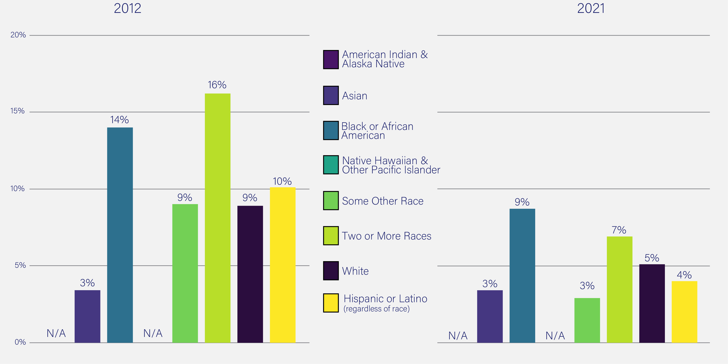
Unemployment Rate
9.3%
Unemployment Rate
(16 and older population)
5.4%
Unemployment Rate
(16 and older population)
Includes all persons who had no employment during the reference week, were available for work, except for temporary illness, and had made specific efforts to find employment some time during the 4-week period ending with the reference week.
Source: US Census Bureau, American Community Survey, 2021 1-Year Estimates, 2012 1-Year Estimates, Table S2301

Slide 29
Workforce Trends
Between 2012 and 2021, the median income amongst almost all observable racial groups increased.
Between 2012 and 2021, the labor force participation rate decreased for white and Hispanic/Latino Kentuckians. It increased for most other racial groups, while some other race remained constant over the time period.
Between 2012 and 2021, the unemployment rate decreased for all racial groups, with the exception of Asians, where it remained the same.

Slide 30
Questions?

Slide 31
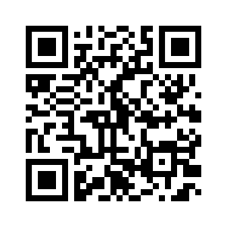
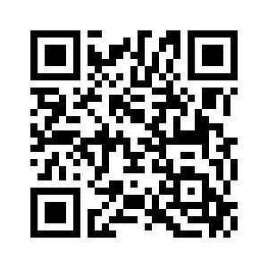
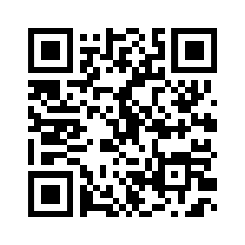
Notes:
These are three reports that are specific to the state’s workforce system. They have county and lwa specific information

Slide 32
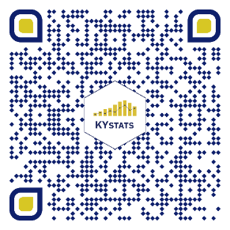
Ready to learn more?
kystats.ky.gov
@kystats
Jessica Fletcher, MPA
Marketing Analytics Director
jfletcher@ky.gov
Brian Mudrak
Senior Data Scientist, Visualization Lead
brian.mudrak@ky.gov
Logan Rupard
Senior Research and Legislative Analyst
logan.rupard@ky.gov
Join our mailing list!

