Slide 2
DE&I Academy Company Participants

Slide 3
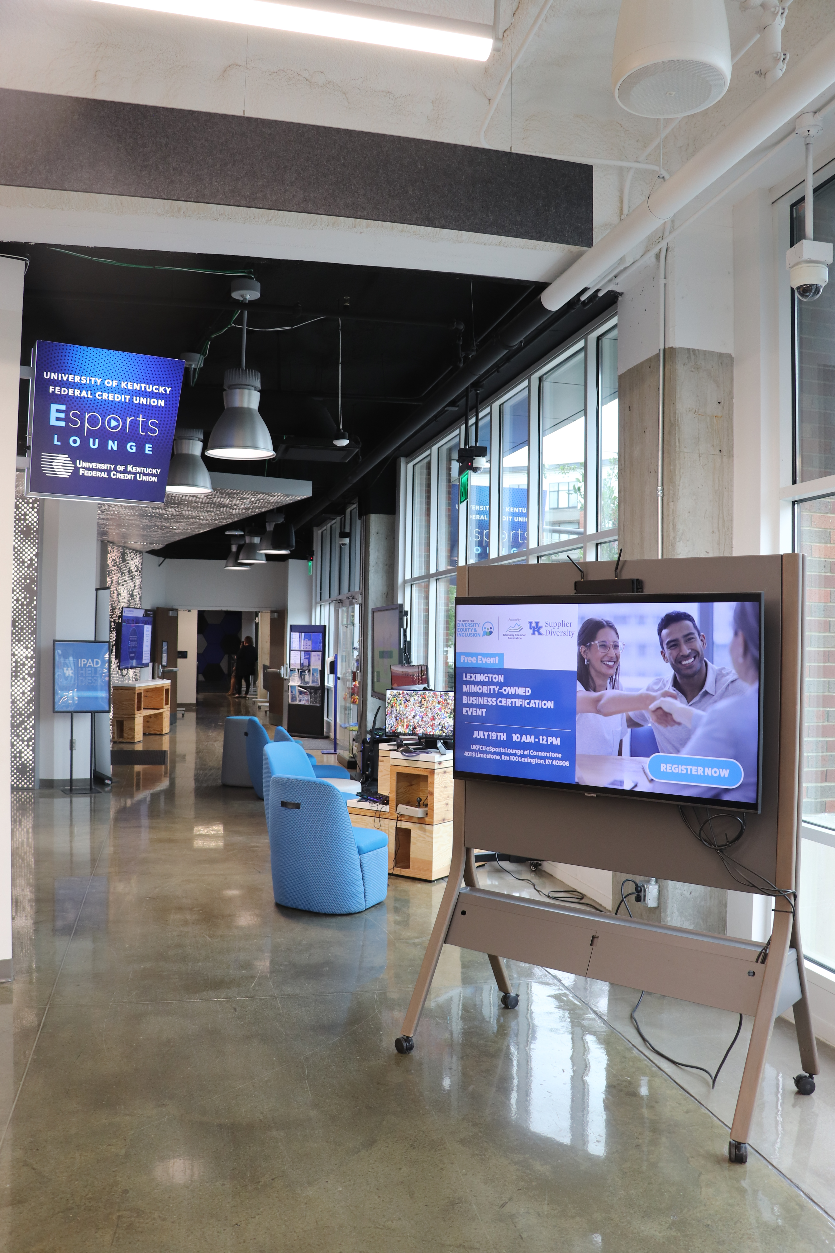
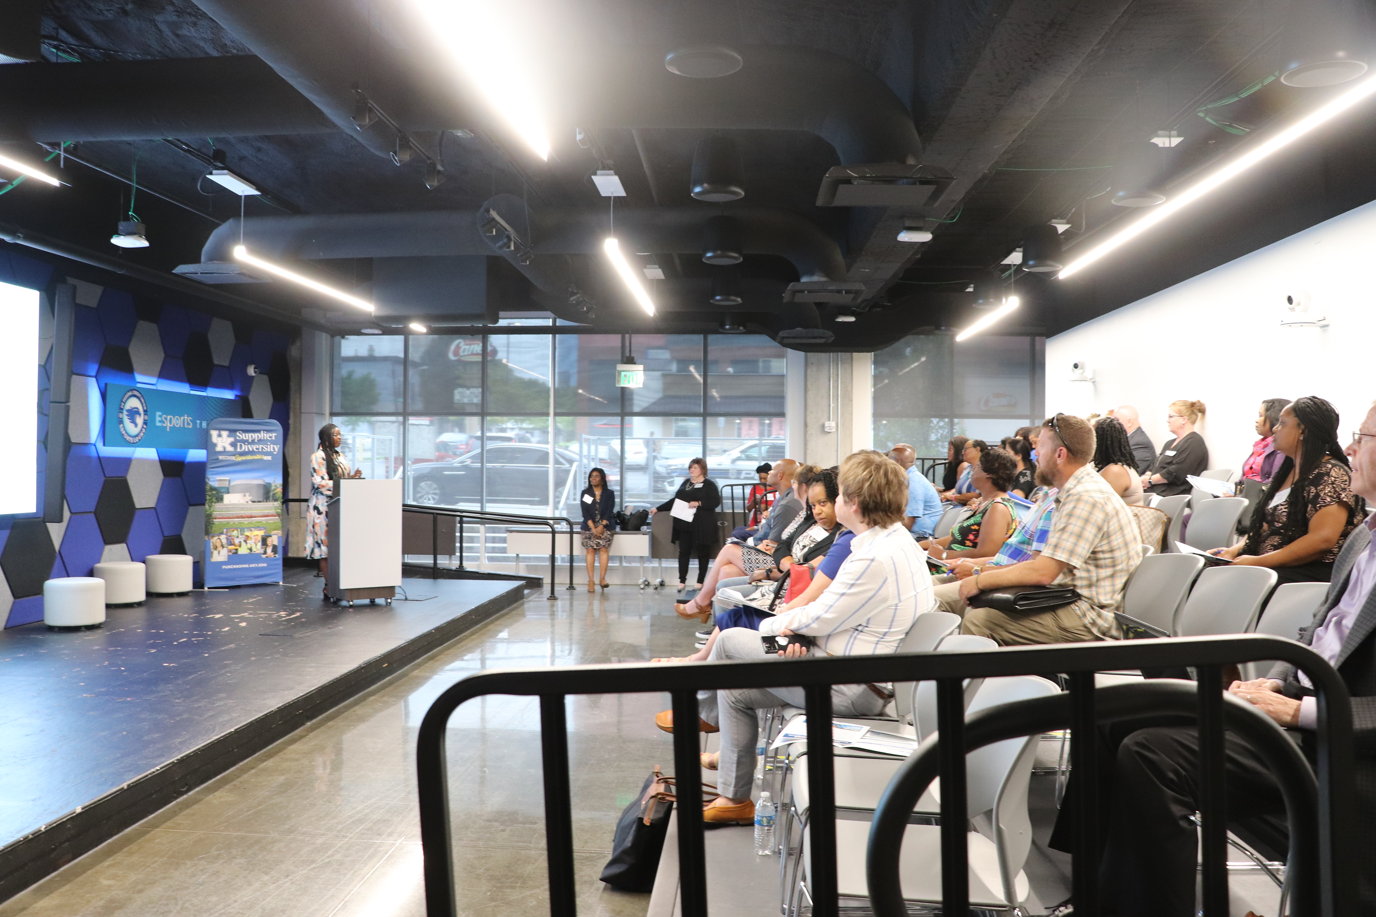
“Shop Conscious” Minority Business Certification Events

Slide 4
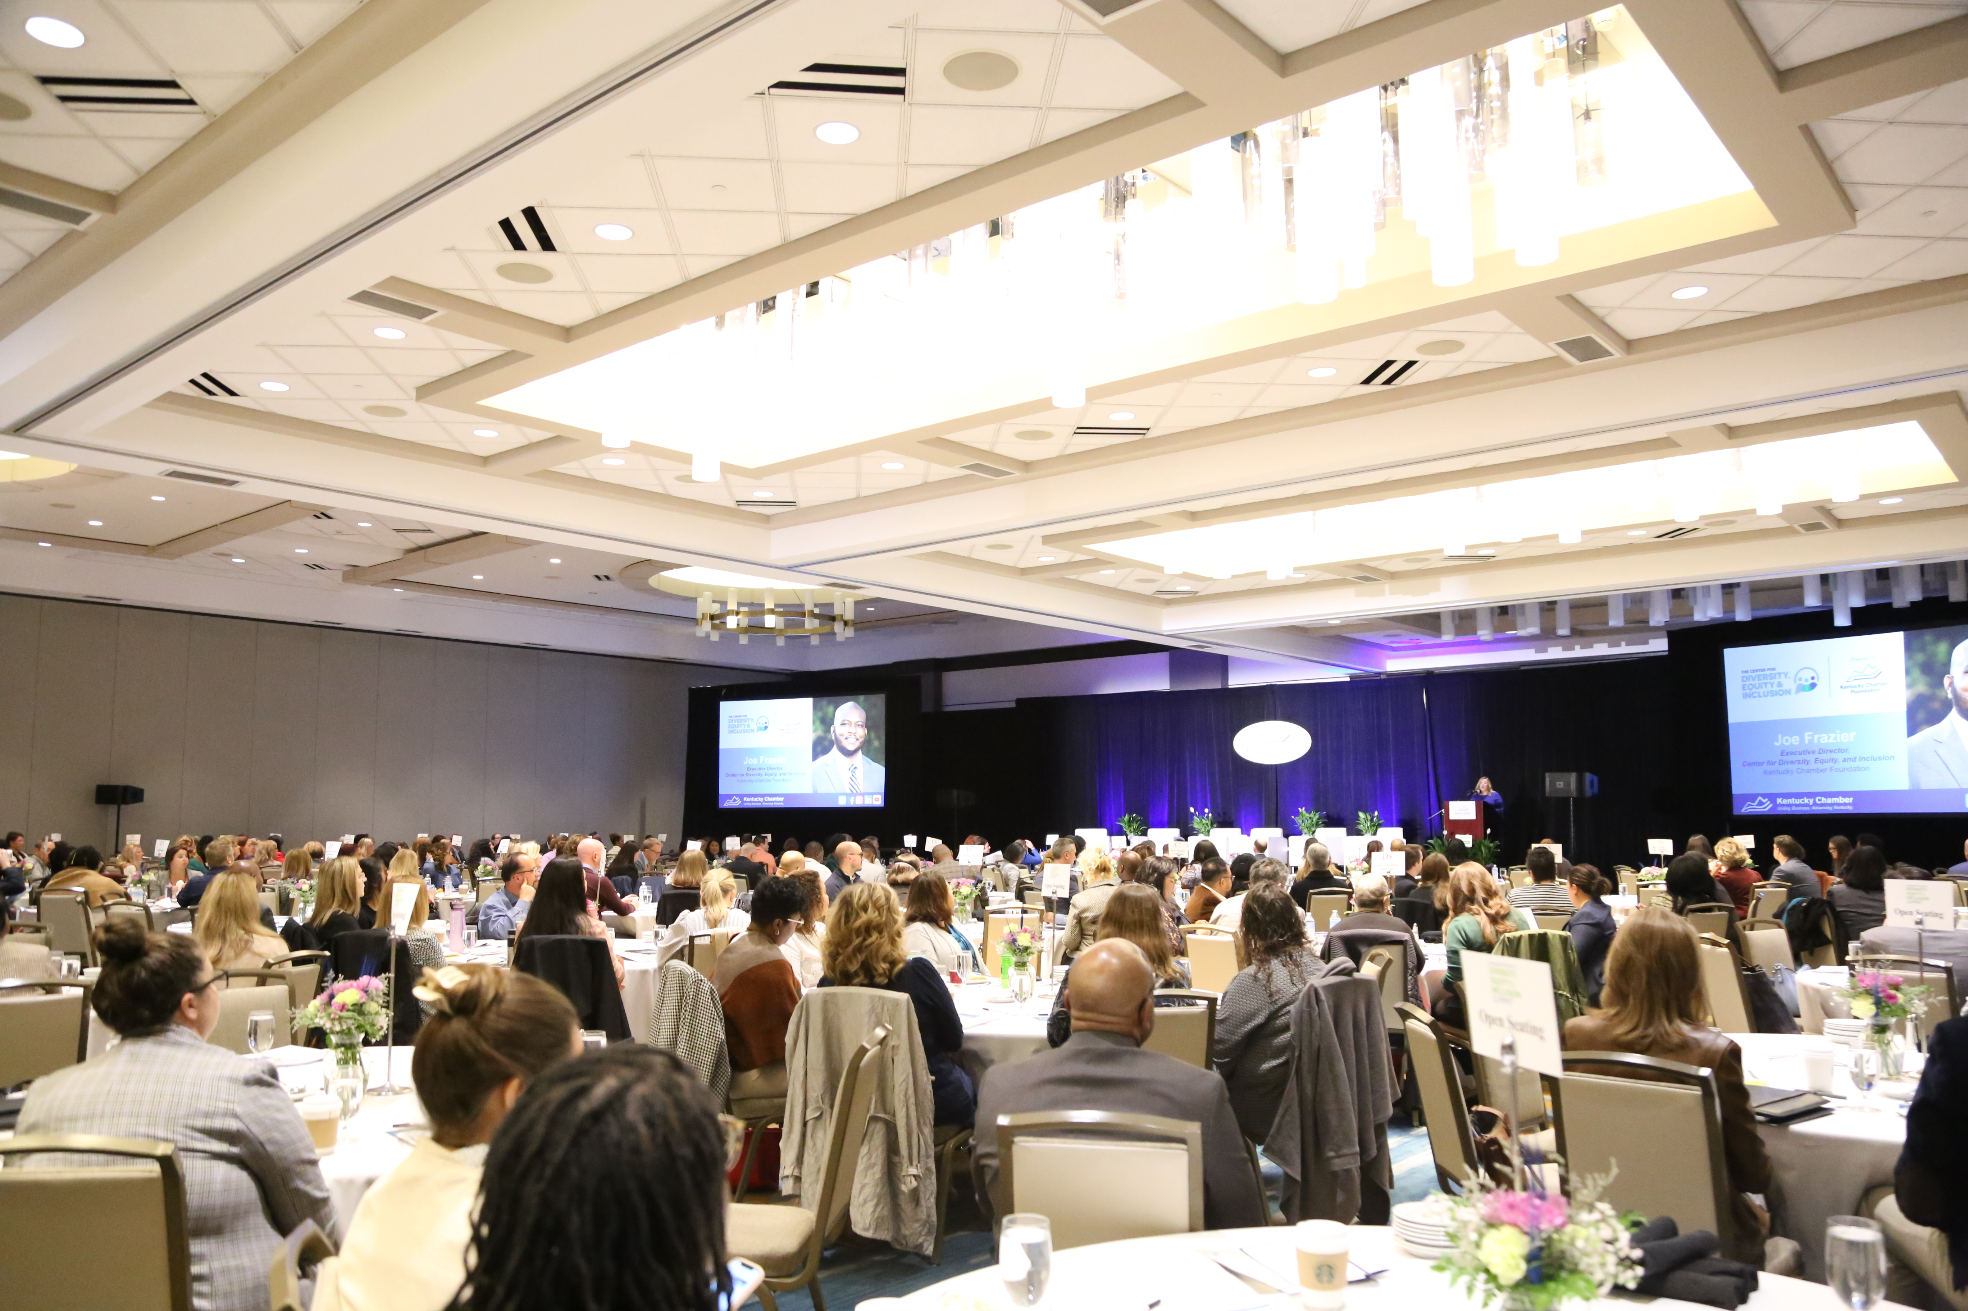
Kentucky Diversity, Equity & Inclusion Summit
2nd Annual Summit: October 10, 2023 | Louisville

Slide 5
www.MBDKY.com

