Slide 1
Commission on Race and Access to Opportunity: UNIVERSITY OF KENTUCKY
Eli Capilouto, President

Slide 2
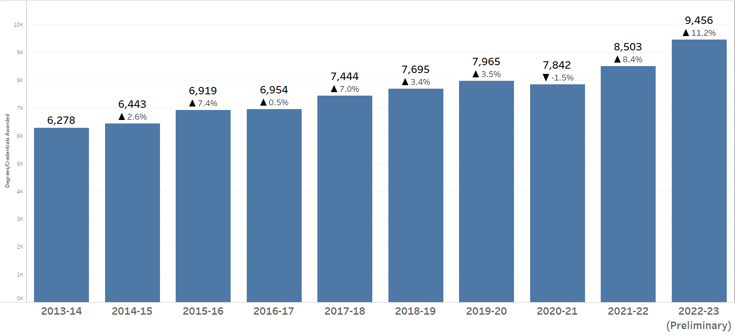
Overall - Degrees & Credentials Awarded
Data Source: https://www.uky.edu/irads/degrees-credentials-awarded
2

Slide 3
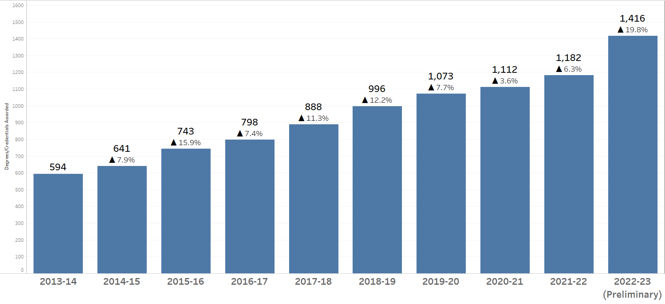
URM - Degrees & Credentials Awarded
Data Source: https://www.uky.edu/irads/degrees-credentials-awarded
3

Slide 4
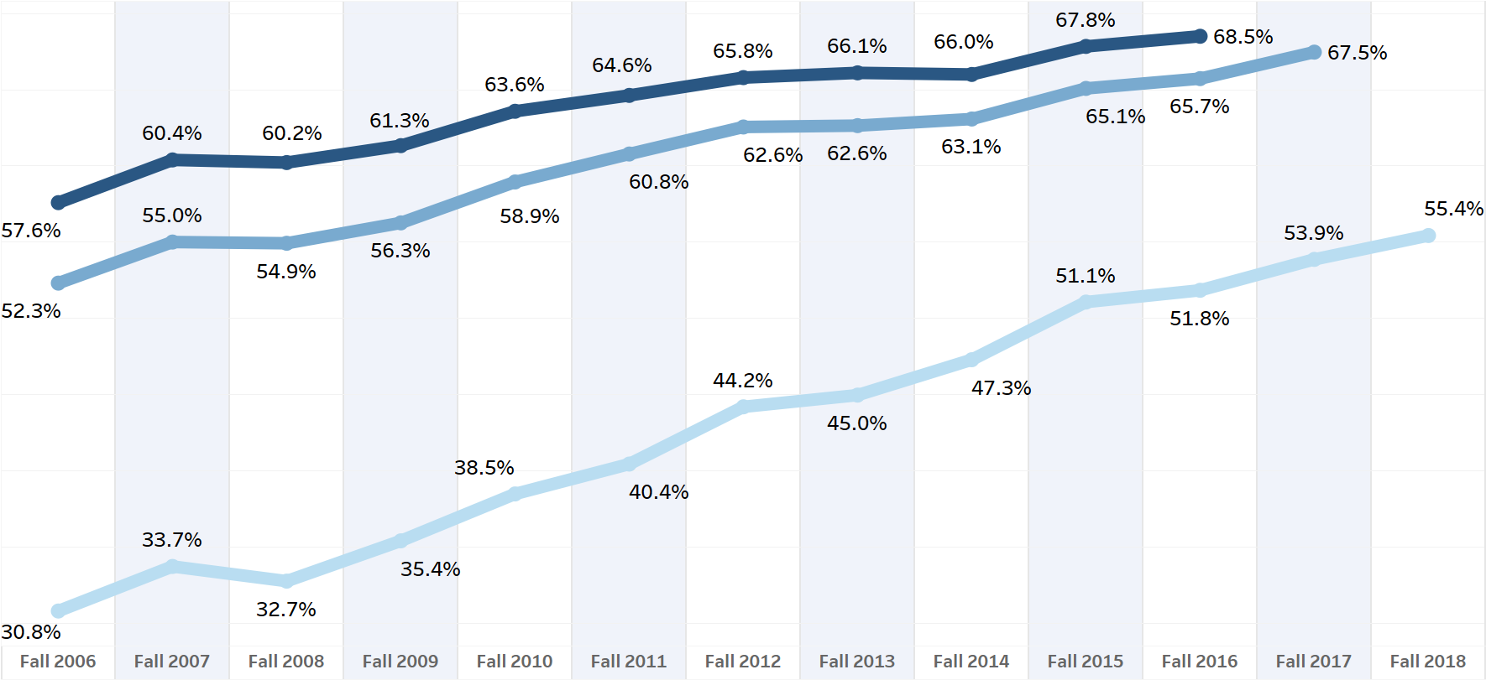
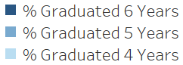
Freshman Cohort Graduation Rates
Data Source: https://www.uky.edu/irads/degrees-credentials-awarded
4

Slide 5
UK LEADS – One Time Grant Summary
Data Source: University of Kentucky Institutional Research, Analytics and Decision Support (IRADS)
5

Slide 6
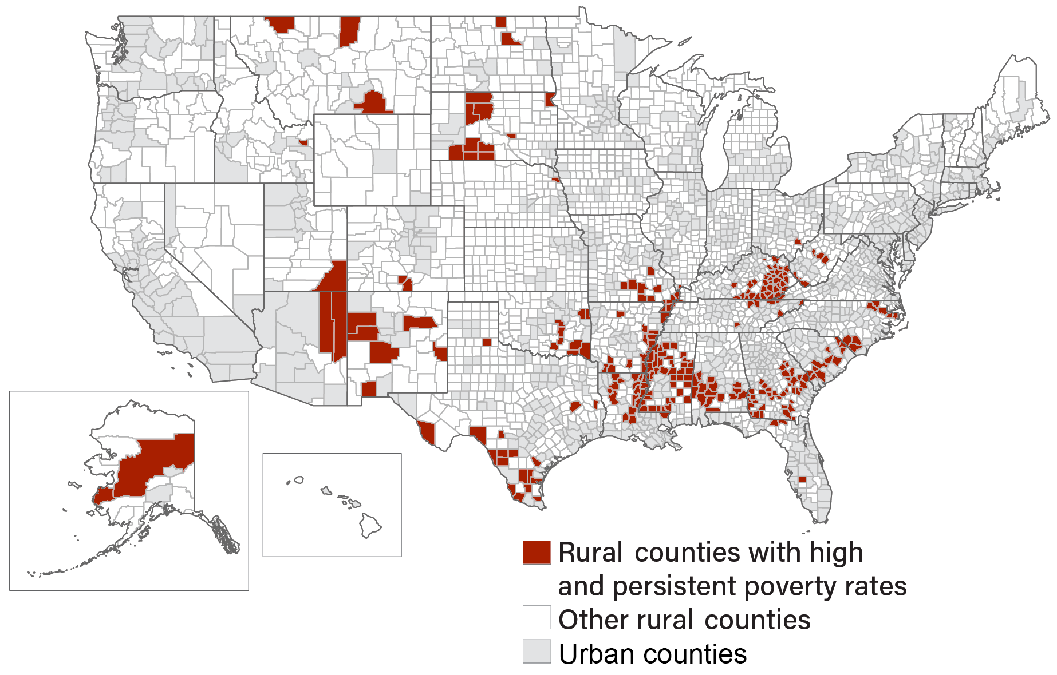
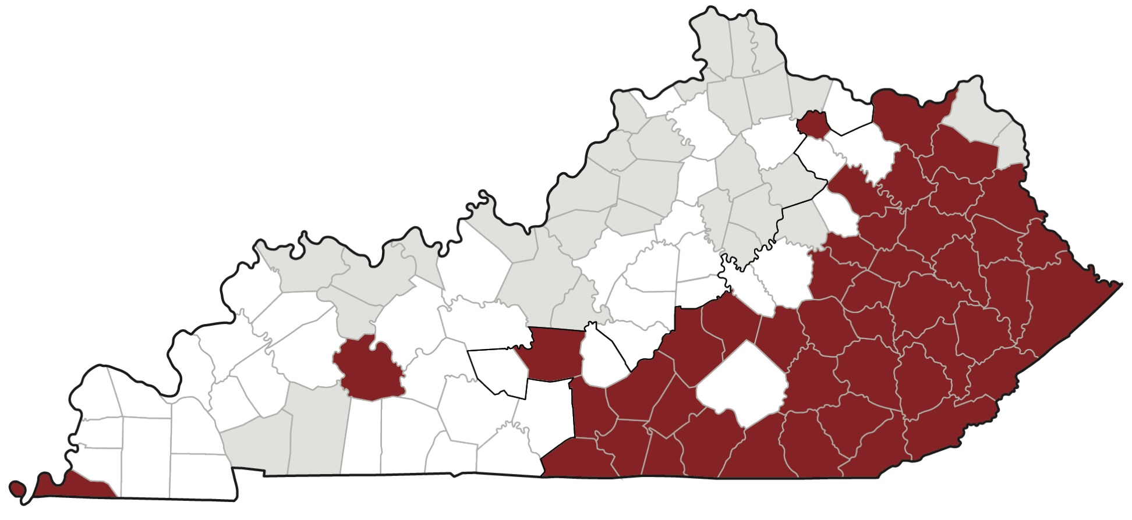
Kentucky Challenges
Persistent Poverty
17% live in poverty
45 counties with persistent poverty
Smoking
Obesity
Low education
Cancer burden
6
Source: USDA, Economic Research Service using data from U.S. Census Bureau

Slide 7
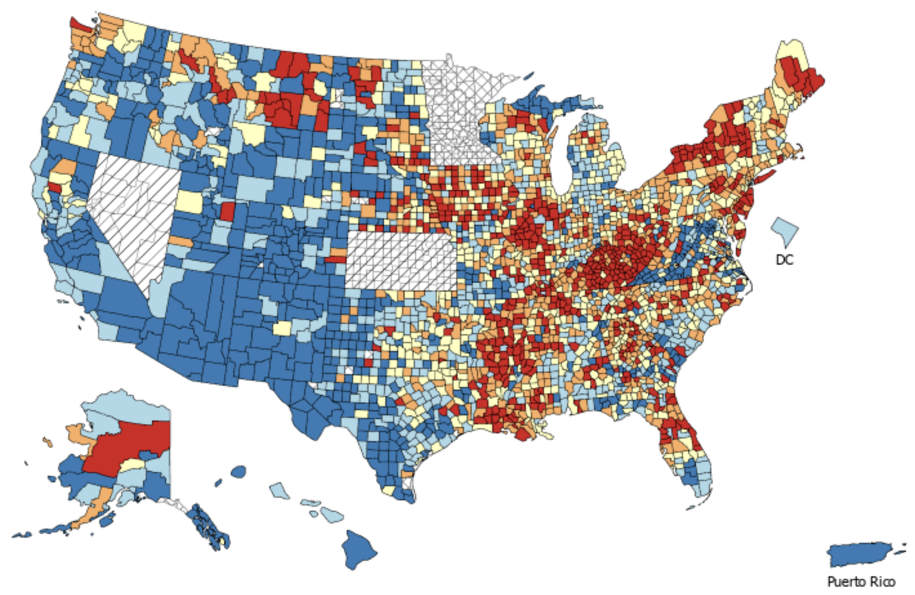
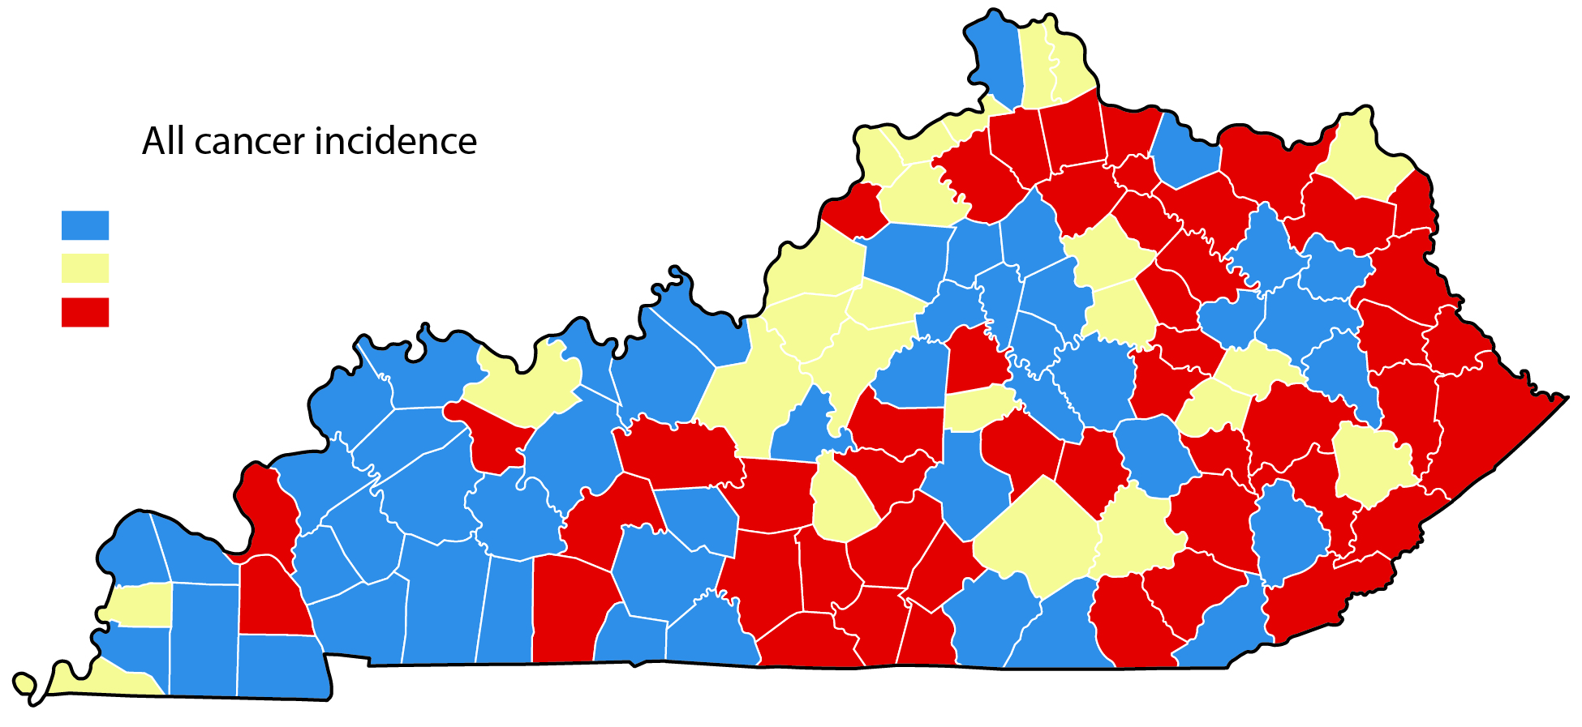
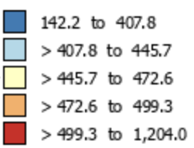
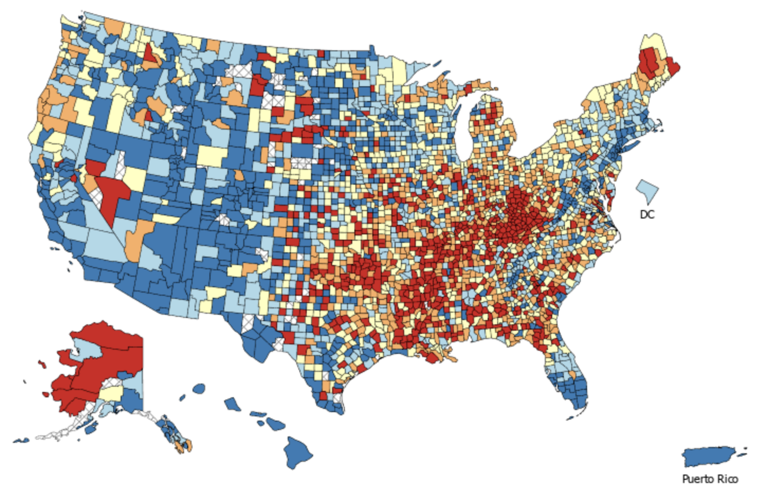
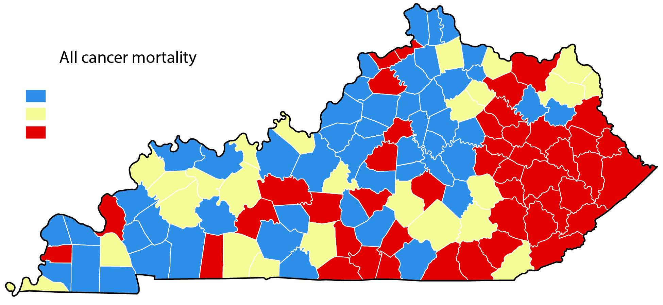
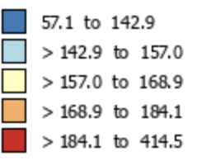
Kentucky’s Cancer Burden
All Cancer Incidence
2015-2019
All Cancer Incidence
2015 -2019
353.7 to 506.7
506.8 to 530.6
530.7 to 620.5
All Cancer Mortality
2016-2020
All Cancer Mortality
2016-2020
143.5 to 190.9
190.1 to 202.6
202.7 to 267.4
7
Source: NIH NCI State Cancer Profiles

Slide 8
Questions

