Slide 1
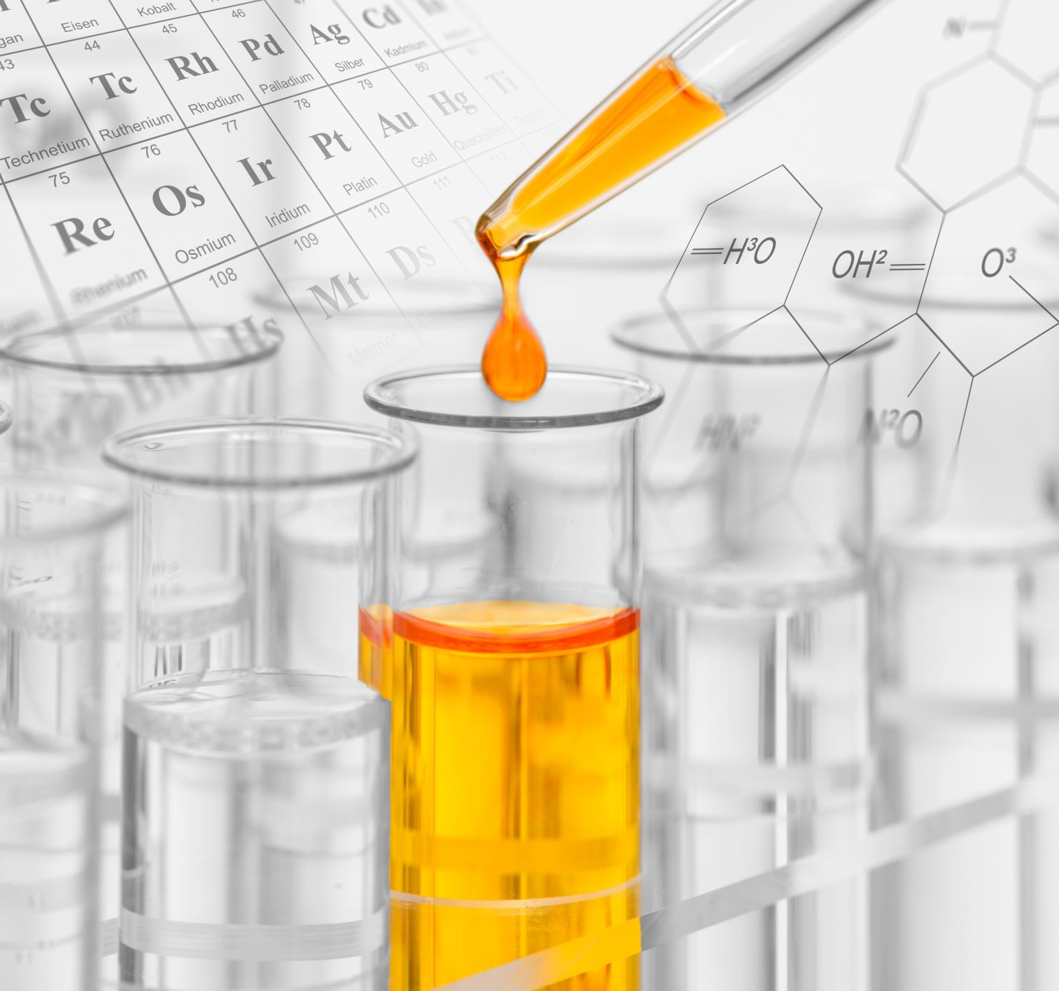
Associated Health Risks of Ethnic Hair Care Products
Dr. Aleeta M. Powe
Associate Professor
Department of Chemistry
University of Louisville
Presented to
Commission on Race and Access to Opportunity

Slide 2
Outline
Associated Risks of Ethnic Hair Care Products
Background
Hair Structure
Hair Formations
Terminology
Reasons why African-American women straighten (relax) their hair
Hair Relaxers
Harmful chemicals
Hair Products
Harmful Chemicals
Desires vs. Reality
Summary

Slide 3
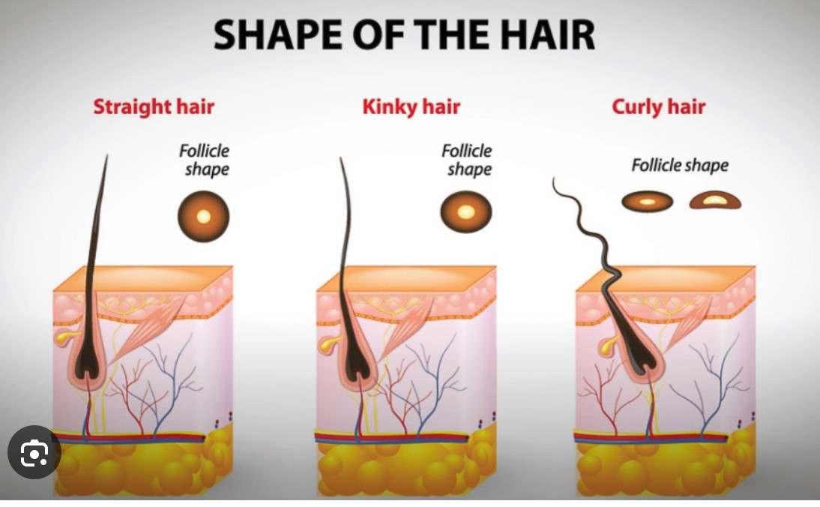
Hair follicle
Background
Oil that
nourishes
the hair
shaft
Secretes oil
that
nourishes
hair shaft
Wikipedia.com
Oushia.com
Notes:
This is a typical hair follicle. Locations are anywhere there is hair on your body. I will focus on the Sebaceous gland because it produces the oil that nourishes the hair shaft. Throughout our lifetimes the sebaceous gland produces this oil, called sebum. The goal is for this sebum to nourish (or oil) the entire shaft of hair no matter the length of the shaft. In straight hair, the oil just slides right down the hair shaft. After a few days, people with straight hair complain that here hair is "Greasy/oily" and they need to wash it.
The picture to the right shows the placement and shape of the hair follicle under the skin and how straight versus curly hair grows out of it.

Slide 4
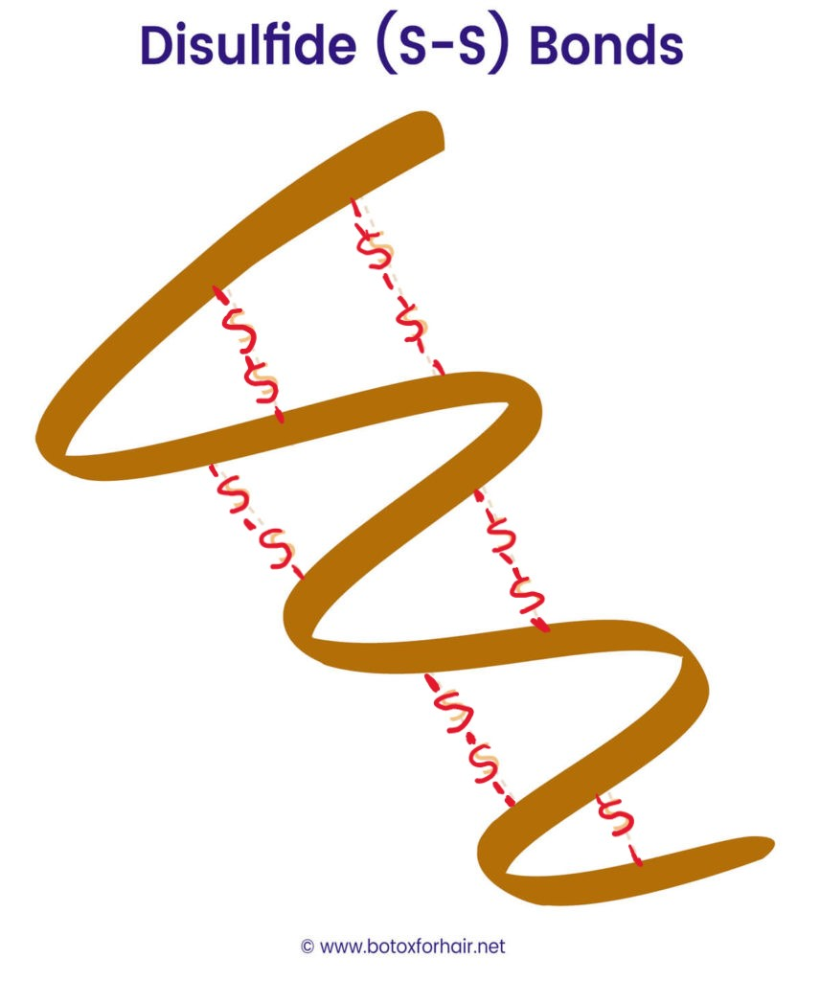
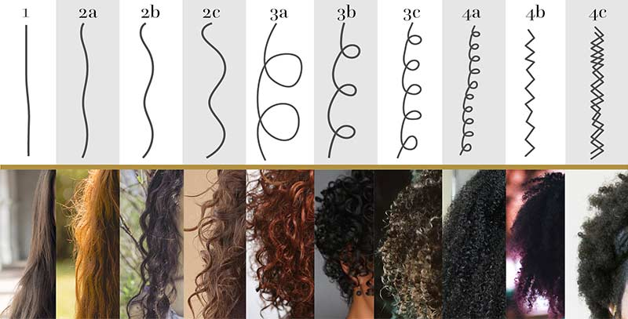
Different Types of Hair formation
Background
Shape or pattern of
your hair strand
No disulfide bonds
Some disulfide bonds
Many disulfide bonds
1 – 2b
2c – 3b
3c – 4c
Wavy
Curly
Coily/Kinky
3a – 4c hair tends to grow UP and OUT rather than down like 1 - 2c
People erroneously confuse
"hair formation" with "hair texture"
Texture = the width of individual strand of hair
Notes:
Here is the huge range of hair formations ... from straight to curly to coily/kinky. We can see here approximately 10 different formations of hair. Formation is the shape or pattern of a hair strand. From these formations, we can see how the shape of individual OR groups of hair strands manifest into particular overall looks.
Notice the curly and coily/kinky hair does not have that amazing shine that we attribute to a sign of "healthy hair". There are two reasons for this: 1) the Natural sebum cannot reach the entire hair shaft because of all the turns, coils and kinks. So, the entire curly hair shaft does not get oil...without some help from the "owner" AND 2) light bounces off the straight hair and reflects directly back to your eyes. When light hits curly hair, it bounces around inside the curl and not directly back to our eyes. So because of this curly hair will rarely have that AMAZING shine that we attribute to healthy hair. It can't This is because of the behavior of light when it hits certain formations of hair. ….into particular Talk about the natural oil (sebum) that the scalp secretes to nourish the hair shaft.
DISULFIDE BONDS: In the upper right of this slide
You can determine your hair formation. Wash you hair and allow it to air-dry WITHOUT and product.
If it dries without any bends or curls, then it's STRIAGHT (1)
If it dries with bends or an "S" shape, it's WAVY (2)
If it dries in curls and loops, then it CURLY (3)
If it dries in coils, compacted spirals it COILY/KINKY (4)

Slide 5
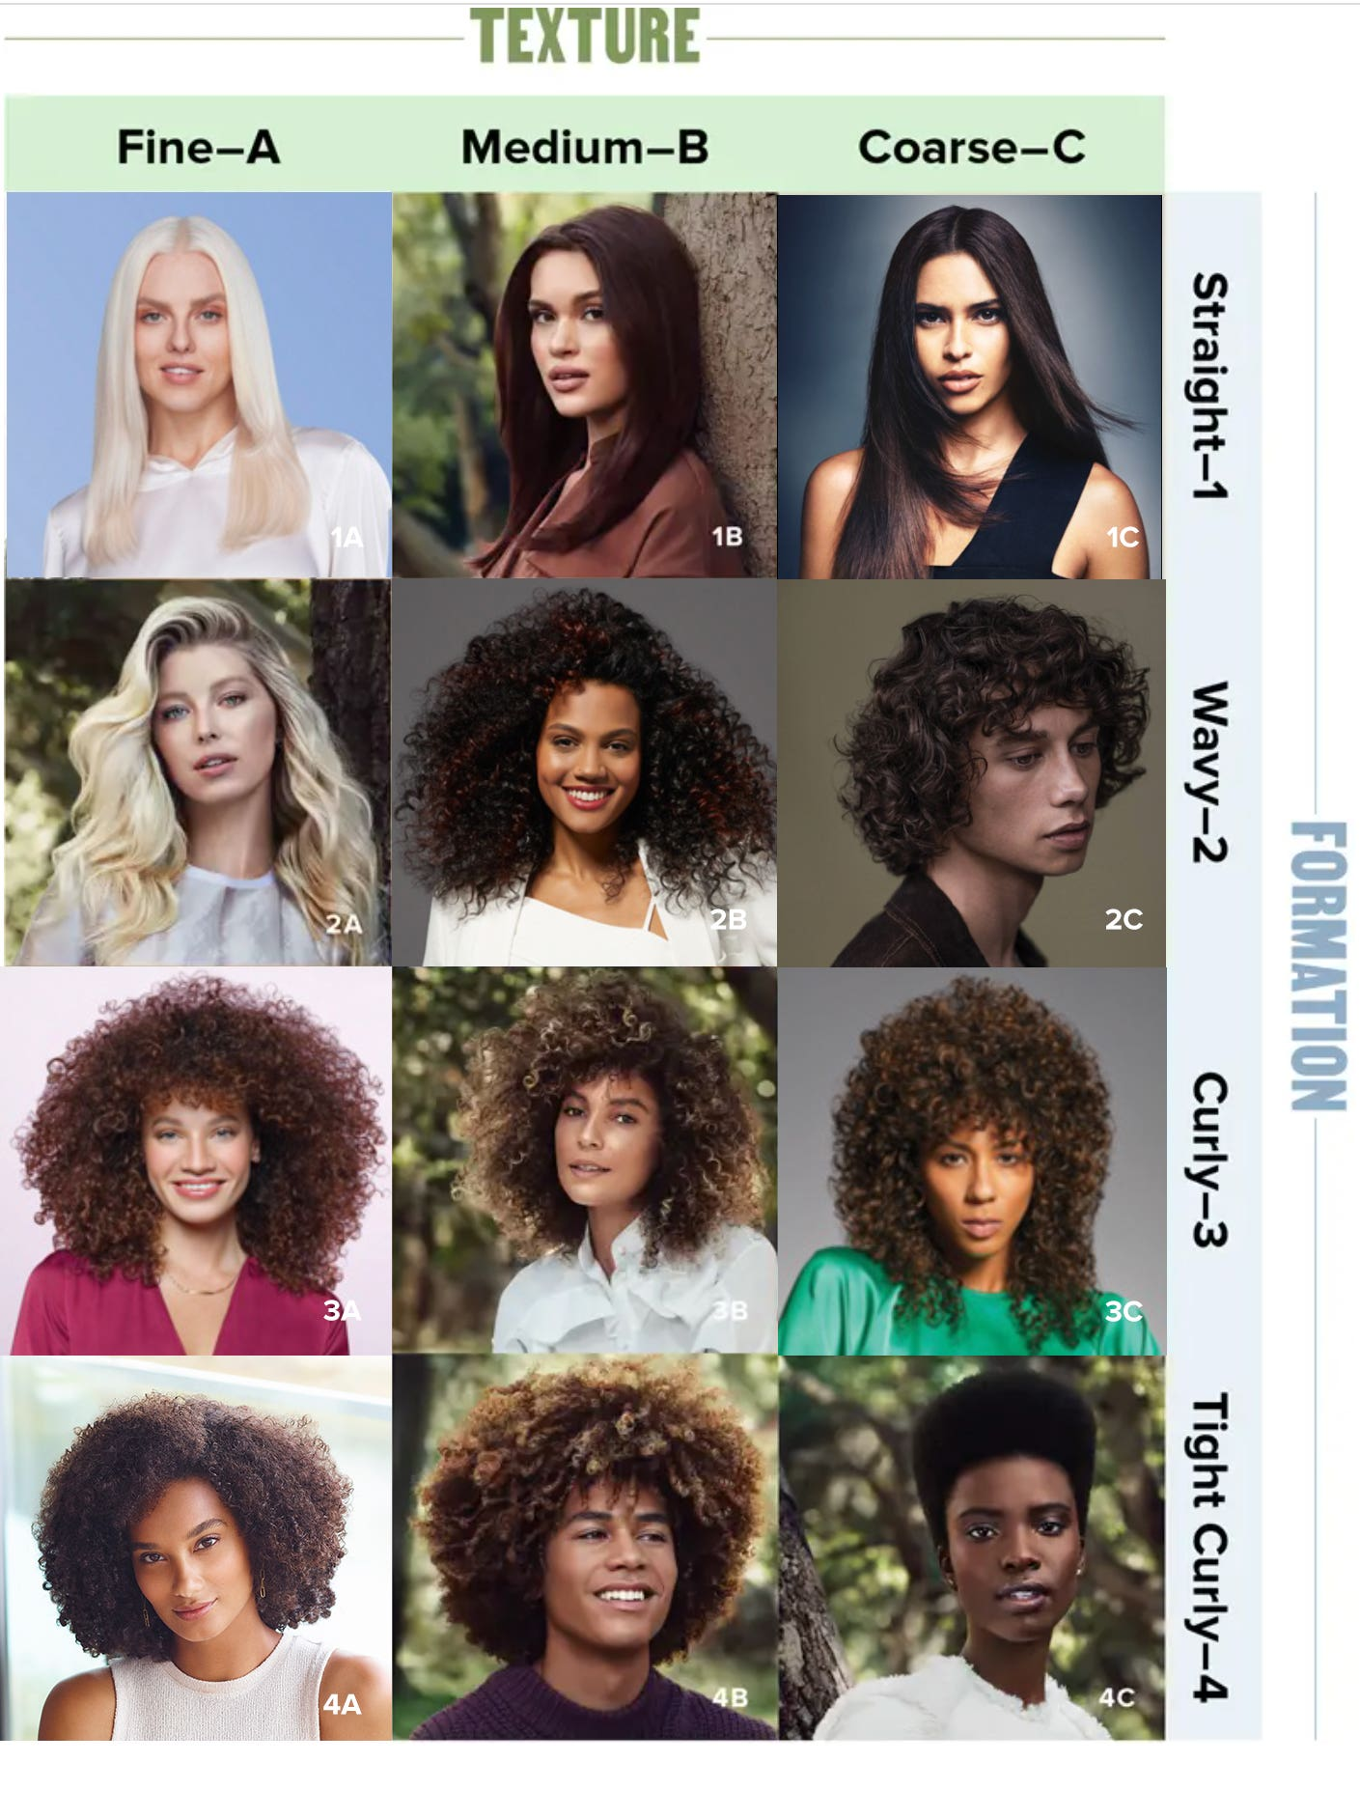
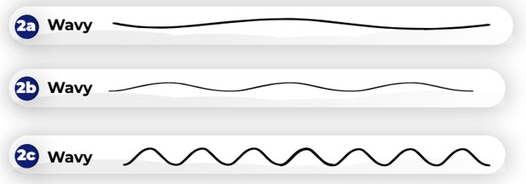
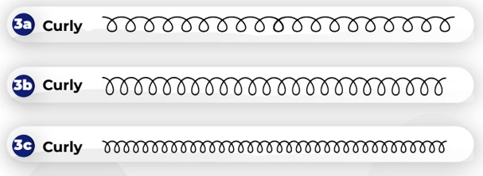
Styles of different formations
Background
Fundamental difference in needs
of curly vs straight hair: sebum
https://www.paulmitchell.com/blog/guide-to-identifying-your-hair-type
Notes:
This slide just shows the whole-head hair styles that manifest from the different hair formations.

Slide 6
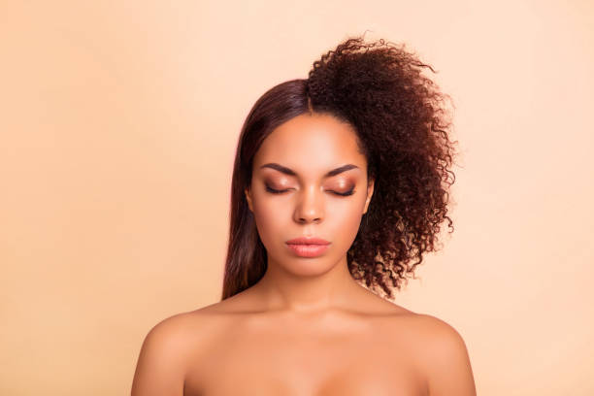
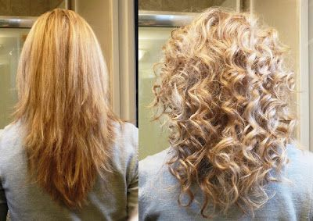
Terminology
Background
Natural hair - hair that has NOT been chemically processed. The pattern that grows out of your head.
Relaxed hair – curly/kinky hair that HAS been chemically processed to REMOVE disulfide bonds. Outcome is straight hair with no curls or kinks.
Permed hair – straight hair that HAS been chemically processed to ADD disulfide bonds. Outcome is straight hair with curls (rarely or never kinky).
Notes:
So with this slide, I want ensure that everyone understands the meaning of the popular terminology.

Slide 7
What is beauty?
Background
American society idolizes “all things European”
Cultural norms and expectations for appearance (body, complexion, hair, clothing) create unrealistic goals for non-dominant groups, especially African-Americans.
Standard is Euro-centric; African culture, dress, features are subjugated.
Historically, strong societal pressure to act, dress, & look like “the standard”
Acceptance, employment are main reasons African-American women go to great lengths to change their appearance and “look acceptable”.
Recent study shows bias against Black women with “natural hair styles” in job recruitment, perception of lower professionalism, less likely to get interview*
Hair is main thing to change
Black women spend 9x more $$$$ than other ethnicities on hair care ** Buy & use more products
Black hair care is approximately $1 billion industry ….annually **
* Social Psy. Personality Sci. 2021, 12:5, p.741 – 750
** https://afrolovely.com/black-hair-industry-statistics/
Notes:
We’ve all been told that beauty is in the eye of the beholder.

Slide 8
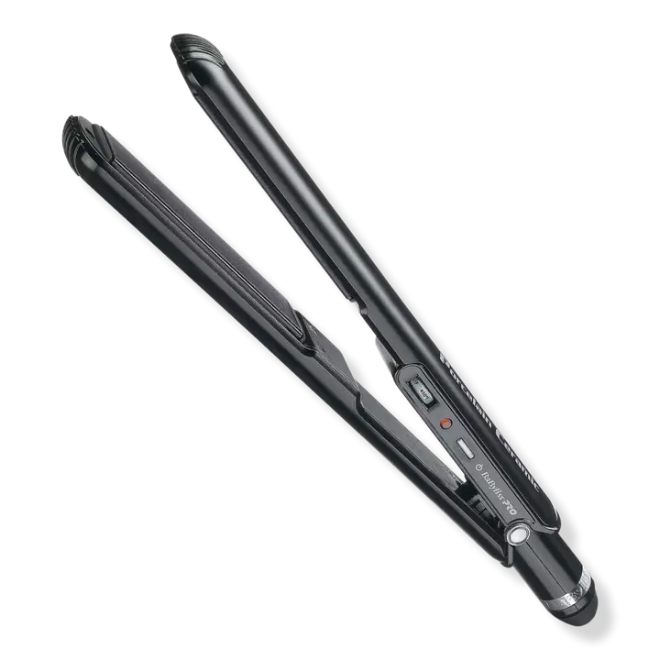
How do Black women adhere to the beauty standard?
Roll over image to zoom in
Background
75% of Black women use relaxers to straighten hair *
Some products are used daily **
Straight Hair
Relaxers
Pressing Combs
Flat Iron
Moisterizers
Leave-in conditioners
Gels
* Int. J. Cancer. July 15 2020, 147:2, p. 383 – 391.
Amazon.com “pressing comb”
** https://www.hsph.Harvard.edu/news/hsph-in-the-news/some-black-hair-products-may-harm-users-health
ulta.com “flat ion”

Slide 9
Hair relaxers

Slide 10
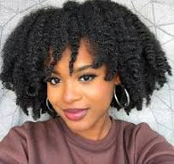
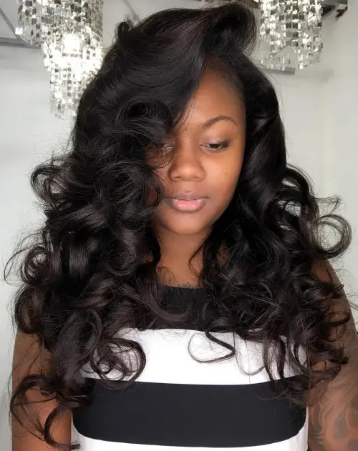
From "Natural" hair to "relaxed" hair
Hair Relaxers
A Long, (4+ hours) process
Expensive (Hair salon) process
Every 6 – 8 weeks, must be relaxed again (whole head) or "touch-up“
New growth is treated once there is enough for chemical processing
"relaxing" Just the new growth...close to scalp
Notes:
The process to make really curly or kinky hair wavy or straight is a long one. Whether you go to a professional in a salon or do it yourself at home, it takes hours

Slide 11
Chemicals in Hair relaxers
Hair Relaxers
Other uses:
Oven cleaner
Drain declogger
Depilatory creams
NEGATIVE EFFECTS continued
Chemical burns (1st, 2nd or 3rd degree)
Inflammation of scalp
Contact irritation
Eczema – dry itchy patches of skin
Hair loss by destruction of hair follicles
Link to breast cancer among heavy users (31% mortality rate among Black women)
NEGATIVE EFFECTS
Breaks disulfide bonds (what makes curly hair straight)
Increased fragility of hair shaft (can dissolve hair)
Loss of hair strength
Scarring alopecia
Highly corrosive to skin
Lye (Sodium Hydroxide)
Anais Brasileiros de Dermatologia. Mar.Apr. 2022, 97:2, 193 - 203
SAMJ. 2019, 109:12, . Mar.Apr. 2022, 97:2, 193 - 203
https://www.prevention.com/beauty/a43048620/are-hair-products-for-black-women-toxic/
Notes:
NaOH is a caustic base and is corrosive to the skin

Slide 12
Chemicals in Hair relaxers
Hair Relaxers
No-lye relaxers marketed as “safer” than lye relaxers
NEGATIVE EFFECTS continued
Scarring alopecia
Loss of hair strength
Split ends
Eventual hair loss by destruction of hair follicles
No-Lye (Calcium Hydroxide, lithium hydroxide, potassium hydroxide)
NEGATIVE EFFECTS
Breaks disulfide bonds (what makes curly hair straight)
Increased fragility of hair shaft (can dissolve hair)
Contact irritation, skin damage
Eczema/dandruff
Inflammation of scalp
Chemical burns (1st, 2nd or 3rd degree)
Anais Brasileiros de Dermatologia. Mar.Apr. 2022, 97:2, 193 - 203
Int. J. Trichology. 2013 Jan – Mar, 5:1, p.26 – 28.
SAMJ. 2019, 109:12, . Mar.Apr. 2022, 97:2, 193 - 203
Bri. J. Dermato. Dec. 1,2019, 181:6, p.1317 – 1319.

Slide 13
Chemicals in Hair relaxers
Hair Relaxers
Other uses:
Preservative in medical labs (Embalm dead bodies)
Preservative in food
NEGATIVE EFFECTS continued
Banned in Brazil above 0.2%
Still found in U.S. products at levels up to 15%
Severe kidney injury following use in Israel*
High doses can cause cancer
Formaldehyde-
Brazilian Keratin Treatment
NEGATIVE EFFECTS
Eye & nose irritation
Respiratory tract irritation
Headaches
Known carcinogen
Banned from cosmetic use in European Union
*Am. J. Kid. Dis. July 2023, 82:1,p. 43 – 52. DOI: http://doi.org/10.1053/j.ajkd.2022.11.016

Slide 14
Other Hair Products

Slide 15
Chemicals in Hair products
Hair Products
NEGATIVE EFFECTS:
Easily absorbed through skin
Harmful to scalp
Hormone (Estrogen) disruptors**
Linked to breast cancer & reproductive issues*
Chronic low-dose exposure causes breast cancer (mice)***
Parabens
USES:
Preservative in products with high water content (shampoos/conditioners)
Prevents bacteria & mold growth
* Environmental Advances, 2023, Vol. 11, Iss , p 100325
** J Biochem Mol Toxicol, 2022 May; Vol. 36: 5, p. e23012.
*** Endocrinology, 2023 Jan 09; Vol.164:3.

Slide 16
Chemicals in Hair products
Hair Products
Phthlates
NEGATIVE EFFECTS:
Associated with weight gain & obesity *
Linked to type 2 diabetes in women **
Reproductive and developmental toxicants & endocrine disrupting chemicals ***
Disrupts normal ovarian function (egg development) ***
Increase incidents on miscarrage
USES:
Ubiquitous class of chemicals used as plasticizers (promotes flexibility and reduces brittleness) in numerous products
Used as solvents in personal care products
* JAMA Netw Open, 2022, 22:5, e2233088. * Toxics. 2022, 10:3, 143: https://doi.org/10.3390.toxicx10030143
** Environ Health Perspect. 2012, 120:9, p. 1307 - 1313
*** Frontiers Endocrinology. 2015, 6:8, doi: 10.3389/fendo.2015.00008
Notes:
Used as plasticizers in numerous products, including cleaning supplies, medical devices, personal care items and cosmetics (perfume, lotion, nial polish and hairspray), pharmaceuticals, toys, construction and paints.

Slide 17
Chemicals in Hair Products
Hair Products
NEGATIVE EFFECTS:
Scalp irritation
Dryness, itching & dandruff (removes sebum)
Hair thinning & loss
Fades color of natural hair
Can disrupt human development
Linked to numerus cancers
Few evaluated for human toxicity
USES:
Varied and numerous in many cosmetic products (an emollients to help water-based and oil-based ingredients mix)
Makes hair look smooth & shiny (short-term)
Used as thickening agent in shampoos
Removes hair’s natural oil (Sebum)
Polyethylene glycols (PEGs)
Toxicol Res. 2015 Jun. 31:2, p.105 – 136 doi: 10.5487/TR.2015.31.2.105
https://www.ncbi.nlm.nih.gov
Notes:
This class of compounds is ONE family of endocrine disrupting compounds (EDCs) that is used widely with over 470 million pounds produced annually in the U.S. alone. Contained in products such as food packaging, building materials, cleaning and medical supplies, nail polish, hairspray, perfume and lotion.

Slide 18
Chemicals In Hair Products
Products not mentioned (because of time):
Hair dye
Synthetic Wigs
Synthetic hair
Synthetic weaves
Synthetic hair extensions
Synthetic braids, locs

Slide 19
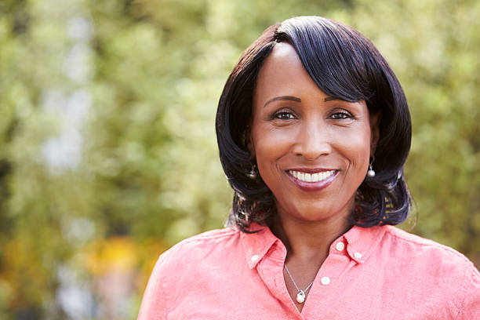
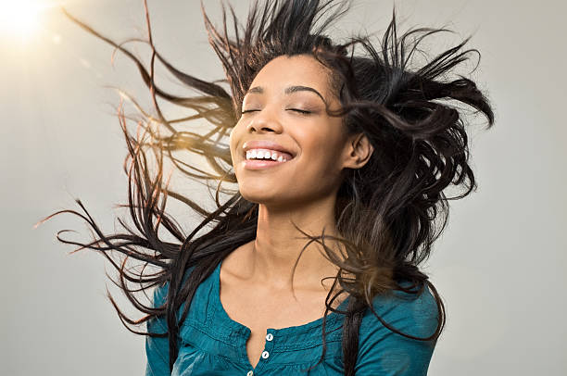
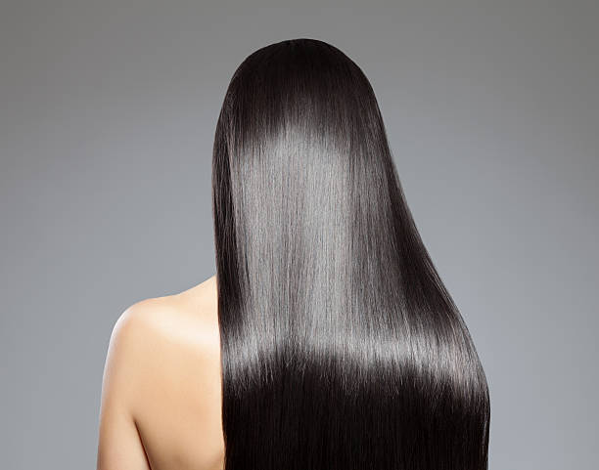
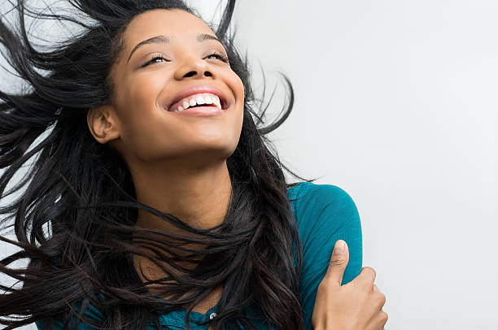
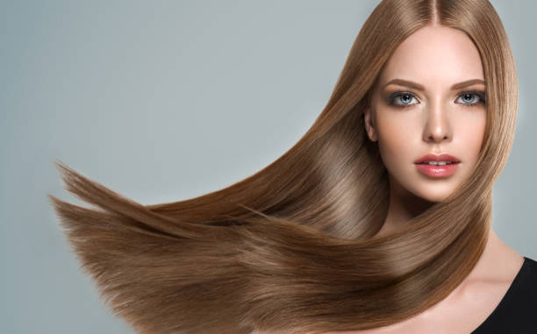
This is what we want

Slide 20
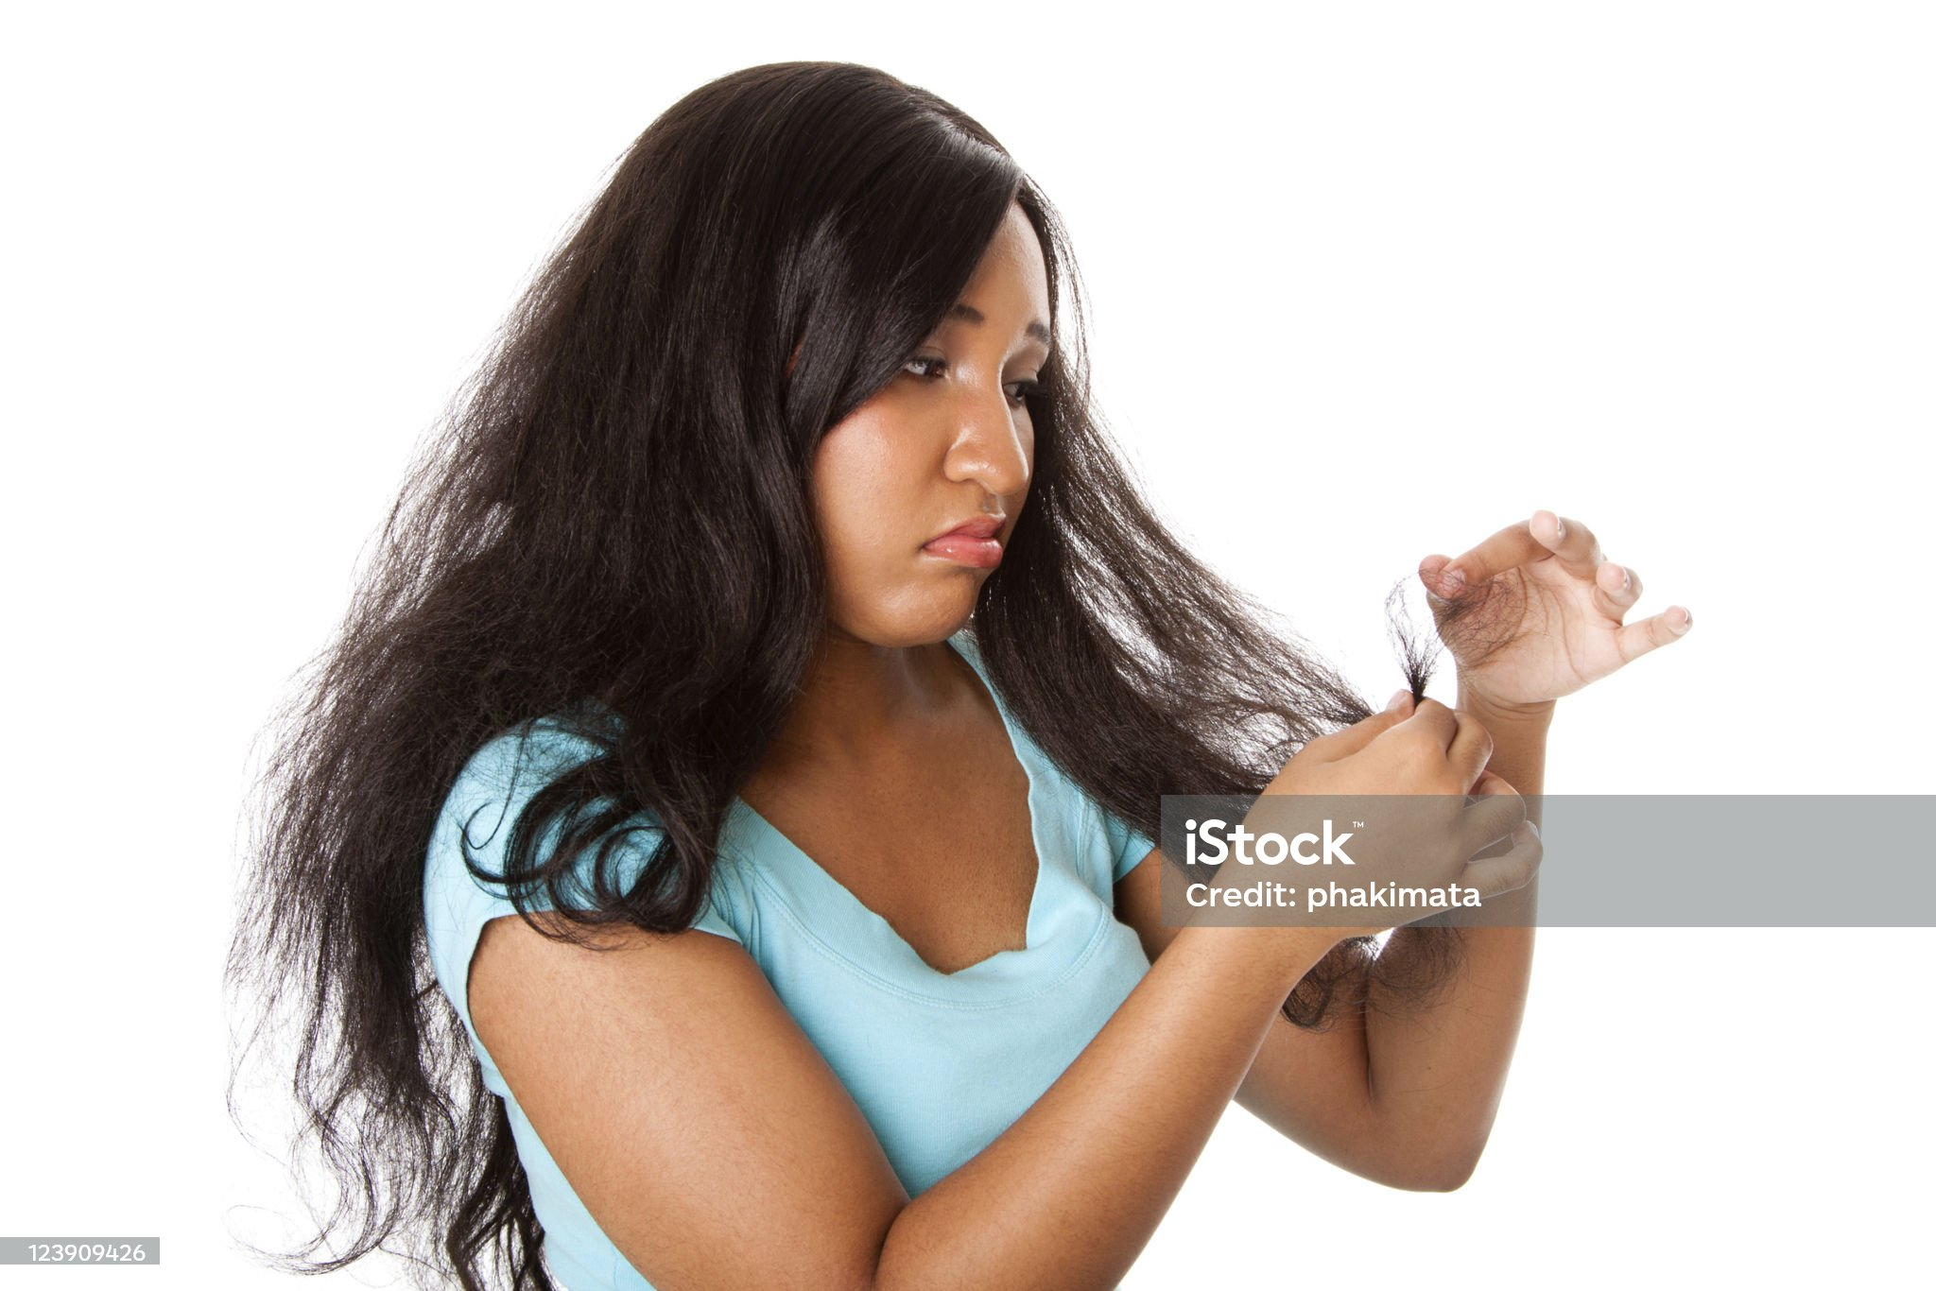
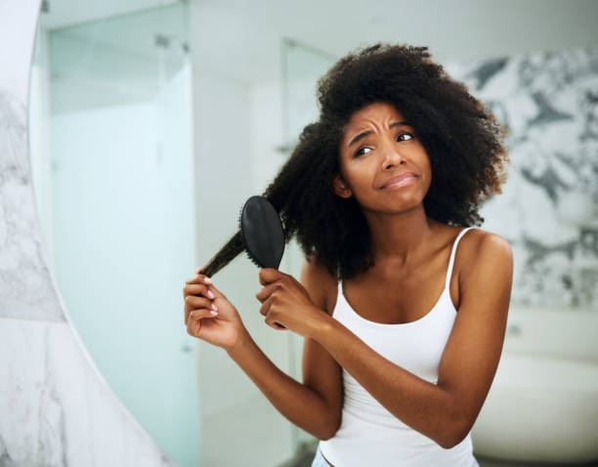
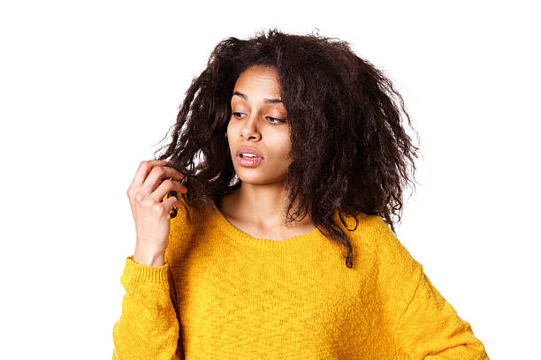
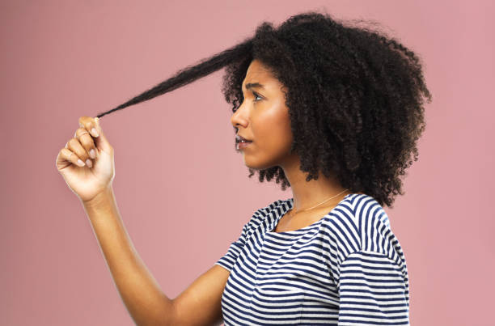
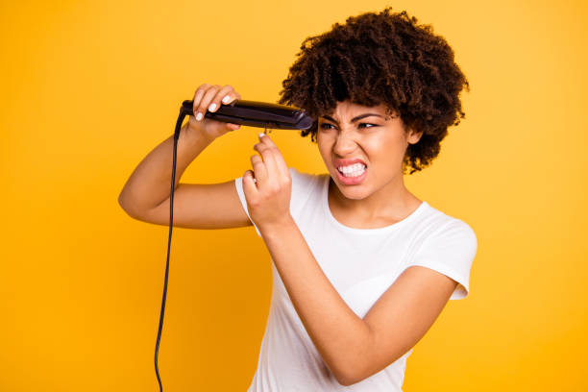
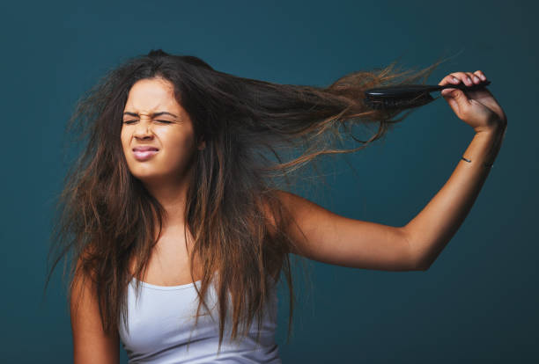
This is what we get
Hair Breakage
Split ends
Hair loss
Chemical burns
Health & fertility issues

Slide 21
Summary
50% of products advertised to black women contain these chemicals compared to ~7% of products advertised to white women*
Frequent users of relaxers >twice likely to develop uterine cancer
Lye hair relaxers linked to breast cancer
Exposure starts early (age 6 – 11 with “kiddie” relaxers)
Black women are the highest consumers of toxic beauty products. Average of 17 products ; use 5 daily = inflated chronic exposure = elevated health risks
Black women spend 9X more money on hair care than non-black counterparts
Black-owned hair products 3% of ethnic hair market (market is ~$1 billion annually)
Most products made by non-black companies (don’t understand [know or care?] about Black hair care needs)
* https://www.hsph.Harvard.edu/news/hsph-in-the-news/some-black-hair-products-may-harm-users-health
* JNCI. 2022, Dec. 114:12, p1636 – 1645

Slide 22
questions?

Slide 25
Thank you!
Questions?

