Slide 1
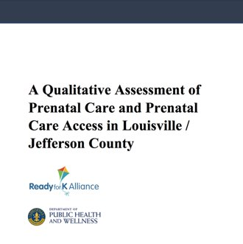


Slide 2
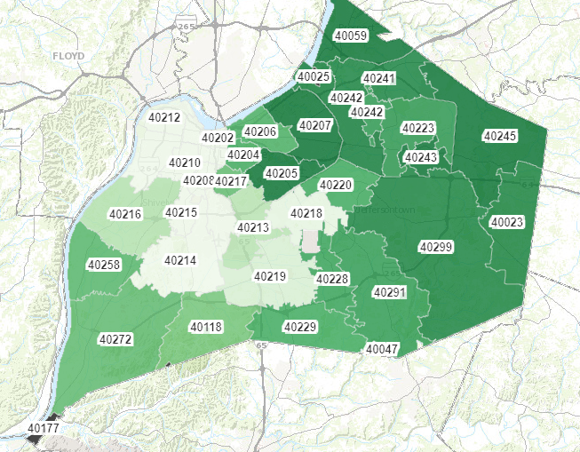
Prenatal Care in Jefferson County – Zip Codes
Percent of births receiving early prenatal care in Jefferson County from 2010 – 2019
Source: KY Office of Vital Statistics

Slide 3
Prenatal Care in Jefferson County – Demographics
Percent of births receiving early prenatal care in Jefferson County from 2010 – 2019
Source: KY Office of Vital Statistics

Slide 4
Methodology
Trained facilitator conducted interviews and focus groups with 34 recent parents
Parents completed brief survey prior to the study

Slide 5
Focus Group and Interview Findings
Difficulty accessing or finding care
Cost and coverage as a barrier
Disruptions in care and breakdowns in communication
Overbooked and burdened providers
Reports of Medical Racism
Developing and honoring birthing plans
Placing fear onto mothers
Feeling that mothers need to be their own advocates
Feelings of isolation

Slide 6
Values for Prenatal Care
Emphasis on relationships
Feeling/being listened to and heard
Desire for midwifes
Desire for black women providers and staff in prenatal and pregnancy care spaces

Slide 7
Recommendations
  Ensure providers work with and respond to parents and mothers to ensure that they feel heard
  Increase access to caseworkers, doulas, and other advocates for parents during prenatal and pregnancy care
  Increase support and guidance in group settings
  Increase the presence of Black women and Nurse-Midwives in OB spaces
  Promote options for births outside of the hospital, VBAC, unmedicated, water births, and models of care such as midwifery
  Increase support following delivery

Slide 8
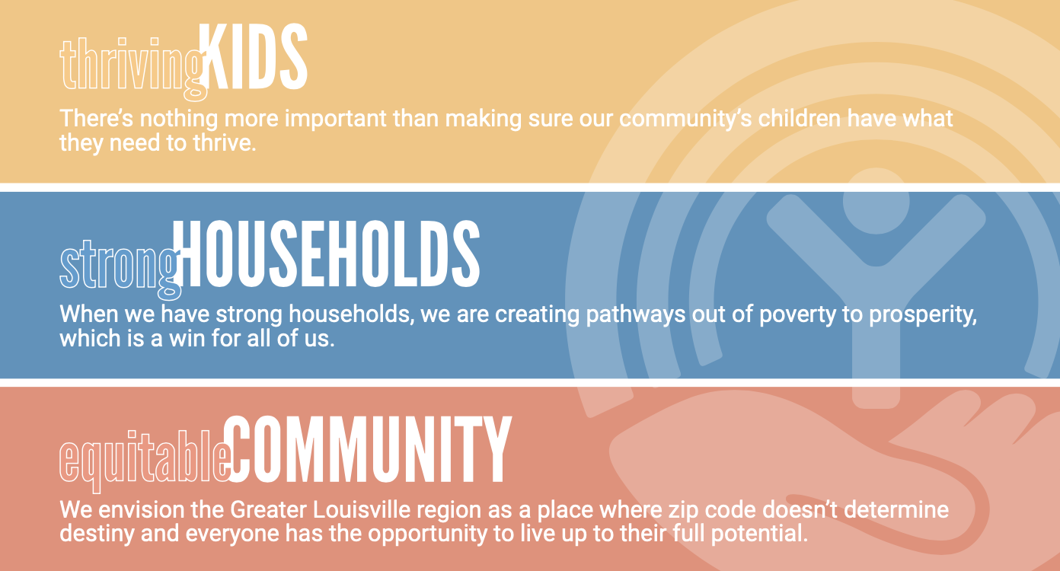

Slide 9
A Qualitative Assessment of Prenatal Care and Prenatal Care Access in Louisville/Jefferson County
Liz McQuillen
Metro United Way Chief Policy Officer
Liz.McQuillen@metrounitedway.org

