Slide 1
KAVIS Program update
Project and Financial Review
Heather Stout, Executive Director
John Eiler, Project Manager

Slide 2
KAVIS Program Status
Overview of the areas we are going to discuss
Project Update
Present and Future Modules
Approach
Iterative and Incremental Delivery
Value Driven Delivery
Creating the Solution they need
Impact to Citizens
Benefits
Budget Review
Implementations
Partnerships with End Users
Solving the Right problems
Spend
Burn down
Financial Breakout

Slide 3
KAVIS OVERVIEW
Project Update
The KAVIS:2 project will provide the Commonwealth with a statewide, automated system for vehicle and boat titling, registration, taxation and related functions. This comprehensive solution will replace the legacy AVIS and BTR systems, other small subsystems, and provide a consistent and updated platform for the Commonwealth to perform vehicle licensing business.
The replacement of the AVIS and BTR systems will streamline and improve efficiencies within the Department of Vehicle Regulation, the Division of Motor Vehicle Licensing, and county clerks’ offices throughout the state. It will also allow the KYTC, Department of Revenue (DOR), County Clerks, Property Valuation Administrators (PVA), and other agencies to better serve the citizens of the Commonwealth.
The KAVIS:2 system will be designed using a customer-centric paradigm, moving from the current vehicle centric model that exists in the AVIS and BTR systems. Establishing a customer-centric system and business model will support moving from the current plate-to-vehicle model to a plate-to-customer model. The current AVIS and BTR systems cannot support this concept.

Slide 4
Project implementation
Project Update
Print on Demand Decal & Real Time Scanning - May 2015
Immediate Access to Documents by multiple agencies
Decrease time in office for customers
Eliminate double entry of data for clerks
Reduce paper handling and archiving
Decrease maintenance of aging printers
Reduce postage for clerks and MVL
Reduce annual audit time
Greatly improve access to vehicle documents
Web Renewal Enhancement Phases (2015 and 2016)
New web renewal site deployed Summer 2015
Enhanced usability through design improvements
Clerks receive money collected immediately
All eligible plates renewable online (Mid-year 2016)
Streamlined process for clerks to approve renewals (EOY 2016)
Notes:
Do we need slide 4 and 5– everything in these slides are in 8/9 slides– This is just a high level view.. We an potentially get ride of these slides

Slide 5
Project implementation
Project Update
Disabled Placard-Complete January 2016
Transition to a Web Based Application Solution
Shift from vehicle centric model to Customer Centric Model
Hardware and software implementations to drive accuracy and precision of data
DL Verification (integration between DL and KAVIS)
State-Wide Point of Sale Solution-Complete March 2018
Stable, reliable and consistent environment
Support revolves around bookkeeping, reports and normal operations with AVIS processes and procedures
Enable use of automated cash drawers
Print on Demand Boat Decal
Vehicle Foundation – Boats July 2019
Framework Application Functionality
Title, Registration, Ad Valorem, Liens etc.
Increased End Users-Clerks, MVL, KSP, F&W, DOR, PVA and Audit
Decommission and Implement Inventory Solution-July 2021
Implement Flat Plate Solution-July 2021
Module – All Vehicles-Target Dec 2022
Decommission AVIS legacy Mainframe
Transition all remaining vehicle types (data, business processes and functionality) to KAVIS

Slide 6
Kavis impact and benefits
Project Update
Standardization
Automatically record all AVIS Transactions into KAVIS
Processes are standardized across ALL counties but include configurations to facilitate business processes for efficiency
Improved processes for reconciliation, mid-day sweeps, NSF management
Data Integrity
Ability to scan Driver’s Licenses to ensure data validity and accuracy
Access to 5 years worth of data versus 1 year
Reduction in Fraud-KAVIS requires correct customer and vehicle data as well as pointing out bad data to clerks so they can fix the issues
Customer Accounts are linked and merged with all vehicle types allowing for a single view of all data on a customer account regardless of vehicle type

Slide 7
Kavis impact and benefits
Project Update
Efficiency/Effectiveness
Reduction in time from title application to title receipt by citizen
Decreased clerk on-boarding time from 3-6 months to less than one (1) day
Performing validations early allowing changes before committing to the transaction
Increased opportunity to identify and collect unpaid or unassessed taxes
Ability to e-mail receipts (paper reduction)
Enable use of automated cash drawers
Auto assigning tax districts for customers who currently have other vehicles assigned to a tax district
Increased Visibility across organizations (MVL/Clerks/DOR/PVA)
Fiscal Year 2021 (June 2020-July 2021)
Receipts Checked Out: 3,917,816
Citizens Served: 4,618,629
Web Renewals: $43,566,193.08
Total Sales: $1,046,814,723.70
Check: $693,074,997.04 (66.21%)
Cash: $110,345,197.10 (10.54%)
Credit: $129,973,310.30 (12.42%)
Notes:
If we need comparison year to year we can get that from Petko today.

Slide 8
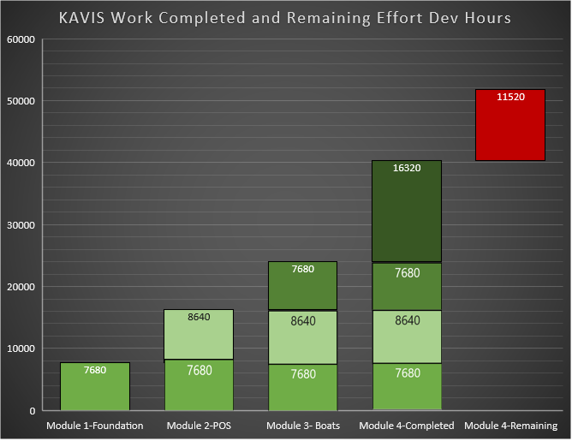
KAVIS PROJECT STATUS
Development Effort Perspective
Project Effort Breakdown
Print on Demand Decal & Real Time Scanning - May 2015
Web Renewal Enhancement Phases (2015 and 2016)
Disabled Placard-Complete January 2016
State-Wide Point of Sale Solution-Complete March 2018
Vehicle Foundation – Boats July 2019
Decommission and Implement Inventory Solution-July 2021
Implement Flat Plate Solution-July 2021
Module – All Vehicles-Target Dec 2022
72%
17 Months
Less than 28% remaining development time
Approximately 17 months remaining effort
Target Goal December 2022
KAVIS:2 is on target currently with the estimated remaining work and remaining budget.

Slide 9
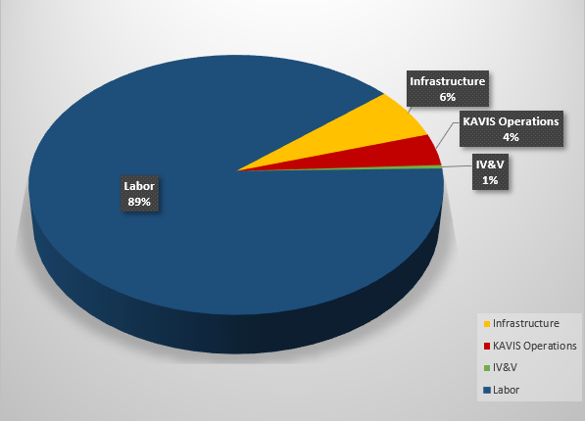
KAVIS BUDGET
Budget Breakdown
Financial Perspective
Initial Allocation: $25,000,000
Total Spend on previous effort: $9,053,334
Current KAVIS Project Allocation: $19,946,665
Total Spend on Current Program: $15,779,127
Remaining Budget: $4,167,537
Over the course of the previous six (6) years, the KAVIS program has delivered high value functionality directly to the end users with positive and conclusive impact to operations.
63%
21%
KAVIS:2 started with only a portion of the originally allocated budget. 37% of the budget was allocated to a previous vendor that did not successfully implement a solution. Recently, an additional source of funding was allocated to fund the remaining work.
With the remaining 21% of the budget, KAVIS plans to develop the remaining vehicle types and push that functionality to the end user by end of year 2022.

