Slide 1
CHFS Organizational Structure and Operations
Presented for the CHFS Organizational Structure,
Operations, and Administration Task Force
July 6, 2022
Eric Friedlander, Secretary
Eric Lowery, Executive Director

Slide 2
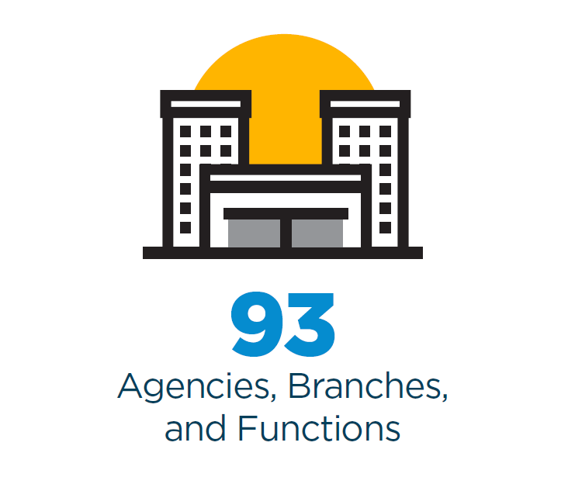
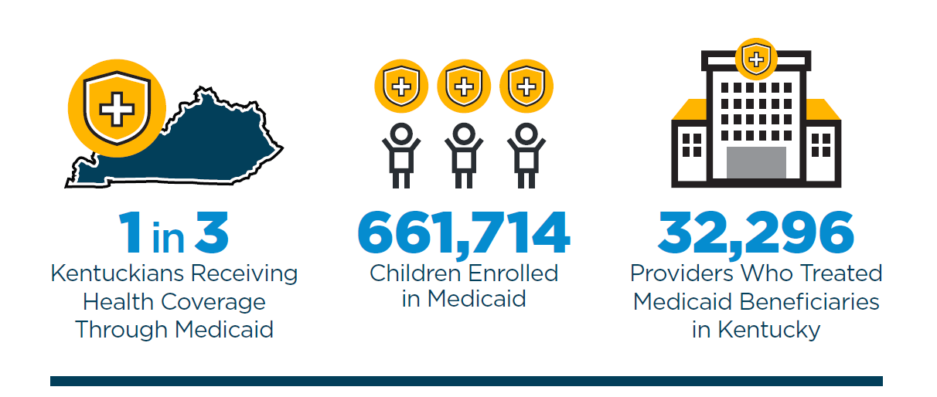
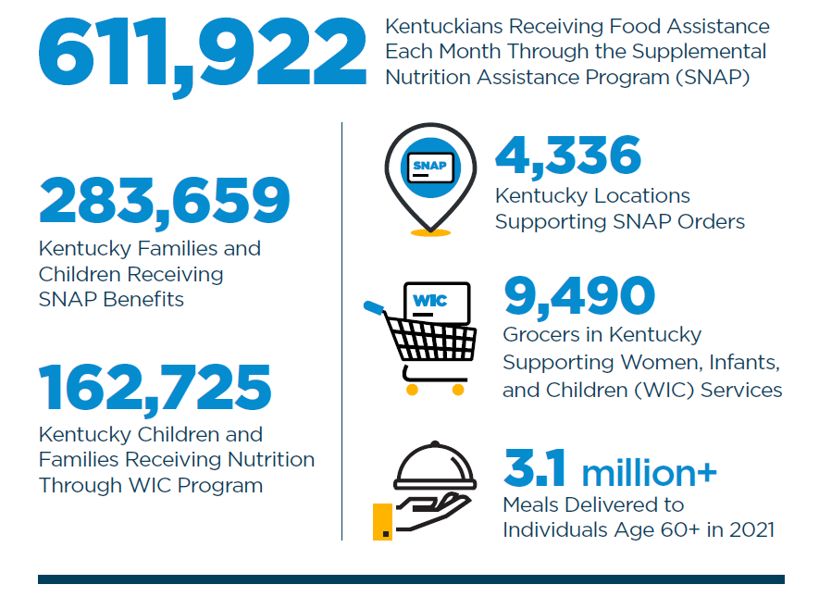
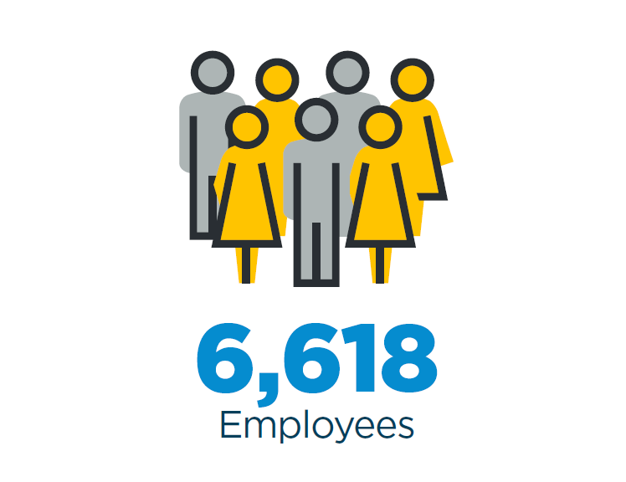
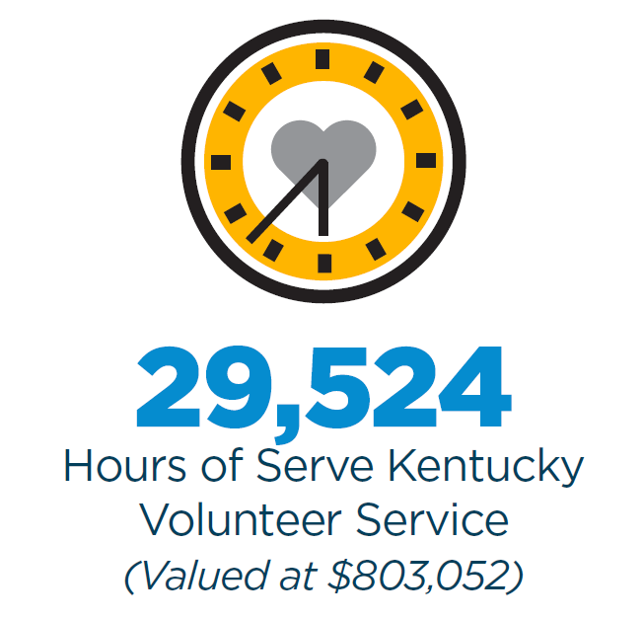
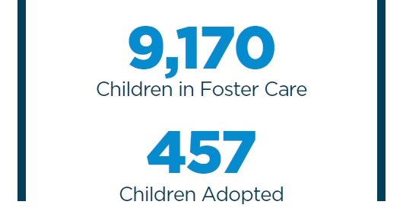
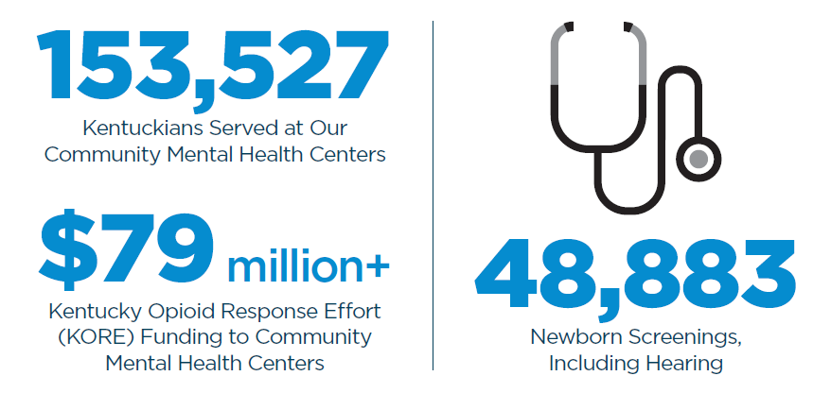

Slide 3
Cabinet for Health and Family Services FY 23 Budget $19,188,809,300

Slide 4
Cabinet Fund Sources
General Fund 16%
Tobacco Funds .1%
Restricted Agency Funds 12%
Federal Funds 72%

Slide 5
How are Cabinet Funds Spent?

Slide 7
General Administration and Program Support FY 2023 Budget - $152,567,100

Slide 9
Department for Medicaid Services FY 2023 Budget - $15,696,685,800

Slide 11
Department for Community Based Services FY 2023 Budget - $1,888,897,000

Slide 13
Department for Public Health FY 2023 Budget - $623,169,200

Slide 15
Department for Behavioral Health, Developmental and Intellectual Disabilities FY 2023 Budget - $524,643,500

Slide 17
Department for Aging and Independent Living FY 2023 Budget - $118,334,500

Slide 19
Division of Family Resource and Youth Services Centers (FRYSCs)
As of July 1, there are 888 FRYSCs statewide in over 1,200 schools
2020-2021 school year
Over 2.2 million services were provided to students during school
Over 1.4 million services were provided outside the regular school day (summer, school breaks, weekends, before school, and after school)
FRYSC reported over $17 million in cash and in-kind contributions (goods, services, and volunteer time)
FRYSCs conducted over 85,000 home visits
The backpack program (weekend food) provided over 275,000 meals to students in need
Almost 7,000 parents/relatives participated in FRYSC-led grandparent/relative support activities
Student contact counts (unduplicated) for select programs:
Suicide prevention 39,627
Internet safety 14,293
Bullying education 26,494
Character education 25,226
Dental 46,065
Summer/Part-time job development 12,595

Slide 20
Department for Family Resource Centers and Volunteer Services FY 2023 Budget - $31,671,600

Slide 22
Department for Income Support FY 2023 Budget - $131,132,800

Slide 24
Office for Children with Special Health Care Needs FY 2023 Budget - $21,707,800

Slide 25
Questions?

