Slide 1
EMS Operational Challenges
Kentucky EMS Task Force
August 16, 2022

Slide 2
Paul Phillips
Regional Director of Operations
Louisville AMR, Lexington AMR, Eastern Kentucky Lifeguard Emergency Medical Services
Terence Ramotar
Regional Director Government Affairs
Global Medical Response Southeast Region

Slide 3
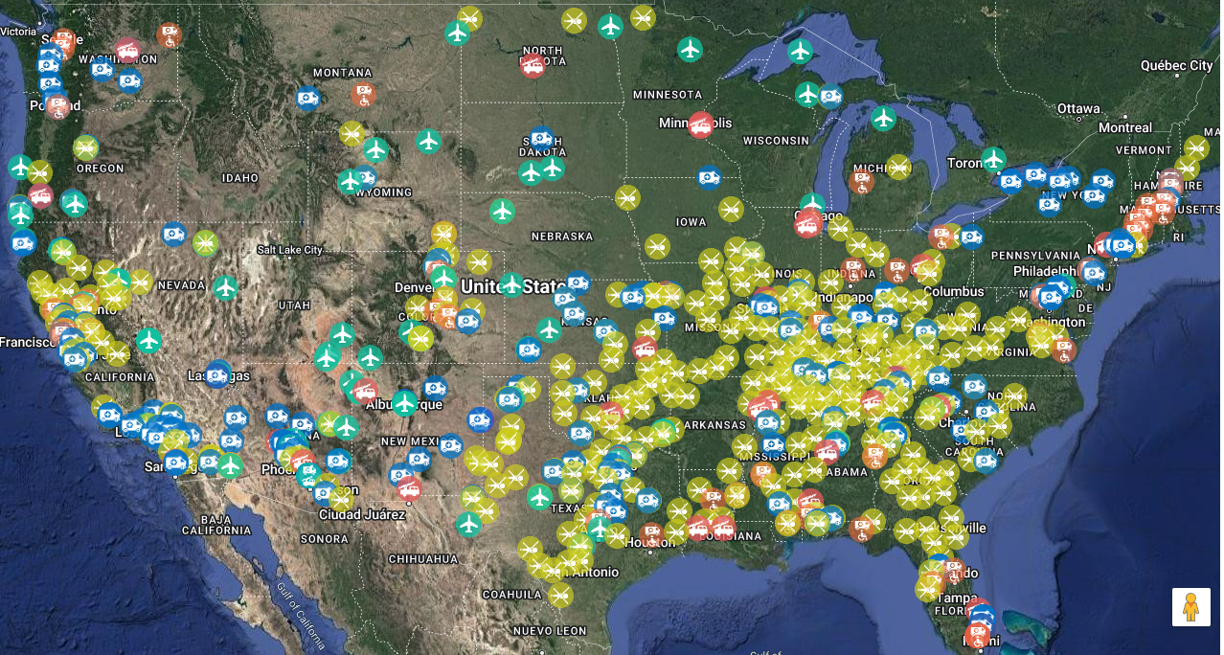
Global Medical Response Overview

Slide 4
GMR Ground Ambulance in Kentucky
Lexington
Louisville
Owensboro
Northern Kentucky
Eastern Kentucky
Floyd County
Harlan County
Knott County
Leslie County
Pike County

Slide 5
EMS Operational Challenges
Reimbursement
Access
Workforce

Slide 6
National Organization Advocacy
National Association of EMT’s (NAEMT) & American Ambulance Association have identified Workforce Shortage and Medicare Reimbursement Reform as top legislative priorities.
Both organizations are advocating for:
Expanding grant programs targeted to EMS (including HHS grant opportunities)
Ensuring EMS is eligible for federal grants targeting healthcare workforce development
Funding for paramedic and EMT recruitment and training, open to public and private nonprofit and for-profit ambulance services
Funding for implementation of a minority and low-income recruitment programs.

Slide 7
Reimbursement

Slide 8
Reimbursement Challenges
Payer Sources
Medicare
Medicaid
Commercial Insurance
Private Pay
Uninsured/Underinsured

Slide 9
Reimbursement Challenges
Payment Model
EMS is paid for TRANSPORT, and not TREATMENT
There is limited to no reimbursement for:
Readiness
Response
Treatment without Transport
Patient Refusals of Care

Slide 10
Reimbursement Challenges
Kentucky Medicaid Ambulance transport rates have remained the same for over 10 years.
Comparatively, the cost of providing ambulance service has risen significantly in the past 2 years alone. Examples include:
Fuel
Vehicles
Required Medications
Physical Infrastructure/Buildings
Wages

Slide 11
Reimbursement Challenges
Medicare & Medicaid reimbursements are fixed fee schedules.
Reimbursement for Medicare & Medicaid have shown to be less than the cost of providing the service.

Slide 12
Reimbursement Challenges
Adjacent State Comparison of Medicaid Emergency Ambulance Reimbursement Rates

Slide 13
Reimbursement Challenges
Adjacent State Comparison of Medicaid Non-Emergency Ambulance Reimbursement Rates

Slide 14
Access

Slide 15
Access Challenges
Long Transport Times to Definitive Care
Currently only two (2) Level 1 Trauma Centers in Ky (and only 1 additional Level 2)
Large Geographical Gaps between Certified Stroke Centers
Transfers from rural areas to a Trauma Center can take an ambulance out of service for 4-8 hours.

Slide 16
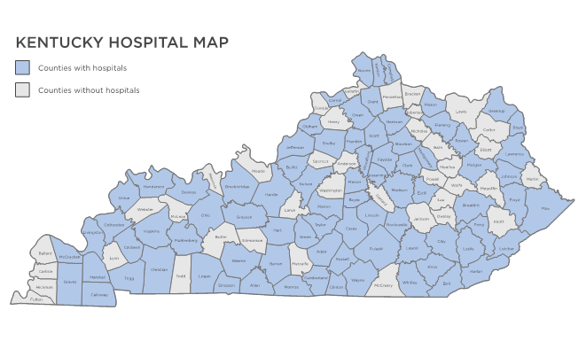
Access Challenges

Slide 17
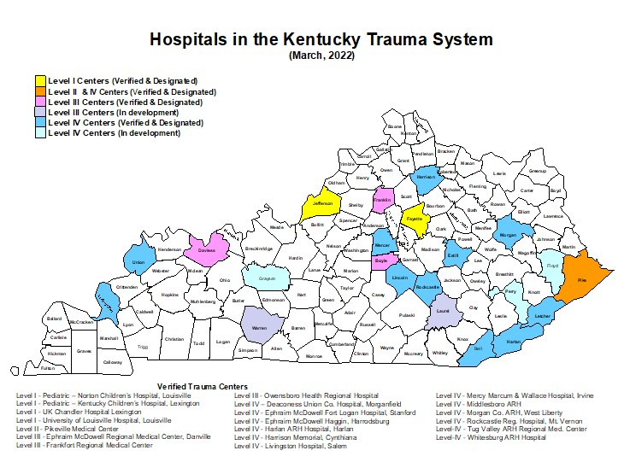
Access Challenges

Slide 18
Access Challenges
Kentucky Certified Stroke Centers

Slide 19
Access Challenges
Transfer Patterns from Kentucky AMR/Lifeguard Operations

Slide 20
Access Challenges
Mental Health Transports
Ambulance resources are utilized for mental health transports
No reimbursement model for non-medical transports in ambulances
EMS personnel in Kentucky lack sole authority to detain

Slide 21
Workforce

Slide 22
Workforce Challenges
The shortage of EMS field staff in this country seems to have approached critical levels. Workforce shortages has to some degree bypassed reimbursement as the number one issue facing EMS today. The Health Resources and Services Administration (HRSA) reports that by 2030, there will be a need for an additional 42,000 EMTs and Paramedics to meet the United States demand for healthcare services.

Slide 23
Workforce Challenges

Slide 24
Workforce Challenges
Unsustainable Turnover
According to a survey conducted by the American Ambulance Association, the turnover among paramedics and EMTs ranges from 20 to 30 percent annually, resulting in an unsustainable 100 percent turnover every four years.

Slide 25
Workforce Challenges
EMS personnel are a finite resource.
Current educational efforts to train paramedics will take approximately two years to start seeing fruit from the effort, if started TODAY.
Paramedics recruited to work in non-traditional environments
Emergency Department/Hospitals
Long-term Care Facilities
Industrial Workplaces
Losing Paramedics to more concentrated areas and out of state

Slide 26
Workforce Challenges
Lack of Quantitative Workforce Data
Greatly reduced applicant pool
Difficulty retaining staff
Inability to increase wages
Lack of career advancement
Unequal distribution of staff across the Commonwealth

Slide 27
Workforce Challenges
FY 2023 HHS Appropriations Package
"EMS Preparedness and Response Workforce Shortage Program.— The Committee recognizes that our Nation is facing a crippling EMS workforce shortage which threatens public health and jeopardizes our ability to respond to healthcare emergencies on a timely basis. ASPR should prioritize ensuring a well-trained and adequate ground ambulance services workforce in underserved, rural, and Tribal areas and/or addressing health disparities related to accessing prehospital ground ambulance healthcare services, including critical care transport."

Slide 28
Innovative Solutions for the Future
How do we expand the reimbursement model to support sustainability?
What are alternatives to the traditional EMS model in Kentucky?
How do we improve recruitment and retention of EMS personnel in Kentucky?

Slide 29
Questions?
Contact Information:
Paul Phillips: paul.phillips@gmr.net
Terence Ramotar: terence.ramotar@gmr.net

