Slide 1
Volkswagen Settlement Funding Update
Rebecca Goodman
Kentucky Energy and environment cabinet

Slide 2
Agenda
Review of Kentucky’s Beneficiary Mitigation Plan
Current Activities and Status of Funding
Next Steps

Slide 3
Kentucky’s Beneficiary Mitigation Plan
Categories of Eligible Mitigation Actions | % of Funds Allocated | $$ Amount
Administrative Expenses | 1.4% | $278,500
Eligible Large Trucks | 0%
Buses Eligible Transit Buses (government entities only) Eligible school buses | 41.8% 41.8% | $8,521,700 $8,521,700
Freight Switchers | 0%
Ferries/Tugs | 0%
Ocean Going Vessel Shorepower | 0%
Eligible Medium Trucks | 0%
Airport Ground Support Equipment | 0
Forklifts & Port Cargo Handling Equipment | 0%
Light Duty Zero Emission Vehicle Supply Equipment (Government & Non-government) | Up to 15% | $3,056,700
Diesel Emission Reduction Act (DERA) Option | 0%
Total | 100% | $20,378,600

Slide 4
Process for Accessing Kentucky’s VW Trust Allocation
Kentucky submits Beneficiary Mitigation Plan (BMP) to Trustee 30 days prior to requesting funds from the Trust
June 4, 2020
Beneficiary submits requests for eligible mitigation action funding by filing Beneficiary Eligible Mitigation Action Form
Within 60 Days the of receipt of request, the Trustee will approve, deny, request modification, or request further information
Trustee shall begin disbursement of funds within 15 days of approval of Beneficiary Funding Request
Beneficiary identifies specific projects consistent with the BMP for funding consideration
The Trustee may only disburse funds for Eligible Mitigation Actions, and for the Eligible Mitigation Action Administrative Expenditures specified in Appendix D-2 and in a Beneficiary’s Mitigation Plan.

Slide 5
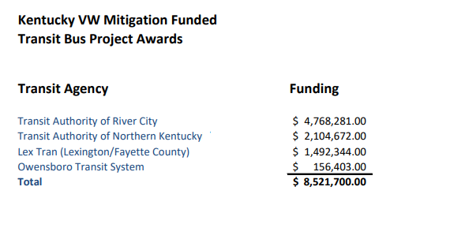
Current Actions by EEC: Awarded Projects
School Bus Project Awards
Application webinar conducted Sept 9, 2020.
School Bus Project Application were due October 9, 2020.
93 school systems submitted applications and were funded, totally $8,128,827 in potential reimbursement.
$392,873 remains from the amount authorized by the Legislature.
https://eec.ky.gov/Energy/Programs/Pages/Volkswagen-Settlement.aspx

Slide 6
Current Actions Taken by EEC (con’t)
Updated Trustee forms to prepare for draw down of funds.
July 2021: Submitted Beneficiary Eligible Mitigation Action Form for preliminary review in order to draw down funds for transit bus projects.
Preparing Beneficiary Eligible Mitigation Action Form for school bus projects draw down in order to begin reimbursement process.
Ongoing discussions with potential grant partners on Light Duty Zero Emission Vehicle Supply Equipment (ZEV) opportunities.

Slide 7
Next Steps
Submit Beneficiary Eligible Mitigation Action Form for school bus projects to trustee to draw down funds for reimbursement.
Begin the reimbursement process for school and transit buses. Reimbursement does not begin until buses are delivered.
Documentation of scrappage and receipt of buses is required prior to reimbursement.
Working with partners on Light Duty Zero Emission Vehicle Supply Equipment contract development.
EEC has allocated 75% for DC Fast Charge and 25% of funding for Level 2
DC Fast Charge Infrastructure is intended to complete EV Corridors for Federal Highway designation
Level 2 charging at publically accessible locations.

Slide 8
APPENDIX
Additional information

Slide 9
Environmental Mitigation Trust Agreement for State Beneficiaries
https://www.epa.gov/sites/production/files/2017-10/documents/statebeneficiaries.pdf

Slide 10
Settlement Agreement
From the National Trustee (Wilmington Trust),
“This is not a grant program but a Trust Agreement.”

Slide 11
Environmental Mitigation Trust (Appendix D of the Settlement)
$2.7 Billion nationwide to remediate excess NOX emissions (Environmental Mitigation Trust) (Appendix D).
Intended to fully mitigate excess NOx emissions from 2 liter and 3 liter diesel engines.
These are the funds states have been provided to expend.
Kentucky’s portion of the Trust is $20,378,649
Kentucky received legislative authorization to expend the funds during the 2020 legislative session and the categories of projects to fund.

Slide 12
2020 Legislative Session: HB 352
SCHOOL BUS FUNDING
$8,521,700 shall be used to reimburse local school districts for 50 percent of the purchase cost to replace up to five school buses per district currently in daily use meeting the necessary criteria with a chassis year of 2001 or earlier.
If these funds are insufficient to cover 50 percent of the purchase costs of districts that have requested 5 reimbursement by June 1, 2021, the reimbursement shall be pro rata reduced.

Slide 13
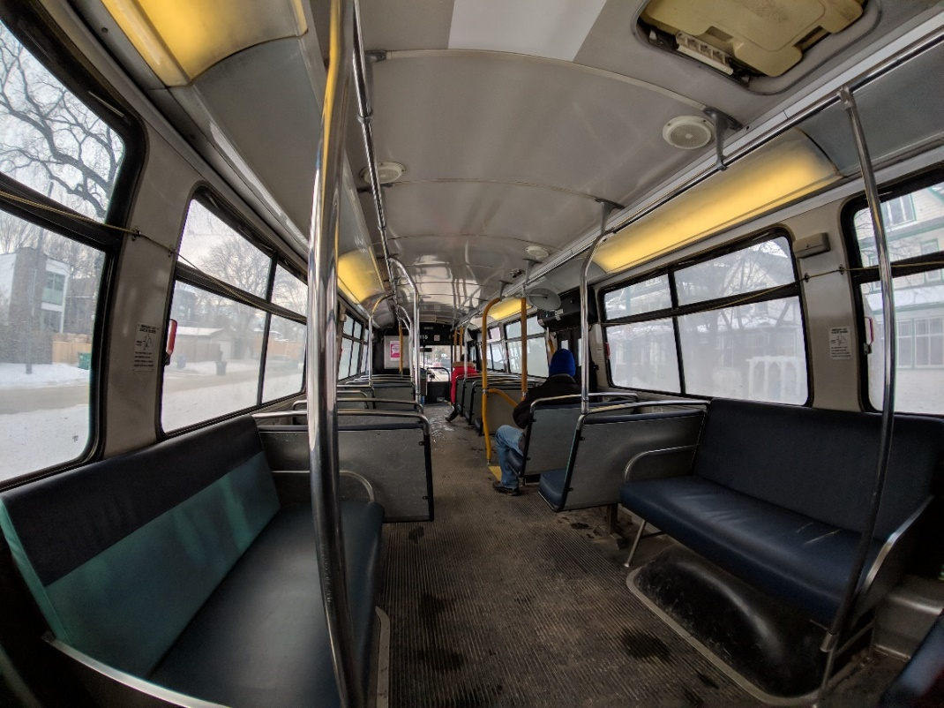
2020 Legislative Session: HB 352
TRANSIT FUNDING
$8,521,700 shall be transferred to the Office of Transportation Delivery to replace public transit buses meeting the necessary criteria. Priority shall be given to maximizing Federal Transit Grants

Slide 14
2020 Legislative Session: HB 352
LIGHT DUTY ZERO EMISSION VEHICLE SUPPLY EQUIPMENT FUNDING
$3,056,700 shall be used for the purchase of light-duty, zero-emission vehicle supply equipment meeting the necessary criteria. Recipients shall provide at least 50 percent of matching funds per project;
EEC Note: Legal interpretation of “matching funds” allows for in-kind contributions

Slide 15
2020 Legislative Session: HB 352
$278,500 may be used for administrative costs.
Notwithstanding Part III, 2. of this Act, unexpended Restricted Funds appropriated in this subsection shall become available for expenditure in the 2020-2022 biennium

Slide 16
Beneficiary Funding Request Requirements
Once a BMP is submitted, each request for funding from the Trustee must include:
Certification that the funding request fits into the Beneficiary Mitigation Plan;
Detailed description for proposed Eligible Mitigation Action (community and air quality benefits);
Estimate of the NOx reductions anticipated as a result of the proposed Eligible Mitigation Action;
Project management plan for the proposed Eligible Mitigation Action (budget and expenditure timeline);
Certification that all vendors were or will be selected in accordance with state public contracting laws;
Detailed description of how the Beneficiary will oversee the proposed Eligible Mitigation Action (review, auditing, compliance procedures) and commitment by the Beneficiary to maintain and make publicly available all documentation;
Description of any cost share requirements;
If applicable, a description of how the Eligible Mitigation Action mitigates the impacts of NOx emissions on communities that have historically borne a disproportionate share of the adverse impacts of such emissions;
A detailed plan for reporting on Eligible Mitigation Action implementation.

Slide 17
Final Disposition of Trust Funds
Beneficiaries have up to 10 years to expend allocations (October 1, 2027)
National Trustee is required to file with the Court and U.S. EPA an accounting of all Trust Assets remaining that have not been expended or obligated on approved Eligible Mitigation Actions.
Beneficiaries may seek to supplement their allocation by filing with the courts and delivering to the Trustee written reports demonstrating that original funds have been expended/obligated (80%) and requesting a portion of any other remaining funds.
Any additional funds awarded will sunset at the end of 5 years after award and those funds will be deemed to have been donated to fund federal agency projects to reduce NOx emissions.

Slide 18
Environmental Mitigation Trust Important Dates
December 2016 – The Governor designated EEC as the lead agency on behalf of the Commonwealth.
March 2017 – The Court designated Wilmington Trust as the national trustee of the Environmental Mitigation Trust. Kentucky is officially listed as a beneficiary.
October 2, 2017 – Trust Fund Effective Date (TED) – (This started the 10 year clock to expend the funds).
Currently in year 4 of the 10 year cycle to expend the funds.
Beneficiaries must submit the final Beneficiary Mitigation Plan at least 30 days prior to requesting to draw down the Trust funds.

Slide 19
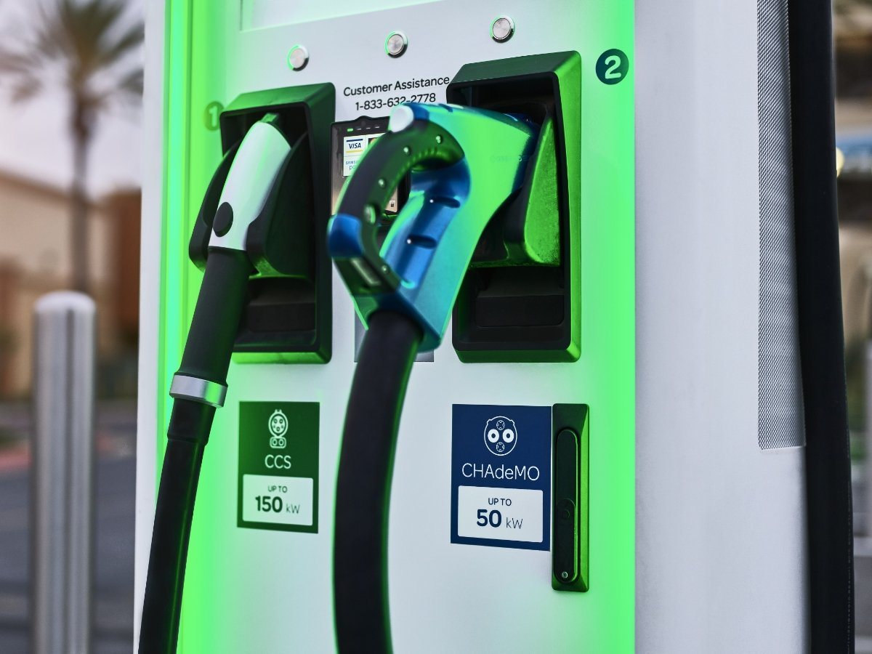
DC Fast Charge (Level 3)
There are currently three types of DC fast charging: Combined Charging System (CCS), CHAdeMO ("CHArge de MOve"), and Tesla Supercharger.
For a much faster and shorter charging experience, there is Level 3 charging, or DC fast charging (DCFC). Generally available at public locations, dealerships, and commercial fleet companies, DCFC chargers can range in output from 50 kW to 350 kW. They can recharge an EV battery to 80% in anywhere from 15 minutes to 45 minutes, depending on the vehicle's voltage capacity.

Slide 20
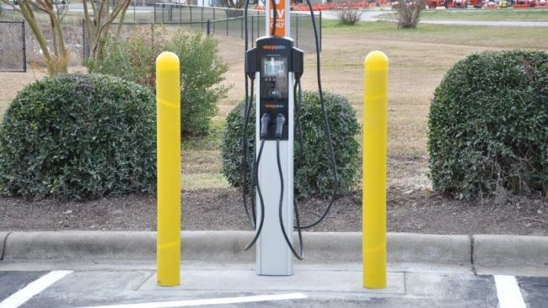
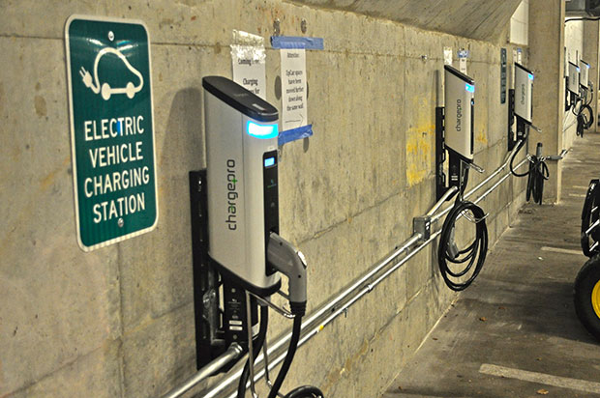
Level 2 Chargers
Level 2 charging uses a 240-volt outlet and produces output ranging from 4 kW to 18 kW of power. This output translates to 12 to 54 miles of range per hour. At the highest rate, an EV with 250 miles of range will recharge entirely in less than five hours. At the lowest rate, it may take about 21 hours. Level 2 charging stations are in homes, workplaces, and public locations such as malls, parking garages, parks, universities and colleges.

