Slide 1
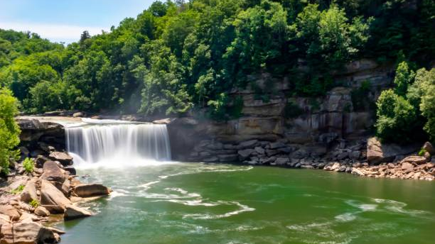
Kentucky State Parks
Commissioner Russ Meyer

Slide 2
Kentucky State Parks
Kentucky is home to 45 state parks that serve as major tourism attractions and employers for many rural communities. Parks operations consist of 17 resorts parks, 19 recreational parks, 9 historic sites, 13 golf courses, 34 pools and beaches, 15 marinas and 30 campgrounds. State Parks operate on an annual budget of $99.4 million and previously ranks 3rd in the nation for revenue production.
Currently, our total maintenance needs at state parks is approximately $231.9 million, and we prioritize these projects based on life safety, severity of need, and structural deficiencies.
The bipartisan investment Kentucky has made into our state parks was not only critical but timely for ensuring our parks can remain competitive in the tourism and hospitality industries.
Your commitment to our parks will allow us to continue modernization efforts by funding essential preservation projects, maintenance, repair and new projects that will continue to position our parks to attract new visitors.

Slide 3
HB1 Capital Budget Plan
FY23/24 - $10 million each year – General Funding – This will address the repair and/or replacement of Equipment/Mechanical Systems/Force Account Projects.
FY24 - $150 million = Bond Funding
Next Steps
Identify opportunities with Local Government and/or Private entities to share capital cost.
If applicable, pursue market analysis studies for key revenue facilities.
Address Structural issues (LB & JW)
Campground improvements statewide (Utilities upgrades/sewer/regrade or expand site layout/bathhouse upgrades/camper cabins/WIFI)
Accommodations upgrades (bedding/flooring/furniture/bathrooms/soft goods)
Utility improvements throughout parks (Line & pole replacement/water lines/gas lines)
Life Safety and ADA improvements
Upgrade Recreational Amenities (Swimming Pools/Golf/Courts)
Roof and Exterior Bldg. repairs (Siding/painting/gutters/windows)
Site Improvements (walkways/lighting/concrete repair/stairways/drainage)
Challenges
Labor market to complete work.
Maintenance work conducive with tourist travel season.
Supply Chain constraints/delays with vendors.
Inflation of labor and materials.

