Slide 1

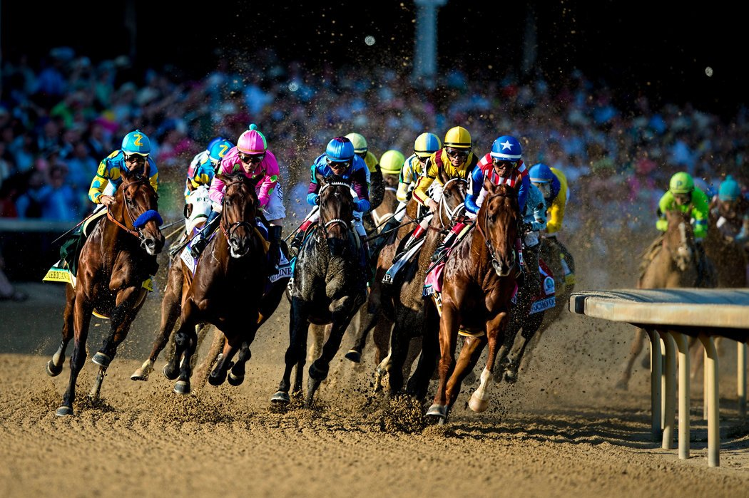
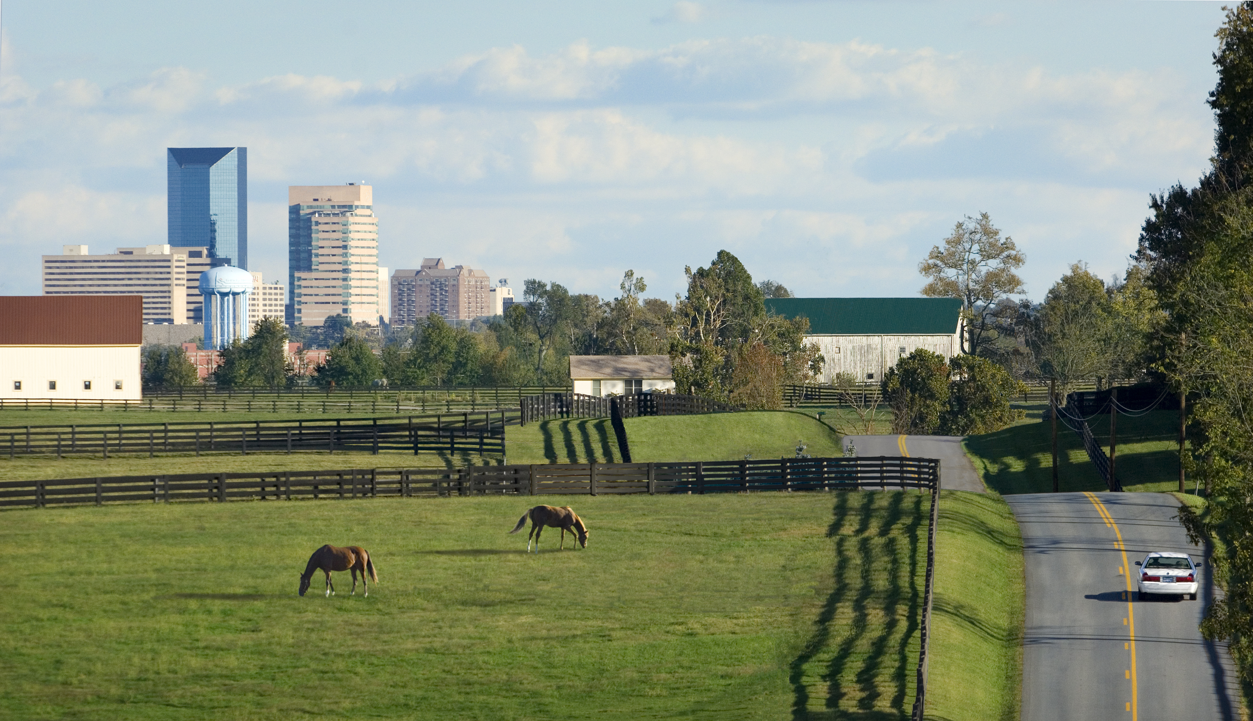

BUDGET REVIEW SUBCOMMITTEE
CABINET FOR ECONOMIC DEVELOPMENT
Rural Economic Development
July 19, 2023

Slide 2
  Appreciation for the Meeting:
  Kentucky has a strong set of smaller and rural communities that are interdependent
  Every project announced should be seen as a building block for the next opportunity, including in rural areas
  Transportation and Education investments by Kentucky supporting Rural opportunities
  Between our “Coastal Communities, Strong Agricultural and Resource-Rich areas, Kentucky has a tapestry of stories to tell, and great places to live.
  KPDI Program has Stimulated Growth in Site Options for Business
  The CED has commenced a Strategic Planning Process to Define a Roadmap for continued growth for all Kentuckians and not just a few
2

Slide 3



RECORD-BREAKING MOMENTUM
2021 - 2022
$
34,000+
New full-time jobs announced
$26.78
2022- Average hourly incentivized wage before benefits
$21.7B
Announced investment
BlueOvalSK and Envision AESC – The two largest economic development projects in Kentucky
Notes:
Data as of (10/13/2022)

Slide 4


ENTREPRENEURIAL SUPPORT
2021 – 2022 KY Innovation Hub Totals
$
900+
New jobs
Added by
served startups
$170+
Startups
Launched
$190M
Private capital
Raised by
served startups

Slide 5
NEW & EXPANDING INDUSTRY
Year | Type | Projects | New Jobs | Investment
2021 | Rural | 144 | 5.7K | $3.2B
 | Populous* | 117 | 12.4K | $7.9B
Year | Type | Projects | New Jobs | Investment
2022 | Rural | 130 | 6.8K | $5.2B
 | Populous* | 118 | 9.2k | $5.3B
*Populous – Top 10 Most Populous Counties: Jefferson, Fayette, Kenton, Boone, Warren, Hardin, Daviess, Campbell, Madison and Bullitt Counties.
Note: BlueOvalSK ($5.8 Billion, 5K new jobs) announced in Hardin County in 2021, and Envision ($2.0 Billion, 2K new jobs) announced in Warren County in 2022
5
Notes:
Notes: 144 projects in 63 rural counties in 2021.
130 projects in 56 rural counties in 2022.

Slide 6
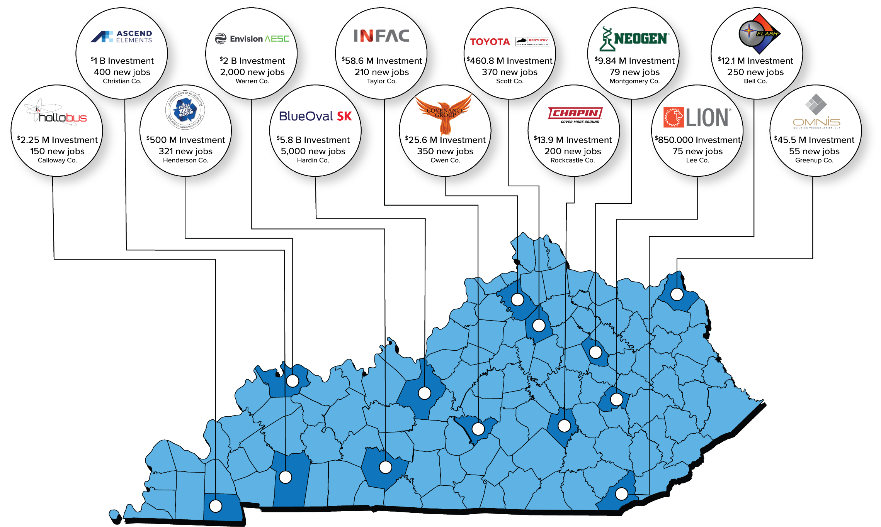

NEW & EXPANDING INDUSTRY
6
Notes:
Announced Projects (2021 – YTD 2023)
Sample of projects statewide with 50+ new jobs that will draw from surrounding areas to attract workforce

Slide 7
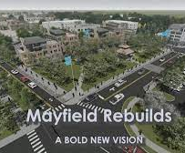
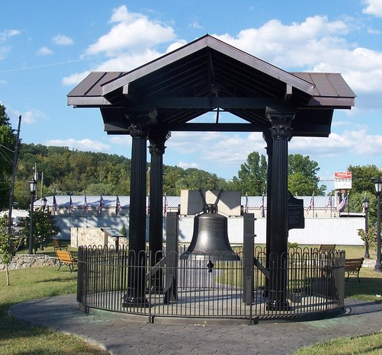
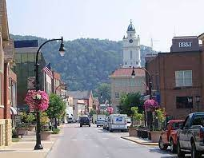
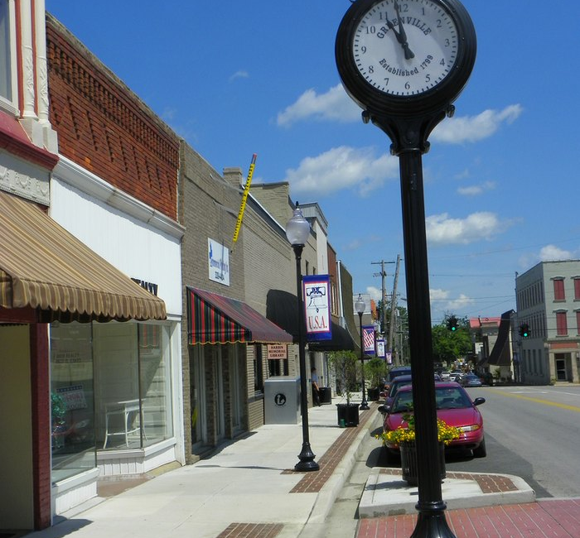
Thoughts on ways to help develop Rural Economies:
Rural economic development should focus on the unique strengths of each area, rather than concentrating solely on weaknesses
Strategies must include tools for rural areas but also adjacent urban centers and build upon unique interdependencies between them
Different types of businesses are needed, including tourism projects
Rural economic development should address economic activity that fits them rather than attempt to replicate urban economies
Communities need to lean in on what makes their respective areas unique and be unabashed about preserving that uniqueness.
Shared opportunities can only be achieved with Shared Responsibilities
7

Slide 8
SUPPLY KENTUCKY
Growing from Within
Incentivized companies are encouraged to use the CONNEX Kentucky tool
Assist existing companies to register on the free CONNEX Kentucky tool to supply new companies
Promote KPDI-awarded sites to Kentucky businesses for expansion opportunities or to bring the suppliers to the commonwealth
Leverage SSBCI funding through Kentucky Entrepreneurship and Innovation to help grow underserved and diverse-led businesses
Link businesses and workforce providers together to help grow opportunities for all Kentuckians and not just a few.

Slide 9

CONNEX TOOL
Kentucky Gov. Andy Beshear recently launched the Supply Kentucky initiative with the goal to boost job growth, reduce costs and provide more security in the supply chains of Kentucky companies
CONNEX Kentucky is at the center of this new initiative through a partnership with the Cabinet for Economic Development and Kentucky Association of Manufacturers
This online platform provides a searchable supply chain database for Kentucky manufacturers
Connects PRIMES, OEMs and suppliers based on deep data
such as equipment, certifications, SBA designation, processes,
capabilities and other criteria
Free registration for Kentucky companies
Learn more at KAM.us.com/home/connexkentucky

Slide 10

COMMUNITY VISITS
The Cabinet has a “Community Visit” program that hosts communities, partner agencies and other organizations for meetings to share knowledge and information, including local community strategies, review sites etc.
Since 2021, CED has coordinated a combined total of 65 community visits, trainings, and workshops (majority from
rural communities)

Slide 11
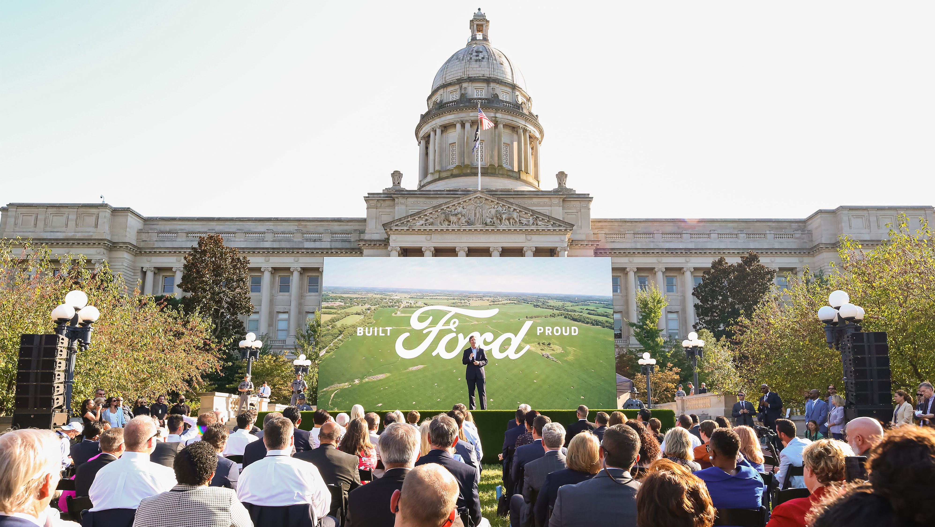
2023 STRATEGIC AND
OPERATING ARCHITECTURE
Kentucky Cabinet for
Economic Development
11

Slide 12
SHARED RESPONSIBILITY - SHARED OPPORTUNITY
WHY?
Our Vision
Team Kentucky: Great jobs for neighbors supporting one another to build a better Kentucky with an economy that works for all residents and not just a few
2023 Performance Goals
12,000 new jobs announced
$7.5 B new investment
$27 average hourly wage without benefits
5% increase in Team Kentucky ED/Site media impressions
1150 compliance reviews found acceptable
575 business applications approved
WHAT?
Our Mission
Earn trust, be strategic and a super collaborator in growing jobs, investments and opportunity in all our interdependent communities
Strategic Imperatives
Strategic roadmap for entrepreneurialism,expanding innovation and growing new and existing industry leaders
Link Job growth to programs that inspire everyone to make lifelong learning and earning a values trait
Targeted industry clusters that strengthen the core areas of Kentucky’s economy
Shared responsibilities, Shared Regional opportunities
HOW?
Operational Priorities
Flawless execution on
all announced projects
to deliver results. Effective compliance
Polished tool kit and narrative that builds the Kentucky brand globally
Best Service
Best Value
Best Opportunity
Team Kentucky is a culture that delivers results that matter
Leadership Behaviors
Lead with Impact: Straight Talk:
Bias for action with accountability
Serve
Listen
Build
Lead
Our Values
Respect
Inclusion & Diversity
Teamwork
Spirit of Winning
with Integrity
12

Slide 13
STRATEGIC IMPERATIVES:
BUILD OFF THE FOUNDATION OF SUCCESS
1
2
3
4
Extend and go beyond our “core” with jobs of the future through startup, expansion and attraction
Link job growth to programs that inspire everyone to make “lifelong learning and earning” a values trait
Shared Responsibilities
Shared Regional Opportunities
Strengthen the core of Kentucky’s economy
ENABLER
Create a strategic roadmap in building entrepreneurialism, expanding innovation and growing industry leaders across Kentucky
ENABLER
Strategies for pathway jobs, clear skills needed for filling key roles, integrated workforce strategies across all providers, amplify success
ENABLER
Embed SSBCI, support industry clusters, supply chain growth and shared learning
ENABLER
Data driven, defined
roles around sense of place, residential and workplace capacities
ACTIONS
Execute on a 6-month planning process
Be proactive in growing and attracting EV suppliers and industry leading companies in sustainability, health sciences and advanced manufacturing
Use data in all attraction efforts
Strengthen our brand and collaborate among regional and local ED efforts
ACTIONS
Be super collaborators in supporting existing businesses and linking them to services that work
Standardize workforce information and programs by segment and area
Encourage business ties to K-12 partnerships
ACTIONS
Determine supplier needs and link to existing companies. Explore a linked system to promote ”Buy KY” B2B
Refine list of Core Industries
Align on common objectives w/E&I
Use PDI to encourage companies to bring supply chains to Kentucky
ACTIONS
With input, define roles and accountabilities for Community colleges, universities and workforce training providers on metrics and ways
to be collaborator
Expand “Everybody Counts” as opportunities to scale allow
Broad encouragement of community-based programs for “sense of place” activities
13

Slide 14

TEAM KENTUCKY: BUILDING A BETTER TOMORROW
A stable job is the beginning, a safe place to live and a community to call home allows us to dream bigger, do better and create more opportunities for future generations who live
in the special place
we call Kentucky.

Slide 15

SPIRIT OF WINNING WITH INTEGRITY
Create a strategy that is operationally focused
Realize and accept some perceptions– agree on who are our customers, increase visibility and accessibility
More nuanced and effective strategies for Eastern Kentucky, Rural communities and distressed urban communities
More proactive marketing and deal development,
add South Korea and Taiwan to our targeted countries
Add Workforce and a formal Business Engagement function as an area of collaboration across the state
Take Entrepreneurship and Innovation to a new level, leveraging the new $117M in federal SSBCI funding
Create five or more 400-750 acre sites across the state
Set out sites on higher performance indexes

Slide 16
CREATE AN OPERATIONAL BLUEPRINT
FOR ECONOMIC DEVELOPMENT
Timing
Need for flexible tools and strategies to meet the needs of Rural communities, Eastern Kentucky and distressed urban neighborhoods
Massive disruptions in global supply chains present opportunities
Potential deindustrializing in Europe due to energy crisis
2022 Federal legislation for onshoring industry
  IRA
  Semiconductor
  Biotech
  DOD
Opportunity
Kentucky’s leadership in EV and Automotive creates a foundation on which to build
Capture momentum of growing Life Sciences and other emerging industry sectors
Workforce needs at an all time high with pockets of unique opportunities in parts of our state
The Product Development Initiative creates opportunities for communities across the state
Benefits
Identify key economic areas of growth needed to be competitive
Prepare communities and businesses across the state to be more strategic in attracting workforce
Position Kentucky communities to competitively market their communities to attract industry

Slide 17
Strategic Pillars
For Rural Development
Innovation and Entrepreneurialism
Small to Mid Size Companies
Eco-Tourism
Workforce Training and Community Development

Slide 18
AN OPERATIONAL BLUEPRINT FOR ECONOMIC DEVELOPMENT
PROCESS MAP
Regional E.D. Advisory Team
KY Association for Economic Development
Consultant
Government
Education & Workforce
Business
Utilities
Entrepreneurism
KY Cabinet for Economic Development
KLC
KACO
EEC
Public Colleges & Universities
K-12 Education
KY Chamber
KAM
KYSB
TVA
LGE/KU
KY Utility Cooperatives
KY Innovation
Others
AIKCU/CPE
Education & Labor Cabinet
KDA
KSTC
Regional Hubs

Slide 19
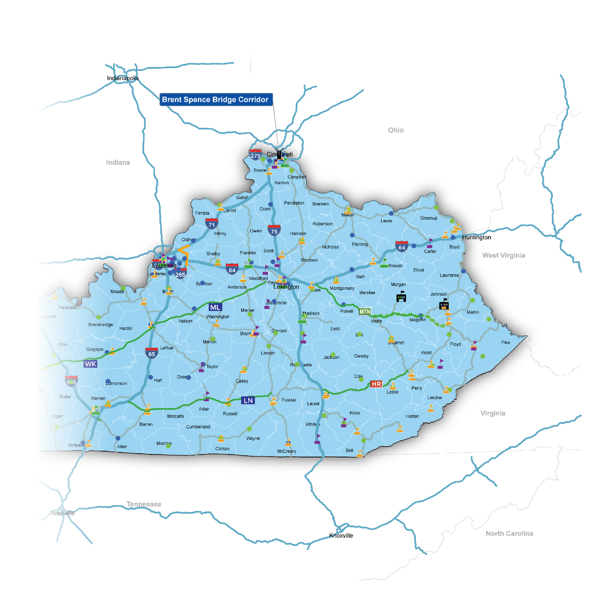







EASTERN KENTUCKY WORKFORCE INFRASTRUCTURE
Major Road Improvement Projects
Brent Spence Companion Bridge
Designed to improve approximately 8 miles of Interstates 71 and 75 through Kentucky and Ohio, including the addition of a new companion bridge to the existing Brent Spence Bridge to reduce congestion, improve traffic flow and safety, and maintain key regional and national transportation corridors.
Mountain Parkway Expansion
The Mountain Parkway Expansion will widen the Parkway to four lanes, allowing for higher volumes of traffic travelling along the Parkway.
Once complete, it will be part of a 400-mile, four lane, high speed corridor from Paducah to Pikeville.
I-Move Kentucky
180 million investment that will widen and improve interstates and revamp congested interchanges to improve safety along Interstate 265 (Gene Snyder Freeway), Interstate 71 and Interstate 64 in Jefferson and Oldham counties.
Workforce Education and Training
ACTC Transportation Training Facility, East Park Industrial Park, Ashland, Kentucky - $9.0 million investment
The recently established Estill County Area Technology Center (ATC) will serve around 300 students from Estill, Powell, and surrounding counties.
In 2021, $75 million allocated for renovation costs for local vocational schools, which will support building the well-trained local workforce of the future.
Awardees in the Region
•. Fayette County Career & Technical Center - $10,000,000
•. Johnson County Career & Technical Center -$10,000,000
• Lawrence County High School - $9,280,350
•. Knox County Career & Technical Center – $10,000,000
•. Magoffin County Career & Technical Center - $4,369,381 (+$5 million from a donor)
19
Notes:
Johnson County-based EKAMI (eKentucky Advanced Manufacturing Institute) added new location in West Liberty, KY (Morgan County) at the East Kentucky Correctional Complex. The new institute, funded by an approximately $3 million Abandoned Mine Lands Economic Revitalization grant, seeks to expand opportunities for those incarcerated at the facility.

Slide 20
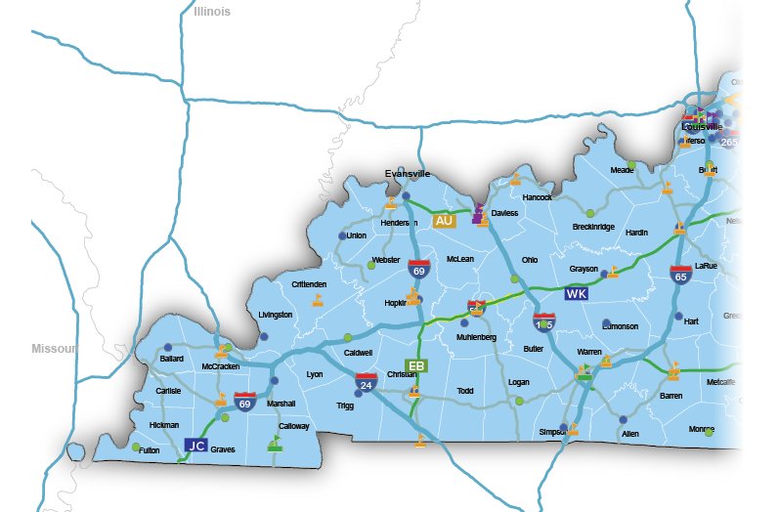

WESTERN KENTUCKY WORKFORCE INFRASTRUCTURE
Major Road Improvement Projects
I-69 Ohio River Crossing
The I-69 Ohio River Crossing is the key final connection of I-69 between Evansville, Indiana and Henderson, Kentucky.
U.S. 641
The U.S. 641 project, from Eddyville to Fredonia, aims to better connect the region and improve safety and mobility. Also, construction of the four-lane widening of U.S. 641 South from Murray to the Tennessee state line is in progress.
Other road projects include new highway signs marking a “Future I-569 Corridor” on a 38.4 mile-long section of the Western Kentucky Parkway in Hopkins, Muhlenberg and Ohio counties.
Workforce Education and Training
Expansion of Leitchfield Technical College Campus, Grayson County, Kentucky - $9.0M investment
$15,095,059 in funding to Calloway, Graves and Marshall counties. The funding will improve vocational education, provide clean water, improve roadways and increase tourism funding in Western Kentucky.
In 2021, $75 million allocated for renovation costs for local vocational schools, which will support building the well-trained local workforce of the future.
Awardees in the Region
•. Hopkinsville Christian County Academy - $10,000,000
•. Trigg County Public Schools -$10,000,000
• Ballard County Career and Technical Center - $68,896
20

Slide 21
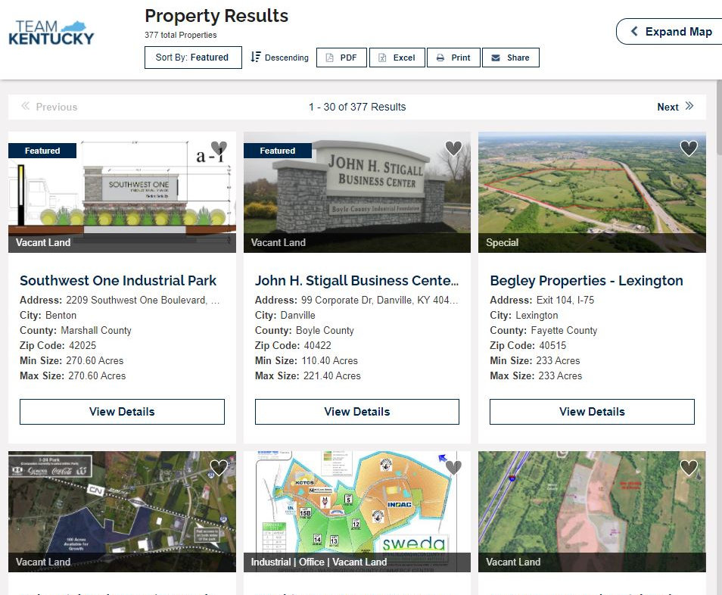
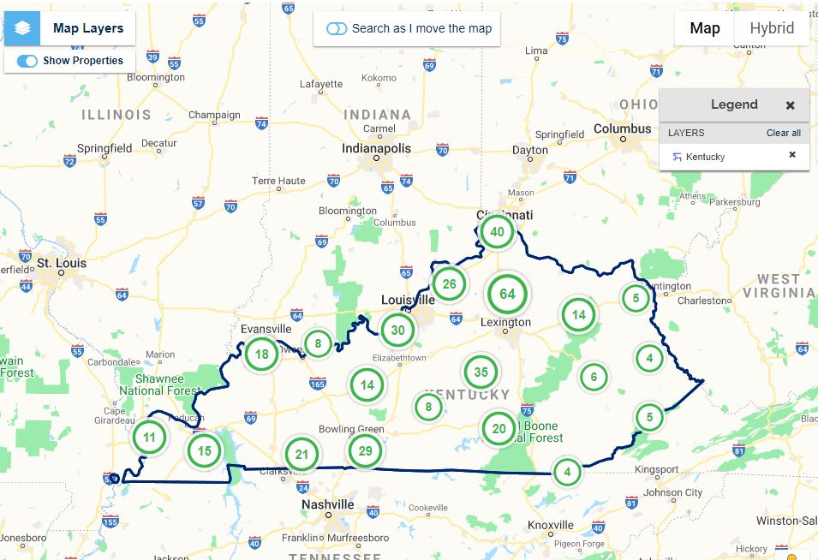
KY PREPARED
MORE GRADE-A
SITES & BUILDINGS
Speed to market
Team effort to attract investment
Build Ready Program
Product Development Initiative Pilot (2019-2022)
Kentucky Product Development Initiative (HB 745)
  $100 million
Current Inventory: 412 Sites, 447 Buildings
  38 sites of 300 acres or more, 18 sites of 500 acres or more and 10 sites over 1000 acres
Notes:
Site inventory data as of 2/9/2023

Slide 22
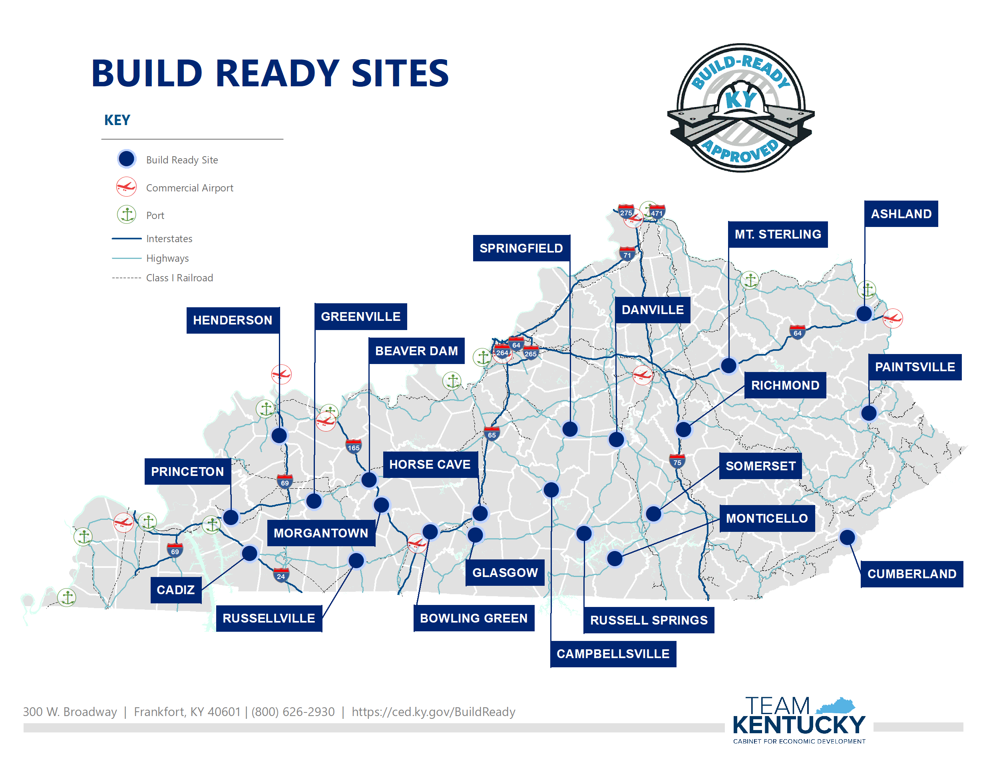
22
Notes:
Updated 2/9/2023

Slide 23



Pilot PDI Program &
Ky Product Development Initiative (KPDI)
23

Slide 24
PILOT PDI PROGRAM
West Kentucky Projects
 | Description | Projected Investment | Amount Approved
City of Henderson | Extend the natural gas line | $350,000 | $175,000
Hopkinsville Industrial Foundation | Spec building on 22 acre site | $3,166,000 | $500,000
Paradise Park Regional IDA | Extend water & sewer to 620 acres in industrial park and enhance entrance | $500,000 | $250,000
Marshall County IDA | Road extension, culvert and 120,000 sf pad ready site | $570,482 | $285,241
Logan IDA | Clearing, grubbing and rough grading of 52 acre site in industrial park | $1,461,763 | $335,361
Eddyville Riverport & IDA | Building pad construction and utility extension plans | $179,895 | $75,000
Graves County Economic Development | 150,000 sf pad on 16 acres | $230,000 | $115,000
Cadiz-Trigg County IDA | Construct 100,000 sf spec building | $3,500,000 | $500,000
Ohio County IDA | Upgrade electric to 9.5MW at Bluegrass Crossings | $600,000 | $300,000
 | Total | $10,558,140 | $2,535,602
Notes:
Add total row for investment and amount approved

Slide 25
PILOT PDI PROGRAM
East Kentucky Projects
 | Description | Projected Investment | Amount Approved
Southeastern Ky IDA | Extend water & sewer infrastructure to spec building #4 | $500,000 | $250,000
Maysville-Mason County IDA | Building upgrades and renovations | $600,000 | $300,000
MMRC Regional IDA | 150,000 sf pad ready site on 22 acres | $425,000 | $212,500
 | Total | $1,525,000 | $762,500
Notes:
Add total row for investment and amount approved

Slide 26
KPDI PROGRAM
West Kentucky Projects
 | Description | Projected Investment | Amount Approved
Cadiz-Trigg County IDA | Upgrade of the wastewater pump station at the I-24 Business Park in Cadiz. | $450,000 | $225,000
Hickman County Fiscal Court | Constructing an entryway into the Enterprise Park Clinton, in addition to water well and high-pressure pump work. | $153,128 | $76,564
Pennyrile Westpark IDA | Pennyrile Westpark flood plain analysis. | $69,429 | $34,715
Princeton Caldwell County IDA | Karst study for the industrial park. | $84,505 | $42,252
The Todd County Industrial Foundation, Inc. | Development of a 25-acre tract within the industrial park. | $650,000 | $297,568
West Kentucky Regional IDA | Site grading plan with an approximate 1 million square foot building pad at the Sandy Lee Watkins site. | $1,400,000 | $700,000
 | Total | $2,807,062 | $1,376,099

Slide 27
KPDI PROGRAM
East Kentucky Projects
 | Description | Projected Investment | Amount Approved
Jackson County/McKee IDA | Due diligence for Build-Ready pad status on their 200,000sqft and for site work in their Annville Industrial Park. (geotechnical and other site development work) | $190,000 | $95,000
Johnson County Fiscal Court | Expanding existing Kentucky Build-Ready Certified industrial park in Hager Hill. | $435,000 | $217,500
London-Laurel County Economic Development Authority | Construction of a 150,000 square foot spec building. | $3,839,000 | $1,521,819
Morehead-Rowan County Economic Development Council | Acquiring 238-acre parcel currently being utilized as farmland and privately owned. | $2,300,000 | $599,414
Northeast Kentucky Regional Industrial Authority, Inc. | The Regional authority will be acquiring 240 acres of additional land. | $1,500,000 | $750,000
Southeast Kentucky IDA | Regional project to construct a 105,000 square foot spec building on Lot #7 in the Southern Kentucky Business Park | $3,784,000 | $1,892,000
 | Total | $12,048,000 | $5,075,733

Slide 28


ADDITIONAL SUCCESS STORIES
ODMUNSON MANUFACTURING
HICKORY, GRAVES COUNTY
EMERALD ENERGY AND EXPLORATION LAND CO.
SALYERSVILLE, MAGOFFIN COUNTY
Announcement of new disc blades manufacturing facility for agriculture and construction industries.
Announcement of relocation of HQ. Company provides right of way land acquisition and project management services
$12.5 million investment
25 full-time jobs
$1.5 million investment
80 full-time jobs
28

Slide 29
ADDITIONAL SUCCESS STORIES
FLASH STEELWORKS
MIDDLESBORO, BELL COUNTY
JACKSON PURCHASE DISTILLERY
HICKMAN, FULTON COUNTY
Announcement of new military-grade plate steel manufacturing facility. The company has a contract with the federal Department of Defense to produce armor for the U.S. military.
The distillery project has grown from an initially planned investment of $8.76 million and 30 jobs.
$12 million investment
54 full-time jobs
$25.8 million investment
250 full-time jobs
29

Slide 30
Kentucky Small Business Tax Credit
(2021 – YTD 2023)
Area Development District | Region | KSBTC Projects | Total Investment | Projected New Jobs
Big Sandy | East | 1 | $20,384 | 4
Buffalo Trace | East | 2 | $28,900 | 2
Cumberland Valley | East | 4 | $42,061 | 11
Fivco | East | 5 | $146,862 | 25
Kentucky River | East | 2 | $89,693 | 9
Green River | West | 10 | $207,370 | 23
Pennyrile | West | 9 | $263,910 | 24
Purchase | West | 26 | $812,869 | 51
 | Total | 59 | $1,612,049 | 149
*For this report, Eastern Kentucky is defined as counties within the following Area Development Districts: Big Sandy, Buffalo Trace, Cumberland Valley, Fivco, Gateway and Kentucky River. Western Kentucky is defined as counties within the following Area Development Districts: Green River, Pennyrile and Purchase.
30
Notes:
KSBTC – (2021 – YTD 2023)

Slide 31







KY INNOVATION HUBS
KY Innovation partners with KSTC and private non-profits through a competitive RFP process to create six regional KY Innovation Hubs.
AWESOME INC.
Lexington
SOAR
Pikeville
BLUENORTH
Covington
GROWEST
Paducah
AMPLIFY
Louisville
CREATE
Bowling Green
The Hubs serve as a “front door” resource to innovative startups in their regions and as a partner to local business support organizations.
31

Slide 32


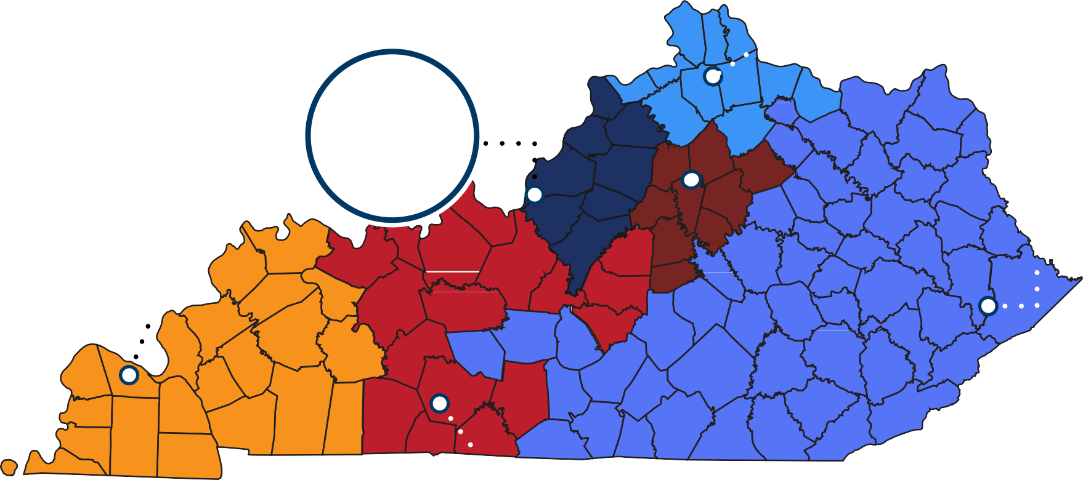



KY INNOVATION HUBS
32

Slide 33
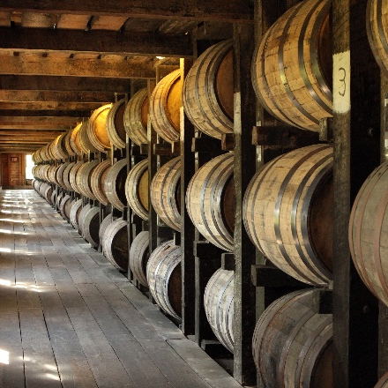

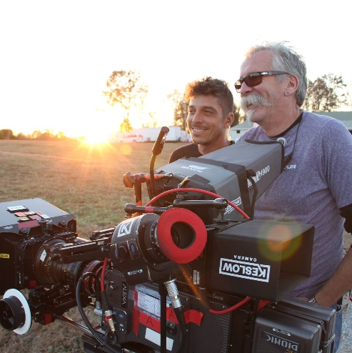


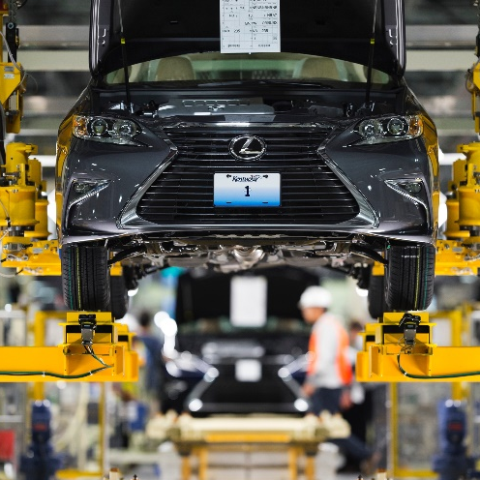
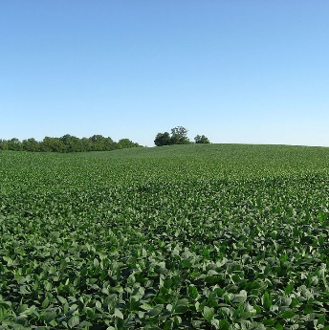

TAX INCENTIVE PROGRAMS
ALL ARE PERFORMANCE-BASED
Kentucky Reinvestment Act (KRA)
Kentucky Entertainment Incentive (KEI) Program
Tax Increment Financing (TIF)
Kentucky Investment Fund Act (KIFA)
Kentucky Angel Investment Tax Credit (KAITC)
Kentucky Selling Farmer Tax Credit (KSFTC)
Kentucky Business Investment (KBI)
Kentucky Enterprise Initiative Act (KEIA)
Kentucky Jobs Retention Act (KJRA)
Incentives for Energy-Related Business Act (IEBA)
Kentucky Small Business Tax Credit (KSBTC)
Programs in dark blue circles have enhanced benefits for projects locating in enhanced incentive counties

Slide 34
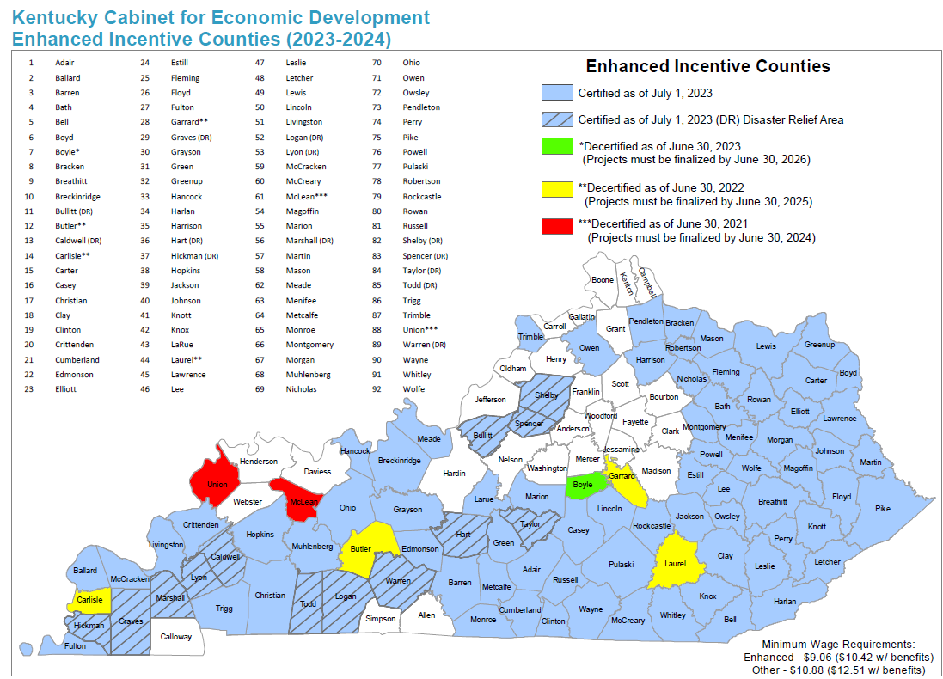
34
Notes:
Note Disaster Relief Area Enhanced Counties

Slide 35
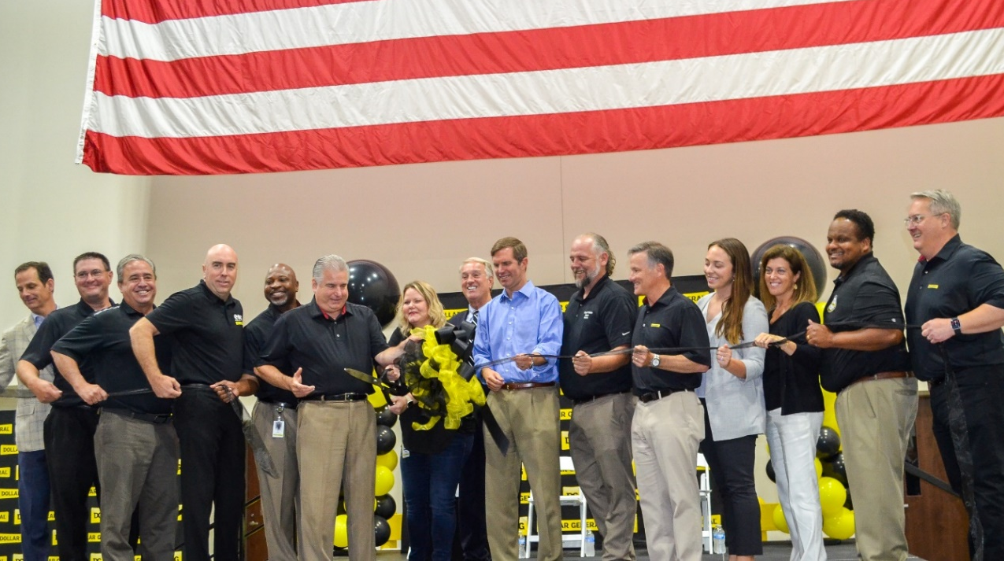
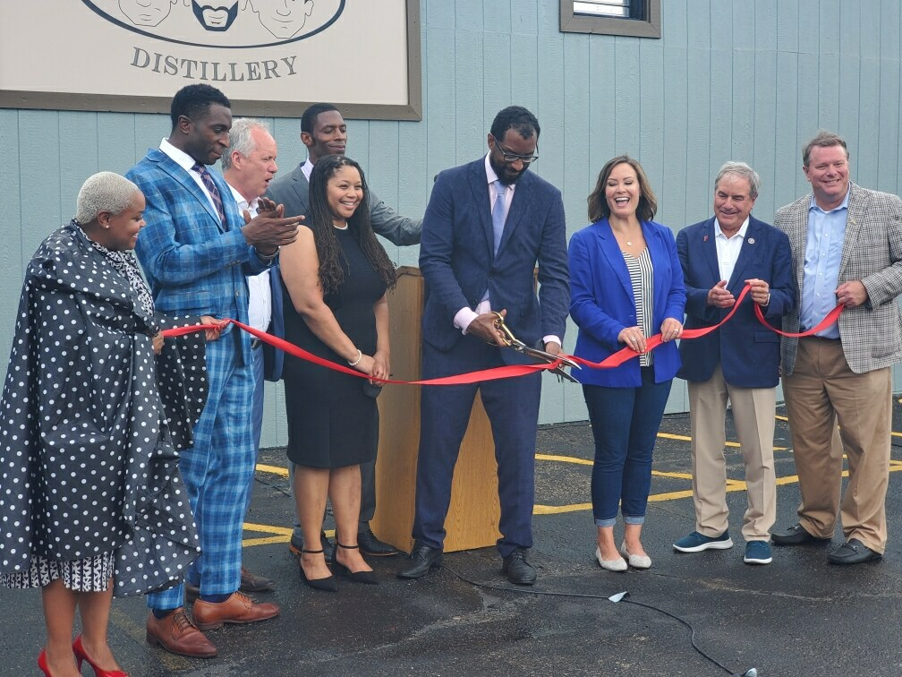
CASH PROGRAMS
ALL ARE PERFORMANCE-BASED
KEDFA Loans and Grants
High-Tech Investment and Construction Pool
Economic Development Fund (EDF)
  Kentucky Product Development Initiative (KPDI)
Kentucky Rural Hospital Loan Program (KRHLP)
Kentucky Small Business Credit Initiative – KSBCI
  Kentucky Collateral Support Program – KYCSP
  Kentucky Loan Participation Program - KYLPP
Western Kentucky Risk Assistance Fund - WKRAF
Export Assistance – STEP Grant
SBIR/STTR Funding Assistance & Matching Funds
35

Slide 36
Q & A

Slide 37

THANK YOU

