Slide 1
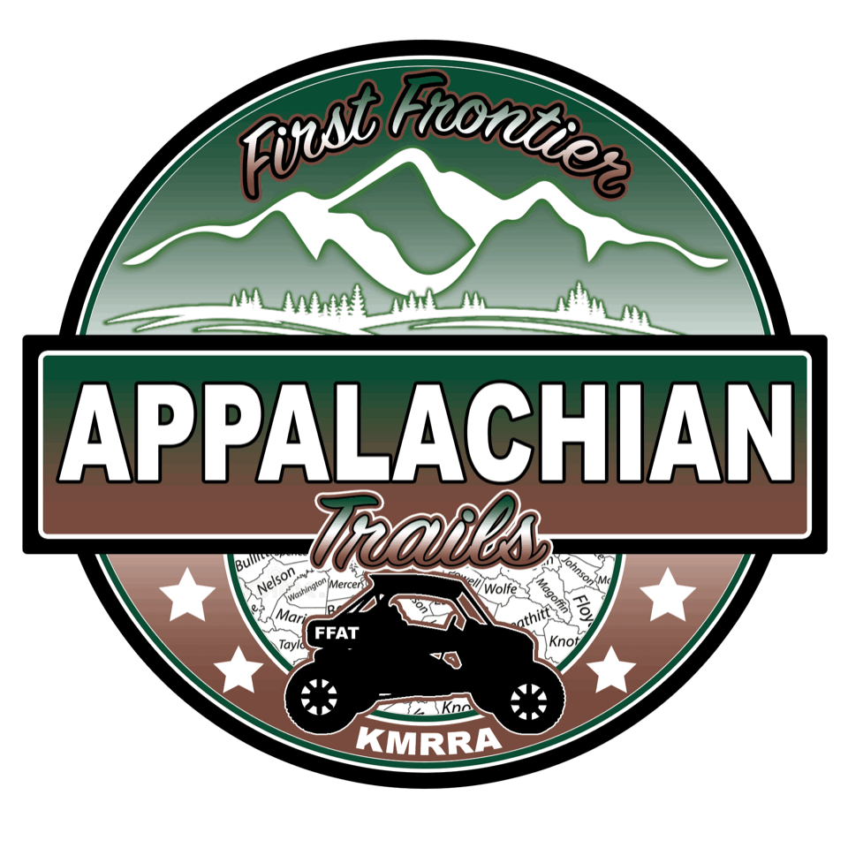
First Frontier Appalachian Trails
Part of a plan for Putting Eastern Kentucky on a new, diverse and sustainable economic path

Slide 2
What can trails mean to us in Eastern Kentucky?
Economic Empowerment
Business opportunities
Pride of place
Maintenance of our cultural integrity
New investment in our growth
Keeping our youth in Eastern Kentucky
Showcasing our natural beauty
Showcasing our rich history
Building a sustainable industry

Slide 3
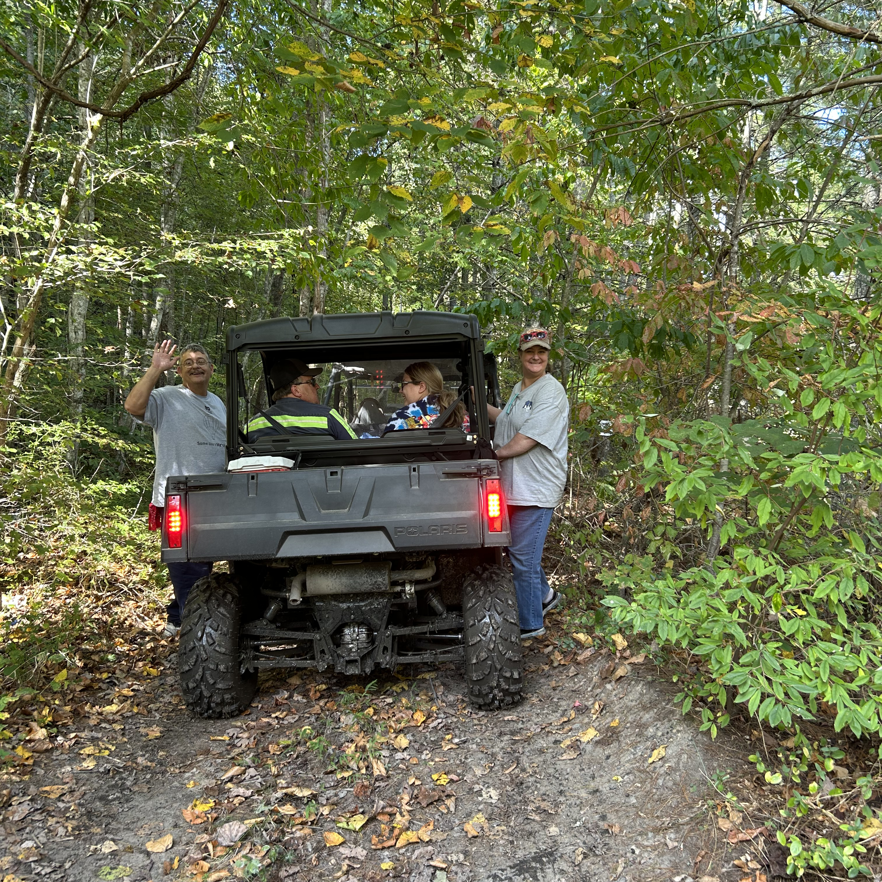
The trails can reshape our economic forecast
The legistlatve formation of the Kentucky Mountain Regional Recreation Authority and First Frontier Appalachian Trails is an economic development plan for Eastern Kentucky utilizing adventure tourism to promote entrepreneurship and job creation. The Trail System is developed and managed by the Authority. The purpose of the Authority is to manage the Trail System AND create an environment for ATV/OHV/UTV riders to enjoy the trails while supporting entrepreneurial opportunities for individuals to invest. Entrepreneurship is the key driver behind growth of the trail system. The development of new lodging and trail supporting business connections is the only way the trail system can expand its ridership and positive economic growth in the hard hit post-coal impacted areas of our region.

Slide 4
A plan with a clearly defined purpose
To diversify the economy of our region utilizing Off-Road trails to create new economic opportunities for entrepreneurs to open businesses.
To provide a positive economic impact within our eighteen county project area and for the region.
To promote regionalism in the economic development project of the trails without concern for county, city and town limits emphasizing overall economic growth and direct capital investment into the region.
To provide a SAFE recreational experience that is richly steeped in our Eastern Kentucky culture for each user of the First Frontier Appalachian Trails
To open miles and miles of the best riding in the eastern United States to be marketed to the world

Slide 5
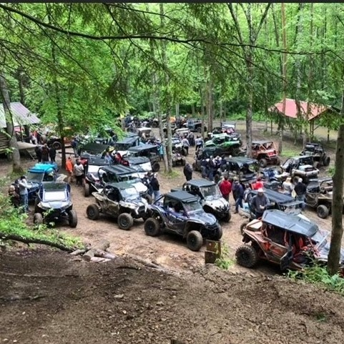
WE ARE MODELING SUCCESS
Hatfield and McCoy has been our constant support system and mentors as we develop our Eastern Kentucky Trail System. Counties in West Virginia with open and running trails have enjoyed a new adventure tourism economy that did not exist prior to the trails opening. The region has continued to work to promote entrepreneurship and investment in trail related businesses. Riders from all 50 states and 13 foreign countries have visited the trails. In 2021 94,464 riders visited the Trail System with over 80% being non-West Virginia Residents. Communities have reinvented themselves as tourist towns and tourist areas by developing businesses to accommodate the trail riders.
WE CAN DO THIS TOO!

Slide 6
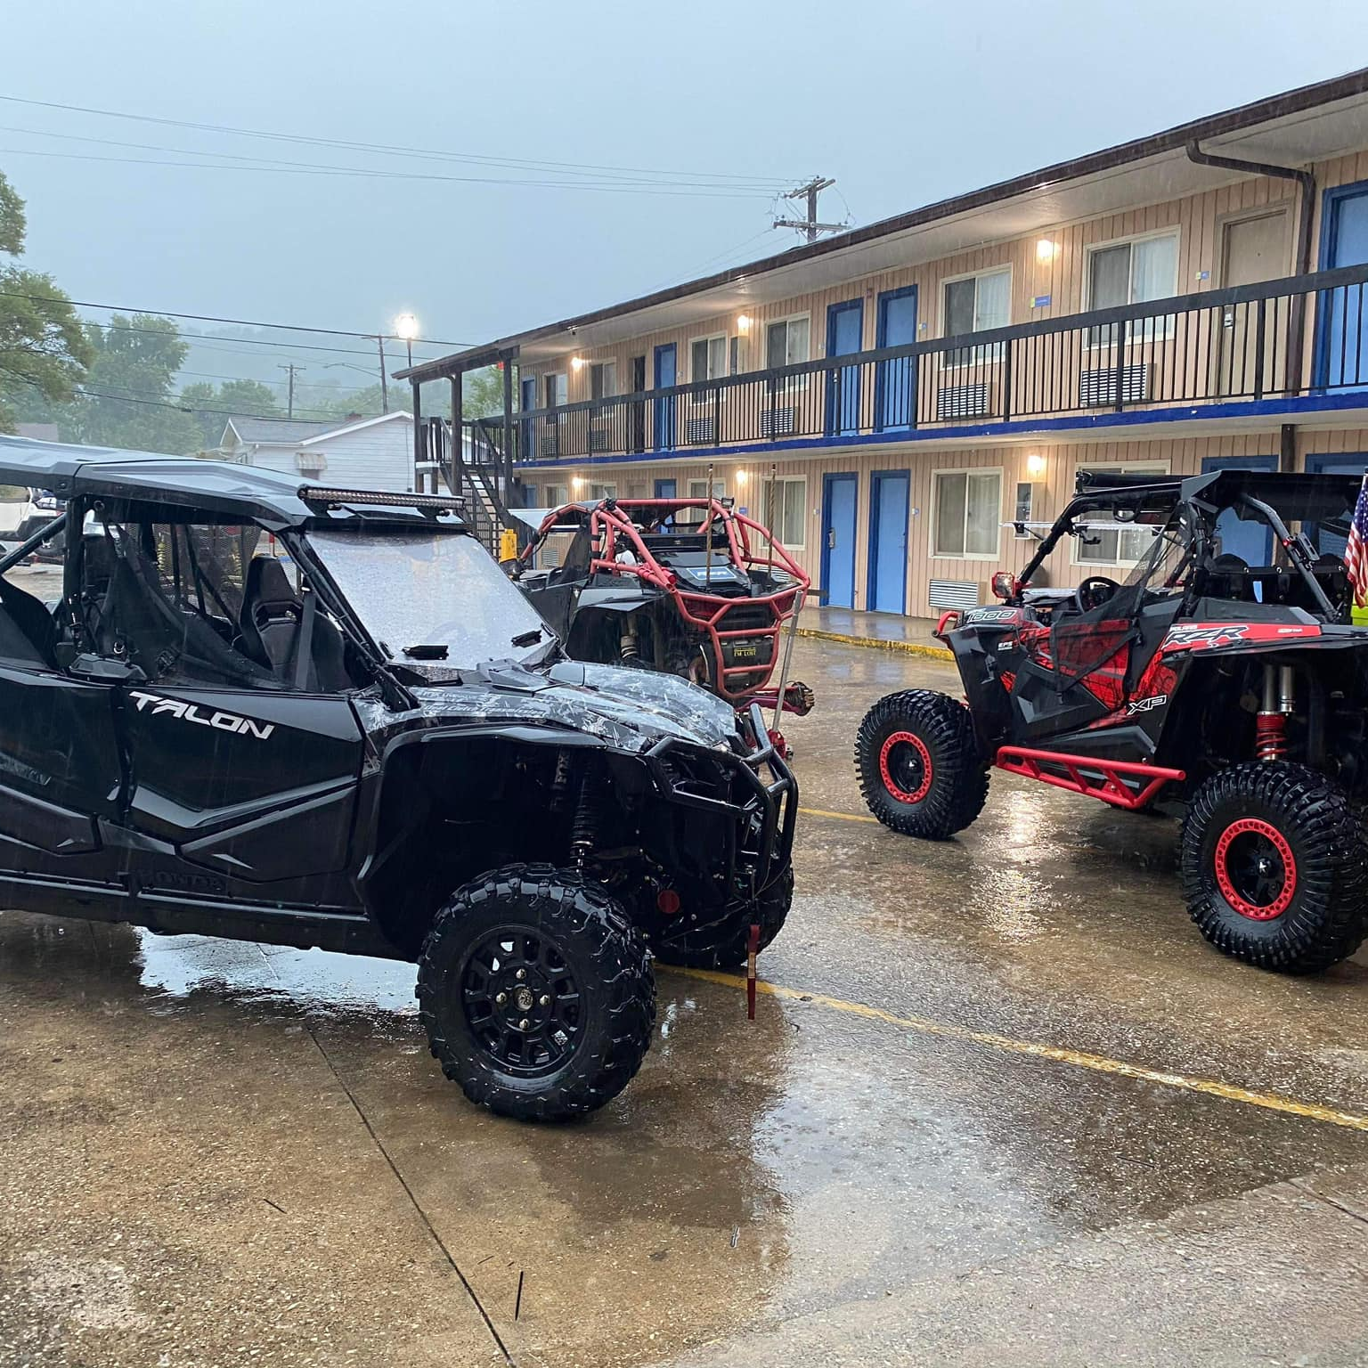
How much money is brought to a local economy by trails?
According to the Marshall University economic impact study on Hatfield and McCoy Trails which was released in 2021, the total economic impact was 40 million dollars!
This is a study of just 9 counties being included.
What can we accomplish here in Eastern Kentucky if we apply ourselves to this endeavor?

Slide 7
How do we make this happen? What are the steps?
Authority was created by KRS statute 148.002 in 2019
An authority board was established by the statue
Counties joined the authority by ordinance
Existing and potential trails were identified in participating counties
Legitimizing of trails began by virtue of leasing agreements
June 2021, legislature passed KRS 189.281 to allow OHVs on public roads
Develop a safety plan for public road use.
Hold public meetings
Submit TC 59 to the state Transportation Cabinet to ask for state routes to be included for connection between trails and the commerce we hope to sustain by trail goers.
Reap the benefits of economic growth

Slide 8
Where We Are Now
Staffed with an Executive Director who came to us with grassroots knowledge of building the model and a great working knowledge for operating with governmental and community agencies.
Staffed with Trail Development Coordinators who are experts in mapping, land acquisition as well as trail design and maintenance. Combined total experience in their fields of expertise is over sixty years!
Branded and actively marketing both the concept and community assets on and near trails.
Actively pursuing more trail milage and more opportunities to connect private individuals with the opportunities to grow economically.

Slide 9
What We Have Achieved Thus Far
Our first land lease with a coal land management company is a huge success.
We have entered into a lease with Pocahontas Properties for 46,000 acres primarily in Martin County who like so many in our region have been grossly impacted by the loss of coal revenues and coal severance dollars
The significance of this acquisition is monumental in that it allows us the much needed connection to our mentors and industry partners at Hatfield and McCoy as well as hundreds of miles of trails .

Slide 10
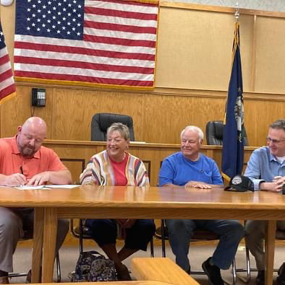
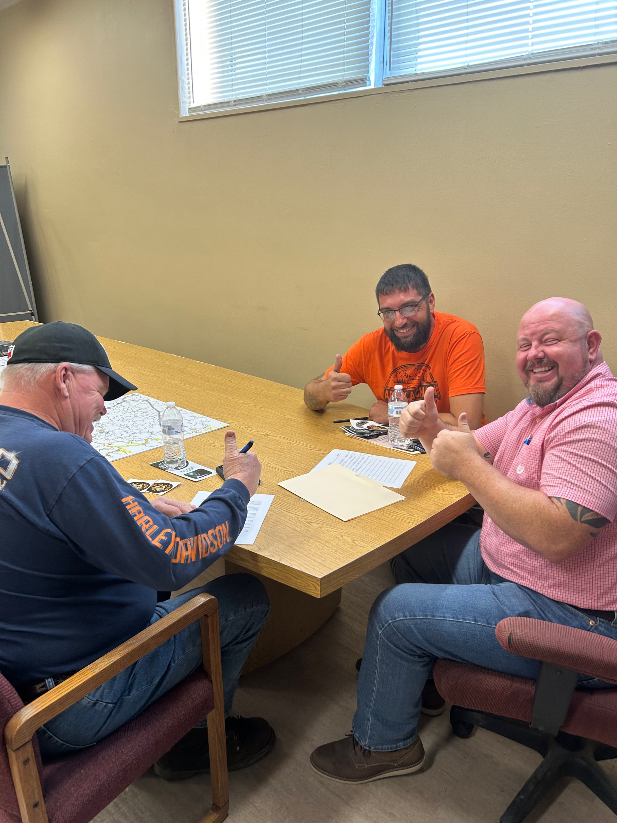
Individual Landholder Lease Agreements and Increasing Investment in the Vision
For example, In Johnson, martin and Morgan counties, we have nearly 2500 acres and nearly 200 miles of trails that are either signed or in the process. These leases provide incredible economic opportunity for these private citizens!

Slide 11
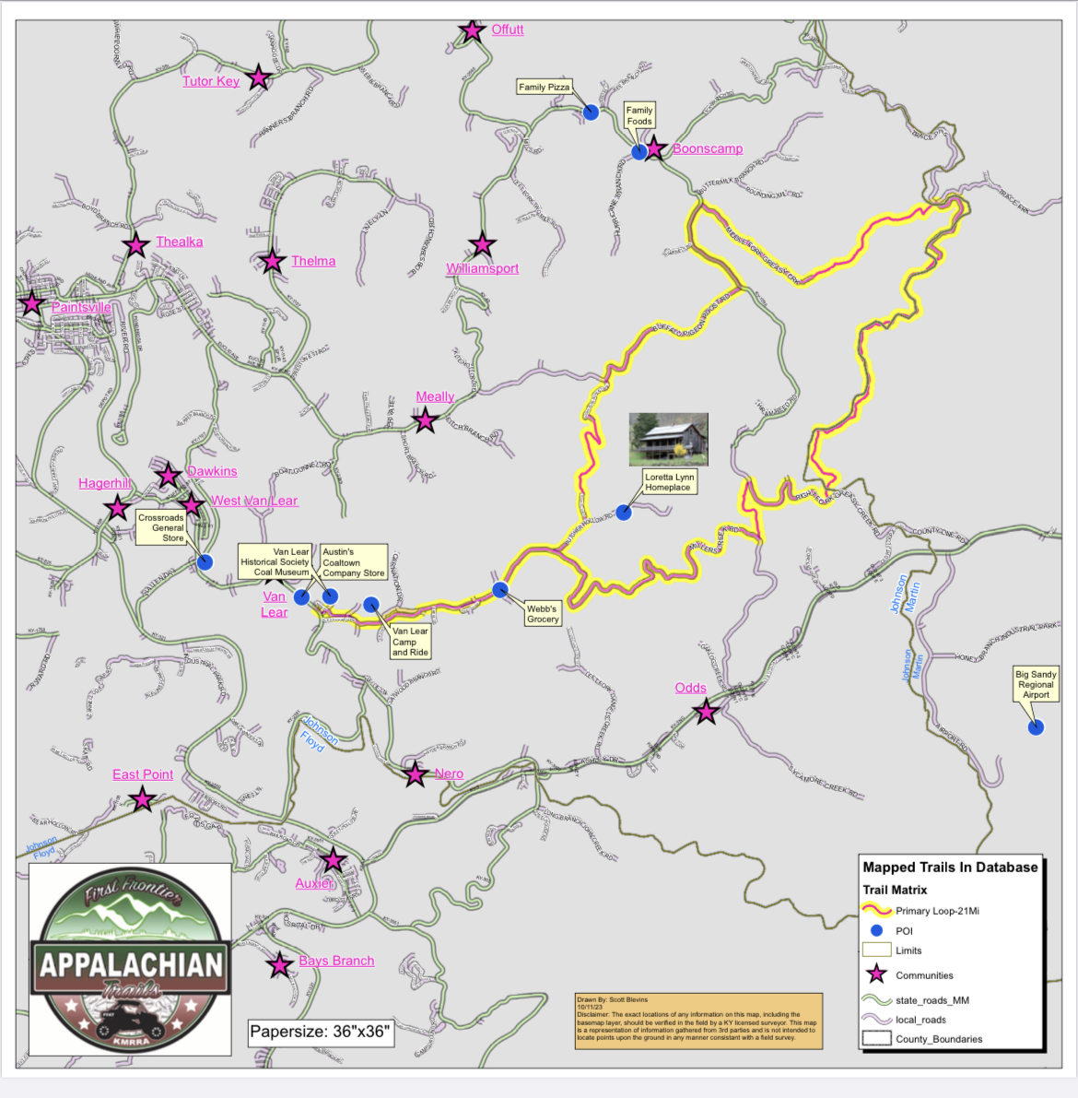
What does this look like for communities?
Butcher Holler Backwoods Trail
Van Lear, KY
Four new businesses just this year!
A completely trained rescue squad with equipment to service trails!
A renewed sense of place and desire to evolve!
A community that is experiencing growth instead of decline!

Slide 12
What does this look like for communities?
MJM Powerhouse Trails
Hargis, KY
Four New Businesses in the past year and expansion of two other businesses.
Multiple county partnership for a common goal
Creating economic opportunities for very rural communities with no other source of growth
Creating tax revenue for counties involved in the development

Slide 13
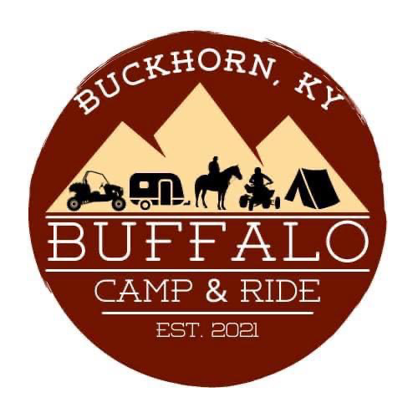
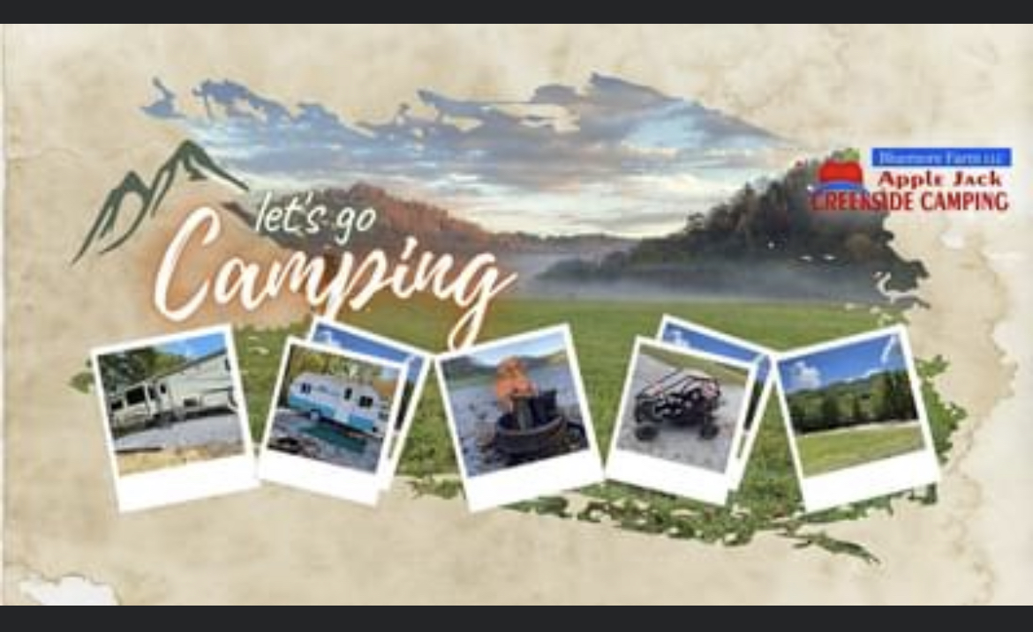
What do we need to continue this very exciting project and see it to fruition?
Long and short, more money!
We are at the point where we will need to at least double our staff as we begin to prepare and open these many miles of trails to the public. By measures obtainable to us from our interstate industry partners, we are going to need more funding to get this massive project live and marketable. Good news is that by those same accessible industry measures, the potential to be realized by the Commonweath's citizens in economic impact is absolutely amazing.

Slide 14
Thank you all for believing in 2019, that this could work....help us see it through in 2023!

