Slide 1
BR SUBCOMMITTEE ON ECONOMIC DEVELOPMENT, TOURISM, AND ENVIRONMENTAL PROTECTION
Oct. 16, 2024
Russ Meyer Commissioner Department of Parks

Slide 2
23 RS HJR76
State Parks Improvement Projects
$40 Million
Campground Upgrades
$20 Million
Utility Improvements
$6 Million
Broadband Upgrades

Slide 3
$40 Million
Campground Upgrades – Bathhouse Upgrades
$2.1 million for parks in-house construction bathhouse renovations.
Two bathhouse Renovations Complete Barren River Lake and Nolin Lake State Park
14 bathhouse Renovations underway

Slide 4
$40 Million
Campground Upgrades
WEST
EAST
$20 million
$1.9 million appropriated for design.
$20 million
$1.9 million appropriated for design.
15 state park projects
have been reviewed by consultants.
10 park projects
have been reviewed by consultants.
6 projects are in design
5 projects are In Design

Slide 5
$20 Million
Utility Improvements
$17 million
for federal matching grant for Grid Resilience Grant project at various park locations.
Kentucky Dam Village and Kenlake State Resort Parks will be the first sites for the grid resilience upgrades.
Secondary electrical project to follow the grid resilience grant project.

Slide 6
$20 Million
Utility Improvements – Wastewater Upgrades
$6.5 million
for wastewater collections piping and pump station upgrades.
8 park projects
have been reviewed for design.
4 projects are In Design

Slide 7
$6 Million
Broadband Upgrades
The Department of Parks has established 15 new projects for Wi-Fi at the campgrounds. COT is the lead for all projects.
15 park Campground projects
Dale Hollow Lake, Carter Caves, Paintsville Lake, Pennyrile Forest, John James Audubon, Big Bone Lick, Lake Malone, Fort Boonesborough, My Old Kentucky Home, Lake Cumberland, General Butler, Cumberland Falls, Natural Bridge, Kentucky Dam Village and Kenlake
2 projects Completed
Dale Hollow and Carter Caves State Resort Park
3 projects are In Design

Slide 8
HB 553
State Parks Improvement Projects
$7.5 Million
Lake Barkley Structural Repairs
$5.5 Million
Jenny Wiley Structural Repairs

Slide 9
$7.5 Million Lake Barkley State Resort Park Emergency repairs
Phase 1: Lake Barkley Lodge Structural Repairs
Status: Complete
Phase 2: Lake Barkley Lodge
Status: Bids are in the process of being reviewed.
Phase 3: Lake Barkley Wings
Status: Construction document production is ongoing. The project will be bid this fall, and work will begin immediately after.

Slide 10
$5.5 Million Jenny Wiley State Resort Park Emergency repairs
Phase 1: Jenny Wiley Lodge Structural Repairs
Status: Completed pool deck supports and safety railings with Parks Construction Branch.
Phase 2: Jenny Wiley Lodge Structural Repairs
Status: In process

Slide 11
24 RS HJR56
State Parks Improvement Projects
$27 Million
Building Systems Improvement
$22 Million
Accommodation Hospitality Upgrades
$22 Million
Recreational Amenities Upgrades

Slide 12
$27 Million
Building Systems Improvement – Building Systems Repair and Replacement
$6.9 million
5 park projects: Building Automated systems updates
General Butler, Barren River Lake, Pennyrile Forest, Rough River and Dale Hollow Lake
2 park projects: Building Systems updates
Jenny Wiley and Rough River Lake
1 park project: Chiller Repairs/Replacement
Barren River Lake
2 projects are In Design and 1 Purchase order Issued

Slide 13
$27 Million
Building Systems Improvements – Life Safety System Upgrades and Replacement
$2 million for door-locking systems at all resort parks.
1 project Completed
General Butler
$14,050 for the sprinkler system at John James Audubon.
$137,600 for elevator upgrades at Dale Hollow Lake and Jenny Wiley.

Slide 14
$27 Million
Building Systems Improvements – Structural and Safety Repairs
$275,000
for west state parks design: Dale Hollow Lake and Lake Cumberland.
$200,000
for east state parks design: Cumberland Falls, Natural Bridge and Pine Mountain.
5 projects are In Design

Slide 15
$27 Million
Building Systems Improvements – Ada Mobility Improvements
Dale Hollow Lake Pedestrian Bridge Project
$1.1 Million
Project is in design

Slide 16
$27 Million
Building Systems Improvements
$1.3 Million
toward E.P. Tom Sawyer pool and recreational building upgrades.
$2.8 Million
toward Lake Barkley’s lodge wing interior upgrades.

Slide 17
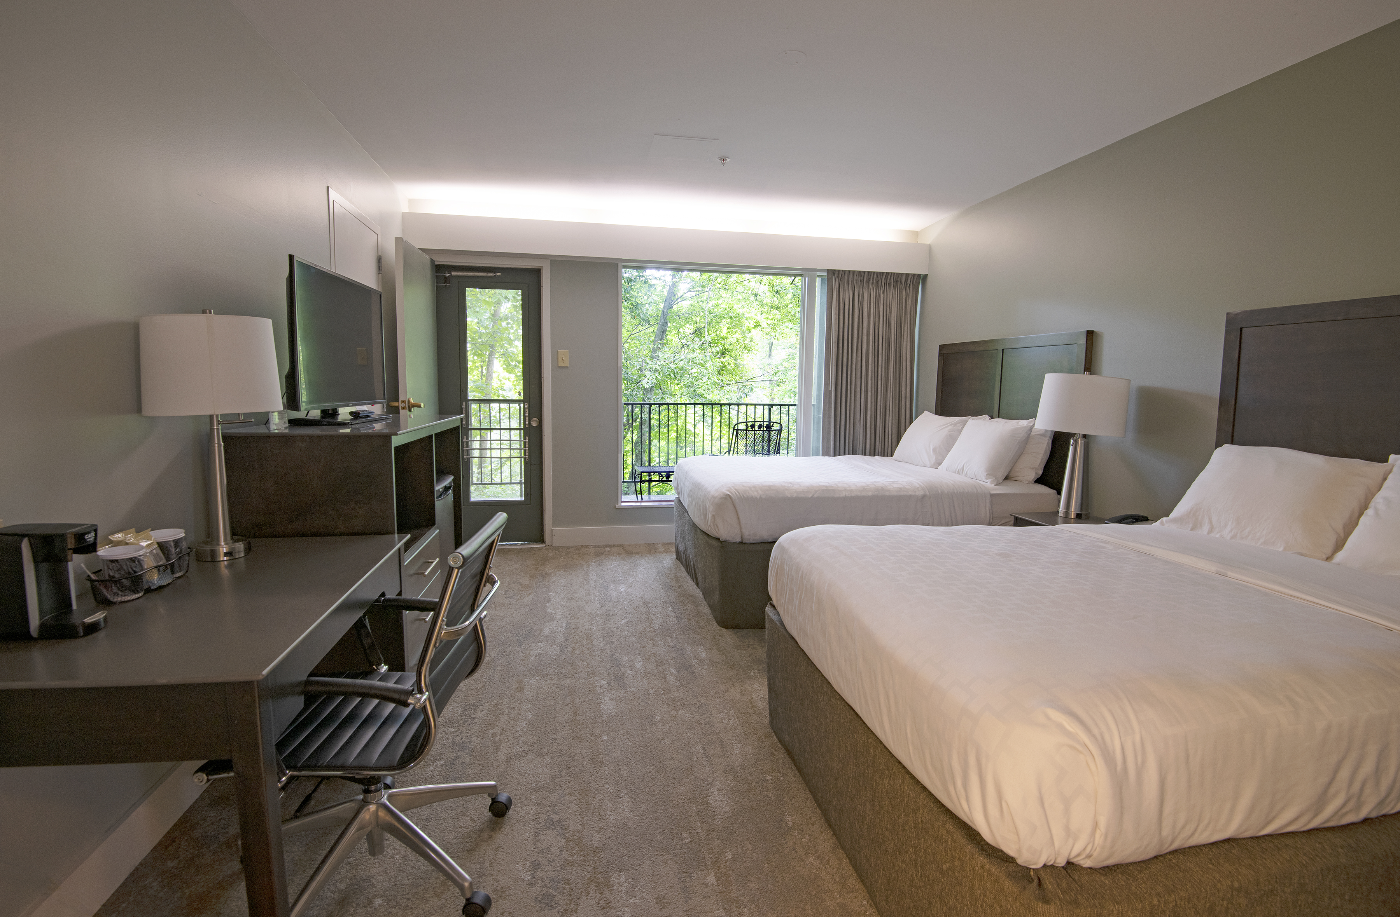
$22 Million
Accommodation Hospitality Upgrades
$1 million
for mattresses and furnishings at various state parks.
$21 Million
for lodge rooms, cottages and common area improvements at various state parks.

Slide 18
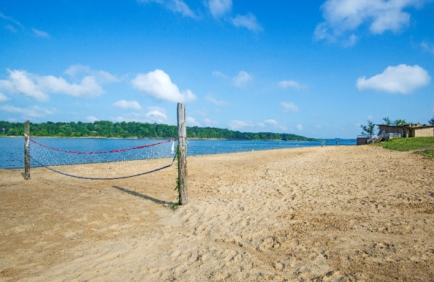
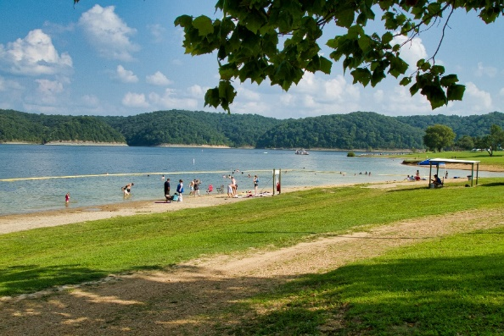
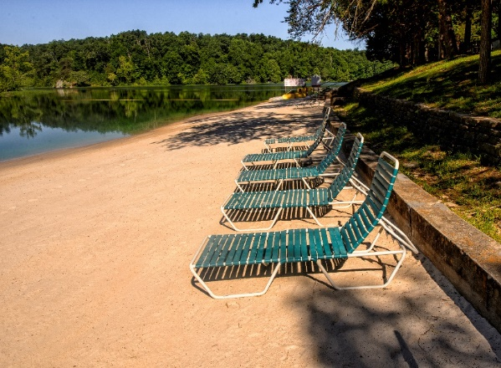
$22 Million
Recreational Amenities Upgrades – Pool Improvement and repairs
$12 million
for pool improvements at various state parks.
Consultants have been selected
Beach Refurbishment
$346,600
for beach sand, beach signage and swim area barriers for various state parks.

Slide 19
$22 Million
Recreational Amenities Upgrades – Playground equipment
$1.2 million
12 park projects
Carter Caves, E.P. Tom Sawyer, Jefferson Davis, Kentucky Dam Village, Pennyrile Forest, Big Bone Lick, Pine Mountain, Yatesville Lake, Buckhorn Lake, Jenny Wiley, Taylorsville Lake and Waveland
4 projects Completed
Carter Caves, E.P. Tom Sawyer, Jefferson Davis and Kentucky Dam Village

Slide 20
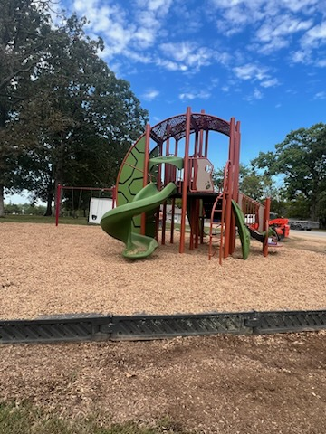
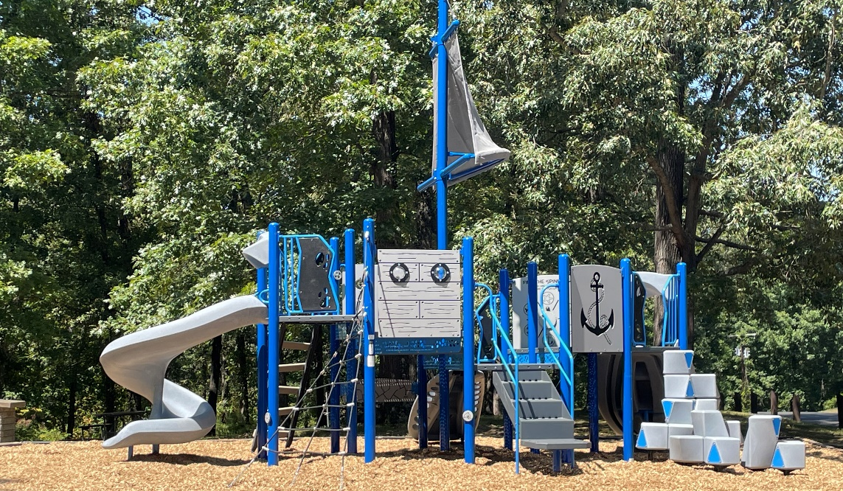
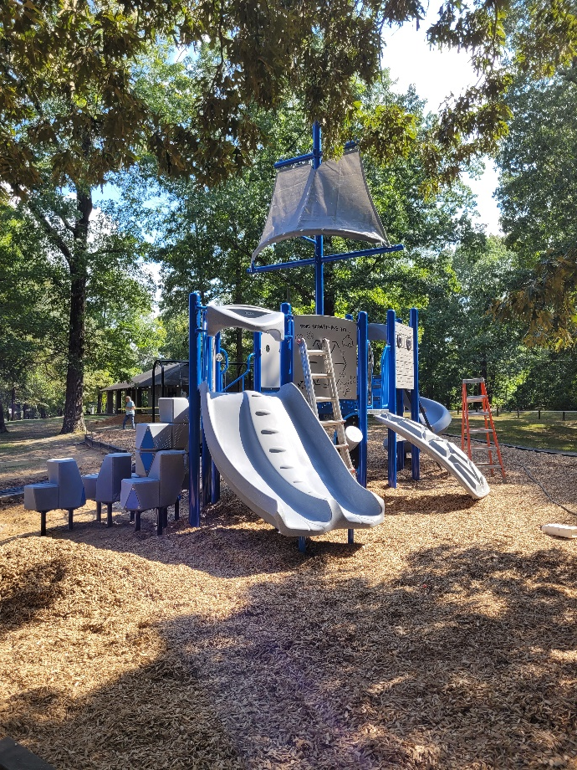
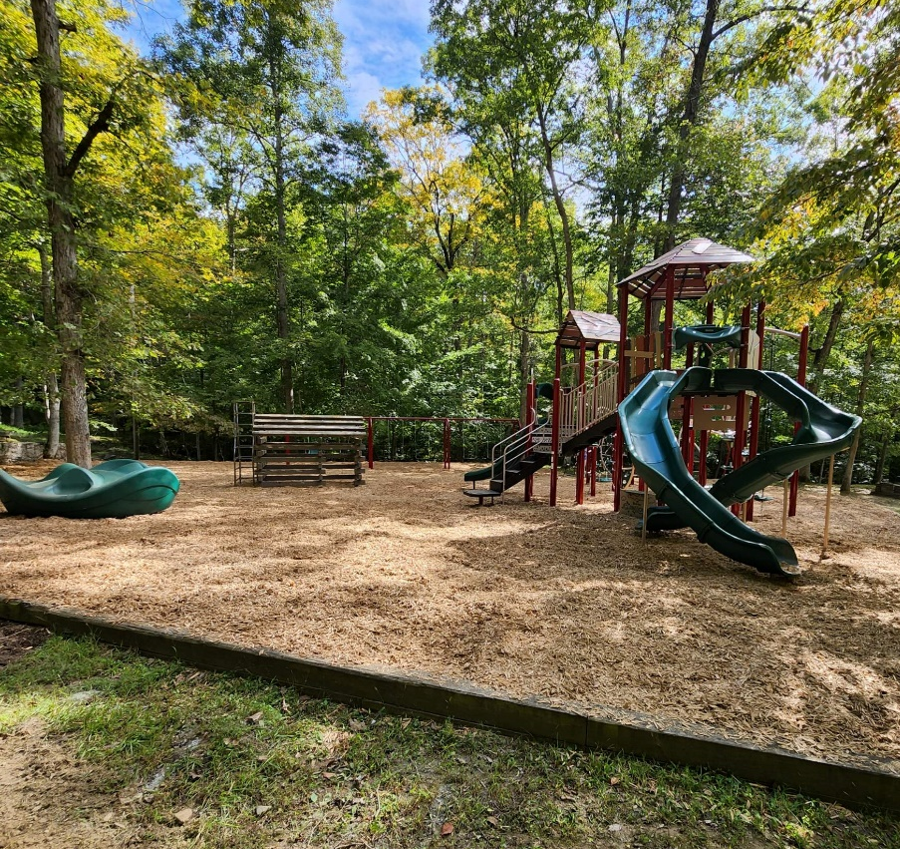
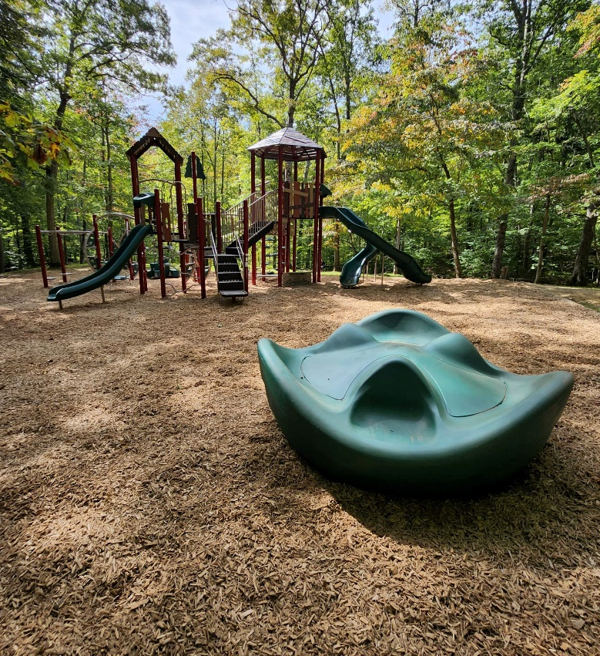
Jefferson Davis
Kentucky Dam Village
Carter Caves
Carter Caves
E.P. Tom Sawyer

Slide 21
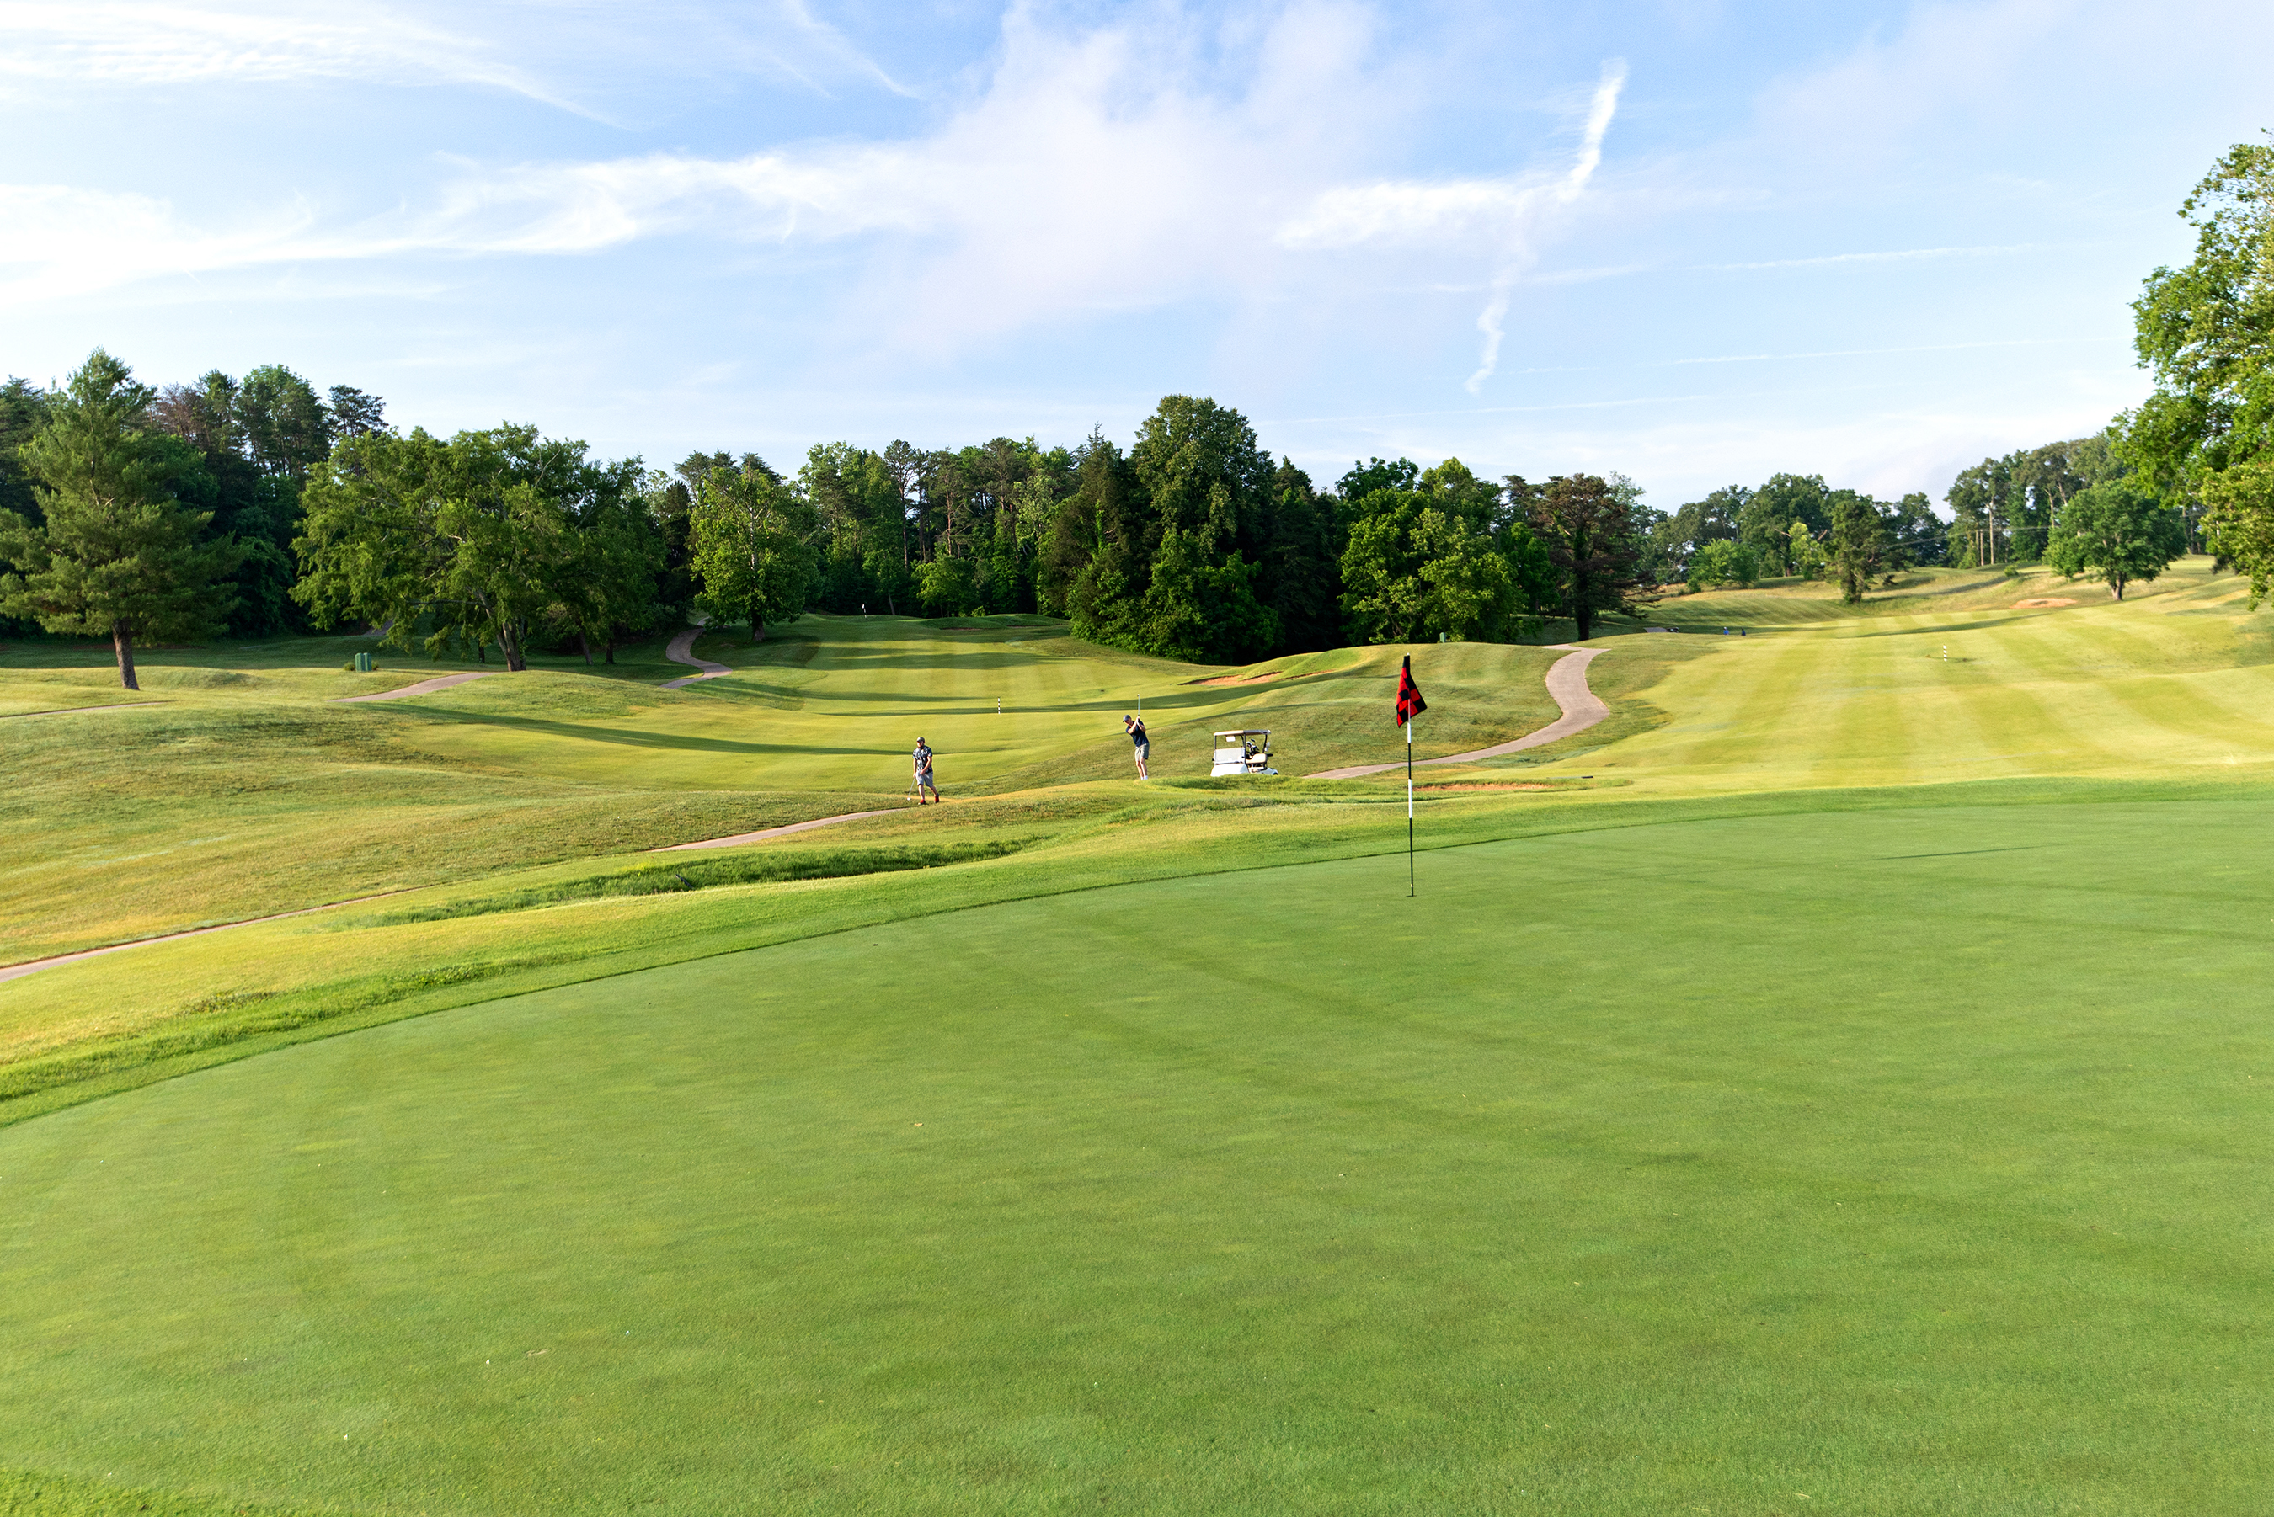
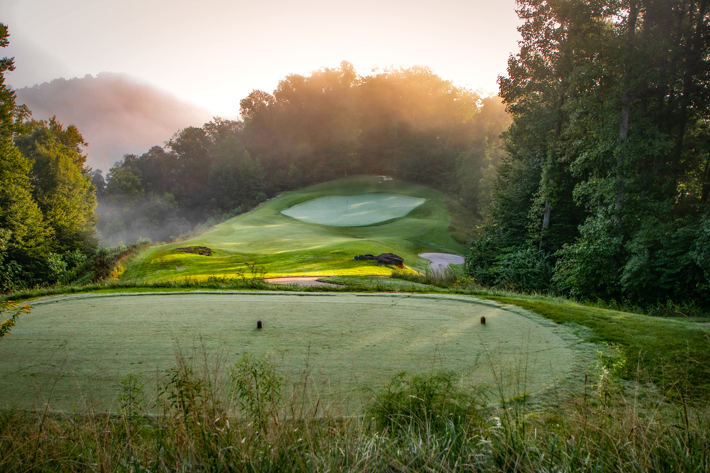
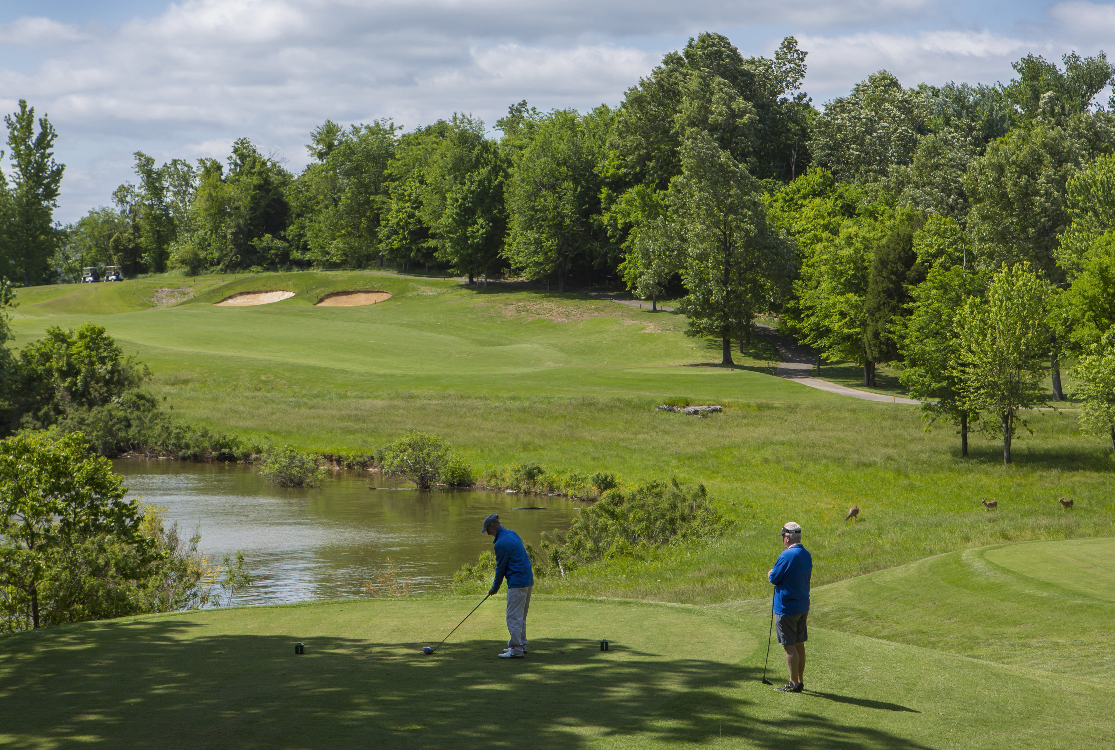
$22 Million
Recreational Amenities Upgrades – golf course upgrades
$8.5 million
for golf course irrigation replacement, Bermuda greens conversion and bunker repairs.
2 projects are in design and 1 is under review

Slide 22
$27 Million
Building Systems Improvements – Dam Safety Reconstruction and Repairs
$5 million
for Pennyrile Forest and Greenbo Lake dams.
2 projects are in design

Slide 23
24 RS HB 6
Line-Item Appropriations
11 projects are in design
Utility Infrastructure Replacement (Phase 2)
Yatesville Lake Marina Improvements
Jenny Wiley Marina Reconstruction
Cumberland Falls Lodge Room Upgrades
John James Audubon New Conference Center
Lake Barkley Lodge Wing Exterior Repair
Pennyrile Beach Complex Repair/Upgrades
Conference Center Upgrades
Lake Barkley Fitness Center Upgrades
Jenny Wiley Archery Center
John James Audubon Beach House Conversion
2 projects are in Review
Perryville ADA Accessible Restroom Facility
Big Bone Lick State Park Nature Center

Slide 24
Questions?

