Slide 1
KENTUCKY HORSE RACING AND GAMING CORPORATION
August 21, 2024

Slide 2
SB299 IMPLEMENTATION
July 1: Kentucky Horse Racing & Gaming Corporation (KHRGC) was formed.
KHRGC entered into Memorandum of Agreements (MOAs) with cabinets in the executive branch.
KHRGC adopted policies
Established a Transition Committee
Established a Hiring and Compensation Committee

Slide 3
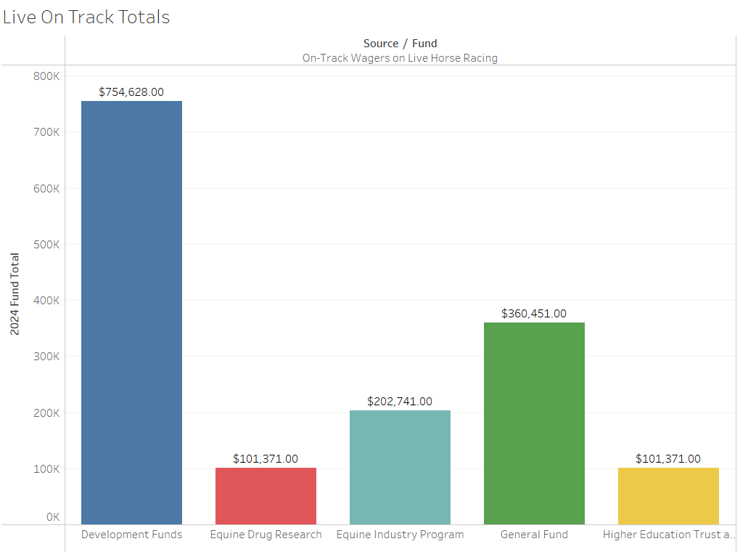
OVERVIEW OF THE PARI-MUTUEL TAX

Slide 4
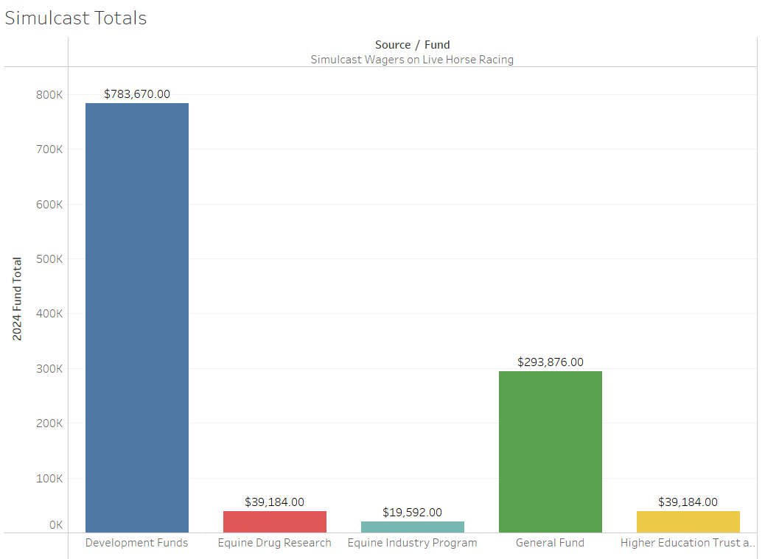
OVERVIEW OF THE PARI-MUTUEL TAX

Slide 5
OVERVIEW OF THE PARI-MUTUEL TAX
Totals from each source:
Development Funds: $78,457,691
Equine Drug Research: $460,555
Equine Industry Programs: $222,333
General Fund: $66,671,169
Higher Education: $460,555

Slide 6
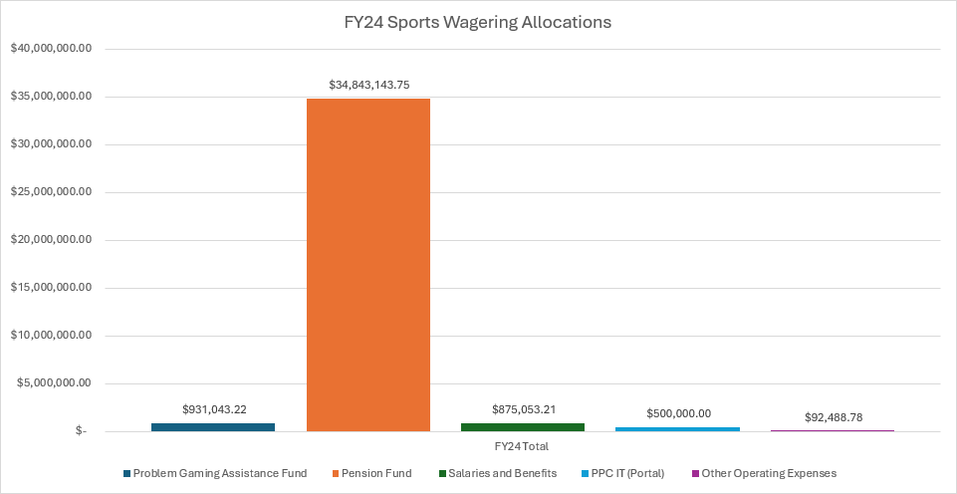
UPDATE ON SPORTS WAGERING TAXES AND FEES

