Slide 1

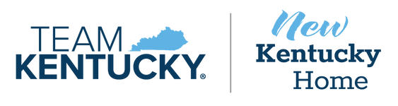
Br Subcommittee on Economic Development, Tourism, and Environmental Protection
August 20, 2025
Mike Mangeot
Department of Tourism Commissioner
Mona Juett
Tourism, Arts and Heritage Cabinet, Chief of Staff

Slide 2

Tourism Funding
KRS 142.406(3): The tourism, meeting, and convention marketing fund shall be used for the sole purpose of marketing and promoting tourism in the Commonwealth including expenditures to market and promote events and venues related to meetings, conventions, trade shows, cultural activities, historical sites, recreation, entertainment, natural phenomena, areas of scenic beauty, craft marketing, and any
other economic activity that brings tourists and visitors to the Commonwealth.
Marketing and promoting tourism shall not include expenditures on capital construction projects.
Increased Marketing
More visitation
Higher Awareness

Slide 3
Tourism Investment for FY2025-26
Agency/Organizations | FY2025 | FY2026
TAH: Tourism Meeting and Convention Marketing Fund | $20,000,000 | $24,000,000
Kentucky Mountain Regional Recreation Authority | $1,750,000 | $1,250,000
National Quilt Museum | $500,000
Southern Kentucky Tourism Initiative | $500,000
TOTAL Appropriation | $22,750,000 | $25,250,000

Slide 4


Slide 5

Tourism Funding
Increased Marketing
Tourism Funding
“Circle of Life”
More visitation
Higher Awareness

Slide 6

Kentucky Department of Tourism
Responsibilities:
  Marketing & Advertising
    2024 placed $10.8 million in paid media
    Pillars: Horses, Bourbon, Outdoors, Music, Arts, Culinary, History
  Public Relations/Communications
    24/7, 365 day-a-year program that works to place articles and stories promoting Kentucky as a tourism destination.
  International Marketing
    International visitors spend 6X the amount of domestic travelers per visit ($775/$124)
    Primary markets are Canada, UK, Germany, and France.
  Cultural Heritage
      Launched African American Heritage Trail in June
  Website Development/Content Creation
  Regional Marketing & Matching Funds
        $2 million to 87 recipients in 80 counties.
  Research

Slide 7
Tourism Funding
Increased Marketing
RETURN ON INVESTMENT
More visitation
Higher Awareness

Slide 8
Kentucky Department of Tourism
Return on Investment
  Public Relations/Communications
    Earned 180 placements with 3.2 billion total earned impressions and a media value equal to $2.1 million*
  International Marketing
    International visitation increased 3% in 2024.**
    International visitors spending increased 12% to $257 million.**
  Cultural Heritage
      Launched African American Heritage Trail
      Published article resulting in 1,309 media placements with 154.6 million audience reach
  Website Development/Content Creation
          2.5+ million users to kentuckytourism.com
          Content creation: Bardstown, Berea, Bloomfield, Bowling Green, Burlington, Cadiz, Campton, Cave City, Corbin, Covington, Danville, Dawson Springs, Elizabethtown, Franklin, Golden Pond, Grand Rivers, Harlan, Harrodsburg, Lawrenceburg, Lexington, Louisville, Madisonville, Mammoth Cave, Maysville, Monticello, Mt. Vernon, Newport, Paris, Pikeville, Shelbyville, Shepherdsville, Verona, Versailles, Winchester.
  Regional Marketing & Matching Funds
        $2 million to 87 recipients in 80 counties.
* Source: Lou Hammond & Associates
* *Source: Economic Impact of Visitors to Kentucky, 2024 by Tourism Economics

Slide 9
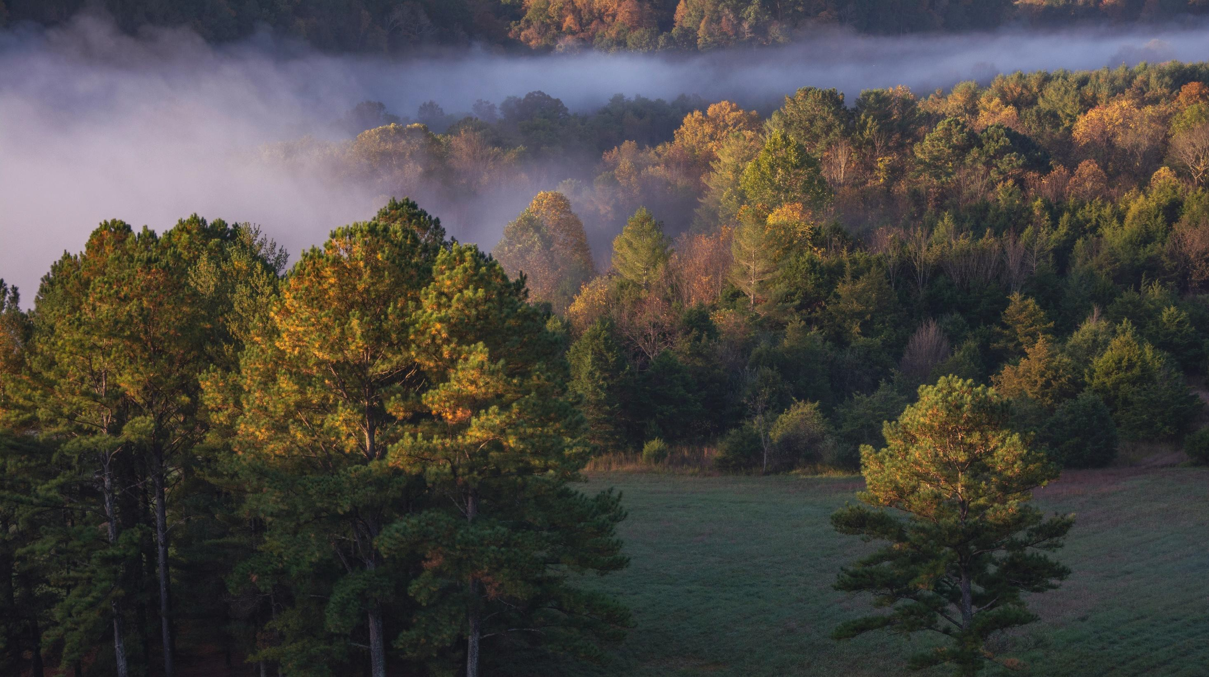



Kentucky 2024
Total Markets Advertising ROI

Slide 10

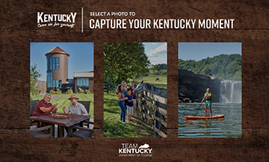
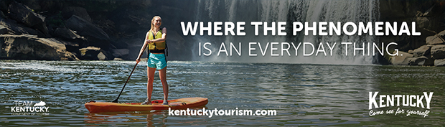
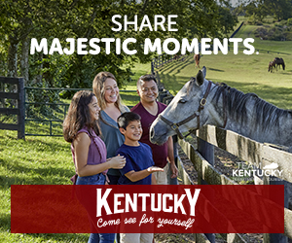
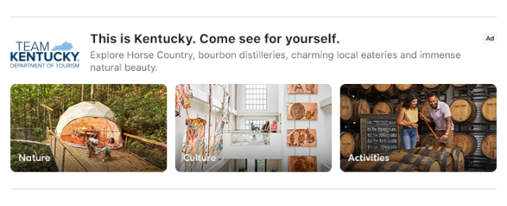

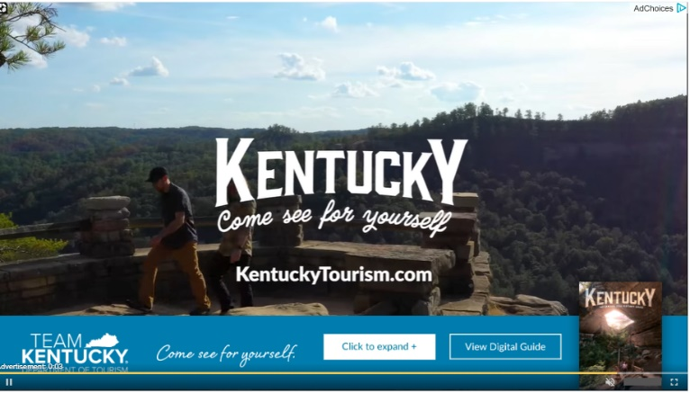
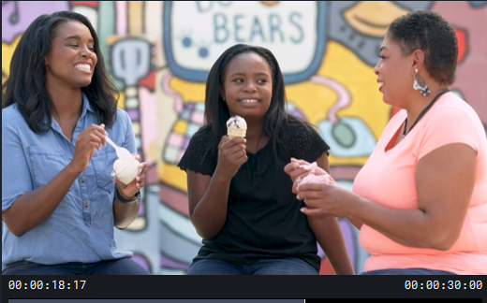

2024 MARKETING CAMPAIGN
Digital Banners
Rich Media
OOH-Billboard
Expedia
Interactive Digital video
Print-2 page spread
Video/TV
Notes:
This is Kentucky. Come see for yourself
Extended the campaign. It has been doing well.
New website coming.

Slide 11


Slide 12

OVERVIEW: Advertising Return on Investment
 | PROJECT OVERVIEW
Longwoods was engaged to conduct a program of research designed to measure the ROI and advertising awareness of the Kentucky Tourism advertising campaigns. A benchmark study was conducted after the conclusion of the advertising period to measure awareness of specific ads, estimate the impact of advertising awareness on intentions to visit and destination image, and measure short-term conversion that occurred during and shortly after the campaign period. The estimates of the campaign’s impacts on visits to Kentucky are conservative in that: Trips taken/intended by people in the absence of advertising are backed out. Conservative control procedures help ensure that only advertising- influenced trips are included.
Campaign Dates
Spring – Fall
2024
The campaign consisted of both traditional and online media including:
Digital Ads Social Ads Print Ads Video Ads
Out-of-Home Ads Audio Ads

Slide 13
2024 SAMPLING MARKETS
Existing Markets
Atlanta
Bowling Green
Charleston-Huntington
Chicago
Cincinnati
Columbus, OH
Evansville
Indianapolis
Knoxville
Lexington
Louisville
Nashville
Paducah-Cape Girardeau-Harrisburg
Saint Louis
New Markets
Champaign-Springfield-Decatur
Dallas-Fort Worth
Detroit
Grand Rapids-Kalamazoo-Battle Creek Orlando-Daytona Beach-Melbourne Washington, DC (Hagerstown)
Dayton
Cleveland-Akron (Canton)
Toronto [CMA], Ontario

Slide 14

KEY FINDINGS: RETURN ON INVESTMENT
RETURN ON INVESTMENT
The 2024 campaign produced an additional 3.2 million trips to Kentucky that otherwise would not have materialized in the absence of this advertising.
Using Travel USA® estimates of average visitor expenditures, Longwoods estimates that these incremental Kentucky visitors spent $529.7 million while in Kentucky.
When related to total advertising costs of $10.8 million, this translates into a return on investment of $49 in visitor spending for each ad dollar spent.
Those incremental expenditures yielded the following in taxes:
$40.9 million in state and local taxes. Return on investment of $4 in taxes for each ad dollar spent.

Slide 15
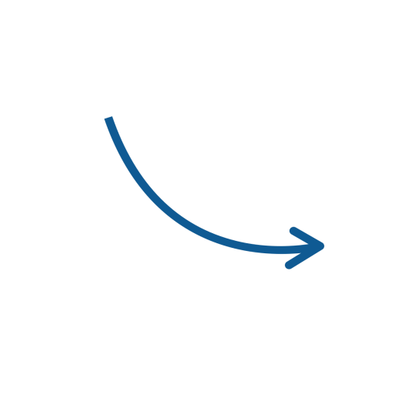
$10.8M
RETURN ON INVESTMENT: 2024
Ad Investment
3.2M Incremental Trips
$529.7M Incremental Visitor Spending
$40.9M Incremental Taxes*
*Effective Tax Rate 7.7% from Tourism Economics
Base: Total Markets

Slide 16
$1
in advertising investment
THE BOTTOM LINE
$49 Spending ROI
$4 Tax ROI
Every $1 invested in the 2024 Kentucky advertising campaign generated $49 in direct visitor spending and $4 in taxes in the destination.
Base: Total Markets

Slide 17
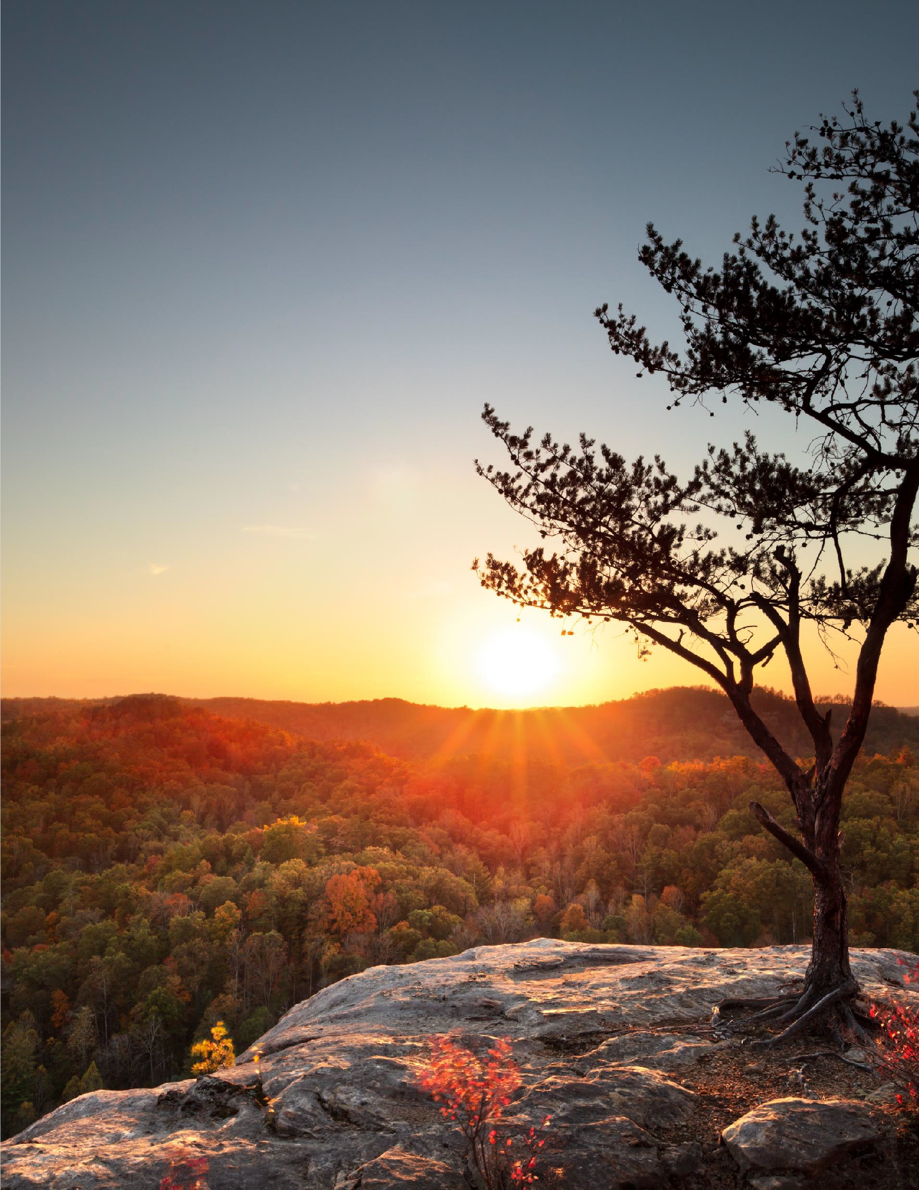





Key Findings
Visitors Generate Significant Economic Impact
In 2024, 80.0 million visitors spent $10.1 billion in the Kentucky economy, increases of 0.9% and 3.8%, respectively. Visitor spending generated a total economic impact of $14.3 billion.
80.0M VISITORS TO KENTUCKY
$10.1B VISITOR SPENDING
$14.3B TOTAL ECONOMIC IMPACT
$3.6M TOTAL PERSONAL INCOME
97,394 TOTAL JOBS SUPPORTED
$1.0B STATE AND LOCAL TAXES

Slide 18
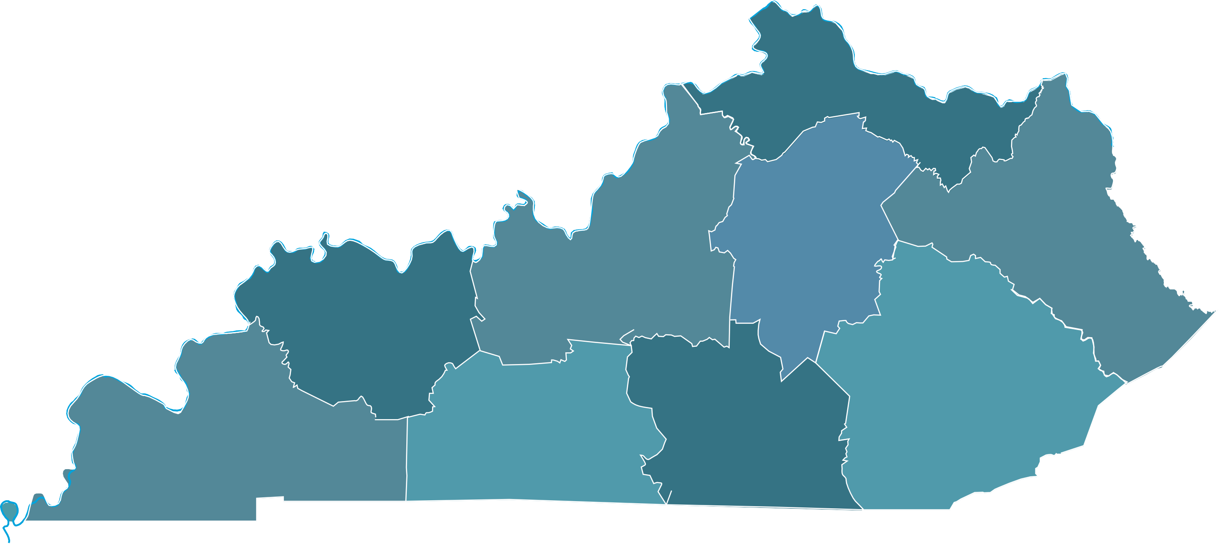
Western Waterlands
$939.7M
Ballard Caldwell Calloway Carlisle Christian Crittenden Fulton Graves Hickman Livingston Lyon Marshall McCracken Todd
Trigg
Bluegrass, Horses, Bourbon & Boone
$2.667B
Anderson Bourbon Boyle Clark Fayette Franklin Garrard Harrison Jessamine Lincoln Madison Mercer Nicholas Scott Woodford
Northern Kentucky River Region
$2.371B
Boone Bracken Campbell Carroll Fleming Gallatin Grant Kenton Lewis Mason Owen Pendleton Robertson
Daniel Boone Country
$561.2M
Bell Breathitt Clay Estill Harlan Jackson Knott Knox Laurel Lee Leslie Letcher Owsley Perry Powell
Rockcastle
Whitley Wolfe
Southern Kentucky Vacations
$356.2M
Adair Casey Clinton
Cumberland
Green McCreary Pulaski Russell Taylor Wayne
All Economic Impact reports including county level numbers can be found under Tourism Resources kentuckytourism.com/Industry
Bourbon, Horses & History
$5.440B
Breckinridge Bullitt Grayson Hardin Henry Jefferson LaRue Marion Meade Nelson Oldham Shelby Spencer Trimble Washington
Kentucky Appalachians
$584M
Bath Boyd Carter Elliott Floyd Greenup Johnson Lawrence Magoffin Martin Menifee
Montgomery
Morgan Pike Rowan
Bluegrass, Blues & Barbecue
$542.6M
Daviess Hancock Henderson Hopkins McLean Muhlenberg Ohio
Union
Webster
$2.371
billion
$584
million
$2.667
billion
Caves, Lakes & Corvettes
$822.8M
Allen Barren Butler Edmonson Hart Logan Metcalfe Monroe Simpson Warren
$5.440
billion
$542.6
million
$561.2
million
$822.8
million
$356.2²⁷
million²⁷
$939.7 million
.
27
6

Slide 19
Tourism Funding
Increased Marketing
Tourism Funding
“Circle of Life”
More visitation
Higher Awareness

Slide 20
Br Subcommittee on Economic Development, Tourism, and Environmental Protection
August 20, 2025
Mike Mangeot
Department of Tourism Commissioner
Mona Juett
Tourism, Arts and Heritage Cabinet, Chief of Staff

