Slide 1
YAP Meeting with KY Juvenile justice oversight council
JULY 2023
Notes:
Prior to starting the slideshow, be sure to do introductions of all individuals in the meeting

Slide 4
What we do
YAP Target Populations and Services

Slide 5
Target Populations
Highest need young people and families who are most at risk of violence and/or out-of-home placements
Secure Settings (e.g. youth prison, detention facilities)
Congregate Care (e.g. group homes)
Residential Treatment Facilities
Violence in Communities

Slide 6
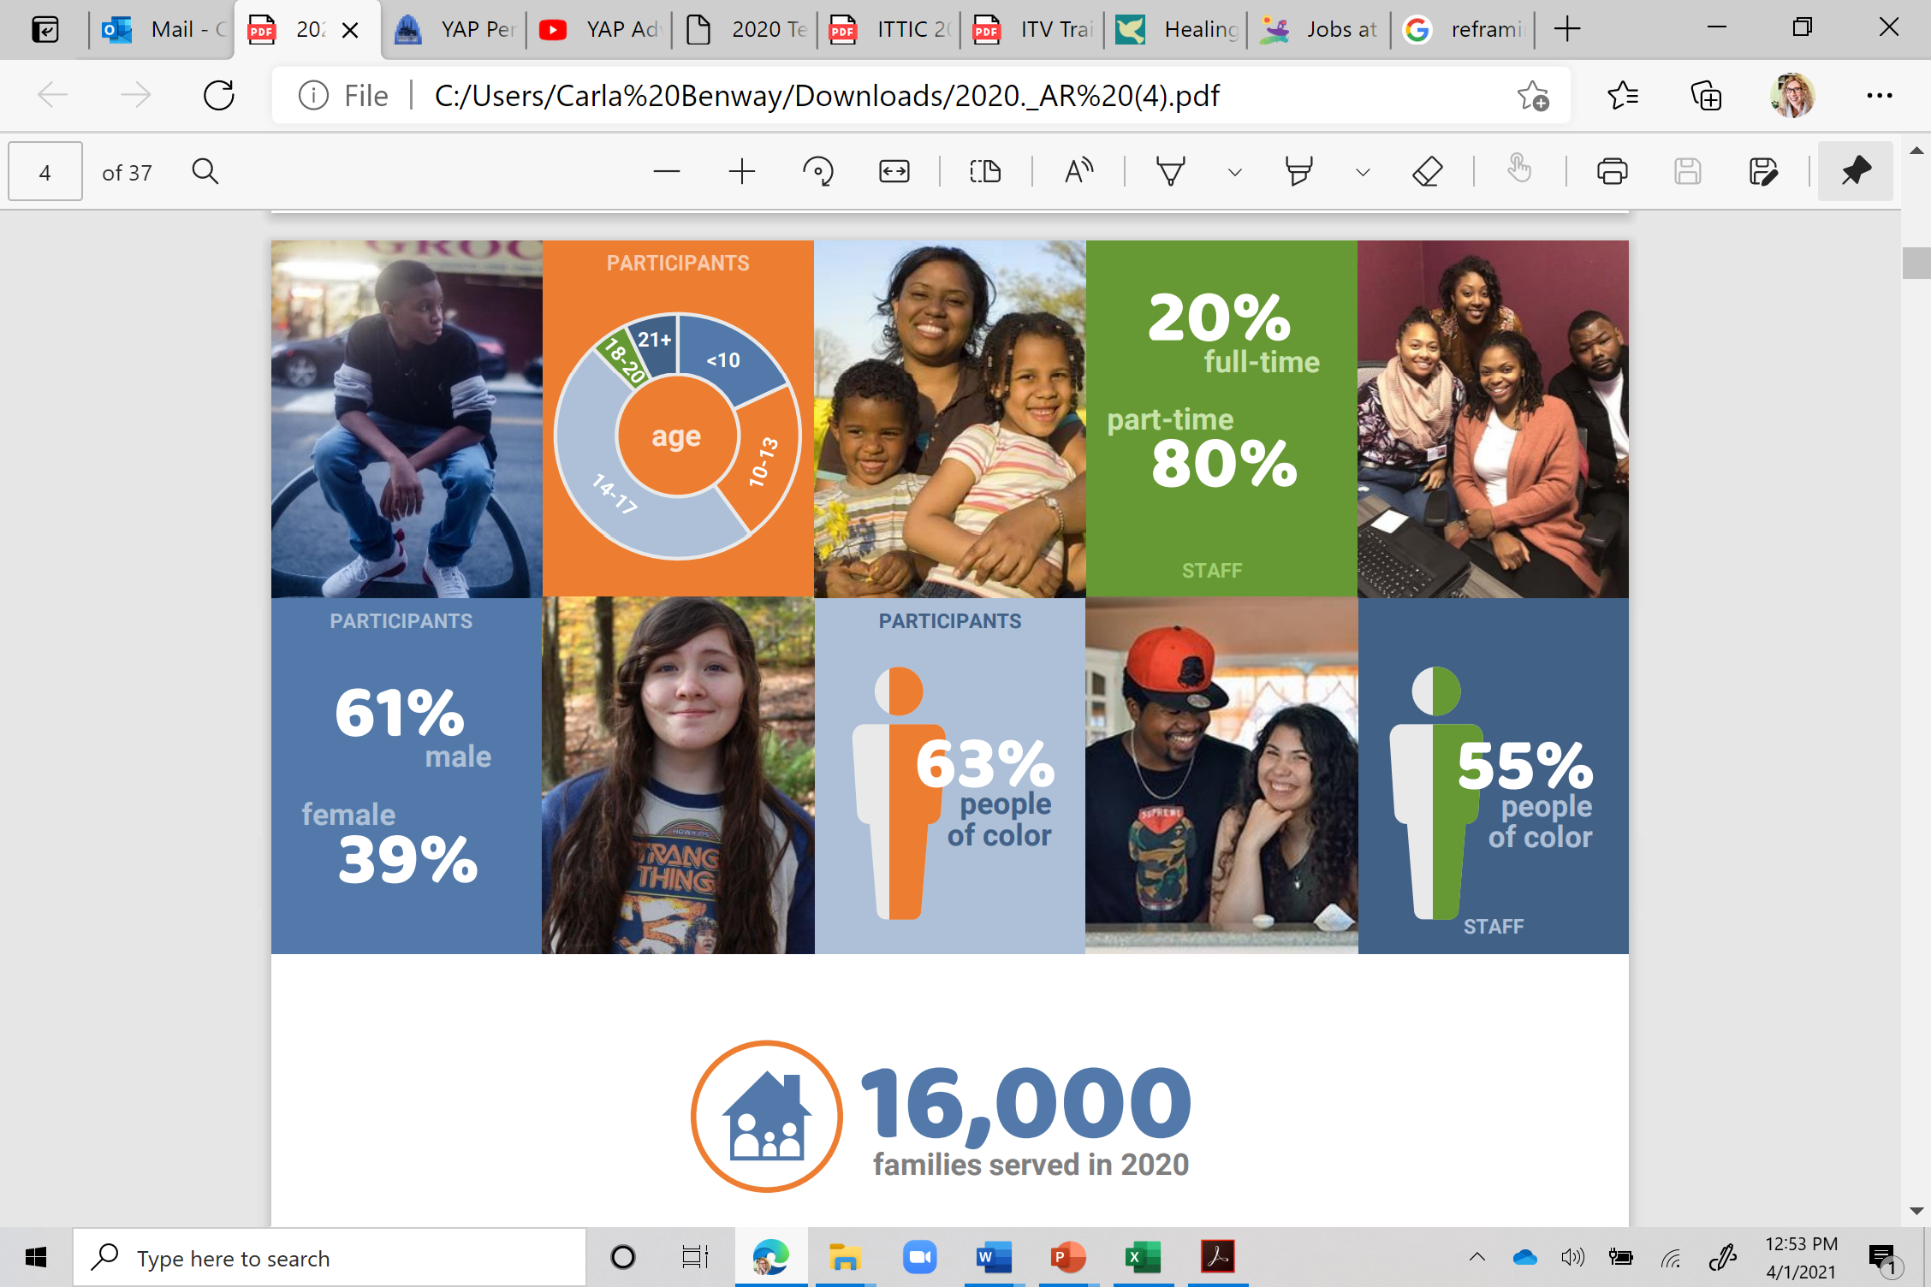

Slide 9
How we Work With Families
YAPWrap

Slide 11

YAP Wrap Model
Match Individuals and Families to Advocates (Staff)
who serve as:
Catalysts for Change
Connectors to Community
Home
School
Youth & Family
Community
Work
YAPWrap is rooted in best practice in wraparound, mentoring, and positive youth development.
Notes:
YAP works with complex-need youth and families from a number of diverse systems. (click) YAP focuses on multi-system and crossover youth, coordinating services and assembling a team-based approach.

Slide 12

Advocates (Staff)
Time Limited, Credible, Trusted
Continually assess needed level of support
Cheer On (Mild)
Do With (Moderate)
Do For (Significant)

Slide 13


Catalyst for Change
Purpose: Help participants and families be open to and accelerate the pace of growth and change; to help to build skills and unlock potential
Expecting
Engaging
Practicing
Educating
Coaching
Exposing
Modeling
Encouraging
Notes:
The advocate’s role then evolves to serve two primary functions: Catalysts of change and Connectors with people, activities/associations, and services. As catalysts, YAP helps youth and families to accelerate the pace of growth and change with better results and more positive outcomes than if they had to manage or negotiate them on our own. These activities are reflected in our second and third pathways, helping youth to develop structured, full lives, and family partnership, support and responsibility.
Advocates engage with the youth to develop a structured and full schedule of activities that meet the requirements of the juvenile justice plan, result in meaningful educational and vocational outcomes, and opportunities for youth to engage in positive community activities based on his/her own strengths and interests. Thinking always of preparing youth for transitions, this pathway begins with direct support and monitoring from the Advocate and shifts to youth and family control by the end of Advocacy services. Through this role the youth develops the life skills, empowerment and self efficacy to move forward as a productive adult integrated within the community. Knowing that much of a youth’s long-term success is predictive of their family functioning, the third pathway engages the youth’s parent(s) as partners, offers emotional and concrete support and encourages responsibility and empowerment of family in supporting their youth and setting appropriate limits.

Slide 14
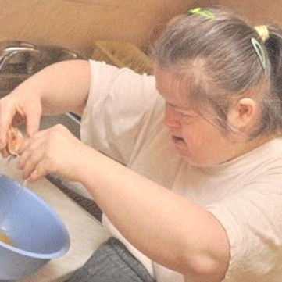
Connector to Community
Purpose: To connect youth and family with positive
people, places, activities and services
Notes:
As Connectors, YAP seeks to identify and develop a youth’s opportunities to contribute. Many YAP youth and families are marginalized and isolated in often literal and figurative ways. YAP seeks to identify each youth’s strengths, gifts, and interests, and (re-)connect them with community supports and opportunities to contribute in meaningful ways. YAP believes that this is critical to long-term success, as these supports are more sustainable than our relationship with them and more naturally occurring than the services often assigned to them.
YAP’s last two pathways really focus on this critical task. The fourth pathway is connecting youth with positive role models. Positive role models are individuals who the young person looks up to and goes to for advice, guidance and encouragement. Though the Advocate can function in this capacity during our work with youth, purposeful effort goes into connecting the youth with positive adults and strengthening relationships with family and others within the community. The fifth pathway is building and strengthening the youth’s broader community of support and the youth’s ability to further develop and engage these relationships post –YAP involvement so that the youth’s sense of connectedness and support are sustained.

Slide 15
The YAP Program Team
State Director
Program Director
Assistant Director
Program Coordinator
Administrative Manager
Advocates*

Slide 18
Core Components
Dosage: Average 7-10 hrs a week
Contact: Avg 3-4 days/wk
Length of Stay: 6 mos
Services at times most needed and/or convenient to families from within their homes and community
  Transportation
  24/7 Crisis Support
Flex Fund
Individual, Family and Group* Interventions

Slide 19
YAP Wrap
Phases of Service
Referral & Engagement
Service Delivery
Transition & Discharge
Assessment & Planning

Slide 20

YAP Wrap
Phase of Service | Action Steps
Referral and Engagement [first week] | Receive and Process Referral Schedule First Visit Introduce Self and YAP Introduce Advocate/Staff Develop Schedule
Assessment and Planning [first month] | YAP Assessment Provide services to build rapport and address immediate needs Family and Team Preparation Develop Initial Service Plan
Delivery | Implement Plan Support Purposeful Transition Build Community Support
Transition [last month] | Identify and Celebrate Success Plan for Cessation of YAP Services Follow-up with Youth and Family
Phases of service
with activities

Slide 22
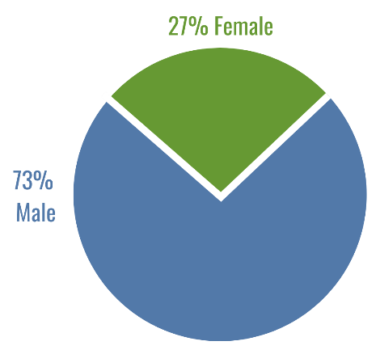
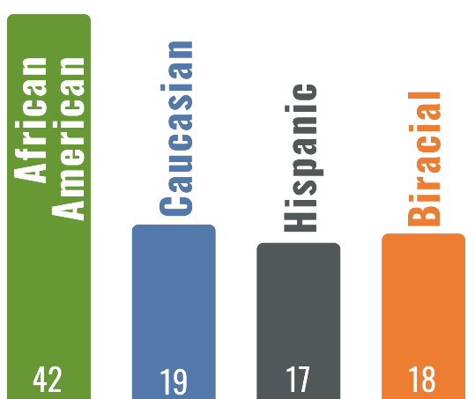


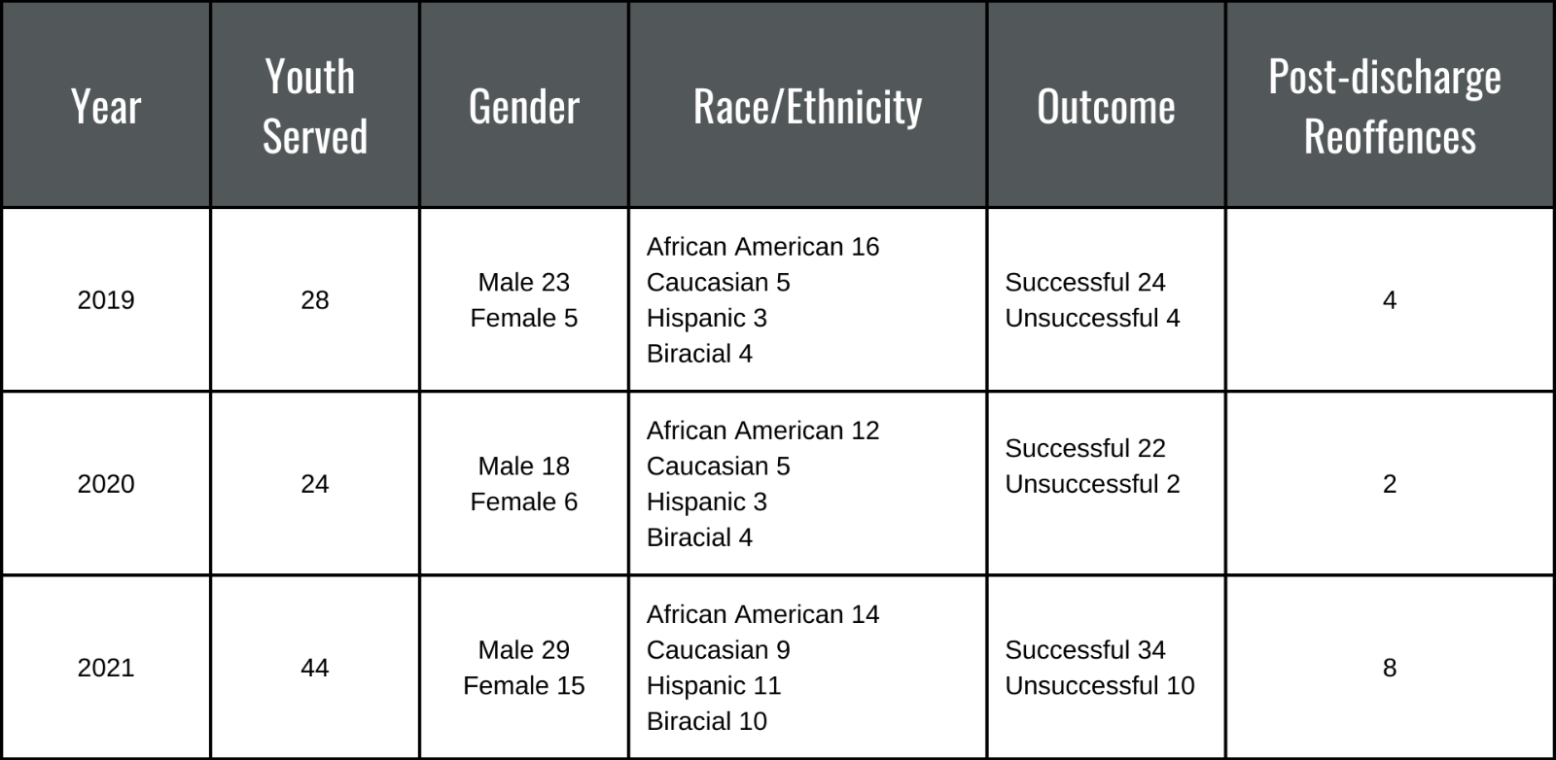
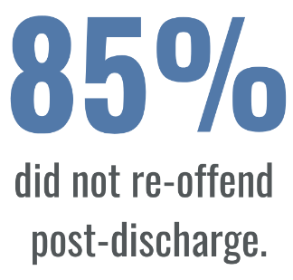
Fayette County YAP Data & Outcomes

Slide 23
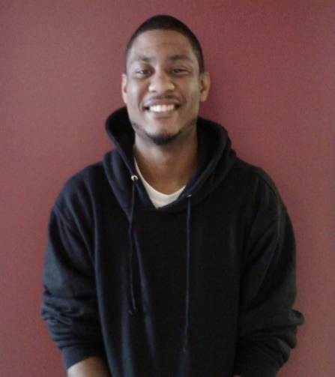

Building Economic Opportunities
YAPWORX
Supported Work
Tom Jeffers Endowment Fund
for Continuing Education
Notes:
Created by YAP to provide high-risk youth with paid, experiential work-based learning experiences
Developed on a Positive Youth Justice (PYJ) framework
Individualized service-learning opportunities designed to increase youth’s labor market knowledge and build social capital
YAP funded employment (3-4 months)
Based on educational/vocational interests
Job coaching for youth/parent at site
Safe, productive community employment
Small business owner as community mentor/role

Slide 24


Thank you!

