Slide 1
Juvenile Justice Oversight Council Court Designated Worker Program

Slide 2
Presented by: Judge Jessica A. Moore, 30th Judicial District Ashley Clark, Executive Officer, Department of Family and Juvenile Services Jason Reynolds, Governmental Affairs Liaison

Slide 3
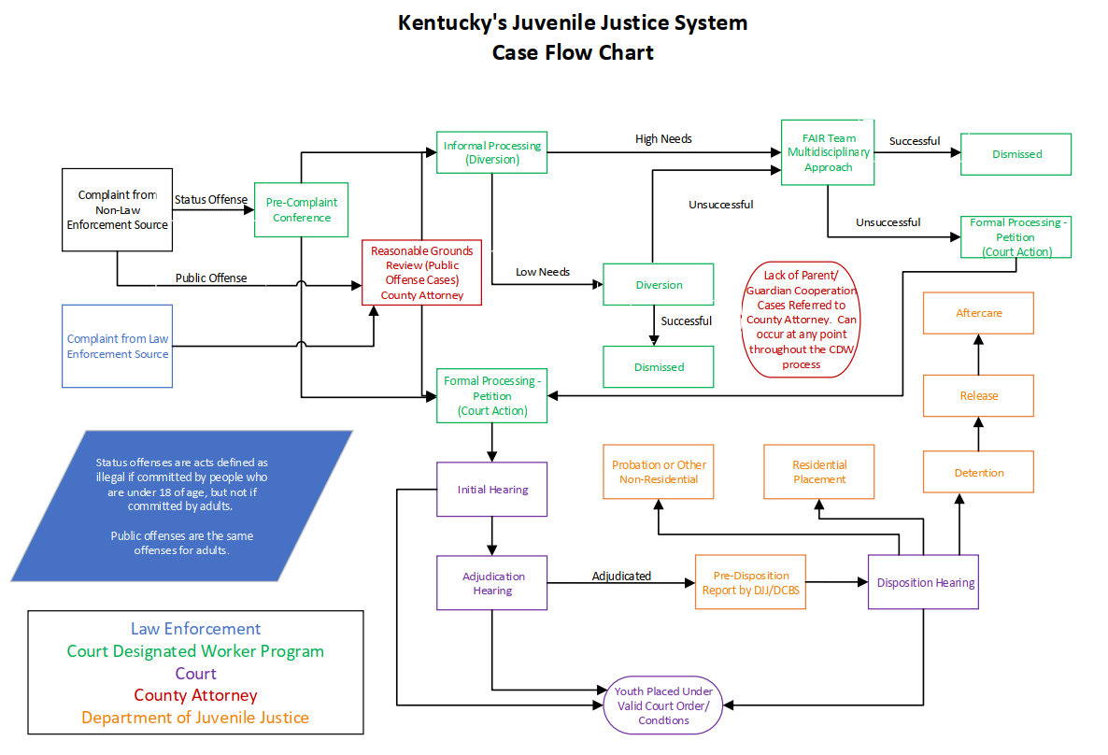

Slide 4
Duties of the CDW
Per KRS 605.030, CDWs process all complaints filed on a juvenile until the age of 18.
CDWs process cases using criteria directing the formal/informal process.
A juvenile can be informally processed (or diverted) in the CDW office a three (3) times for complaints where the youth is charged with only misdemeanor or status offenses.
The juvenile is also eligible for diversion of one felony offense:
If approved by the county attorney, and
If the felony does not involve the commission of a sexual offense or the use of a deadly weapon

Slide 5
What is a Complaint?
A “verified statement” by an officer, parent, victim or other interested party setting forth allegations regarding a youth which contains sufficient facts for the formulation of a subsequent complaint or petition.
Complaints can be filed regardless if a youth is in custody or not.

Slide 6
Reasonable Grounds Review
KRS 635.010:
All public offenses must undergo a reasonable grounds review by the county attorney before the CDW can process the complaint.
Status offenses do not require the reasonable grounds review and can be processed immediately.

Slide 7
Complaint Filings by Year
FY 2019: 17,816
Public – 12,501; Status – 5,302
FY 2020: 14,784
Public – 10,763; Status – 4,010
FY 2021: 7,254
Public – 5,962; Status – 1,283
FY 2022: 14,156
Public – 10,864; Status – 3,284
FY 2023: 17,160
Public – 13,525; Status – 3,624

Slide 8
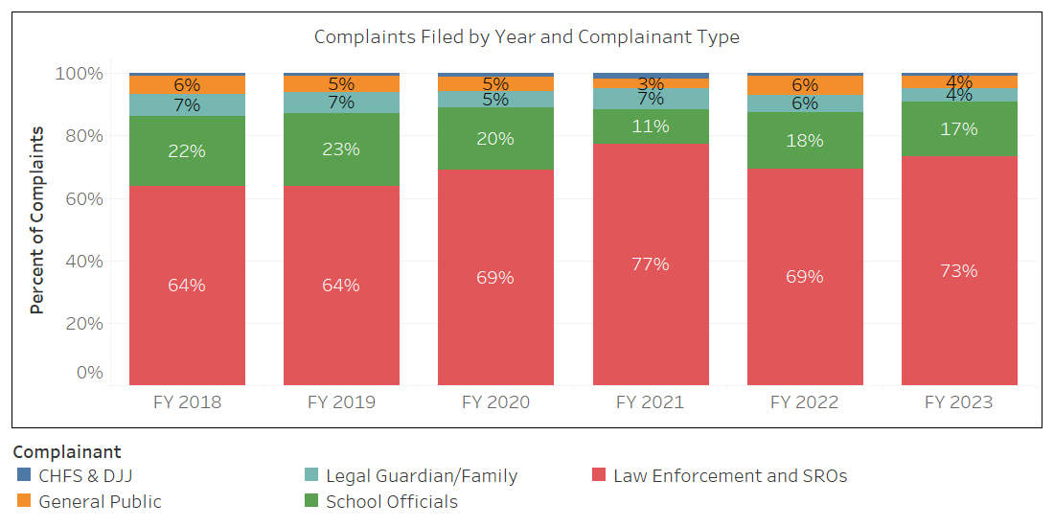

Slide 9
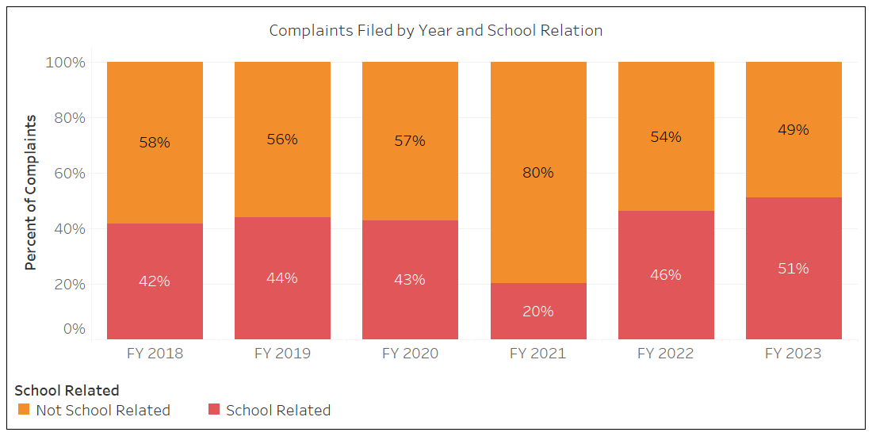

Slide 10
Preliminary Inquiry Interview
Non-Custody Situations
County attorney completes the reasonable grounds process
CDW reads youth their rights, explains current charges & verifies demographic information
Custody Situations
CDW is contacted by an officer with a youth in custody
CDW processes complaint, reads youth their rights, explains current charges, verifies demographic information & identifies least restrictive placement options
CDW conducts the GAIN-SS & human trafficking screener
CDW conducts the GAIN-SS & human trafficking screener
County attorney determines youth eligibility for informal processing
CDW contacts judge and presents least restrictive placement options
Judicial determination

Slide 11
Diversion Overview
A youth may be eligible for up to 4 diversions (3 misdemeanor/status, 1 felony) with graduated responses.
The goal of diversion is to reduce recidivism by providing case management that focuses on accountability, education, treatment and pro-social involvement.
Youth eligible for diversion are monitored for up to 6 months by a CDW.

Slide 12
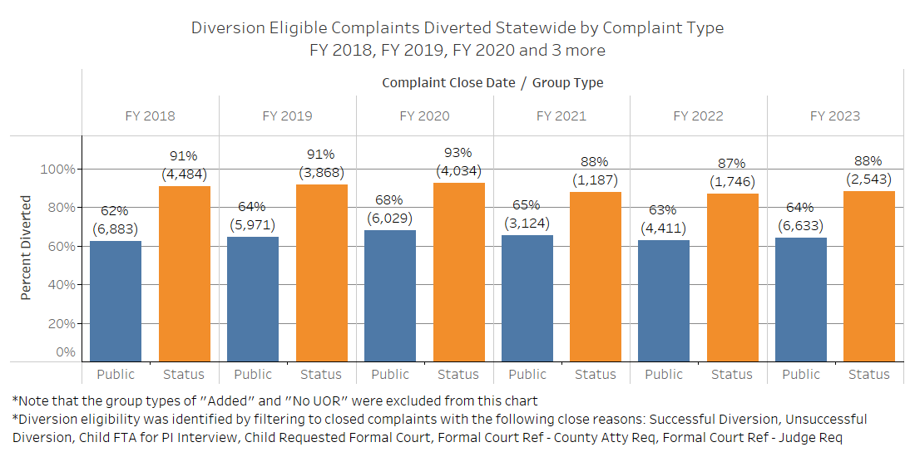

Slide 13
Understanding the Custody Process
KRS 610.200:
If a police officer is unable to release a youth taken into custody, the CDW must be contacted.
The CDW then utilizes the detention screening instrument (DSI) to determine if the youth can be released.
A youth can be released to his/her parents; guardians; relatives; or to an emergency shelter, if available in the area.
If the youth meets criteria for detention, the CDW contacts the judge or trial commissioner for a decision on a placement decision.

Slide 14
Law Enforcement and Custody
KRS 610.190 & 630.030:
An officer may take a juvenile into custody if he/she has reason to believe that a juvenile:
Committed a capital or felony offense
Committed the offense of shoplifting
Assault 4th domestic violence
Driving under the influence
Violated an emergency protective order (EPO)
Is a habitual runaway or missing person
If juvenile commits a public offense in the officer’s presence
If the officer feels the juvenile is a risk to themselves or others

Slide 15
Securing Least Restrictive Placement (LRP)
Detention Screening Instrument (DSI) is completed. Youth scores low to moderate. Call is placed to the Detention Alternative Coordinator (DAC) for available placements. A call to the judge is made.
CDW offers all available LRPs. If youth is released, judge directs whether an arraignment is necessary or if the case can go through CDW processing.
CDW makes a referral to least restrictive placement.
If released, judge will determine when youth can be released from least restrictive placement.
CDW notifies DAC of the placement option chosen by the judge. Additionally, the CDW will send the DAC a copy of the DSI, JW-18, and referral form.
Police call CDW and CDW responds to interview youth.

Slide 16
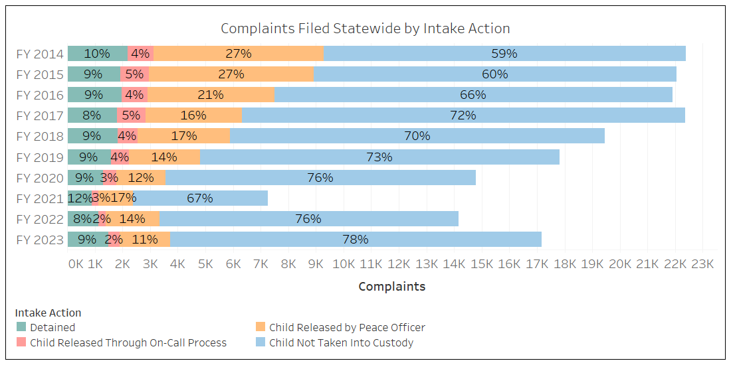
Breaking Down Complaints by Intake Action

Slide 17
Child Not Taken Into Custody

Slide 18
Child Released by Peace Officer

Slide 19
Child Released Through On-Call Process

Slide 20
Detained

Slide 21
Complaints Referred to Court
Complaints may be referred to court if the youth is not eligible for diversion, the youth requests court or fails to appear at required appointments, if the youth was unsuccessful on diversion, or if a county attorney or judge requests the referral.
Once referred from the CDW program, the juvenile complaint becomes a petition in district court. The petition may be referred to circuit court if it meets youthful offender criteria.
In a typical year, between 5-10% of court referrals meet youthful offender criteria.

Slide 22
Juvenile Court Process
Initial Hearing
Valid Court Order/Conditions
Adjudication Hearing
Disposition Hearing

Slide 23
Anticipated Impacts of House Bill 3
Removes Discretion for Law Enforcement and Locally-Elected Judges
When the automatic detention provision of House Bill 3 goes into effect on July 1, 2024, law enforcement and judges will no longer have discretion as to whether a youth is detained for a KRS 532.200 offense including whether to release to home incarceration.
Before House Bill 3, law enforcement or a judge may have a released a youth for one of the below reasons:
Age
Disability
Safety concerns for the youth
Cooperation with law enforcement, etc.
Currently, law enforcement presents 40% of violent offense complaints to the CDW for processing on-call. Judges then detain approximately 90% of the violent offense complaints presented to them.

Slide 24
Anticipated Impacts of House Bill 3
Detention Increases
In FY 2023, 1,486 complaints were detained at intake. If House Bill 3 had been in effect, an additional 458 complaints would have been detained – a 31% increase in detentions.
These newly detained youth will come from across the state. From FY 2019-2023, this provision would have impacted youth from 111 counties.
In previous years about 21% of these new detentions would have come from Jefferson with the other 79% coming from the 110 other counties.
The youth effected by House Bill 3 will be younger than those already detained for KRS 532.200 offenses, with 22% being under the age of 14 in FY 2023.

Slide 25
For questions, please contact:
Judge Jessica A. Moore: jessicaamoore@kycourts.net
Ashley Clark: ashleyclark@kycourts.net
Jason Reynolds: jasonreynolds@kycourts.net

Slide 26
Disclaimer
Information received from KYCourts/CourtNet is subject to change(s), reprogramming, modification(s) of format and availability at the direction of the Administrative Office of the Courts (AOC), and may not at any particular moment reflect the true status of court cases due to ordinary limitation(s), delay(s) or error(s) in the system’s operation. The KYCourts/CourtNet database is not a real-time system. All datasets are a snapshot of case data at the time a query is run. Case counts are not counts of individuals as some persons may have multiple cases.
The AOC disclaims any warranties as to the validity of the information obtained from KYCourts/CourtNet. The recipient is solely responsible for verifying information received from KYCourts/CourtNet through the cross-referencing of official court records. The AOC shall not be liable to the recipient, or to any third party using the system or information obtained therefrom, for any damages whatsoever arising out of the use of KYCourts/CourtNet.

