Slide 1
Growing cities are a growing Kentucky, and that’s good for everyone.
Presenter: KLC Executive Director|CEO J.D. Chaney

Slide 3
Growing cities are a growing Kentucky, and that’s good for everyone.

Slide 4
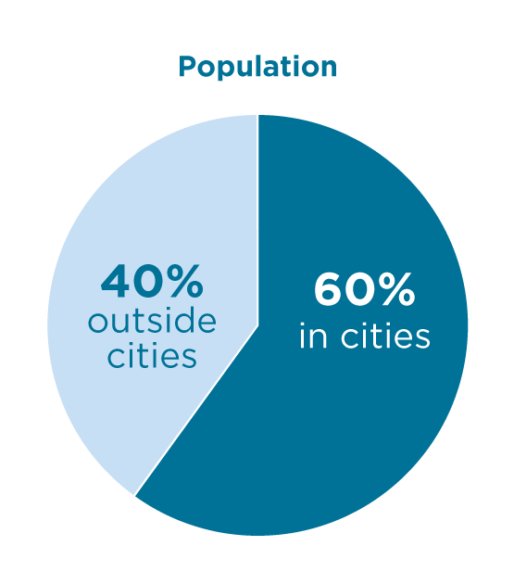
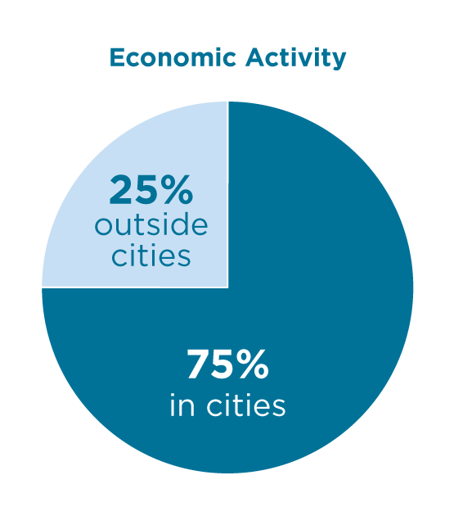
Putting Annexation into Perspective
Kentucky’s Land
3.6% Incorporated
96.4%
Unincorporated

Slide 5
Putting Annexation into Perspective

Slide 6
The Shape of Cities

Slide 7
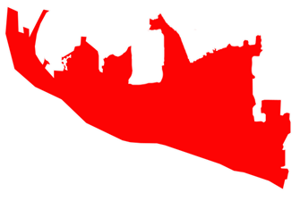
The Shape of Cities Vancouver, WA

Slide 8
The Shape of Cities San Jose, CA

Slide 9
The Shape of Cities Austin, TX

Slide 10
The Shape of Cities Aurora, CO

Slide 11
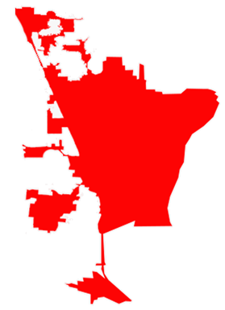
The Shape of Cities Cape Girardeau, MO

Slide 12
The Shape of Cities South Bend, IN

Slide 13
The Shape of Cities Columbus, OH

Slide 14
The Shape of Cities Knoxville, TN

Slide 15
The Shape of Cities Birmingham, AL

Slide 16
The Shape of Cities Savannah, GA

Slide 17
The Shape of Cities Raleigh, NC

Slide 18
The Shape of Cities Charleston, SC

Slide 19
The Shape of Cities Kentucky cities are not unique in shape

Slide 20
Annexation Math
Prior to Annexation
100 Acres at $10,000 per Acre | $1,000,000
Annual Insurance Premiums | $3,000
Net Profits | $50,000
Wages | $100,000
County Collects Annually
10 Cents per $100 | $1,000
Insurance Premium Tax (7%) | $210
Occupational Taxes | $1,500
Total | $2,710

Slide 21
Annexation Math
City Annexes
and Develops Property:
County Collects Property Taxes Annually of:
County Revenue Increased by:
$2,290
without
Insurance Premium Taxes, Occupational Taxes, and County Investment
Value Increased to
$5,000,000
$5,000

Slide 22
Annexation Math
Bowling Green:
Buhr-Rock Development, Inc.
Prior to Annexation:
Acres:
Total Tax
Base:
22.6
$1,130,000
Following Annexation:
Average
Lot Price:
Average Home Value:
Total Tax
Base:
$95,079
$418,650
$10,430,900

Slide 23
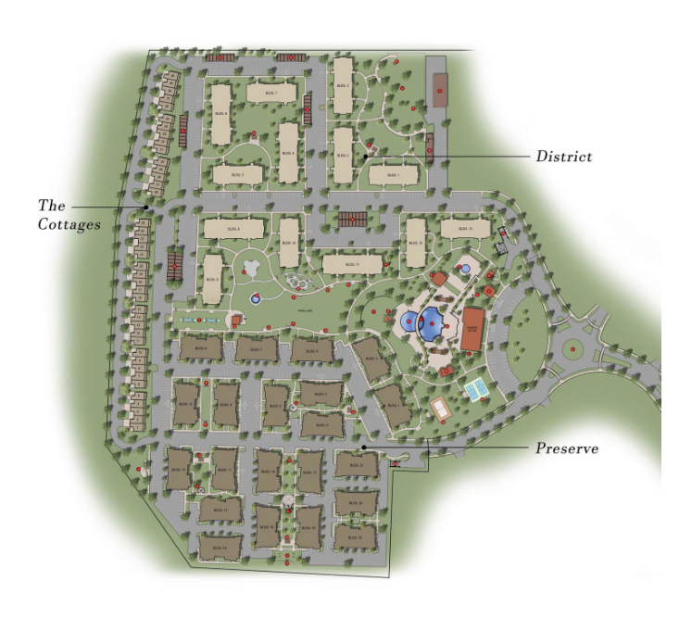
Annexation Math
Bowling Green:
The HUB
Purchase Price: $4.15M
Prior to Annexation:
Hotel FMV
in 2018:
Multi-Home FMV in 2018:
Other Plots FMV in 2018:
$1,000,000
$4,000,000
$3,200,000
Following Annexation:
Hotel FMV
In 2023:
Multi-Home FMV in 2023:
American Bank & Trust Development:
Bankwalkers Investment, LLC Development:
$24,800,000
$75,000,000
$7,500,000
$6,100,000

Slide 24
Annexation Math
Elizabethtown: City Annexations (2013-2023)
Number of
Annexations:
Number of Acres:
Increased FMV
Value:
29
1,482
$48,818,502

Slide 25
Annexation Math
Daviess County
Year | County | County Adopted Rate | County Revenue: Adopted | Historical County 4% Rate | Estimated 4% Rate | Estimated County Revenue: 4% Rate | Unrealized Revenue
2018 | Daviess | 13.5 | $7,921,889 | 14.1 | 14.1 | $8,273,973 | $352,084
2019 | Daviess | 13.5 | $8,299,315 | 13.8 | 14.2 | $8,729,650 | $368,858
2020 | Daviess | 13.4 | $8,644,380 | 13.9 | 14.3 | $9,160,462 | $451,572
2021 | Daviess | 13.4 | $9,167,344 | 13.6 | 14.3 | $9,646,235 | $342,065
2022 | Daviess | 13 | $9,375,660 | 13.5 | 14.1 | $10,168,985 | $649,084
2023 | Daviess | N/A | N/A | 13.1 | 13.9 | $10,545,780
 |  |  |  |  | Total Difference |  | $2,163,663

Slide 26
Annexation Math
Madison County
Year | County | County Adopted Rate | County Revenue: Adopted | Historical County 4% Rate | Estimated 4% Rate | Estimated County Revenue: 4% Rate | Unrealized Revenue
2018 | Madison | 8.2 | $3,885,011 | 8.4 | 8.5 | $3,979,767 | $94,756
2019 | Madison | 8.3 | $4,105,631 | 8.3 | 8.4 | $4,204,562 | $49,465
2020 | Madison | 8 | $4,192,558 | 8.3 | 8.3 | $4,454,592 | $157,221
2021 | Madison | 7.6 | $4,345,430 | 7.9 | 8 | $4,745,667 | $228,707
2022 | Madison | 7.3 | $4,552,245 | 7.5 | 7.9 | $5,113,481 | $374,157
2023 | Madison | N/A | N/A | 7.3 | 8.2 | $5,453,593
 |  |  |  |  | Total Difference |  | $904,306

Slide 27
Reaching a Resolution
Constitutional Amendment Related to Local Taxation
Limited
Reprieve from
Recall Provisions of HB44
Revenue Hold Harmless Calculation
Jail Reform
Limited Exception to Occupational Tax Crediting
in Newly
Annexed Areas
Strengthen
Property Owners’
Rights on
Non-Consensual Annexation
Changes to Statute of Limitations and Legal Standing
Clarify Ownership of City Utility Infrastructure

Slide 28
Growing cities are a growing Kentucky, and that’s good for everyone.
Thank You!

