Slide 1
Kentucky Riverports, Highway & Rail Freight Analysis Study
Multimodal Freight Transportation System Improvement Task Force
Jeremy Edgeworth
Freight, Rail and Waterways Coordinator
Division of Planning
Frankfort, Kentucky | July 18, 2023

Slide 2
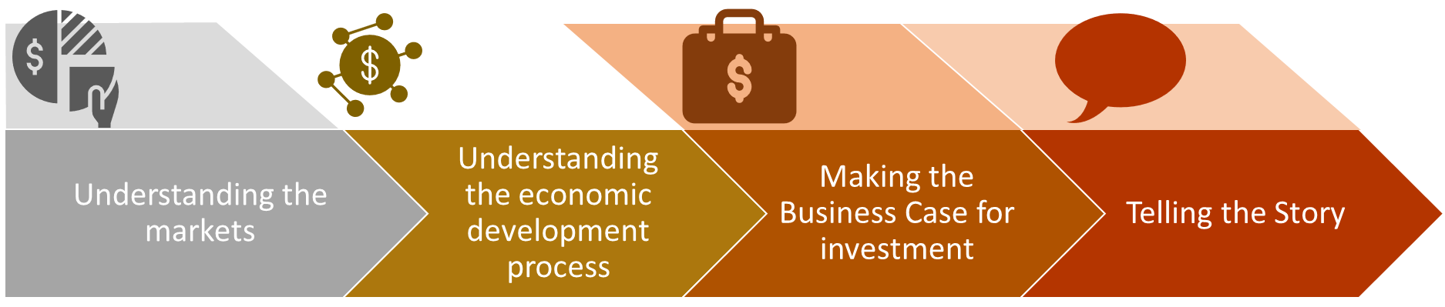
How Was the Study Conducted?
Notes:
Good afternoon, the Kentucky Riverports, Highway & Rail Freight Analysis Study began in 2020. In 2018, the governor challenged the state transportation community to find ways to better utilize our waterways. The Kentucky Association of Riverports took up the challenge, drafted the framework for a new study to address the governors challenge, and approached the leadership of the Transportation Cabinet. The Transportation Cabinet was project manager for the study on behalf of the public riverports. The study entailed two rounds of site visits to Kentucky’s public riverports, three virtual statewide summits, a series of technical memoranda and a final report. The study assessed the waterborne commerce markets in Kentucky, the riverport’s current state and potential future directions for riverport investment in the Commonwealth. These activities have provided an understanding of today’s waterborne commerce markets, the role public riverports play in future economic development and the potential benefits of investing in Kentucky’s public riverport infrastructure.

Slide 3
Study Partners
Kentucky Cabinet for Economic Development
Kentucky Department of Agriculture
Kentucky Association of Riverports
US DOT Maritime Administration
US DOT Federal Highways Administration
US Army Corps of Engineers
Kentucky Transportation Center
Notes:
The Transportation Cabinet did not undertake this important study independently. In addition to our consultant team, we had a wide range of local, state, and federal partners advising us on the study. It should be noted that despite the involvement of several state agencies, this report and recommendations do not represent an official position of the Transportation Cabinet or the administration.

Slide 4
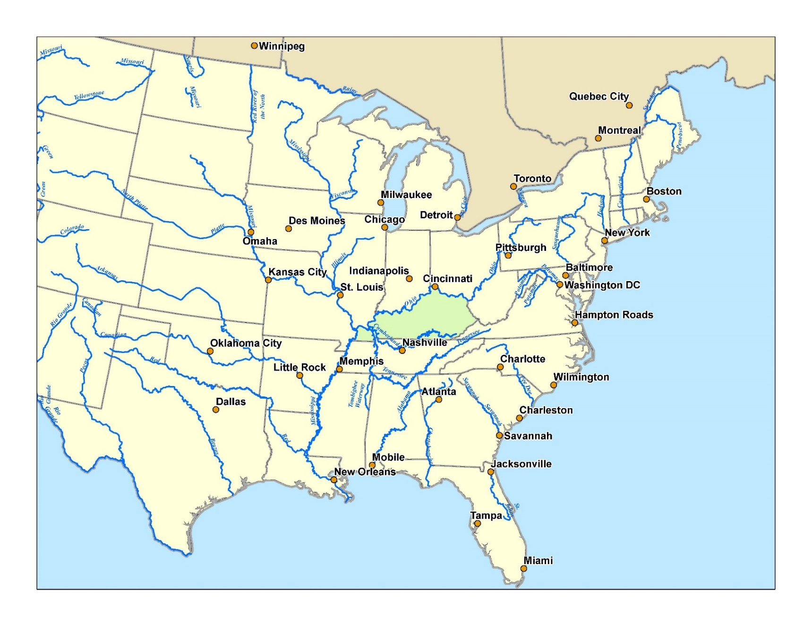
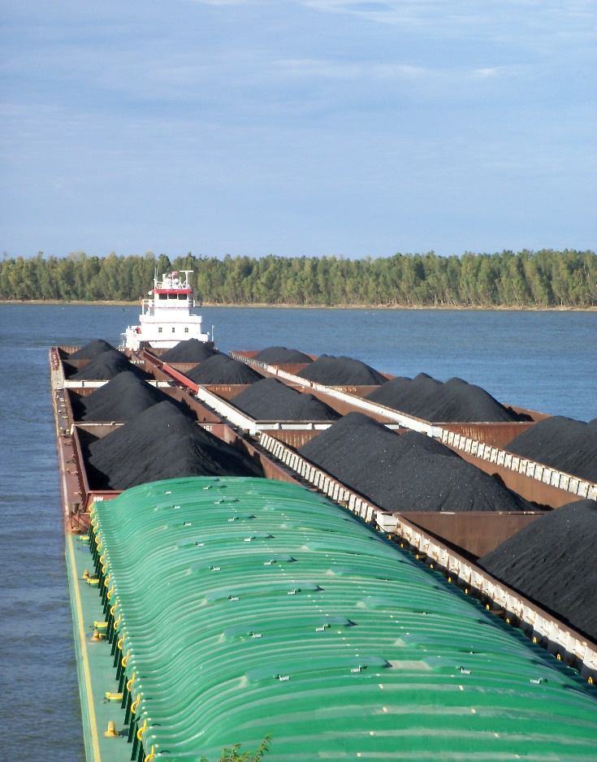
Kentucky’s Waterway Network
Notes:
To provide some geographical context about our study, Kentucky has 1,662 miles of inland waterways, 1,020 of which are commercially navigable, ranking us 4th in the nation. Kentucky is surrounded on 3 sides by the commercially navigable rivers of the Mississippi, Ohio and Big Sandy River, and we also have the Tennessee, Cumberland, Green and Licking Rivers able to move freight. Kentucky’s geographic location provides us great advantages in being at the center of a vast inland waterways network and at the confluence of several critical inland waterway routes.

Slide 5
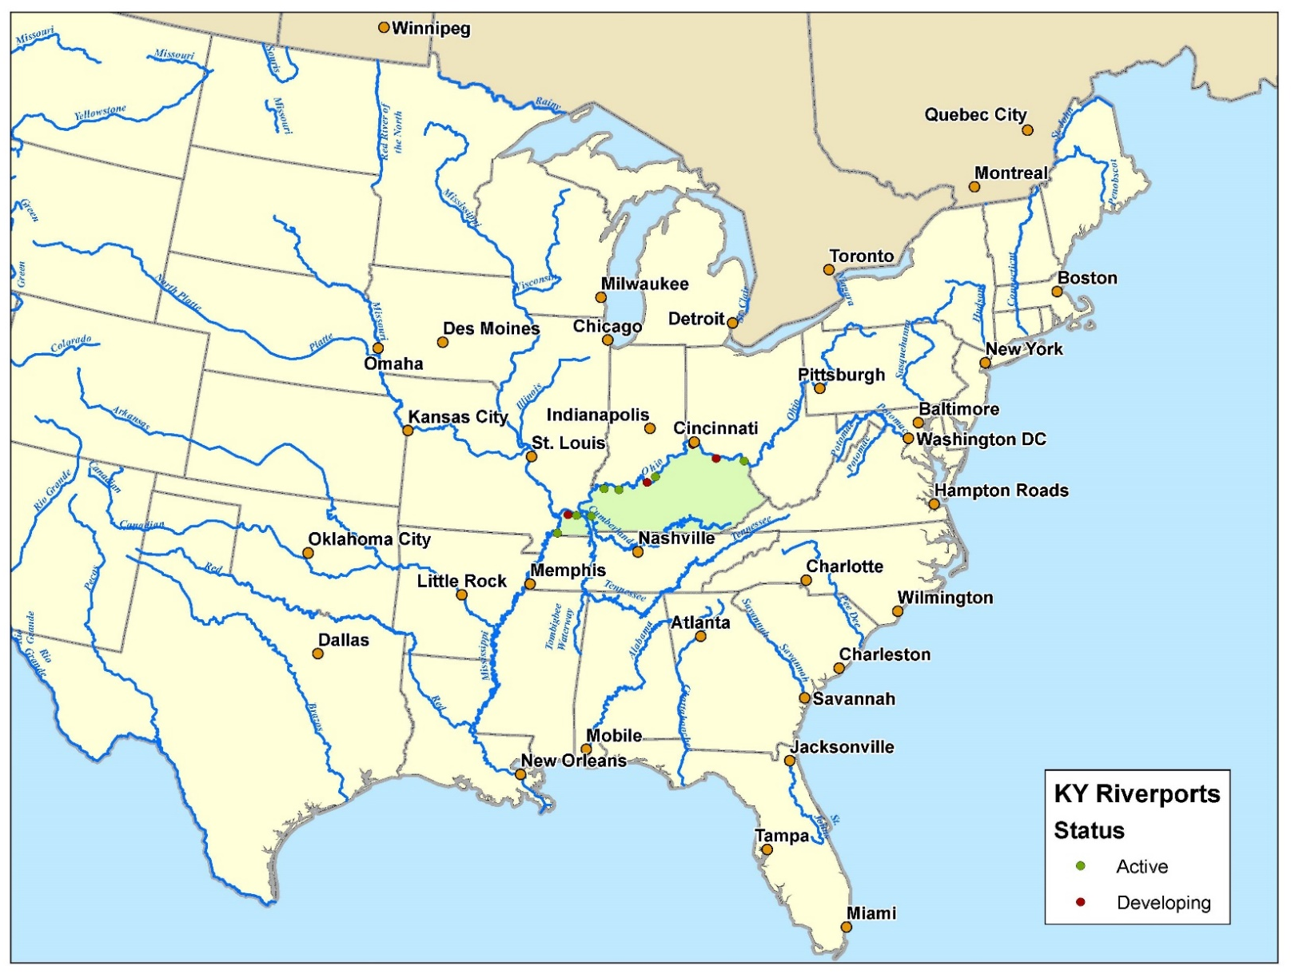
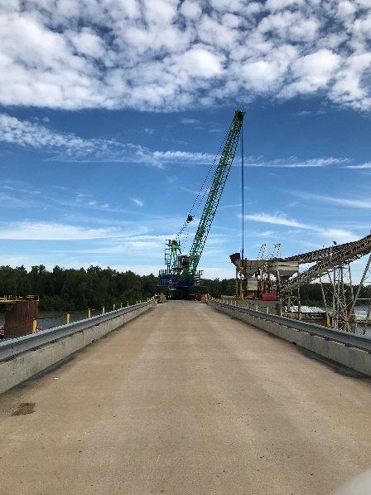
Kentucky’s Public Riverports
Notes:
Kentucky’ waterways are supported by 10 public riverports, 7 active ports and 3 ports at differing stages of development. They range in size from smaller agricultural hubs providing fertilizer and gathering the grain of the local farmer to large players in the world aluminum markets being listed on the London Metal Exchange. They move heavy steel coils on and off the river for manufacturing and provide warehousing and distribution. These ports provide critical connections moving goods on and off the rivers. Kentucky’s public riverports are supplemented by over 160 private river terminals. These are privately owned terminals that provide many of the same services as our public riverports moving goods on and off the rivers, but often are developed for a single commodity.

Slide 6
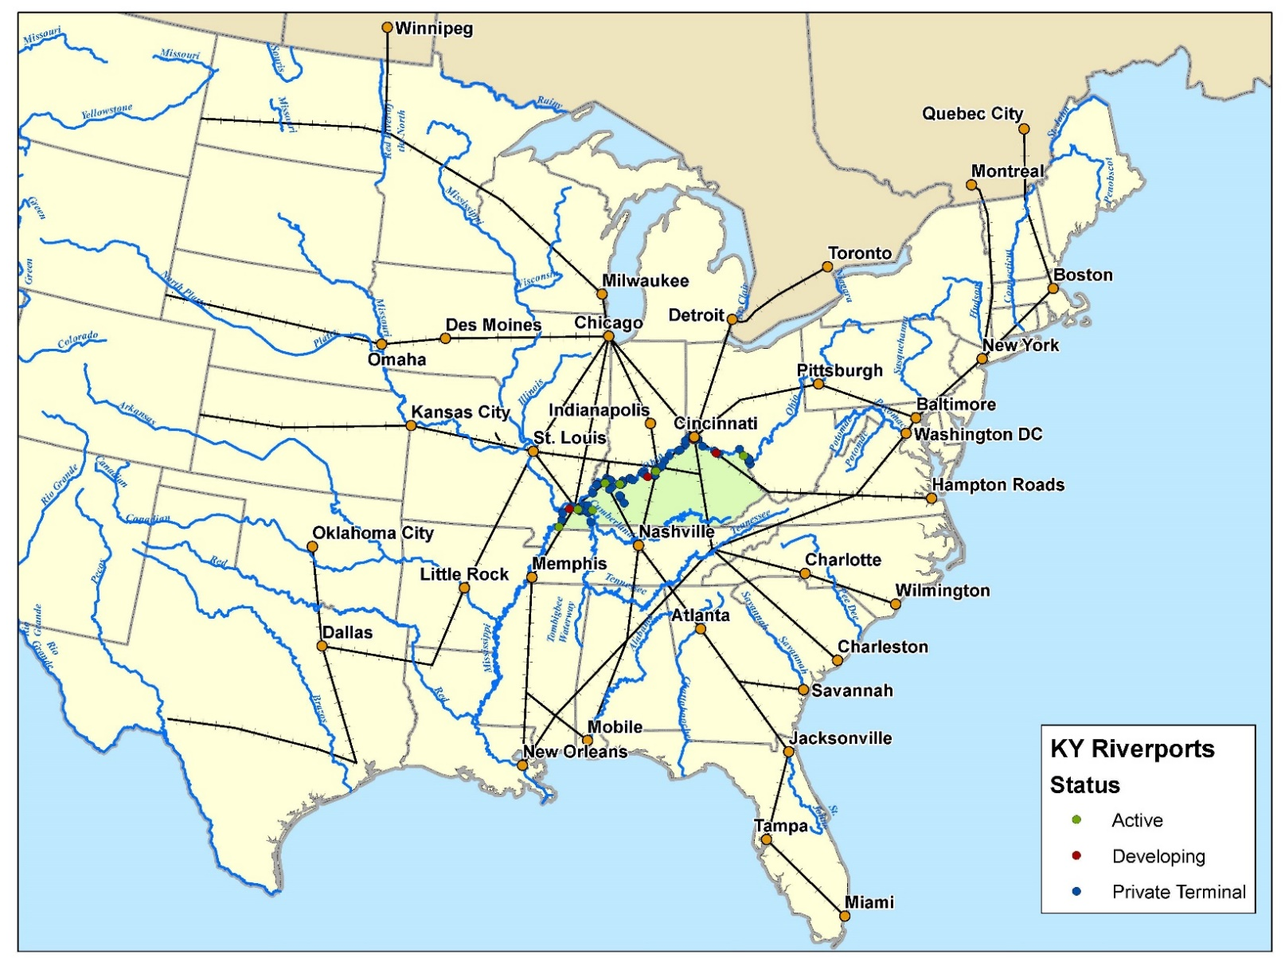
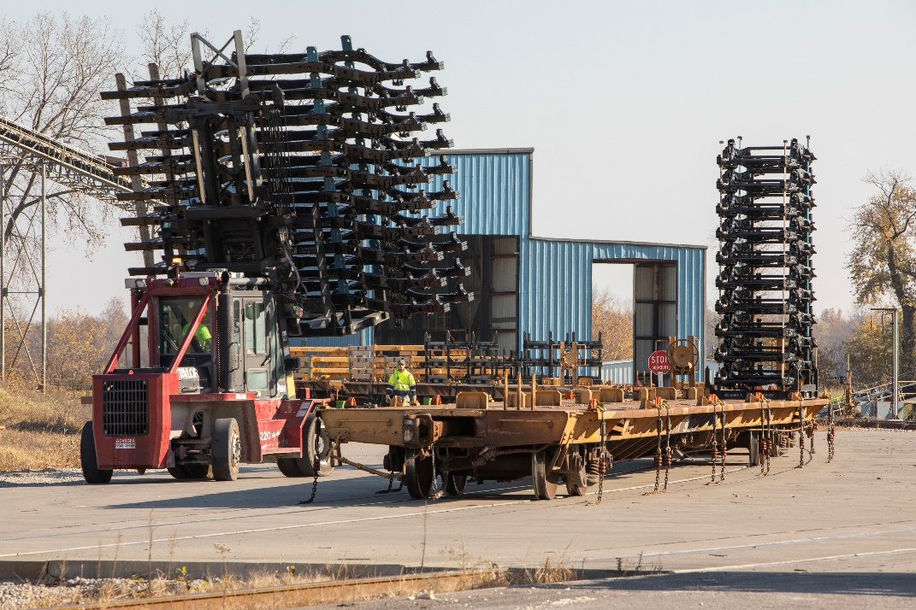
Kentucky’s Rail Network
Notes:
To help move freight on and off the waterways, our public ports and private terminals connect to a network of over 2,600 miles of rail throughout Kentucky. Kentucky serves as an important hub connecting 5 Class I railroads in the western part of the state, while a network of Class II and Class III railroads fill in the gaps to efficiently move freight within our state. Our rail network provides access to the greater markets outside of Kentucky to places like Chicago, New Orleans, and the ports on the East Coast.

Slide 7
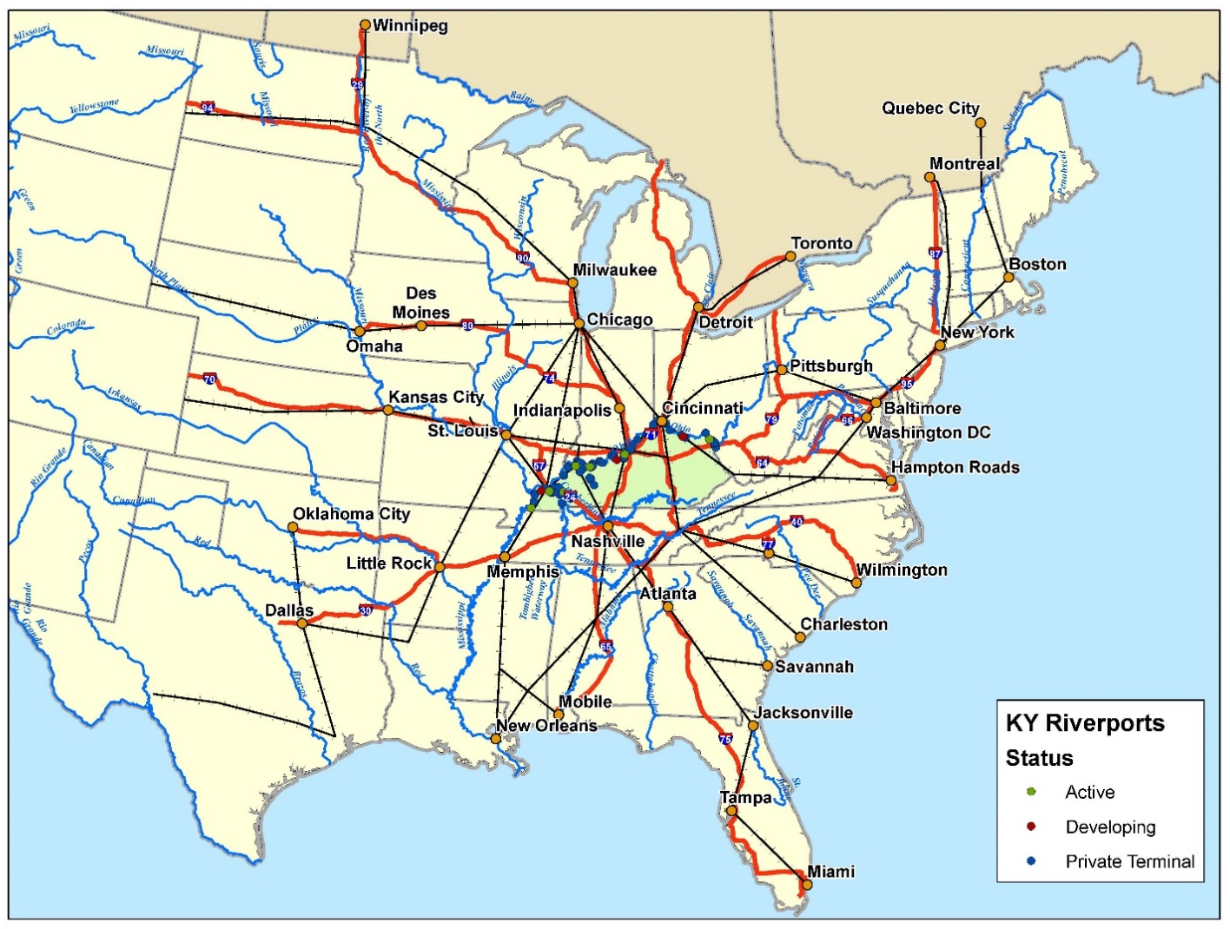
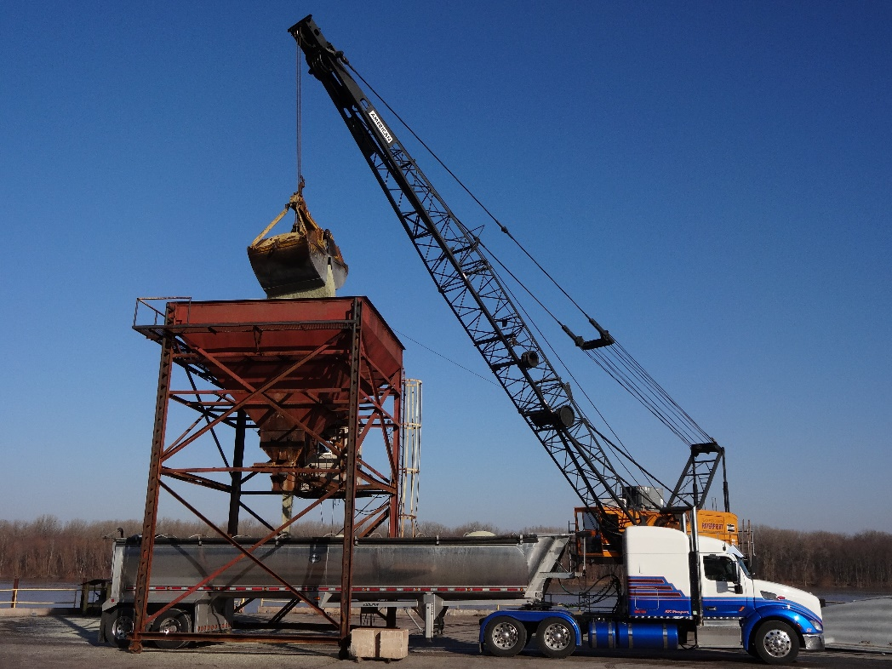
Kentucky’s Road Network
Notes:
The first and last mile connection of our states freight network rests on our public road network. Kentucky has over eighty thousand public road miles that provide those critical first and last mile connections. And while our public and private ports can reach into the large metropolises of the Eastern portion of the United States' using this road network, often the impact of our public and private ports is more regional.

Slide 8
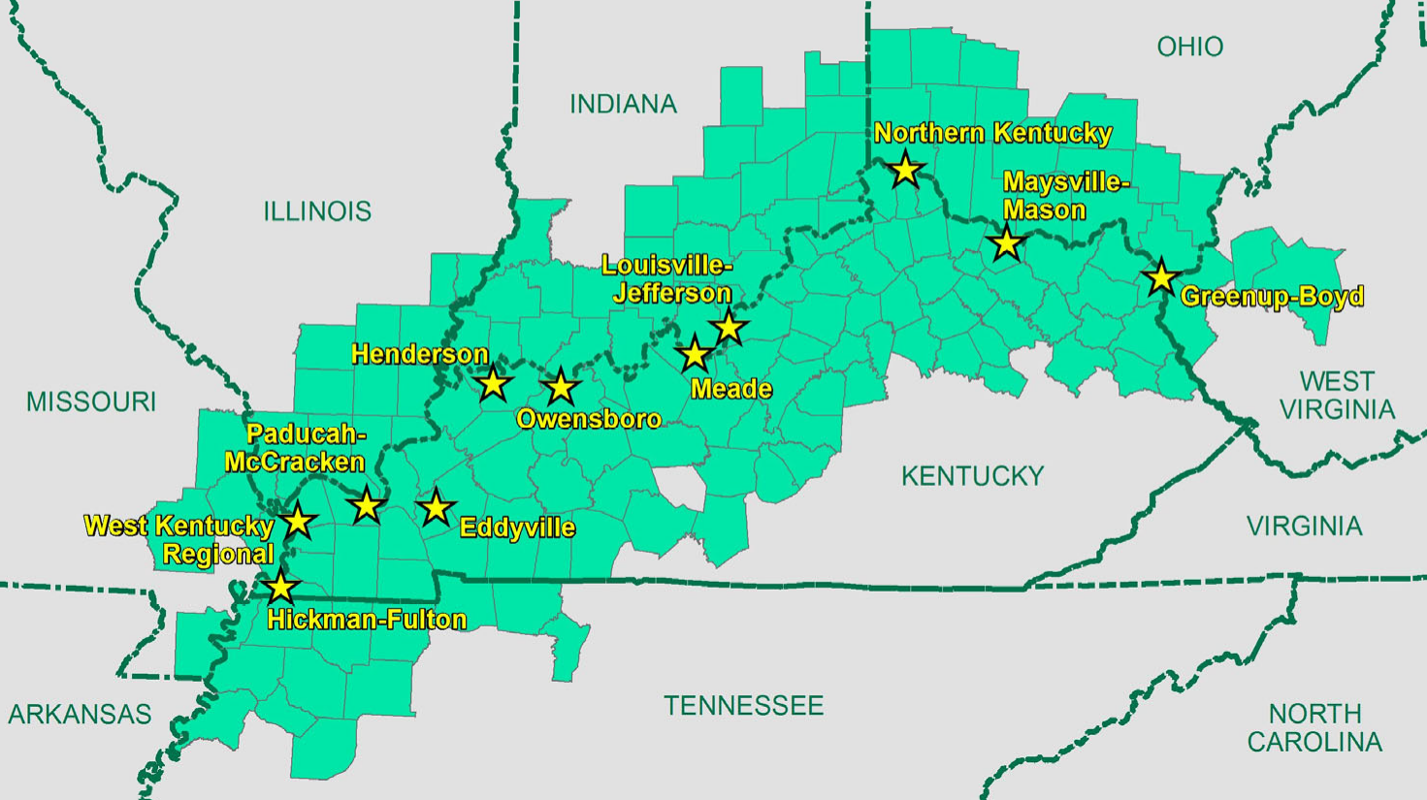
Riverport Hinterlands
Notes:
We refer to this as the Riverport Hinterlands. These are the counties that can be reached within a 90-minute drive of our public ports. The reach and benefits of our public riverports extend throughout much of Kentucky as well as into neighboring Tennessee, Missouri, Illinois, Indiana, Ohio, and West Virginia.

Slide 9



What Have We Learned About Riverports?
=
=
1
15-Barge Tow
216
Rail Cars
1,050
Trucks
Notes:
While every Kentucky community may not be adjacent to a river or have a riverport, all of Kentucky benefits from the efficiency of waterborne transportation. One 15 barge tow and towboat which is commonly seen working our inland waterway network, moves the freight equivalent of 6 locomotives and two hundred and sixteen railcars. This same 15 barge tow moves the equivalent to one thousand and fifty large semis and tractor trailers. Looking specifically at the freight moved by waterways in Kentucky in 2018, 89 million tons of freight valued at $18 billion moved on Kentucky’s inland waterways. This would be the equivalent to adding 3.5 million trucks annually to our roadway network without the contribution of the waterways. About 79% of Kentucky’s waterborne trade (by tonnage) is exchanged with trading partners outside of the Commonwealth.

Slide 10

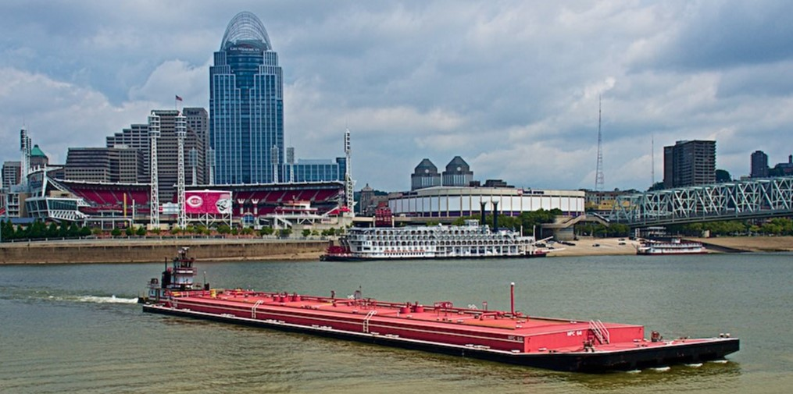
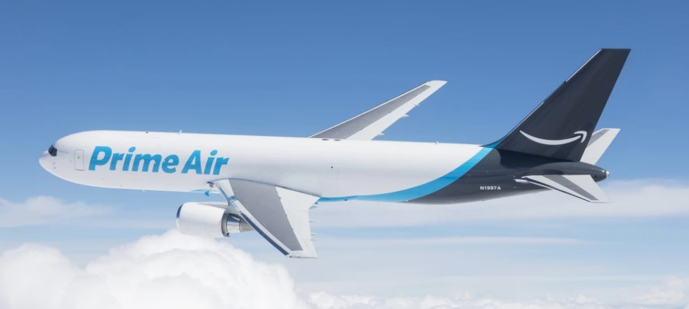
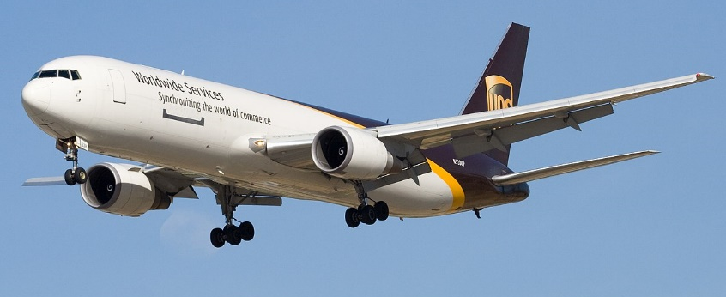
Supporting Kentucky's Air Cargo
Notes:
Our waterways and our public and private ports support more than just the river borne commerce. The jet fuel that powers the US hubs for DHL, UPS, and Amazon Prime Air are all delivered by barge. Manufactured at the Marathon Catlettsburg Refinery, the jet fuel is transported down the Ohio River to Cincinnati. Pipelines then deliver the fuel to the Cincinnati Airport which is the US hub for DHL and the new hub for Amazon Prime Air. The jet fuel then travels further down the Ohio River to Louisville where pipelines deliver the jet fuel to the Louisville Airport which is the worldwide air hub for UPS.

Slide 11




What Have We Learned About the Riverport Markets?
Riverports connect Kentucky to the national and global economy
Kentucky’s waterways carry over 80 million tons of freight each year, worth over $18 Billion
80M
Approximately 19% of Kentucky’s tonnage moves by water, but only 3% of the value
59% of new jobs in Kentucky in 2020 were from new business locations, suggesting opportunities and new markets
19%
59%
Growth potential includes manufacturing, food & beverage, trade/logistics, aluminum
Kentucky’s current funding level lags behind other states
Notes:
What are some of the things we learned from the study? Our riverports connect Kentucky to the nation and the world through our inland waterway system. The riverports represent an opportunity to affordably move a significant tonnage of inexpensive freight across a wide range of commodities. While the market for waterborne coal is declining in Kentucky, other commodities are growing with newly locating businesses in Kentucky representing potential future markets for public riverports. As noted, in 2018, 89 million tons of freight valued at $18 billion moved on Kentucky’s inland waterways. Approximately 19% of Kentucky’s freight tonnage moves by water, but this only makes up 3% of the value. This is largely due to the nature of the commodities moved. Waterways tend to move heavier, yet less valuable cargo due to the lower cost to move goods by water. The top inland waterways commodities by weight were coal, lignite, and coal coke-- sand, gravel, shells, clay, salt & slag --and petroleum products. By value, the top inland waterways commodities were basic chemicals used in consumer products including appliances, toys, and cosmetics—gasoline--and coal. Finally, Kentucky is bordered by states that share access to the same inland waterway systems. These states compete with us for customers, tenants, federal funding and their port facilities are sometimes just minutes across the river from ours. These states provide financial assistance to their public ports to maintain and upgrade their facilities and infrastructure to retain long standing tenants or attract new users.

Slide 12
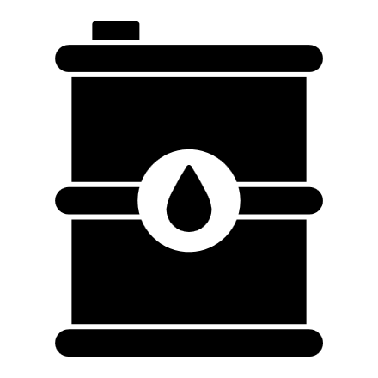

Demand is Shifting Away from Long-Standing Markets
Fuels
Minerals
National market increased by 67%
National market unchanged
Fuels declined by 48%
in Kentucky
Minerals declined by 95%
in Kentucky
Expected to lose an
Expected to lose an
additional 62% by 2045
additional 26% by 2045
Notes:
Overall, Kentucky’s long standing waterborne commerce markets in coal, fossil fuels and minerals have declined at a rate faster than the nation as a whole. Moreover, these waterborne commerce markets are projected in the future to shift even more away from these long-standing commodities. The changes highlight the importance of modernizing Kentucky’s public riverports to compete for new, more diverse markets.

Slide 13


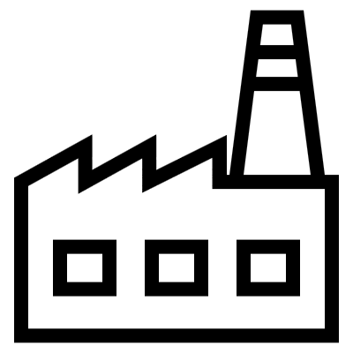
Smaller, Different Markets Will Increase
Plastic & Machinery
Food & Livestock
National increased by 17 X
144% Increase in
food projected
Kentucky increased by 11 X
81% Increase in
livestock projected
Plastic/rubber, textiles and machinery
1997-2017
2018-2045
Notes:
Plastics, rubber and chemicals as well as food and livestock are growing markets for waterborne commerce in Kentucky. While these markets are smaller than today’s mineral and fossil fuel markets, they are rapidly growing and the public riverports are already working to keep up with this growth. Waterborne trade in plastics, rubber, textiles and machinery increased 11 times from 1997 to 2017. And from 2018 to 2045 it is projected that waterborne trade in chemicals and allied products such as plastics, rubber and similar goods will increase by 23%. It is also projected that from 2018 to 2045, Kentucky's waterborne trade in food and kindred products will increase by 144% and its trade in agricultural and livestock products will increase by 81%. So, there are opportunities for our ports, but it is going to require collaborative effort to best position the ports to attract and grow these new markets.

Slide 14
What Will Riverport Investment Cost?
Notes:
One critical component of the study was the assessment of the public port infrastructure and identifying needs. The study identified that in 2020, Kentucky’s riverports had a $12.3 million dollar backlog in unmet needs to simply get the existing infrastructure into a state of good repair and continue business as normal. The ports also identified additional modernization and expansion needs to successfully compete for business and serve new markets in the long-term. To upgrade our ports that were constructed in the 1960s and 1970s to modern operational efficiency would require an additional $51.6 million and to upgrade the public riverports to attract new markets and expand capacity would require an additional $158 million. All told, the 2020 total investment needs was $222 million and with current inflation, these figures would be much higher. The study recommended a one-time injection of funds to allow the ports to address their most pressing preservation needs followed by a dedicated stream of funding to address on-going preservation but also the ability to use state funds to match available federal funds to modernize and expand. Several of our public ports have been successful at receiving federal grant funds to preserve their existing infrastructure, but often the local match is a hinderance to applicants.

Slide 15
What Choices Do We Face?
Kentucky’s ports, inland waterways, and inland waterway dependent industries in Kentucky:
  110,000 jobs
  $5.9B in personal income
  $12B Gross State Product
  $30.7B in Total Output
  $1.2B in State and Local Tax Revenue
State Port Assistance
  Kentucky
    $500,000 annually
  Ohio
    Increased from $12M to $20M annually
  Missouri
    $12M annually
    In FY 23 added $30M in ARPA funds
  Illinois
    $150M annually, $40M dedicated to new Cairo port
Invest vs. Scaling Back
Notes:
Kentucky today faces a critical choice of whether to invest in modernizing the public riverports and their capacity to handle a new and increasingly diverse market, or see waterborne commerce play less of a role in Kentucky’s economy. Kentucky is also able to choose the degree to which its business attraction and economic development strategies will play a role in building markets for highly efficient waterborne transportation. But Investing in our public riverports will create benefits to Kentucky’s economy far exceeding the costs. Kentucky’s ports, inland waterways, and inland waterway dependent industries currently support nearly one hundred and ten thousand jobs. This equates to $5.9 billion in personal income, $12 billion in Gross State Product, and $30.7 billion in total output. This gives rise to more than $1.2 billion in state & local tax revenue. As noted previously, Kentucky is bordered by states that share access to the same inland waterway systems. These states compete with us for customers, tenants, federal funding and their port facilities are sometimes just minutes across the river from ours. These states provide financial assistance to their public ports to maintain and upgrade their facilities and infrastructure to retain long standing tenants or attract new users. Ohio’s Maritime Assistance Grant Program was just increased by their legislature from $12M to over $20M annually. Missouri annually allocates $12M from their state funds for public riverports, but they recently infused an additional $30M in FY 23 from their allocation of federal American Rescue Plan Act (ARPA) funds. Illinois annual grant program for their public port's totals $150M, with $40M alone dedicated to build a new port in Cairo, Illinois very close to our Paducah Riverport.

Slide 16

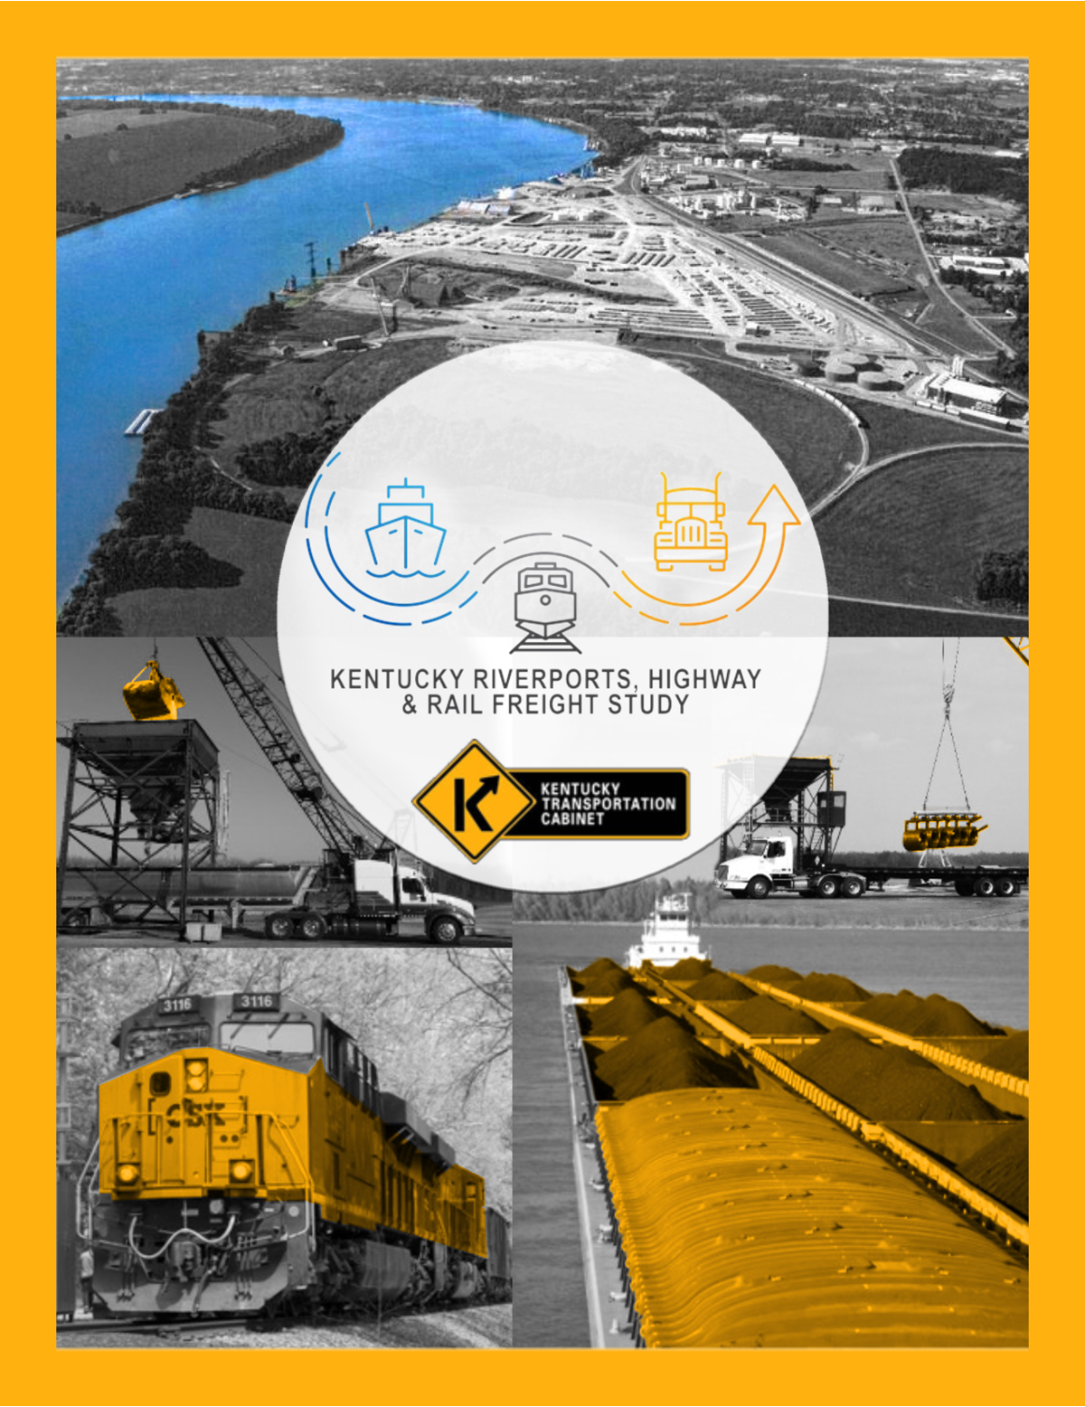
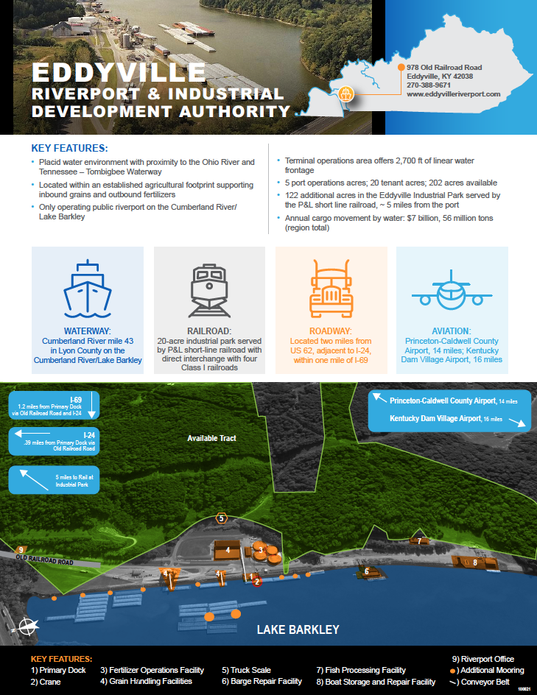
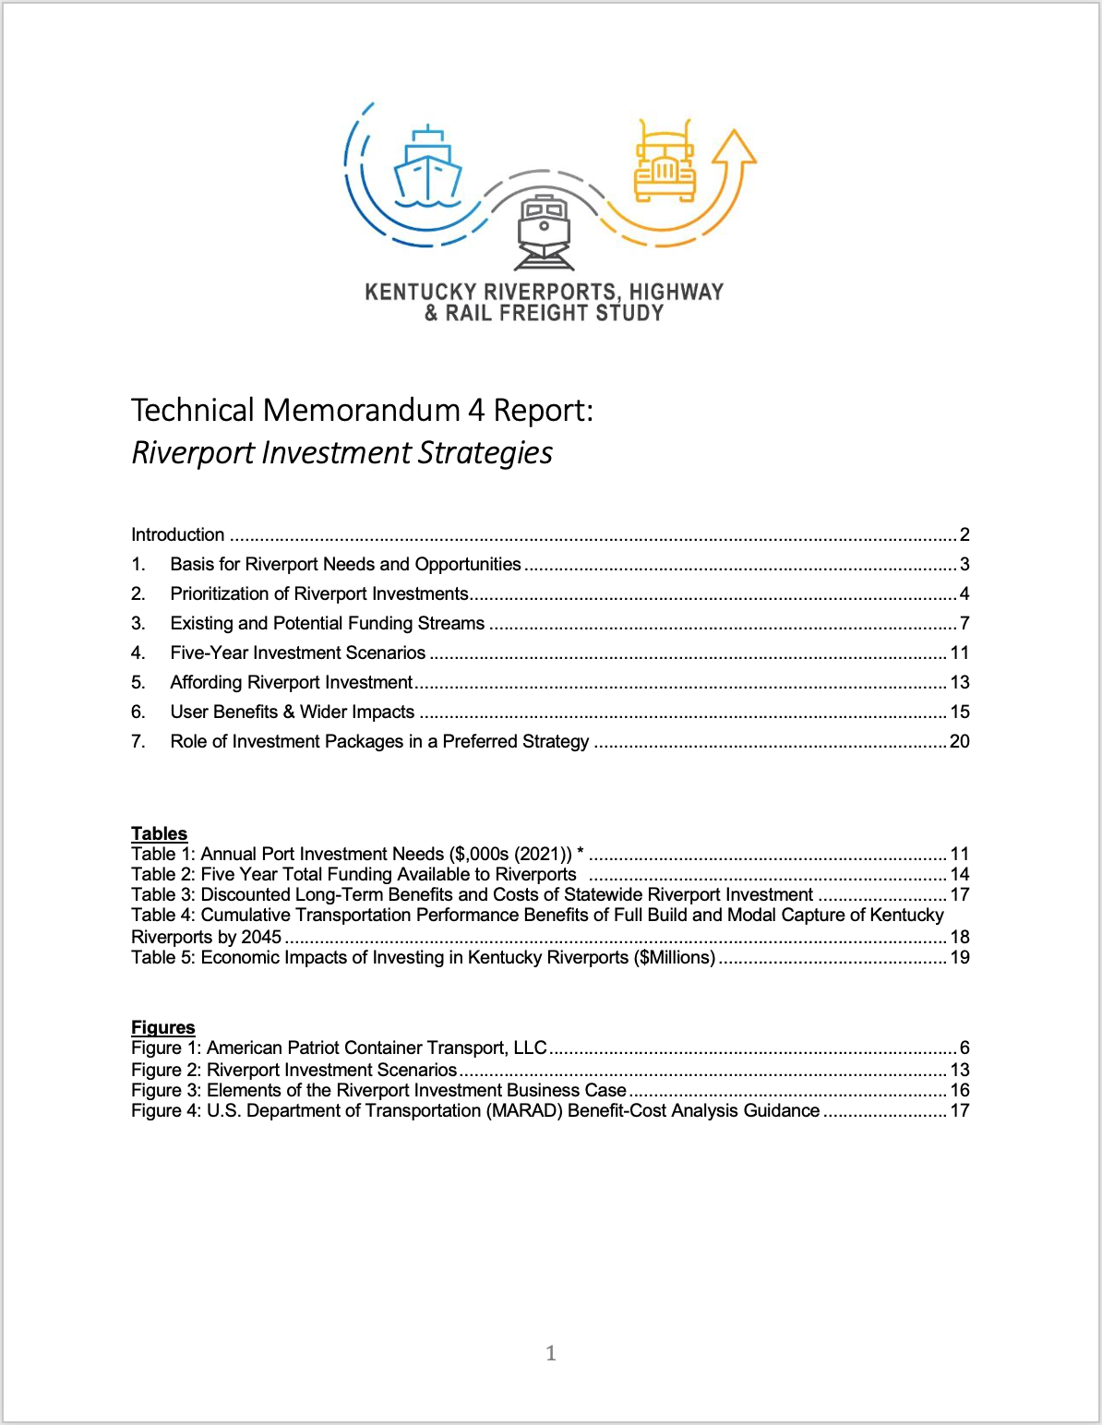
Final Report Deliverables
REPORT
PORT PROFILES
TECH MEMOS
https://transportation.ky.gov/MultimodalFreight/Pages/Kentucky-Riverports,-Highway-and-Rail-Freight-Study.aspx
Notes:
The final riverport study materials include the 200-page report, a 12-page executive summary and a 4-page brochure of the main study. We also have a marketing toolkit to guide the ports in their marketing efforts as well as PowerPoint presentations about the role of a port. There are also 4 technical memorandum as well as port profiles of all our public ports. These materials as well as the recordings and materials from the 3 summits have all been posted on our website and can be accessed at this link or using this QR code. This presentation provided a summary of inland waterways system as well as some of the findings and recommendations of the Riverports, Highway & Rail Freight Analysis Study. But it should be noted that this this report and recommendations do not represent an official position of the Transportation Cabinet or the administration or an official budgetary request. I believe the Kentuckians For Better Transportation and Kentucky Association of Riverports are working on specific funding request amounts.

Slide 17
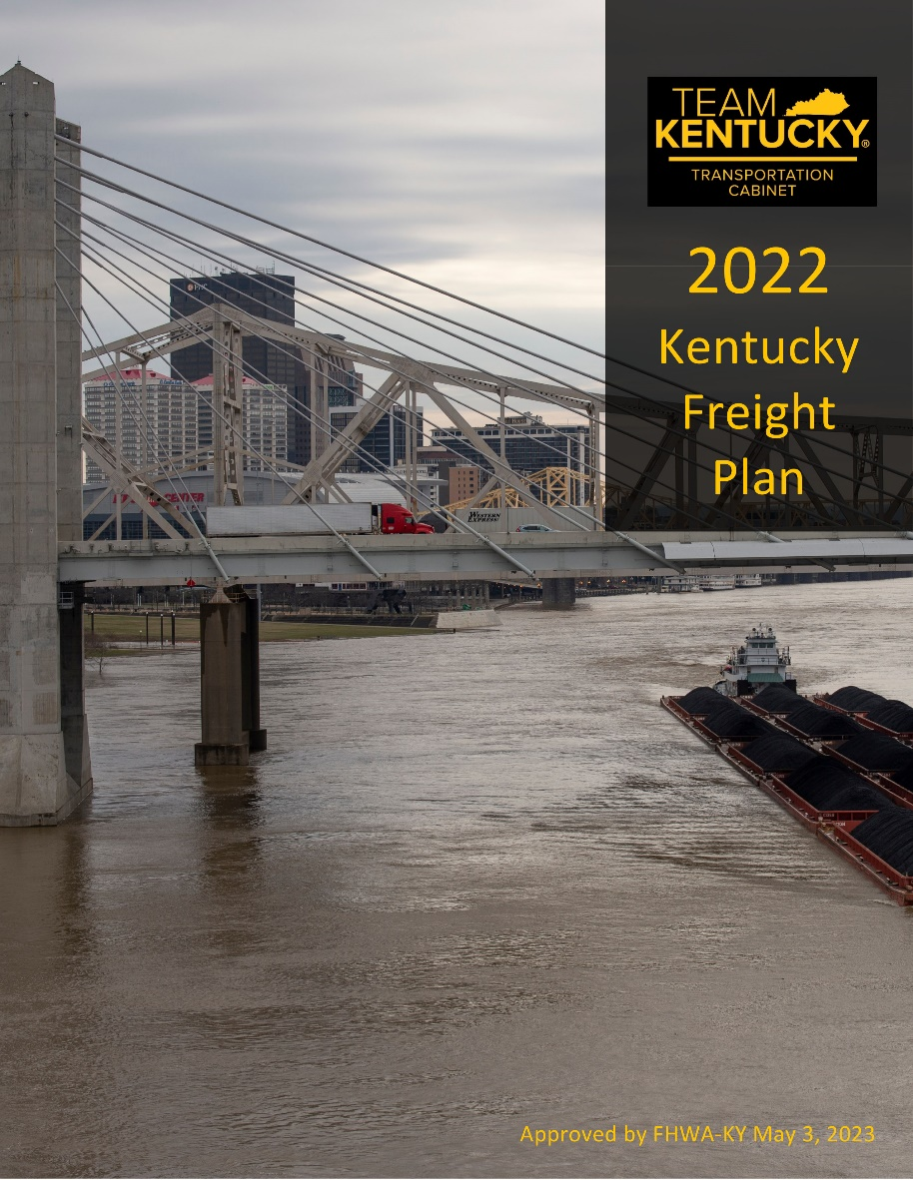
Kentucky Freight Plan
  Inventory multimodal freight networks
    Highways
    Waterways
    Rail
    Pipelines
    Air cargo
  Freight goals & performance measures
  Current conditions
  Key industries & supply chains
  Freight trends & challenges
  Freight system needs
  Policy & strategic recommendations
  Freight investment plan
Notes:
I would like to add a note about Kentucky’s Freight Plan. Our prior freight plan was approved by the Federal Highway Administration in 2017 with a 5-year update cycle. With the passage of the Bipartisan Infrastructure Law, this update cycle was shortened to 4 years, and it added some new required content. Kentucky was already in the process of updating our state freight plan when the BIL requirements came out. So, we were able to adjust our freight plan submission to be BIL compliant. The Kentucky Freight Plan was officially approved by the Federal Highway Administration on May 3, 2023. The state freight plan covers all modes including road, rail, river, air, and even pipeline freight. The Freight plan includes an Inventory of Multimodal Freight networks including highways, waterways, rail, pipelines, and air cargo. Looked at goals & performance measures, Current conditions, key industries & supply chains, freight trends & challenges, freight system needs, policy & strategic recommendations and most importantly a freight investment plan.

Slide 18
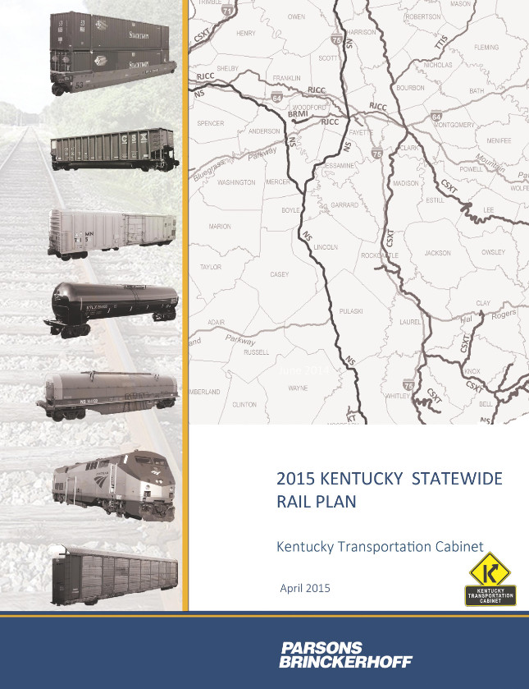
Kentucky Statewide Rail Plan and Infrastructure Assessment
Update to the 2015 Kentucky Statewide Rail Plan to Federal Railroad Administration criteria.
Notes:
Not to be left out, we are also just beginning the update to the Kentucky Statewide Rail Plan. Last completed in 2015, our update will bring our rail plan into compliance with the Federal Railroad Administration’s updated guidelines for a state rail plan. This update mainly focuses on an inventory of the rail system in the state, passenger and freight rail facilities, rail tonnages, available funding, and rail safety and security. We have partnered with Kentucky’s railroads to expand the scope of the Rail Plan update to include a more in-depth look at rail infrastructure needs, rail bottlenecks and connectivity, rail bridge conditions, tie conditions, rail industry forecast & growth opportunities, rail line preservation needs, etc. This expanded and updated rail plan would help our railroads as they seek federal grant opportunities to improve their infrastructure by having their needs reflected in the state’s rail plan. The Notice to Proceed was just issued on June 27th so the Kentucky Statewide Rail Plan and Infrastructure Assessment project is just commencing.

Slide 19
For More Information
KYTC Freight Planning Webpage
Jeremy Edgeworth, KYTC
Jeremy.edgeworth@ky.gov
502-782-5095
Notes:
Information on our Kentucky Riverports, Highway & Rail Freight Analysis Study, Kentucky Freight Plan, or our Kentucky Statewide Rail Plan and Infrastructure Assessment can all be found on our Freight Planning website. I would also be happy to answer any questions.

