Slide 1
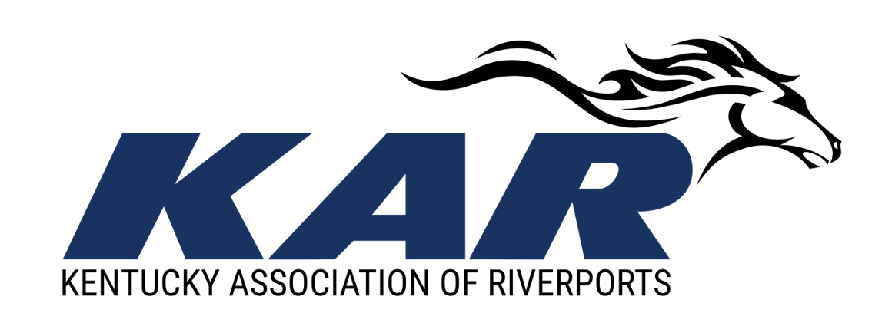
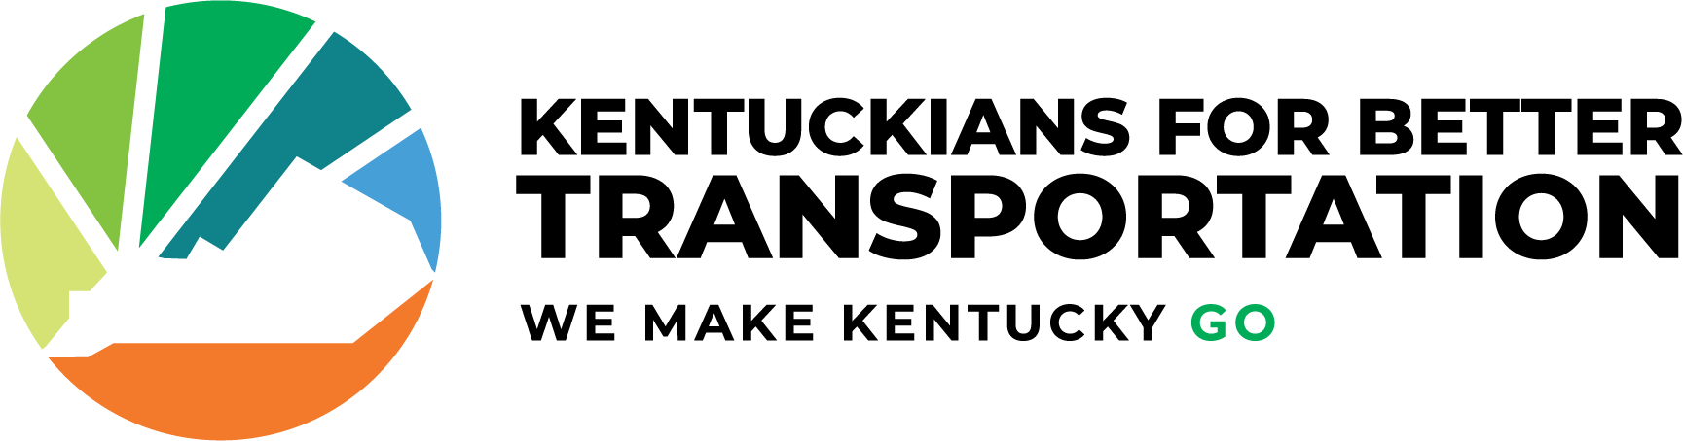
The Riverport Industry in Kentucky

Slide 2
Public Riverports in Kentucky
Any governmental unit by act of its legislative body or two or more units acting jointly and with approval of the Transportation Cabinet may establish a riverport authority
Kentucky Public Riverport Authorities are established under Kentucky law with powers and duties prescribed by KRS 65.510 to 65.650
Authority members are appointed by the local executive – Mayor, Judge Executive, or both
Currently, there are 10 public riverport authorities in Kentucky
7 are active and operational in the movement of goods
3 are developing, have authorities in place, but not yet fully operational

Slide 4
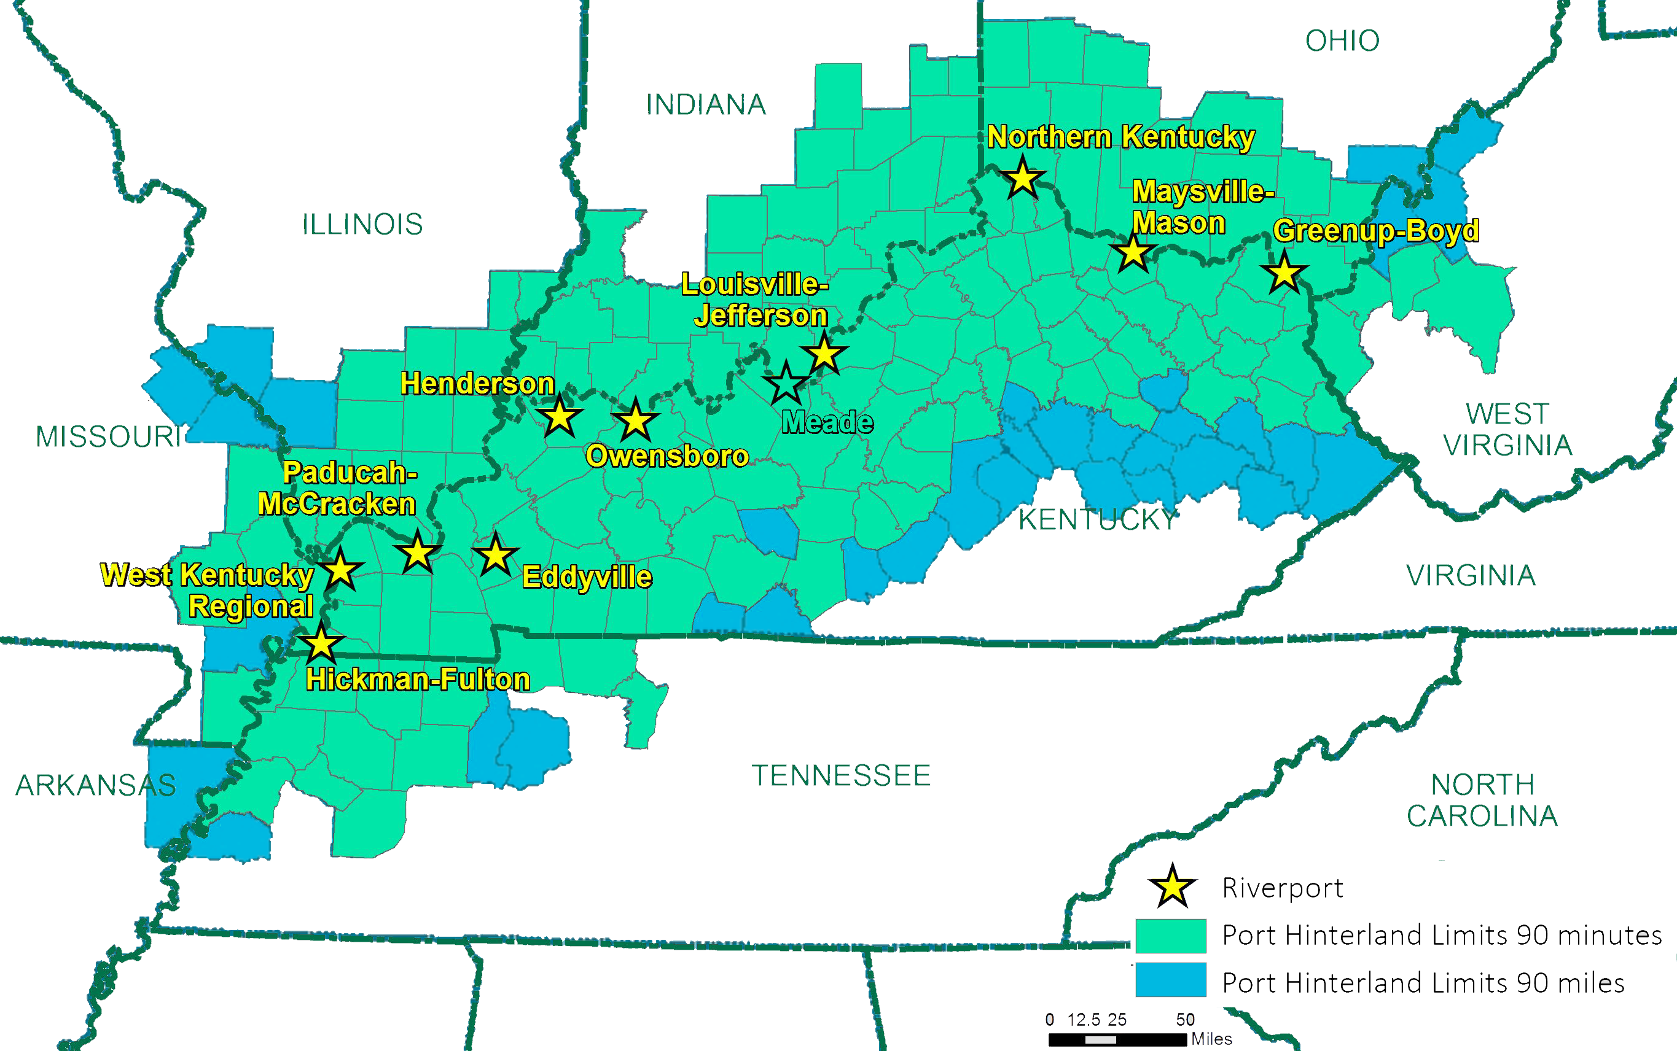
Kentucky Riverport Hinterlands
*area within a 90 mile distance of a public riverport

Slide 5
Kentucky’s Waterways Create Value
Kentucky’s Waterways Create Value by Enabling the Commonwealth to:
  Trade with the World: In 2018, Kentucky traded over 89 million tons of freight using inland waterways, valued at over $18 billion. About 79% of Kentucky’s waterborne trade (by tonnage) is exchanged with trading partners outside of the Commonwealth.
  Kentucky’s waterborne transportation system overall saves approximately 2.3 billion vehicle-miles of travel (VMT) and over 43 million vehicle-hours of travel (VHT) each year in ground transportation costs.
  Our Waterways Support Kentucky’s Supply Chains: energy, chemical, agriculture/food/lumber, and metals/minerals supply chains are highly dependent on Kentucky’s waterways.

Slide 6
How Does Kentucky Invest in Riverports?
Since 2013, the Commonwealth has supported the riverport industry through the Kentucky Riverport Improvement (KRI) Grant Program. Current budgeted allocation is $500,000 annually.
KRI funds are a General Fund appropriation in the Transportation Cabinet Budget.
The program requires a 50% local match.
KRI applications due each year in May for July 1 FY and funds must be used by June 30th or returned to General Fund. No carryover.
Funding can be used for new construction, repairs, or replacement of docks, wharves, equipment, port buildings, storage facilities, roadways and railroads, other onsite improvements, and related professional services. Funds are not to be used on routine maintenance, port operations, or plans/studies

Slide 7
Public Riverport Challenges
Inadequate funding
  $12.3M needed for asset preservation (based on 2018 data)
  Increased annual state funding needed to continue investment and compete with surrounding states
Riverports are unable to use state grant funds to match federal grants
The funds don’t carryover
The current grant program requires a 50% local match and is a disincentive for some riverports to participate.

Slide 8
Investment by Surrounding States
*Indiana and Tennessee don’t currently have state grant programs
 | Kentucky | Ohio | Missouri | Illinois
Number of Public Ports | 10 | 8 | 15 | 19
State Investment | $500K | $20M (recent increase from $12M) | $12M plus $30M (ARPA) in FY 23 | $150M

Slide 9
Asset Preservation vs Modernization
All current active ports in Kentucky where built in early 1970’s.
Preservation needs are based on “Business as Usual” today.
Each of the Kentucky ports are similar in base commodities, such as Fertilizer and Grain, but additional commodities handled are based on location to industries.
Examples of Asset Preservation:
  Hickman – Grain Conveyor Replacement $4,500,000
  Paducah – River Mooring Cells to dock barges $669,000
  Owensboro – Heavy Lift Equipment $900,000

Slide 10
Modernization & Expansion
To optimize port efficiency and expand markets to attract new anchor tenants and service new industries.
Examples of Modernization & Expansion:
  Henderson – Terminal Warehouse $2,000,000
  Louisville – Cargo Dock $8,000,000
  Owensboro – 50 Acre Rail Site Development $1,000,000

Slide 11
Owensboro Riverport Authority
Chartered in 1966 by the City of Owensboro
2022-2023 Inbound Volume (Short Tons) - 1.2 Million
  Barge - 657,000 ST (438 Barges) = 27,000 trucks
  Rail – 230,000 ST (2,300 Rail Cars) = 96,000 trucks
  Truck – 329,000 ST (13,700 Trucks)
Commodities: Grain, Fertilizer (dry & Liquid), Salt, Aluminum, Copper, Steel, Paper, Graphite.
Revenue Generation:
  Use of equipment, facilities and land
  Per Ton Throughput

Slide 12
Owensboro Riverport Authority
Economic Development
  131 jobs added to local Auto Chassis Manufacture thru port utilization and Infrastructure upgrade.
  BUILD Grant recipient for “Last Mile” highway upgrade enhancing multiple local industries access.
  Economic Impact Study – 2018
Operational Impact
  It is estimated that the total economic impact of Authority riverport operations in 2018 included $16.1 million of total output, $8.6 million of labor income, and support for 197 jobs annually. When analyzing the last six years, it is estimated that the annual impact of Authority riverport operations to the City of Owensboro is, on average, $13.8 million of total output, $7.0 million of labor income, and support for 161 jobs annually throughout the region.

Slide 13
Proposal
$15 Million one-time allocation to address asset preservation – no required match
Increased annual sustainable funding
Utilize the Riverport Financial Assistance Trust Fund (KRS 174.210) to allow for:
  Funding to carry forward
  A decrease in the local match requirement from 50% to 20%

Slide 14
Jennifer Kirchner
Executive Director
Brian Wright
President/CEO
Owensboro Riverport Authority

Slide 15

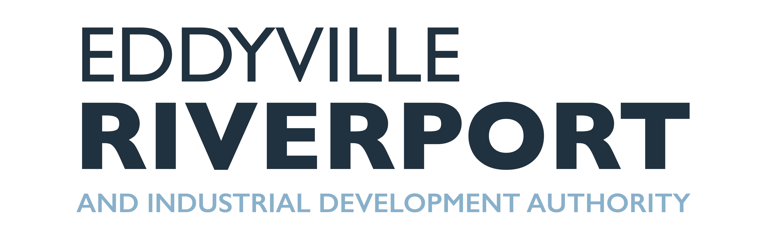
Amanda Davenport
Executive Director, Lake Barkley Partnership
Chair Elect, Kentucky Association for Economic Development
Member, Water Transportation Advisory Board

Slide 16
ERIDA
“Eddyville Riverport and Industrial Development Authority”
Established in 1976 by Cities of Eddyville and Kuttawa and Lyon County
In 2002, combined with Industrial Development Authority
Only board in Kentucky to own and operate both the riverport and industrial park

Slide 17
ERIDA
Riverport Industrial Clusters & Impact
  Agriculture
  Maritime
  Tourism
  Directly supports 200 jobs
  Indirectly supports 3,200 agriculture jobs
Industrial Park Clusters & Impact
  Trucking
  Chemicals
  Target Industries: EV; Plastics; Small Manufacturing

Slide 18
ERIDA
Revenue Generation:
  Use of facilities and land through leases
  Per Ton Throughput Charges
2019-2021 $1.6 million in capital investment
  $900,000 at riverport
  $700,000 at industrial park
2021 PIDP Small Port Grant $6.1 million
  $5.9 million in federal funds
  $1.2 million in local match

Slide 19
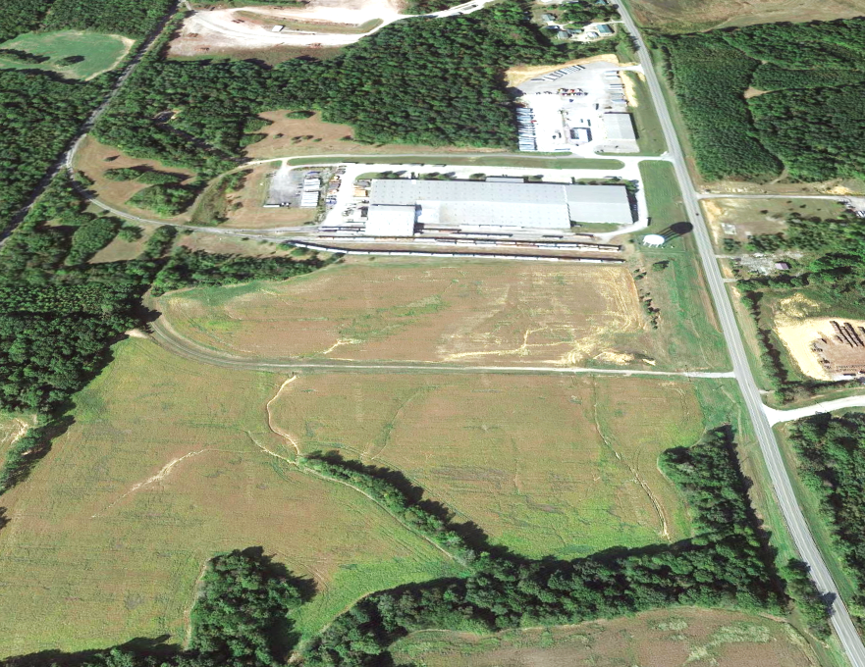
Eddyville Industrial Park Before

Slide 20
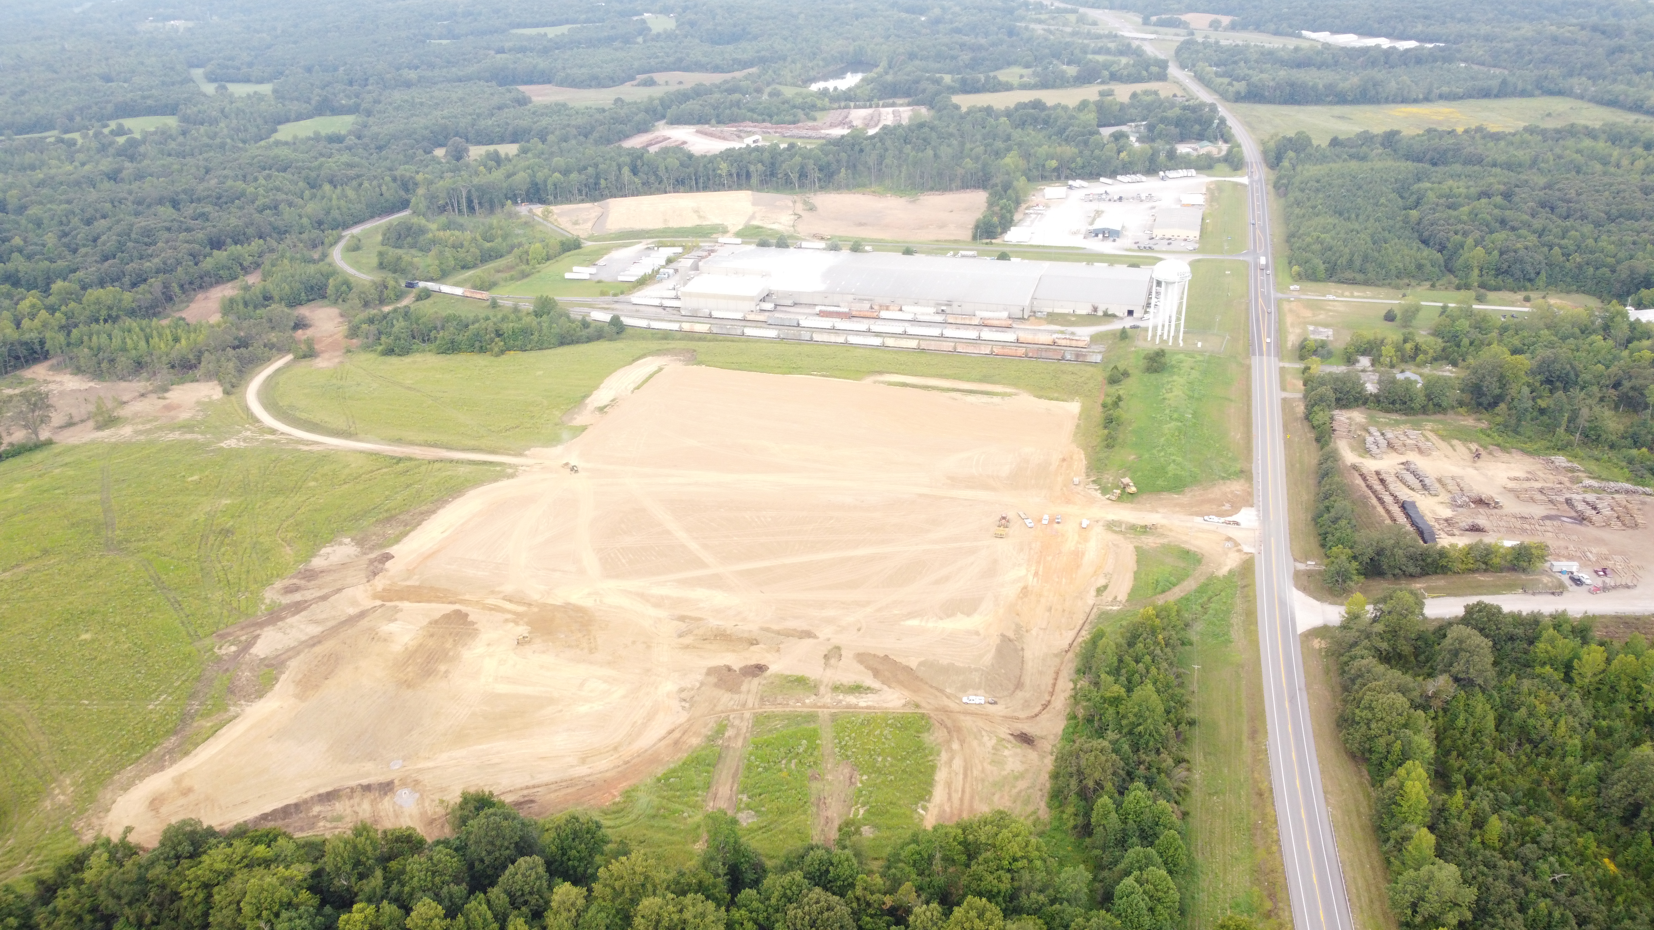
Eddyville Industrial Park After

Slide 21
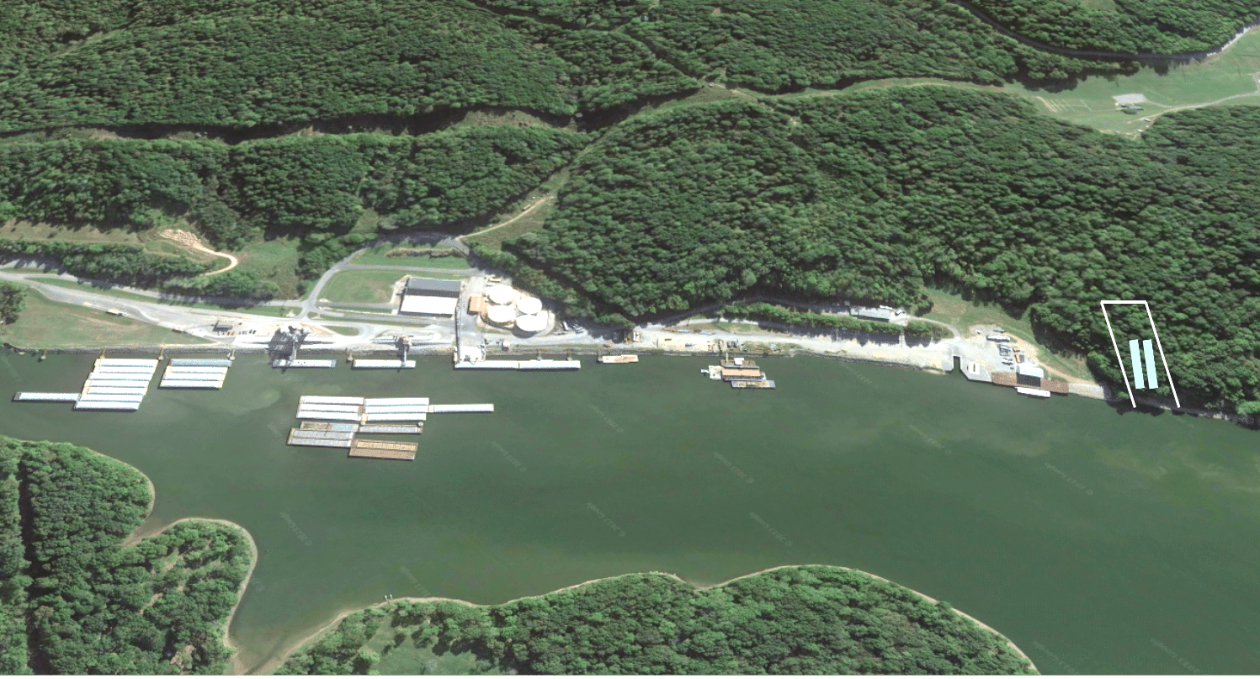
Eddyville Riverport Future Inlet

Slide 22
Riverports & Economic Development
Riverport Hinterland Industrial Clusters
  Chemical Complex in Calvert City
  Ascend Elements in Hopkinsville, KY
  Envision Battery Plant in Bowling Green, KY
  BlueOvalSK Battery Park in Glendale, KY
  Blue Oval City in Stanton, TN
Kentucky Riverports are in a perfect position to continue the growth of record breaking economic development projects we have seen across all regions and industries in Kentucky.

