Slide 1
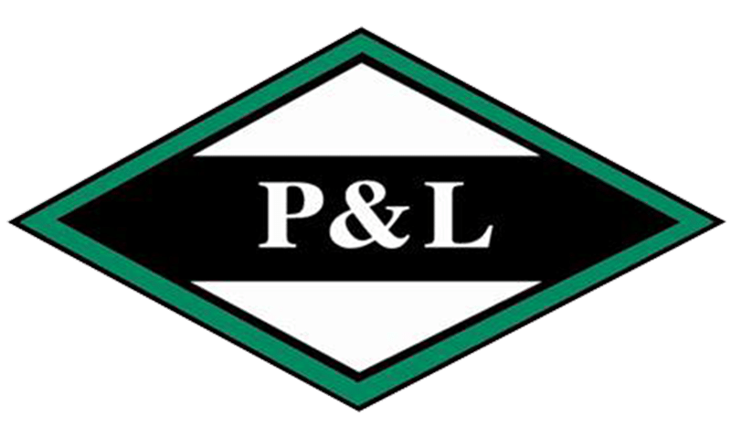
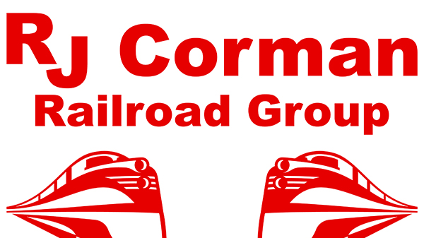
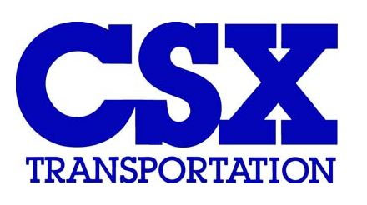
Kentucky Rail Association
William Downey, Chair

Slide 2
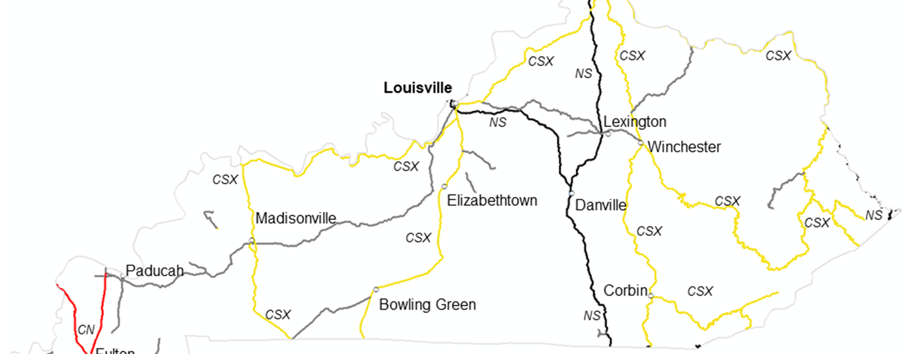
Railroads in Kentucky

Slide 3
Rail Funding Needs
KYTC and HDR Engineering – Rail Assessment Study
Investment in Rail Infrastructure
KFRSIP – Kentucky Freight Rail and Safety Improvement Program
Preservation and maintenance, expansion, industrial access, economic development
KFFF – Kentucky Federal Freight Fund
Program to assist communities, authorities, railroads, riverports seeking federal grant opportunities for rail infrastructure projects

Slide 4
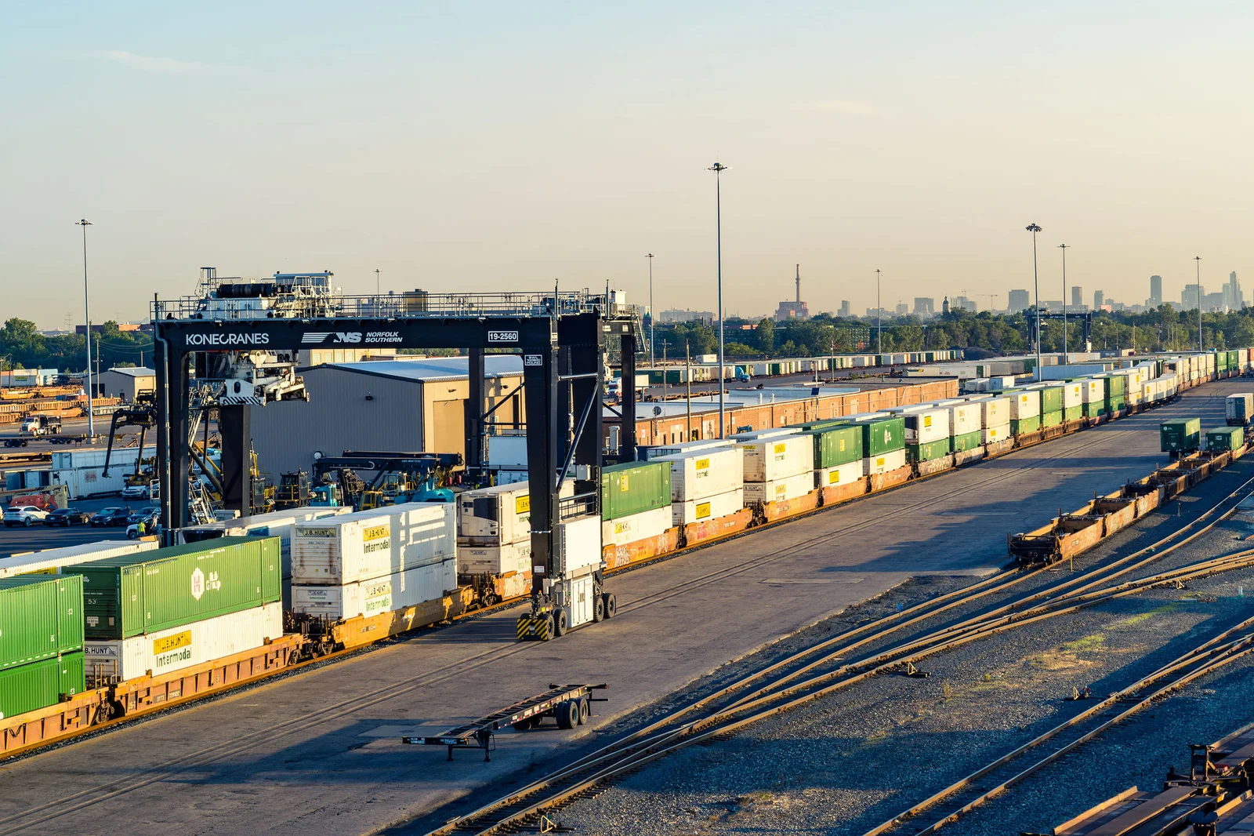
Rail Connectivity
Transloading is the process of "transferring-the-load" of products from one mode of transportation to another, specifically between trucks and railcars.
Rail intermodal is the long-haul movement of shipping containers and truck trailers by rail, combined with a truck or water movement at one or both ends.

Slide 5
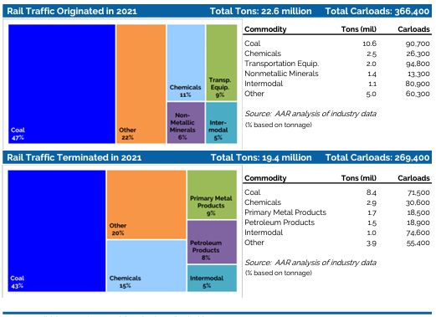
Kentucky Carload Data

Slide 6
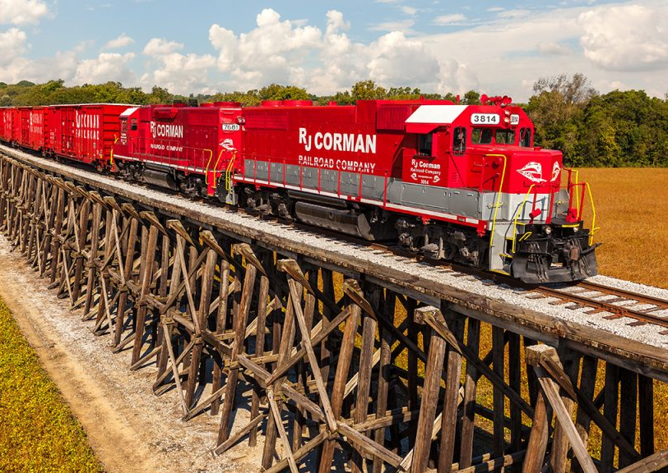
Private Investment in Kentucky
Industry Average – 25% total revenues invested back into rail network
Annual investment in Kentucky railroads $160 million+ in rail infrastructure
Includes maintenance and rehabilitation, capital expenditures

Slide 7
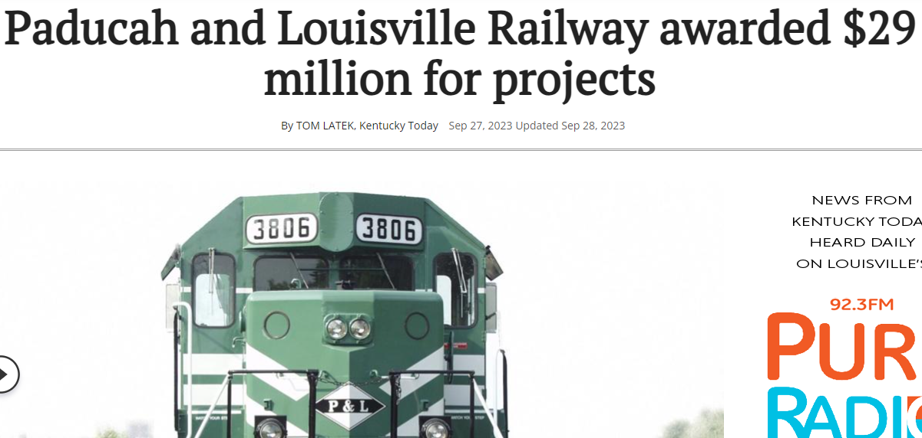
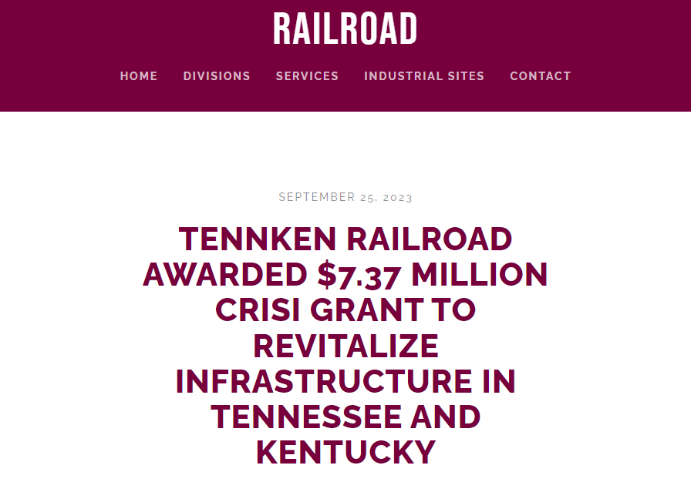
Public/Private Investments

Slide 8
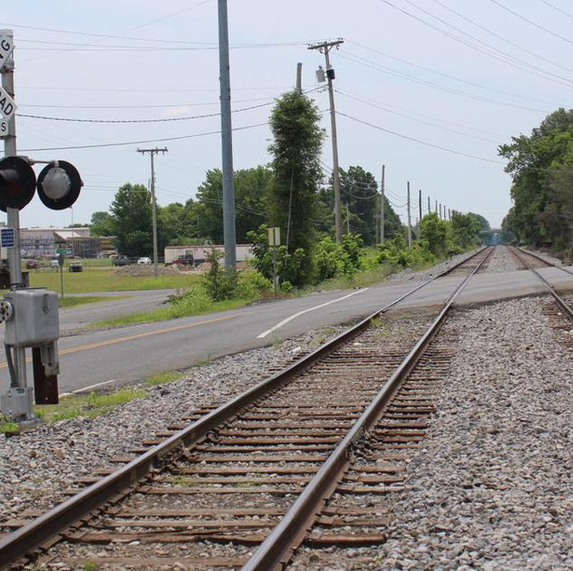
Public Investment in Kentucky
Kentucky Rail Crossing Improvement Program (KRCI)
$1.6 million annually
Limited to grade crossing repairs and improvements
$350K of funds went towards needs assessment study in partnership with KYTC

Slide 9
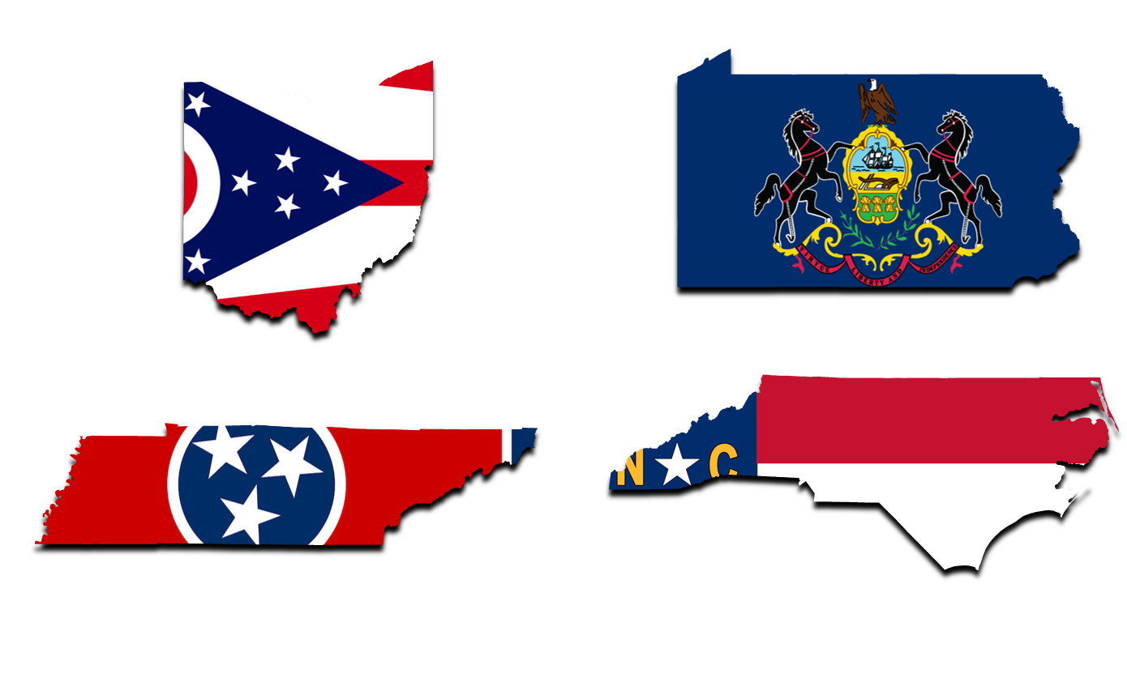
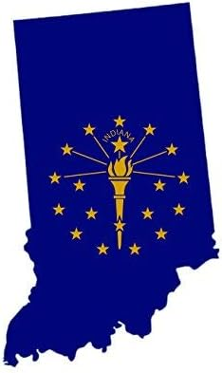
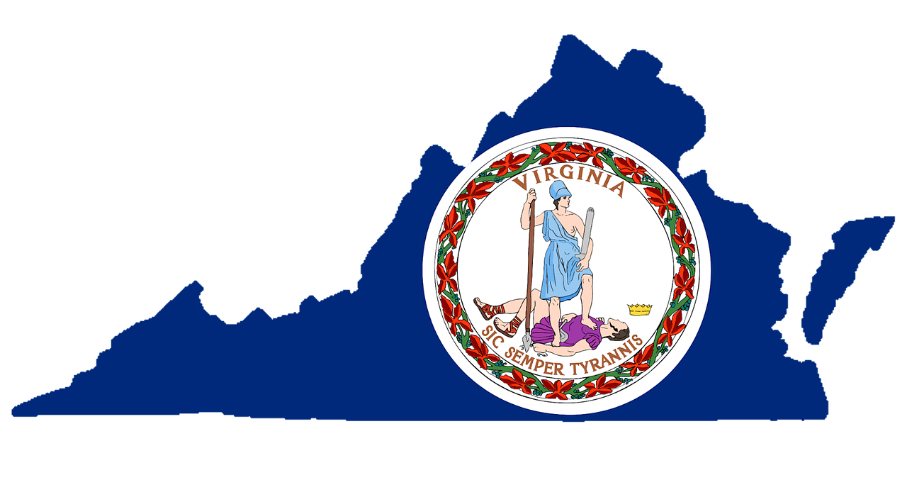
State Leaders in Funding Programs

Slide 10
State Funding Programs
Local Trax Rail Overpass Program
Indiana is known at the Crossroads of America in part due to the many busy railroad lines that carry trains across the state. In total, Indiana has more than 8,700 at-grade railroad crossings, two thirds of which are public crossings.
To improve safety and reduce crashes, injuries and fatalities at railroad crossings, the Indiana legislature in 2017 passed HB 1002, establishing the Local Trax Rail Overpass Program. The program provided grants to cities and counties for grade separation, crossing closure and other safety enhancement projects at highway-rail intersections. Lawmakers approved $10 million in annual debt service, which amounted to about $125 million for the Local Trax program.
Industrial Rail Service Fund
The program provides grants to assist Class II and III railroads, as well as railroad port authorities, with the maintenance and upgrade of rail infrastructure to better serve existing customers and to promote rail-based business development.
The fund receives a percentage of the state sales tax (0.031%) which is deposited into the fund quarterly. The fund receives between $3.5 million and $4 million each year.
Grant awards must not exceed 75 percent of the total cost of a project. The railroad contribution may include funds from other state or federal agency. The maximum grant award for a railroad in a fiscal year is $250,000.

Slide 11
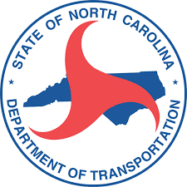
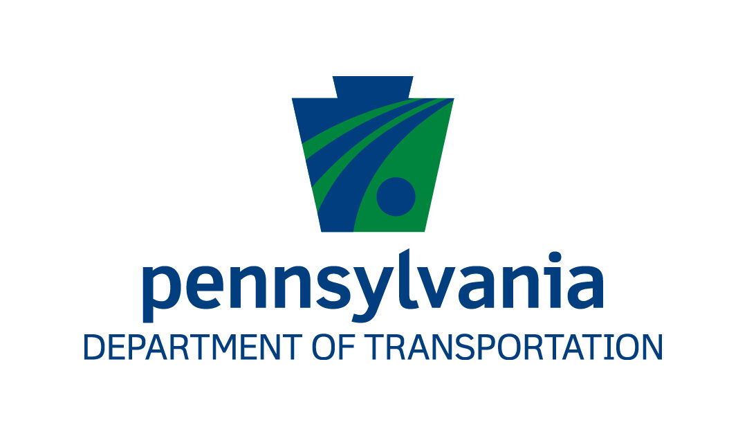
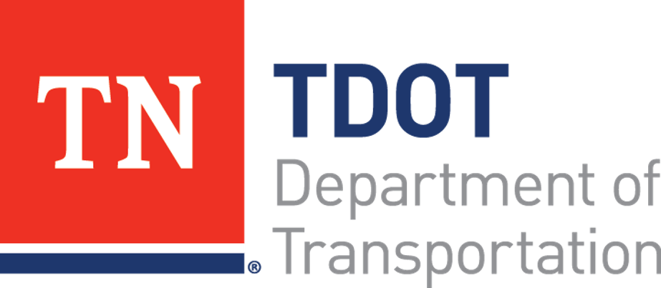
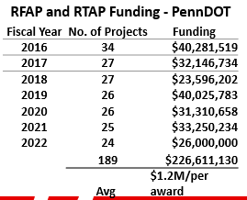
State Funding Programs
Older Funding - $32.4 Million
Released in Fiscal Year (FY) 2019
Percent Under Contract - 87% or $28 Million
# Projects/Contracts Closed/Completed from FY 2019, 2020, and 2021 - 45
Newer Rail Preservation Funding - $85 Million
Released Beginning in FY 2022
$85 Million - FY 2022 Tennessee Appropriations Bill
20 New Projects Started Already in FY 2022
Fiscal Year | Amount
2014 | $19.2M
2015 | $3.75M
2016 | $3.75M
2017 | $17.5M
2018 | $17.5M
2019 | $17.2M
2020 | $21.75M
2021 | $9.95M
2022 | $20.95M

Slide 12
Next Steps
KYTC and HDR Engineering – Rail Assessment Study
Investment in Rail Infrastructure
KFIP – Kentucky Freight Rail and Safety Improvement Program
Preservation and maintenance, expansion, industrial access, economic development
KFFF – Kentucky Federal Freight Fund
Program to assist communities, authorities, railroads, riverports seeking federal grant opportunities for rail infrastructure projects

