Slide 1


Louisville & Jefferson County Riverport Authority

Slide 2
Louisville Riverport Authority established by KRS in 1965
Foreign Trade Zone #29 Established in 1977
  Grant of Authority issued to the Louisville Riverport Authority by the Foreign Trade Zones Board (Federal)

Slide 3
Executive Summary
Created by State Legislature in 1965
  Quasi Governmental organization
  Executive Director & Board of Directors appointed by Mayor
  Executive Management Team
Grantee – Foreign Trade Zone #29
  Grant Issued in 1977
Developed 2000+ Acre Industrial Park in 5 Phases
  120+ Companies / ~15,000 Direct Jobs
300+ Acre Riverport Facility w/14-mile short line railroad
  Operated by Leaseholder – Port of Louisville

Slide 4
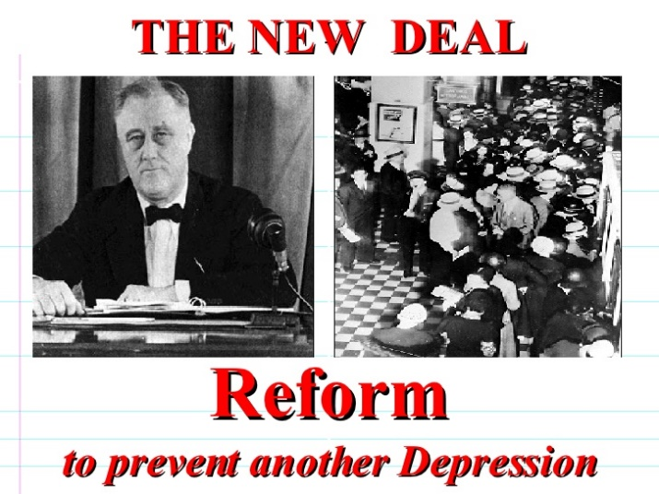
Foreign-Trade Zones
Foreign-Trade Zone (FTZ) Act
Passed in 1934 as part of the “New Deal” legislation
Purpose of the U.S. FTZ Act of 1934 was to “expedite and encourage foreign commerce”
Part of effort to revitalize trade after the Smoot Hawley Tariff Act of 1930 and the Great Depression
Create jobs and investment in the U.S. that could otherwise take place overseas
Notes:
RTA (reciprocal tariff act) Cousin to FTZ Act…both passed as a remedy to the Smoot-Hawley Tariffs imposed in 1930 and widely blamed economic shrinkage that worsened / prolonged the great depression.

Slide 5
Foreign-Trade Zones similar programs in other countries
Many countries have free zones to expedite and encourage foreign commerce
    Entrêpots
    Special Economic Zones (SEZ)
    Free Zone
    Export Processing Zones (EPZ)
    Maquiladoras
Notes:
Entrepot - Transshipment port/trading post-import, store, trade for re-export-one of the oldest “eco-devo” programs, one dating to Ptolemaic Alexandria, Egypt, 300 BC, Dilman, present day Bahrain/Kuwait) – 2000 BC - proliferated in 17th & 18th centuries..term used now by duty free ports (Free Zones) w/high volume re-export trade - Singapore, hong kong…largest current examples…
SEZ ---1950s…industrial…1st Shannon Airport – Clare, IReland– business & trade laws are different from rest of country. ECO DEVO (increase trade balance, employment investment, job creation..special financial policies-favorable tax, investment, trde quota, customs & labor regs and tax holidays..ie
…lower taxes for a period of time in return for investment …LABOR issues – each country creates own rules, set geographic area, management entity, etc..
Free zone – focus on designation of existing port / trading centers as duty free and / or lower tax zones…seem to focus on re-export activity – not so much value add / manufacturing activities
EPZ specific FREE TRADE ZONE (an SEZ similar in scope to a US Foreign Trade Zone) - specializing in manufacturing for Export – South / Central America, Caribbean, Africa, Middle East ~116 countries
Maquila - 1964 – implemented in MX w/ Border industrialization program-replaces Bracero program, of 194..also..Paraguay,Nicaragua & El Salvador – Direct Foreign Investment – usually foreign owned plants / labor intensive operations to create goods for export 58% of manufacture GDP / 48% industrial employment –MX…evolved from low skill low wage to high wave/productivity (advanced manufacture) …. DFI – was limited to areas proximate the border of Mexico..but strategies created to establish maquila type operations within central MX areas…

Slide 6
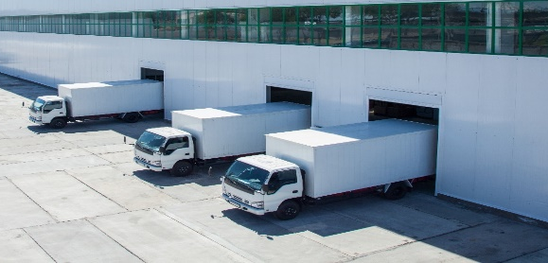
Foreign-Trade Zones
Definition
Foreign-Trade Zones (FTZs)
  Secure areas located in or “adjacent to” a CBP Port of Entry
  Legally outside the U.S. Customs territory for duty purposes when activated
    Outside the Customs Territory is the legal structure that provides the benefits of the FTZ program
    Goods in zones are considered to be part of international commerce
    It is only once (and if) goods leave the zone to enter the commerce of the U.S. that normal tariff and Customs regulations apply to those goods
Warehouse

Slide 7
Stakeholder hierarchy
Foreign-Trade Zones Act
Foreign-Trade Zones Board
(15 CFR, Part 400)
US Customs & Border Protection
(19 CFR, Part 146)
Grantee
FTZ Operator/User
Operator FTZ Administrator, Broker, 3PL

Slide 8
Key Participants – FEDERAL LEVEL
Foreign-Trade Zones Board
  Comprised of the Secretary of Commerce and the Secretary of Treasury
    Action authority on most matters has been delegated to a Committee of Alternates, composed of the Assistant Secretary of Commerce for Enforcement and Compliance and the Deputy Assistant Secretary of the Treasury for Tax, Trade, and Tariff Policy
  Issue grants to establish, expand, operate, and maintain FTZs in all forms
  Prescribe rules and regulations to establish and operate zones - 15 CFR, Part 400
Foreign-Trade Zones Board staff
  Department of Commerce, International Trade Administration staff responsible for overseeing the administration of Foreign-Trade Zones
  The Executive Secretary and staff manage all day-to-day activities, as directed
  by the FTZ Board
  Prepares annual report of FTZ activity to Congress – Telling the story of the
  impact of FTZ to US economy

Slide 9
Key Participants – FEDERAL LEVEL
U.S. Customs and Border Protection (CBP)
  Port Director oversees zone as local FTZ Board representative
  Approves the activation of zones within their port of entry
  Regulates merchandise moving into (admission) and transferring out of (withdrawal) FTZs
  Interfaces with Participating Government Agencies (PGAs) for compliance purposes
  Advises Zone Operator on questions presented regarding CBP operational issues
  Collects CBP duties and fees
  Performs FTZ Compliance Reviews & Audits

Slide 10
Ftz movement of goods
Export
Zone A Inventory
Entry to U.S. Commerce
Pre-Arrival
Arrival
Advance Shipping Notice
Arrival at Port of Entry / Unlading
Zone B Inventory

Slide 11


FOREIGN TRADE Financial FEATURES
Duty Savings
  Deferral
  Elimination
  Reduction
  Production or
  Manufacturing Equipment
Fee Savings
  Weekly Entry
Other Taxes

Slide 12
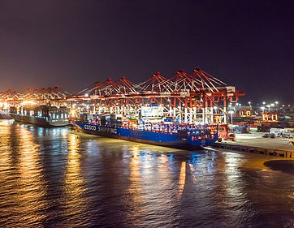
FOREIGN TRADE ZONE USES
ECONOMIC DEVELOPMENT TOOL
  JOB ATTRACTION / SITE SELECTION ADVANTAGE
OPERATIONS SAVINGS VIA DEFERRAL, ELIMINATION OR LOWERING OF DUTY LIABILITY
  TARIFF SHIFT INVERSION & OTHERS
OPERATIONS SAVINGS VIA LOWER TRANSACTIONAL COSTS FOR IMPORTS (PROCESSING FEES)
OPERATIONS SAVINGS VIA CASH FLOW IMPROVEMENTS DUE TO DEFERRAL
OPERATIONS IMPROVEMENTS VIA DIRECT DELIVERY, ENHANCED INVENTORY CONTROL PROCEDURES & QUOTA MANAGEMENT CAPABILITIES, etc…
BEST PRACTICE REQUIRMENT FOR PARTICIPATION CERTAIN COMMODITY EXCHANGES

Slide 13
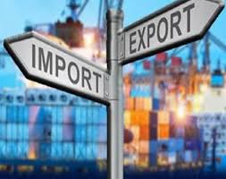
FOREIGN TRADE ZONE #29
Foreign Trade Zones provide economic advantages that allow U.S. based business remain competitive in the global trade marketplace.
FTZs are highly regulated by the U.S. Customs and Border Patrol.
FTZ #29 currently includes 20 operators at 27+ sites located throughout Kentucky
FTZ #29 has a 25 County Alternate Site Framework Service Area
FTZ #29 provides service via the Traditional Site Framework (TSF) for Companies outside of ASF (5 Sites)

Slide 14
FOREIGN TRADE ZONE Service Area
Zones are overseen by CBP officers from a Port of Entry
CBP must agree to oversee a site / subzone.
Proposed site must be “adjacent” to the port of entry to be considered for service
  The zone or subzone site is within the limits of a CBP port of entry (19 CFR §101.3).
  The zone or subzone site is within 60 statute miles of the outer limits of a Customs port of entry (19 CFR §101.3).
  The zone or subzone site is within 90 minutes’ driving time from the outer limits of a CBP port of entry (19 CFR §101.3) as verified or concurred upon by the CBP Port Director.

Slide 15
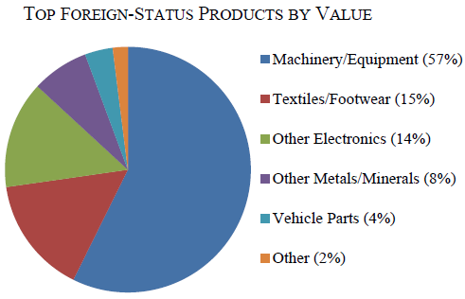
KENTUCKY’s FTZ ACTIVITY –2022
State Summary (FTZ 29, FTZ 47 and FTZ 294)
  Merchandise Received: $10,000 - $25,000 mil
  Exports: $750 - $1,000 mil (up)
  Total Shipments: $10,000 - $25,000 mil
  Employees: 26,001 – 27,000 (up)
Merchandise Received: #11 (#12 ’21)
Exports: #16 – no change
Source: 83rd Annual Report of the Foreign-Trade Zones Board to the Congress of the United States
Notes:
Boone, campbell & Kenton, County, and Paducah, KY

Slide 16
KENTUCKY FTZ #29 ACTIVITY –2022 (CONTINUED)
Employees – 26,001 – 27,000
Merchandise Received – $10,000 - $25,000 mil - #25 (18)
Exports – $750 – $1,000 mil
Warehouse & Distribution Activity (10 Operators)
  Merchandise Received – $1,000 - $5,000 mil - #25 (18)
  Exports – $50 – $75 mil
Production Activity (10 Operators)
  Merchandise Received - #23 (8)
  Exports - >#25 (11)
Top 25 by Zone (Merchandise Received)
  Warehouse / Distribution Activity
    #25, FTZ 29 – Louisville, KY (24)
    Production Operations
    #23 - 29#E – Toyota Motor Manufacturing (17)
Source: 83rd Annual Report of the Foreign-Trade Zones Board to the Congress of the United States
Notes:
FTZ 47 less than 1K employees, $500 - 750 mil total shipments w/3 operators)

Slide 17
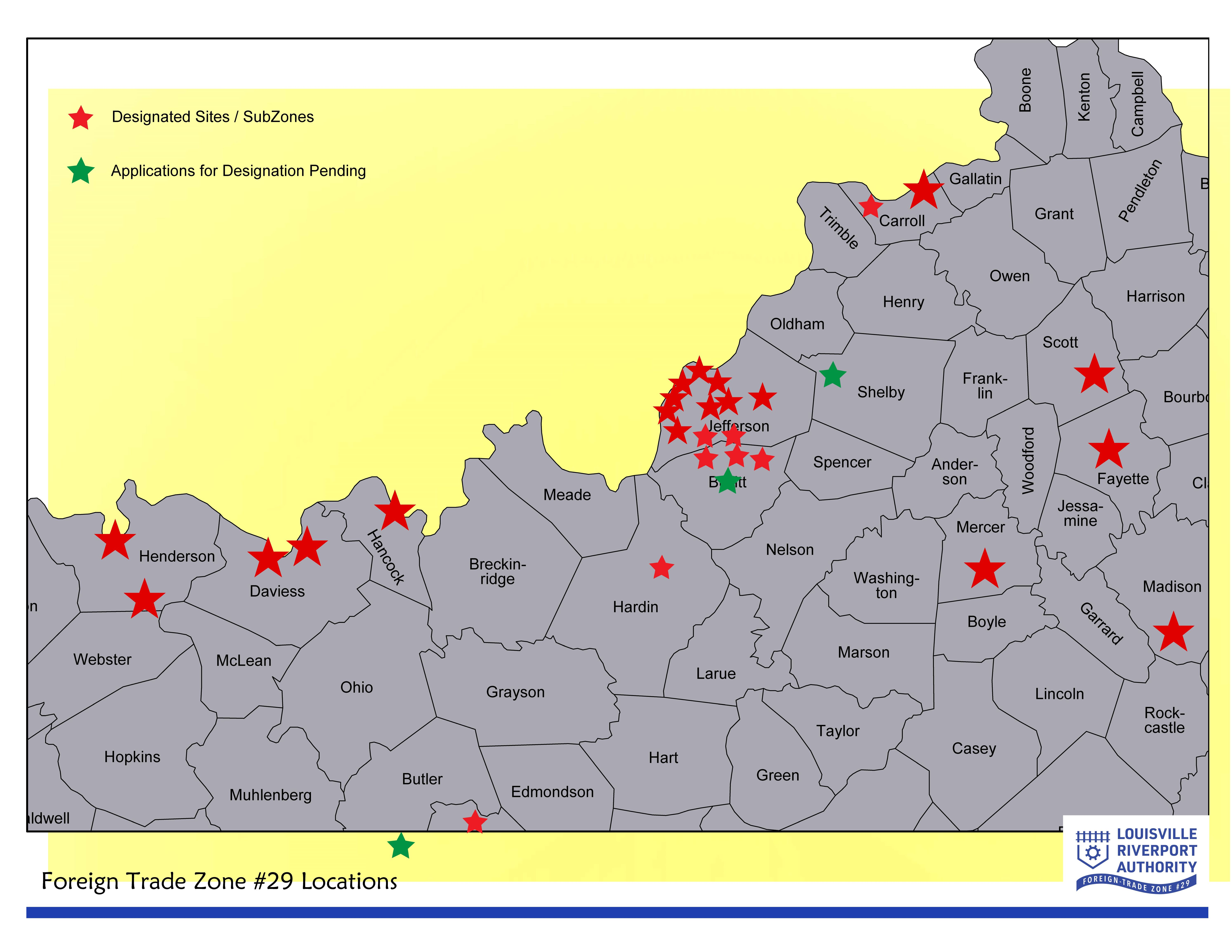
FTZ #29
Designated Sites

Slide 18
FTZ #29
Alternate Site Framework Service Area
25 Counties
Notes:
Anderson, Breckinridge, Bullitt, Butler, Carroll, Crittenden, Daviess, Franklin, Hancock, Henderson, Henry, Hopkins, Jefferson, McLean, Meade, Muhlenberg, Nelson, Ohio, Oldham, Shelby, Spencer, Trimble, Union, Webster, and Woodford

Slide 19



















FOREIGN TRADE ZONE #29 OPERATORS

Slide 20
CHALLENGES
LOCAL ADVALOREM TAX EXEMPTION
  The FTZ Act exempts any operator / user of a designated FTZ from any and all local ad valorem taxes.
  The FTZ Board now requires applicants to obtain letters of non-objection from all local tax entities affected by the potential zone designation, or in the alternative, the applicant can choose to commit to continuing to remit all local taxes.
    This creates a barrier to use of the program for some entities, and additional administrative issues for the relationship between the user/operator, Grantee and CBP.
AVAILABILITY OF SUFFICIENT CBP Officers AT INLAND PORTS OF ENTRY
  Lack of resources at CBP Port of Nashville lead to the failure of a seven county expansion of FTZ 29 in South Central Kentucky.
  CBP Louisville and Evansville/Owensboro is having more difficulty responding to additional requests for service in our existing ASF service area.
  CBP faces the same manpower challenges that exist in rest of the economy compounded by expanded operational requirements.
LACK OF UNDERSTANDING / AWARENESS OF FTZ PROGRAM
  FTZ 29 has made more efforts to spread awareness and will continue to do so.
Notes:
FTZ 47 less than 1K employees, $500 - 750 mil total shipments w/3 operators)

Slide 21
What is next
Extend ASF Service area to South Central KY
  7 counties envisioned: Todd, Logan, Simpson, Allen Warren, Barren
  Extend ASF Service area to North Central KY (I75 Corridor), ie..Fayette, Scott, Harrison, Grant, Pendleton, Owen & Gallatin)
ASF for South Central KY failed
  Lack of resources @CBP Nashville.
Advocacy @ US Congress, CBP, Dept of Treasury
  How can we engage Frankfort (Legislature and Economic Development and Trade Cabinet and related organizations?
QUESTIONS
Notes:
FTZ 47 less than 1K employees, $500 - 750 mil total shipments w/3 operators)

Slide 22
References and links
US Foreign-Trade Zones: https://www.trade.gov/about-ftzs
2022 Annual Report of the Foreign- Trade Zones Board to the Congress of the United State: https://www.trade.gov/annual-report (past reports available at this page as well)
U.S. Customs & Border Protection Foreign Trade Zones Manual: https://www.cbp.gov/document/guides/foreign-trade-zones-manual

