Slide 1
Kentucky Multimodal Freight Transportation System Improvement Task Force – 11/1/23

Slide 2
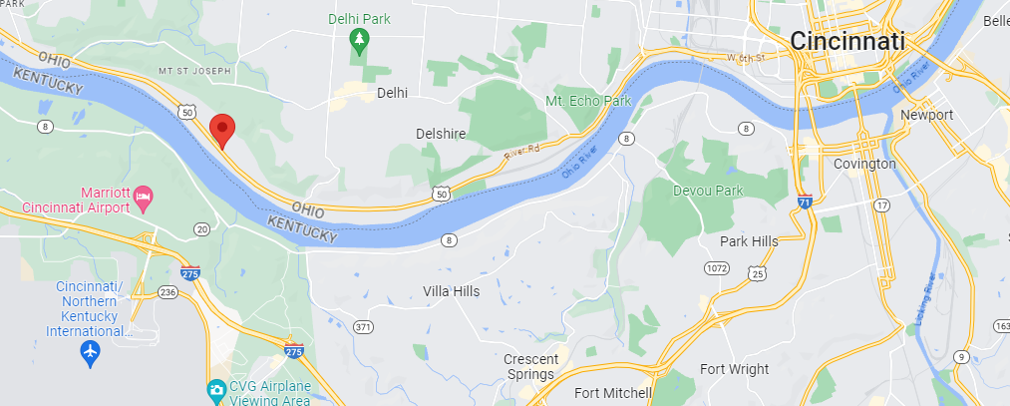
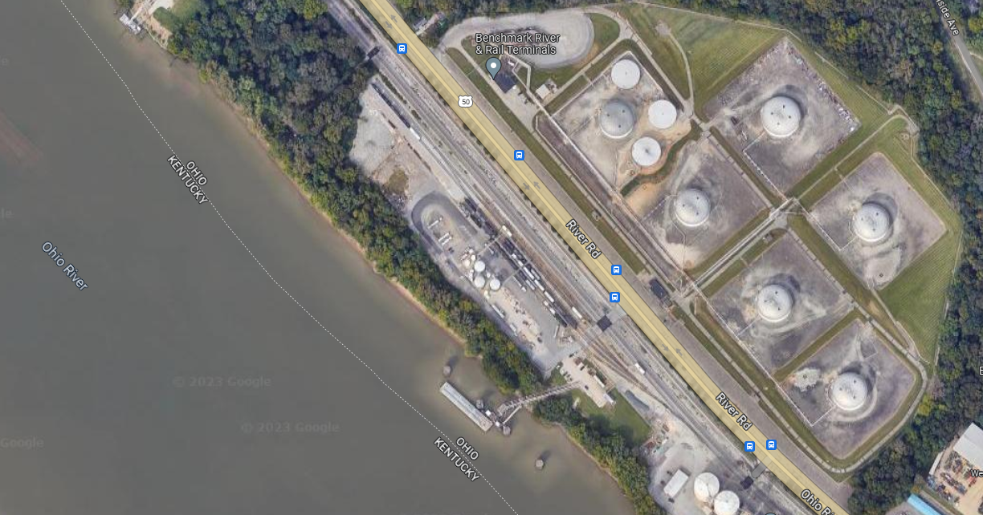
Benchmark River and Rail Terminals, LLC

Slide 3
Benchmark River and Rail Terminals, LLC

Slide 4
Benchmark River and Rail Terminals, LLC
Privately owned “port” established in 2010
Former DOD Air Force fuel depot originally built in 1950s
65 acres, 21 tanks, and 4 x 1,000’ spurs (about 100 railcar spots)
Primarily inbound by barge and rail; outbound by truck
Receive over 200 barges and 1,500 railcars annually
Outbound over 21,000 bulk tanker trucks annually
Employ 15 full-time employees

Slide 5
CORBA – Who We are
Formed in 2011 as a 501(c)(3) not-for-profit trade association
All-volunteer association funded by member dues
A founding objective was to Re-designate the USACE Port Statistical Boundary and redefine the “port” as a regional port; achieved in 2015
Currently represent more than 60 members of the maritime industry and support companies throughout the Ports of Cincinnati and Northern Kentucky

Slide 6
CORBA’s Mission
The Central Ohio River Business Association (CORBA) is an alliance of businesses and industry engaged in river commerce on and along the Ohio River and its tributaries from approximately Ohio River mile 357 to 576 (Greenup, KY to below Carrolton, KY).
The mission of CORBA is to unite the river businesses and industry into a common voice in order to promote commerce, safety and security, environmental stewardship, and public relations concerning the Ohio River and its tributaries throughout the central Ohio River region.
www.corba-usa.com (www.centralohioriverbusinessassociation.com)

Slide 7
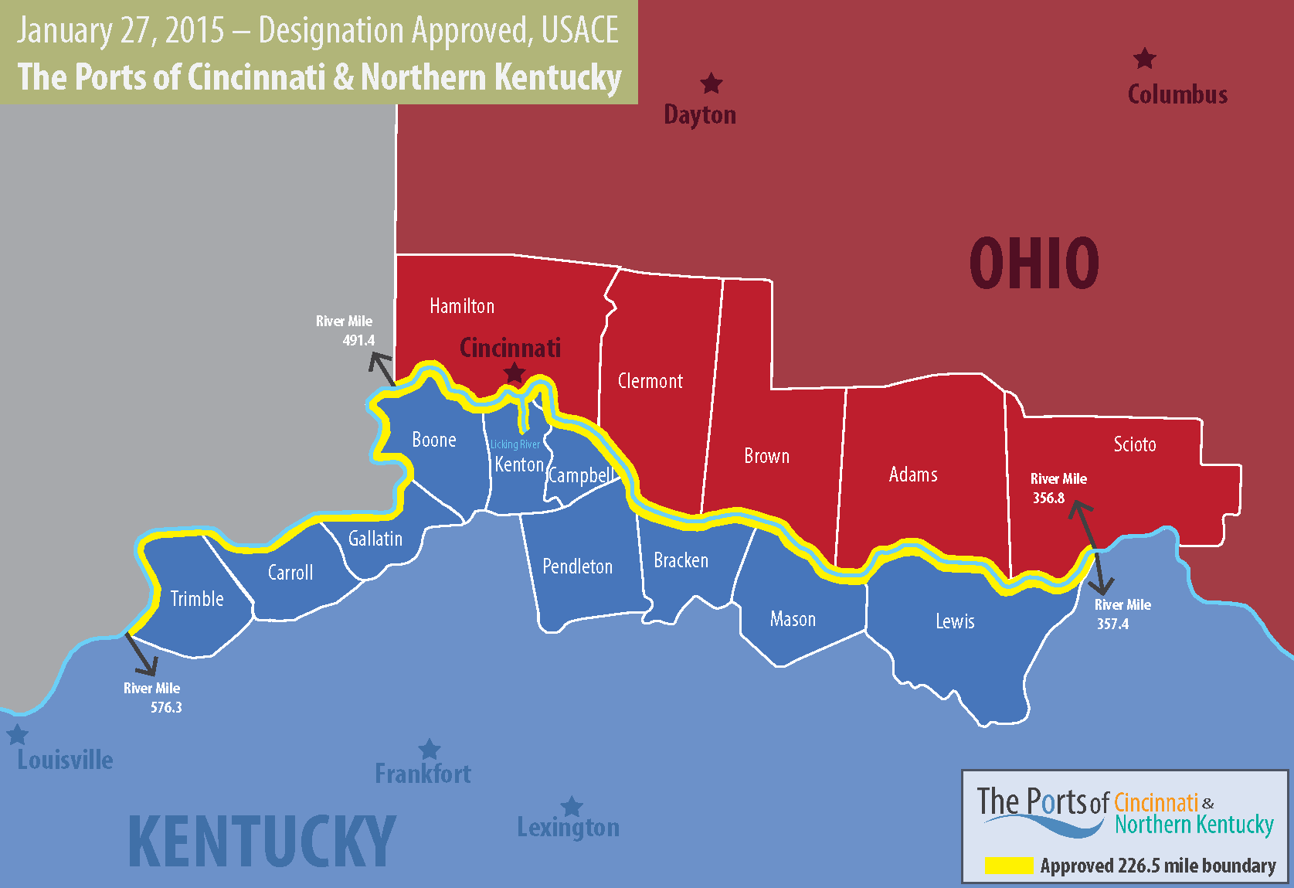

Slide 8
The Ports of Cincinnati and Northern Kentucky
2015: Re-designated to 226.5 miles extending either side of downtown + Licking
2021 Tons Through the Port: 35.9M tons (1.5-million truck loads)
CVG – top 3 busiest airport in the USA by landed tons
Two Class-I railroads (CSX and NS) and multiple short-lines
Intersection of I-71, I-75, and I-74
Includes two public port authorities (Northern Ky and Maysville-Mason County)
Within one day’s drive of 60% of population and 55% of manufacturing in the USA

Slide 9
The Ports of Cincinnati and Northern Kentucky Maritime Industry Snapshot
Privately owned and operated port complex; no (active) public ports
66 Terminals
78 Docks
5 Coal-fired Power Plants
5 Fleet and Tow Operators
4 Shipyards
41 Marinas
3 Ferries, 2 Dinner-cruise lines, and 8 Floating Restaurants

Slide 10
Private Kentucky ports in CORBA region include…
BP Oil
Transmontaigne Terminals
Martin Marietta
Northern Kentucky Aggregates
Duke Energy
LG&E/KU
McGinnis/McNational
Certainteed
CHS Crop Nutrients
Carmeuse Lime & Stone
Marathon Petroleum
Nucor Steel
North American Stainless
C&B Marine

Slide 11
CORBA Strategic Partnerships include…
OKI – Ohio Kentucky Indiana Regional Council of Governments (MPO)
Kentucky Department of Transportation
Ohio Department of Transportation
REDI Cincinnati
BE NKY Growth Partnership (Formerly Tri-ED)
U.S. Maritime Administration (MarAd)
Northern Kentucky University

Slide 12
NUCOR - Gallatin
Steel manufacturer with three locations on the Ohio River
Gallatin, Brandenburg, KY and Apple Grove, WV
Posterchild for the near “ideal” river port operator
Bulk raw materials inbound
Finished steel outbound
Need for abundant water supply
Hub-and-spoke distribution networks
PRIVATE operator – not in any public ports
Multi-billion $$ investments – almost exclusively private investments
Partnered with OKI to secure Marad Marine Highway Grants

Slide 13
Regional Ohio River Ports and PSAs – Ohio River = 981 miles (2021 USACE)
Port of Pittsburgh (OR mile 0 to 40)
16.431 million tons (Rank #36 overall; #6 Inland port)
Mid-Ohio Valley Port, OH and WV (OR mile 40 to 256)
35.933 million tons (Rank #18 overall; #1 Inland port)
Port of Huntington – Tristate, KY, OH, WV (OR mile 256 – 356)
31.117 million tons (Rank #21 overall; #3 Inland port)
Ports of Cincinnati-Northern Kentucky (OR mile 356 to 560)
35.932 million tons (Rank #19 overall; #2 Inland port)
Port of Louisville (OR mile 601 – 616 = ONLY 15 miles!!)
8.633 million tons (Rank #59 overall; #13 Inland port)
Owensboro, Henderson, Paducah (OR mile 616 – 981)
2.8M; 2.0M; 7.7M tons, respectively = total 12.5M tons combined)

Slide 14
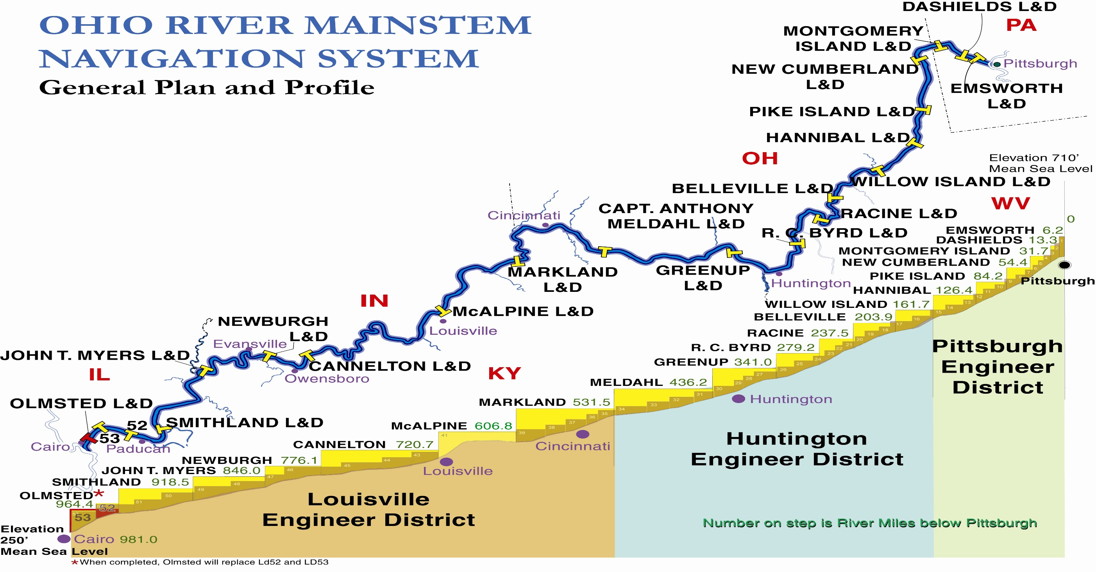
#6 - Port of Pittsburgh PA
#1 - Mid-Ohio Valley Port, OH, WV
#3 -Huntington Tristate – OH, WV
#2 - Ports of Cincinnati and No. KY
?? Louisville/Jeffersonville ??
?? Paducah / KY Lakes ??

Slide 15
Regional Waterborne Tonnage By State Millions of tons (2021 USACE)
Kentucky: 78.971 (#7) – Ohio, Kentucky, and Tennessee River
Illinois: 77.070 (#8) – Ohio, Mississippi, Illinois Rivers and Lake Michigan
Ohio: 70.955 (#9) – Ohio River and Lake Erie
Indiana: 55.404 (#12) – Ohio River and Lake Michigan
West Virginia: 45.712 (#17) – Ohio River and Atlantic Coast
Pennsylvania: 48.296 (#14) – Ohio, Monongahela, and Allegheny Rivers + Lake Erie and Delaware River
Missouri: 41.492 (#19) – Mississippi and Missouri Rivers
Tennessee: 29.470 (#24) – Mississippi and various other rivers
Virginia: 70.022 (#10) – East coast

Slide 16
Kentucky Waterborne Tonnage: Public Ports vs. Non-public
Includes private terminal operators, manufacturers, and utilities
Kentucky total tonnage (2021 USACE) = 79 million tons
Kentucky’s (7) active public port authorities = 23 million tons
Kentucky waterborne tons NOT at public ports = 56 million tons
About 71% waterborne tonnage NOT at Kentucky’s public ports

Slide 17
Challenges and Opportunities …
Port development: Transportation, or economic development, or both?
Public ports vs. Private ports
Public ports’ tenants are generally private companies
Private ports lack the “public” capabilities – may be able to solicit a public sponsor
State investments can and do support private ports, too
Road/highway connectivity
Utilities
Equipment investments
State benefits from private investments by the same metrics (jobs, tax generation, etc.)
Private ports should not have to compete with public financing and investment
Ohio River is a federally maintained waterway
States have no skin in the game - no state investment in the navigation infrastructure
Not a source for state’s tax revenues
Cannot use other tax revenues (i.e. highway taxes) to fund projects

Slide 18
Challenges and Opportunities (continued)
Ohio River is interdependent system
Need to encourage port-to-port, state-to-state cooperation
Match up origins and destinations (hub and spoke)
Ports (and states) cannot be successful in a vacuum
Limited funding ($500,000 annual) via Kentucky Riverport Improvement Grant Program
Available only to “public” ports
Has not increased, even for COLA, since inception (2012)
Could be $650,000 to $700,000 if adjusted for inflation
Kentucky Freight Plan has identified a minimum of $12.3M up to $222M needed investments
Kentucky (and Ohio) has limited administrative/agency resources (one person)
KDOT Freight, Rail and Waterways Coordinator

Slide 19
ORCO – Ohio River Coalition of Ohio
Coalition of Ohio River maritime industry in OHIO
Formed in response to Ohio’s maritime assistance program (MAP)
Petitioning the State of Ohio to form the Ohio River Commission
Should Kentucky stand-up the KY-ORC?

Slide 20
Thank you for this opportunity! Questions?

