Slide 1
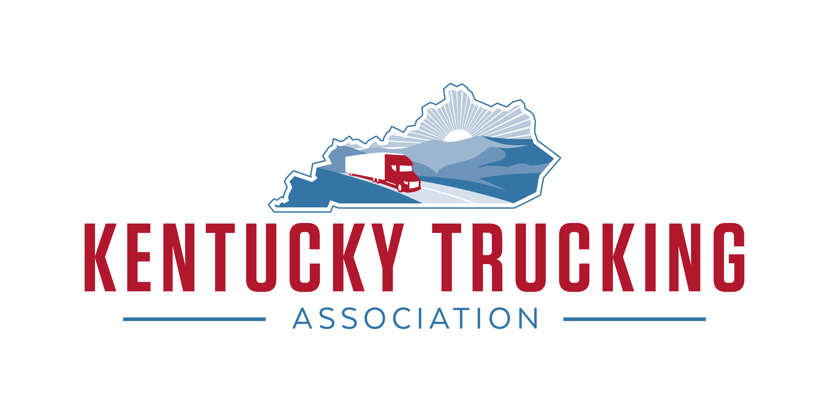

Slide 2
Kentucky Trucking Association
Established in 1962
300 Members
113,000 Kentuckians work in the trucking industry/27,000 drivers
Nationally, trucks move 72.5% of all freight, that is 12 billion tons of freight. This includes stocked store shelves, materials delivered to manufacturers, construction equipment, and even packages delivered to your front door.
In Kentucky, trucks transport 86.5% of manufactured tonnage/ 185,000 tons per day
89.2% of Kentucky communities depend solely on trucks to move their goods

Slide 3
Kentucky Trucking Industry Tier1 State Issues
$34 County Clerk Registration Fee for vehicles 44,001 lb. or greater (KRS 186.040 (3)). This fee discourages motor carriers from basing their operations in Kentucky and it is burdensome with unnecessary trips to the clerk’s office when commercial registration is processed on-line. No One-Stop Shop like other states such as IN.

Slide 4
Kentucky Trucking Industry Tier1 State Issues
Consolidation of motor carrier weight distance tax (KRS 138.660)
We want to pay our fair share of road taxes to maintain and expand our highways. This is vital to our industry’s operation. Highway congestion costs our industry 94.5 billion dollars each year, 2.4 billion in KY (ATRI 2023). In Kentucky a typical 5 axle tractor trailer will pay $19,200 in state and federal tax.
Collect efficiently while maximizing compliance. Weight distance tax – KY is 1 of 5 states (NY, CT, NM, OR – no fuel tax). KYU – 70,000 returns each quarter, 20,000 file zero miles. We want to create a level playing field and improve efficiency for the motor carrier and the state.

Slide 5
Kentucky Trucking Industry Tier1 State Issues
Eliminate the weight distance tax and add to the diesel fuel tax rate. Collect at the distributor level rather than from 70,000 individual filers for the weight distance tax. Compliance would be 100%. Do not revenue share this portion of the diesel fuel – 100% road fund.
Benefits: Compliance –Equal playing field, eliminate 280,000 tax returns, eliminate the need to audit, eliminate roadside enforcement for noncompliance, eliminate phone calls.

Slide 6
Kentucky Trucking Industry Tier1 State Issues
State Registration Diesel Rate Surcharge
KY $1,410 .2570 .1240
IN $2370 .5500 0
IL $2909 .7880 0
OH $1420 .4700 0
VA $1928 .3080 .1400
WV $3235 .3720 0
TN $1461 .2700 0
NOTE: based on 6 miles/gallon, the KY WDT adds another .1710

Slide 7
Kentucky Trucking Industry Tier1 State Issues
Truck Parking
3.5 million trucks, only 313,000 parking spaces
Kentucky - On an average night, 9,000 trucks compete for 7,196 marked, designated parking spots
According to the USDOT, 98% of truck drivers regularly have trouble finding safe parking
Park illegally on the on/exit ramps or side of the road vs. violating federal hours of service. A no win situation. This is unsafe for the motoring public and the truck driver
Law Enforcement faces a difficult decision – make a sleepy fatigued driver move violating HOS or remain parked illegally
In 2023 truck drivers identified truck parking as their number 2 issue.

Slide 8
Kentucky Trucking Industry Tier1 State Issues
Truck Parking
Discretionary funding is available through the National Highway Performance Program, Surface Transportation Block Grant Program, Highway Safety Improvement Program, Carbon Reduction Program, National Highway Freight Program
Department of Treasury confirmed that Covid 19 funds awarded to states and local agencies (State & Local Fiscal Recovery Funds (SLFRF)) can be used for truck parking projects.
Truck Parking Safety Improvement Act – bi partisan legislation – designated funding, 755 M – competitive grant program – pending in Congress

Slide 9
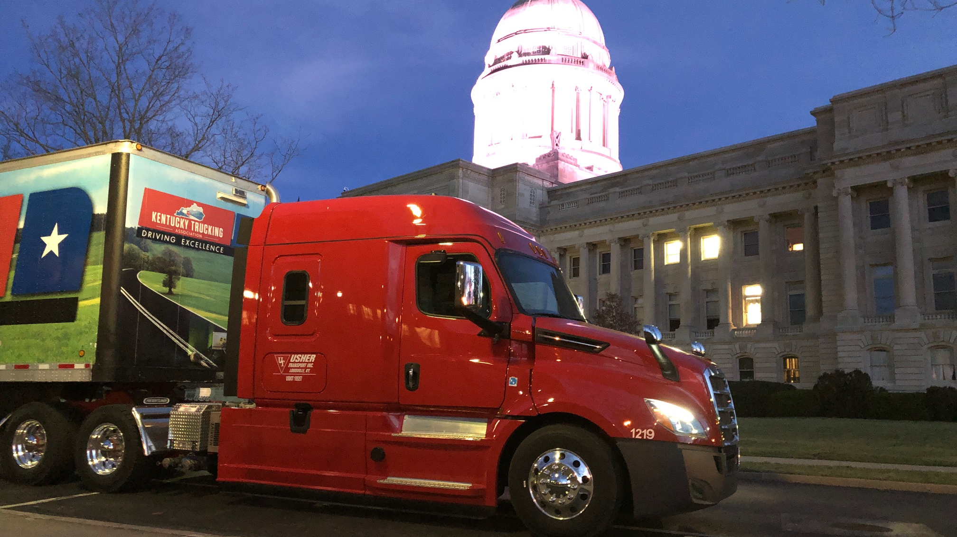
Questions?
Thank you

Slide 10
Kentucky Trucking Industry Tier2 State Issues
Surtax – Kentucky is 1 of 2 states (VA) that continues to collect a separate tax on vehicles greater than 26,000 lbs. If this tax were absorbed into the diesel/gas tax it would eliminate the Kentucky Intrastate Tax (KIT) return and the 2nd line on the IFTA return.
Predatory Towing Amend KRS 281.920 – 281.936 – add penalties for noncompliant towers. Some towers are not following the law, they refuse to provide their published rates to the motor carrier and charge whatever they want at the time of service.
Suggested penalty is to remove a noncompliant tower from the Kentucky State Police call list for 30/60/90 days.
Insurance Surcharge for Vehicle Liability/Local Government Premium Tax – 1.8% by DOI. This law passed in 2008, HB 524. Allows municipalities and counties to charge a premium tax on liability insurance policies. This is adding a substantial amount per vehicle.
APU Weight Exemption 23 CFR 658.17 passed in 2005 and updated in 2012. Thia allows states to adopt this weight exemption. KY is 1 of 6 states that has not adopted this allowance, 400/600 lbs. This limits fuel use while the vehicle is parked/idling so the driver can enjoy the vehicles comfort systems.
Collection/Cost Recovery by 3rd Party – overcharging motor carriers for fire department service calls.
3rd Party Litigation Funding – do not support
Autonomous Vehicles - Support

Slide 11
American Transportation Research Institute (ATRI) Top 10
1 Economy
2 Truck Parking
3 Fuel Prices
4 Driver Shortage
5 Driver Compensation
6 Lawsuit Abuse Reform
7 Driver Distractions
8 Driver Retention
9 Delays at Customers Facilities
10 Zero Emission Vehicles

Slide 12
Workforce
Independent Contractors – 350,000 (9%) - Legislation like AB5 and the DOL Proposed Rulemaking (54,000 comments) are trying to eliminate the IC by returning to a multi factor approach of worker classification, integral part of the business . This is about choice, owning a business and not about forcing someone into an IC position. Final Rule expected in October 2023.
Driver Shortage/Safe Driver Apprenticeship Program/Drive Safe Integrity Act
78,000 drivers short now, we will need 1.2 million drivers over the next decade
We need to recruit and retain the next generation of drivers. How?

Slide 13
Workforce
Safe Driver Apprenticeship Program/Drive Safe Integrity Act – allow under 21 to drive in interstate commerce under an apprenticeship program with 400 hrs. training/240 behind the wheel, collision avoidance technology on the vehicle, no inward facing camara. Requires reporting to Congress by the Secretary of Transportation.
Freedom to Invest in Tomorrow’s Workforce Act – direct federal job training resources to the trucking industry and the trades. Support the expansion of Pell Grant eligibility to CDL schools (15 wks to 8-9 wks), allow 529 accounts to be used on trades, expand eligibility to use VA GI benefits for truck driver training.
Kentucky – KCTCS, High Schools, Work Ready Programs/Scholarships, SB 54 –use KEES money with KCTCS for high demand work sector training, HB 320 CDL skills test in KY

Slide 14
Workforce- Kentucky schools
Kentucky Schools
CDL -14 of the 16 KCTCS colleges have CDL programs. -11 colleges offer CDL training as a credit class which would qualify for Work Ready Kentucky Scholarship funding; however, the WRKS would not cover the entire cost of the training. -The remaining three CDL programs are offered as noncredit courses but follow the same curriculum. -3 High Schools offer CDL
Training Diesel Tech -13 of the 16 KCTCS college have diesel tech programs. -All 13 of those programs are offered for credit and would qualify for Work Ready Kentucky Scholarship funding. Fairdale HS Program.

Slide 15
Lawsuit Abuse- The issue
Injured parties should be fairly compensated: the trucking industry is not trying to shirk responsibility
Nuclear verdicts and a greed trial bar are driving a proliferation of abusive lawsuits targeting the trucking industry.
Increase in the number and size of lawsuits against trucking companies. Data collected by ATRI shows that awards have grown by 51.7% compared to inflation 1.7% and healthcare cost 2.9% annually (2018).
“Verdicts in trucking accident cases accelerated in size starting in the 2000s but have skyrocketed over the last 10 years, despite a decreased rate of serious trucking crashes over that time frame,” the study said. “Moreover, with the inflation of verdicts and settlements, the search for deep pockets is expanding and the circle of potential defendants is widening.” A review of 154 trucking litigation verdicts and settlements from June 2020 to April 2023 revealed a statistical mean plaintiffs’ award of $27.5 million and a statistical median award of $759,875 for settlements.
This rise occurred despite a declining rate of fatal crashes.

Slide 16
Lawsuit Abuse
Reform on the state level - TX, IA, FL
Examples: Seat belt gage rule, limitations on punitive damages (pain and suffering, phantom damages, disclose 3rd party funding.
The day before FL’s reform became law, Morgan & Morgan filed 230,000 lawsuits.
Reform on the Federal level: Highway Accident Fairness Act of 2023 (HR 2936)
Expands the jurisdiction of federal courts to hear high stakes highway accident cases involving CMVs – 5 M and up. Requires public disclosure when third party financing firms are involved. Establishes a federal crime for staged collision schemes.

Slide 17
Energy and environment
The trucking industry has made major steps to reduce emissions over the past 40 years. 60 trucks today emit the same pollution as a single truck did in 1988.
Fleets are transitioning to low and zero emissions trucks – industry is developing and investing in electric and hydrogen trucks.
However, unrealistic timelines and mandates like those in the Advanced Clean Trucks (ACT Rule) in CA, OR, WA, VT, NY, NJ, MA are unachievable. The ACT rule requires truck manufacturers to increase new truck sales to 55% (Class 2b-3), 75% (Class 4-8), and 40% of semi-tractor sales to be zero-emissions by 2035. All cars by 2035.

Slide 18
Energy and Environment
Issues: cost of an electric truck is 2 to 3 times higher, the electric grid, charging station availability, time to charge, range of the truck, weight of the batteries – smaller payload, mining of the minerals – already a shortage of lithium, 3rd world countries mine most the required minerals with unregulated child labor, slave labor.
It would take over a trillion dollars to replace the current fleet of trucks, currently it takes 15 min. to fuel a vehicle that will travel 1,200 miles, with electric it takes anywhere from 5 hrs. ($100,000 charger) to 10 hrs., and you can travel 150-300 miles. To electrify the current US fleet, it would consume almost 41% of the entire electric grid.

Slide 19
Energy and Environment- Suggested Solutions
If we replace trucks prior to 2010 with current diesel technology, we’d see an 83% reduction in emissions.
This should be incentivized by repelling the Federal Excise Tax (FET), 12% or $25,000/vehicle. This tax was put in place over 100 years ago for WWI.
Advocated for renewable fuels such as biodiesel, renewable diesel, CNG, and hydrogen as well as battery-electric.
Change needs to be done in a careful manner to minimize the risk to the supply chain and understanding the collateral impacts on several fronts, including additional driver capacity, the increased stress on already critical truck parking issues, and safety concerns with heavy-duty batteries. Importantly, over 90% of the trucking industry is comprised of small businesses operating five or fewer trucks. Forcing these small businesses into equipment that costs two to three times more than diesel and natural gas equipment will put them under.

