Slide 1
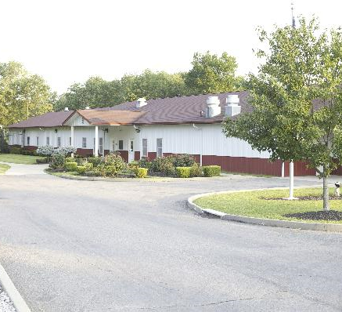
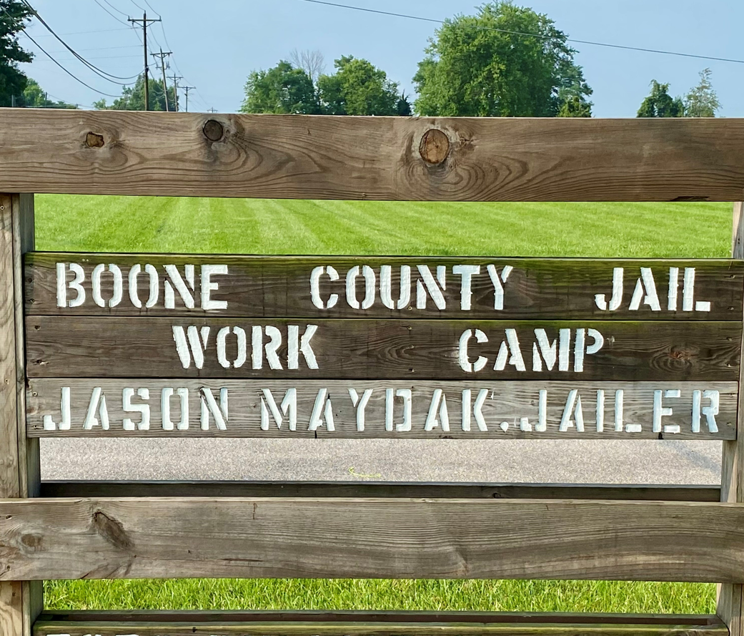
Boone County Jail Community Service Work Program

Slide 2
Services The Work Program Provides to Boone County
Labor to the Sanitation District.
Labor to the Boone County Public Works Department.
Labor to the Boone County Recycling Program.
Community service to the county by keeping the roadways and other areas of the county clean by the removal of trash, dead animals, and illegal dump sites.
Assisting the Boone County Clerk in delivery and breakdowns of all voting equipment during elections.
Assisting in preparing the fairgrounds for the Boone County Fair.

Slide 3
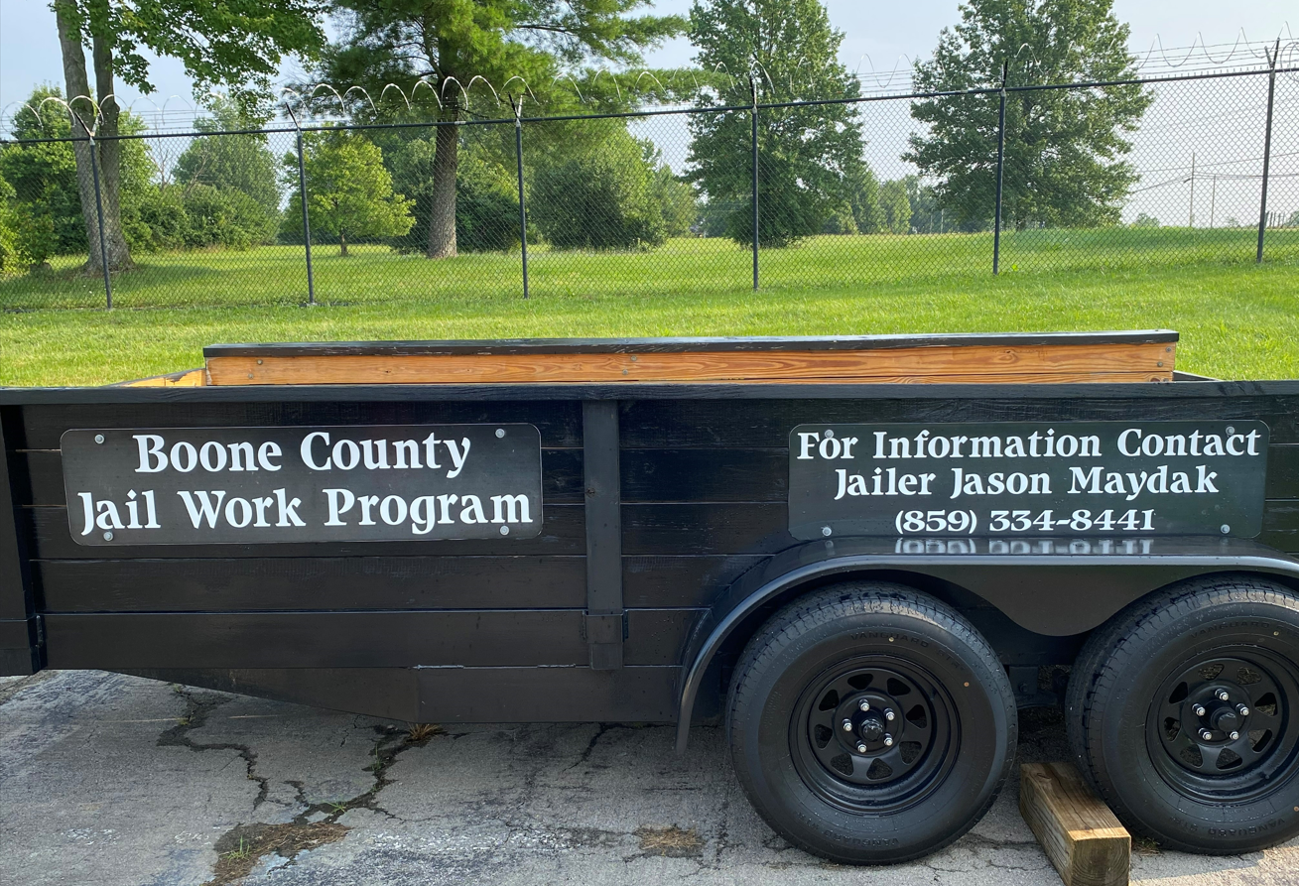
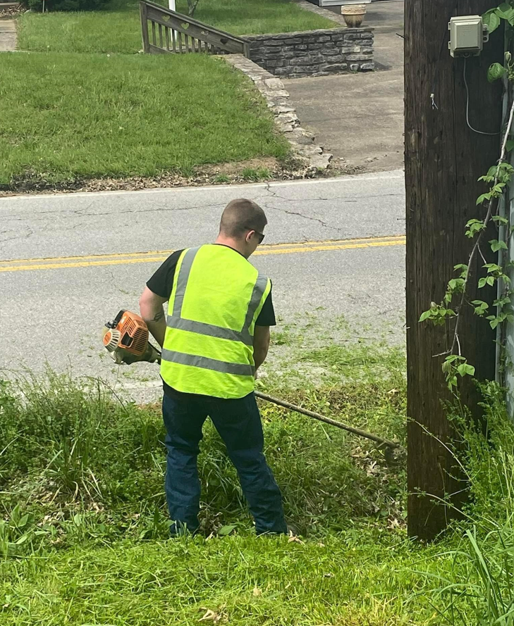
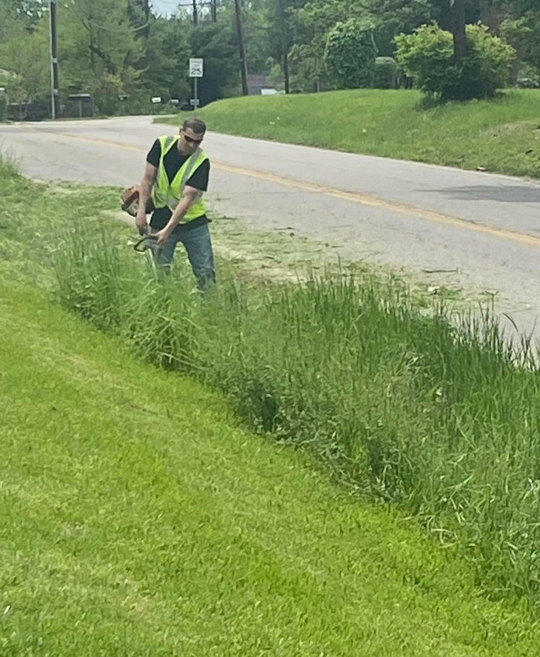

Slide 4
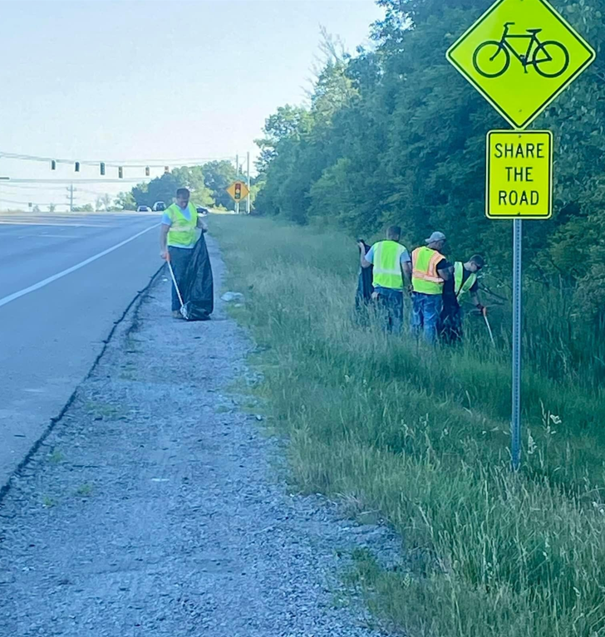
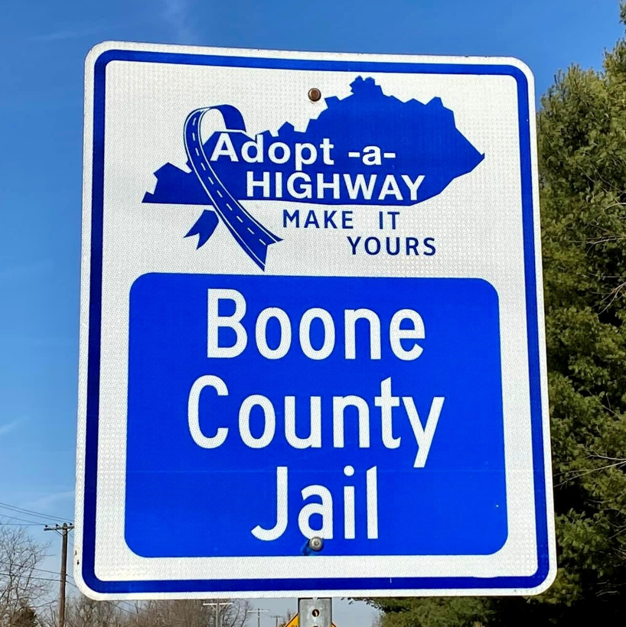
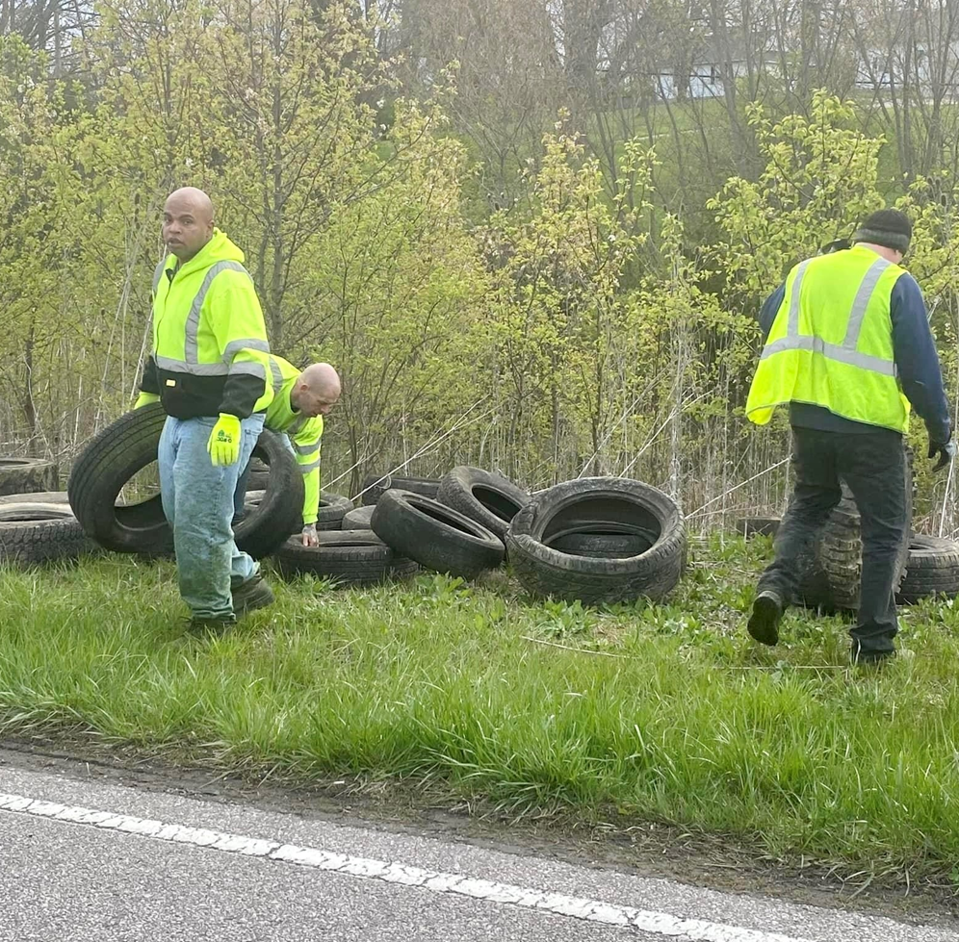

Slide 5
Services The Work Program Provides to Boone County Cont.
Participating in the Adopt a Highway Program.
Providing maintenance to several county buildings.
Planting, raising, and harvesting a garden to help offset food costs to both the workcamp and main jail.
Mowing and maintaining several Boone County Properties.
Servicing and maintaining equipment such as mowers, weed eaters, trimmers, chainsaws, etc…
Delivering food and commodities to the senior centers in the community.
Maintaining the Workcamp building and grounds.
Maintaining the Boone County Jail grounds.

Slide 6
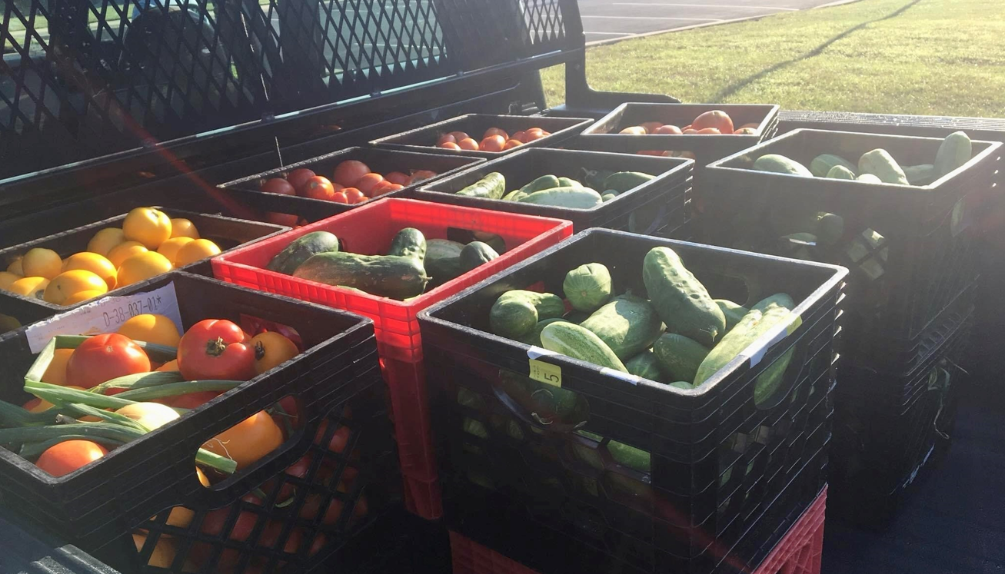
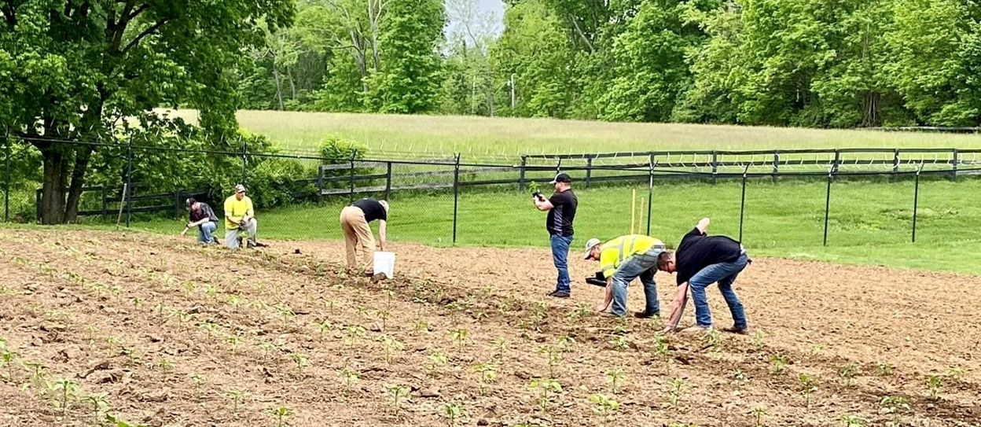
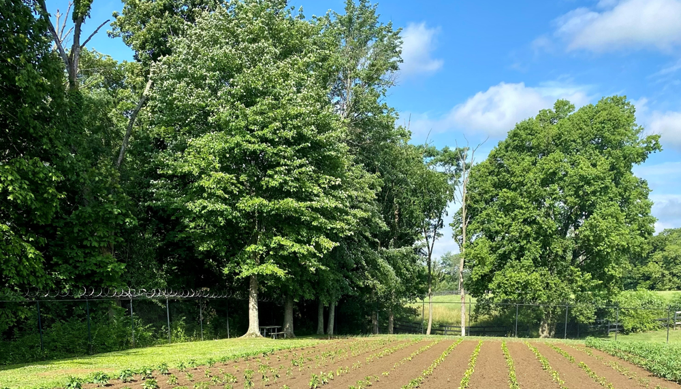

Slide 7
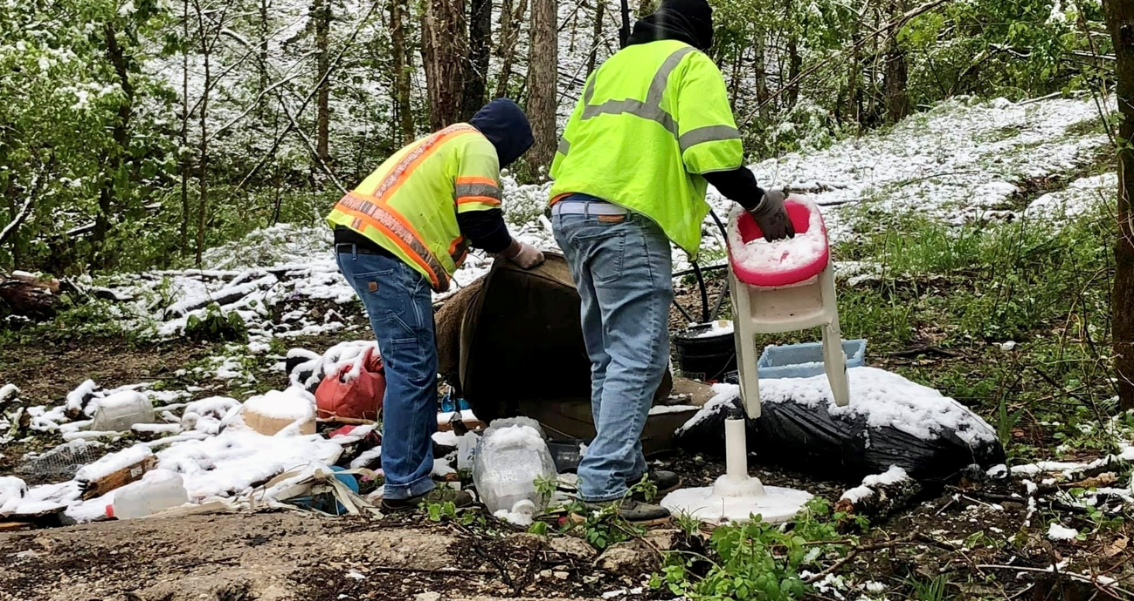
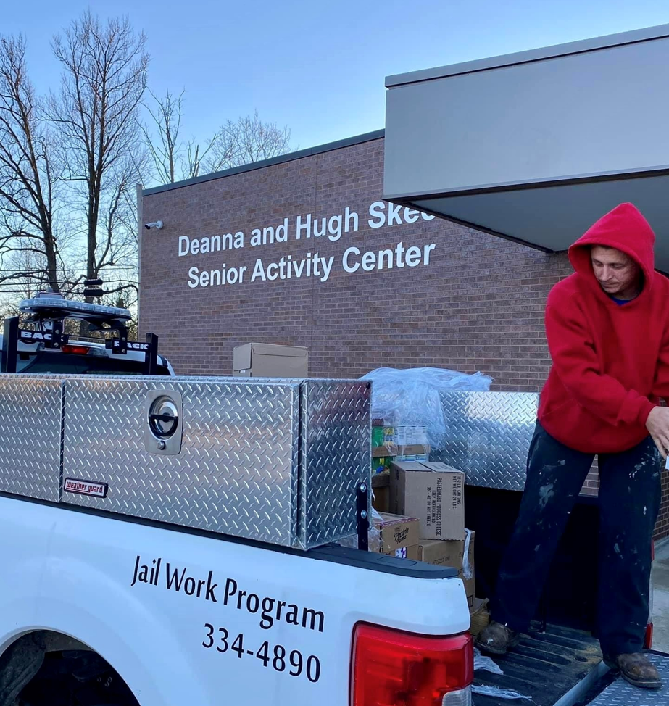
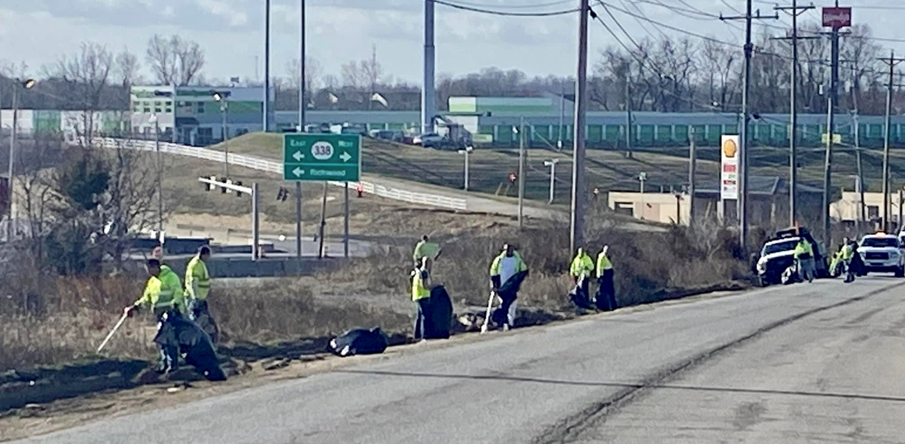

Slide 8
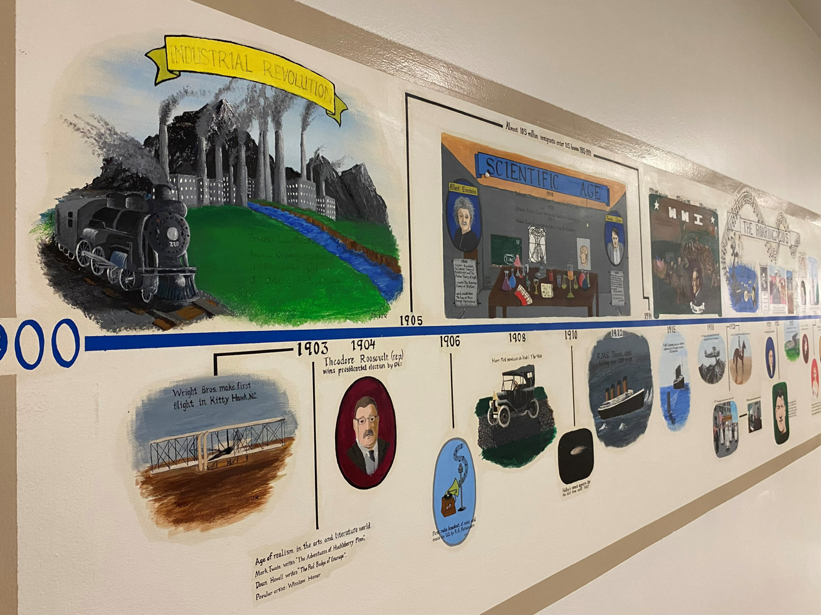
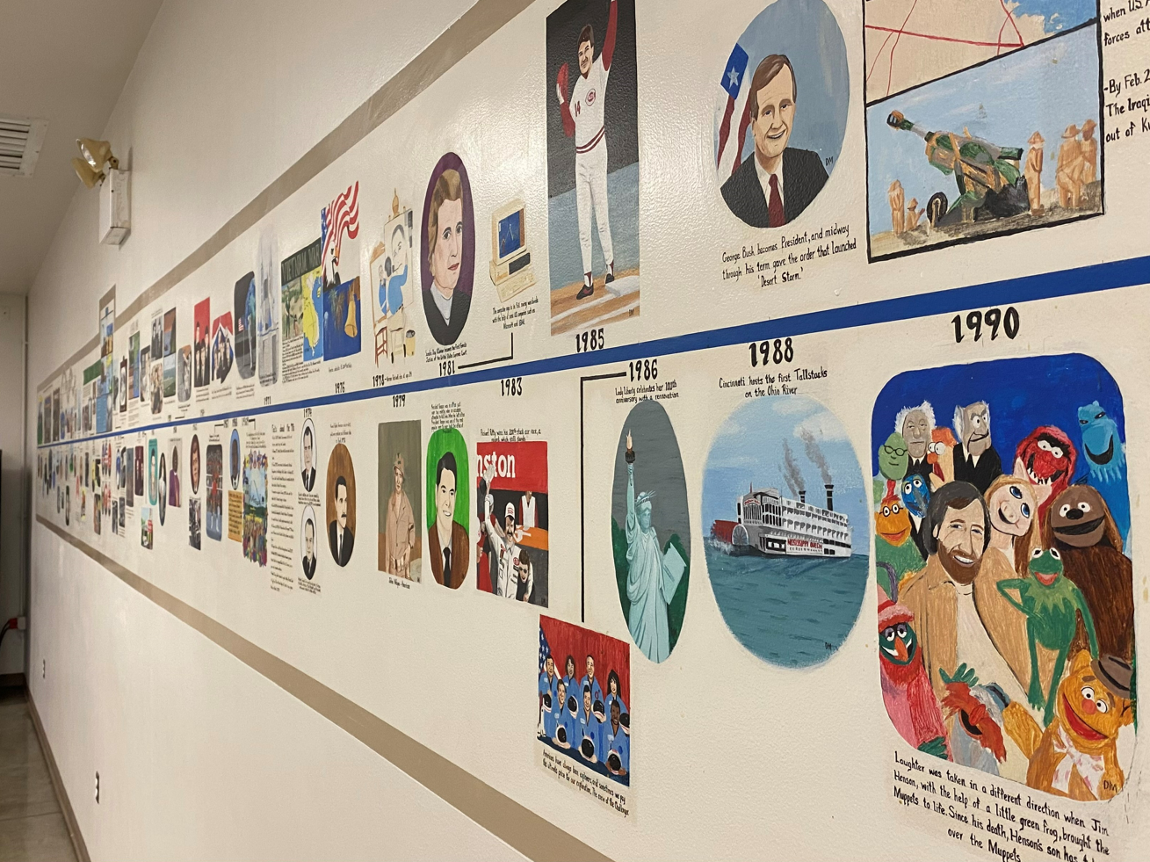

Slide 9
Hours Worked and Wages Saved Based on a State Average of $15.83 per Hour

Slide 10
Hours Worked and Wages Saved Based on Boone County Starting Hourly Wage by Dept.

