Slide 1
Kentucky Correctional
Industries
Department of Corrections
Kentucky Correctional Industries
Toney Bailey, Director

Slide 2
Kentucky Correctional Industries
Mission Statement
The mission of KCI is to provide inmates with a realistic
work experience and teach them marketable job
skills while maintaining a self-sufficient business
model that provides quality goods and services to
our customers. This is part of an effort to improve
the chances of those offenders employed by KCI to
secure gainful employment upon release from custody,
reduce the states recidivism rate and lower the
Commonwealth’s resource commitment for maintaining
the prison system.

Slide 3
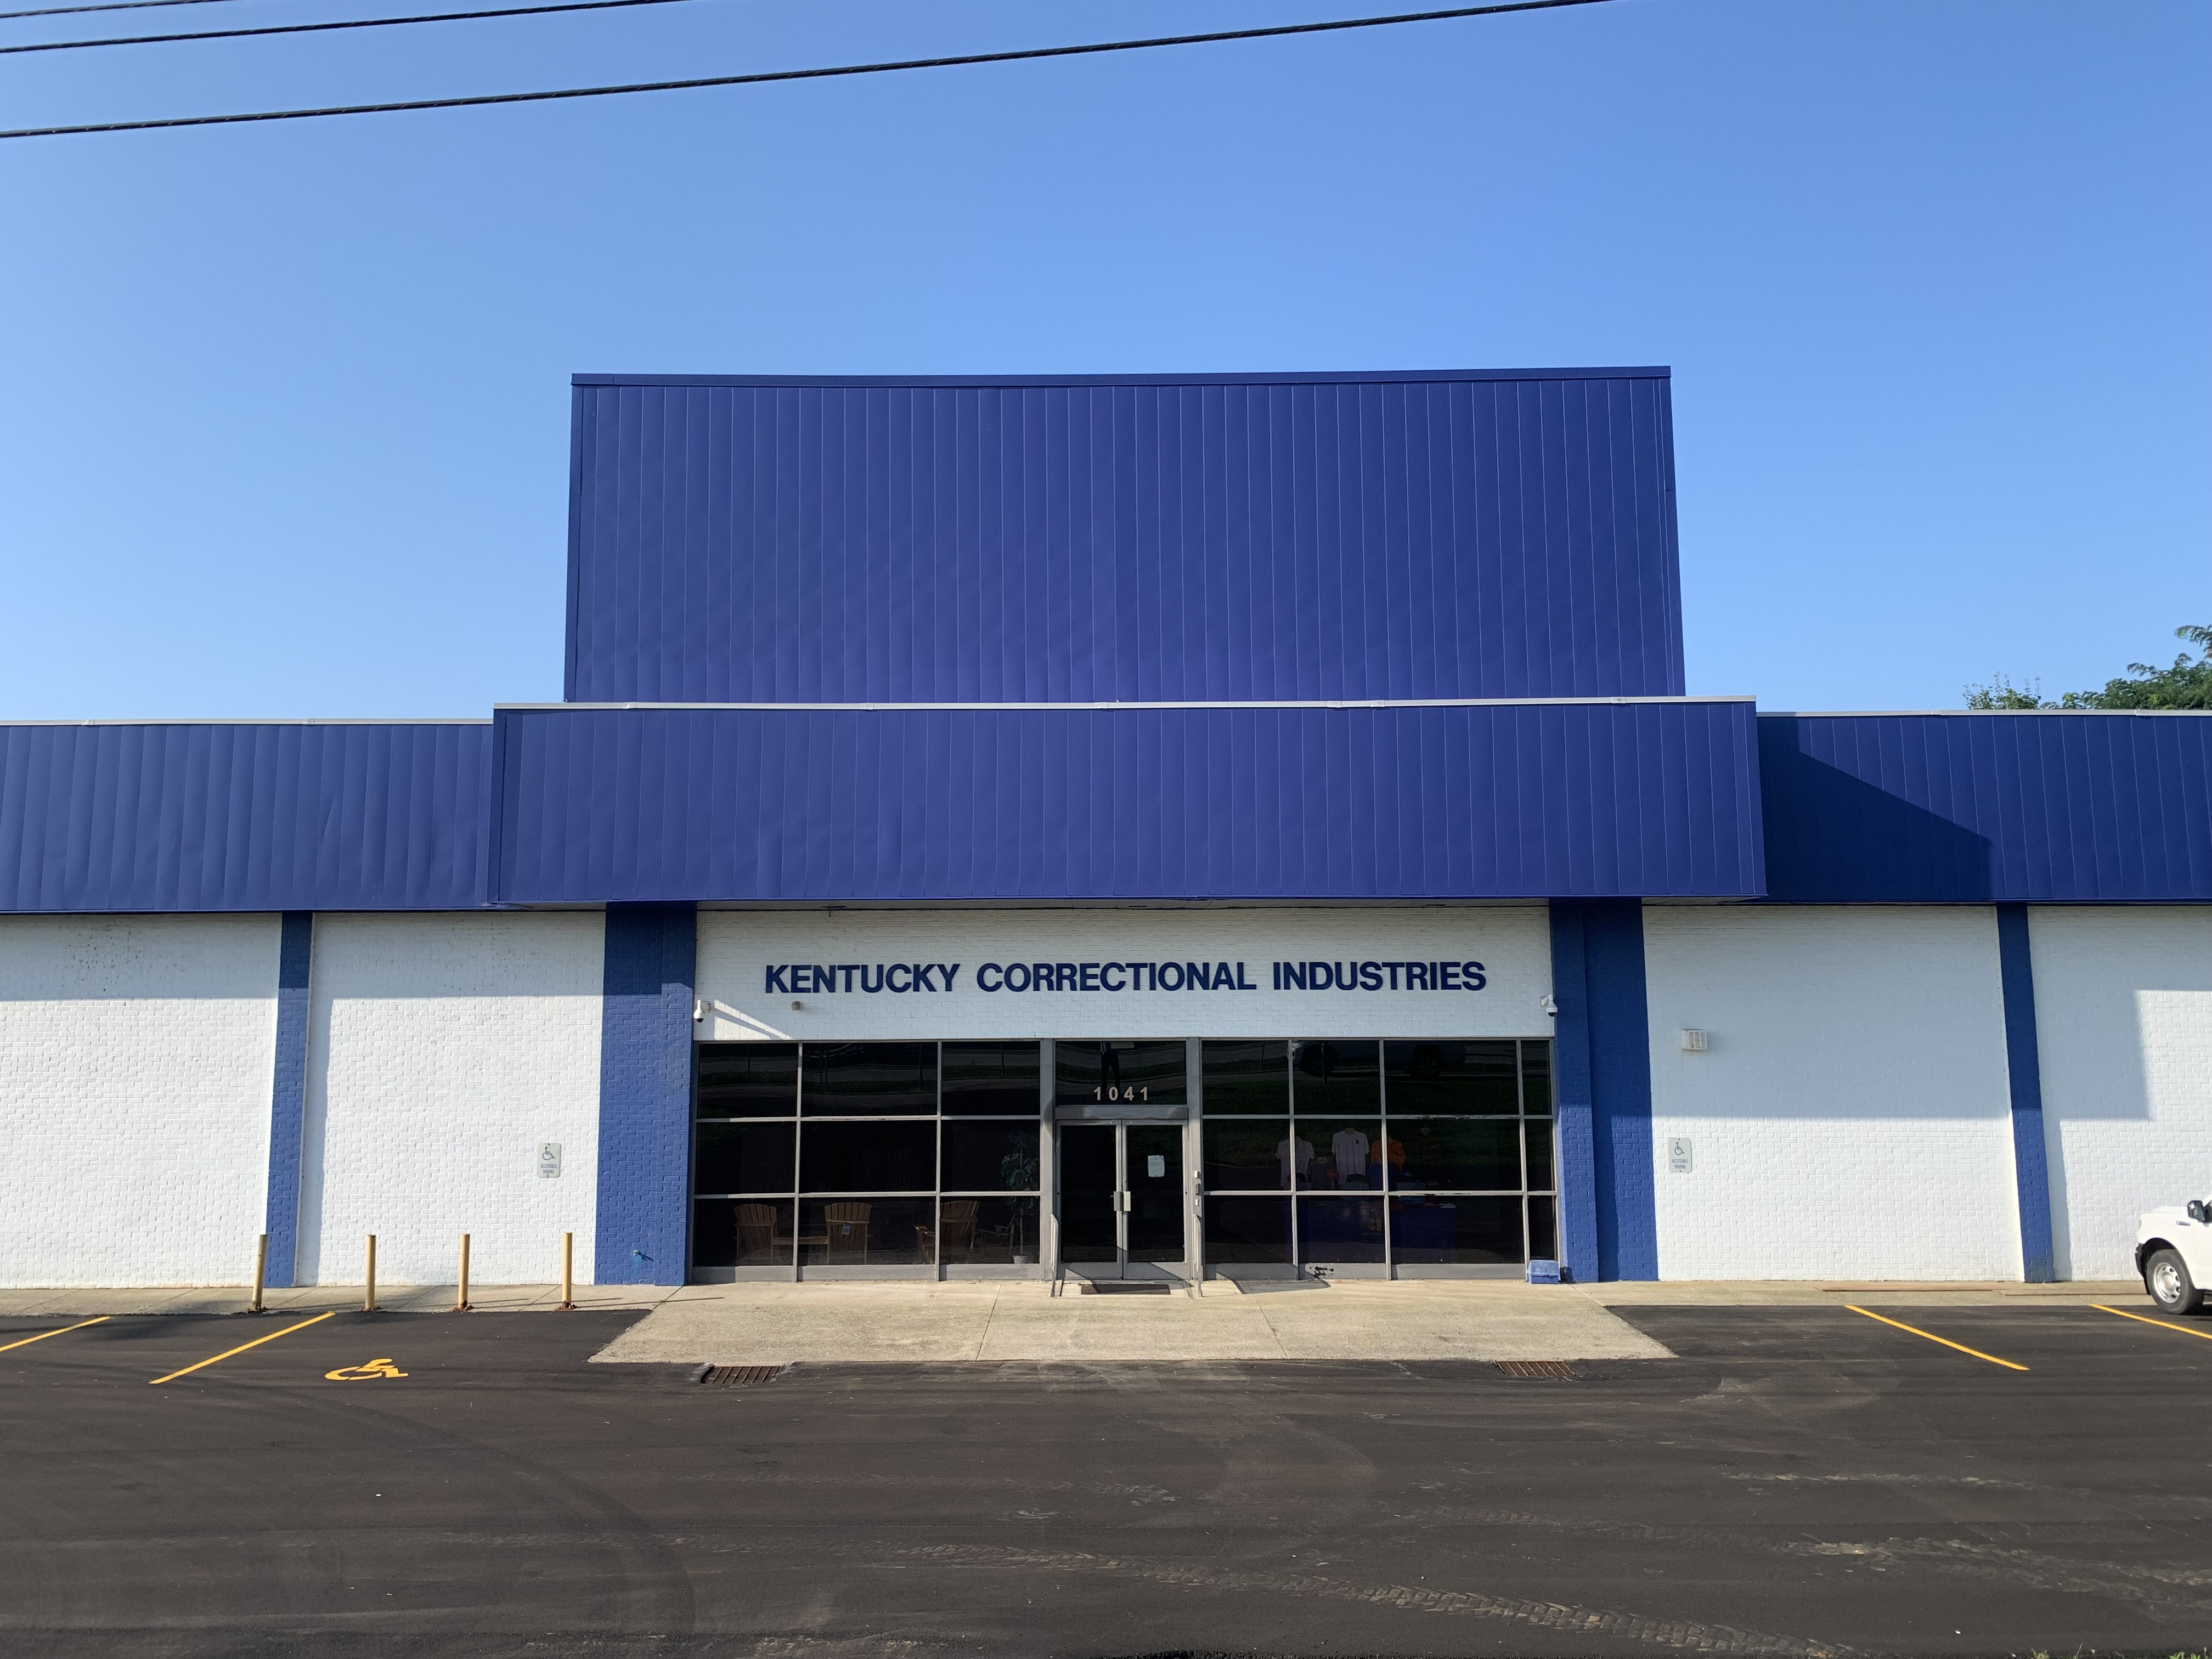
KCI Currently has:
39 KCI Staff
375 inmate workers with the
capacity to employee over 700 Inmates.

Slide 4
KCI at EKCC
KCI plant at Eastern Kentucky Correctional Complex is located in West Liberty, Kentucky.
This facility processes coupons, manufactures mattresses, and produces inmate clothing, sheets, and pillowcases.
Currently, there are 2 KCI staff members and 24 inmate workers.

Slide 5
KCI at GRCC
KCI plant at Green River Correctional Complex is located in Central City, Kentucky.
This facility manufactures office furniture and custom wood items.
Currently, there are 4 KCI staff members and 44 inmate workers.

Slide 6
KCI at KCIW
KCI plant at Kentucky Correctional Institute for Women is located in Pee Wee Valley, Kentucky.
This facility produces bar soap, Portion Pac (correct-PAC), and cleaning supplies.
KCI at KCIW also provides Braille transcription.
Currently, there are 2 KCI staff members and 38 inmate workers.

Slide 7
KCI at KSP
KCI plant at Kentucky State Penitentiary is located in Eddyville, Kentucky.
This facility produces inmate clothing, sheets, pillowcases, and any other garments required by DOC for inmate issue.
Currently, there are 3 KCI staff members and 40 inmate workers.

Slide 8
KCI at KSR
The KCI plant at Kentucky State Reformatory is located in La Grange, Kentucky.
This facility manufactures metal products and license plates.
Currently, there are 3 KCI staff members and 60 inmate workers.

Slide 9
KCI at LLCC
KCI plant at Luther Luckett Correctional Complex is located in La Grange, Kentucky.
This facility produces embroidery/silk screen apparel and has a full-service printing facility specializing in forms, envelopes, business cards, etc.
Currently, there are 4 KCI staff members and 53 inmate workers.

Slide 10
KCI at LSCC
KCI plant at Little Sandy Correctional Complex is located in Sandy Hook, Kentucky.
This facility produces office seating, upholstery, and office furniture refurbishing.
KCI at LSCC offers laser engraved plaques and commemorative items.
Currently, there are 4 KCI staff members and 46 inmate workers.

Slide 11
KCI Warehouse
The KCI warehouse currently provides logistics to all KCI plants for finished goods and some raw materials.
This includes transportation of items to and from its manufacturing facilities and delivery to customers across Kentucky.
Currently, there are 6 KCI staff members and 10 inmate workers.

Slide 12
KCI Farms
KCI currently has 4 farm operations located at the following institutions:
Northpoint Training Center
Blackburn Correctional Complex
Roederer Correctional Complex
Western Kentucky Correctional Complex
KCI has 375 acres of corn, 860 acres of soybean, and 1,143 head of cattle between all its farm locations.
Currently, there are 46 inmate workers.

Slide 13
KCI PIECP
KCI currently has its first Prison Industries Enhancement Certification Program (PIECP) in operation at KCIW.
At KCIW, KCI is in a partnership with a private sector company called Restoration Parts Unlimited, located in La Grange, KY.
Currently, KCI has 7 inmate workers manufacturing classic car interior pieces for the company.
US Code 18 and KRS 197.105, allows KCI to manufacture items in DOC institutions and to sell across state lines, providing that participating inmates are paid a prevailing 10th percentile wage within that locale of the prison.

Slide 14
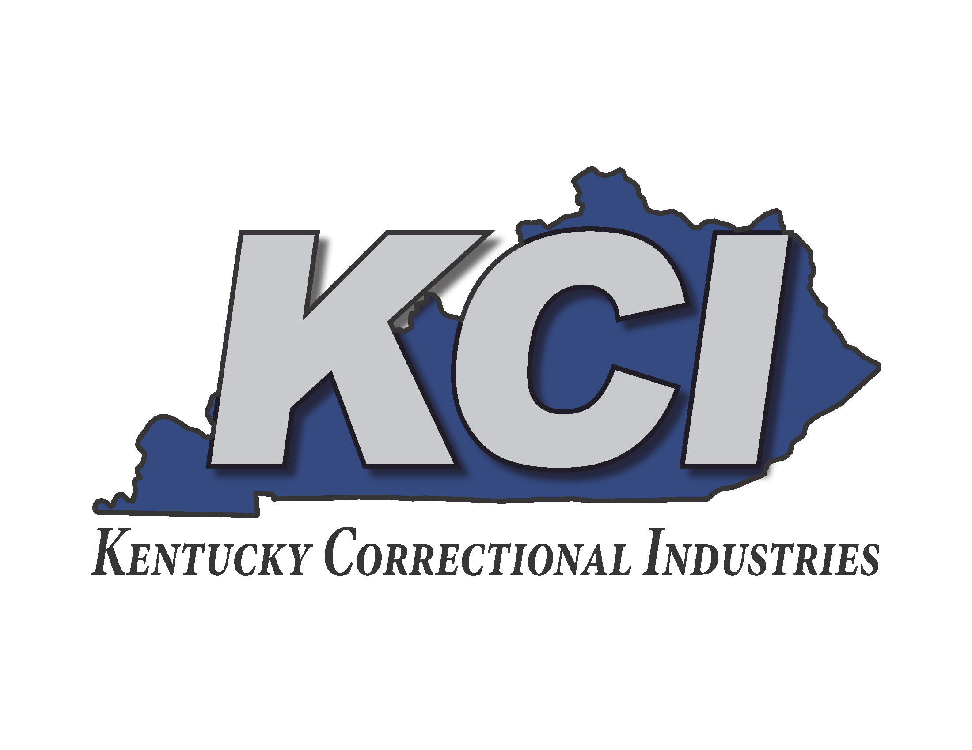
Questions ?

