Slide 1
COUNTY JAILS In the Commonwealth
James Daley, President
Josh Lindblom, Legislative Chair &KJA Jail Reform Committee Members

Slide 2
Facilities Overview

Slide 3
Who Do We House?
COUNTY INMATES
Pretrial misdemeanants and felons
Sentenced Misdemeanants
Fugitives from other states
STATE INMATES
Class D Felons
Class C Community Custody
Controlled Intake (inmates awaiting classification)
Parole Violators
Alternative Sentence
OTHER
Federal Inmates
ICE Detainees
Notes:
The State pays a higher per-diem to private prisons that county jails. The state also encumbers the cost of inmate healthcare, and pays the private prison guards extra money to guard the inmates while they are in the hospital.
Counties are only reimbursed $1.91 a day for medical, which is part of our overall per diem. We are not reimbursed for guarding inmates and the hospital.

Slide 4
About County Jail Populations
We do not arrest, set bail/bond, prosecute, sentence or classify the inmates located in our facilities.
We are charged with the custody, care and control of all inmates.
The population is often in very poor health, drug addiction, mental illness, dental decay, need for dialysis, heart conditions, etc.
The states classification system dictates what inmates can be housed in what facilities, and when those inmates are eligible for programming.
Notes:
Stress that over 10,000 inmates are misdemeanants or pre-trial felons.
Discuss our willingness to be a partner in moving justice reform forward

Slide 5
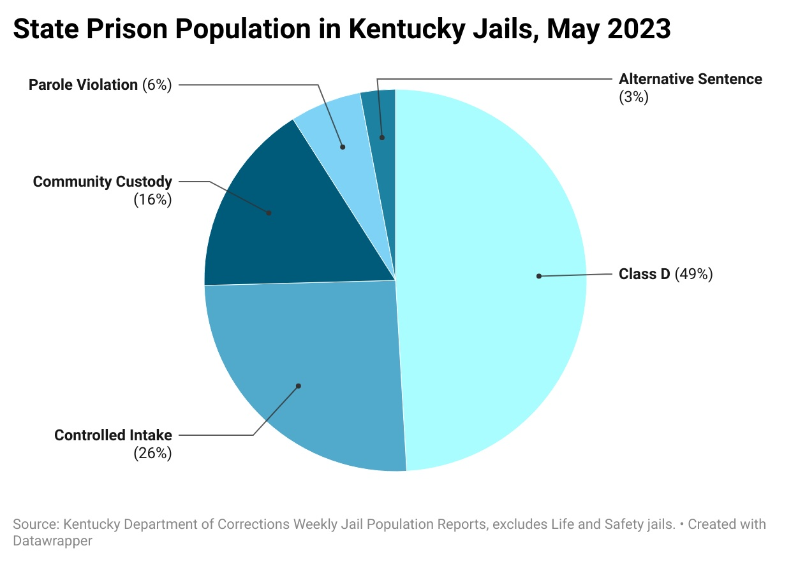
COUNTY JAIL POPULATION SNAP SHOTS
Notes:
44% of our current jail population is being held pre-trial.
In Kentucky, similar to other parts of the country, incarceration rates are highest in rural areas, and over half of all people incarcerated in local jails in Kentucky were in rural areas as of January 19, 2023.

Slide 6
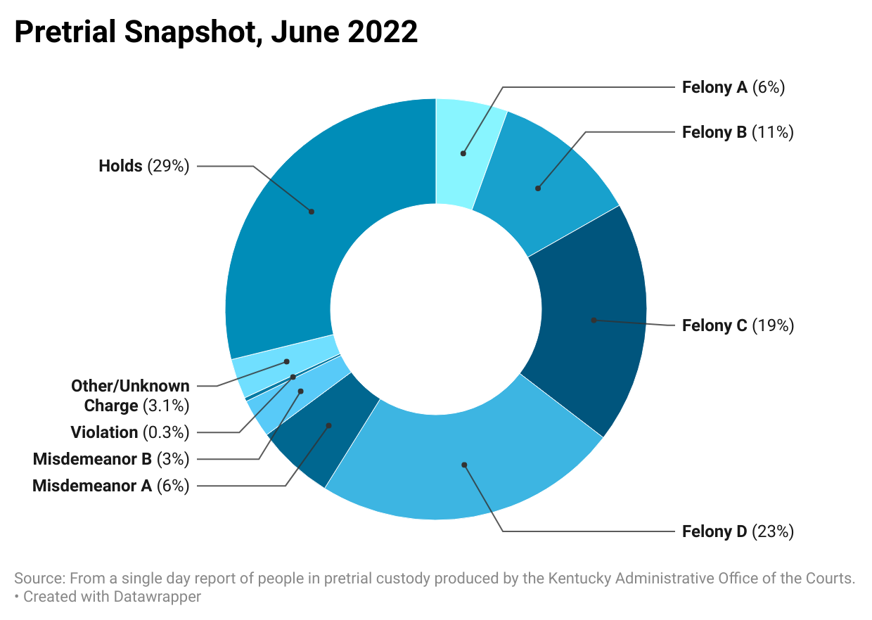
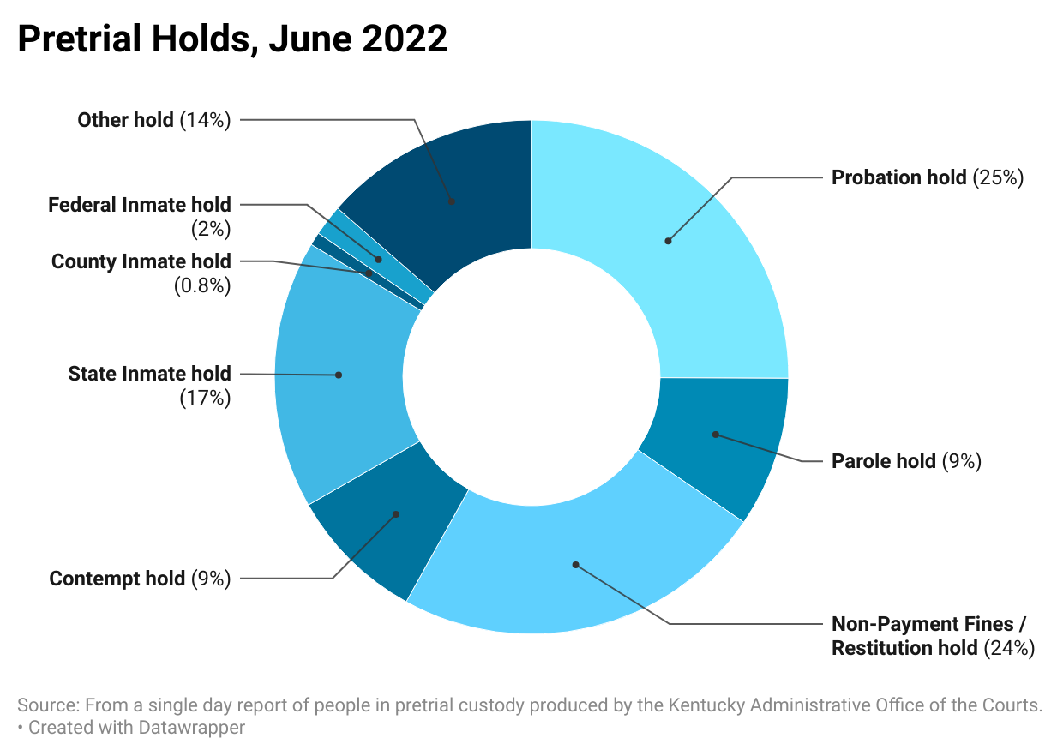
PRETRIAL JAIL POPULATION SNAPSHOT
Notes:
Around 44% of our current jail population is being held pre-trial, on the county’s dime.
Nearly a third of the pretrial inmates have a hold of some kind. The rest are being detained on money bail or because they were charged with a capitol offense.
A third of all pretrial holds are for probation and parole violations. These people can sit in jails for a very long time.
In Kentucky, similar to other parts of the country, incarceration rates are highest in rural areas, and over half of all people incarcerated in local jails in Kentucky were in rural areas as of January 19, 2023.

Slide 7
About Jail Budgets
FUNDING COMES FROM
State Appropriations (Jail Bed Allotment, Daily Per Diem, Local Corrections Assistance Fund)
County General Fund Dollars
Federal Contracts ( not every facility)
Restricted Funds (Commissary)
Grant Funding
WHILE WE HAVE CONTINUOUSLY BEEN ASKED TO DO MORE,
WE WANT TO CONTINUE WORKING WITH THE STATE TO:
Keep Kentucky Safe
Institute Smart Programs
to reduce recidivism
Notes:
More from KACo a little later.

Slide 8
THANK YOU
RECENT FUNDING GIVEN BY THE GENERAL ASSEMBLY
$4.00 Per Day Per Diem Increase
Funding for Programs Increased and Education based incentives
$15 million for virtual arraignment equipment (deployment July 2023)
Statutory change to allow for telehealth within local facilities

Slide 9
CURRENT Challenges

Slide 10
Distinct Jail Challenges
Inmates are not eligible for programming until they are classified by the Kentucky Department of Corrections. The current classification process has fallen behind its statutorily requirements for years.
Wheels of Justice are slow. As a result of the pandemic a backlog remains in the court systems causing the county inmate populations to skyrocket.
Probation and Parole as well as technical violations are often placed back into our facilities on new charges. Making a cycle that aids in excessive court dockets.
County jails combined hold the largest number of mentally ill Kentuckians with very little access to mental healthcare.
Notes:
Be sure to expand on the health issues. Detox centers, substance abuse providers, mental health providers.

Slide 11
Resolutions

Slide 12
CLASSIFICATIONS AT LOCAL FACILITIES
Expand access to substance abuse treatment programs inside and outside jail facilities. Partner within patient rehabilitation centers.
Local Facilities already classify nonstate inmates housed in their facilities. Allow DOC to train jails to classify the controlled intake population.
Expand/Fund greater access to mental health care for incarcerated individuals through CMHCs, local health departments and private mental health centers.
Add tools that allow for swifter access to justice. Less than 1% of jury cases go to trial. Revisit graduated sanctions to prevent new charges for probation, parole and technical violators.
Notes:
Classifying the controlled intake population would allow for swifter access to programming needs. This will allow for the inmate to seek positive mental reforms earlier. It would also allow the inmate to earn more credits toward their sentence ultimately getting them out of incarceration and into wrap around services faster.

Slide 13
Uniform Training for Deputy Jailers
Kentucky Jailers Association has been working with members of the General Assembly to to ensure such training.
This training could be regionally set up to minimize the cost to both the state and county.
Recruitment and retention issues are becoming a major problem within local jail facilities. Offering proper training will help with obtain a quality workforce.
Uniformed training would help ensure the continued safety of both the incarcerated and jail staff.

Slide 14
QUEsTIONS?

