Slide 1
Commonwealth of Kentucky
Jail and Corrections Reform Task Force
Brad Sassatelli – Senior Vice President
October 23, 2023

Slide 2
Corrections and Jail Consulting
System and Facility Operations Consulting
Criminal Justice System Performance Reviews
Staffing Needs Assessment
Master Planning
Operating Budget
Analysis
Organizational Analysis
After-Incident Reviews
Facility Conditions Assessments

Slide 3
CGL EXPERIENCE
500+
800+
49
Years of Criminal Justice Experience
Justice Clients
County Jail Assessments
2,000+
300+
Criminal Justice Projects
Justice Staff
34
15.2M
State Correctional System Master Plans
SF criminal justice facilities maintained
Notes:
Greg

Slide 4
BRAD SASSATELLI
50+
4
39
Years of Corrections
Experience
State Correctional System Master Plans
Major State & County Projects Led
20+
State Corrections Operations/Needs Assessments
75+
County Jail Operations/Needs Assessments
Recent Major State Projects
Recent Major County Jail Projects
DOC Master Plan: Illinois, Rhode Island, Pennsylvania, North Carolina, Alabama, and Utah
Operational Assessments: Florida, Minnesota, Iowa, South Dakota
Philadelphia, PA
St. Louis County, MO
Milwaukee County
Berks County PA
Louisville Metro
Dallas County
Notes:
Greg

Slide 5
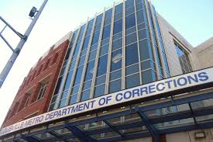
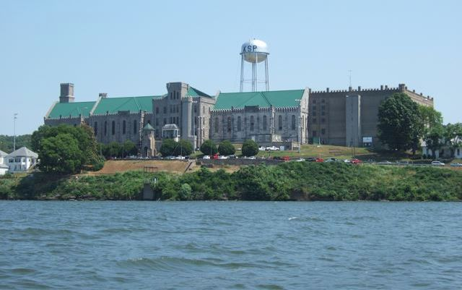
KY Jail and Corrections Reform Task Force
Jails and Prison Systems are facing unprecedented change & Challenges

Slide 6
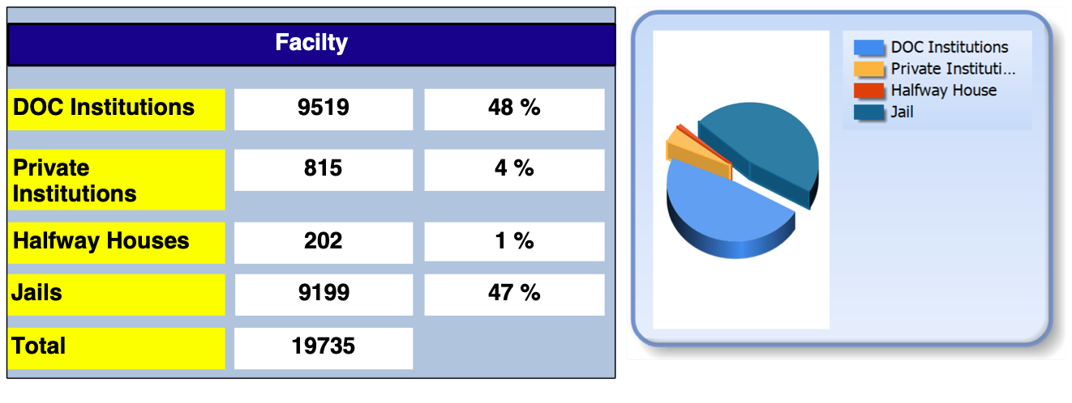
KY Jail and Corrections Reform Task Force
Kentucky’s jail/correctional System

Slide 7
Comprehensive Approach to Jail/Correctional Reviews
Where are we at?
Where do we want to go?
How do we get there?
1. Understand
2. Define
3. Analyze
4. Report

Slide 8
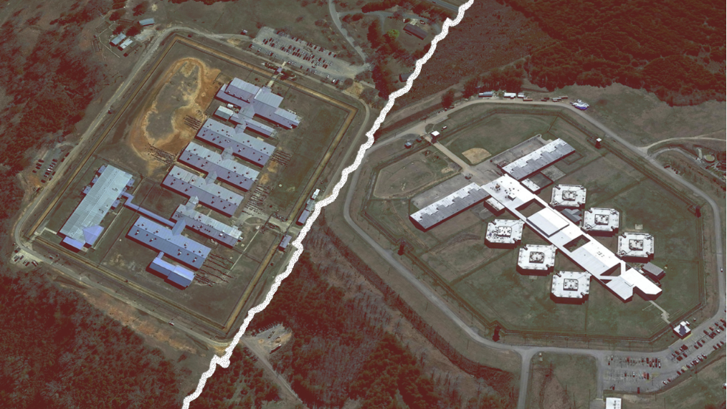
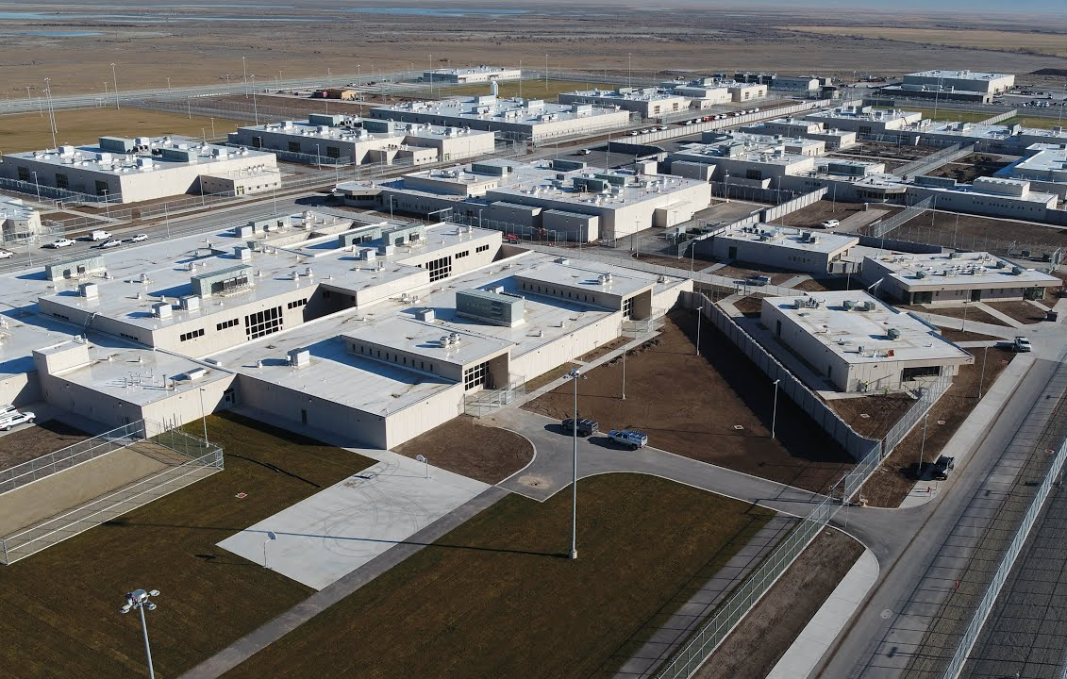
Past Major State Correctional/Jail Projects
Alabama Prison Transformation Project
Assess Facility Conditions
Determine Bed needs
Develop Agency Master Plan
Develop Life-Cycle cost analysis of options
New Prison Construction Started
Utah DOC Master Plan
Worked for state legislature
Assessed system operational performance
Determine future bed needs
Review housing of state inmates in county jails
Determine whether 4,000 bed prison should be relocated
New Prison Completed, Jail monitoring enhanced
Florida DOC Operational Review
Contracted with Florida Legislature Research Arm (OPPAGA)
Reviewed Security Operations and Inmate Programs
Assessed correctional staffing
Reviewed facility conditions
Conducted Inmate Risk Needs Assessment
State addressed deferred maintenance needs and implemented measures to address staffing needs

Slide 9
Brad Sassatelli
Ph: 217.823.3526
bsassatelli@cglcompanies.com

