Slide 1
Task Force on School & Campus Security 9/19/2023
Joseph L. Bargione, PhD
Licensed Psychologist

Slide 2
What
does:
Bounce builds the resiliency of children, adults, and families by improving knowledge about the impact of adverse childhood experiences (ACEs) and the skills to help people bounce back from adversity. This includes:
Education and training
Providing evaluation services to measure the impact of healing-centered practices
Advocating for policies that support people who have experienced trauma, help prevent trauma, and build resiliency
Notes:
Tell participants that Bounce was founded to help reduce the effects of ACEs make communities healthier.
Introduce Bounce and your relationship to Bounce. You may use some of the following points but try not to just read the bullets to the audience.
Bounce Coalition launched in 2014 with a grant from Foundation for a Healthy Kentucky
Bounce developed, piloted, and evaluated a trauma and resilience program for Jefferson County Public Schools, parents, and out-of-school-time providers
Our focus is on the impact of ACEs and training staff to recognize and respond using a trauma-informed approach
Today, Bounce has expanded its scope and works with schools, public health departments, and health providers across Kentucky.

Slide 3
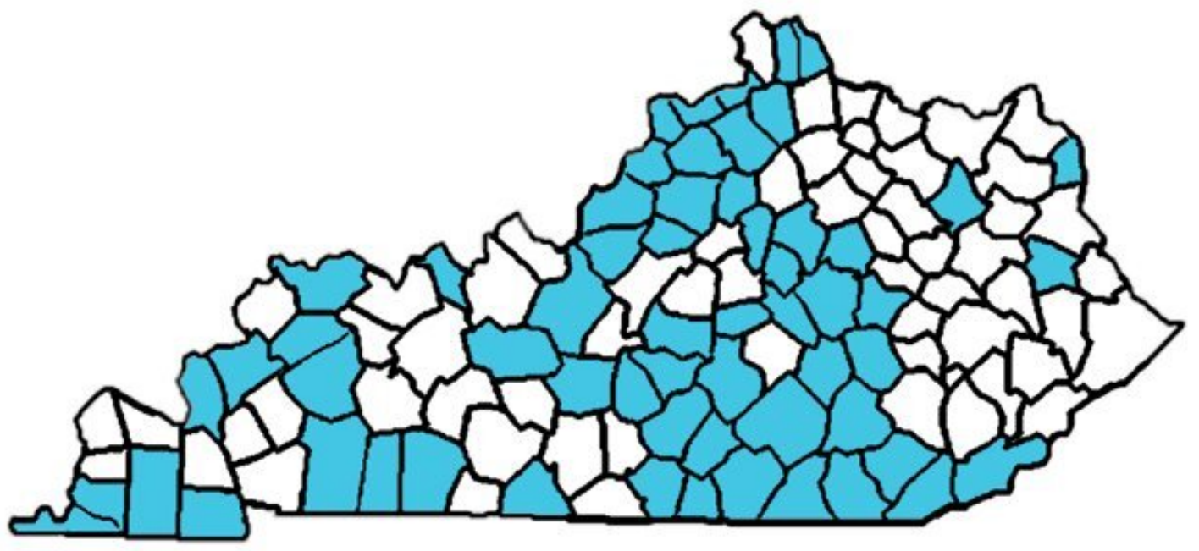
Bounce Partnerships
School Districts
Educational Cooperatives
HeadStart Programs
Out of School Providers
Health Departments
Hospitals
Residential Programs
Manager Care Organizations

Slide 4
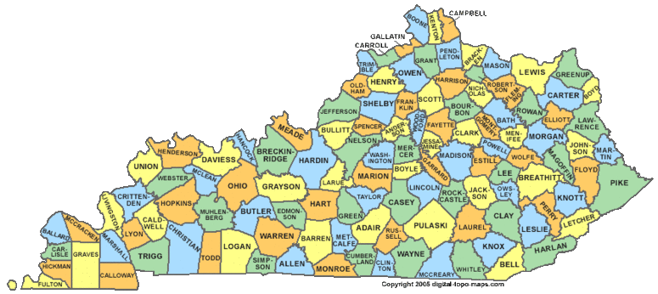
Our Journey Supporting Students
Where we started
Where we are
Where we are going

Slide 5
Where We Started
Two students were killed on campus
Local, state, and federal resources were activated to support students, staff, families and community
General Assembly established the School Safety Work Group
Chaired by Senator Wise & Representative Carney
Led to the passage of the School Safety and Resiliency Act (2019, 2020)

Slide 6
Where We Are School Safety and Resiliency Act (2019, 2020)
Physical Safety
Established State Security Marshall
School Resource Officers
School Security Risk Assessments
“Handle with Care”
For additional information
https://kycss.org/
Psychological Safety
District Trauma-Informed Education Plans (DTIEPs)
Suicide Prevention Program
Additional mental health specialists
Recognition of how trauma and adverse childhood experiences (ACEs) impact students
For additional information
https://education.ky.gov/

Slide 7
Brief Review of Concepts
Adverse Childhood Experiences (ACEs)
Are potentially traumatic events that occur in childhood. ACEs can include violence, abuse, and growing up in a family with mental health or substance use problems. (CDC)
Resilience
The combination of protective factors that enable people to adapt in the face of serious hardship, and is essential to ensuring that children who experience adversity can still become healthy, productive citizens. (Harvard Center on the Developing Child)

Slide 8
Building Resiliency In Students Using Positive Childhood Experiences Framework
Positive Childhood Experience
Can help protect against the poor health outcomes associated with ACEs
4 Components
Relationships within families and others through interpersonal activities
Safe, stable, and equitable environments for living, playing and learning at home and in school
Social and civic engagement to develop a sense of belonging and connectedness
Emotional growth through playing and interreacting with peers for self-awareness and self-regulations
Source: Healthy Outcomes from Positive Experiences (HOPE)

Slide 9
Where We Need To Go
Update District Trauma-Informed Education Plans
Update Suicide Prevention Programs
Update existing structures and programs to support work (e.g., MTSS)
Note: Input for recommendations were from leaders for school psychologists, school counselors, school social workers, mental health experts, KY Center for School Safety and KY School Safety Marshall
This Photo by Unknown Author is licensed under CC BY

Slide 10
District Trauma-Informed Educational Plans
Need for accountability and continuous monitoring
Plans need to be at school and district levels
Data on well being of students should be collected (e.g., KIP, YRBS) and used to develop strategies
Potential impact of SB-150 on collecting data
Scheduled reviews within districts and by an outside agency (e.g., KDE, CTAC, Educational Cooperatives)
Monitoring results should be reviewed at the school, district and state level so effective strategies can be shared, and support provided to schools or districts that need it

Slide 11
District Trauma-Informed Educational Plans
Focus should also include building resiliency in students
Use three tiered system of support similar to what schools use when teaching reading, writing and math
Use evidenced based strategies/services at each level
Tier 1 needs to include prevention component
Consider using similar process for Comprehensive District Improvement Plans (CDIPs) and Comprehensive School Improvement Plans (SCIPs)

Slide 12
Suicide Prevention Programs
Suicide prevention programs that are presented to students and staff should be evidence-based.
Programs presented to staff should include risk factors, warning signs, protective factors, response procedures, referrals, postvention, and resources regarding youth suicide prevention.
After the initial lesson occurs before September 15, a follow up lesson should occur prior to January 15th to reinforce prior learning.
Schools make a good faith effort to reach students who are absent on the day of the instruction
All certified and classified staff who have direct contact with students in grades four through twelve should be trained on suicide prevention. This adds any staff who have contact with students in fourth and fifth grades.
See position paper from the school psychologists, school counselors, and school social workers associations for additional recommendations

