Slide 1
INVESTMENTS IN INFORMATION TECHNOLOGY IMPROVEMENT & MODERNIZATION PROJECTS OVERSIGHT BOARD
TESTIMONY OF
SEAN KNOWLES
12.11.2023

Slide 2
Agenda
Overview/Work History
Cooperative’s Commitment
Emerging Trends/Potential Issues
Best Practices and Key Takeaways

Slide 3
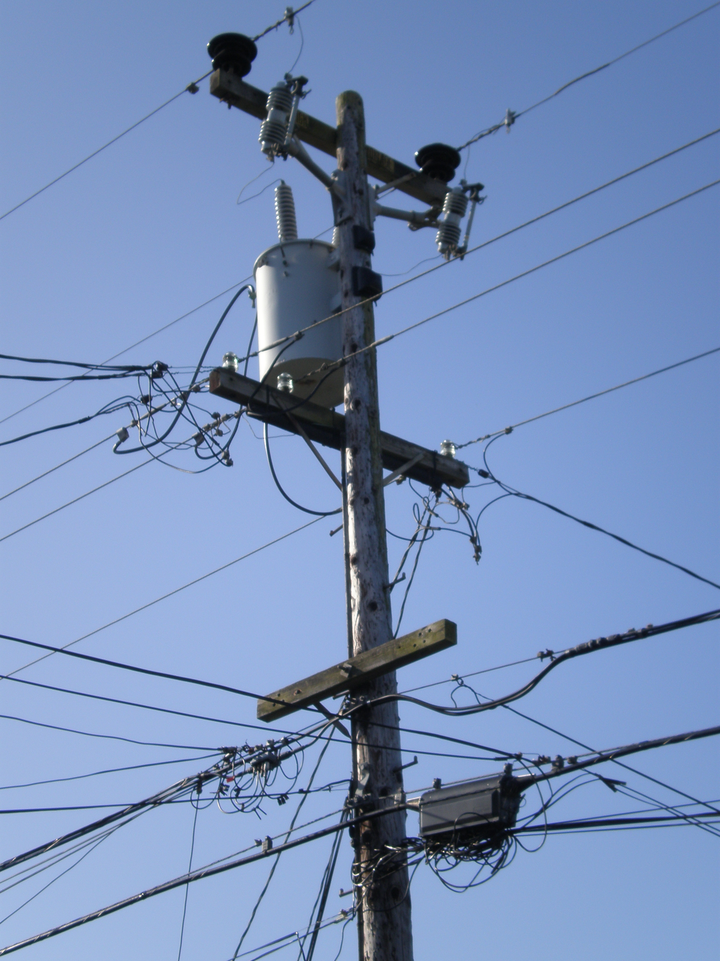
A Brief History
35,000+ Pole Permits Received/Processed for 9 Cooperatives
Implied Investment:
$150+M
50,000+ Expected in 2024
Implied Investment: $250+M
This Photo by Unknown author is licensed under CC BY-SA.

Slide 4
Cooperatives’ Commitment
4 Statewide Meetings
7 Working Group Meetings
8 Conference Presentations
$1,000s in Software Systems
10,000s of Manhours
50+ Meetings with Attachers

Slide 5
Issues/Trends
Unauthorized Attachments
Broken Poles/NESC Clearance Issues
Shared Contractors
Post-Construction Inspection

Slide 6
Best Practices & Key Takeaways
All parties → Collaborate, Communicate, Continue to invest in/improve permitting
MUST actively administer the process
Tariff/contract/regulation awareness is key
Don't forget Post-Construction Inspection!
Requires Significant Resources: Systems and Personnel

Slide 7
Questions?

