Slide 1
Peter Waldrab – Vice President, Electric Distribution
Caroline Clark – Director, External Affairs
Jason Jones – Manager, Distribution Systems, Compliance, & Emergency Preparedness

Slide 2
Pole Spaces
Power Supply Space
Communication Worker Safety Zone
Communications Space
Public Use Space

Slide 3
Attachment Process
Application
Field Survey
Engineering / Design
Make Ready Construction
Communications Construction
Post Construction Inspection
Application Fee
Make Ready Estimate
Cost
True-Up

Slide 4
Pole Attachment Application Tiers
Small
Medium
High Volume Plans
1000+ Poles/Month
1 – 300 Poles/Month
105 days for construction
Volume and timing mutually agreed upon by LG&E / KU and Attacher
301 – 1000 Poles/Month
150 days for construction

Slide 5
Project Delivery
LG&E and KU have demonstrated the ability to deliver on large projects
Keys to Success
Defined scope of work and timeline
Communication
Identify roadblocks and streamline processes
MetroNet High Volume Plan
Storm Restoration
Ford BlueOval SK Battery Park

Slide 6
Questions

Slide 7
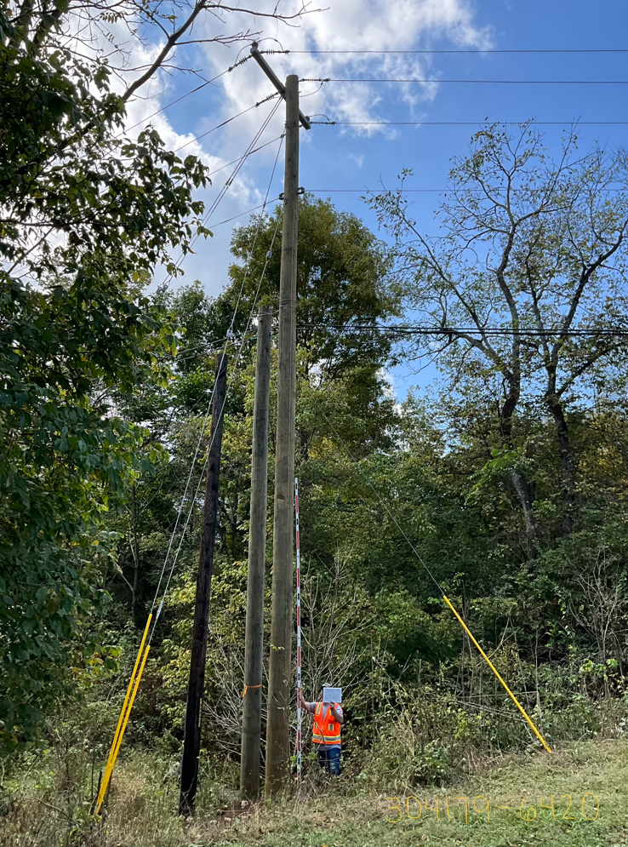
Examples

