Slide 1
Commonwealth Office of Technology Finance & Administration Cabinet
Investments in IT Improvement and Modernization Projects Oversight Board
David Carter
Chief Information Security Officer, COT
January 23, 2024

Slide 2
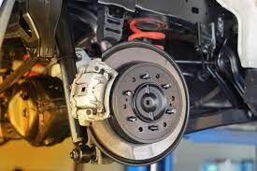
Defense in Depth
Reactive
Proactive
OR
Having the right technology, monitoring, processes and staff to respond rapidly to incidents when they occur.
Having the right technology, monitoring, processes and staff to catch and mitigate threats when they attempt to enter the environment.

Slide 3
Defense in Depth
Reactive
Proactive
X
AND
OR
A thoughtful and comprehensive security approach that begins at the mindset of the user, ends at the data, and is diligently applied every step in between. A combination of effective front line proactive defenses paired with comprehensive monitoring and response capabilities.

Slide 4
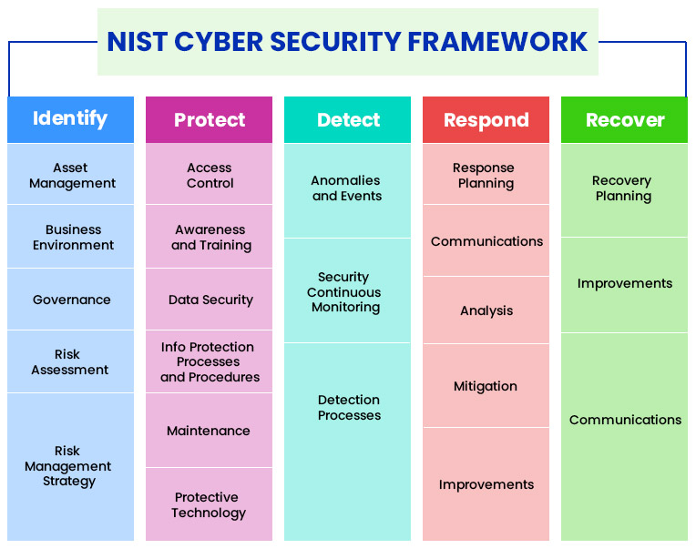
Defense in Depth

Slide 5
Traditional Security
The fortress approach that relies on strong walls and boundaries to keep threats outside the protected enclave.

Slide 6
Traditional Security
Modern threat actors know we have strong walls and employ their trade craft taking lessons from the Greeks and their use of the trojan horse to breach those walls.

Slide 7
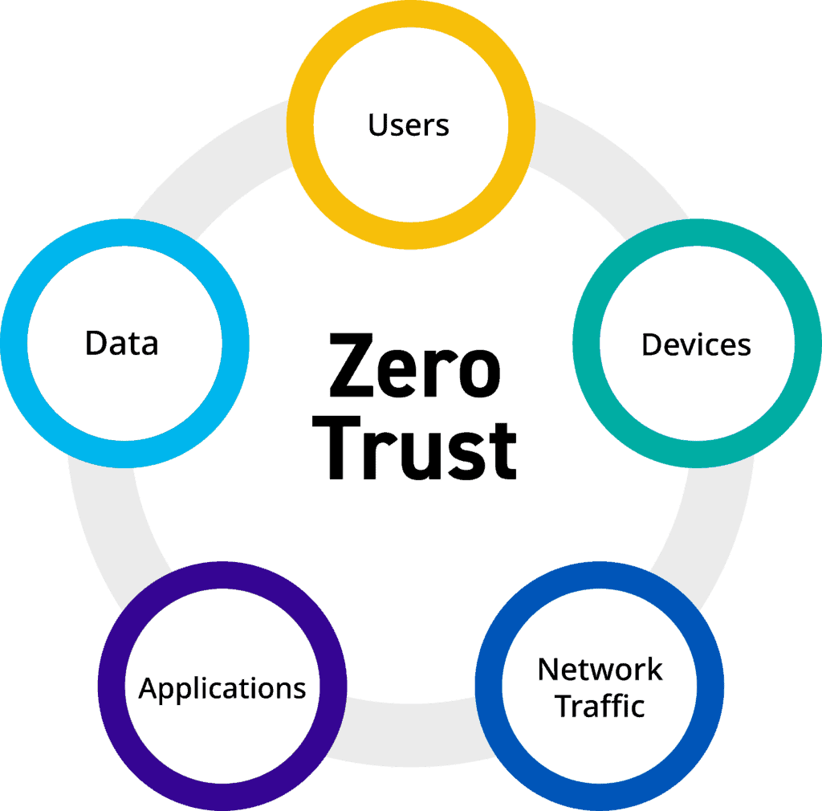
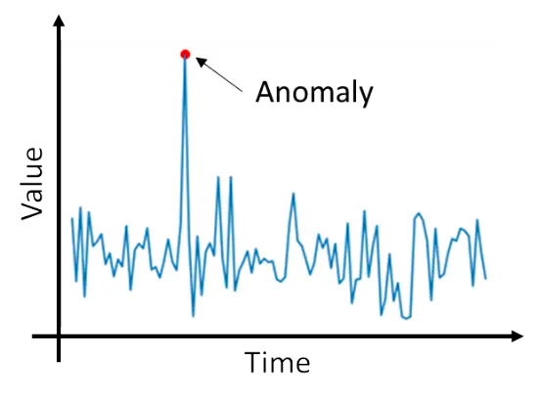
Modern Security
Modern security must be intelligent, watching not only for bad things but also good things behaving badly. The detection of, and response to, deviations from the norm and risky behavior is the new standard.

Slide 8
The Edge Defenses

Slide 9
Zone Defenses

Slide 10
Granular Lateral Defenses

Slide 11
Endpoint Defenses

Slide 12
Comprehensive Monitoring

Slide 13
The Big Picture

Slide 14
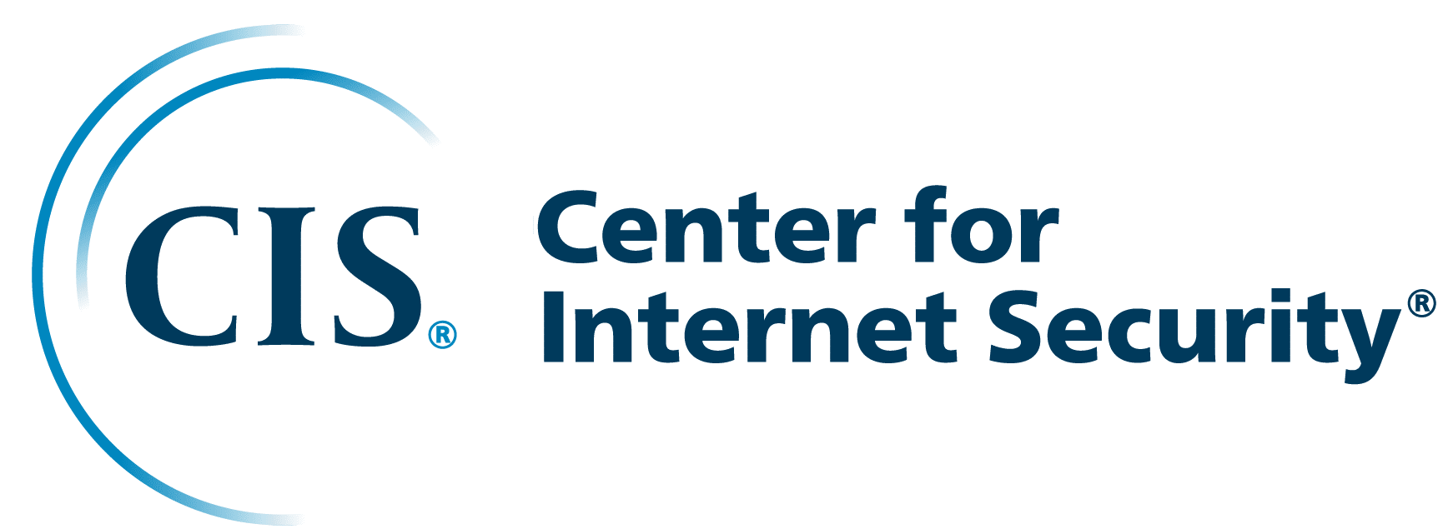
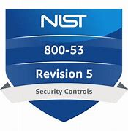
Industry Frameworks
1007
150/270

Slide 15
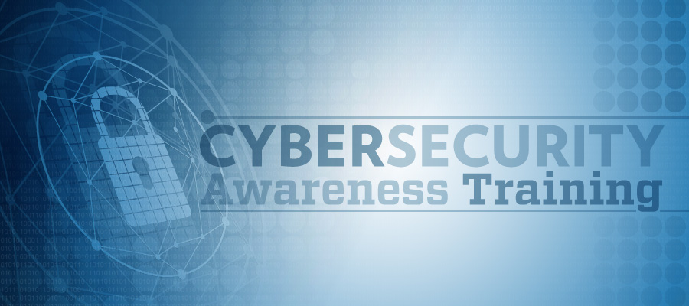
The Human Element

Slide 16
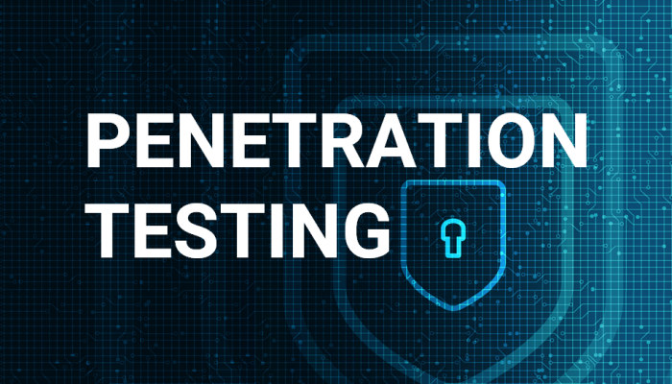
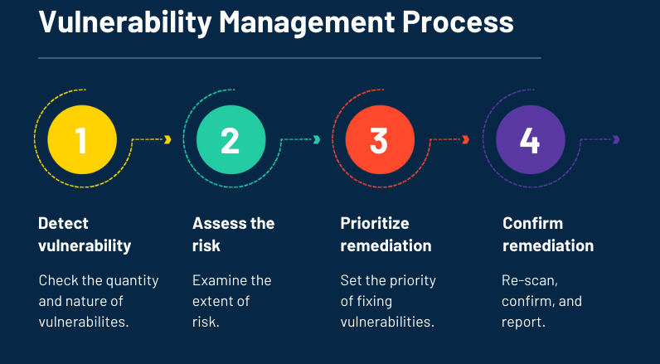
Risk Management

Slide 17
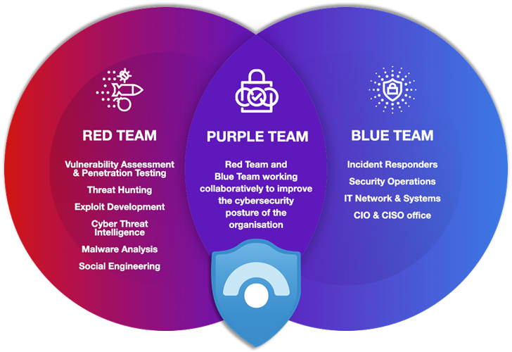
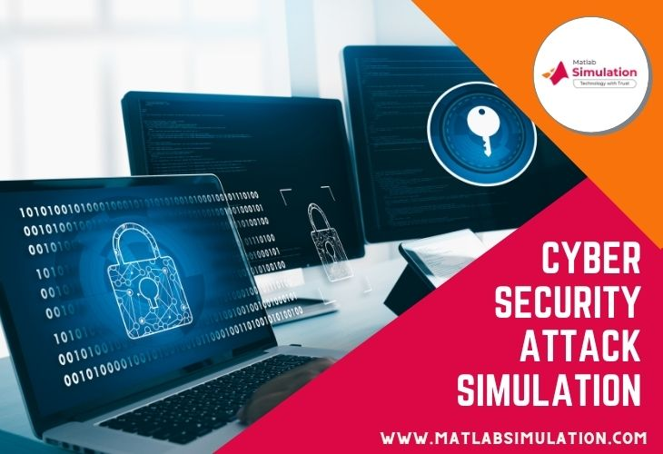
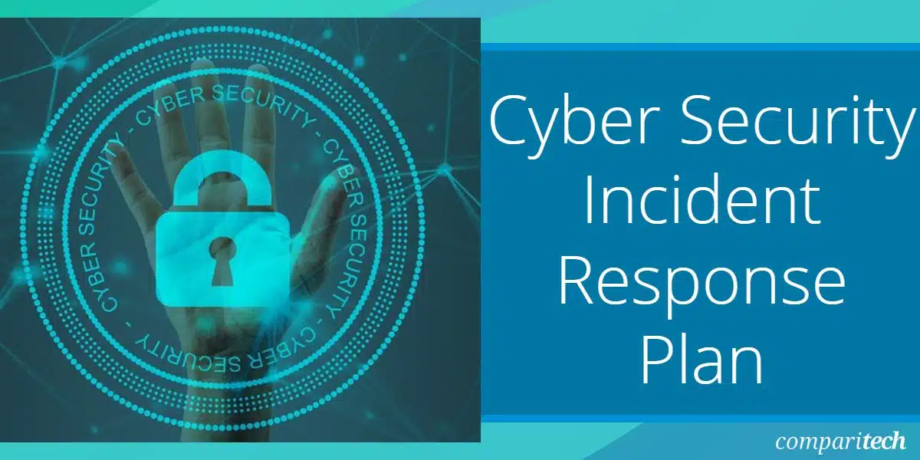
Advanced Incident Response

Slide 18
Questions
Contact Information:
David Carter
Chief Information Security Officer
Commonwealth Office of Technology
davidj.carter@ky.gov
502-564-8734

