Slide 1
KYTC GIS… United We Stand!
Investments in Information Technology Improvement & Modernization Projects Oversight Board
Presentation by Will Holmes, KYTC, OIT
Frankfort, Kentucky | April 23, 2024
Notes:
GIS is most valuable when everyone shares and works together.

Slide 2
Why GIS?
Leaders MUST make informed decisions…
with information available…
in the time allowed.
GIS is more than a map!
GIS quickly synthesizes MANY different types of data into MEANINGFUL INFORMATION to empower decision makers.

Slide 3
Why is Kentucky a leader in GIS?
Committed to sharing… freely.
Still some work to do.
Innovative
Committed to delivering value to decision makers and the people of the Commonwealth.
Notes:
United we stand… divided we fall.

Slide 4
Kentucky GIS Community
40+ years of GIS in Kentucky
Long history of sharing.
Extremely collaborative.
Geographic Information Advisory Council
Kentucky Association of Mapping Professionals
ACTIVE peer to peer problem solving.
Large network of people
Federal Government
State Government
Div. of Geographic Information (DGI)
KYTC, OIT-GIS (me)
…
Local Government
Private Sector
A lot of engineering firms.
Universities
Non-Profits
Notes:
Other states do not have this culture and active engagement.

Slide 5
What has made KYTC successful in GIS?
Leadership expects “Results-driven solutions”
Solving REAL problems with technology
Tech must fit the business need.
Provide answers in customer’s language.
A culture of innovation & adaptability
Embrace new technology/techniques.
Determination to solve hard problems.
Vision of “Seeing a path forward.”
Hired and grew the right people.
Collaboration/Partnerships
Willingness to share the work, investments, AND the success.
Built standards
Notes:
I was just in a meeting last week and a GIS person from OHIO was complaining, “Why can’t we have awesome data like Kentucky?”
The answer is we work TOGETHER to create, share, and use the data for everyone’s benefit.
SAG: 2024: Hub Sites
SAG 2021: COVID Response (Joint with EM, DGI, CHFS) https://events.esri.com/conference/sagList/?fa=Detail&SID=3239
SAG 2016: Real-Time COP: https://events.esri.com/conference/sagList/?fa=Detail&SID=2225
SAG: 2012: Billboards Project
SAG 20??: Mine Mapping (Joint Award)

Slide 6
Location (GIS) is the “Backbone” of KYTC information systems
Program Management
Planning
Environmental
Etc.
GIS
Information Ecosystem
Aviation
Right of Way
Financials
CADD
Etc.
Audits
Big Data
GIS Location
2D/3D CADD Models
Legal
Design
TED
TOC
Asset Mgmt
Districts
Traffic
Maintenance
Construction
Notes:
We understand that information is an “Ecosystem” not a single database. It MUST be available to the customer in a format that is natural and comfortable to them.

Slide 7
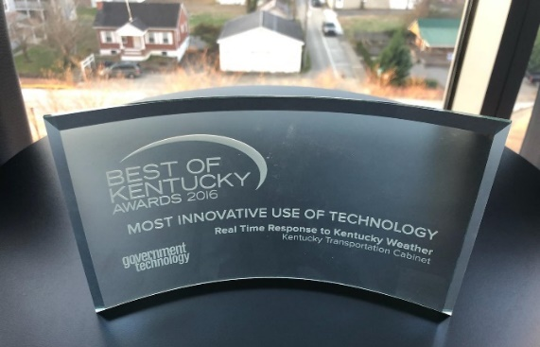
KYTC GIS success metrics?
“Top 5” – among DOTs for GIS
Innovative for 30+ years.
Won 9 awards (since 2012, but more before that)
6 International Awards
3 State Awards
International and state thought leaders/influencers
Teach workshops & regular presenters at conferences.
Active Member of AASHTO Committees & Task Forces.
Key state GIS partner…

Slide 8
Does KYTC have a statewide GIS roads database?
Yes! AND we have freely shared it for 27 years.
Updated weekly
1997: Detailed state-owned road network shared with other state agencies, the public, and the private sector
1998: Local roads added to statewide network.
2000: GPS-based network initiated by KYTC.
2004: Unified very accurate GPS-based road network
Completed for $17 million less than private contractor estimates.
Notes:
Kentucky (and KYTC) has a long history of leading the nation in how we leverage GIS to serve our customers.

Slide 9
How KYTC’s data interacts with county and local data?
KYTC Centerlines were foundation for
(Most) NG911 centerlines.
MANY local/county GIS groups’ road data.
Div. of Planning partners with Area Development Districts to
Integrate local road information changes into our unified network
Share/collaborate on other local transportation related information.
NOTE: A small handful of more urban areas are directly engaged by Planning.

Slide 10
History of KYTC GIS Collaboration…
Key member of GIAC for 30 years
Help write standards
Help state and local agencies with technical challenges or responding to emergencies.
Key investor in shared needs (LiDAR & Aerial Photography)
$5.7M since 2010
Consistent publisher to State repository for 17+ years
Free access of KYTC GIS data for all through the state clearing house.
Close collaborator with COT-DGI (The state’s coordinating GIS function) and other agencies.
Notes:
KYTC comprises ~35% of the state agency funding for LiDAR and Aerial photograph… to share the results with everyone.

Slide 11
GIAC Value… KY Single Zone Standard
EVERY state agency, engineers, surveyors (and the customers that depended on them) were paying a high cost of time and money dealing with data in multiple projections.
GIAC assigned a technical subcommittee
Developed a proposed new standard
Reviewed and approved by the National Geodetic Survey
GIAC approved and helped get it codified into law.
KYTC and MANY other organizations have saved hundreds of thousands of dollars over the past 20+ years because of it.
Kentucky Single Zone is the model for Nation Geodetic Survey’s current national modernization.

Slide 12
How KYTC uses GIS…

Slide 13
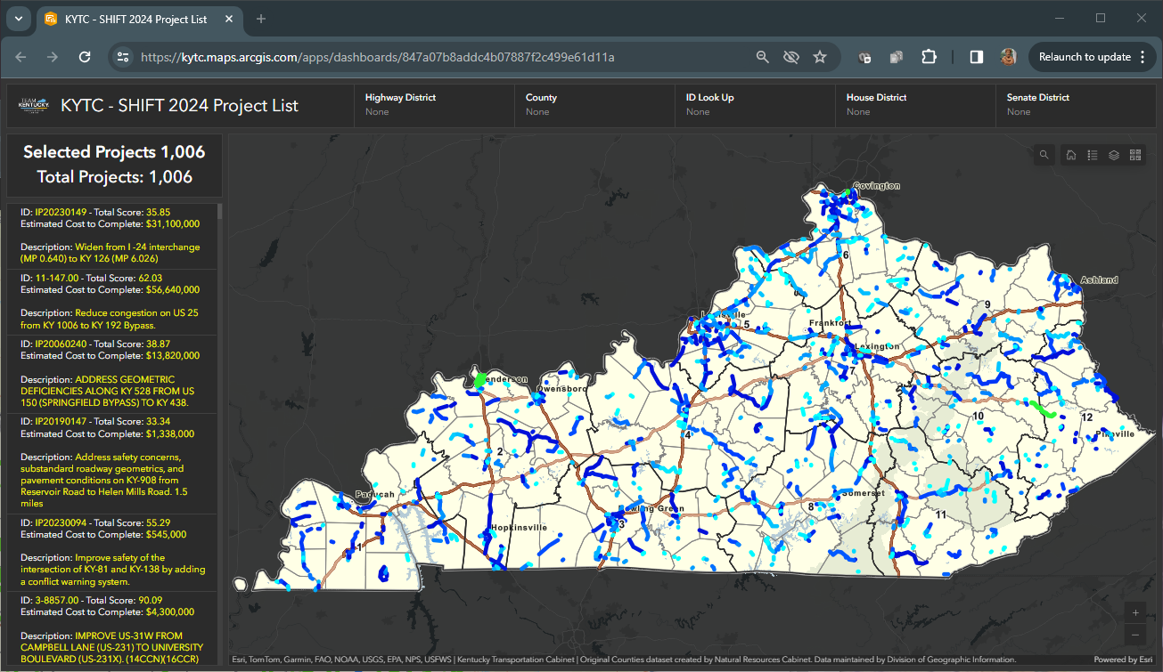
Project Development Process
At KYTC, GIS is used from project conception through maintenance…
Program Management
Planning
Environmental
Design
Construction
Traffic
Operations & Maintenance
SHIFT 2024

Slide 14
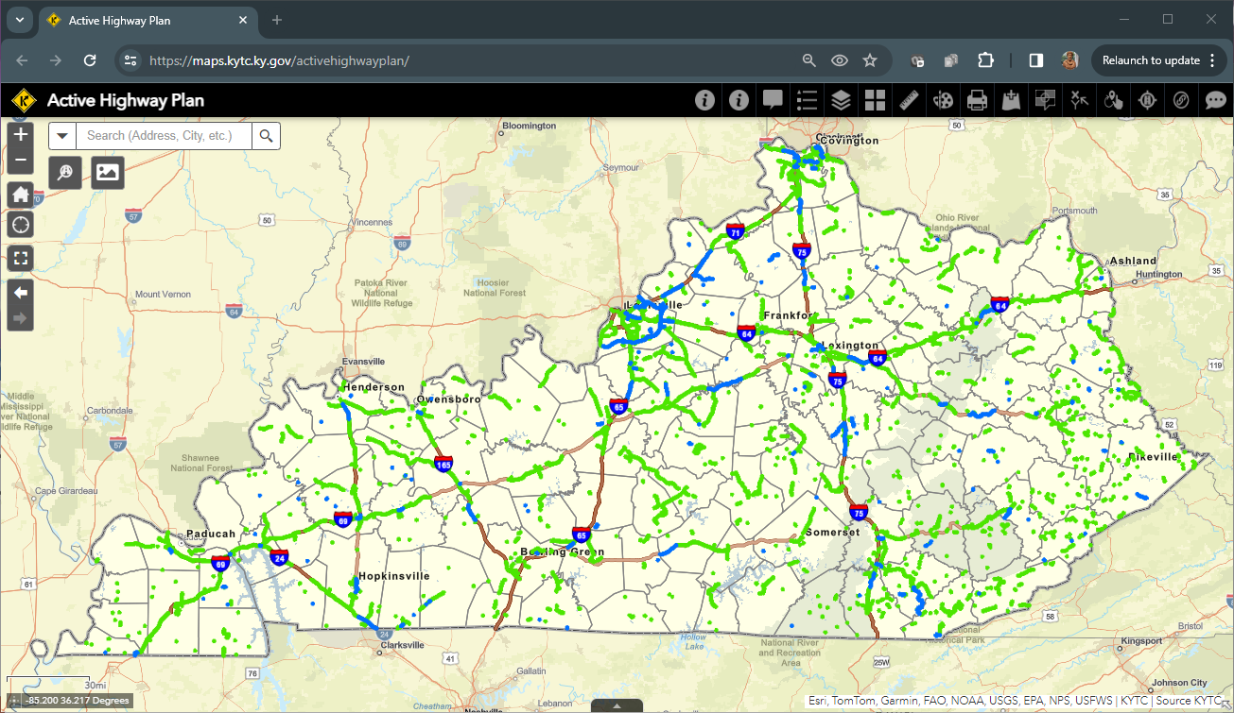
Plan results published to public (for 21 years)

Slide 15
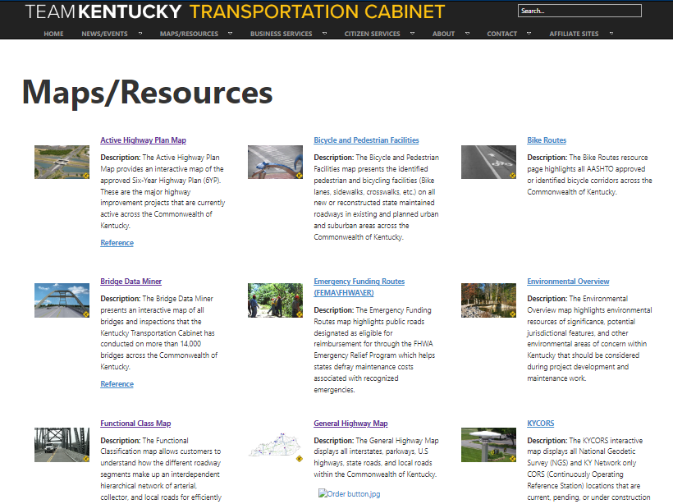
Public self-service sites
30+ public facing maps
Available 24/7/365.
Current information.
Focused to key themes.

Slide 16
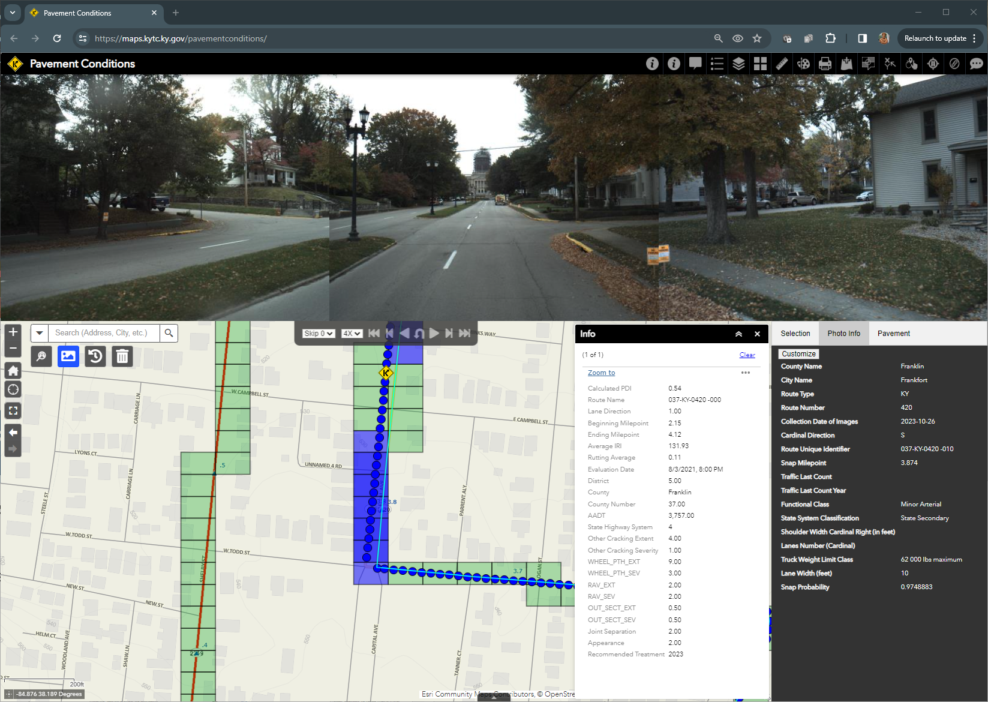
Each site is packed with powerful tools.

Slide 17
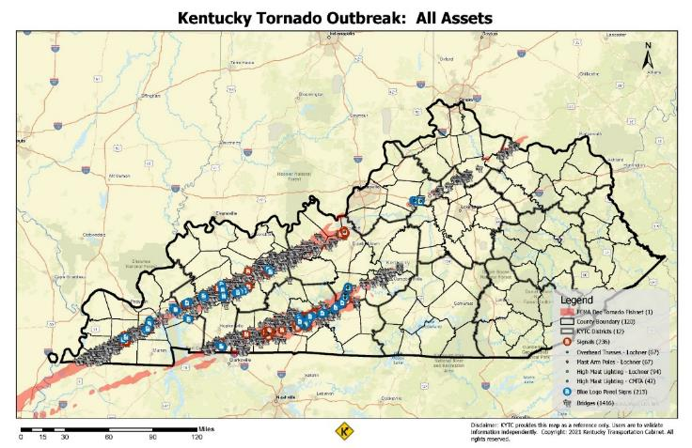
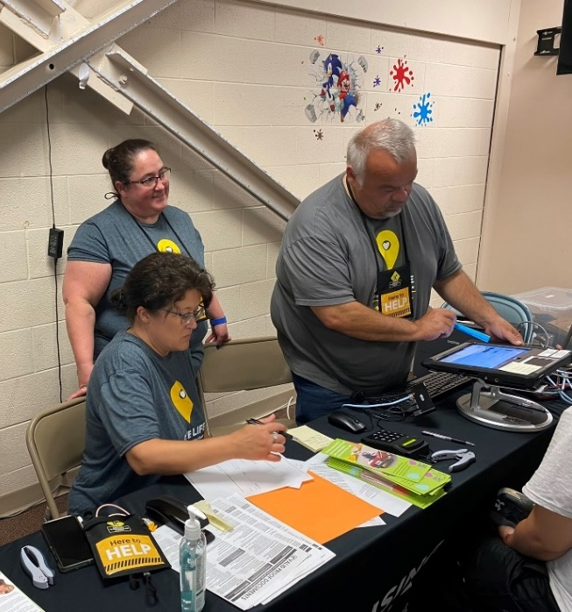
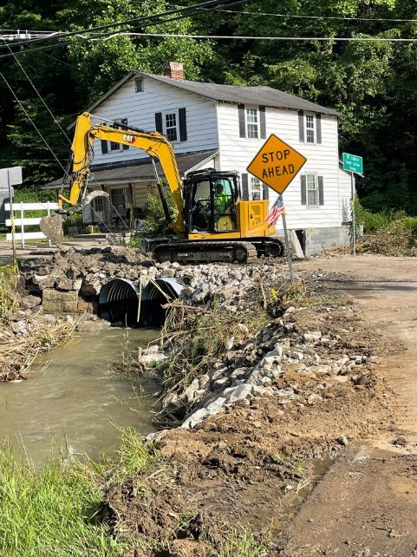
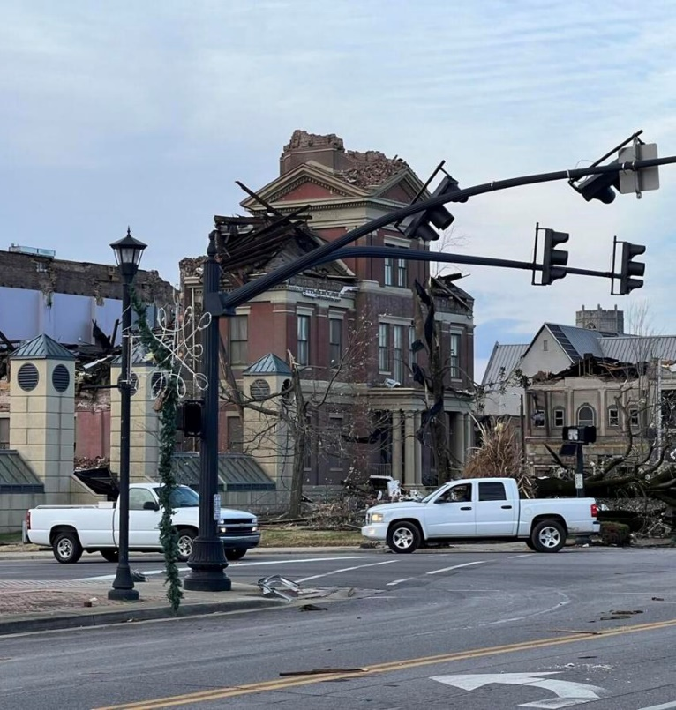
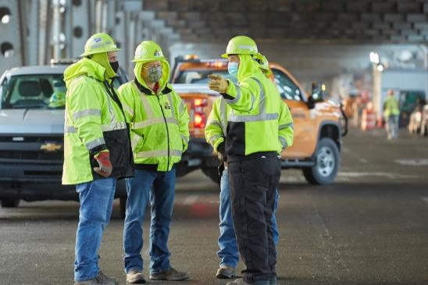
Support During Emergencies
Damage assessment & Reporting
Repair/Recovery

Slide 18
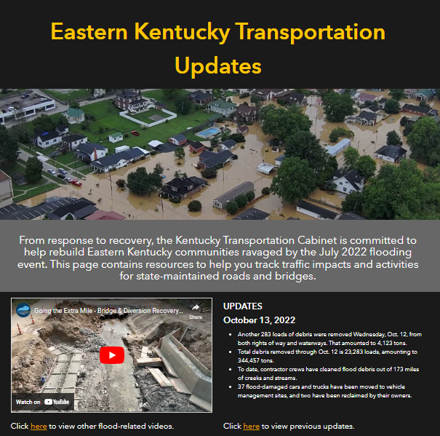
Public Communication
Custom Hub sites.

Slide 19
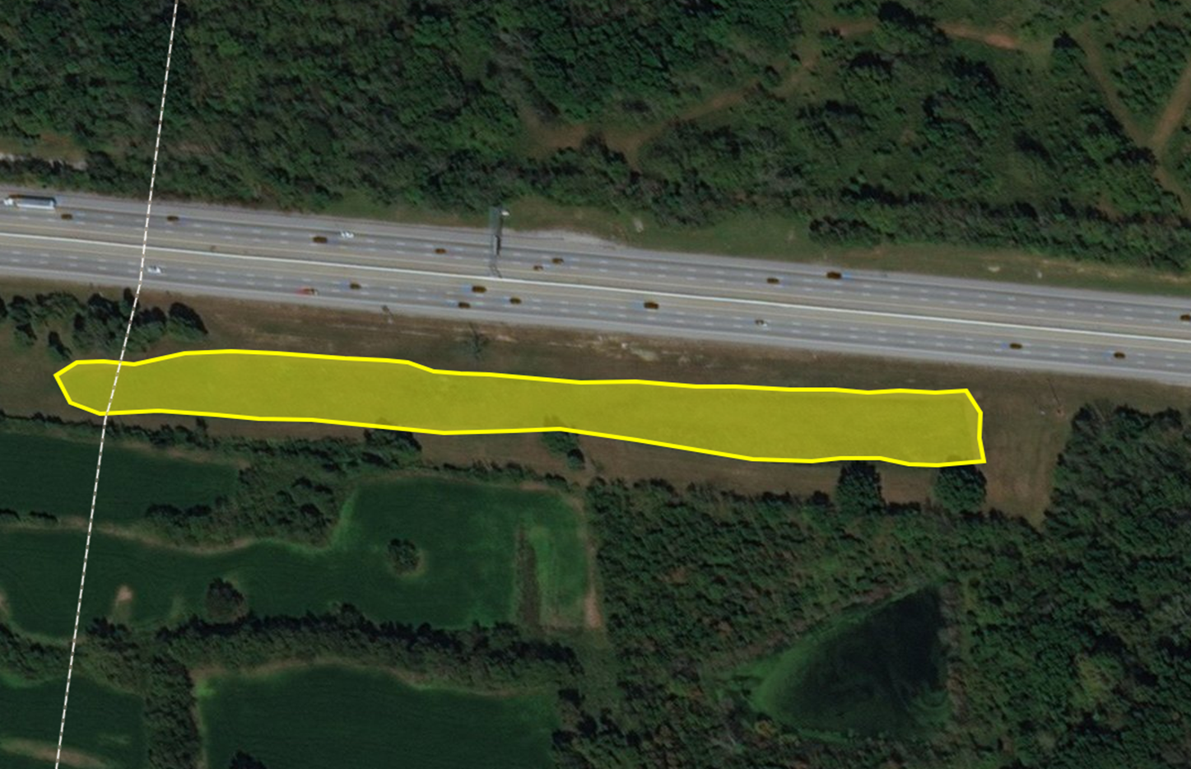
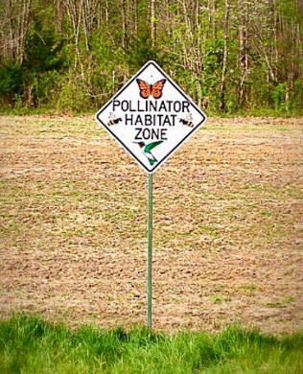
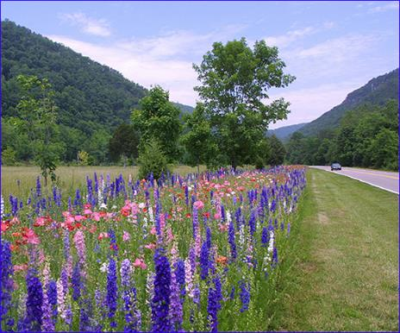
Environmental Management: Pollinator Plots

Slide 20
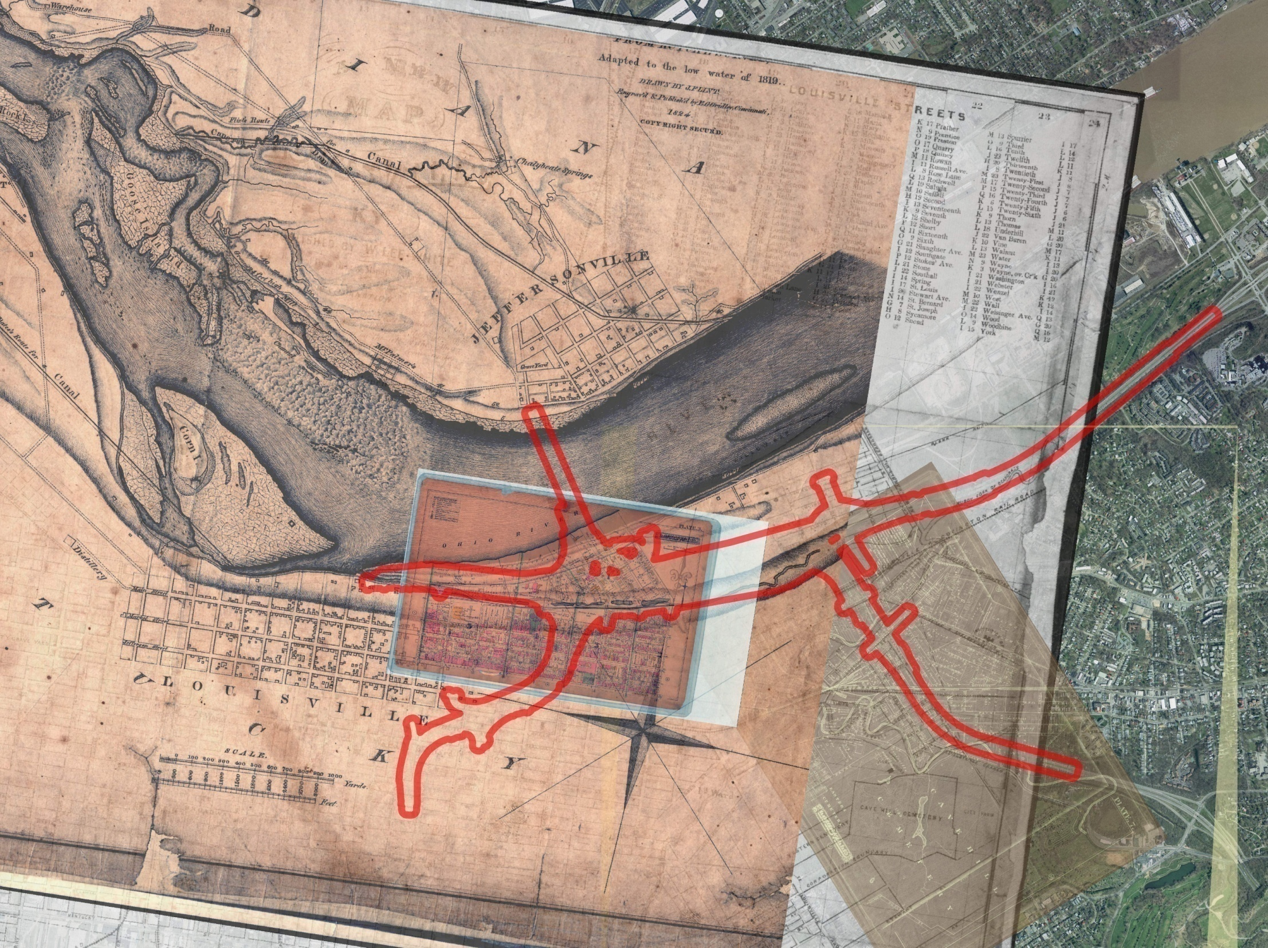
Environmental: Leverage “History” to streamline KYTC project work.
KYTC project limits overlaid on 1884 Map.
Louisville Bridges Project
Notes:
Senators Chambers Armstrong & Wise and Representative Aull – History Caucus
Hopkins 1884, Plate 3 Map, draped on the 2008 KYTC Louisville Bridges Road Project

Slide 21
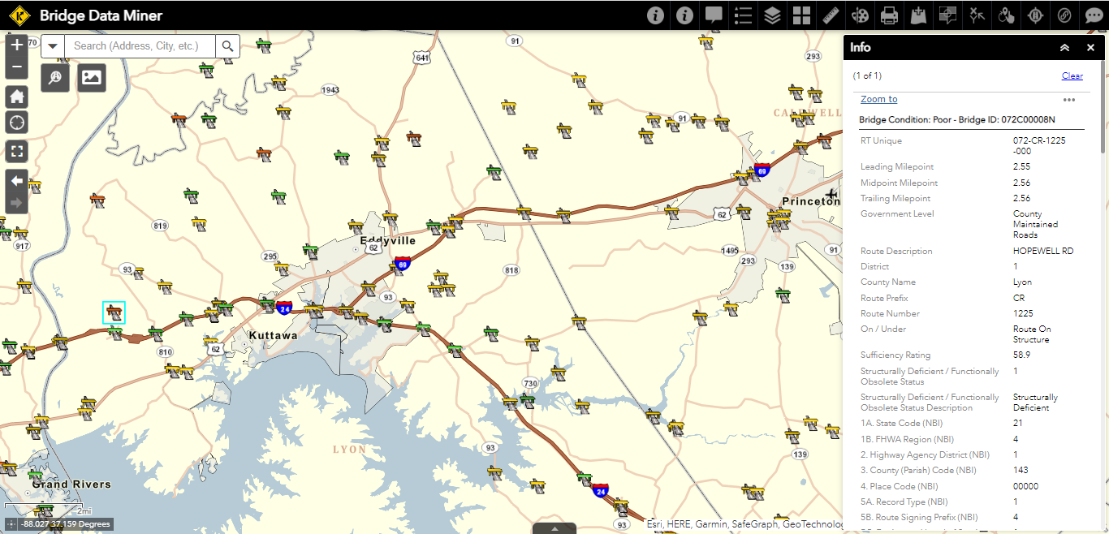
Maintenance: Bridge Data Miner
Notes:
Provides staff and public information about our bridges and their condition.
Displays all 14,000+ bridge locations across KY.
Displays inspection and attribute data for each bridge location.

Slide 22
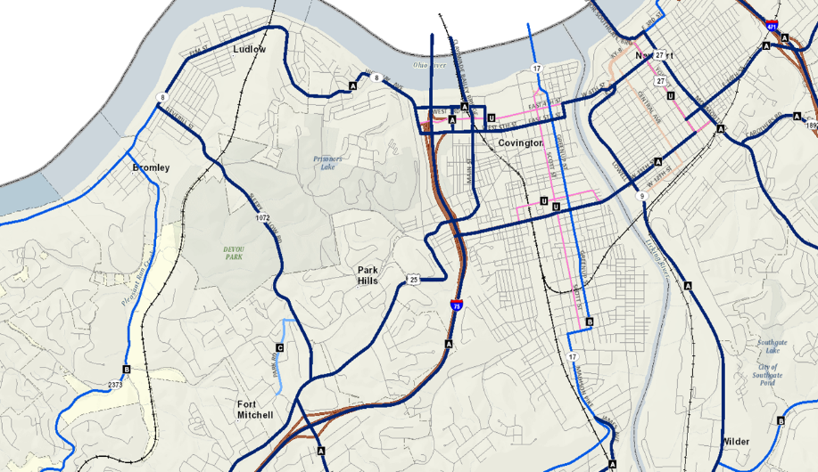
Maintenance: Snow and Ice Priorities
Notes:
Displays all snow routes categorized by priority that the Commonwealth of Kentucky monitors and maintains in the event of inclement weather.

Slide 23
Real-time Decision Support
“Live” statewide understanding of our road network.
Integrating ~166 Million records per day.
Gives decision makers improved situational awareness.

Slide 24
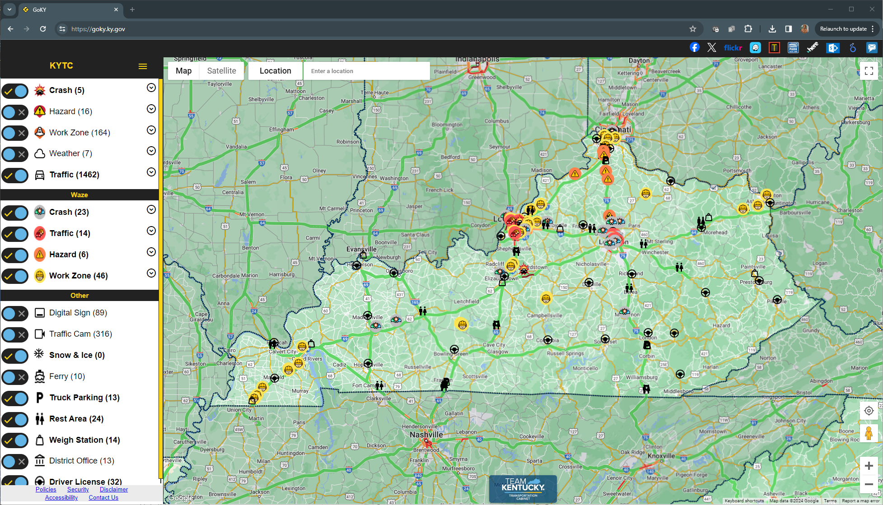
GoKY: Live to the public… and decision makers.

Slide 25
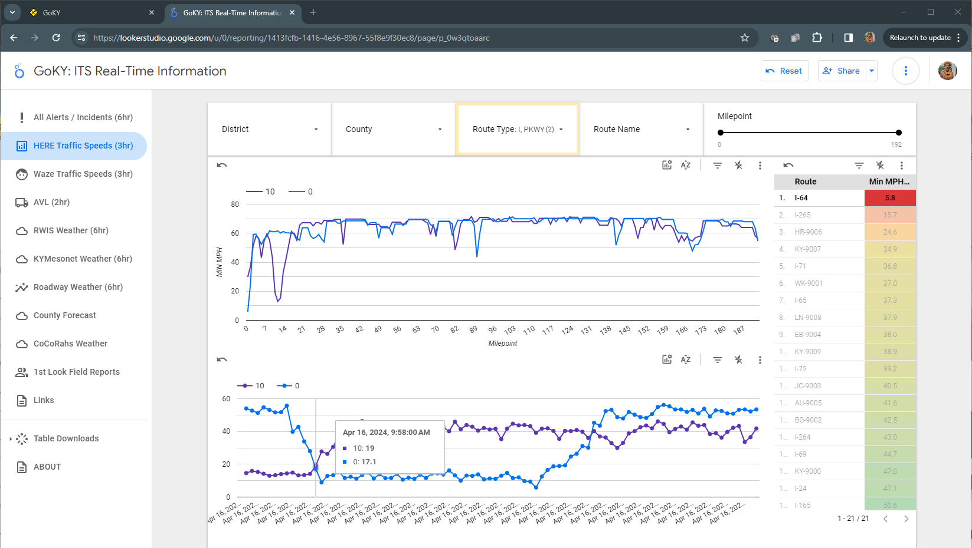
GOKY: ITS Real-time Dashboard
Notes:
I-64 Minimum Speed Performance

Slide 26
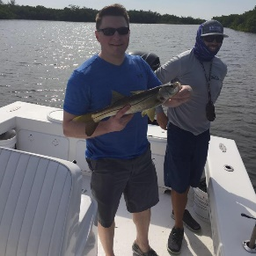
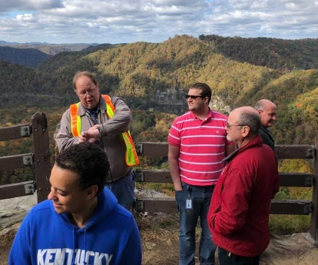
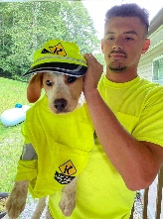
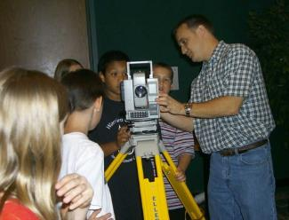
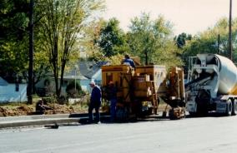
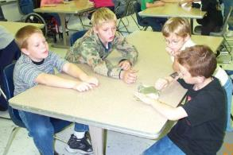
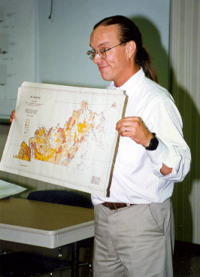
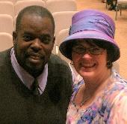
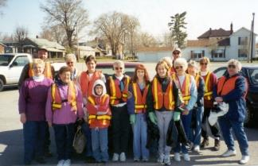
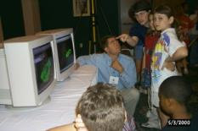
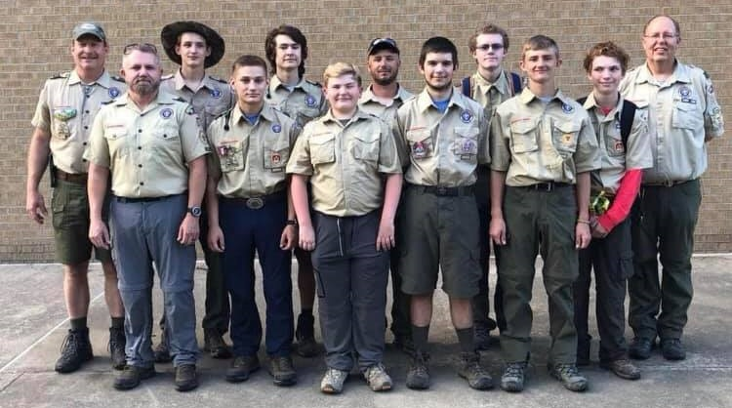
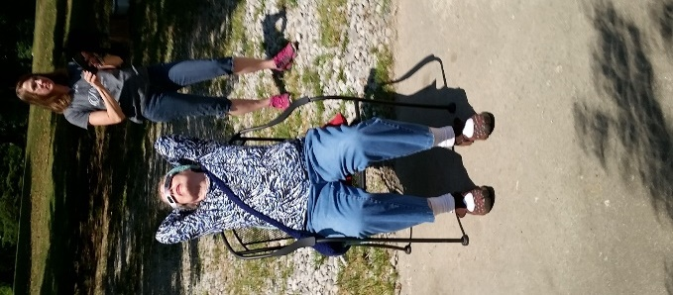
The GIS investment is worth it because Kentuckians are worth it!!!
Notes:
New pictures include: Naitore Djigbenou, John Moore, Mikael Pelfrey, Jason Siwula, John Sykes, Tracy Nowaczyk, Jamie Emmons, Eric & Shelby Pelfrey, Travis Wagers, John Clark, Jim & Rosetta Ramsey, Heather Stout, Melvin & Kimberly Bynes, and Boday Bores

Slide 27
Thank you.
Kentucky Transportation Cabinet
Office of Information Technology
Will Holmes, GIS & Big Data Branch

