Slide 1
BRINGING THE Ohio Cyber COLLABORATION COMMITTEE (OC3) to KENTUCKY
Dave Hatter, CISSP, CISA, CISM, CCSP, CSSLP, PMP, ITIL
Cybersecurity Consultant / Mayor of Fort Wright, KY

Slide 2
ABOUT ME
Technology leader with over 30 years of software development and cybersecurity
BS in Information Systems from NKU
Earned industry leading certifications including CISSP, CISA, CISM, CCSP, CSSLP, PMP, PMI-ACP, PMI-PBA and ITIL Foundation V3
Regular media subject matter expert interviewed more than 2,500 times since 1995
Educated over 1,000 students as an adjunct at Cincinnati State Technical and Community College, the University of Cincinnati and Gateway Community and Technical College
Written or contributed to 12 technology books
Written more than 100 technology articles
Delivered dozens of technology presentations to community and industry organizations
Over 25 years of local government service: 8 terms on Fort Wright City Council, 3rd term Mayor of Fort Wright, Kentucky
Kentucky League of Cities 2020 Elected Official of the Year

Slide 3
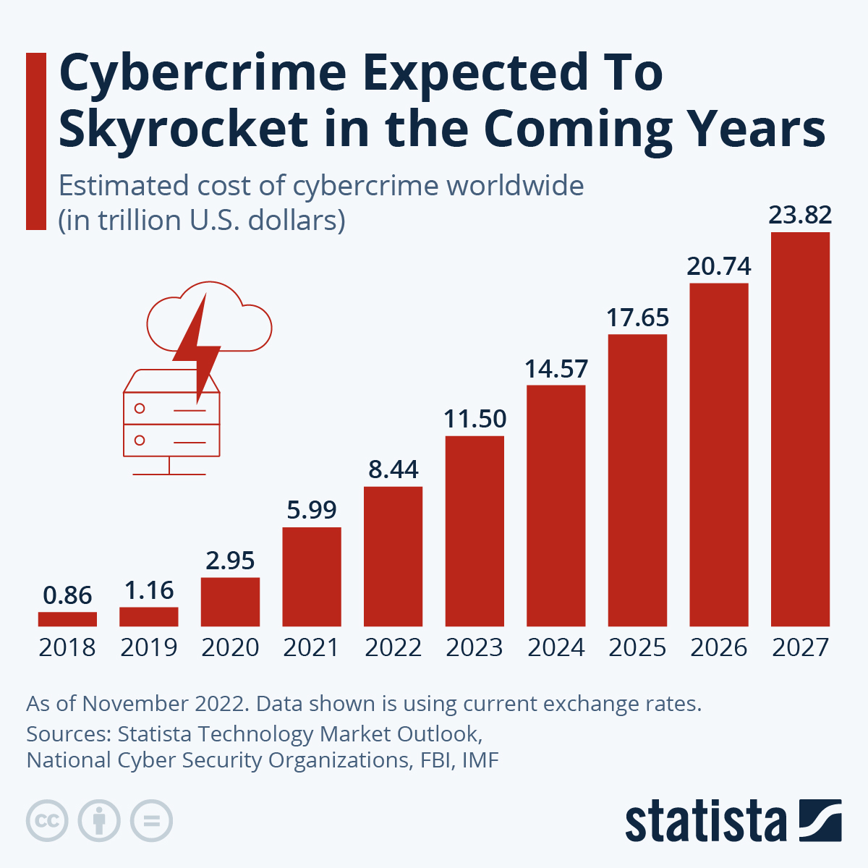
Notes:
If it were measured as a country, then cybercrime would be the world’s third largest economy after the U.S. and China. Press Release

Slide 4
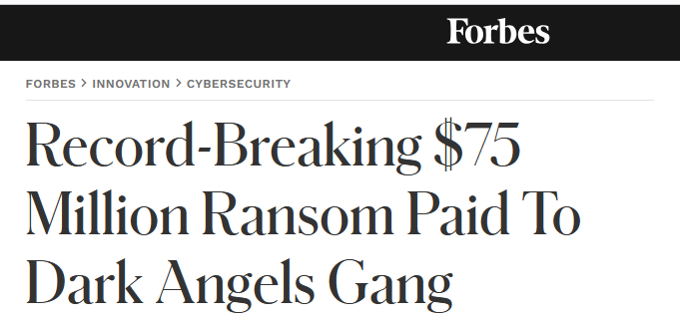

Slide 5
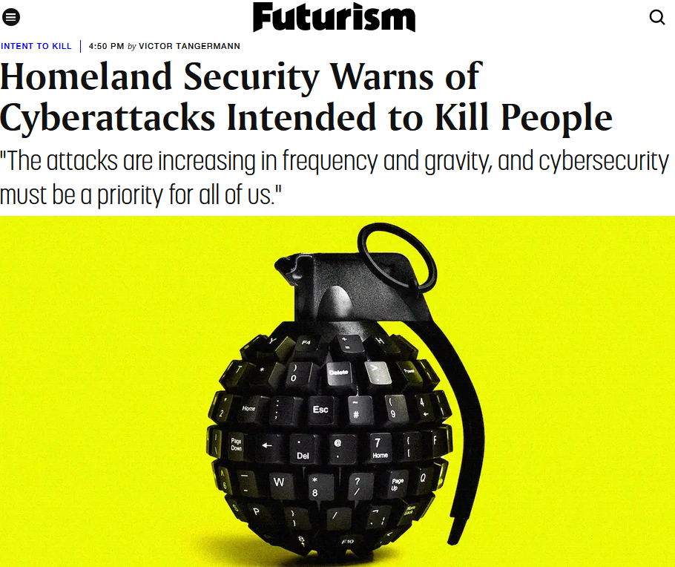
Notes:
Warnings from WH, FBI, DHS, CISA, EPA

Slide 6
Ohio Cyber Collaboration Committee (OC3)
Ohio’s cyber community working together to help Ohio’s citizens and organizations achieve world class cyber security
https://www.oc3.ohio.gov/

Slide 7
Ohio Cyber Collaboration Committee (OC3)
The Threat
Cyber crime is projected to cost the global economy $9.2 trillion by 2024, more than 10 times the cost since 2015. Average per attack is 9.48 million.
There were over 4,100 recorded data breaches and those breaches exposed 22 billion records in 2023
The cyber-insurance industry is already estimated to be worth well over $10.33 billion growing to $27.8 billion by 2026
Multiple firms project that by 2023, 30 billion devices will be connected to the “Internet of things,” a huge growth in the number of devices that connect ever more of daily life to the Web
Prevention is cheaper than remediation
The frequency and impact of threats is rising
https://www.oc3.ohio.gov/

Slide 8
Ohio Cyber Collaboration Committee (OC3)
Threat Actors
Nation State actors
Criminal enterprises
Intellectual property theft/industrial espionage
“Hacktivists”/terrorists
Personal/political attacks/insiders
Malicious Acts/Vandalism
Rogue Malware
https://www.oc3.ohio.gov/

Slide 9
Ohio Cyber Collaboration Committee (OC3)
Our Mission: To provide an environment for collaboration between key stakeholders, including education, business and local government to strengthen cyber security for all in the State of Ohio and to develop a stronger cyber security infrastructure.
Our Goals/Committees: OC3 has established four subcommittees to help it achieve its primary goals:
Education/Workforce Development
Cyber Range
Cyber Protection and Preparedness
Governance and Public Awareness
The committees are composed of Ohioans with a wide range of cyber and educational expertise dedicated to making Ohio a leader in how to integrate public-private partnerships into solving the cyber security problem.
https://www.oc3.ohio.gov/

Slide 10
Ohio Cyber Collaboration Committee (OC3)
Why is Cyber Education/Workforce Development so important?
Grow the workforce and improve the training and education of users and students in cyber security
Nearly 11K advertised vacancies in cyber security in Ohio!
High paying positions well above state average:
https://cyberseek.org/heatmap.html
https://www.nist.gov/itl/applied-cybersecurity/nice/resources/career-pathways
NICE Framework for Cybersecurity
https://ohio-k12.help/cyber-security/
https://www.oc3.ohio.gov/

Slide 11
Cyber Club Toolkit
How to work with your school or organization to create a cyber club
Understanding the different cyber club advisor roles
Finding a mentor for your cyber club
Using membership agreements in your cyber club
Marketing your cyber club http://education.ohio.gov/Topics/Learning-in-Ohio/Computer-Science/Resources-for-Computer-Science/Cyber-Club-Toolkit

Slide 12
Ohio Cyber Collaboration Committee (OC3)
Ohio Cyber Range/OCRI:
A secure cyber security test and training environment:
Support the education of students at the K-12 and University level.
Conduct cyber security exercises and competitions to hone cross organizational incident response capabilities and develop future cyber security professionals.
Research and test industry-standard best practices, evaluate and test innovative technologies and processes.
Enable a training environment for the current and future cyber security workforce, including National Guard personnel, state and local government personnel, faculty and students in the education community, and private sector entities.
Provide a Cyber Portfolio for learners, and support internships.
Will be able to connect from any location with OARnet access.
https://www.oc3.ohio.gov/

Slide 14
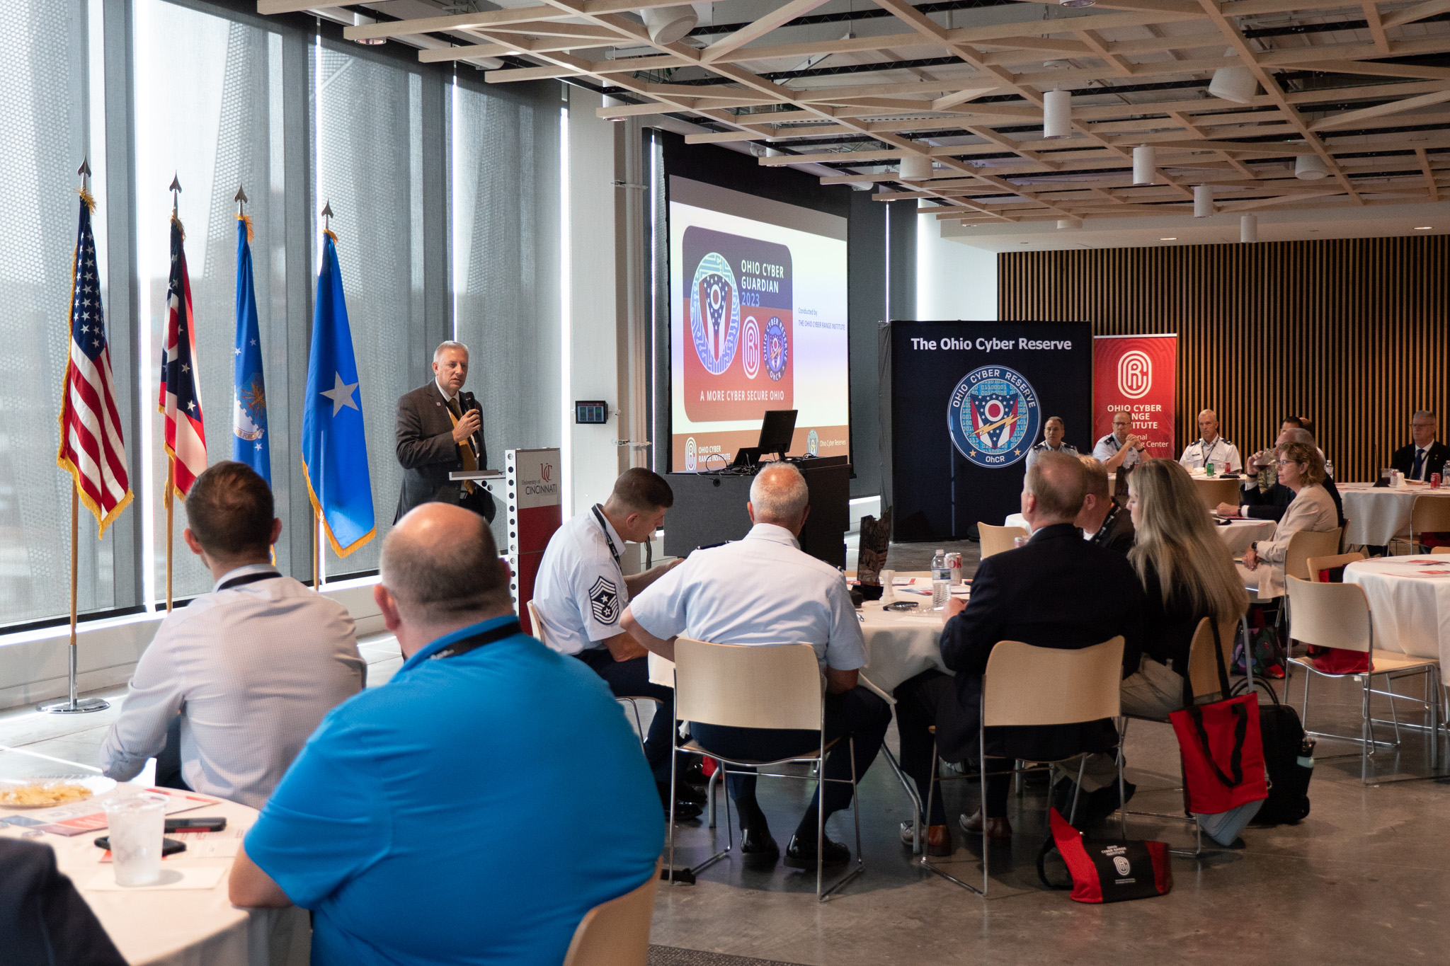
Ohio Cyber Guardian 2024 July 19-23, 2024
Incident Response Training Exercise
Training 4 Ohio Cyber Reserve Teams:
Cincinnati, Columbus, Cleveland
100 people
White Cell/Exercise Orchestration
OpFor, Range, ExCon, Assessments, NetO: 55 people
Emulation of City and Cyber Incident
Infrastructure virtualized in the range
Grey space and traffic generation
Distinguished Visitors Day
July 22, 2024
Notes:
Bekah

Slide 15
OCRI Advisory Board - Executive Committee
Team of leaders with backgrounds and expertise as diverse as the problems educators, citizens, and companies of Ohio face, overseeing OCRI policies and ensuring proper governance

Slide 16
OC3 Cyber Protection Subcommittee
Deliverables
Ohio Cybersecurity Strategic Plan
K-12 Cyber Challenge – IN PROGRESS
OC3 Website Development
Cyber TTX Exercises – IN PROGRESS
Cyber Toolkit / User’s Guidebook of Best Practices – IN PROGRESS
Mock Cyber Incident
Cyber Risk Assessment
Cyber Symposium / Annual Conference
Ransomware Awareness Campaign
https://www.oc3.ohio.gov/

Slide 17
Ohio Cyber Collaboration Committee (OC3)
Governance and Public Awareness Subcommittee:
Identify and share best practices, policies and technologies for all Ohioans by:
Providing a collaborative research and development environment for the development and testing of innovative technologies and processes.
Ensuring cyber threats are part of emergency planning at all levels both public and private.
Using public awareness tools to educate and inform key decision makers of good cyber security practices and the latest information.
Educating the general public on the importance of cyber security for the “Internet of Things.”
Sharing threat intelligence between both public and private sector entities, facilitated through the Ohio Homeland Security State Fusion Center.
https://www.oc3.ohio.gov/

Slide 18
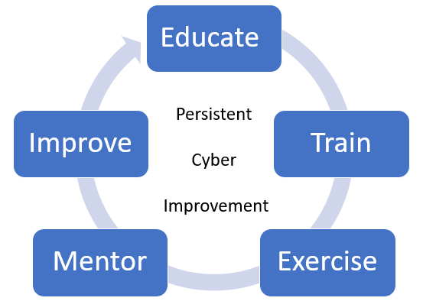
Problem Statement
Large number of eligible entities in Ohio
88 Counties, 1308 townships, 250 cities, 688 villages, 264 places, 611 school districts, 211 colleges and universities = 3,420 entities
Critical infrastructure – number in Ohio 11,440
Currently maxed at about 100 events per year. OhCR and CISA spending a lot of time teaching basic concepts.
Need to scale our efforts to maintain an ongoing and persistent effort to educate/evaluate/test cyber skills and preparedness of Ohio’s eligible entities
Notes:
Ohio Homeland Security’s
Critical Infrastructure Assets in CIMS.
Sector
Chemical: 4
Commercial Facilities: 19
Communications: 2934
Critical Manufacturing: 2865
Dams: 2
Defense Industrial base: 1
Emergency Services: 4
Energy: 1469
Food & Agriculture: 1236
Government Facilities: 300
Healthcare & Public Health: 284
Transportation Systems: 1924
Water & Wastewater: 398

Slide 19
The Ohio Cyber Reserve
The Need for a Cyber Reserve
1. Ohio’s cyber experts are understaffed and over missioned
DAS
ONG
2. Small governmental entities do not have the resources or expertise to deal with cyber threats
Entities need help with assessments and best practices, as well as assistance when a cyber event occurs
Townships, villages, small cities, and smaller counties, eligible nonprofits
First responders, city services and utilities, Boards of Elections, public data
3. Critical infrastructure needs more protection, especially smaller utilities and emergency services
K-12 educators are typically not cyber security experts
They need help setting up cyber programs and cyber clubs within Ohio’s high schools and junior high schools
Students need mentors who can inspire them and show them the pathways to a cyber career
5. Ohio needed a way to tap into the wealth of cyber talent that exists throughout the state and connect that talent to the needs of Ohio, but in a way that is sustainable from a budget perspective

Slide 20
The Ohio Cyber Reserve
The Ohio Plan
Created a volunteer firefighter style Cyber Reserve made up of trained civilians nested under the Adjutant General’s Department
Legislatively modeled after the Ohio Military Reserve ORC Chapter 5920
The Adjutant General’s Department has developed appropriate policies to support and regulate the teams
Members are volunteer civilians subject to state call up in a cyber emergency to support the Ohio National Guard’s cyber response efforts
While in training status, volunteers are not be paid, but when activated will be paid as state civilian employees
Volunteers are vetted with appropriate background checks, training requirements
Volunteers are organized into regionally based teams
The teams are provided training, equipment and IDs and work out of ONG armories
When fully trained and certified will be available for call up to assist in cyber response
Volunteers who are not fully trained, but who have been vetted can be used to support student mentoring efforts under the Ohio Cyber Collaboration Committee (OC3)

Slide 21
The Ohio Cyber Reserve
OhCR Mission Set
Assist - While in a volunteer status, the Cyber Response Teams will provide outreach, training, education, and security assessments to eligible governmental entities and critical infrastructure to reduce cyber vulnerability and increase resiliency.
Educate - While in a volunteer status, the Cyber Response Teams will assist K-12 educational efforts supporting cyber clubs and mentoring students in support of the Ohio Cyber Collaboration Committee’s (OC3) Education and Workforce Development efforts.
Respond - When called to paid state active duty status, the Cyber Response Teams, under the direction of the Adjutant General’s Department will be available to respond to cyber incidents at eligible governmental entities and critical infrastructure.

Slide 22
Overview
Ohio Persistent Cyber Improvement (O-PCI) Purpose
Supporting local government entities and their staff in all of Ohio’s 88 counties in building and sustaining their capacity to anticipate, adapt, withstand and, when necessary, recover from cyber aggression.
Delivered at no cost to Ohio-based Local Government Entities (LGE)
Funded through the Cybersecurity and Infrastructure Security Agency (CISA) and the State of Ohio.
Persistent Cyber Improvement Model
Includes a blend of online, hybrid, and in-person modules that are tailored to local government entities of all sizes as well as to the range of organizations that have a strong cybersecurity posture and those that are actively developing in this critical space.
cyberrangeinstitute.org/opci
Notes:
Serving Ohio’s Public Servants

Slide 23
Ohio Cyber Collaboration Committee (OC3)
Other Pending Programs:
State aggregate purchasing program
Cyber Fusion Center
.GOV migration
https://www.oc3.ohio.gov/

Slide 24
.GOV Domain Benefits
Exclusively available to U.S.-based government organizations, ensuring that any website with this domain is an official government site. This exclusivity reduces the risk of cyberattacks and phishing attempts.
According to CISA, a .gov domain helps the public quickly identify genuine government communications and websites, which is crucial in an era where cyber threats are increasingly sophisticated and pervasive​ (CISA)​​.
Eric Goldstein, Executive Assistant Director for CISA’s Cybersecurity Division, emphasizes that "people see a .gov website or email address and know they are interacting with an official, U.S.-based government organization."

Slide 25
.GOV Domain Benefits
Improved Security: .gov domains provide enhanced security measures, such as mandatory HTTPS encryption, which protects data in transit from eavesdropping and tampering.
DNS Security: Administrators receive notifications of any Domain Name System (DNS) changes, enabling them to respond quickly to potential threats. This helps mitigate risks before they can impact citizens and city services​​
Phishing Resistance: With a .gov domain, it becomes more difficult for malicious actors to spoof government emails and websites. This decreases the likelihood of successful phishing attacks, protecting citizens from fraud and identity theft​
Two-Factor Authentication: The .gov domain registrar incorporates two-factor authentication, adding an extra layer of security for administrators managing the domain. This reduces the risk of unauthorized access and enhances overall security

Slide 26
Why All Local Governments Should Switch to .GOV
Enhanced Public Trust: A .gov domain signals to citizens that they are engaging with an authentic government entity. This builds trust and encourages more people to use online government services confidently.
Reduced Cyber Risk: Local governments often handle sensitive data, making them prime targets for cyberattacks. The security features inherent in .gov domains provide robust protection against these threats, safeguarding both the government and its citizens.
Compliance with Best Practices: Following CISA’s recommendations and adopting a .gov domain aligns local governments with best practices in cybersecurity. This proactive approach demonstrates a commitment to protecting citizens' data and maintaining the integrity of government services.
Simplified Management: With features like DNS change notifications and two-factor authentication, managing a .gov domain is streamlined and secure, reducing the burden on IT staff and enhancing overall cybersecurity posture.

Slide 27
Ohio Cyber Collaboration Committee (OC3)
OC3 is supported by a “whole of government” approach to ensure its success.
Primary sponsors are the
Adjutant General’s Department/Ohio National Guard,
Department of Higher Education
The Department of Education
The Department of Administrative Services
The Department of Public Safety
The Department of Transportation.
OC3 has over 120 organizations who are active members who support the OC3 mission and objectives
https://www.oc3.ohio.gov/

Slide 28
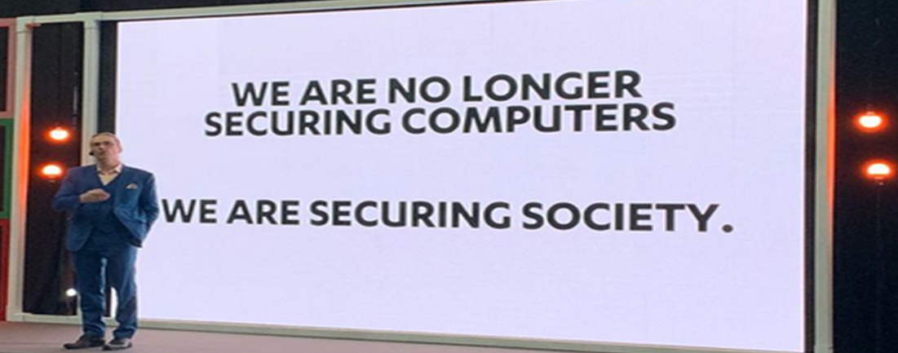

Slide 29
We Need This In Kentucky!
Ohio is running a very successful program that:
Provides resources to protect critical infrastructure
Bolsters the Ohio work force and the economy
Raises awareness about cybersecurity which increasingly impacts us all
Gets students interested in these important and lucrative careers
Helps stop the “brain drain”
We can model the good work done by Ohio for Kentucky
There are people willing to help get this running here
It will take money
We should adopt a “whole of government” approach
What can I do to help make this happen in Kentucky?

Slide 30
Thank You!
Dave Hatter, CISSP, CISA, CISM, CCSP, CSSLP, PMP, ITIL
linkedin.com/in/davehatter
twitter.com/davehatter
dhatter@fortwrightky.gov

