Slide 2
JCPS Overview & Statistics
Enrollment: 93,980
Students of Color
Free or Reduced Lunch
Multilingual Learners
Students with Disabilities
Homeless Students
66%
65%
21%
13%
3%

Slide 3
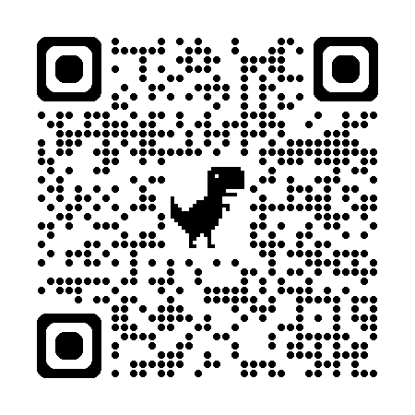
JCPS Overview & Statistics
ATTENDANCE
CHRONIC ABSENTEEISM
88%
Down from 93.2% in 2019
38.4%
Up from 22.8%
in 2019
Kentucky School Report Card link:

Slide 4
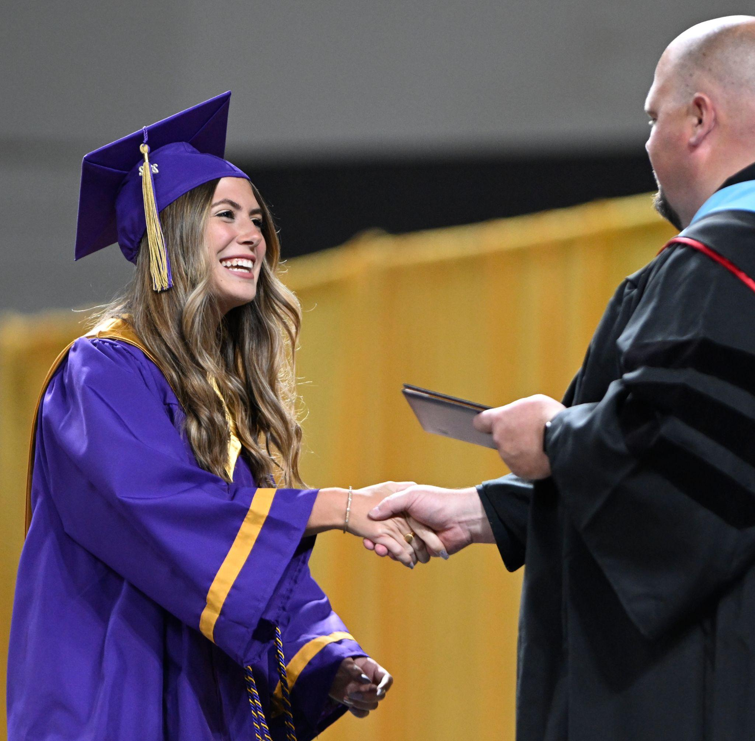
JCPS OVERVIEW & STATISTICS
GRADUATION RATE
2023-24
2017-18
GRADUATION RATE
87%
81.6%
POSTSECONDARY READINESS RATE
80.5%
50%
READINESS GAP & GRADUATION GAP
21%/2%
34%/4%

Slide 5
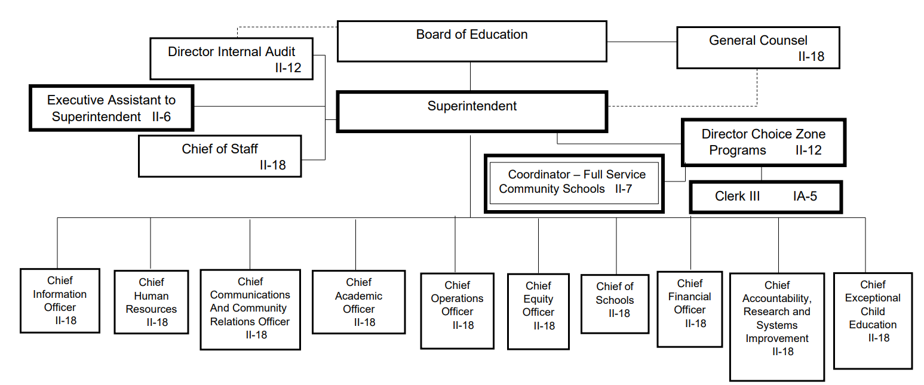
Organizational Structure

Slide 6
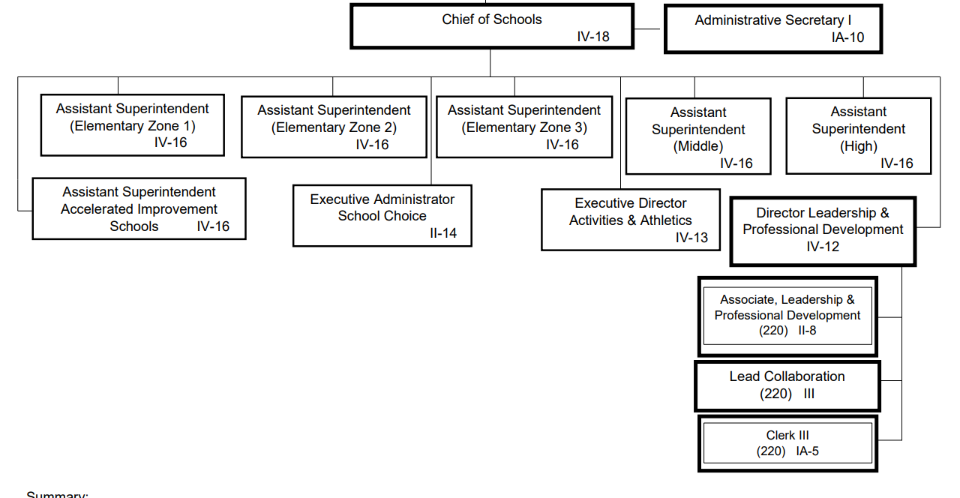
Organizational Structure
Link to all JCPS organizational charts

Slide 7
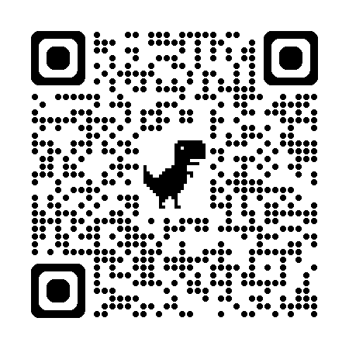
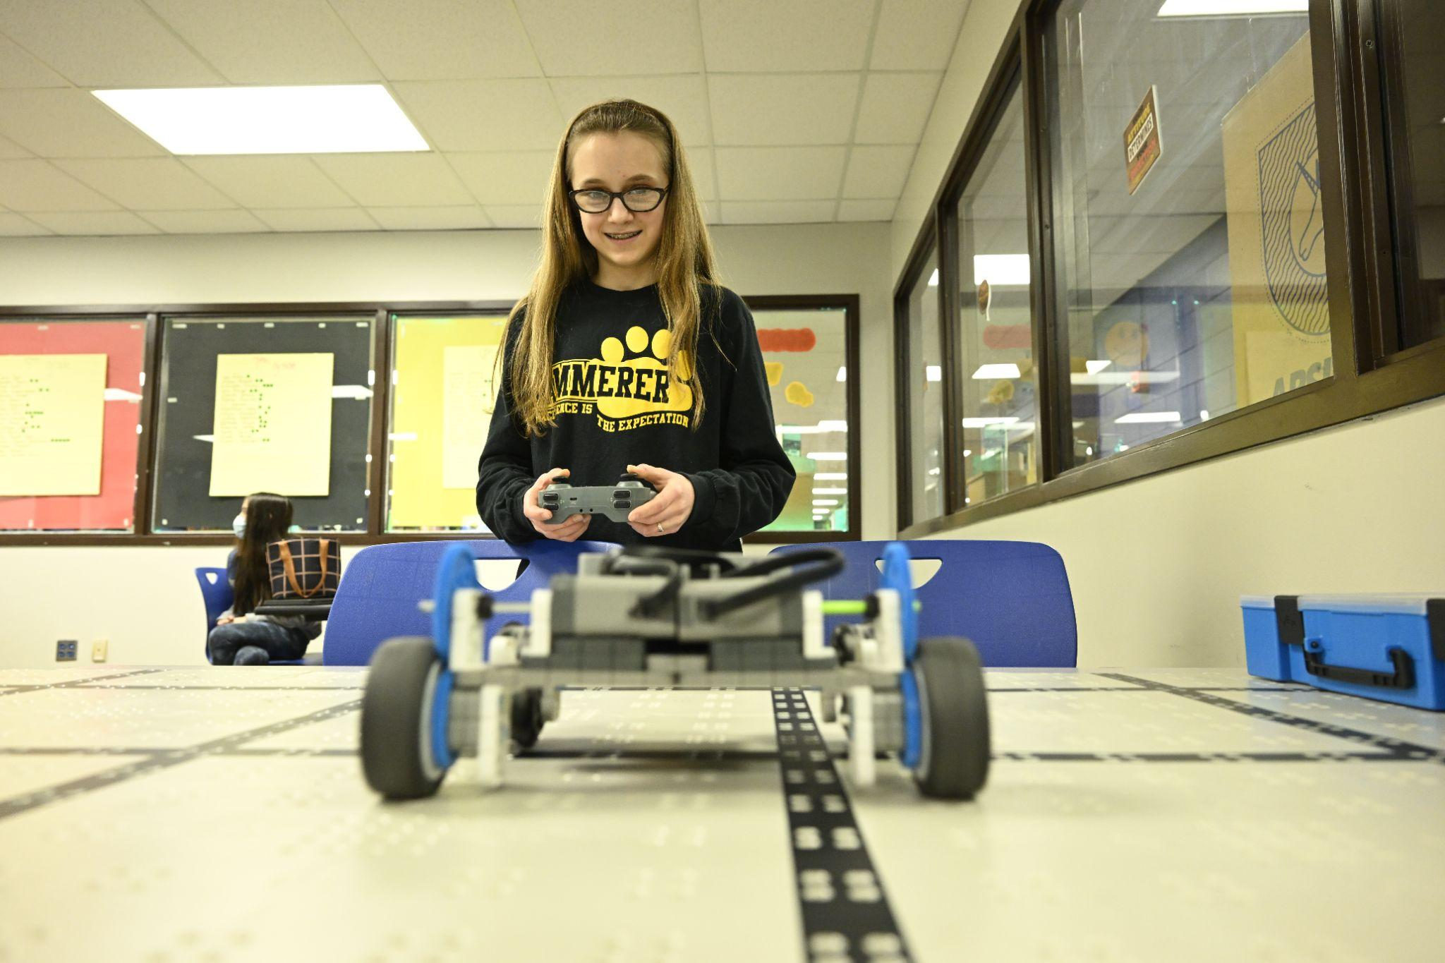
JCPS SCHOOLS
*Includes multilevel schools
JCPS Choices Books link:
HIGH SCHOOLS
MIDDLE SCHOOLS
23
28
ELEMENTARY SCHOOLS
SPECIALTY/ALTERNATIVE & OTHER SCHOOLS
89
20+

Slide 8
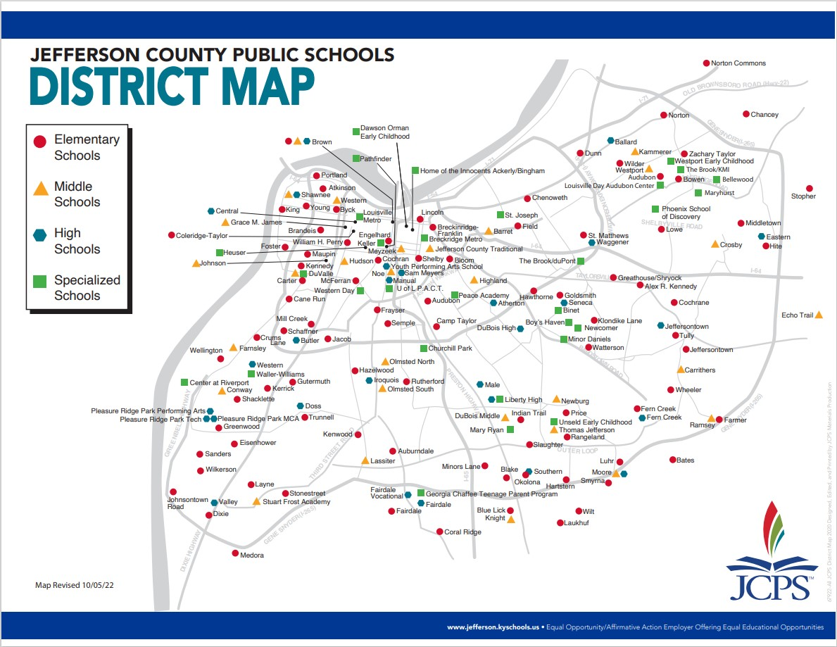

Slide 9
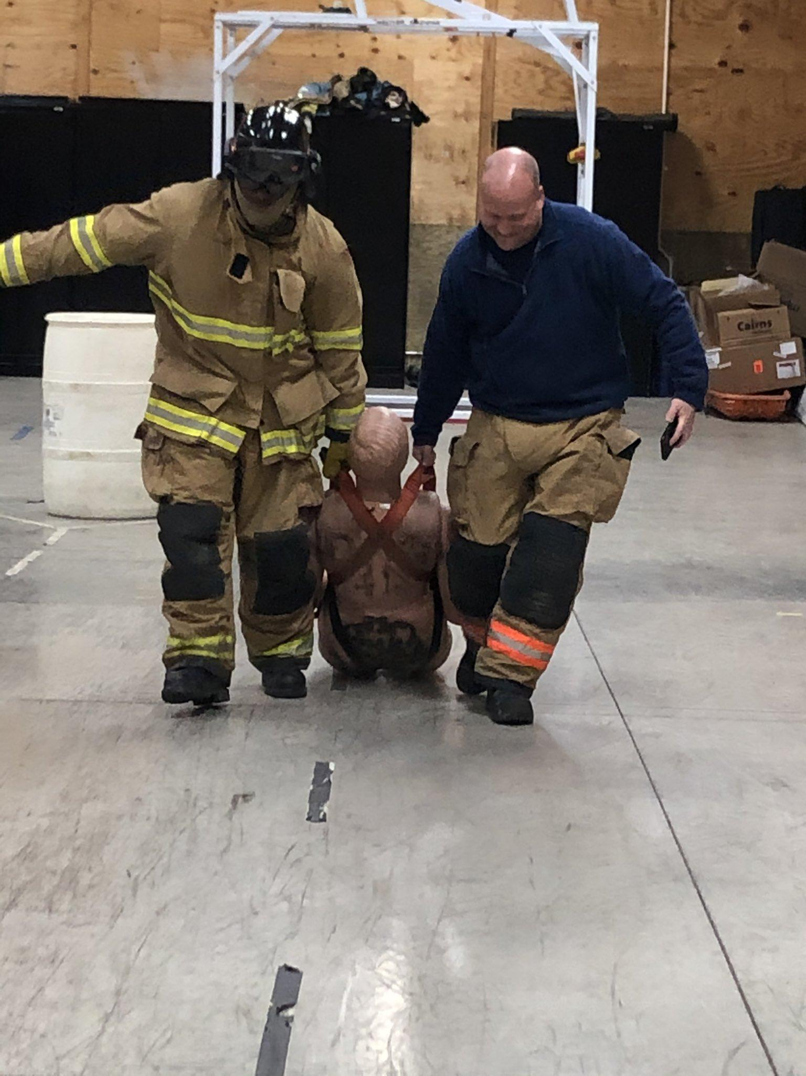
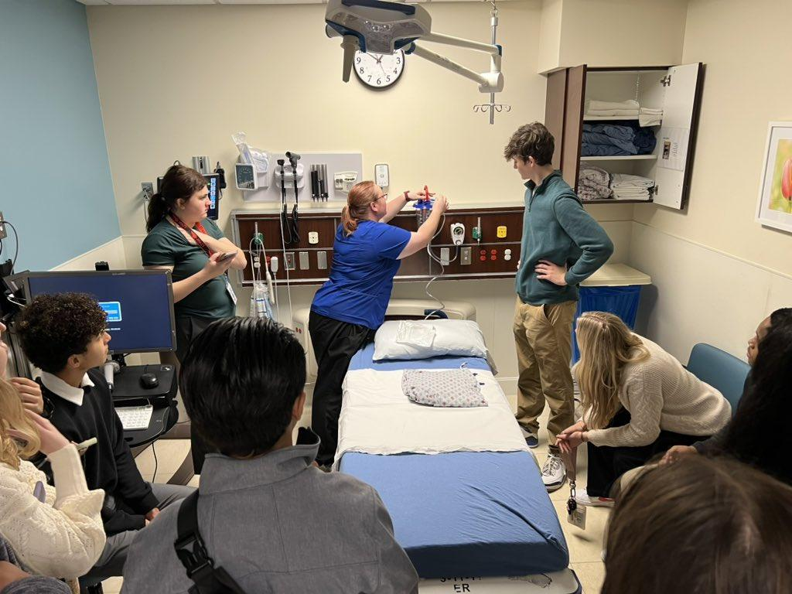
JCPS CAREER & TECHNICAL EDUCATION
SERVICES
209 total (74 Unique) CTE approved pathways
~20,000 students enrolled
Career Exploration, Labs and/or Programs in all high schools, including specialty schools

Slide 10
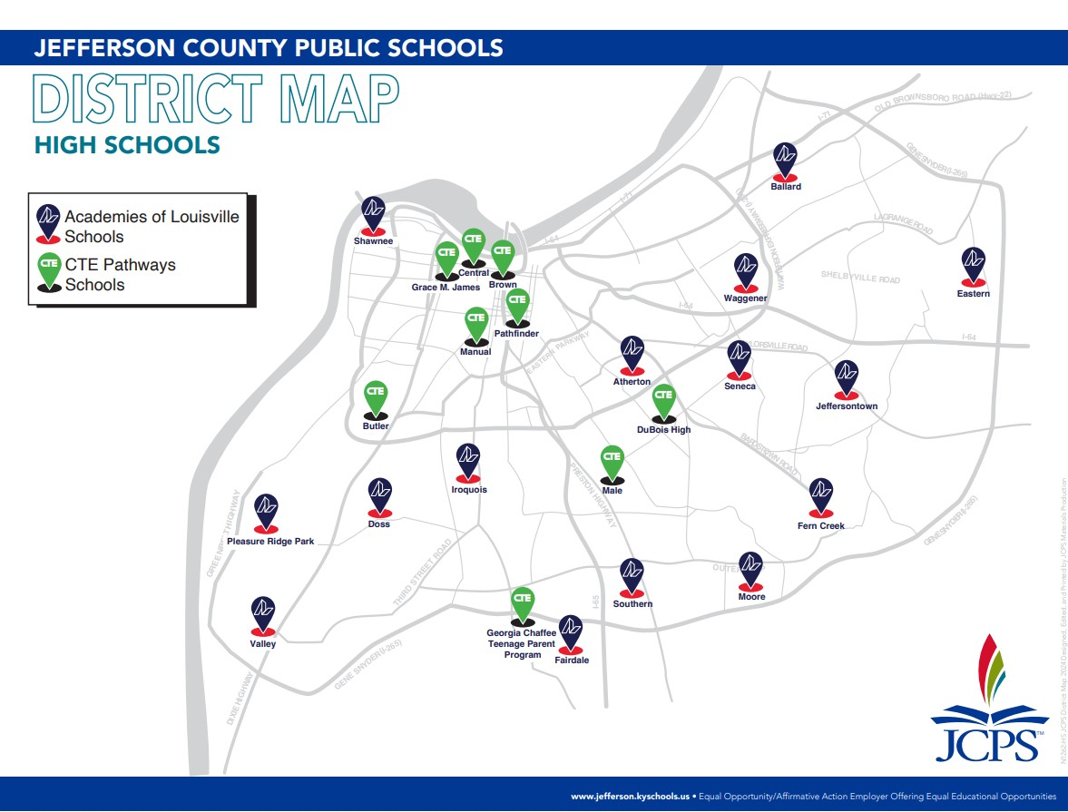
JCPS CAREER & TECHNICAL EDUCATION
Notes:
Academies of Louisville -- with regard to ensuring students have access to all CTE sectors regardless of where they live
Convening partners: GLI, KentuckianaWorks, JCPS

Slide 11
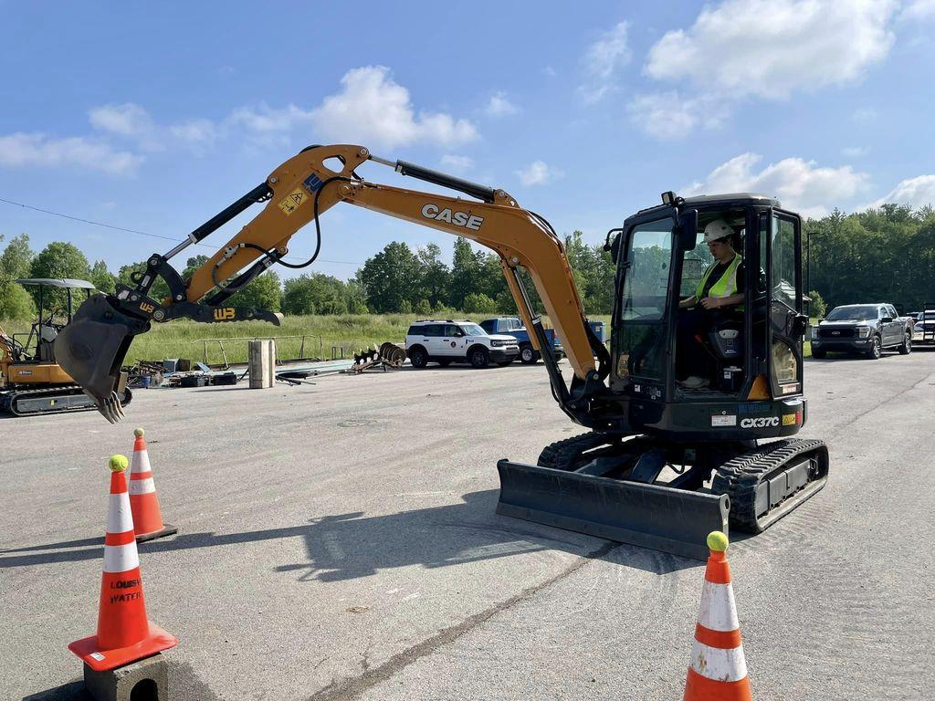
JCPS CAREER & TECHNICAL EDUCATION
All Pathways evaluated against KentuckianaWorks Labor Market Data and are reviewed by Business and Industry Partners each year
Funding and personnel is allocated to schools based on approved pathway demand, growth, wages, and equitable needs
JCPS provides 120% district funding for each State and Federal CTE dollar
~$37,000,000 in CTE equipment, classroom upgrades and consumables in last 3 years

Slide 12
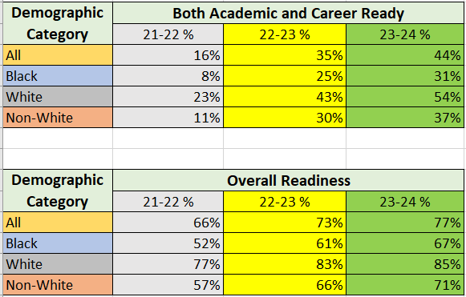
JCPS CAREER AND TECHNICAL POSTSECONDARY READINESS

Slide 13
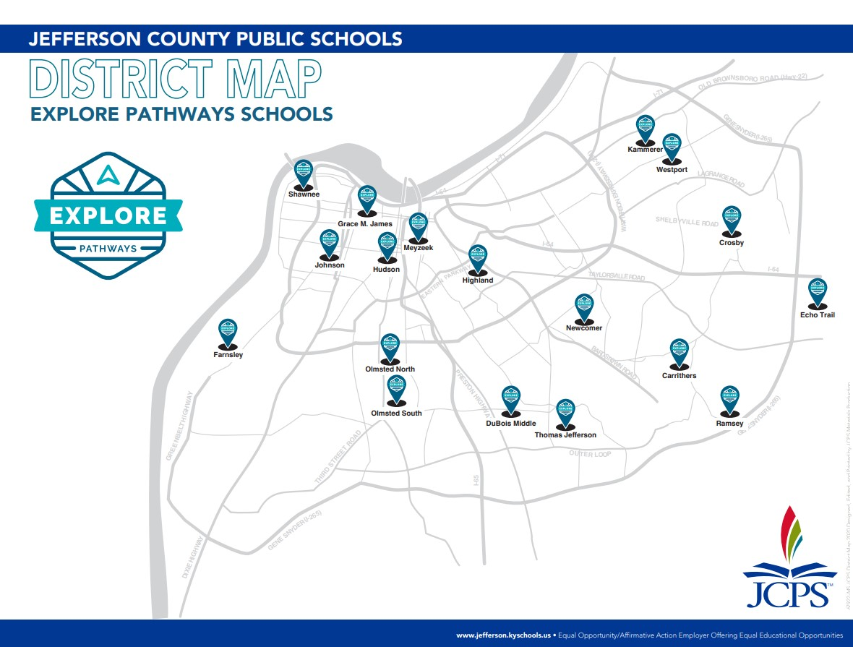
JCPS MIDDLE SCHOOL EXPLORE PROGRAM
Pathways in 8 CTE sectors
18 schools (4 new in ‘24-’25)
Aligned with their high school pathways

Slide 14
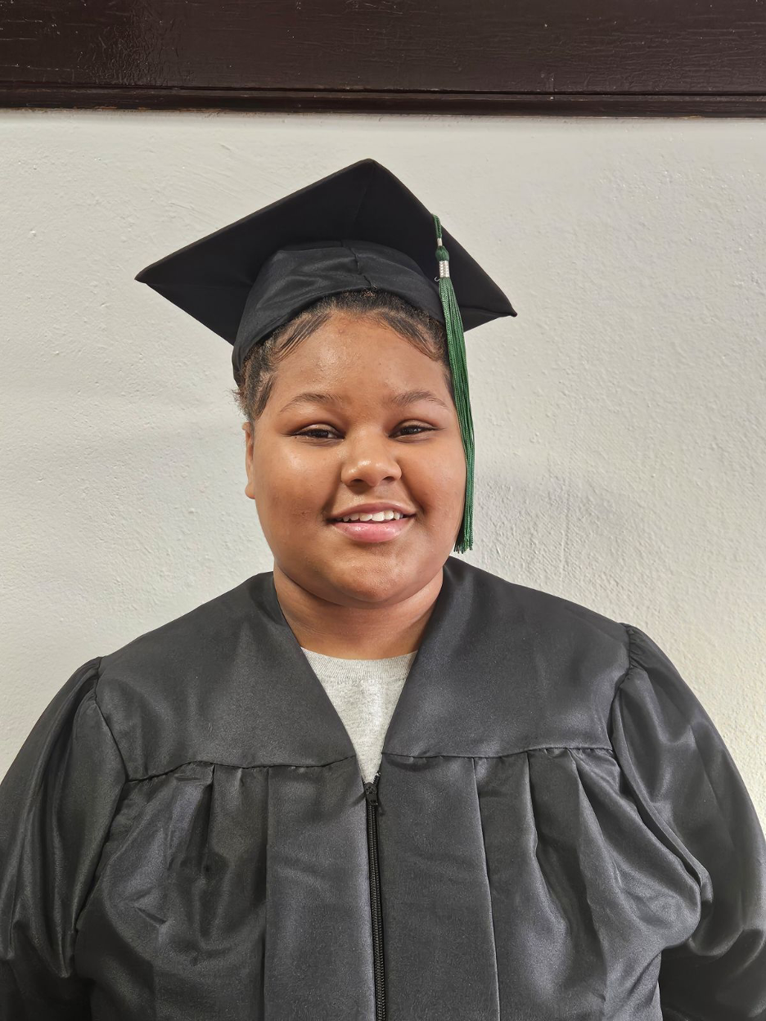
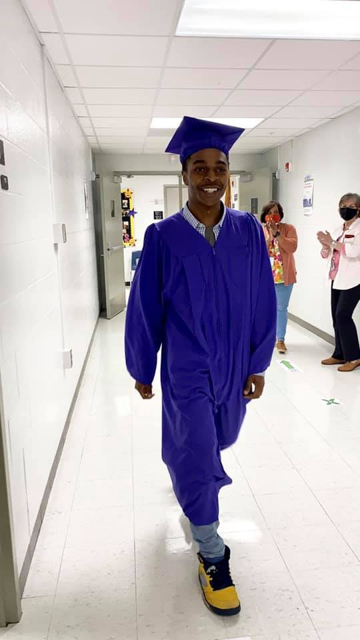
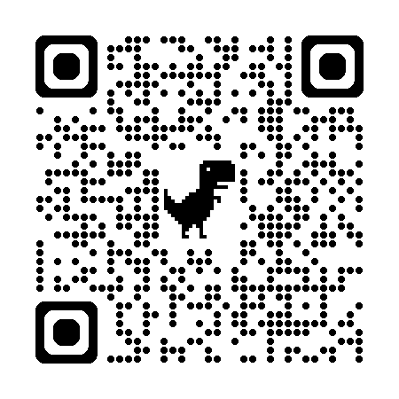
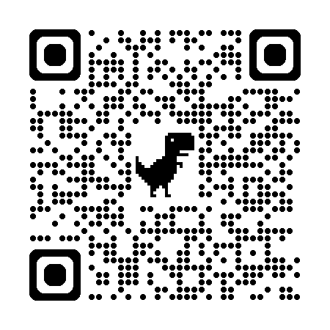
JCPS ALTERNATIVE INSTRUCTION PROGRAMS
Breckinridge Metropolitan
Minor Daniels Academy
Learn more about Breck Metro
Learn more about Minor Daniels Academy

Slide 15
DISTRICT-LEVEL PROGRAMS
SPECIALTY SCHOOLS
Binet School
Churchill Park School
Georgia Chaffee TAPP
Liberty
Newcomer Academy
Pathfinder School of Innovation
Phoenix School of Discovery
State Agency Schools
Waller-Williams Environmental

Slide 16
DISTRICT-LEVEL PROGRAMS
WHOLE-SCHOOL MAGNET, TRADITIONAL, & CHOICE SCHOOLS
PARTIAL-SCHOOL PROGRAMS
8 HIGH SCHOOLS
1 HIGH SCHOOL
8 MIDDLE SCHOOLS
8 MIDDLE SCHOOLS
11 ELEMENTARY SCHOOLS
2 ELEMENTARY SCHOOLS
It's the closest planet to the Sun
It's a gas giant and the biggest planet
Free
Standard

Slide 17
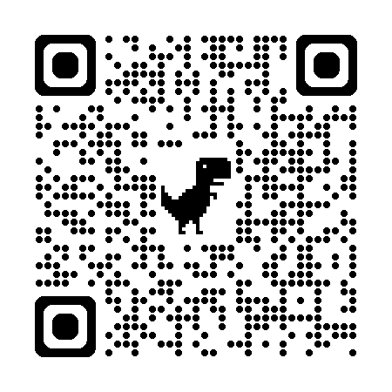
CLOSING THE ACHIEVEMENT GAP
ADDITIONAL PROGRAMS
CURRICULUM DEVELOPMENTS
Jupiter
Elev8 Centers
Backpack League
Lit &
Becoming
Level Up
Journey to Success
Districtwide Curriculum (2022 SB 1)
Journey to Success link:

Slide 18
DISTRICT EMPLOYEES
Employees by school:
18,025 TOTAL EMPLOYEES
12,479
5,546
7,800
10,225
SCHOOL-BASED
NON SCHOOL-BASED
CERTIFIED STAFF
CLASSIFIED STAFF
69%
31%
43%
57%
8,530
1,184
778
406
ADMINISTRATORS
ASSIGNED TO CLASSROOM INSTRUCTION
SCHOOL-BASED ADMINISTRATORS
(Principals, APs/Counselors)
NON-SCHOOL BASED ADMINISTRATORS

Slide 19
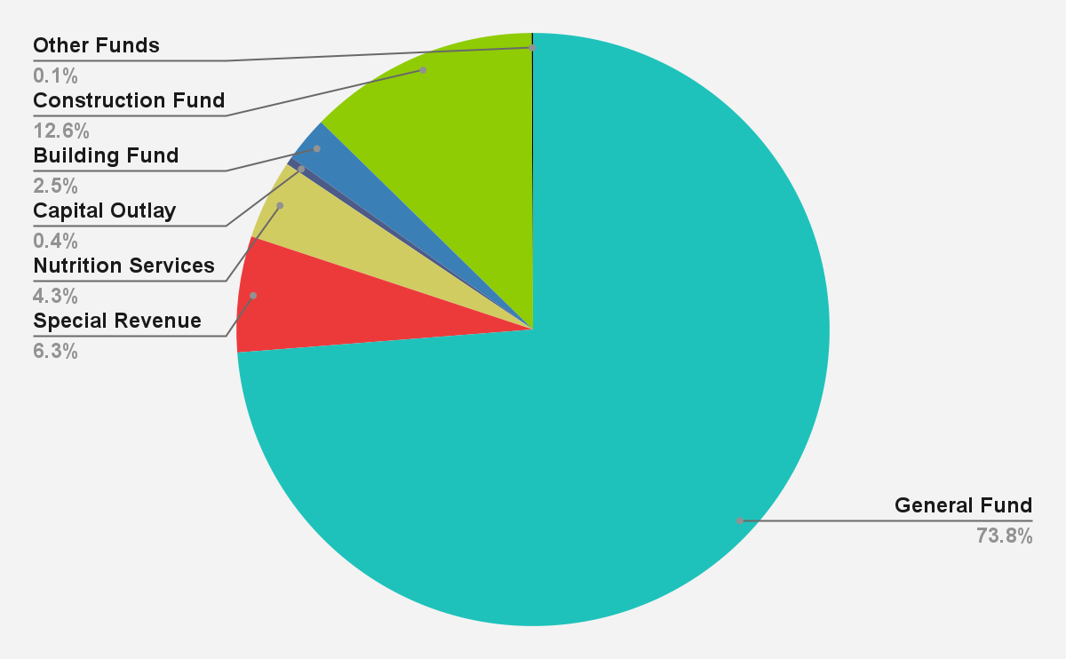
Total Budget: $1,985,207,448
General Fund
Special Revenue
Nutrition Services
Capital Outlay
Building Fund
Construction Fund
Other Funds

Slide 20
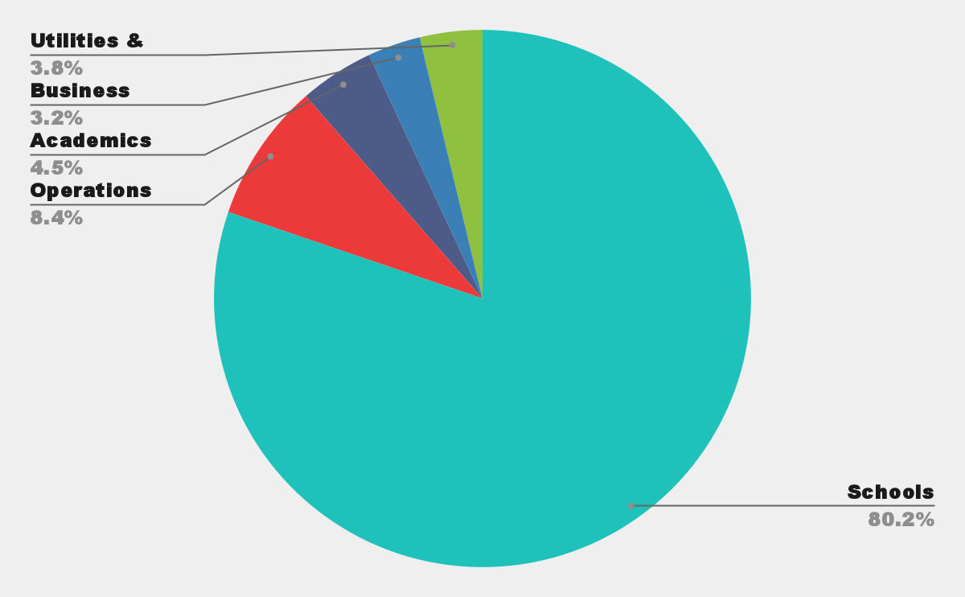
General Fund Budget
Schools: 80%
Operations: 8%
Academics: 4%
Utilities & Insurance: 4%
Business Offices: 3%

Slide 21
Audited Expenditures Per Pupil
Comparison of Kentucky Districts
Instructional Support Staff
District Administration
School Administration
Transportation
Instruction
Student Support
$11,846
$1,414
$2,246
$121
$1,666
$1,098
Highest 15%
Highest 5%
Third Highest
Lowest in Kentucky
Second Highest
Second Quartile

Slide 22
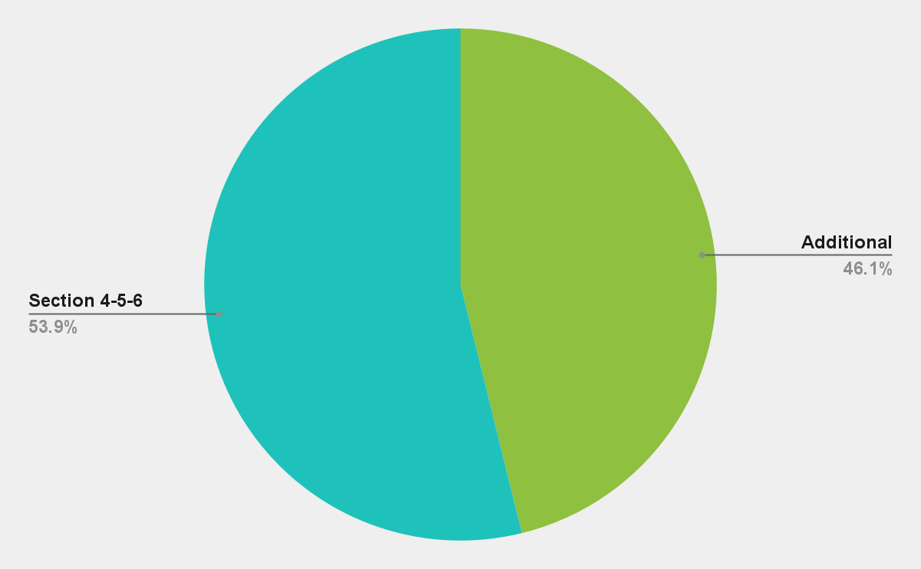
School Funding Per Pupil
Section 4-5-6:
$426
Additional Support: $365

Slide 23
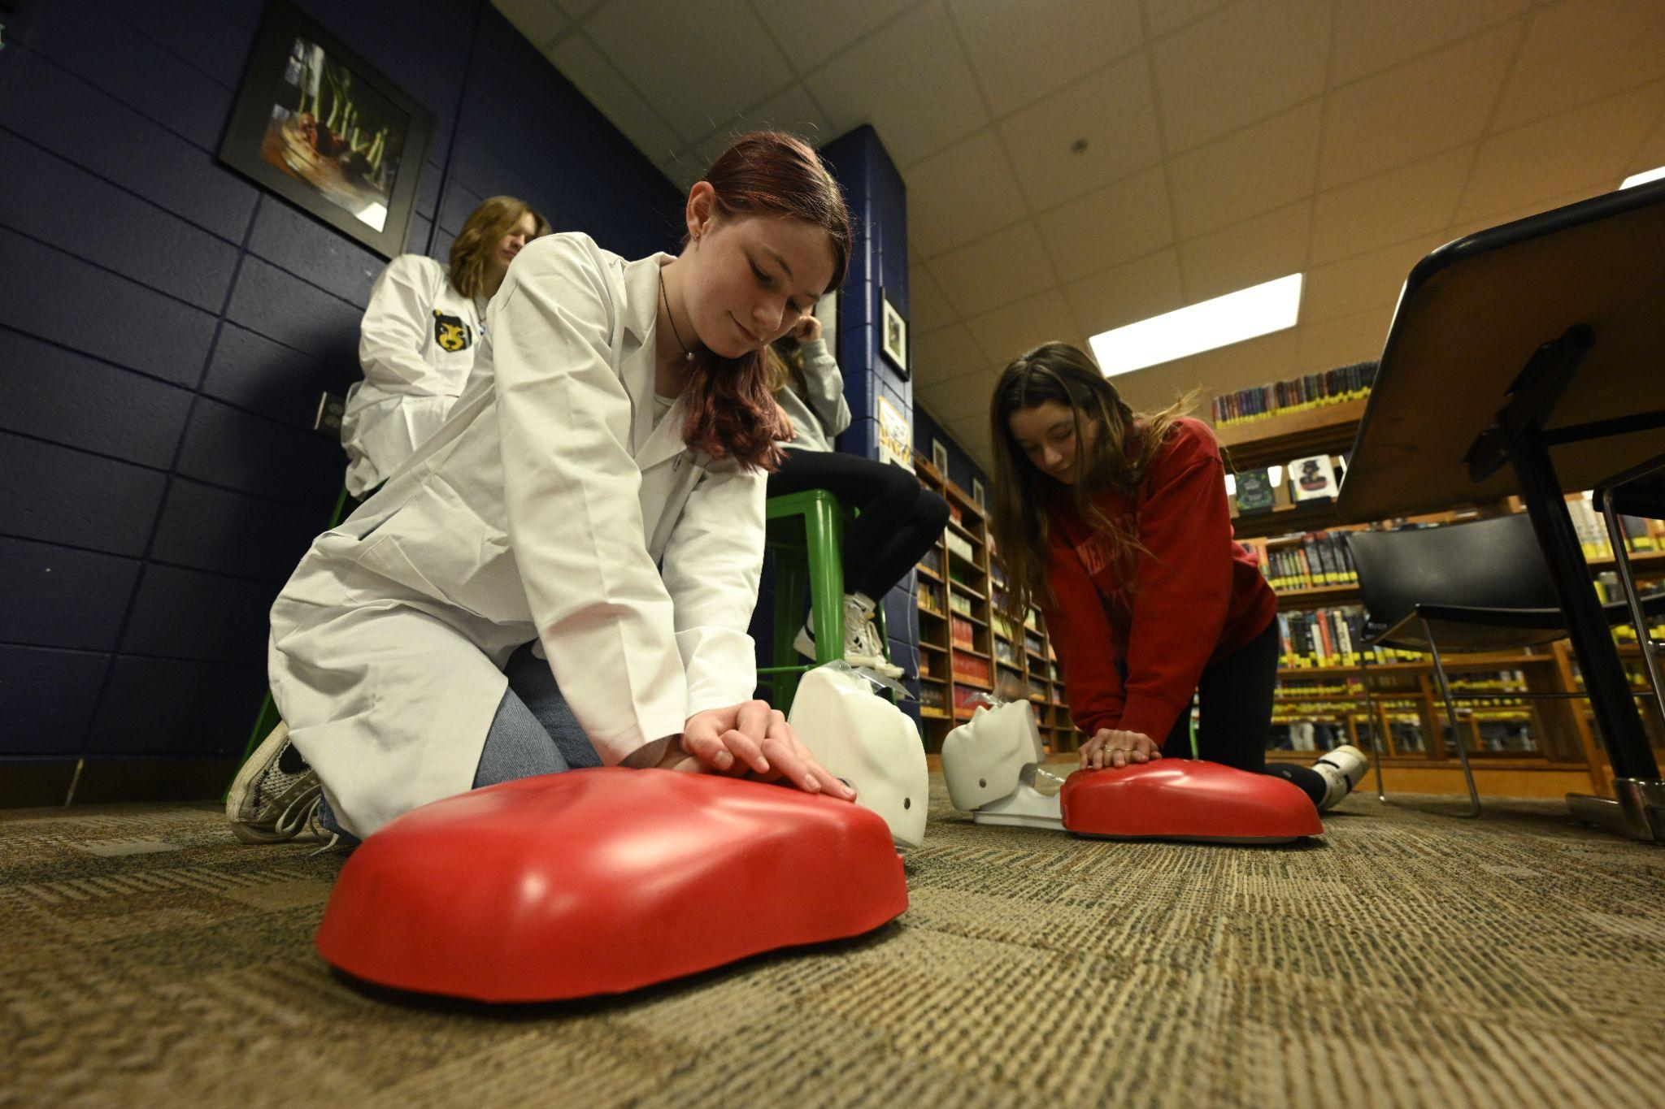
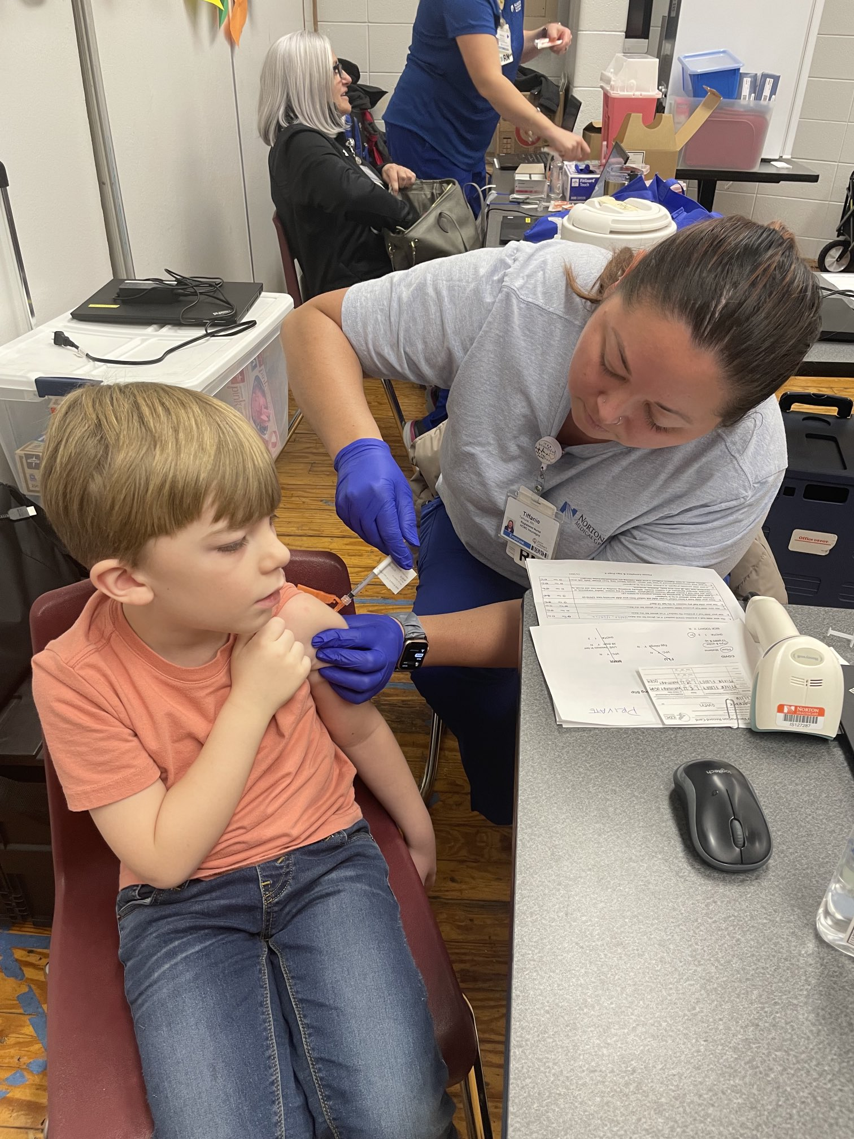
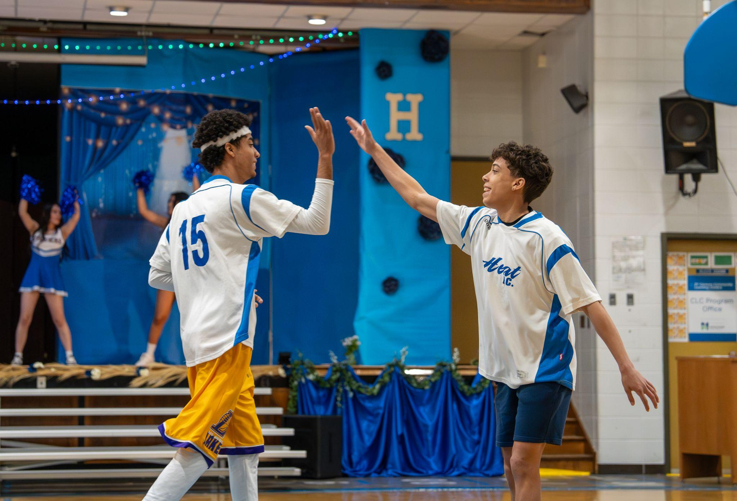
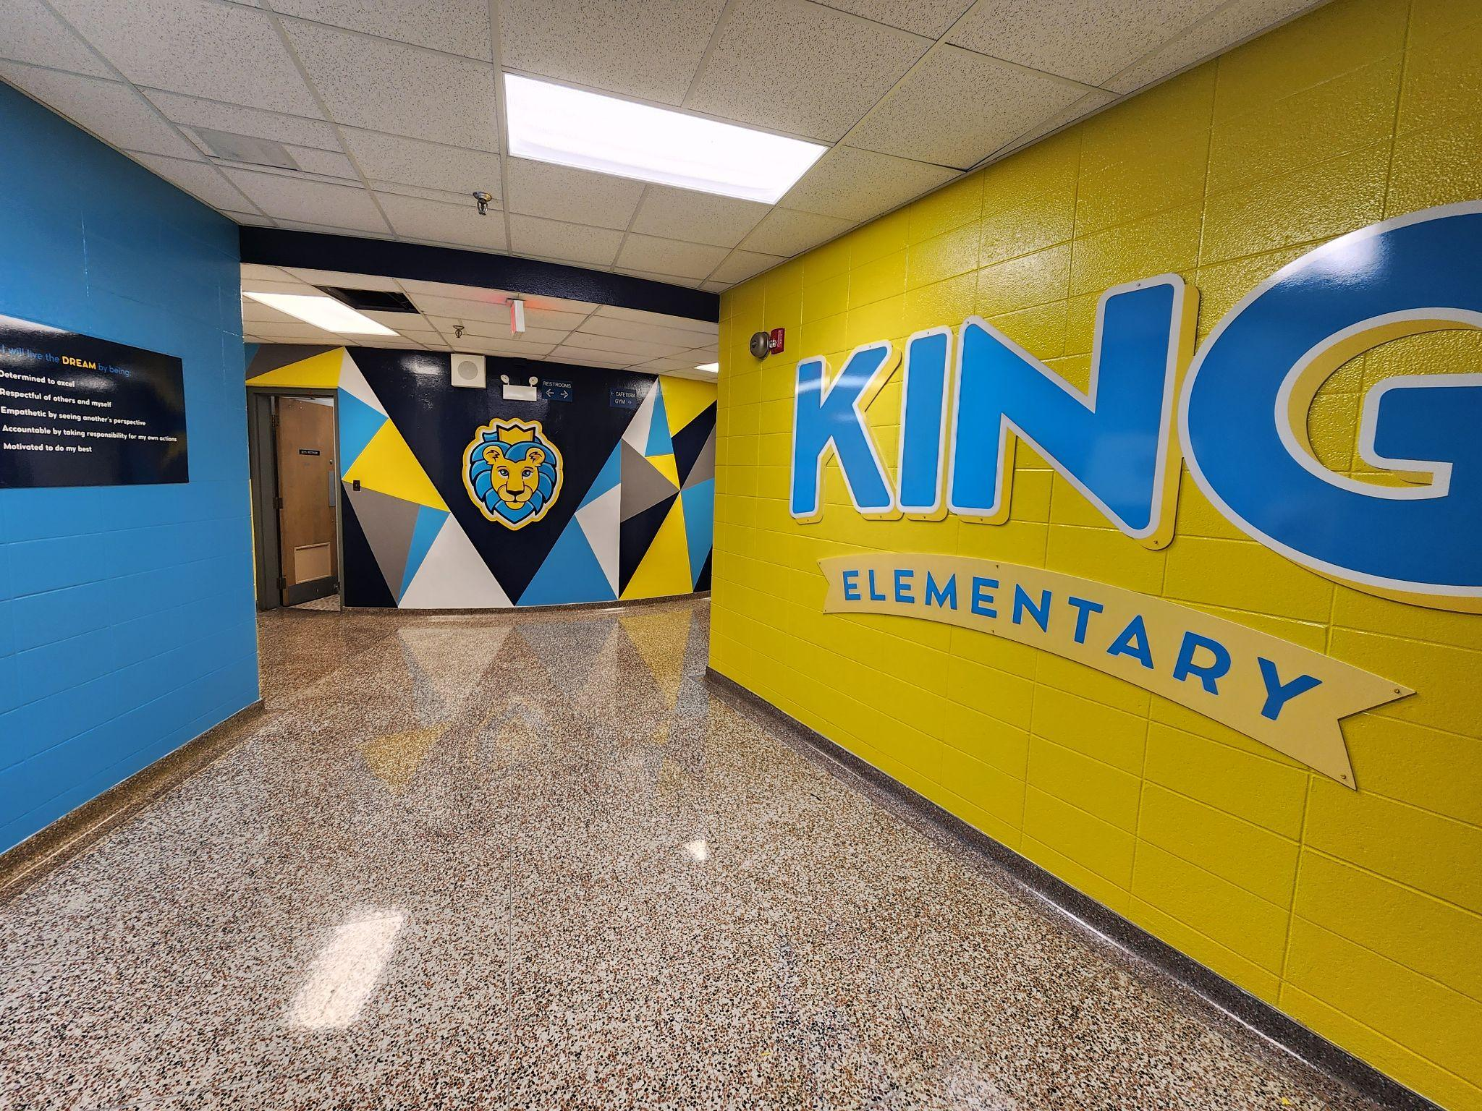
ADDITIONAL SCHOOL SUPPORT
$35.9 Million
Equity Funds
$14.2 Million
MS Explore, Career & Technical Education, & Academies of Louisville
$11.4 Million
Nurses
$9.2 Million
Multilingual Student Support
$16.6 Million
AIS/Choice Zone Support

Slide 24
General Fund Per Pupil Expenditures
Elementary Schools: $8,831
Middle Schools: $8,994
High Schools: $7,692
ECE Centers: $98,156

Slide 25
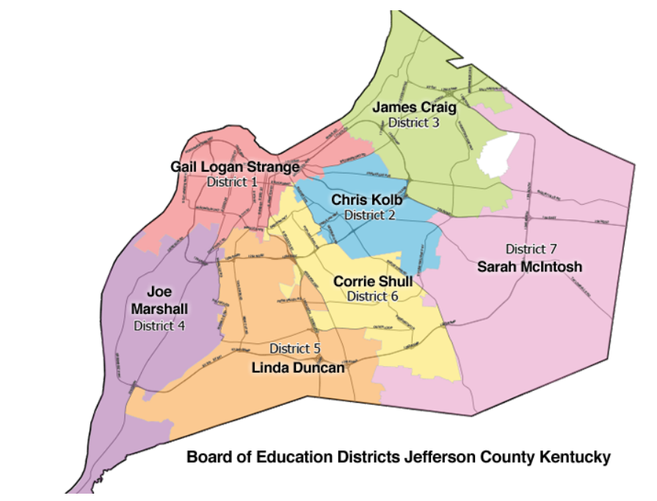
Jefferson County Board of Education
2023-24 Board Expenditures
$60,020.89

Slide 26
BOARD OPERATIONS
Sixteen regular meetings in 2024.
Agenda and materials are available to the Board and the public online 12 days prior to each meeting.
Meetings are live-streamed on the JCPS YouTube Channel.
Public comment at each regular meeting, up to a maximum of 90 minutes.
Board members submit questions regarding agenda items prior to the meeting. Written staff responses are provided to all Board members, and are available to the public upon request.

Slide 27
BOARD COMMITTEES
Reviews policy changes to align with legislative action and changes to state and federal law.
Amendments to policies are largely based on KSBA Policy Service model language.
Members - 2 Board Members, Superintendent, Chief of Staff, General Counsel, Representatives for Teachers and Classified Staff, Community Members.
Meets 8 times per year
Advises and provide feedback on challenges and issues with racial equity in the district based on the racial equity policy.
Provides technical support to schools and District leadership with the development of racial equity improvement strategies.
Members – Representatives for Teachers, Administrators, Classified Staff, Parents, Community members.
Membership reflects the racial and ethnic population of the District’s student population.
Meets 4 to 6 times per year
Board Policy Committee – Standing Committee
Advisory Council for Racial Equity (ACRE)

Slide 28
BOARD COMMITTEES
Audit and Risk Management Advisory Committee (ARMAC) – 2018 to present
Expert advisory committee to assist the Board in the oversight of risks impacting the financial and strategic objectives of the District.
Members are to possess knowledge in accounting, external auditing, internal auditing, governmental fund accounting, financial reporting, operational risk management, and strategic risk management.
Members are external to JCPS, selected by the Committee, and approved by the Board.
ARMAC advises the Board on:
Integrity and presentation of financial statements and operational reporting;
Qualifications, independence, and performance of independent external auditors and the internal audit function;
System of internal controls including procedures for detecting fraud, waste, and abuse;
Adequacy of the JCPS strategic and operational risk management processes;
Compliance with laws and regulations;
Adequacy of JCPS investigations processes;
JCPS ethics, values, and culture; and
Other matters as directed by the Board.

Slide 29
BOARD COMMITTEES
Committees Created by Board Action as Required by State Law
District Facilities Local Planning Committee
Develops and amends the District Facilities Plan.
School Calendar Committee
After seeking feedback from District employees, parents, and community members, recommends school calendar options to the Superintendent for presentation to the Board.
Membership includes a principal; a District administrator; a Board member; 2; 1 elementary school teacher; middle or high school teacher; 2 classified employees; and 2 community members representing business/tourism.
Student Support and Behavior Intervention Handbook (SSBIH) Committee
SSBIH is the District’s Code of Acceptable Behavior and Discipline required by Kentucky state law.
Membership includes students, administrators, teachers, classified staff, parents, community members, DPP.
Educator Quality Oversight Committee (EQOC)
Develops procedures and forms for the District Educator Growth System in alignment with the Kentucky Framework for Teaching
Has an equal number of teachers and administrators and meets monthly.

Slide 30
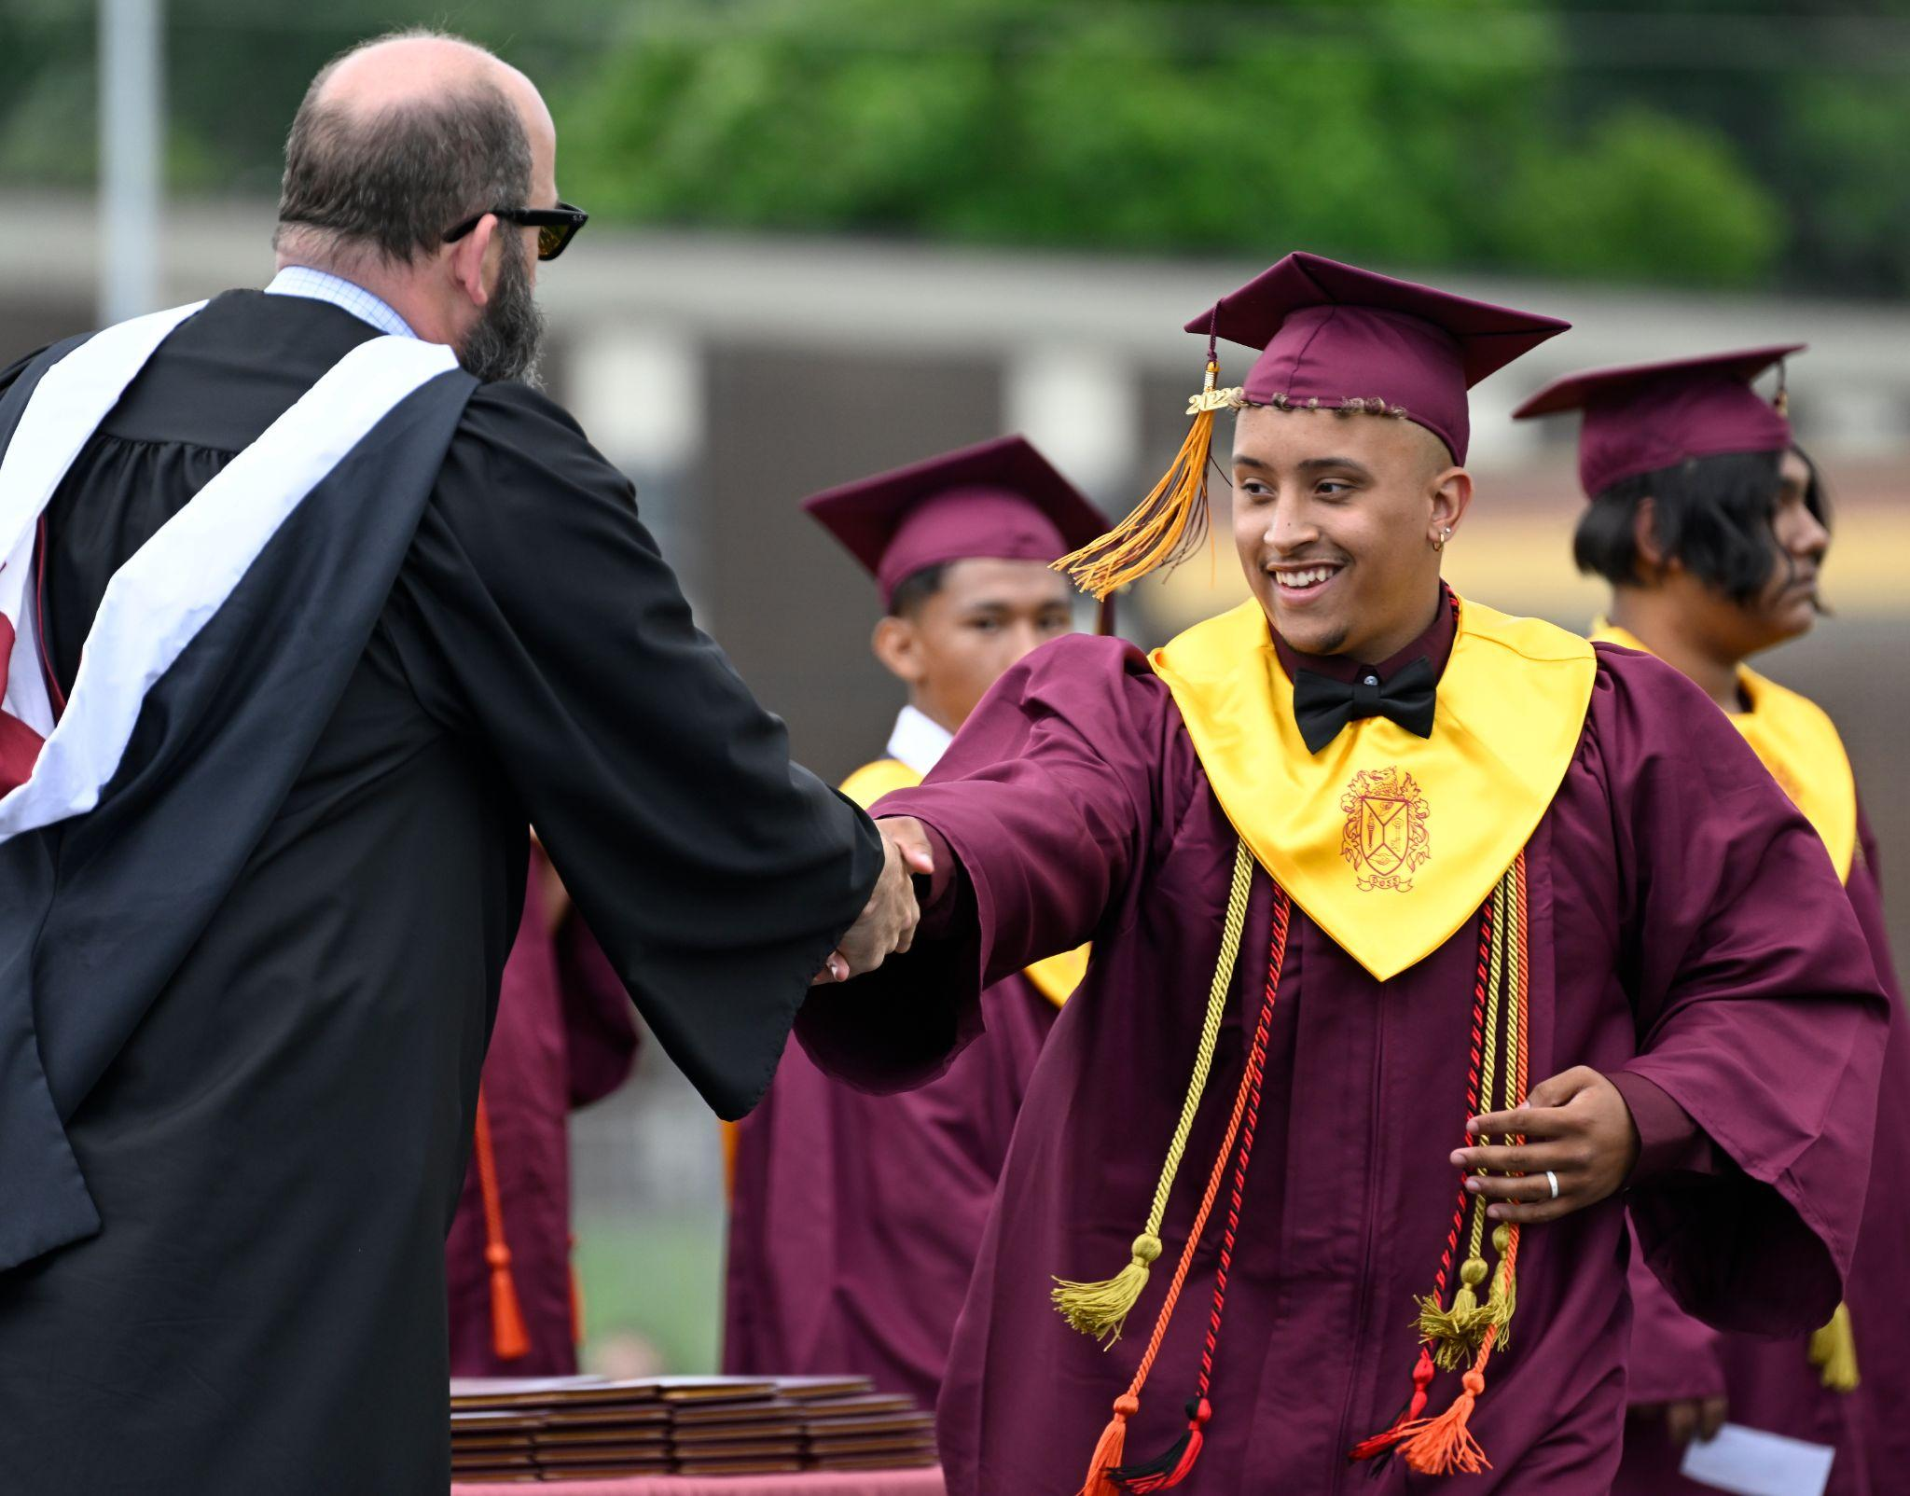
STUDENT OUTCOMES FOCUSED GOVERNANCE
Board working with the Council of the Great City Schools since January 2023
Focusing board work on student achievement - 3-5 metrics
Goals and Guardrails
Superintendent responsible for strategies to meet goals
Evaluation focused on those goals
Monthly Board monitoring of progress toward student achievement goals
Quarterly Board self-evaluation to prioritize the Board’s time and attention on things that impact student outcomes

Slide 31
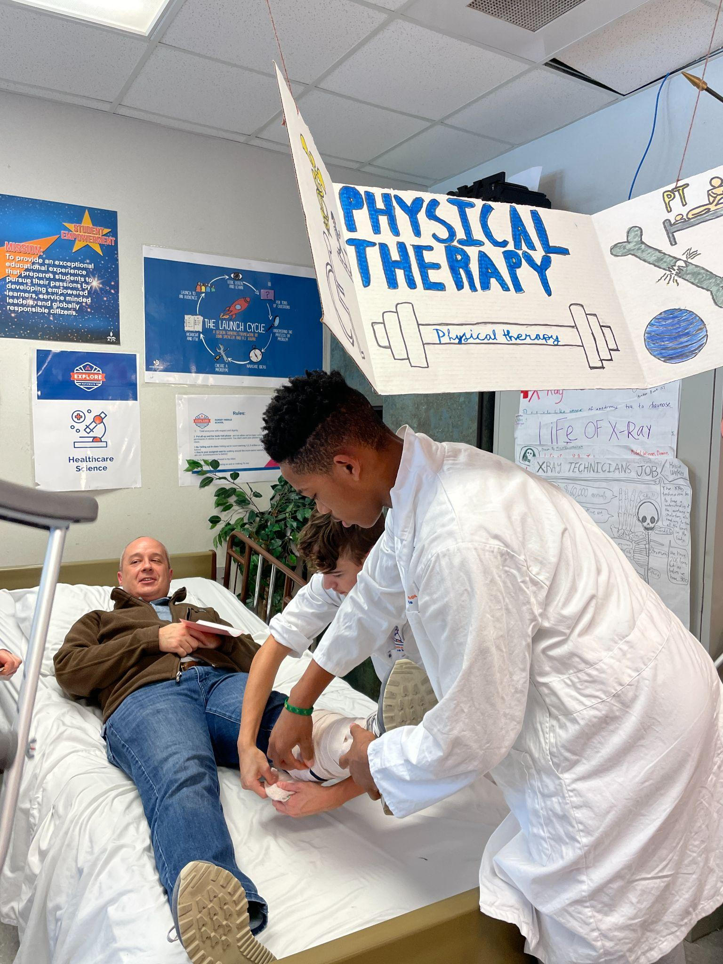
QUESTIONS?

