Slide 1
The Power of Rethinking Literacy & Math
Jefferson County Public Schools

Slide 2
JCPS Literacy
The Missing Piece:
Foundational Skills

Slide 3
What Is Literacy?
What
How
Why
The creative and analytical ability to identify, understand, interpret, create, compute, and communicate, using visual, audible, and digital texts across disciplines.
The development of literacy skills is on a continuum allowing for individuals to utilize it over varying contexts and with varying abilities.
Literacy is a moral imperative because it gives humans the ability to articulate our experiences and interact with others to improve the world around us.

Slide 4
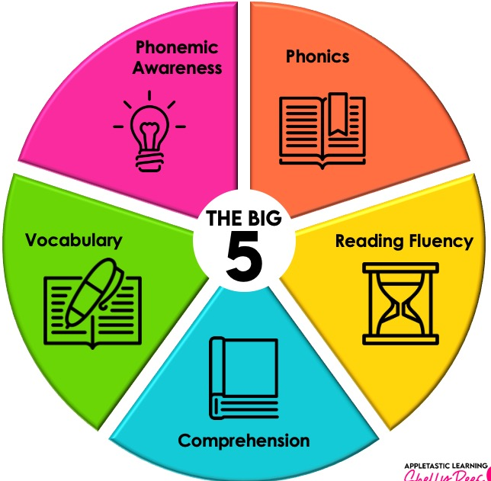
The Five Components of Literacy
Phonemic Awareness-An understanding of phonemes, or the smallest units of spoken language which combine to create syllables and words. Phonemic awareness is the ability to isolate, identify, focus on, and manipulate sounds in spoken words.
Phonics-The relationship between letters and sounds in written language. A student who is strong in phonics is able to sound out and spell different words.
Reading Fluency-The ability to read quickly and accurately, and comes about when the reader has mastered enough
Vocabulary- The amount of words with which the reader is familiar. The larger a student’s vocabulary is, the easier it is for them to derive meaning from the text.
Comprehension- The ultimate goal of literacy. It is the reader’s ability to understand and make sense of written text.

Slide 5
The Need For Early Foundational Skills
Data from the Universal Screener (MAP) suggested that for students who did not master the foundational literacy skills by the end of 2nd grade, their chance to improve their reading ability or reach reading proficiency is scant.

Slide 6
Implications for Teaching
Reading IS a Science- It’s not magic
Education is ever evolving and we must stay on top of best practices.
Know better, do better.
Foundational Skills Matter
Without phonemic awareness and phonics, reading cannot sustain higher level texts.
Tier 1 (ALL student exposed) curriculum should be KNOWLEDGE BUILDING
“The implication for reading instruction is that expanding students’ background knowledge and enriching their reading experiences across different disciplines and genres should be an integral part of a comprehensive reading curriculum.”

Slide 7
Missing Pieces
Consistent Literacy Structures
01
an updated Literacy Plan
a consistent foundational literacy experience for students
Tier 1 or CORE ELA Curriculum
A common approach to Literacy Professional Learning (LETRS)

Slide 8
Finding Solutions
NAEP Data For Partner School Districts
Our research concluded, districts were excelling with implementation of consistent and common HQIRs…
Hillsborough: Journeys
Miami Dade: Wonders
Charlotte: EL
San Diego: Benchmark

Slide 9
Legislative Actions and Implications for Reading
Senate Bill 1 Enactment:
In JCPS Senate Bill 1 became effective for grades Kindergarten through 8th during the 2023-2024 school year. Implementation begins in High School in 2024-2025.
SB1
Senate Bill 9:
Senate Bill 9 became effective for K-3 students during the 2023-24 school year; however, as we believe literacy is a human right, we expanded the guidance with the implementation of our K-12 literacy plan.
In 2023-24, a reading screener was adopted for all students K-8 (MAP Growth) and 9-12 (CERT)
In 2023-24, a reading diagnostic was adopted for K-3 students (MAP Reading Fluency) below the 60th percentile
In 2024-25, evidence-based reading instruction, interventions and intensive supports are being provided to grade 4 students based on performance on the 3rd grade reading assessment
In 2024-25, a reading diagnostic (Capti) will be implemented for students in grades 6-12
Literacy Leadership Teams monitor and evaluate student data in concurrence with the implementation of a High Quality Instructional Resource
Notes:
What routine can we embed here?
Pull language from the HQIR resource…why does the state feel this is the shift….what does the research say about this….cite someone here that says this and the state recognizes why we have to make this shift. Allows us to execute the standards in the way they should be implemented. This is backed by the state and legislation, not just another rollout. Bring in the problem based and how the bill promotes the implementation of the standards. Highlight that we are out in front of the legislation.

Slide 10
Curriculum
Comprehensive academic content that progresses through a series of learning goals connected to grade level standards.

Slide 11
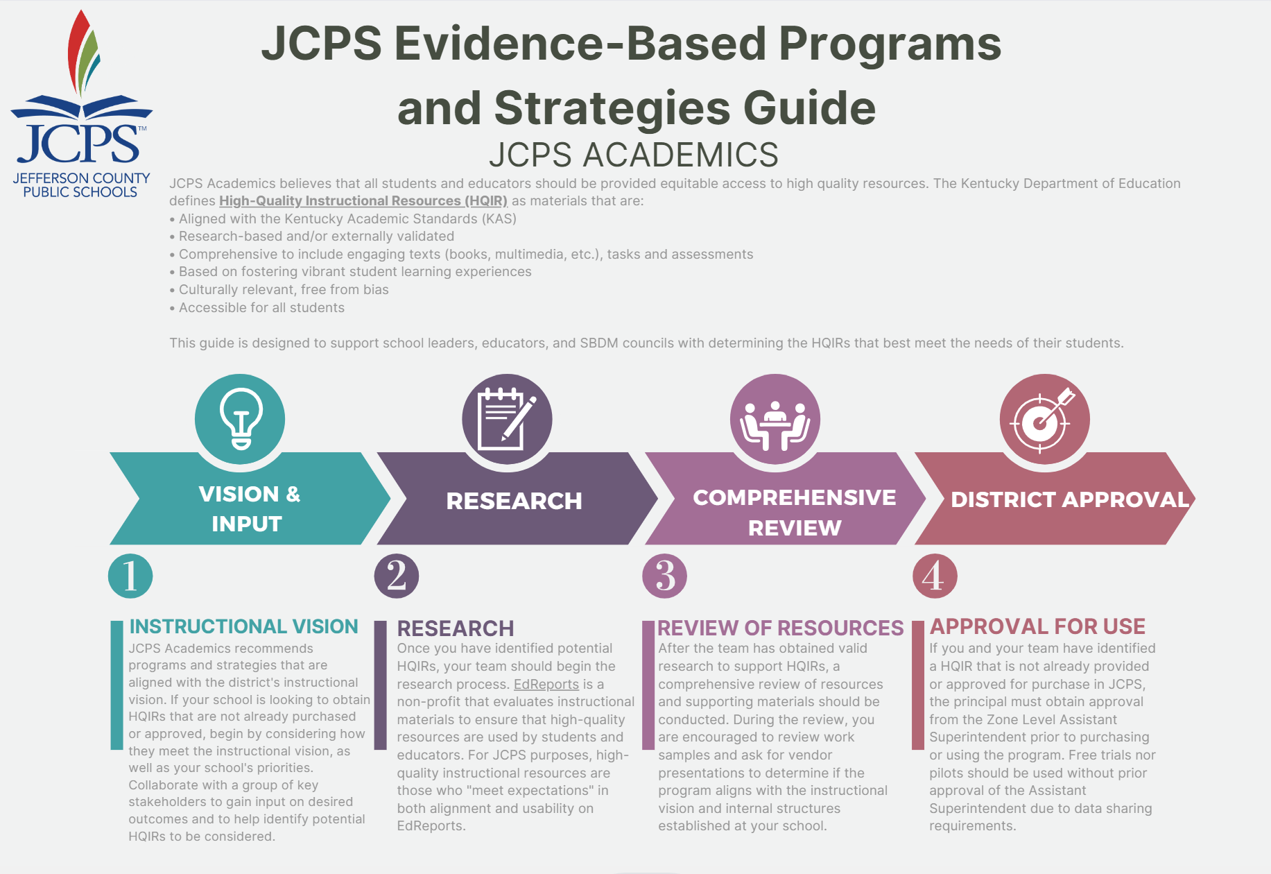
How to determine if curriculum is a high quality instructional resource (HQIR)?
An HQIR…
Gives Teachers CLARITY for daily lessons and yearly progress monitoring
Aligns to Grade Level Standards
Backwards plans with assessment in mind
Provides flexibility while providing structure
Provides diverse perspectives and promotes equity centered learning
Accommodates a wide variety of learning needs
Encourages collaboration and agency

Slide 12
Timeline for Curriculum Adoption
Committee Research & Recommendations
Initial Process
Reflection & Review
Curriculum consultation with the community
Curriculum implementation feedback from JCPS stakeholders
Representation from various stakeholders
Committee review of curriculum
Curriculum recommendations from the committee
The committee ensures curricula choices are equitable.
Final Committee recommendations
Established a jointly selected 50/50 committee including JCPS and JCTA (union) members
Identified collective beliefs and core values
Committee provided input for curriculum considerations
Vendor Curriculum Specialist presented to the committee and left the Committee with materials to review
Cabinet members, Assistant Sups, EAs, Principals
Open SBDM meetings: teachers, parents, students
Community Organizations: feedback and presentations
District Leadership, Principals, teacher work groups, and student reflections and feedback
Mar 7-April 13

Slide 13
Curriculum Selections
K-12 Math
Illustrative Mathematics
Student Driven: Students DO the math!
Coherent progression of mathematical understanding across K-12
Anchored in equitable access for all learners
Supports teachers in internalizing mathematical best practices
K-12 ELA
EL Education & myPerspectives
Knowledge Building Curriculum- Deeper Not Wider
Foundational Skills - Essential Phonics Instructions
Commitment To Student Perspectives- Equitable access and diverse resources
Values & Learner Profile- Values Student Centered Learning (Whole Child)
Literacy Best Practices - Focus on vocabulary, interactive writing, and discussion through Performance-Based Assessments

Slide 14
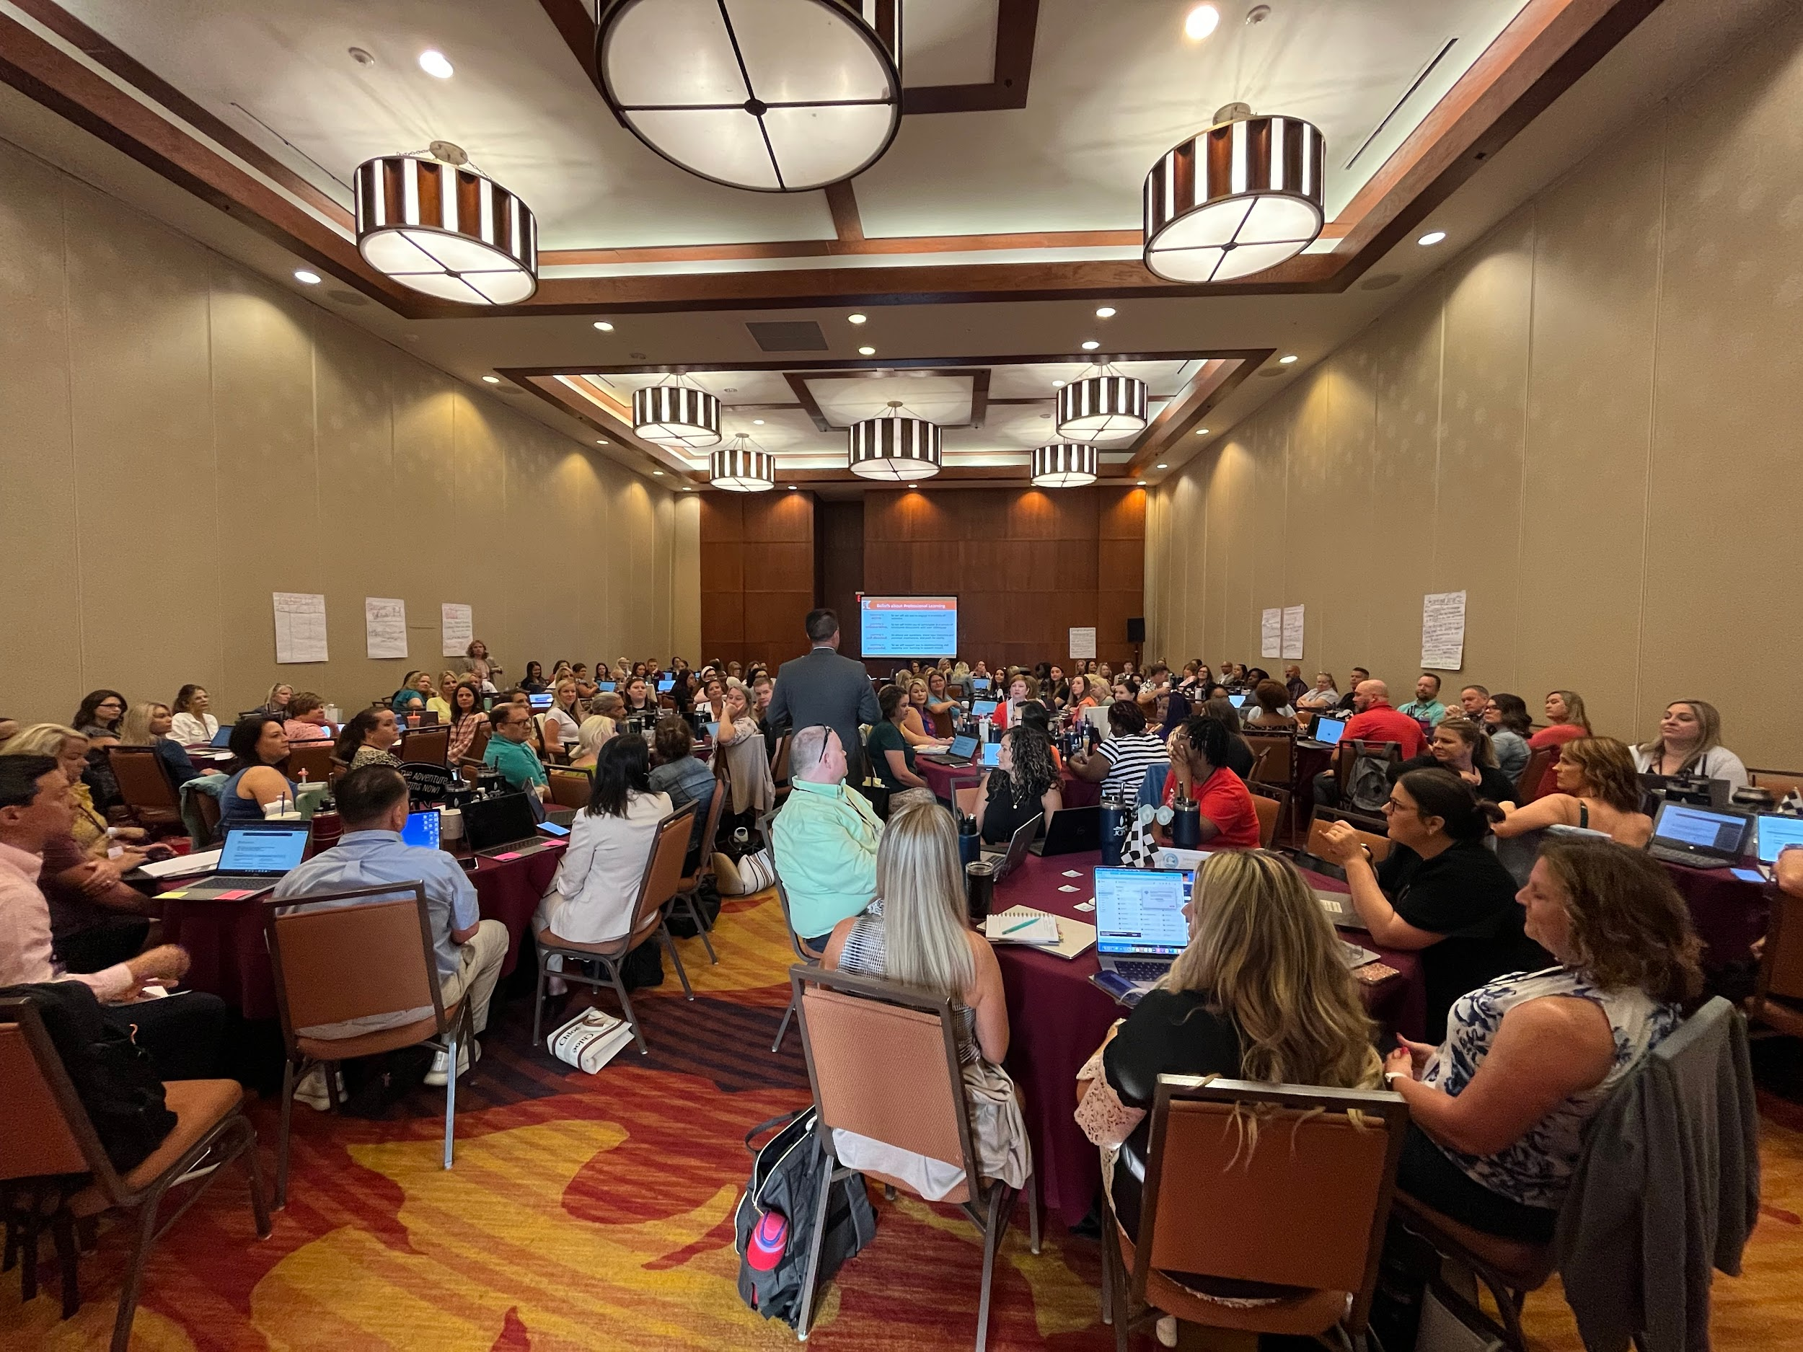
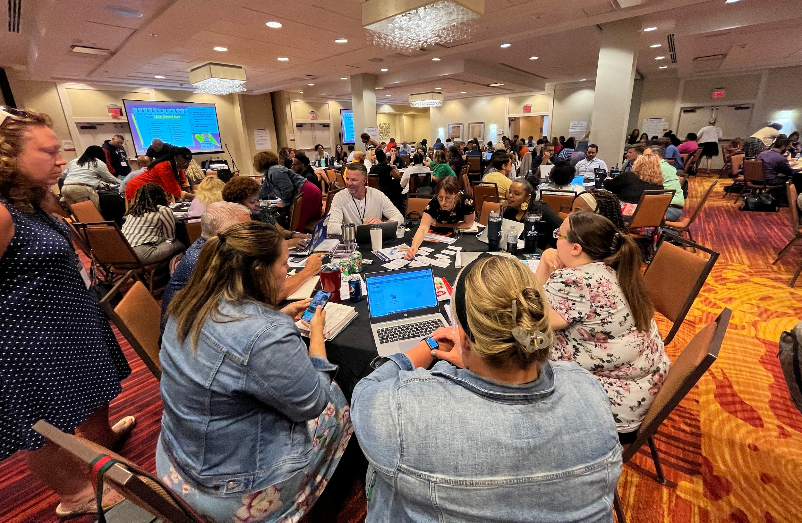
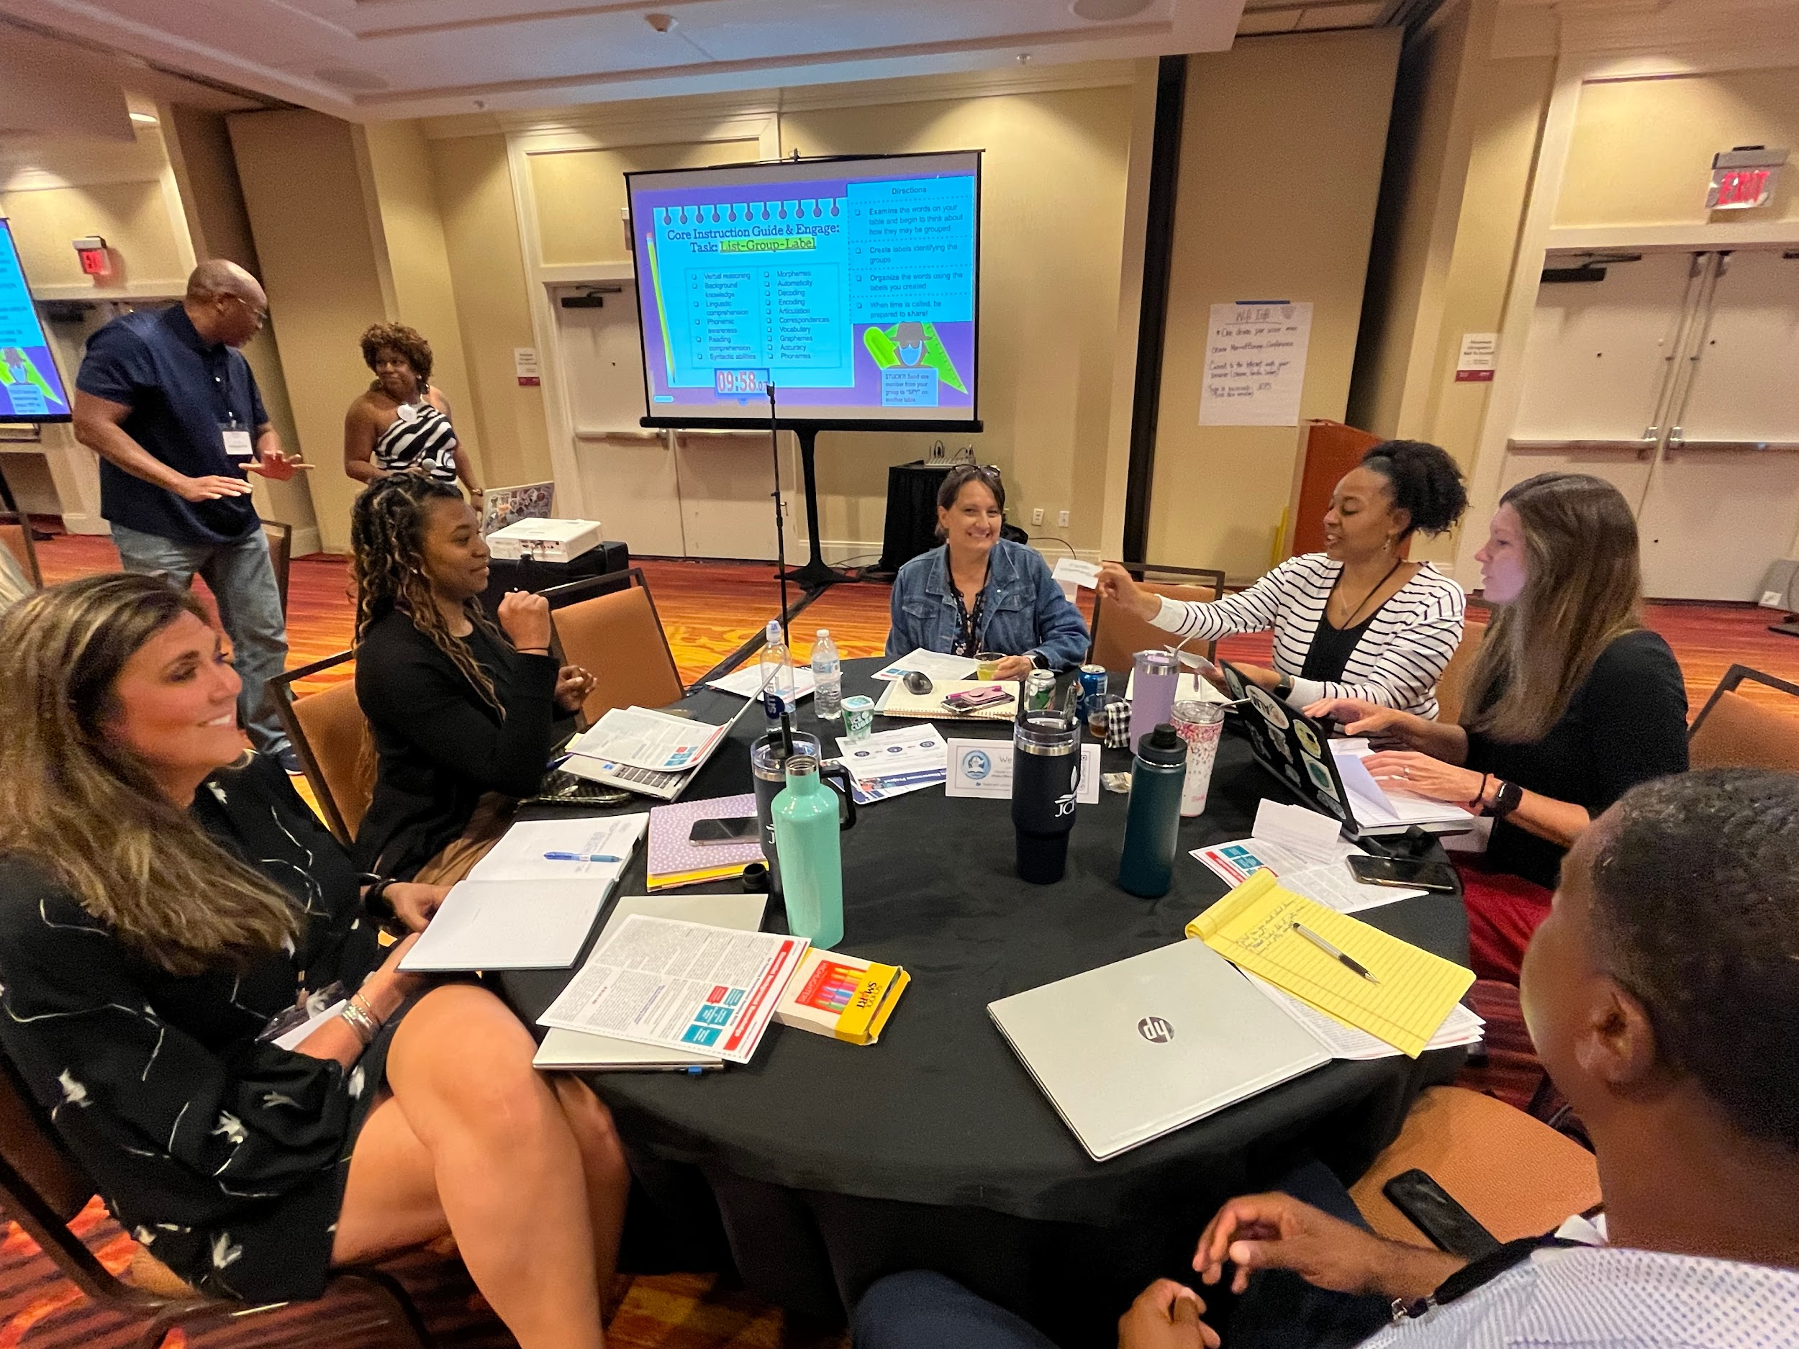
TRAINING
Over 3400 trained educators in 23-24 (Year 1)
AND Over 3000 in the Summer 2024 (Year 2)!
June, July, August, September, October of 2023 & January 2024
June & July of 2024
Capacity Building & Continued Support

Slide 15
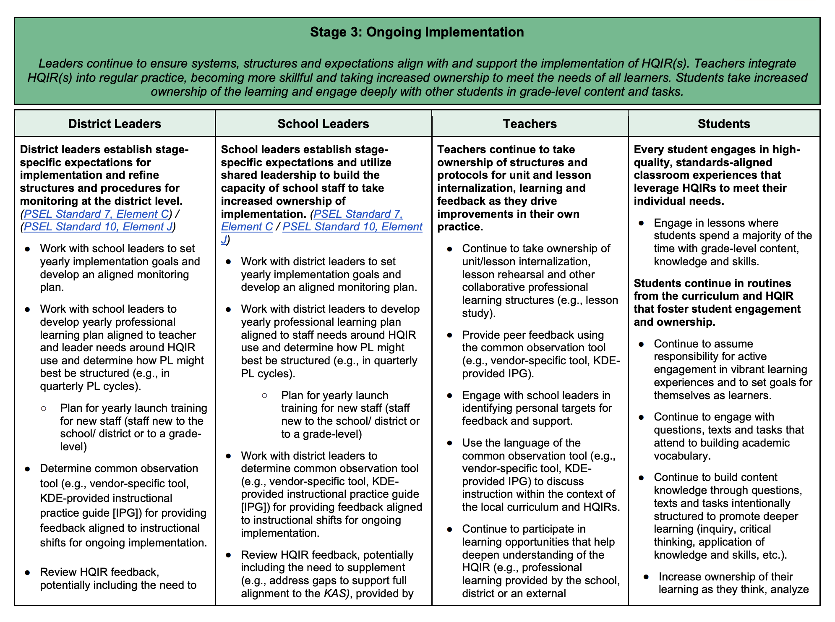
Alignment to Best Practice!
Alignment to Policy & Legislation
Screener, Diagnostic, Read-At-Home, Reading Improvement Plan, Literacy Plans, Math Plans, etc.
Alignment to KDE Curriculum Framework Guidance
Stage 1: Launch (Summer prior to 1st year of implementation) (Science/SS)
Stage 2: Early Implementation (Year 1) (Math)
Stage 3: Ongoing Implementation (Year 2 and beyond) (ELA)
Developed Ongoing HQIR Guidance Aligned to KDE Recommendations

Slide 16
Alignment to Comprehensive Literacy Plans
Purpose
The purpose of this Comprehensive Literacy Plan is to provide an overview of how school educators will continually work to improve the academic achievement of all students by identifying needs, implementing research-based instructions, engaging in ongoing study and self-reflection to improve the shared practice of teaching, and involving parents and the community in a joint partnership to stay actively responsive to the needs of our children. This is a living document that should be reviewed and modified at least three times a year to monitor school progress.
Essential Literacy Components
Literacy Leadership Team | Literacy Instruction | Literacy Data & Assessment | Literacy Data Based Decision Making | Literacy Intervention | Literacy Professional Learning | Literacy Community & Family Involvement

Slide 17
The Experience of a Core Curriculum- Let’s see it!

Slide 18
Legislative Actions and Implications for Math
Senate Bill 1 Enactment:
In JCPS Senate Bill 1 became effective for grades Kindergarten through 8th during the 2023-2024 school year. Implementation begins in Algebra 1 in 2024-2025.
Senate Bill 162 - KY Numeracy Counts Act:
KY Numeracy Counts Act (HB 162- HPS1) is the legislative initiative for numeracy, with the main accountability focus being on kindergarten through third grade. The bill’s focus is on increasing early student outcomes and develop mathematical proficiencies with an intensive identification and monitoring of student performance.
HB 162 ensures standards based instruction in alignment with the Kentucky Academic Standards for Mathematics. Students are exposed to rigorous tasks that promote critical thinking, problem solving and conceptual understanding.
Mathematical Improvement Teams will monitor and evaluate student data in concurrence with the implementation of a High Quality Instructional Resource.

Slide 19
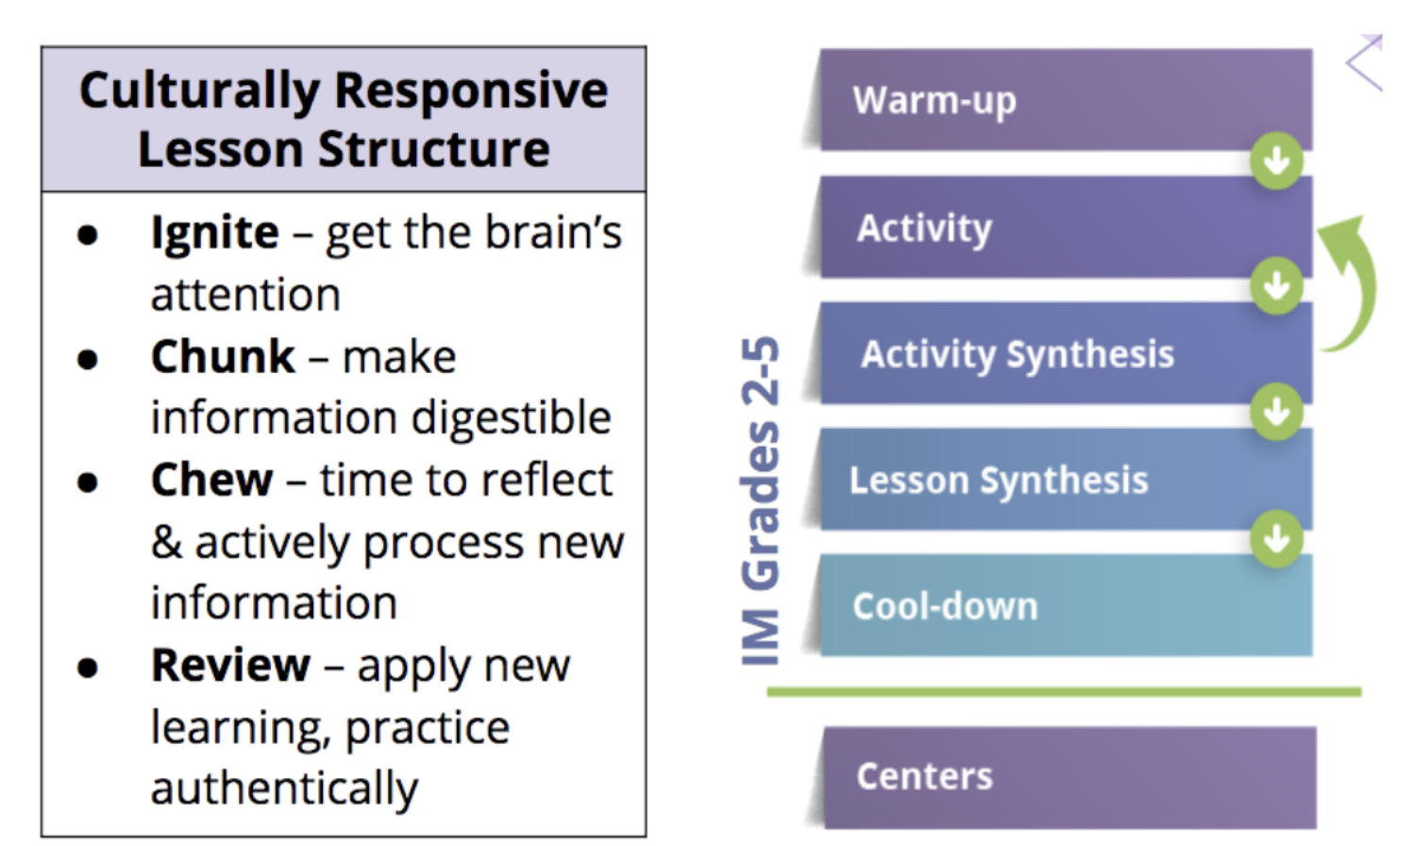
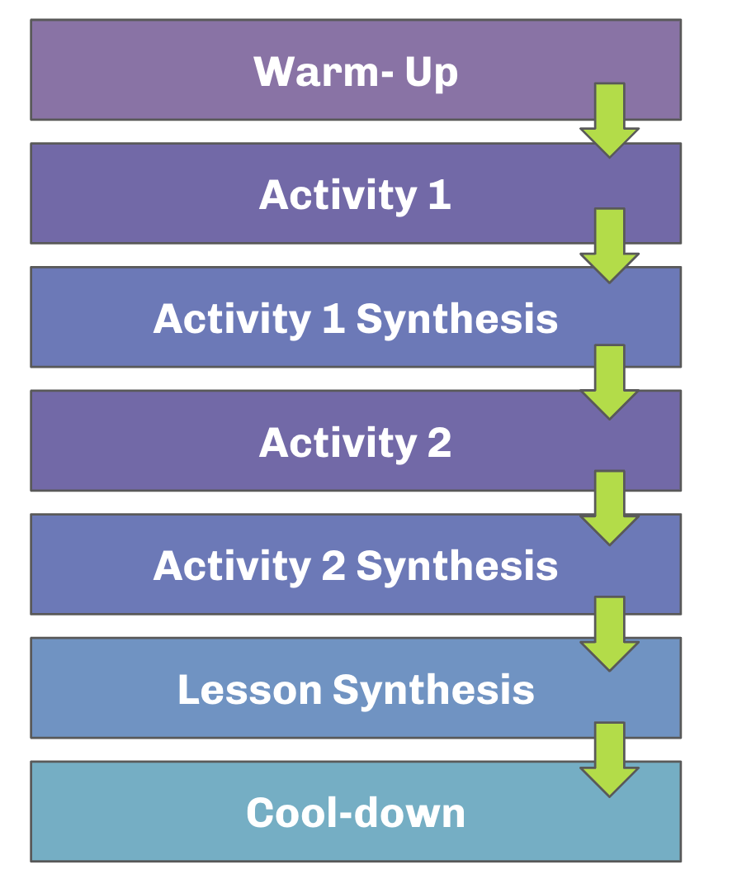
We cannot teach math the way we always have. We must make shifts aligned to research and best practice.
How does our current curriculum help?
✅ Problem- Based
✅ Aligned to the 5 Practices for Orchestrating Mathematics Discussion, Universal Design for Learning & 8 Mathematical Practices
✅ Embedded Supports for ECE and MLs & G/T
✅ Instructional Routines Aligned to Best Practices
✅ Structured Activities & Lessons that can be adapted
✅ Practice Problem sets with Cumulative Review
✅ Culturally Responsive Lesson Structure
✅ Intentional Lesson Plan Writing to Support Diverse Populations

Slide 20
JCPS believes that ALL students. . .
can learn mathematics
have a unique perspectives that are welcomed and needed
can make sense and solve problems on their own
must play with mathematical ideas before formal names, conventions, or processes are introduced
develop mathematical understanding and language capacity interdependently

Slide 21
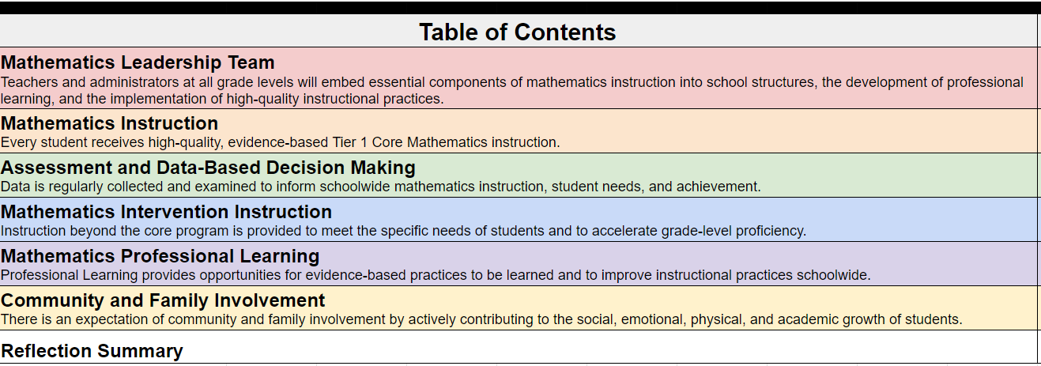
Math Improvement Teams & Math Plan
Required Yearly with Frequent Monitoring

Slide 22
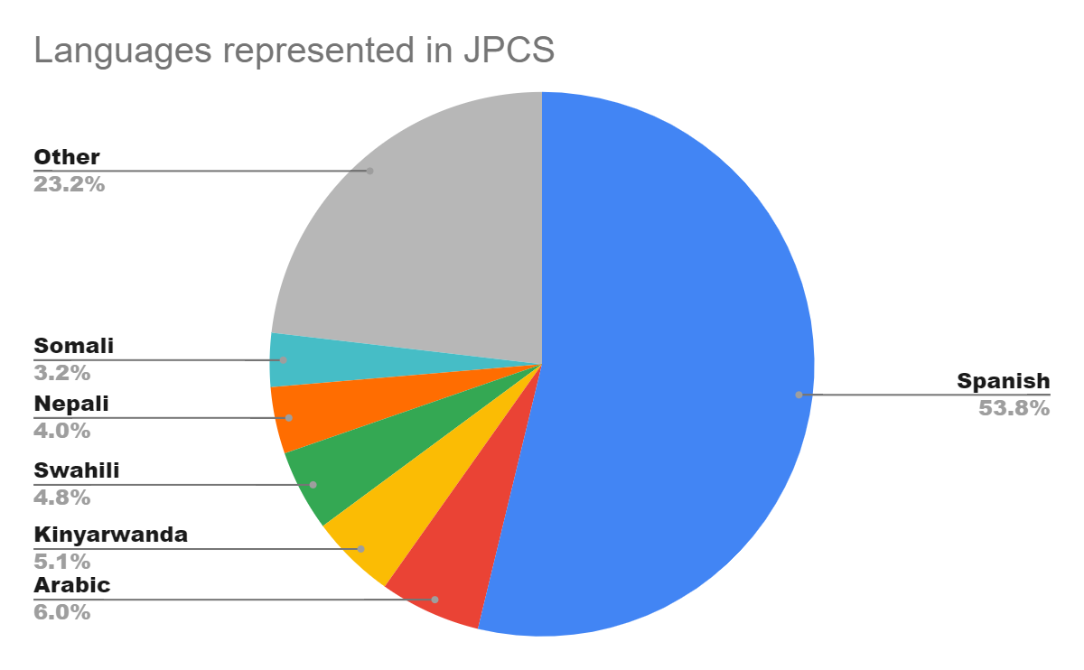
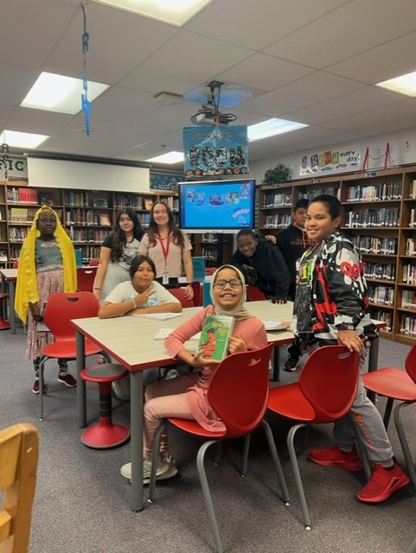
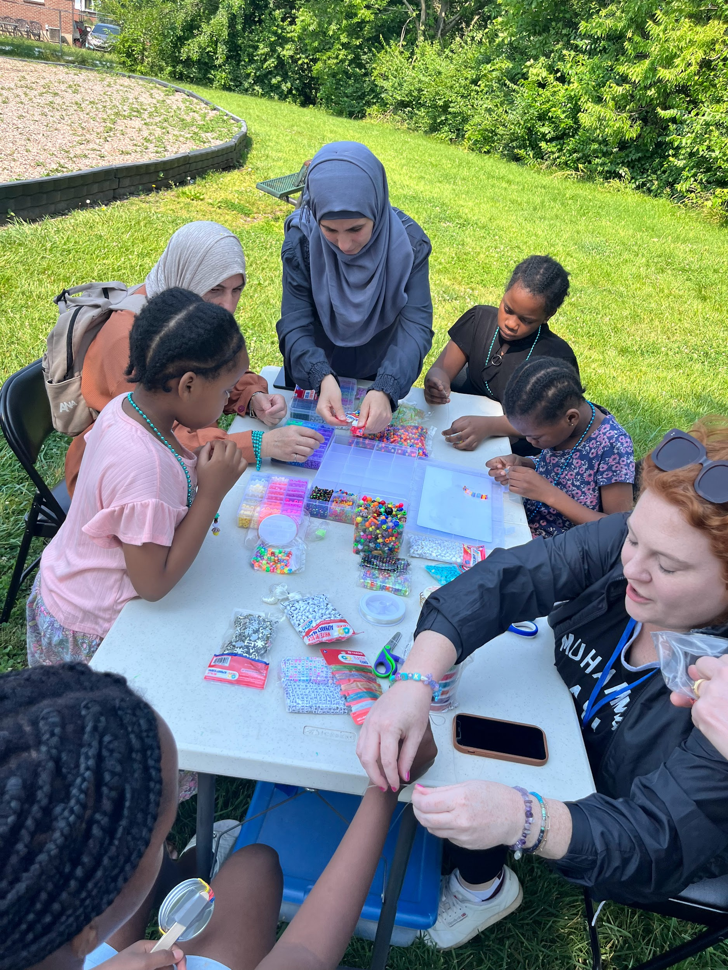
Key Take-Away # 1: Consider Multilingual Learner Support and Alignment- Asset Based Approach
Multilingual Learners “face a dual learning task of acquiring grade-level content knowledge as they learn the corresponding academic English language. They do so within a compressed timeline, developing oral language in English and simultaneously learning about the print forms of English related to the grade-level content.”
JCPS had nearly 20,000 Multilingual Learners and over 150 languages!
Foundational literacy skills instruction requires building new vocabulary and phonological sensitivity obtained through Oral Language (OL) development.
English Language Development (ELD) instructional services are for all MLs as part of their Tier 1 core instruction.
Interventions are IN ADDITION to the ML students’ Tier 1 ELD instructional services.
Professional Learning around literacy values the asset based approach for our MLs

Slide 23
Key Take-Away # 2: On Going Support & Monitoring
Implementation Plans reviewed & monitored by Assistant Superintendents
Formative Systems Review
System Alignment
Walk Through Tools
Student Experience
Internal Monitoring process through our Accountability and Research Division
Surveys on Implementation, Resources
Quantitative Feedback on Progress: Saw increases in achievement with those previously using the foundational literacy approach (Skills Block)
HQIR Coordinator Aligned to KDE
Recently Reviewed our Systems with the KDE Curriculum Implementation Framework
Expectations | Supports
JCPS Literacy Curriculum is implemented with integrity Kindergarten - 12th grade K-8: EL 9-12: myPerspectives is implemented with integrity English 1-4 Tight: First four units Loose: Optional room for novels Walk Throughs include the JCPS Academics Look Fors for ELA (shared at Principals’ & AIC Meetings) Literacy Plan monitoring and reflections completed in October and April | Quarterly Academic Academies: Unit unpacking and planning Triangulation of Data Curriculum Specific Workshops Literacy Best Practices K-12 Specific Supports Coaching Modeling/Co-teaching PLC Support Literacy Plan Support EL Coaching & Walkthroughs Administrator & AIC Training myPerspectives onsite coaching and learning walks for all high schools

Slide 24
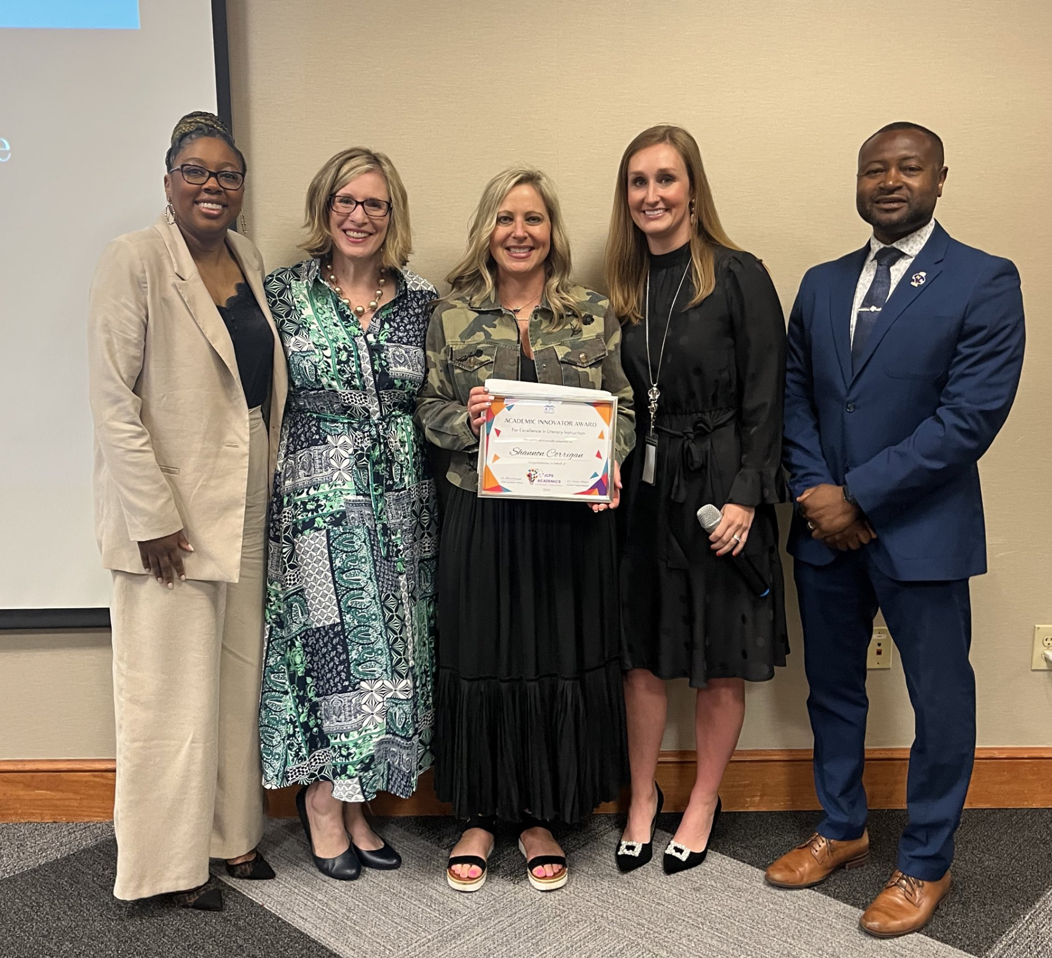
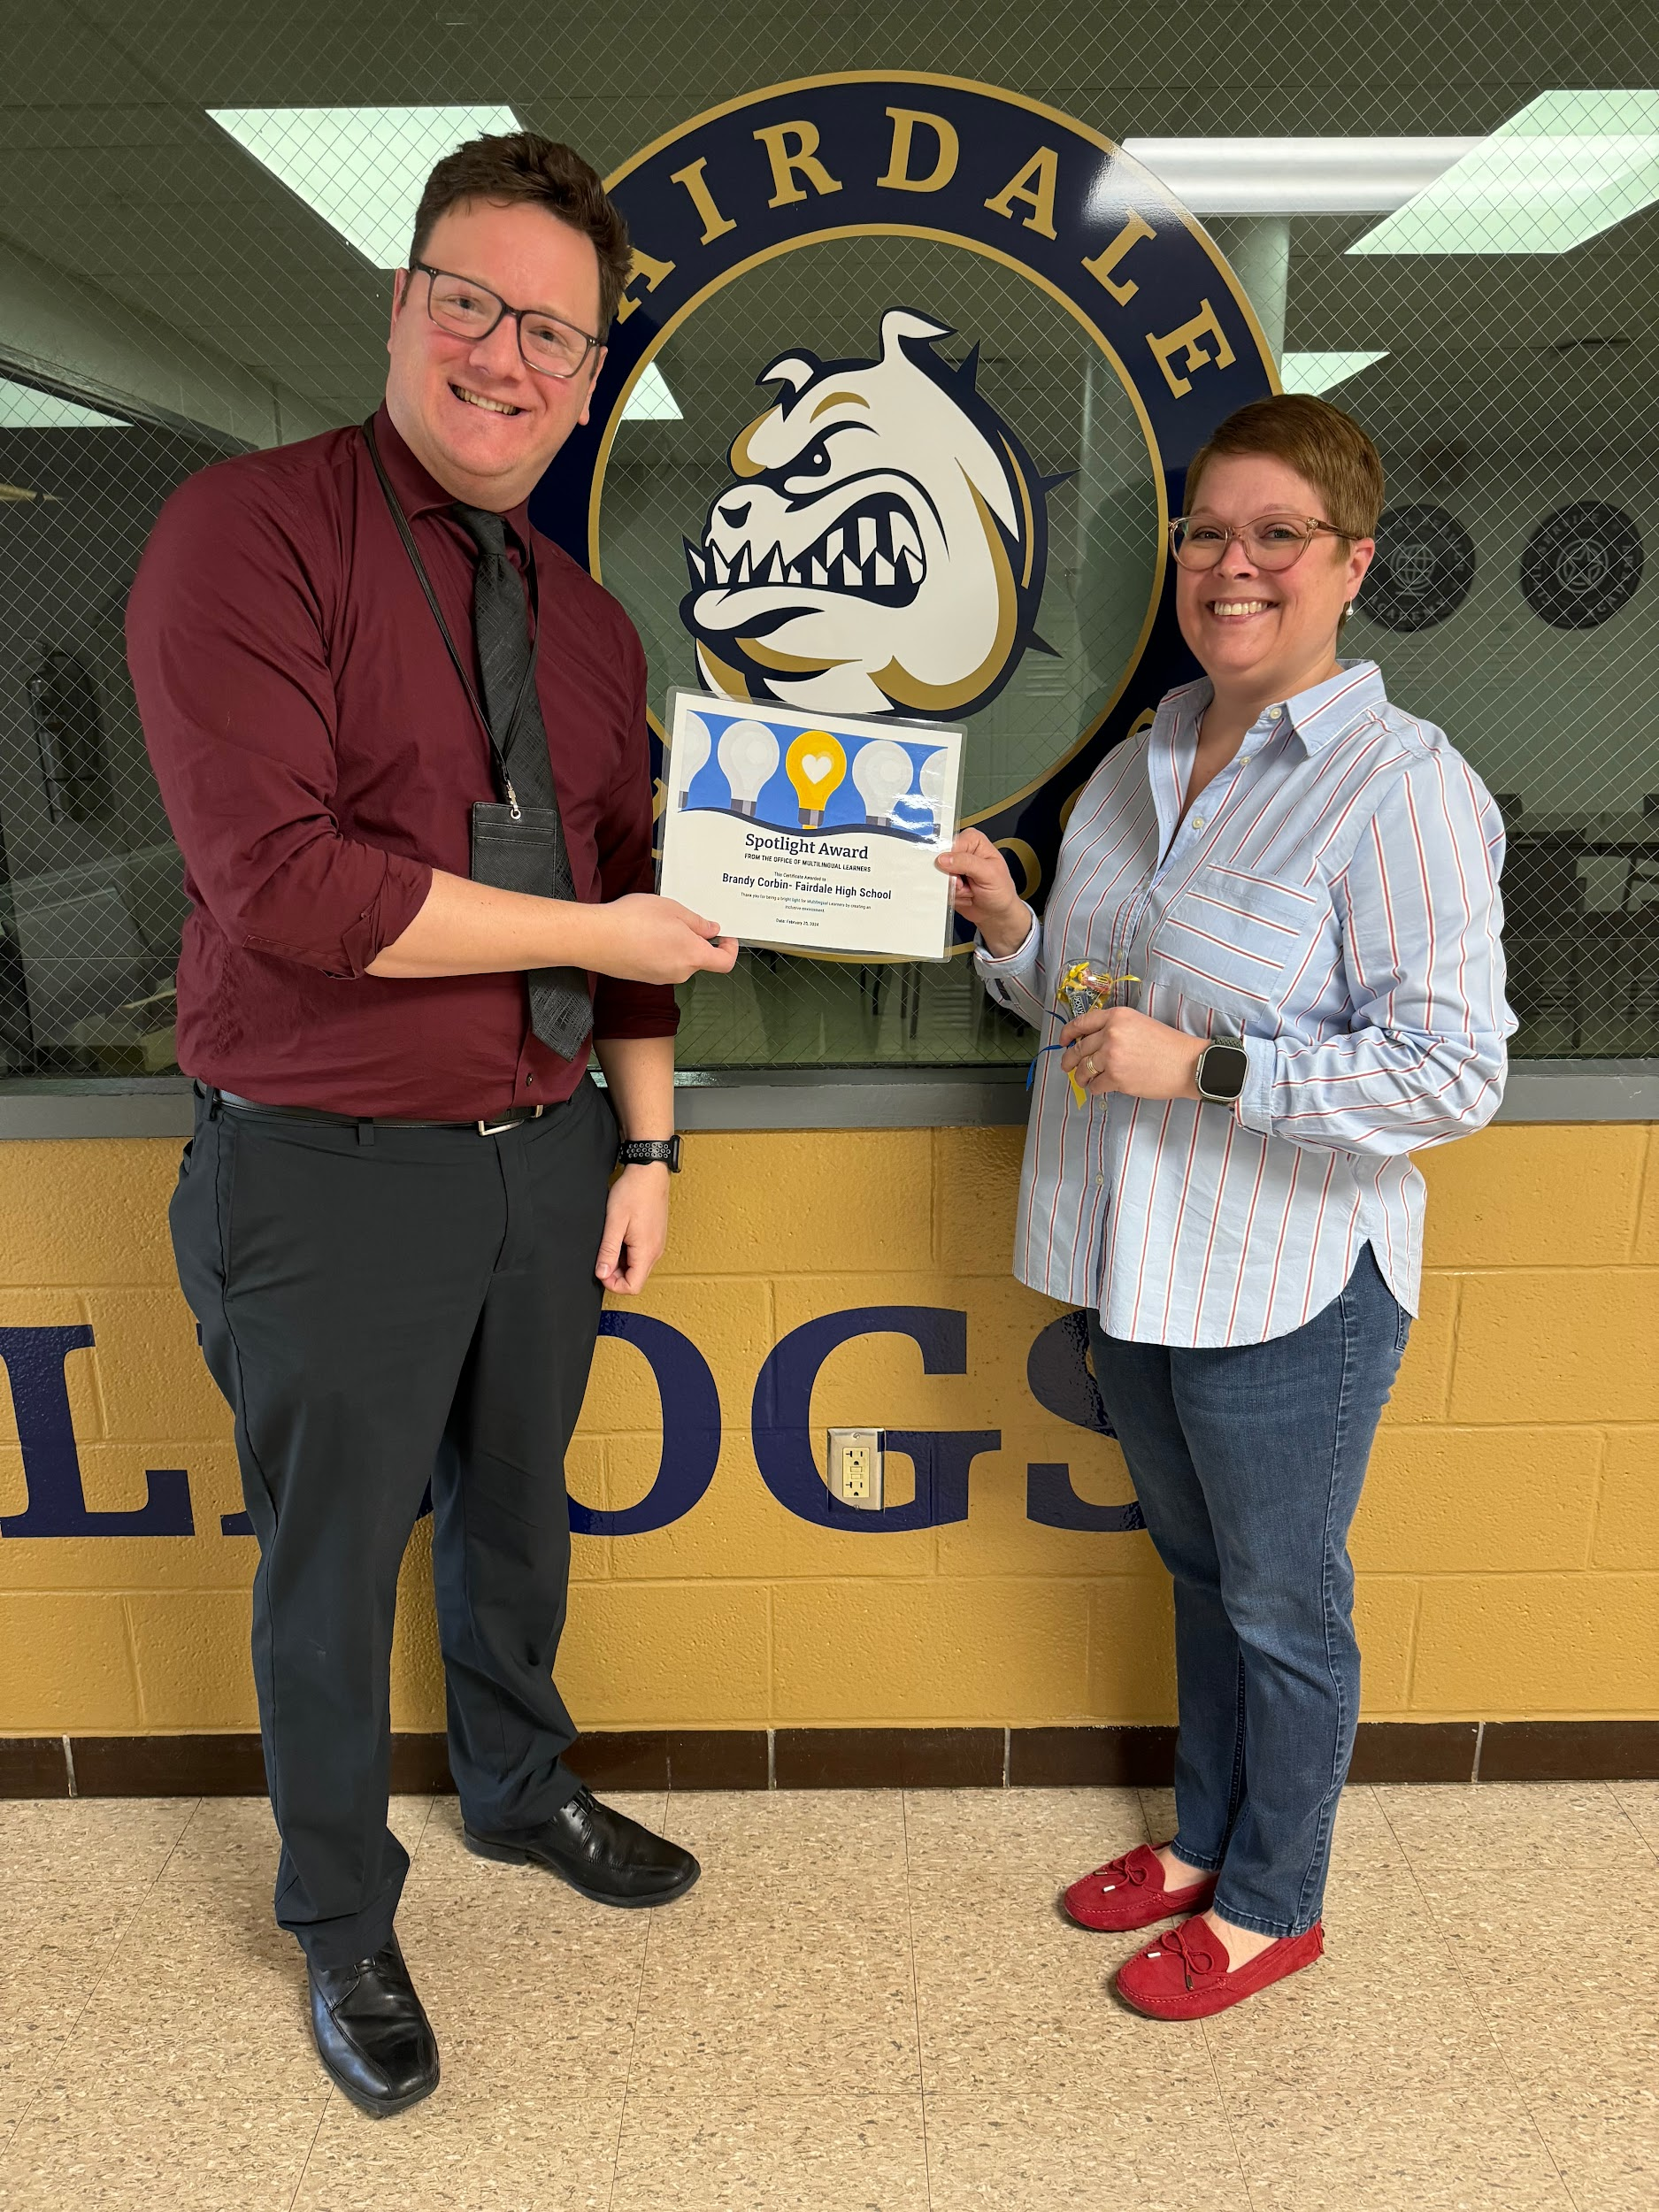
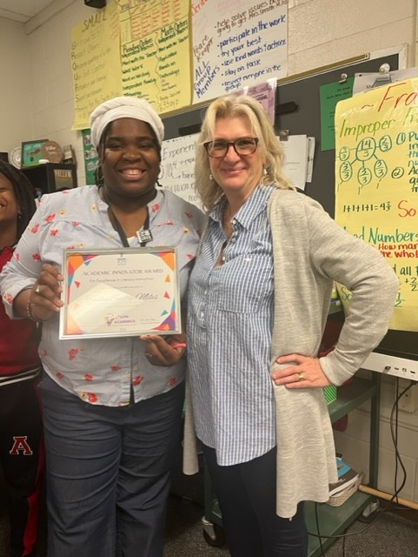
Key Take-Away # 3- CELEBRATE!

Slide 25
Key Take-Away # 4- Be Proactive!

Slide 26
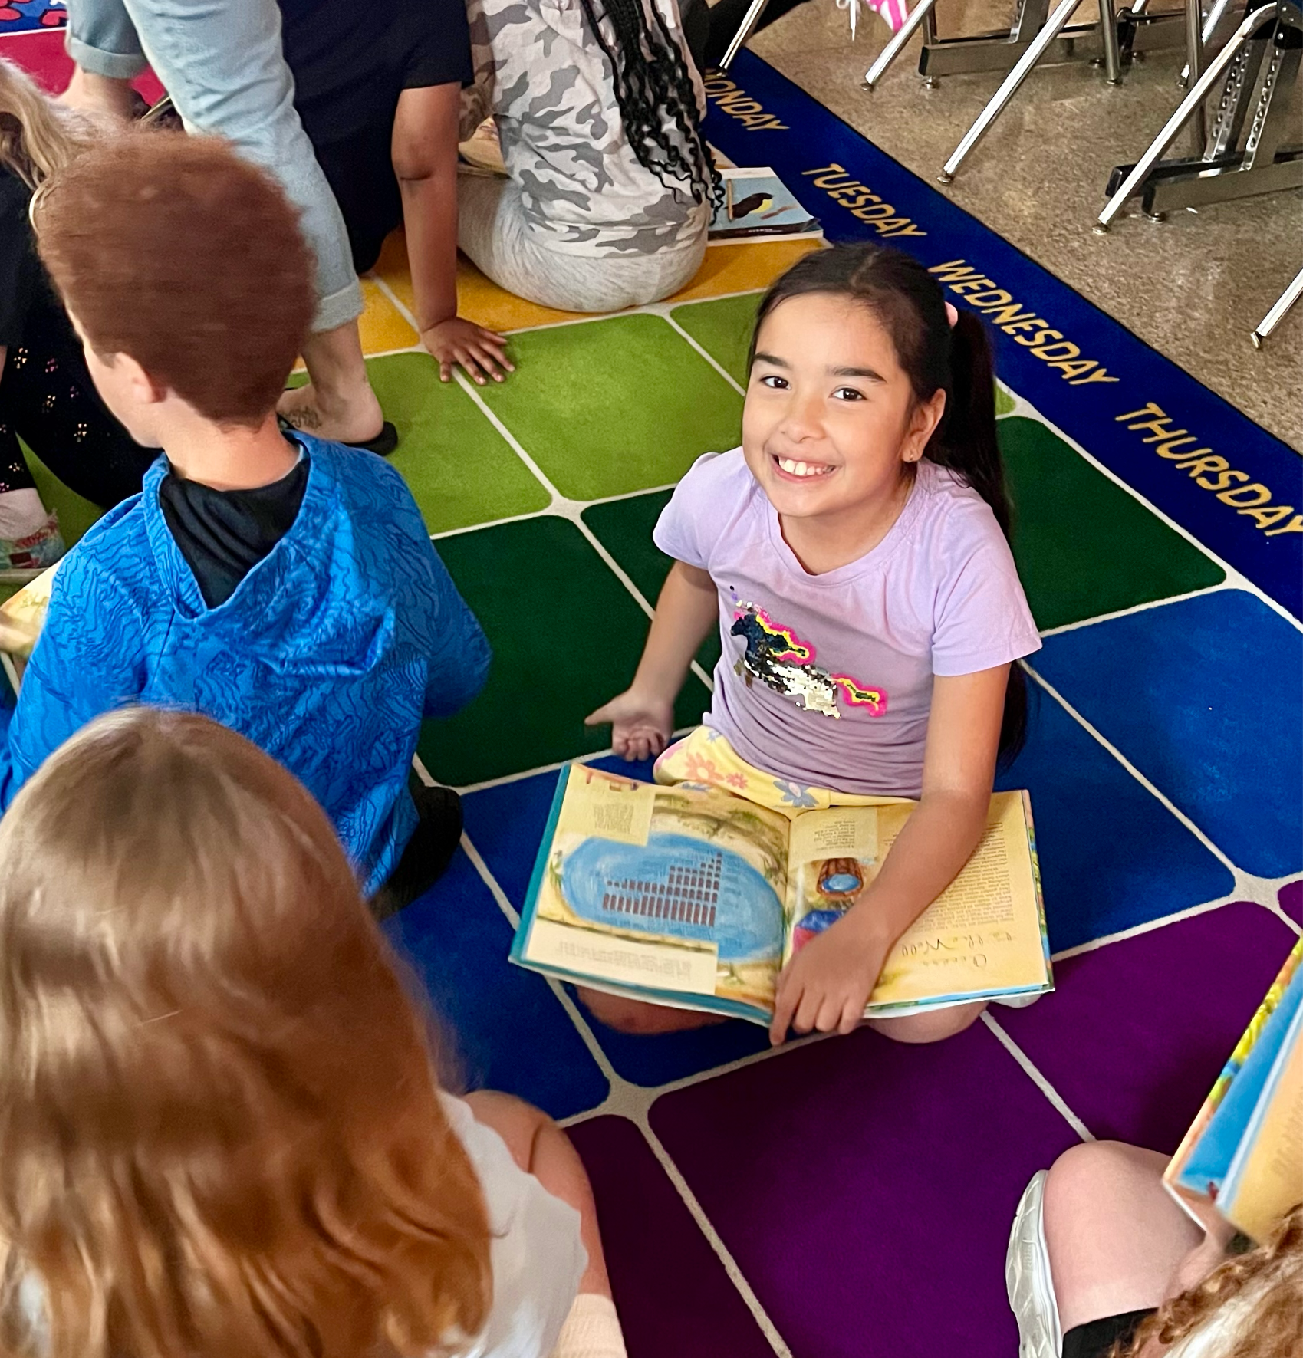
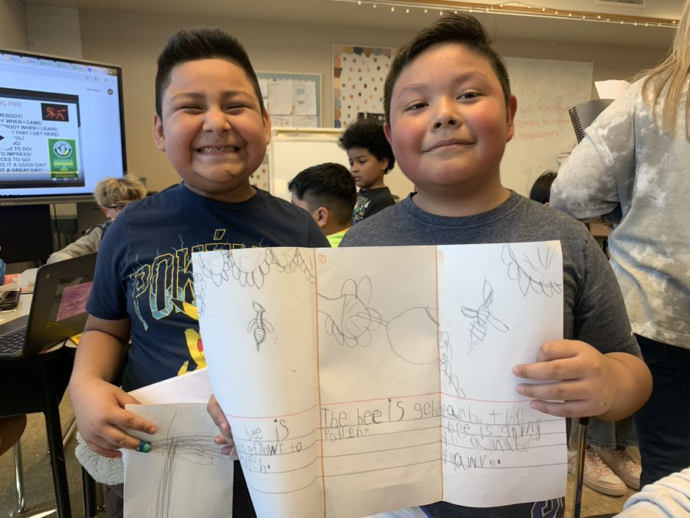
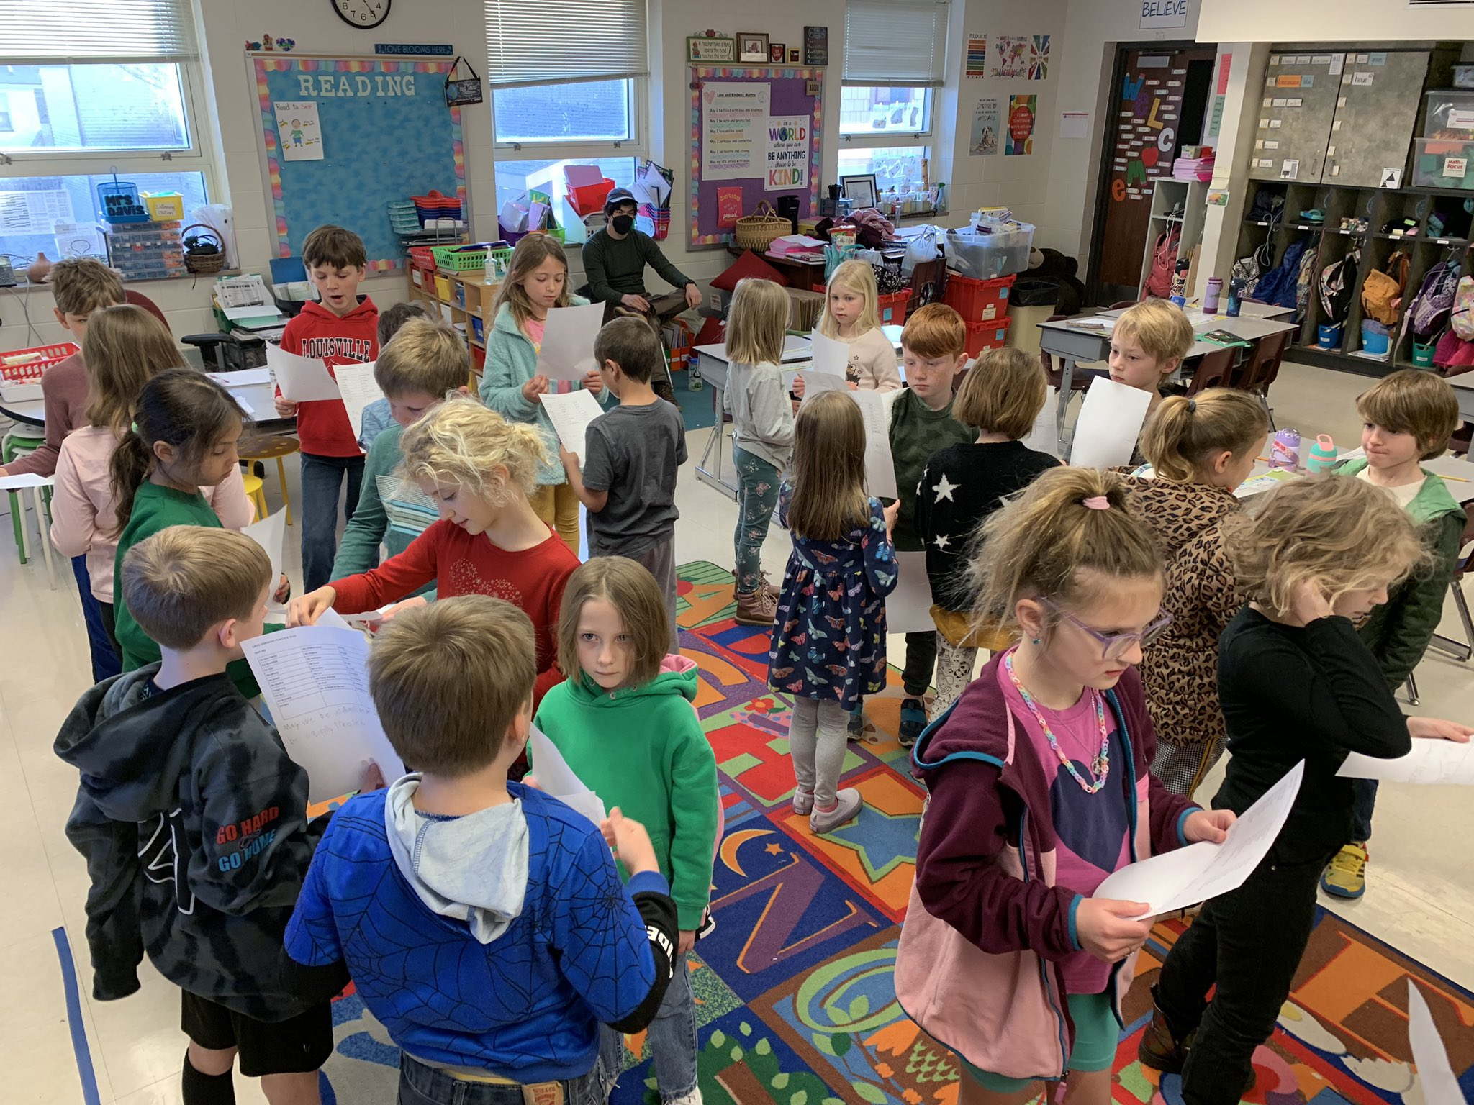
Key Take-Away # 5: Consistency & Momentum are essential!
Students were able to grow understanding and skill through student-to-
student inquiry and discourse.
School leaders ensure implementation data was collected and organized to support reflection and decision- making
Teachers engaged in Professional Learning and using the literacy curriculum as designed in instruction.
INTEGRITY VS Fidelity
District leaders established expectations, structures and procedures for monitoring implementation.
Notes:
Gains? Elementary schools who have used EL saw gains in proficiency rates and declines in novices, with greater improvements in schools using EL for 2 or more years
Elementary schools who have used EL Skills Block for 2 or more years have stronger fluency skills compared to those schools only using for 1 year.

Slide 27
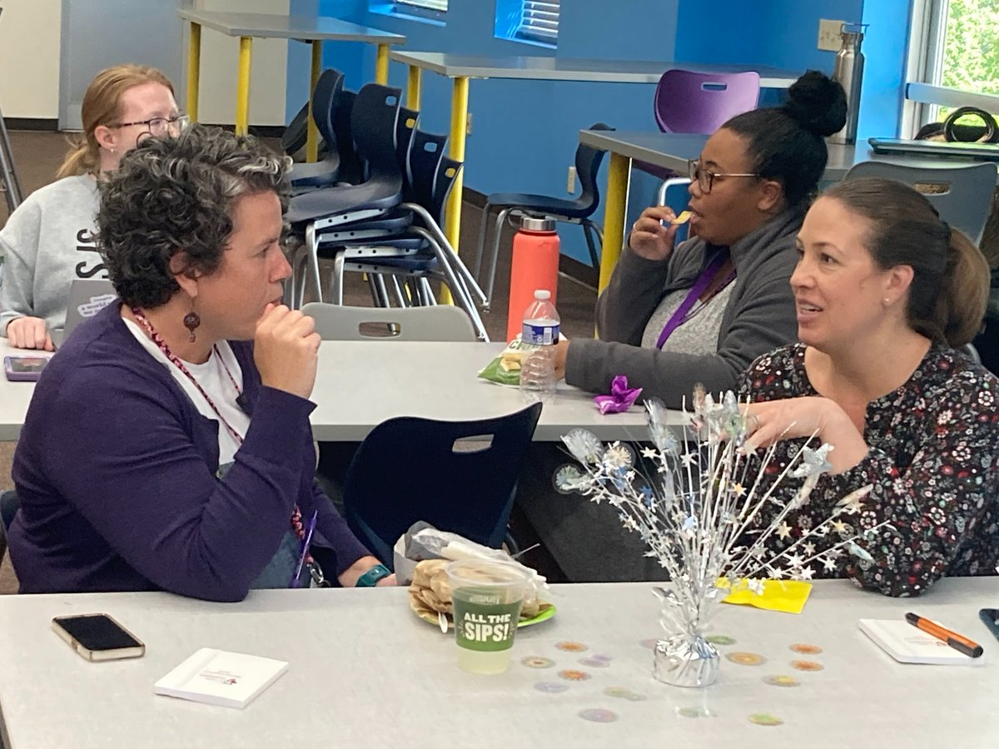
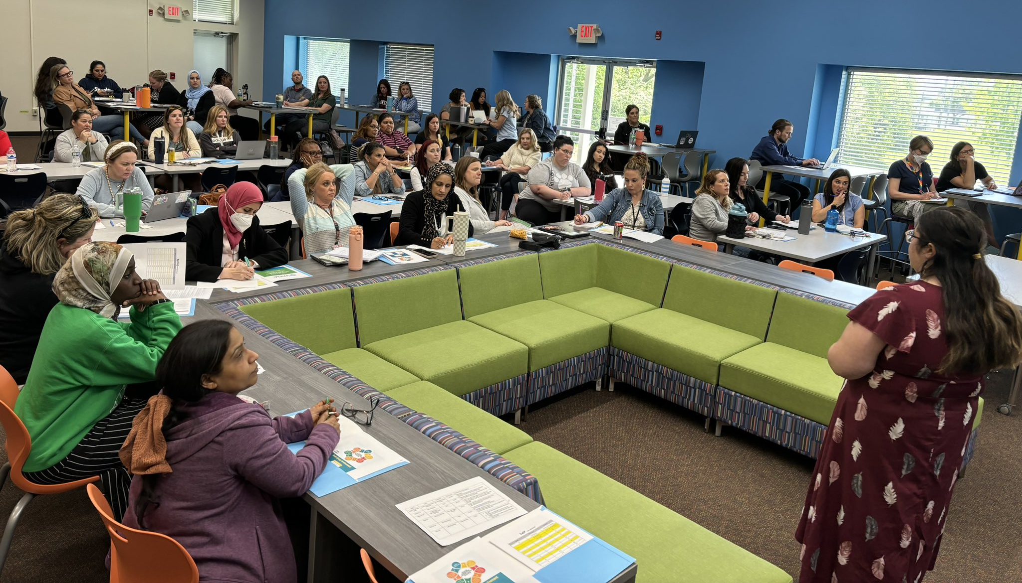
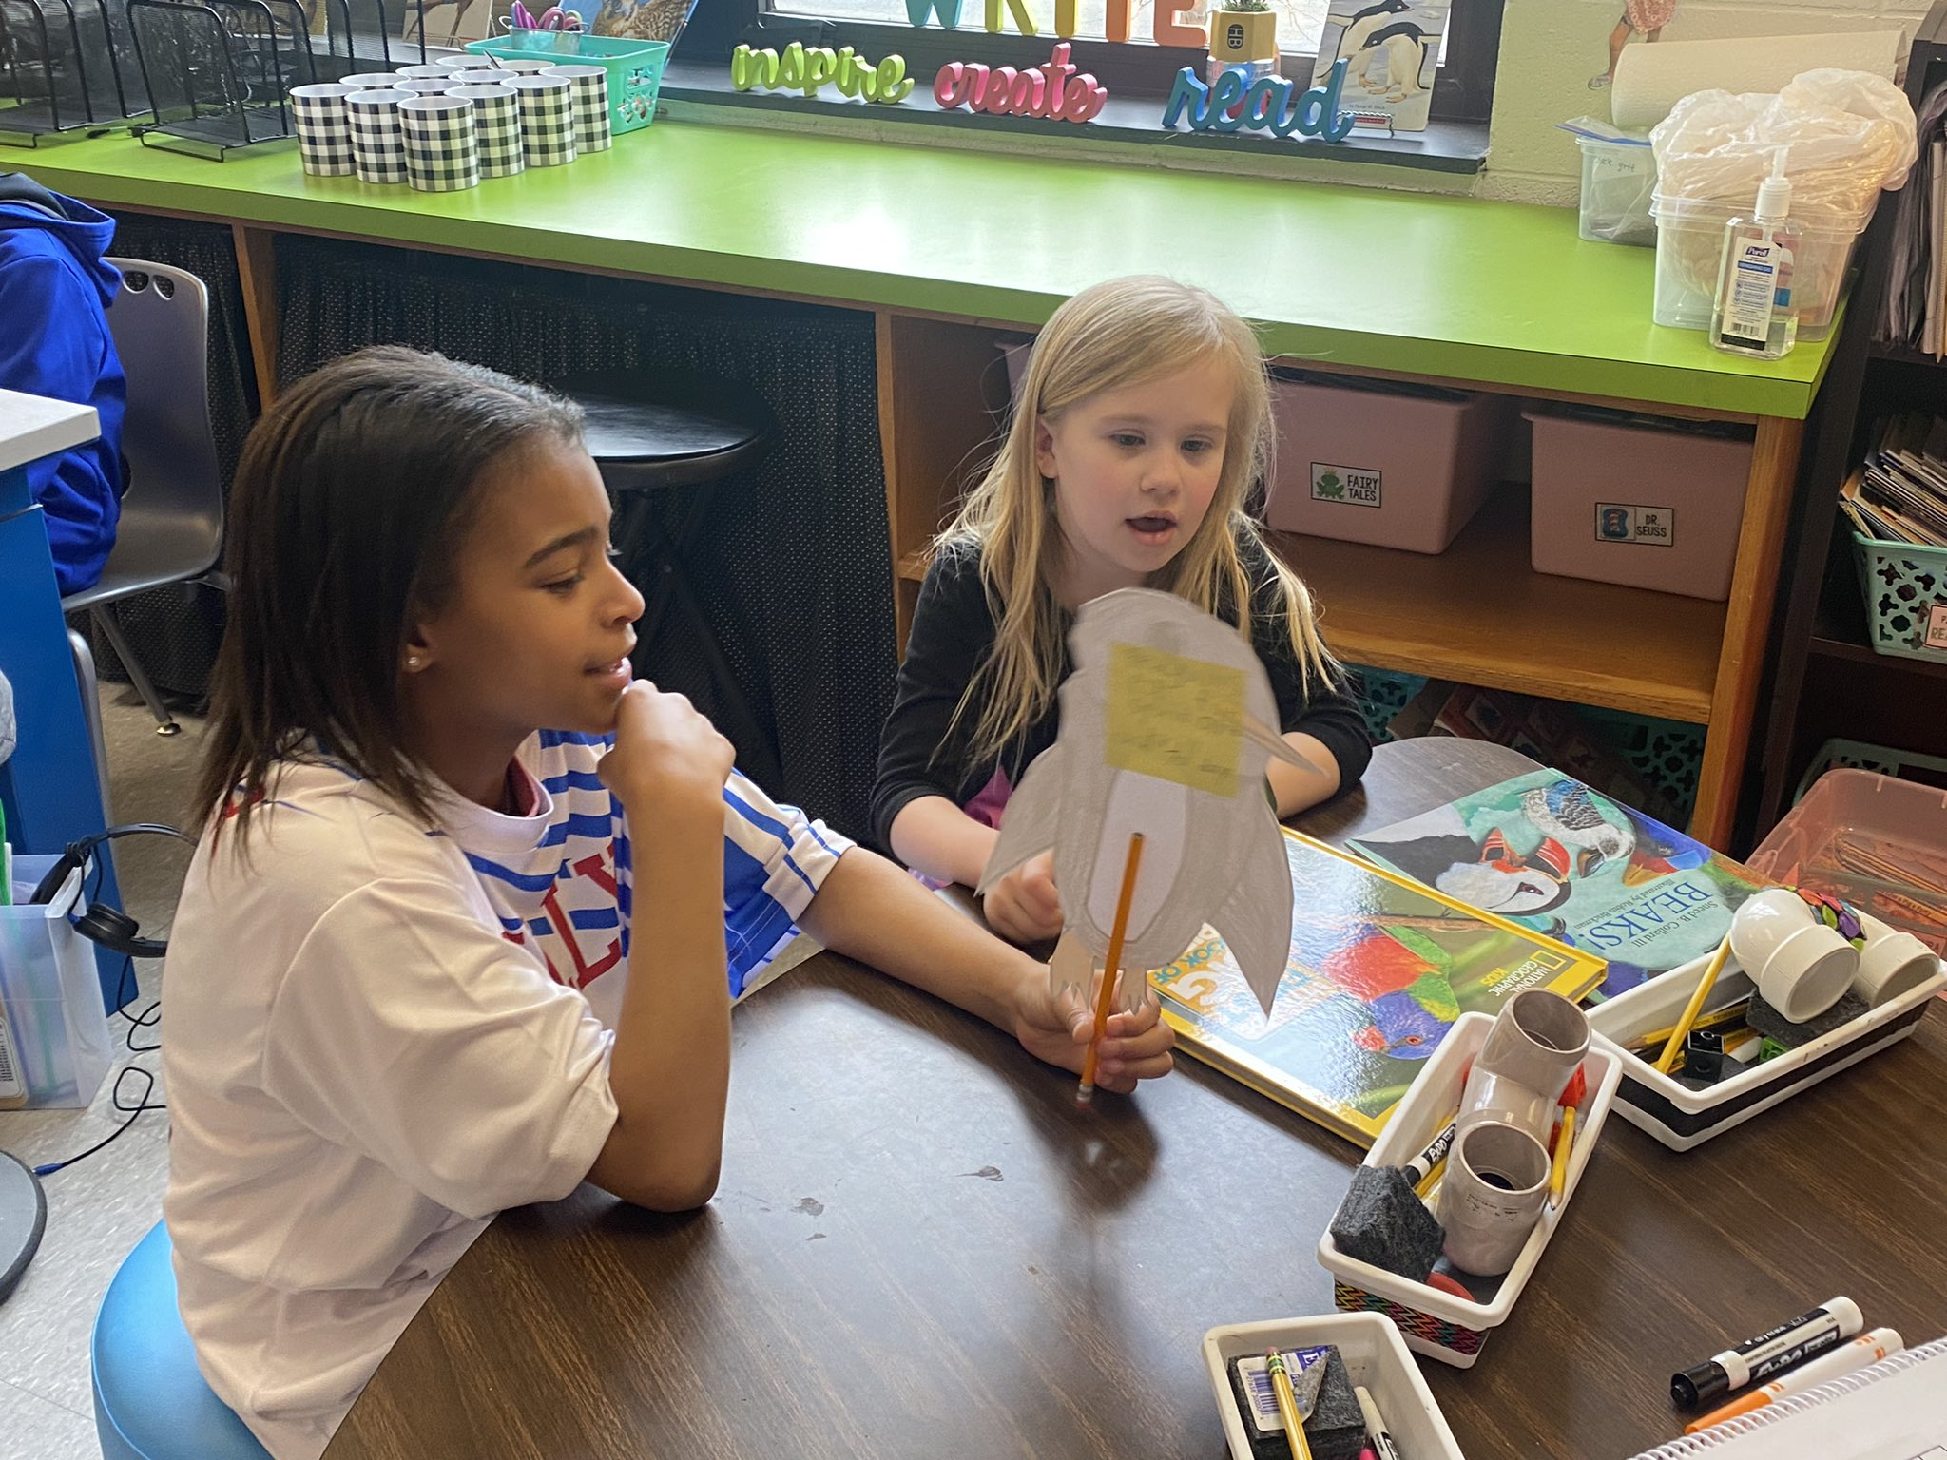
Consistency & Successes Continued
LETRS
Robust Training for ML Supports- Asset Based! Messaging is clear!
Monthly academies for teachers that are conducive to what they are needing to implement our HQIR.
Improved student discourse, writing, and foundational skills!

Slide 28
Next Steps
✅
Evidence of Learning Checks and Academic Innovation
2024 Summer Training for teachers K-5; making intentional instructional decisions for ALL based on data analysis & ML Support!
Focusing on Background knowledge and standards aligned assessments to measure true comprehension.
Journey to Success Work- Valuing success skills and multiple forms of student learning
Creating tight systems for curriculum support to ensure consistent messaging for all stakeholders
Building leaders, Academic Instructional Coaches, teachers and support staff, and

Slide 29
Thank you for for joining us on the Journey to Success!

