Slide 2
DISTRICT EMPLOYEES
18,025 TOTAL EMPLOYEES
12,479
5,546
7,800
10,225
SCHOOL-BASED
NON SCHOOL-BASED
CERTIFIED STAFF
CLASSIFIED STAFF
69%
31%
43%
57%
8,530
1,184
778
406
ADMINISTRATORS
ASSIGNED TO CLASSROOM INSTRUCTION
SCHOOL-BASED ADMINISTRATORS
(Principals, APs/Counselors)
NON-SCHOOL BASED ADMINISTRATORS

Slide 3
TEACHER SALARIES
Rank III
0 Years
Average JCPS Teacher Salary
Rank I
25 Years
Choice Zone/AIS Stipends
$48,038
$76,224
$94,207
$8,000 - $14,000
Tuition Assistance and Praxis Reimbursement for Critical Needs Teachers

Slide 4
COLLECTIVE BARGAINING AGREEMENTS
Teachers, Mental Health Practitioners, Librarians, Occupational Therapists, Physical Therapists, Speech Therapists
JEFFERSON COUNTY TEACHERS ASSOCIATION
Nutrition, Clerical, Instructional Support, Technology (Job Family 1B)
JEFFERSON COUNTY ASSOCIATION OF EDUCATION SUPPORT PERSONNEL
Custodians, Housekeeping, Utility Employees, Plant Operators (Hourly, Job Family 1B)
SERVICE EMPLOYEES INTERNATIONAL UNION
Bus drivers, Mechanics, Service Maintenance, In-School Security Monitors, Information Technology, Special Needs Transportation Assistants
TEAMSTERS LOCAL 783 (Contract updated 7/23/24)

Slide 5
WHAT’S NEGOTIATED
Compensation
Hours, Overtime, Extra Work
Working Conditions
Transfers, Assignment, Selection
Grievances
Employer-Provided Training
Employee Rights, Employee Discipline, Personnel Records
Evaluation

Slide 6
BARGAINED VS. JCPS POLICY
BARGAINED
BOARD POLICY
Compensation
Hours, Overtime, Extra Work
Working Conditions
Transfers, Assignment, Selection
Grievances
Employer Provided Training
Employee Rights, Employee Discipline, Personnel Records
Evaluation
Powers and Duties
Administration
Personnel
Fiscal Management
School Facilities
Transportation
Support Services
Curriculum & Instruction
Student Procedures
Community Relations
Employee Negotiations

Slide 7
EMPLOYEE RAISES
Cost of Living Allowance increases are negotiated through JCTA. All other groups benefit from the increase.
2017-2018
2018-2019
2019-2020
2020-2021 & 2021-2022
(Grade 8+ Admins excluded)
(Grade 8+ Admins excluded)
1.5%
0.5%
0.5%
0%
2022-2023
2023-2024
2024-2025
2025-2026
4%
5%
2%
3%

Slide 8
2024-2025 MOAs: Kentucky Department of Education (KDE)
29 employees to KDE
Six have been with KDE since pre-pandemic
Five moving to KDE new for the 24-25 school year
Five went to KDE last year as Literacy Coaching Specialists
18 of the 29 are Education Recovery Specialists/ER Leaders
24 had their last position in a school
Nine had their last position as teacher (plus three resource teachers)
Seven Academic Instructional Coaches
Five Assistant Principals

Slide 9
CONTRACTS: LEGAL
Wyatt, Tarrant & Combs
Property Acquisition, HR, Overflow Work
U’Sellis Mayer & Associates
Workers Compensation
McBrayer, McGinnis, Leslie & Kirkland
Special Education
Tachau Meeks
Specific Litigation

Slide 10
CONTRACTS: FINANCIAL
Dean Dorton
Financial Auditing Services (CAFR, School Activity Funds, Federal Grants
Fifth Third, Republic Bank, Truist
General Banking Services
Armanino & LMBC
Internal Audit Services
MUNIS
Statewide School Accounting Software

Slide 11
CONTRACTS: STAFFING
CUSTODIANS:
64 from 7 vendors
NURSING ASSISTANTS:
30
NURSES:
120
BUS DRIVERS VIA TARC
FRONTLINE (not staffing, but helps with HR):
HR Applications
Time and Attendance

Slide 12
CONTRACTS: EDUCATIONAL PARTNERS
YMCA:
CEP Services
UNIVERSITY INSTRUCTORS:
Early Childhood
EVOLVE 502:
Backpack League
NURSES:
120

Slide 13
CONTRACTS: ACADEMIC
EL Education
Professional learning for school administrators & teachers on Literacy best practices
Illustrative Math
Professional learning for school administrators & teachers on Mathematics best practices
Otus
Data hub for schools and district leaders to measure student growth aligned to Math & Literacy academic standards, as well as JCPS Journey to Success
NWEA, Capti, Cert
Grade-level specific assessment platforms to measure student growth in Literacy, including foundational reading skills in grades K-12
Imagine Learning & Kiddom
Digital access to Literacy & Math curriculum including digital math fluency practice, foundational literacy small-group resources, & performance tasks
Language Line Solutions
Interpretation services for schools to communicate with Multilingual families through voice, video, and virtual appointments
Edmentum
Includes academic intervention programs as well as credit recovery Courseware. Provides KY certified teachers to specialized courses for schools with staffing shortages
ThinkCERCA & The DBQ Project
Curriculum and professional learning for Writing through the Curriculum and Civics education

Slide 14
ACADEMIC CONTRACTS
Equity of access to curriculum materials, professional learning and academic intervention tools through volume-discounted pricing, resulting in up to 70% savings per student
Centralized and effective management of partner relationships at the district level ensures consistent and clear communication to all schools for implementation of resources
Systems for vetting vendors, including curriculum providers and training companies, ensure we are aligned to KDE’s guidance for High-Quality Instructional Resources and research-based practices
Partnerships are collaborative with Academic Specialists to align our Instructional Vision with product delivery and usage- intentional implementation with a laser focus on student growth and learning

Slide 15
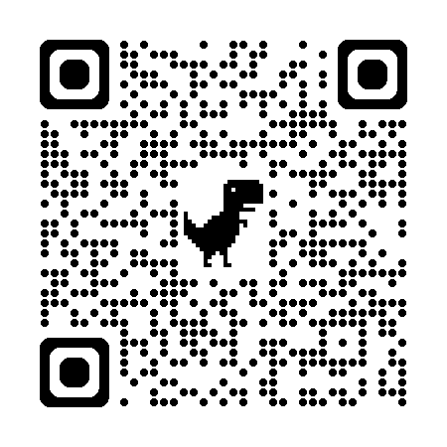
SCHOOL ALLOCATIONS
Regulatory Formula (702 KAR 3:246)
Certified
Classified
Operational
District Add-On Funding
Future State
AIS/Choice Zone
Academic Support
Student Athletics & Activities
Career/Technical Education
Attendance Support
Student Support
FRYSCs
Counseling Services
Multilingual Learners
ECE

Slide 16
PREVIOUS AUDITS AND REVIEWS
There is no reason to believe that the district’s very experienced and committed staff will not rise to the occasion if appropriately led by the school board and superintendent. The Council of the Great City Schools emerged from the review very optimistic about the district’s future and stands at the ready to help going forward. Council of Great City Schools - 2018
With the advent of new leadership and initiatives (often characterized as “north stars”) that promote collaboration coupled with innovation, a Culture of Hope and Promise are emerging. Cognia Accreditation 2019
a pattern of significant lack of efficiency and effectiveness in the governance and administration of JCPS does not exist and no further action towards JCPS, should be taken pursuant to KRS 158.785. KDE Management Audit 2020
There is evidence that the district leads and operates under a governance and leadership style that promotes and supports student performance and system effectiveness. The Board operates responsibly and ethically and engages in predominantly data-driven policy decisions. KDE Diagnostic Review 2022
It's the closest planet to the Sun
Free

Slide 17
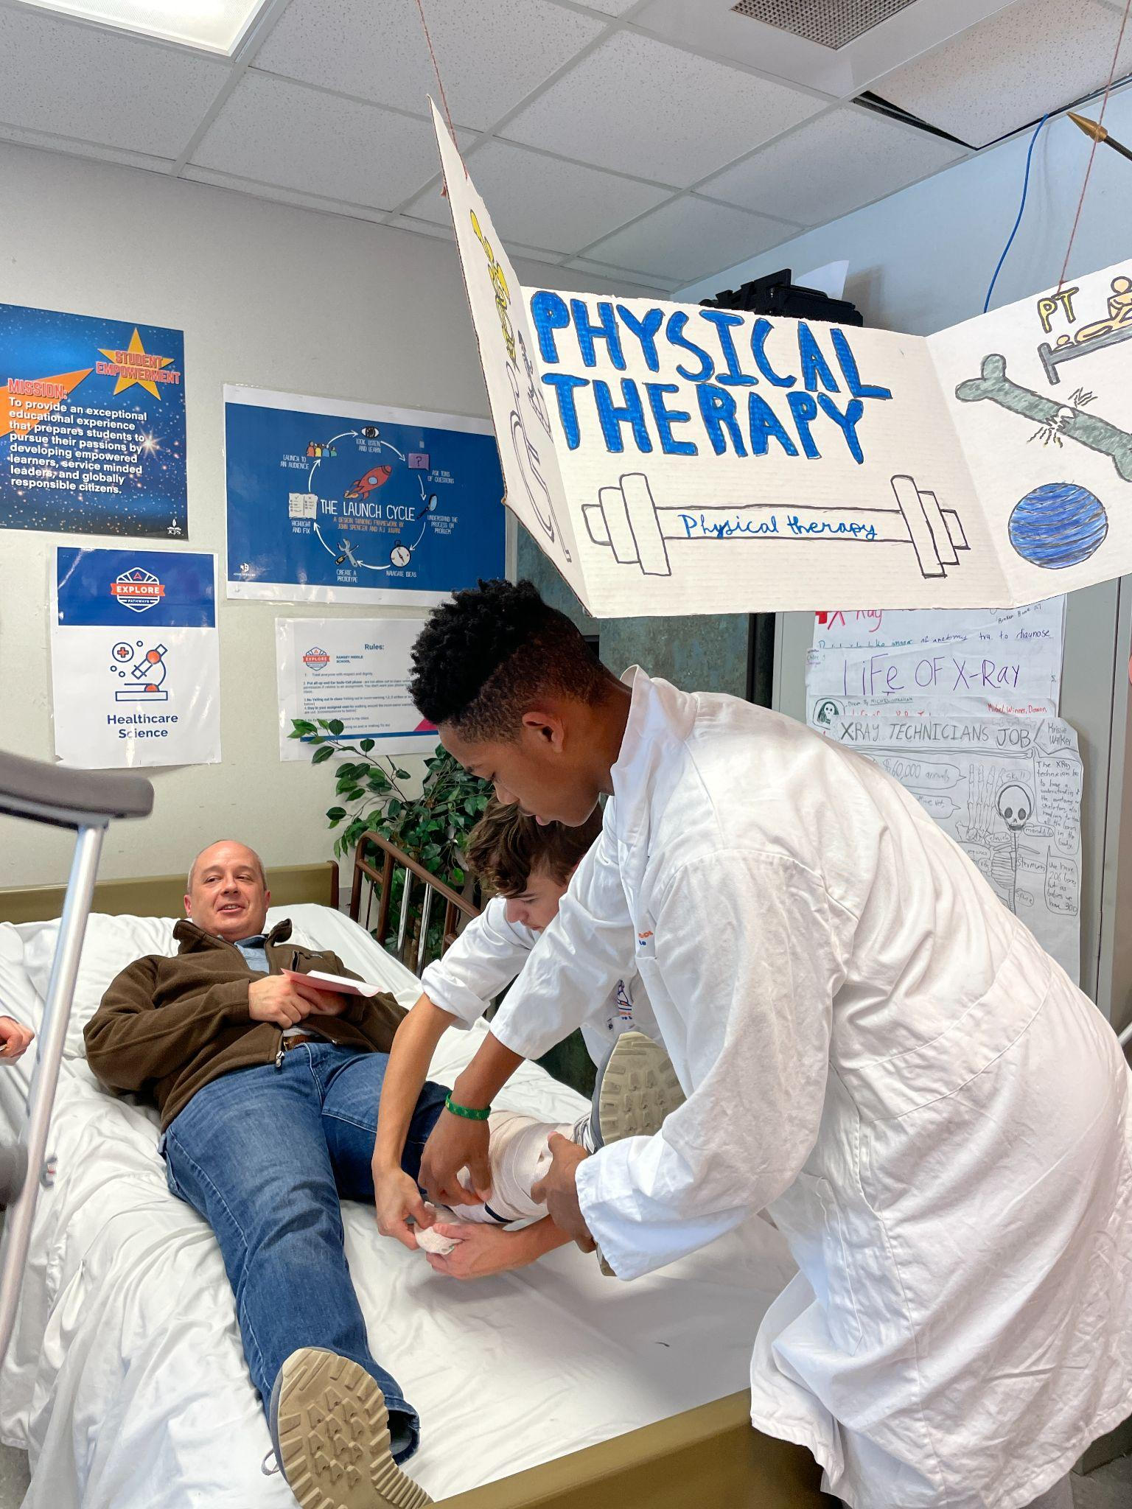
QUESTIONS?

