Slide 1
Workforce Challenges and Solutions in Kentucky
Dr. Charles Aull, Executive Director,
Kentucky Chamber Center for Policy and Research
Dub Newell, CEO, Louisville Tile Distributors, Inc.

Slide 2
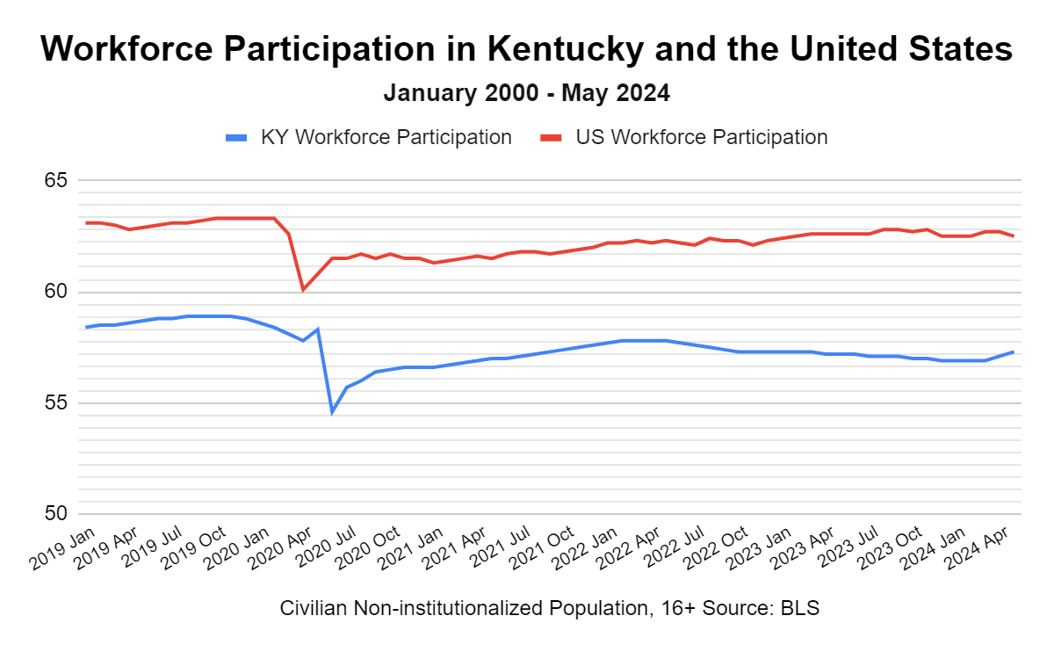
57.3 in May 2024
1.3 points lower than January 2020 (58.6)
5.2 points lower than U.S. rate in May (62.5)
Some signs of a soft rebound in 2024

Slide 3
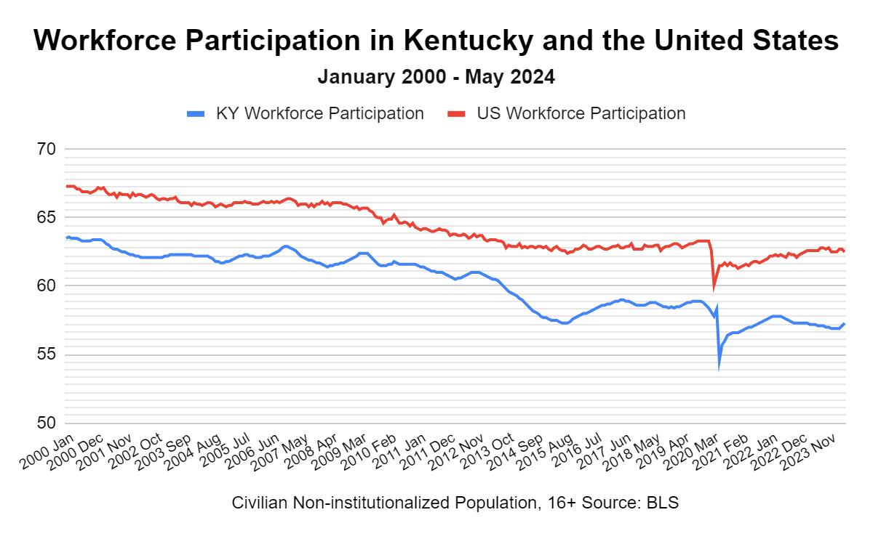
WFP has been declining in KY and the US since 2000
Jan. 2000: 63.5
May 2024: 57.3

Slide 4
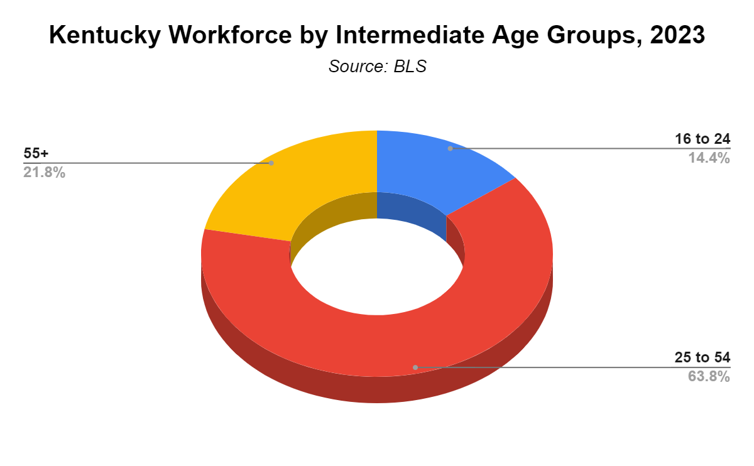
An aging population and retirements have been primary drivers of falling workforce participation in Kentucky and the nation since 2000 – but do not fully explain the problem.

Slide 5
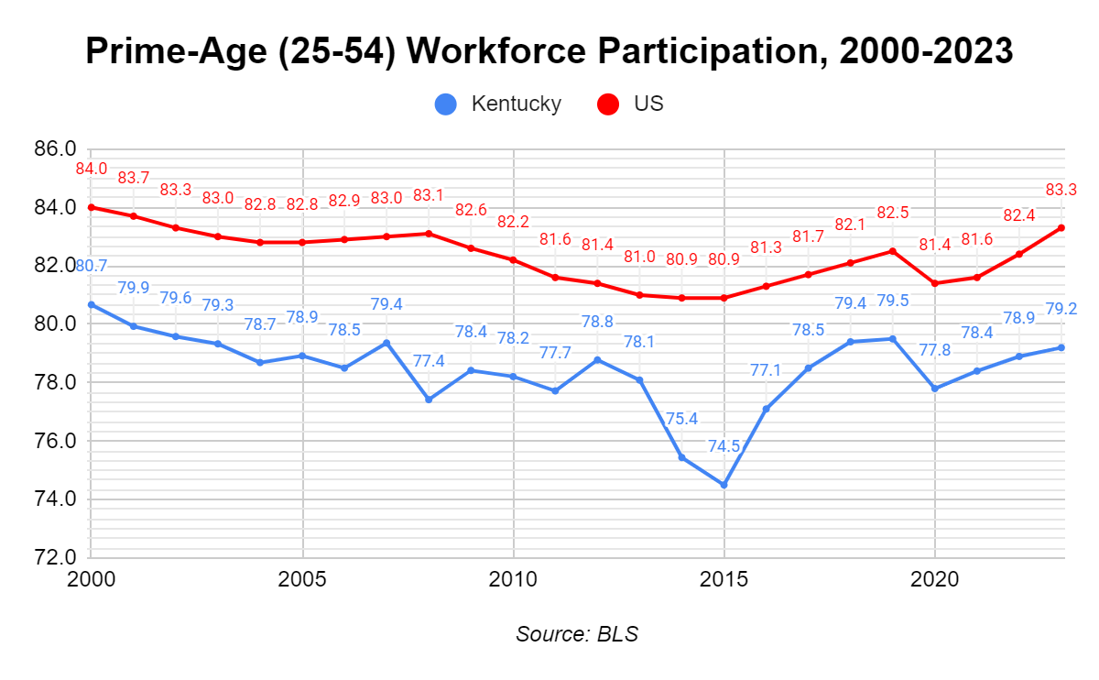
Kentucky prime-age WFP was 1.5 points lower in 2023 than in 2000.
Kentucky prime-age WFP has been slower to recover from the pandemic than national WFP.
Kentucky prime-age WFP has averaged 3.8 points lower than the nation (2000-2023).

Slide 6
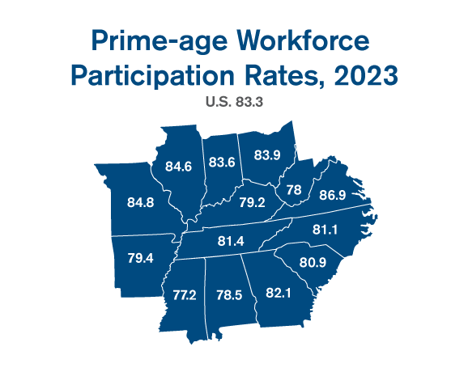
Kentucky prime-age WFP is the 4th lowest among regional states
Kentucky prime-age WFP is the 6th lowest in the nation

Slide 7
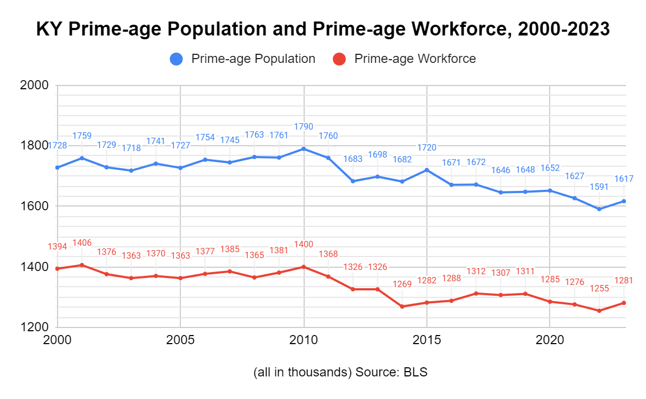
Kentucky’s prime-age population has decreased by 111K (-6.4%)
Kentucky’s prime-age workforce has decreased by 113K (-8.1%)

Slide 8
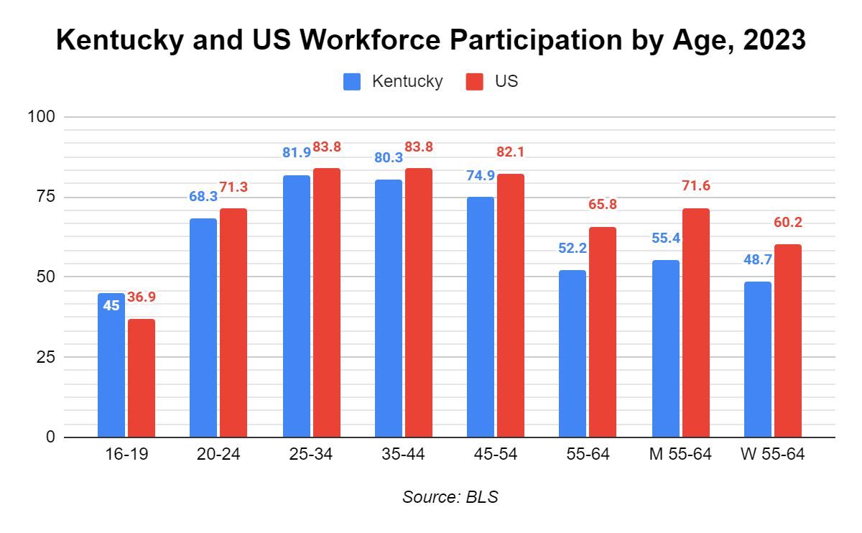
Kentucky WFP trails national averages across all age groups 20+
Biggest gap is among 55-64 yr olds
13.6 pts 16.2 pts 11.5 pts

Slide 9
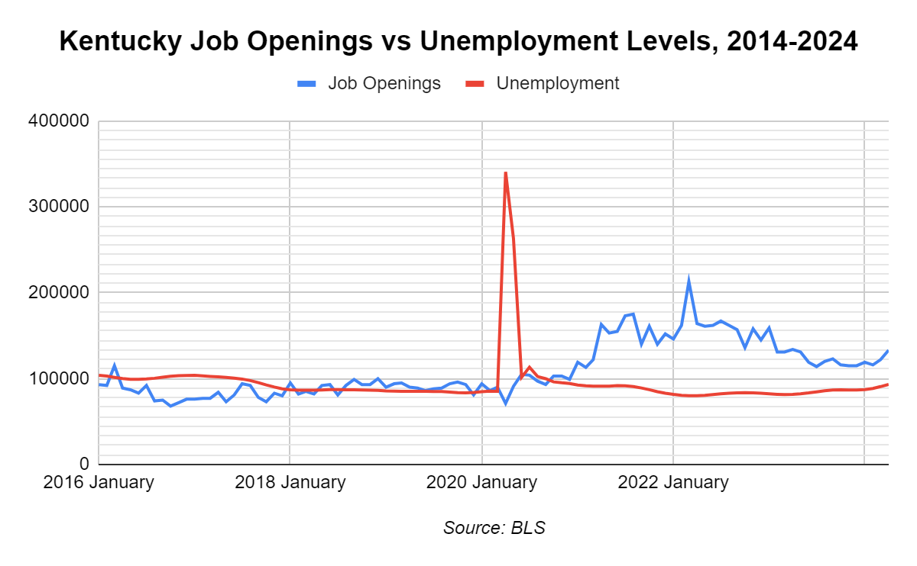
Hiring remains very difficult in Kentucky
2022 averaged 2 open jobs per unemployed worker.
2023 averaged 1.5 open jobs per unemployed worker.
This does not account for worker training and qualifications

Slide 10
Employer Perspective
Dub Newell, CEO, Louisville Tile Distributors, Inc.

Slide 11
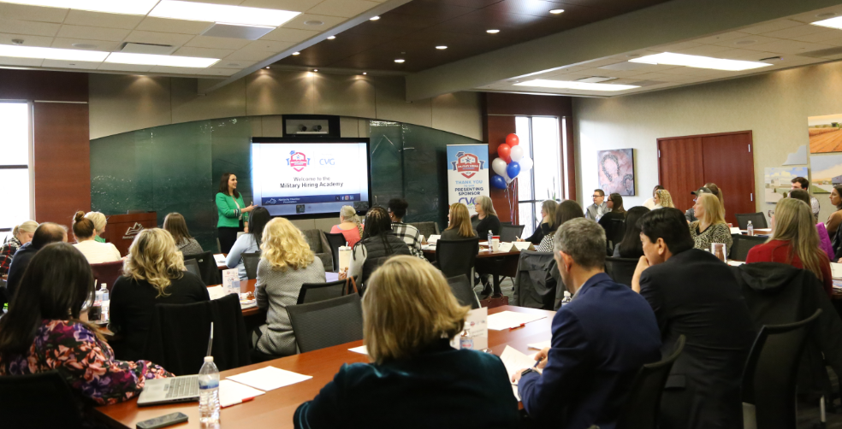
Private Sector Initiatives: Kentucky Chamber Foundation
Workforce Recovery Program
Fair Chance Academy
Bus to Business®
KHA Hospital TPM® Initiative
Military Hiring Academy
New American Hiring Academy
Disability Hiring Academy
Educator’s Guide to Industry
Rising Leaders Program

Slide 12
The Role of State Policymakers: Two-Fold Strategy
Optimize our current workforce to help bring KY WFP into alignment with the nation
Remove barriers for would-be workers on the sidelines
Ensure a highly-trained and qualified in-state workforce
Attract skilled prime-age workers to reverse current trends
Attract workers from other states
Attract a strong share of incoming international talent
Six specific examples for state lawmakers

Slide 13
Optimize Our Current Workforce with Training and Removing Barriers
Increase access to child care
Maintain a strong subsidy program for low-income working families (HB6)
Innovations in Early Childhood Education Delivery Grant Program (HB6)
Public-private grant programs to increase child care capacity (esp. home-based care)
Help low-level non-violent offenders find employment
HB569/SB218 (Bratcher/Storm) – automatic expungement processes
HB124 (Callaway) – reduce barriers to public employment and occupational licensure
Gather more data on employment outcomes of non-violent offenders post-sentence
Support the 60x30 initiative
Fund and strengthen the Work Ready Kentucky Scholarship
Emphasize populations with high unemployment

Slide 14
Attract Skilled Prime-Age Workers
Create a favorable tax climate
Continue reducing income taxes
Keep other taxes competitive
Ensure a strong housing market
Incentivize local planning and zoning reform
Residential infrastructure investment
Incentivize workforce housing development
Enhance quality of life
Amenities and recreation
Indiana’s READI program

Slide 15
Dr. Charles Aull, Executive Director caull@kychamber.com

