Slide 1
An Unfilled workforce Potential
Attracting more of the military/veteran/family population
Presented to the Special Committee
Workforce Attraction & Retention Task Force
September 12, 2024
Taylor Hayes- President
Christian County Chamber of Commerce
Derek Poor – Veteran Transition Liaison, West KY Workforce Board
Shannon Lane – Director of Military Affairs, Christian County Chamber

Slide 2
The military/veteran/family population provides an unfilled potential benefiting Kentucky’s …
Workforce
Population Growth and
Overall Economic Growth

Slide 3
Kentucky’s Defense Community Impact is sizeable
$13.9 Billion Total Impact
$10.6 Billion in DOD grants/contract spending
56,290 jobs connected to the military
$1.75 Billion in annual veteran’s compensation and pensions
270,000 Veterans / 29,000 Military Retirees

Slide 4
But … there is Untapped potential for growth ...
200,000 transition out of the military per year in the US.
8,000 transition out of service within KY
4,500+ transition out just from Fort Campbell
Fort Campbell boast the highest retention rate transitioning out wanting to stay in the area = 38%
24% choose KY / 76% choose TN
Notes:
military often experience a profound sense of purpose and belonging
they often seek employers that provide a similar sense of fulfillment and camaraderie. Once they have found an employer that aligns with their values and provides a supportive work environment, they are committed to staying with that employer for the long term
“Companies investing in mentorship programs and professional development opportunities for veterans will likely witness improved employee retention as veterans find a sense of belonging and growth within the organization.”
military spouses can also embody a similar level of dedication to their employers

Slide 5
Why should Kentucky focus more intention on attracting this population?
Transitioning service members bring robust and translatable job skills to the civilian workforce. They are mechanically inclined, team-oriented, have a good work ethic, and are highly skilled in multiple trades.
Different skill/experience levels transitioning out. Can’t look at everyone the same.
○ Young, careered, and special operations

Slide 6
To attract and retain more
from this population how does Kentucky be more competitive and move from being
Military/Veteran FRIENDLY to Military/Veteran READY?

Slide 7
How does Kentucky Become more attractive?
Reaching 0% income tax level is the primary key factor.
Allow 100% exemption on pension pay NOW vs. waiting
KY is one of only 11 states that tax some or all military pensions
Continue to create Interstate occupational licensure compacts
9 of 16 are already in place in KY
Continue to address the supply of quality Childcare
Childcare is the #1 barrier to spouse employment
Kentucky one of the first states receiving federal approval allowing DOD to up to $1500 per month
Review statutes involving property taxes on veterans
Notes:
military often experience a profound sense of purpose and belonging
they often seek employers that provide a similar sense of fulfillment and camaraderie. Once they have found an employer that aligns with their values and provides a supportive work environment, they are committed to staying with that employer for the long term
“Companies investing in mentorship programs and professional development opportunities for veterans will likely witness improved employee retention as veterans find a sense of belonging and growth within the organization.”
military spouses can also embody a similar level of dedication to their employers

Slide 8
How does Kentucky become more attractive?
The state and employers must become more focused, intentional and engaged in attracting this population.
Importance for employers to better understand the population, the transition process and values of hiring veterans and family members. (Example: Kentucky Chamber Military Hiring Academy)
Notes:
military often experience a profound sense of purpose and belonging
they often seek employers that provide a similar sense of fulfillment and camaraderie. Once they have found an employer that aligns with their values and provides a supportive work environment, they are committed to staying with that employer for the long term
“Companies investing in mentorship programs and professional development opportunities for veterans will likely witness improved employee retention as veterans find a sense of belonging and growth within the organization.”
military spouses can also embody a similar level of dedication to their employers

Slide 9
Service members are handed a large amount of responsibility, often at a very young age, and they quickly learn to succeed with that significant burden on their shoulders. As civilians, they will excel when given responsibility and guidelines for work accomplishment.
“Match a veteran to civilian work that they find inspirational and their contribution to your business can be limitless.”

Slide 10
Connect with us.
Taylor Hayes
President – Christian County Chamber
thayes@christiancountychamber.com
Shannon Lane
Director Military Affairs
Christian County Chamber
slane@christiancountychamber.com
Derek Poor
Veteran Transition Liaison
West Kentucky Workforce Board
Derek.poor@ky.com

Slide 11
Additional information and resources in the following slides

Slide 12
Resources for hiring veterans
KY Career Center Veteran Services link: https://kcc.ky.gov/veterans/Pages/default.aspx
KCC / DOL Military Spouse link: https://www.dol.gov/agencies/vets/veterans/military-spouses (Leads to this link: https://www.dol.gov/agencies/vets which leads to this link: https://www.dol.gov/agencies/vets/veterans/military-spouses -- information about licensure).
SHRM Veteran Hiring Factsheet: https://www.shrm.org/content/dam/en/shrm/foundation/inclusion-captains-veterans-vaw-overview-factsheet.pdf
Institute for Veterans and Military Families published a brief https://ivmf.syracuse.edu/wp-content/uploads/2016/06/The-Business-Case-for-Hiring-a-VeteranACC_2.21.18.pdf
Employer Guide to Hiring Veterans https://www.dol.gov/sites/dolgov/files/VETS/files/Employer-Guide-to-Hiring-Veterans2022.pdf
Blue Star Families – Military Family Life Survey https://bluestarfam.org/research/mfls-survey-release-2023/#reports
Kentucky Valor Program - https://kyvalor.com/
DOD Transition Assistance Program - https://www.dodtap.mil/dodtap/app/home

Slide 13
Interstate Licensure Compacts already passed that helps Military Spouse Employment and Economic Opportunities
Kentucky is a member of nine of the 16 current DOD Priority Compacts
Audiology/Speech-Language Pathology Interstate Compact
Cosmetology Licensure Compact
Interstate Teacher Mobility Compact
Licensed Professional Counseling Compact
Nurse Licensure Compact
Occupational Therapy Licensure Compact
Physical Therapy Licensure Compact
Psychology Interjurisdictional Compact
Social Work Licensure Compact
These are the following DOD Priority Interstate Compacts that need to be passed in Kentucky:
Advanced Practice Registered Nurse Compact
Dental and Dental Hygienist Compact
Dietitian Licensure Compact
Emergency Medical Services Licensure Compact
Interstate Massage Therapy Compact
Physician Associates Compact
Interstate Compact for School Psychologists
Notes:
military often experience a profound sense of purpose and belonging
they often seek employers that provide a similar sense of fulfillment and camaraderie. Once they have found an employer that aligns with their values and provides a supportive work environment, they are committed to staying with that employer for the long term
“Companies investing in mentorship programs and professional development opportunities for veterans will likely witness improved employee retention as veterans find a sense of belonging and growth within the organization.”
military spouses can also embody a similar level of dedication to their employers

Slide 17
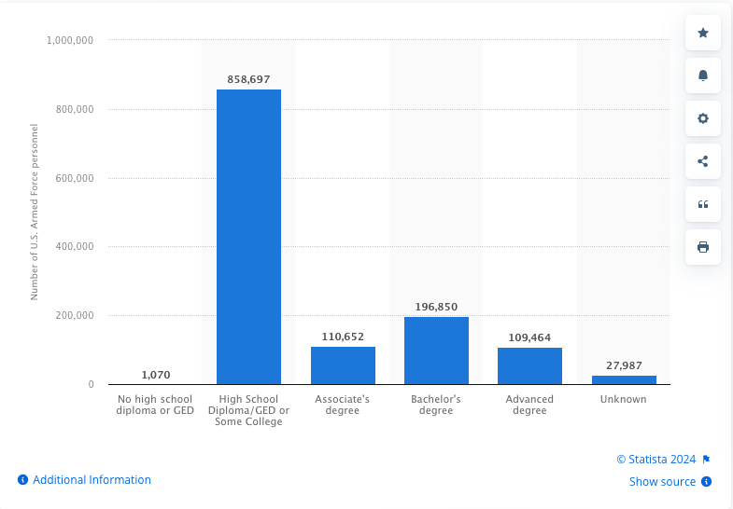
Education level of active-duty
United States Armed Forces personnel in 2022

Slide 18
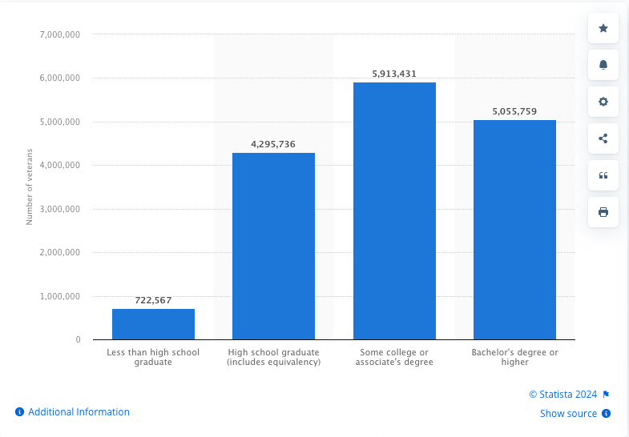
Number of Veterans in the United States in 2022,
by educational attainment

Slide 19
Military Employment by County
County | Active Duty | Civilian | National Guard | Reserve | TOTAL
Christian | 27,614 | 2,337 | 51 | 185 | 30,187
Hardin | 6,487 | 4,401 | 66 | 2,190 | 13,144
Jefferson | 137 | 1,205 | 1,805 | 595 | 3,742
Madison | 13 | 983 | 640 | 28 | 1,664
Franklin | 17 | 284 | 1,120 | 0 | 1,421
Fayette | 58 | 117 | 278 | 512 | 965
Boone | 43 | 17 | 506 | No data | No data
Muhlenberg | 0 | 73 | 332 | 0 | 405
Campbell | No data | 29 | 0 | 369 | No data
McCracken | No data | 12 | 128 | 187 | No data
Reserve Component | 12,159 (TOTAL)
Army National Guard | 6,228
Army Reserve | 4,410
Navy Reserve | 231
Marine Corps Reserve | 104
Air National Guard | 1,125
Air Force Reserve | 4
Coast Guard Reserve | 57
Active-Duty | 30,755 (TOTAL)
Army | 30,252
Navy | 10
Marine Corps | 87
Air Force | 246
Space Force | 0
Coast Guard | 160
Top Kentucky Defense Contractors, FY2022
Humana $7.7B
Lockheed Martin $668.1M
Bechtel Group $384.9M
Boeing $128.9M
United Parcel Service, Inc. $73.2M
Raytheon Technologies $70.1M
Anduril Industries, Inc. $63.4M
Inverness Technologies, Inc. $60.3M
SourceAmerica $59.1M
Global Asset Technologies $53.6M
Source: Department of Defense/KCMA
Top National Contract Spending Locations, FY2022
Tarrant, TX $18.6B
Fairfax, VA $17.8B
New York, NY $17.2B
San Diego, CA $11.9B
Dallas, TX $9.8B
Los Angeles, CA $9.3B
New London, CT $9.7B
Pima, AZ $8.6B
Hartford, CT $8.1B
Jefferson County, KY $8.0B
Source: Department of Defense/KCMA

Slide 20
